Slide 1
AI in Mental Health Research: Promise, Practice, and
Future Directions
Using Digital Tools to Advance Suicide Prevention and Mental Wellness
Camille Nebeker, Professor, School of Public Health, UC San Diego
Director, CAPES ELSI Unit | Director, ReCODE Health
May 20, 2025

Slide 2



Learning Objectives
Understand current and emerging applications of generative AI in digital mental health research.
Evaluate the ethical considerations surrounding GenAI use in research.
Apply guiding principles to distinguish responsible GenAI use from practices that may compromise research integrity.
Notes:
As generative AI tools like ChatGPT become increasingly integrated into digital health research, they offer powerful opportunities for innovation—especially in areas as sensitive and urgent as suicide prevention. This interactive workshop explores how GenAI is currently being used to support research design, data analysis, and participant communication, while also addressing the ethical boundaries of its use. Drawing on real-world examples, we will examine when GenAI tools enhance research integrity and when their use may cross into questionable research practices. Participants will leave with practical strategies for responsibly integrating GenAI into their own work.

Slide 3

Path towards Ethical AI in Mental Health
Artificial Intelligence (AI) is transforming mental health care through advanced diagnostics, predictive modeling, and personalized interventions.
In this context, how do we practice:
Transparency
Risk assessment
Informed consent
Data governance
  Collection
  Storage (privacy)
  Access
  Use and Reuse
  Closure
Notes:
Mental health conditions affect millions worldwide. AI tools offer scalable, efficient solutions for early detection, treatment planning, and monitoring—especially when integrated into digital health platforms.

Slide 4




Overview of AI in Mental Health Research
Analyzing social media and smartphone data to detect mood changes
Predicting psychiatric diagnoses using EHRs and neuroimaging
Monitoring speech and language for signs of isolation
Identifying treatment adherence patterns
Graham, S., Depp, C., Lee, E. E., Nebeker, C., Tu, X., Kim, H.-C., & Jeste, D. V. (2019). Artificial intelligence for mental health and mental illnesses: An overview. Current Psychiatry Reports, 21(11), 116. https://doi.org/10.1007/s11920-019-1094-0.

Slide 5
Overview of AI in Mental Health Research (cont.)
Key Findings:
AI models show high accuracy in predicting conditions like schizophrenia and depression, but findings are often based on small, non-representative samples.
Highlights ethical issues including privacy, bias, transparency, and the risk of over-reliance on automated systems.
Recommendations:
Promote interdisciplinary collaboration between data scientists, clinicians, and ethicists.
Establish regulatory frameworks to oversee AI integration into mental health care.
Prioritize research into fairness and explainability to ensure equitable deployment.
Graham, S., Depp, C., Lee, E. E., Nebeker, C., Tu, X., Kim, H.-C., & Jeste, D. V. (2019). Artificial intelligence for mental health and mental illnesses: An overview. Current Psychiatry Reports, 21(11), 116. https://doi.org/10.1007/s11920-019-1094-0.
Notes:
.

Slide 6
Do Words Matter? Detecting Social Isolation and Loneliness in Older Adults Using Natural Language Processing
We looked at the potential of natural language processing (NLP) to detect social isolation and loneliness in older adults through transcribed interviews.
Identified specific linguistic markers (e.g., emotional tone, sentence complexity) that correlate with validated loneliness scales.
NLP tools could offer low-cost, scalable mental health screening in clinical and home settings.
Badal, V. D., Nebeker, C., Shinkawa, K., Yamada, Y., Rentscher, K. E., Kim, H.-C., & Lee, E. E. (2021). Do words matter? Detecting social isolation and loneliness in older adults using natural language processing. Frontiers in Psychiatry, 12, 728732. https://doi.org/10.3389/fpsyt.2021.728732

Slide 7
Do Words Matter? Detecting Social Isolation and Loneliness in Older Adults Using Natural Language Processing (cont.)
Apply NLP models in clinical practice as a supplement to traditional screening.
Continue refining models using diverse linguistic and cultural datasets.
Integrate linguistic analysis into remote monitoring systems for aging populations.

Slide 8
AI for Suicide Risk Detection and Prevention
Algorithms monitor search terms, social media posts, and wearable data
Risk detection score
What action should be taken?
Digital health tools can offer real-time, passive surveillance. Ethical use requires careful oversight to avoid false positives or privacy breaches.

Slide 9
Ethical Oversight in Big Data Health Research
Critiques traditional ethics review processes for being ill-equipped to handle the complexities of big data research.
Identifies persistent challenges such as informed consent, data anonymization, and third-party data use.
Highlights the importance of trust, transparency, and participant engagement in data-intensive research contexts.
Ferretti, A., Ienca, M., Sheehan, M. et al. Ethics review of big data research: What should stay and what should be reformed?. BMC Med Ethics 22, 51 (2021). https://doi.org/10.1186/s12910-021-00616-4

Slide 10
Where are the Guardrails
Risk assessment is challenging. What tools are available to assist?
What are the challenges to our current methods of obtaining informed consent and can GenAI help?
Data management practices are complex – can GenAI help to unpack privacy policy language?
Notes:
Consent and Privacy Protection
Implement robust consent mechanisms, ensuring individuals understand how their data will be used.
Employ encryption, pseudonymization, and other privacy-preserving techniques.
We assume that most people are well versed in the scientific method and know how health research is different from healthcare.
Consent is only a starting point and usually happens at the onset of a data collection process.
What if consent were dynamic and you could know what happens downstream?

Slide 11

How to Transition within the AI Era?
AI and digital tools are reshaping how we understand and respond to mental health needs. With ethical design, we can create inclusive and effective systems for prevention and care.

Slide 12
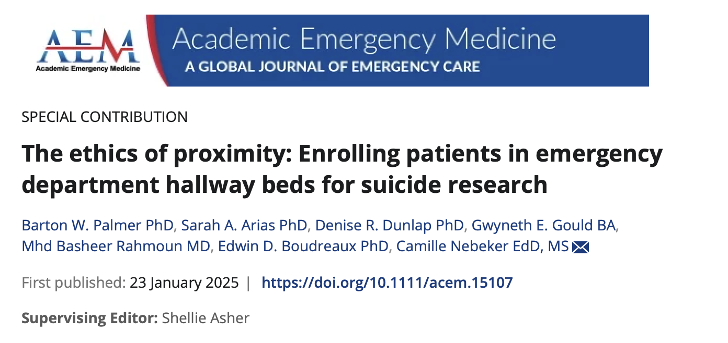
Tools Don’t Need to Be Technical

Slide 13

Digital Health Checklist Tool for Researchers

Slide 14
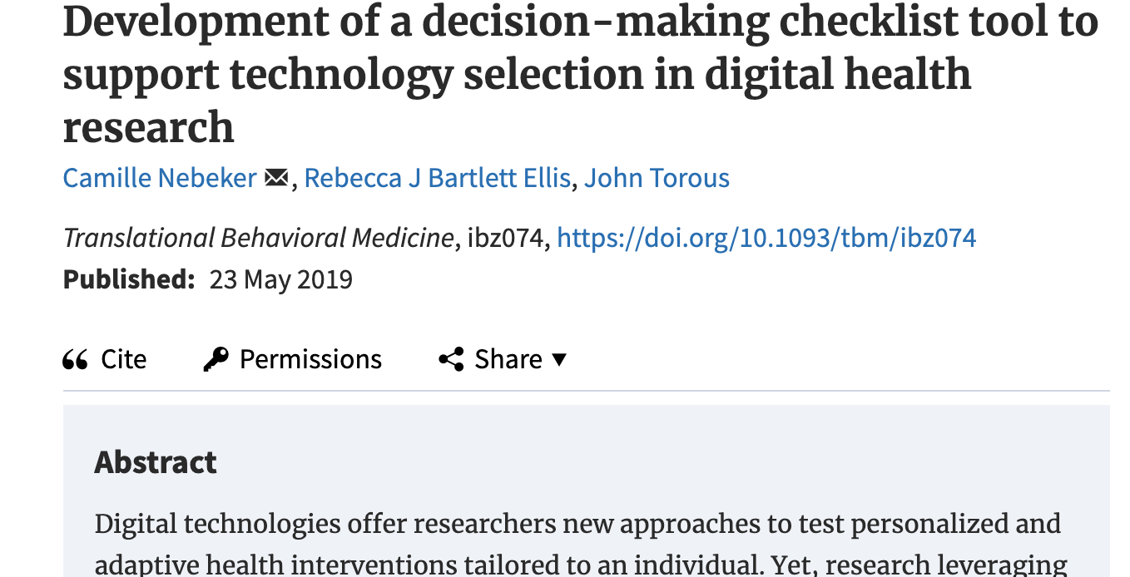
Article screenshot

Slide 15
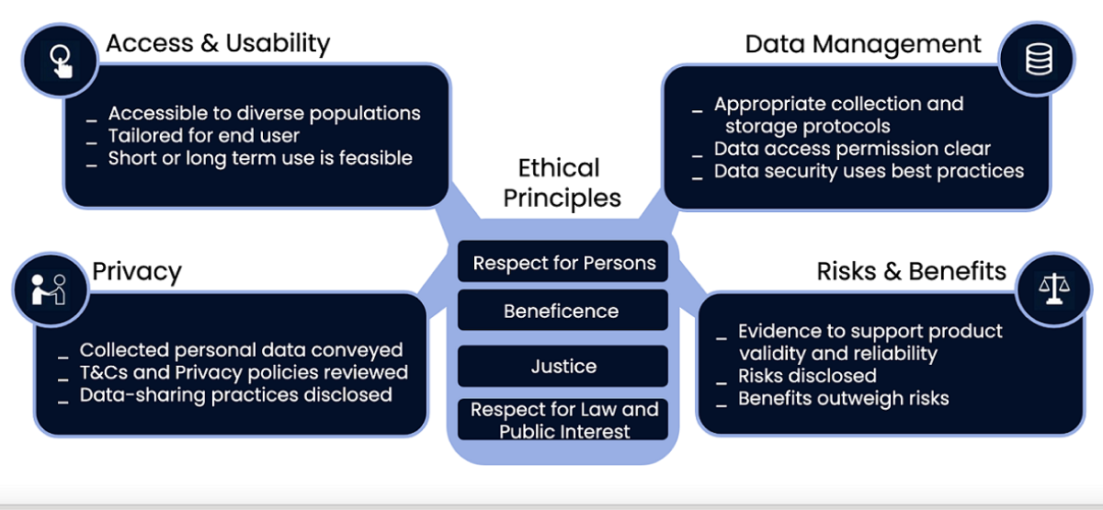
Digital Health Checklist | Decision Support Tools
https://recode.health/tools
Notes:
The research questions focus more on the process and less on the individual
What questions might a provider ask?
Is the product supported by sound scientific evidence?
Has it been tested by diverse populations?
Is short- and long-term use feasible?
What are the possible risk and benefits?
What patient data are collected?
How is personal health data managed (collected, stored and shared)?

Slide 16
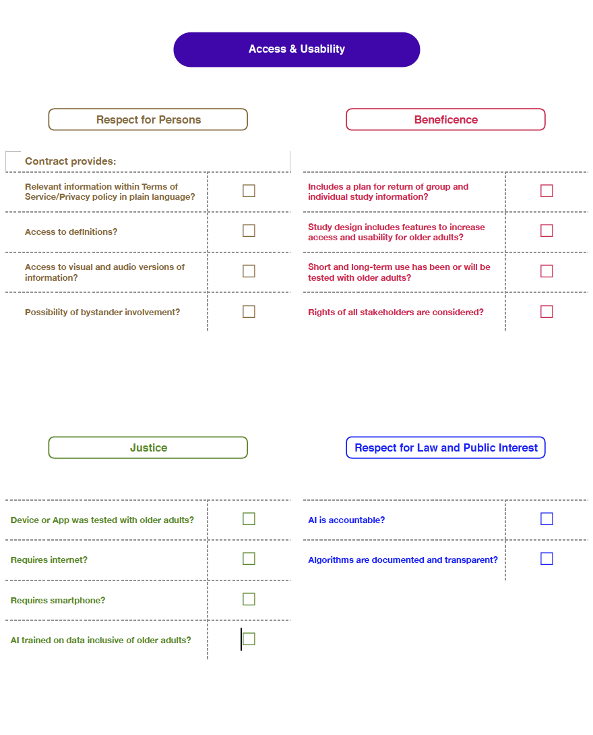
Access and Usability
The domain of access and usability is about the product design and whether end-users are able to use the tool.
How does it work?
How that this information communicated to the user (informed consent or terms of service)?
Has it been used with the target population? Are accessory tools needed (smartphone, internet access)?
Can the product can be used both short and long-term?
Notes:
Focuses on how digital health products are designed and selected to ensure that end-users can access and use the product.

Slide 17
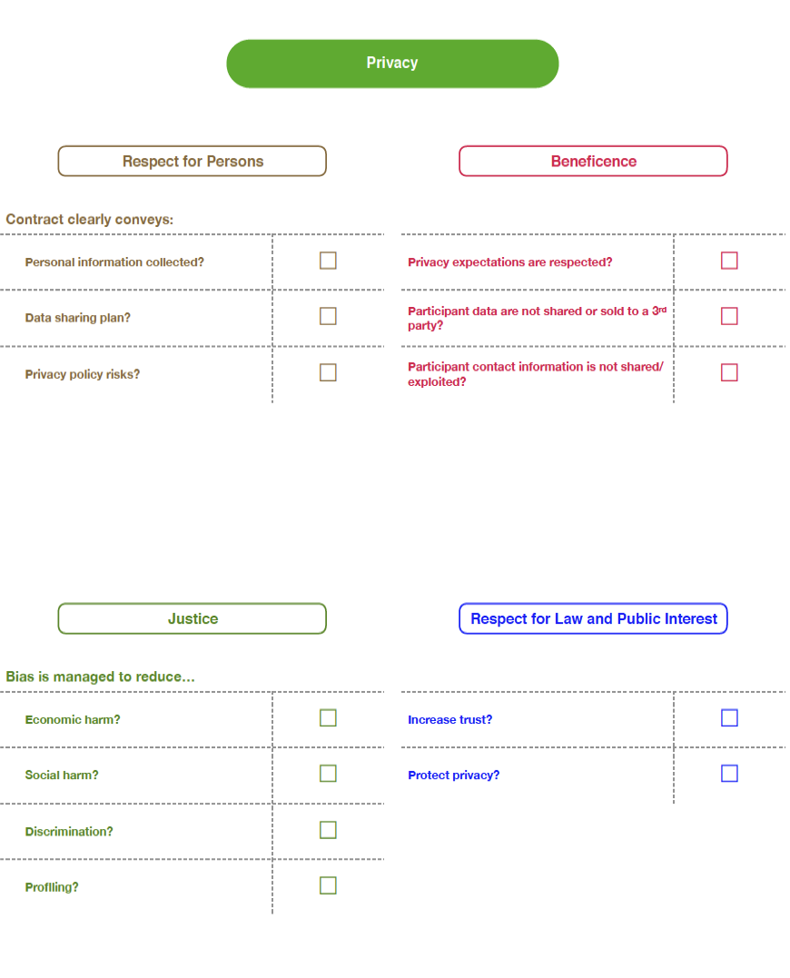
Privacy
Privacy is about the personal information collected and expectations of the patient or participant to keep information secure. If shared:
What is collected?
What is shared?
Why is it shared?
What control does the end user have?
Notes:
Reflects the type of personal information and/or health-related data collected and expectations of the participant to keep information secure or, if shared, accessible information about how and with whom data are shared.

Slide 18
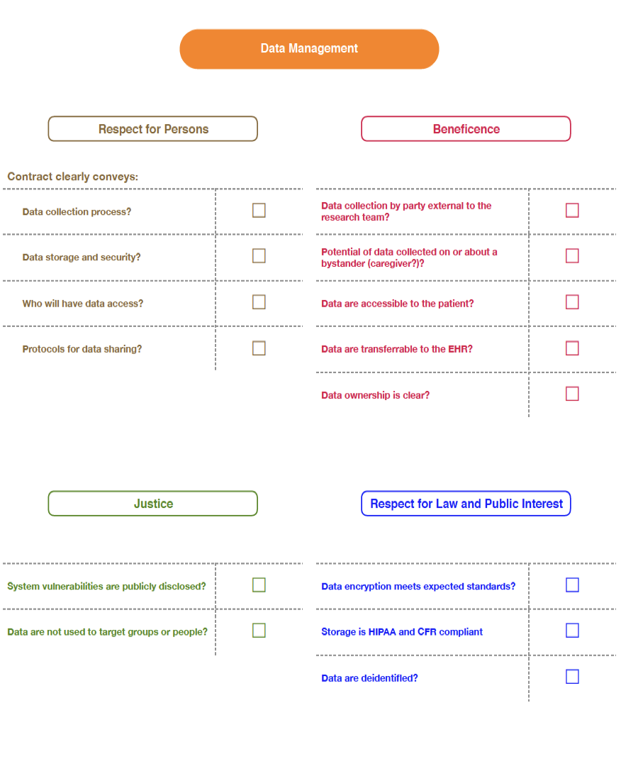
Data Management
Data management includes how data are collected, stored and shared and the extent of incorporation within other systems.
What is collected?
What is shared?
Why is it shared?
What control does the end-user have?
Interoperability?
Notes:
Builds on the domain of privacy and refers to the practices of how data are collected, stored and shared including understanding of who owns data, how data are shared including to what extent data are incorporated into other systems (interoperability, encryption standards, and compliance with existing regulations.

Slide 19
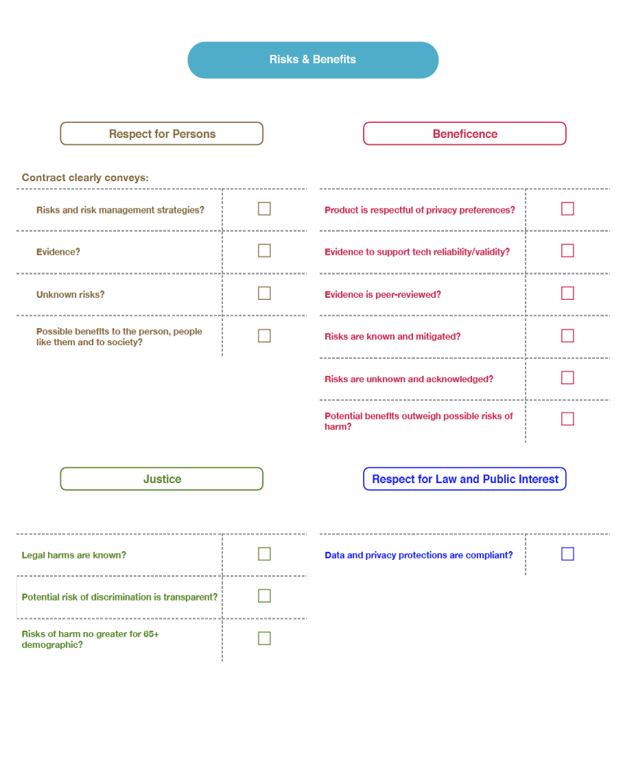
Risks and Benefits
The goal of this domain is to evaluate the types of possible risks as well as the extent of possible harm.
Types of harm?
Severity?
Duration?
Intensity?
AI Accountability and Transparency?
Assessment of risks and benefits is influenced by the evidence available to support the reliability of the product, risk mitigation strategies and recognition of unknown risks.
Notes:
An ongoing assessment of possible risks and the extent of possible harm if the risk occurs. Includes assessing the severity, duration, and intensity of risk. Product reliability, risk mitigation strategies, prior evidence about the product or other relevant products can inform risk assessment. Recognizes that there are unknown risks.

Slide 20
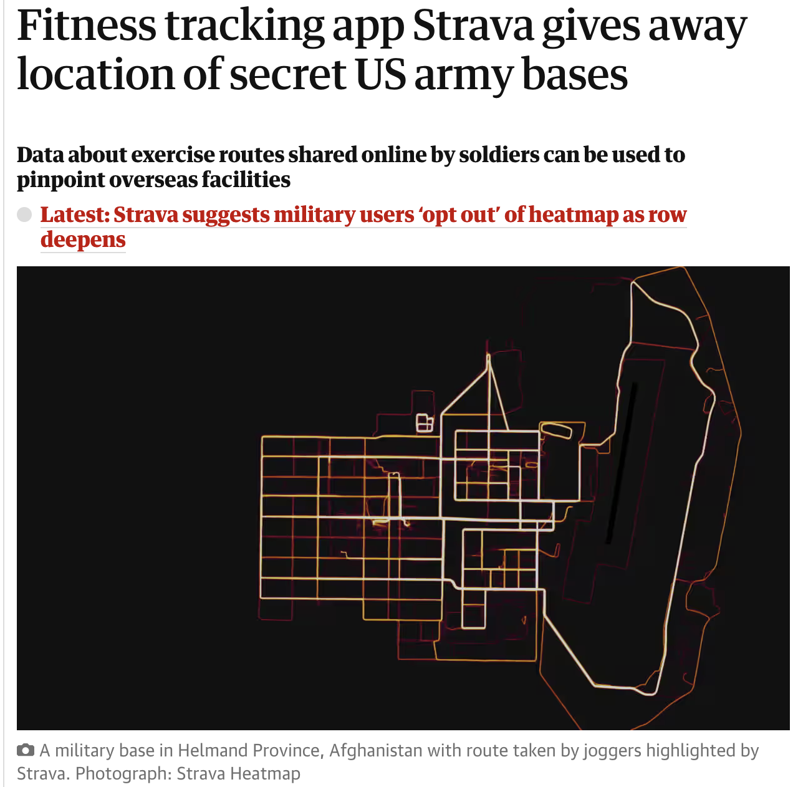
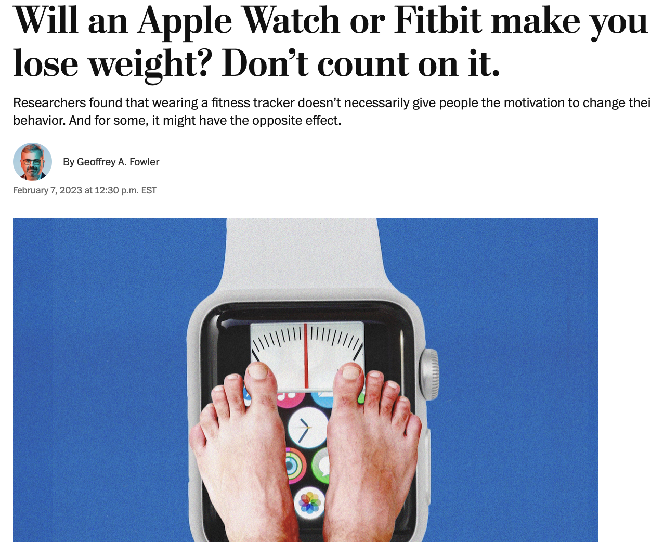
Identifying hazards is crucial... but severity matters, too

Slide 21

Digital Health Checklist Risk Management Tool
Alan Card, PhD
San Diego State University
Risk = Likelihood x Consequence
...for an event that is not certain to occur.
Use of the DHC-RM Toolkit was associated with a large and statistically significant increase in the number of risks identified (a mean of 14 additional risks identified in Phase 2 for the toolkit vs. 0.26 for current practice).

Slide 22
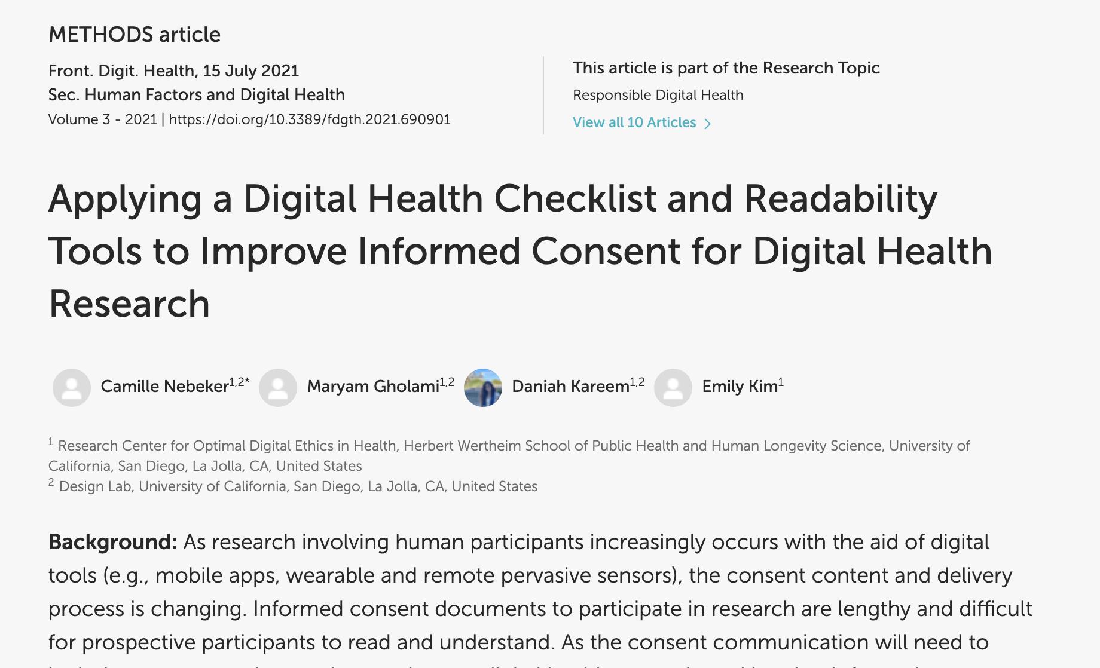
Using the DHC to Improve Consent Communications

Slide 23
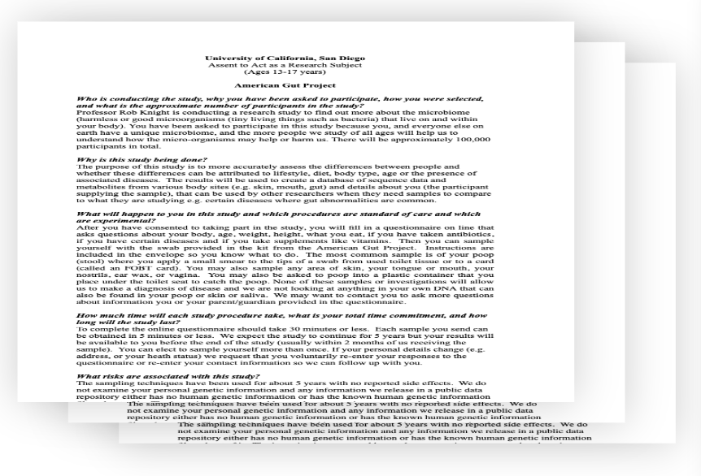
Exploring the Future of Informed Consent
It is important to partner with participants in digital health research
The informed consent process is a key opportunity to cultivate trust
There are clear opportunities to improve informed consent processes
  People have expectations for a consent process
  People want different levels of detail in consent materials
  Data visualizations can help people into the technical details of a study
  Researchers, IRBs, and patient advocates need to weigh new considerations as informed consent becomes increasingly computer-mediated
How to incorporate the responsible use of AI into your digital health studies

Slide 24
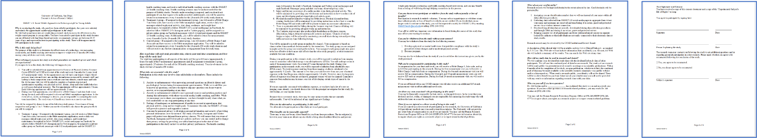
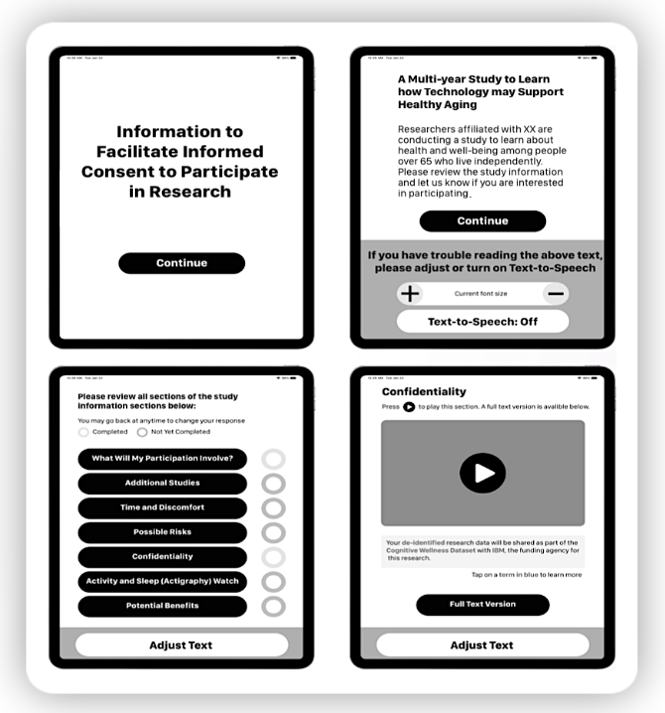

Human Centered Design of Informed Consent
•Who is conducting the study
•Why is the study being done

Slide 25
Study decision-making timeline (highlights)
Before active study participation (Enrollment)
During the study
(Procedures)
Continuing
Participation
START OF STUDY
  Before active study participation (Enrollment)
    Purpose
    Source of Funding
    Eligibility
    RISKS
    DATA COLLECTION AND MANAGEMENT
      Confidentiality of research information
      Use of information and specimens
    Other information
    BENEFITS
  During the study (Procedures)
    In-person study participation
    At home study participation
CONTINUING PARTICIPATION (Return of results)
  Before active study participation (Enrollment)
    Continuing participation
    Eligibility
  During the study (Procedures)
    In-person study participation
END OF STUDY
    NIH funding for this study ends

Slide 26
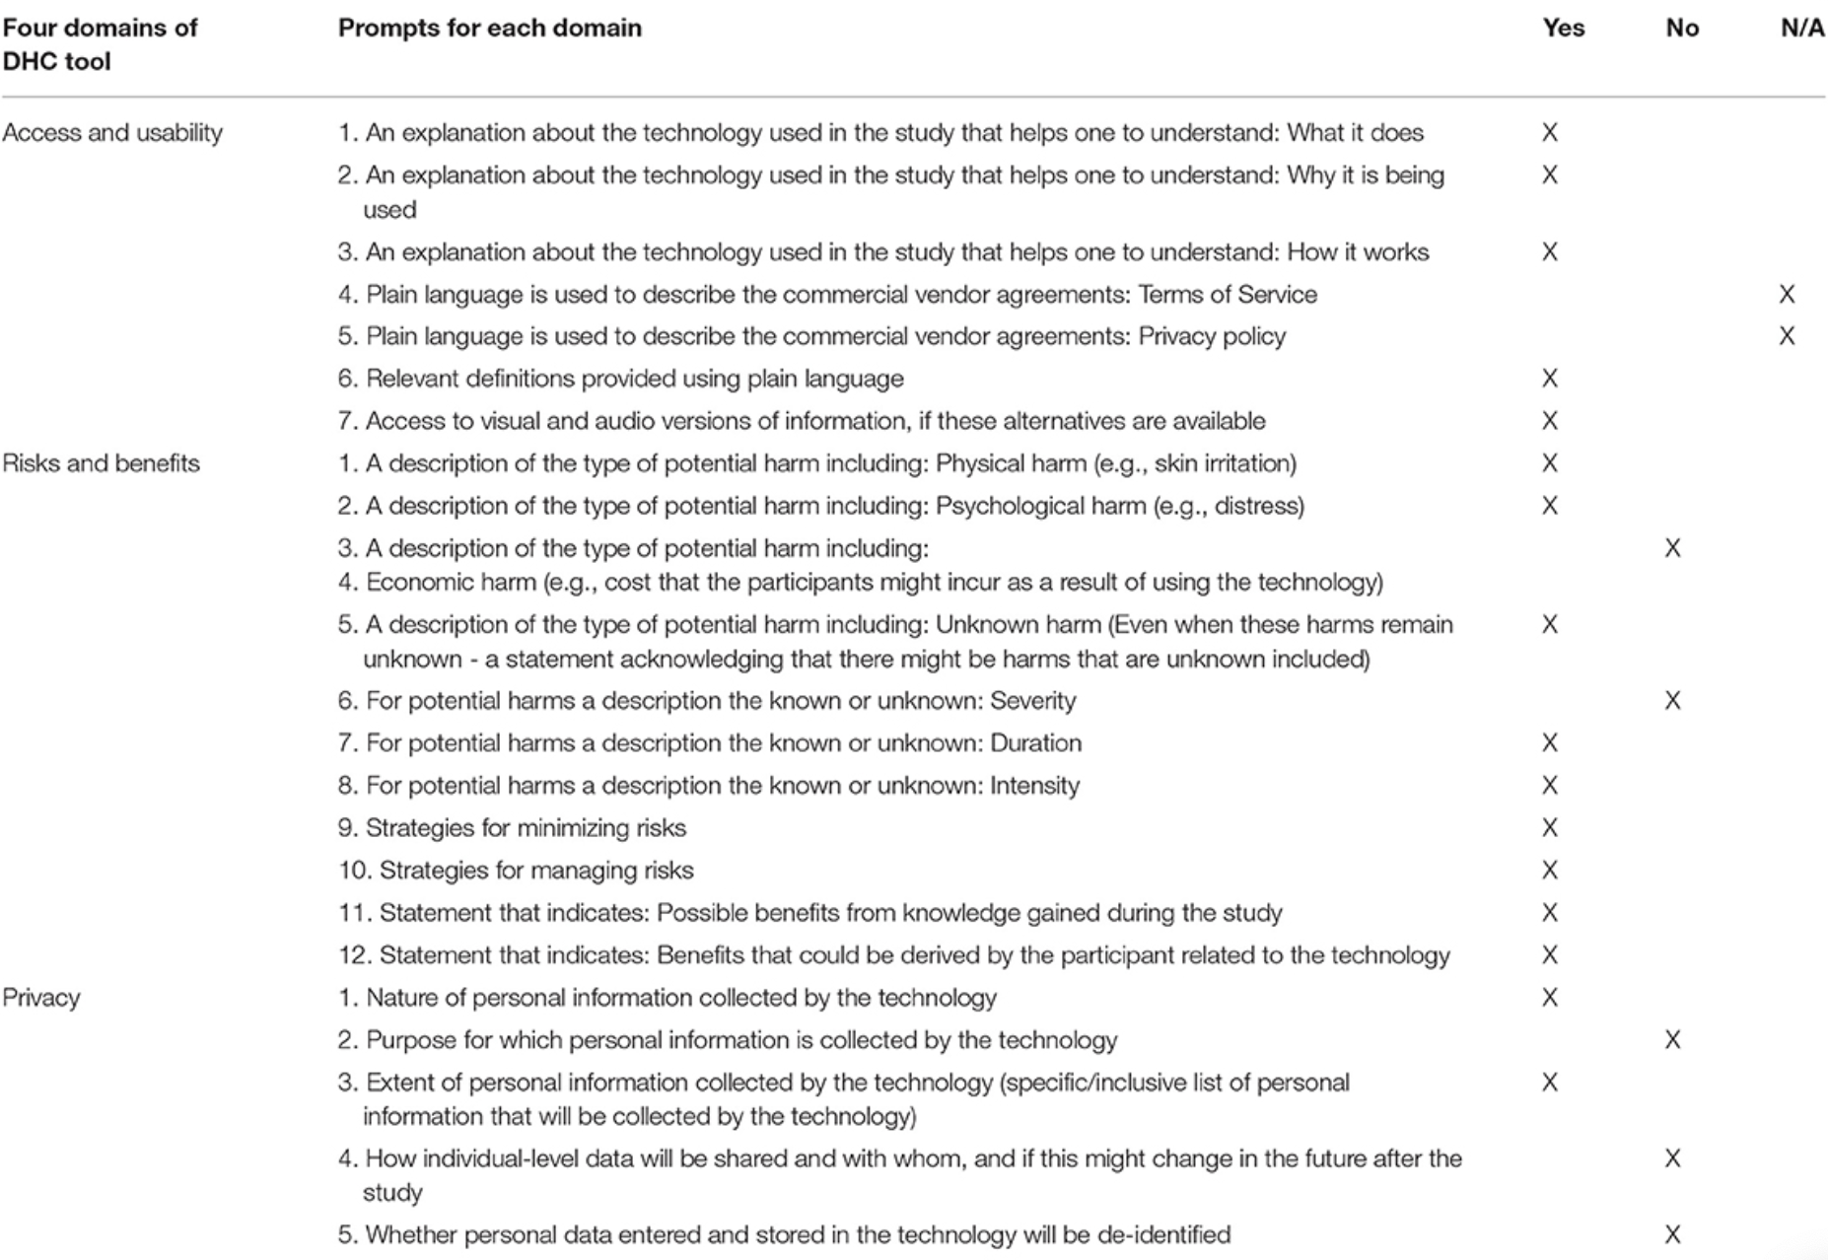
How might we communicate…
What is real time data?
How does a personalized algorithm work?
How is my health data transmitted and stored in a cloud?
Who has access to data collected by the device?
What information about me is shared?
Notes:
For this initial work, our goal is to help researcher understand and apply a process for conveying complex topics, via a consent communication using tools to make language accessible and content complete. Areas of interest expressed by researchers, which led, in part, to development of the DHC tool, are framed as “how might we” questions. Examples follow:
• Improve understanding of how the technology works?
• Convey individual and societal implications of the knowledge gained?
• Communicate how personal health information is transmitted and stored to the cloud?
• Describe differences between real-time data collection?
• Respect preferences for privacy and control of personal information?
• Understand the extent of control participants want with respect to managing data?
• Accurately convey how personalized algorithms work to nudge behavior change?
• Gauge acceptance of health technologies among family, coworkers and friends?

Slide 27

Consent Communications Created by GenAI
“We are doing a study to see how different things affect police officers' moods and stress levels. We will be asking police officers to download an app that will track their mood and activities. The research team will use this data to see how different things affect police officers' moods and stress levels. Participation in the study is voluntary and you can drop out at any time.”
Would you be willing to participate?

Slide 28
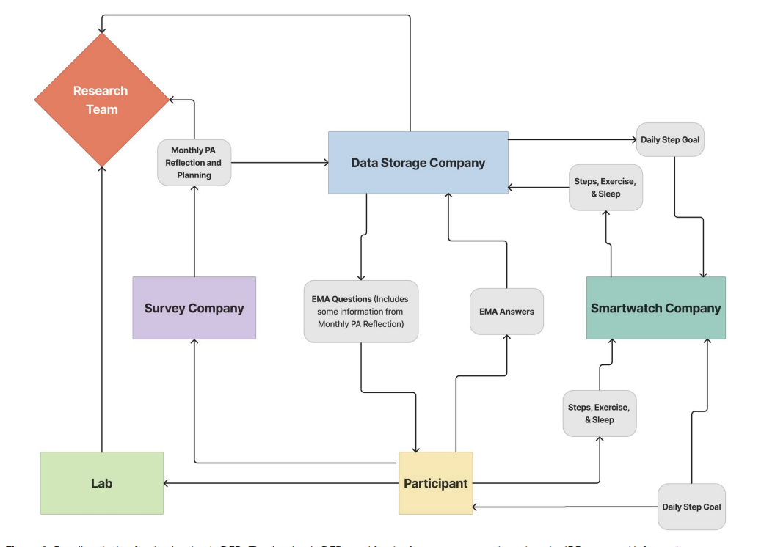
Data Flow Diagrams to Improve Consent
McInnis BJ, Pindus R, Kareem DH, Cakici J, Vital DG, Hekler E, Nebeker C. Using dataflow diagrams to support research informed consent data management communications: participant perspectives. J Am Med Inform Assoc. 2025 Apr 1;32(4):712-723. doi: 10.1093/jamia/ocaf004. PMID: 39903169; PMCID: PMC12005621.a

Slide 29

TaCoS and Privacy Policies
What is our responsibility when using digital and AI products from 3rd party vendors in research?

Slide 30
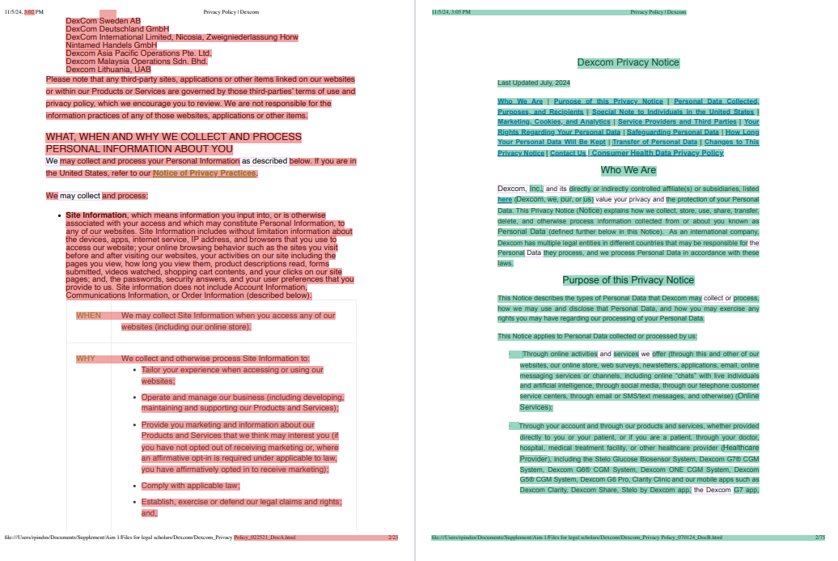
PRISM Study: Privacy Policy Comparison
From your expertise and experience reviewing privacy policies, conduct a comprehensive comparison of the two privacy policies. Differences between the two versions of the documents have been highlighted. Review side-by-side highlighted versions of the privacy policy documents.
NOTE: Diffchecker was the tool used to make the comparison between versions.

Slide 31
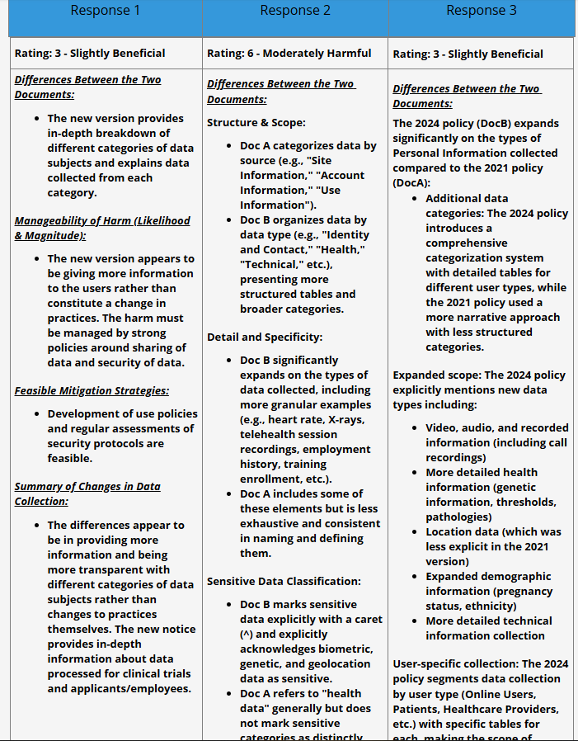
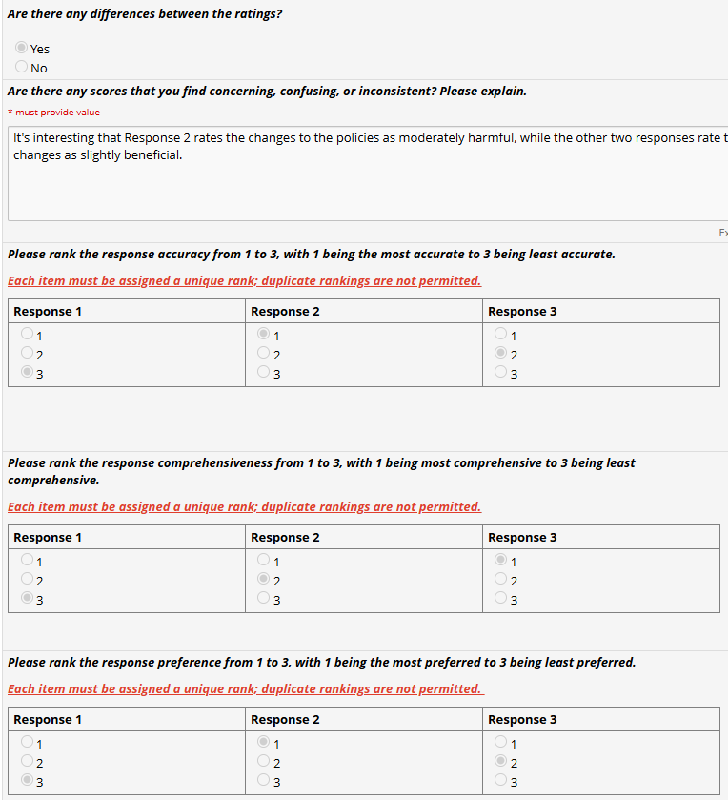
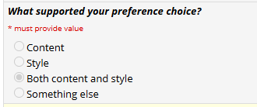
PRISM – Privacy Policy Review Comparisons

Slide 32

PRISM Aim 2: Co-Designing Improved Privacy Policy Communications
Event on March 10, 2025
Notes:
Aim 2 of the PRISM project is designed to be independent but complementary to Aim 1. As such, while Aim 1 seeks the perspective of experts who routinely review privacy policy documents, Aim 2 seeks the perspective of stakeholders who may use the products without necessarily reviewing the privacy policy.

Slide 33
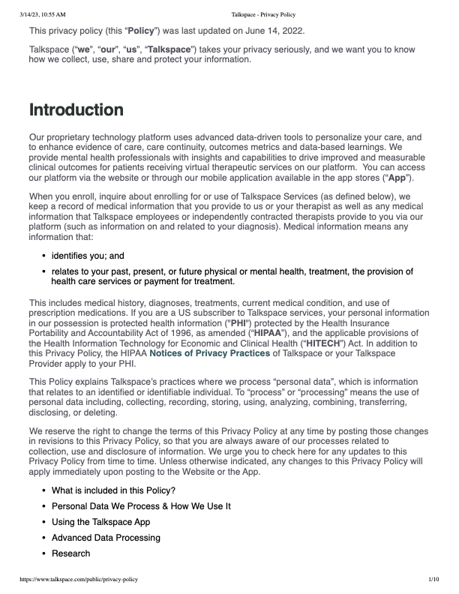
Aim 2 Overview
Objective: Facilitate stakeholder co-design activities to improve communication of third-party privacy policies in digital health research
Core Challenge:
Privacy policies are:
Complex legal documents
Difficult to interpret for researchers, IRB members, and participants
Critical for informed consent and risk assessment
Inconsistent across platforms and technologies
Project Status:
Complete data collection and preliminary analysis for Phase 1 (Workshop)
Beginning Phase 2 (Survey)
Notes:
Our Objective is to Facilitate stakeholder co-design activities to improve communication of third-party privacy policies in digital health research
We think this is important and needed because:
In digital health research:
Commercial products like fitness trackers, health monitor devices, and apps, collect sensitive participant data.
While Privacy policies describe how data is managed by third parties,
Understanding these practices is essential for:
Researchers conducting risk assessments,
for IRBs reviewing protocols,
and for Participants when making decisions about study participation.
However, privacy policies are often:
Long text documents,
they are Written in complex and ambiguous legal language, and
They are Inconsistently organized.
These factors make privacy policies difficult to review and understand, which means we have grown accustomed to accept them and move on, a practice that has potential serious implications for research safety.

Slide 34
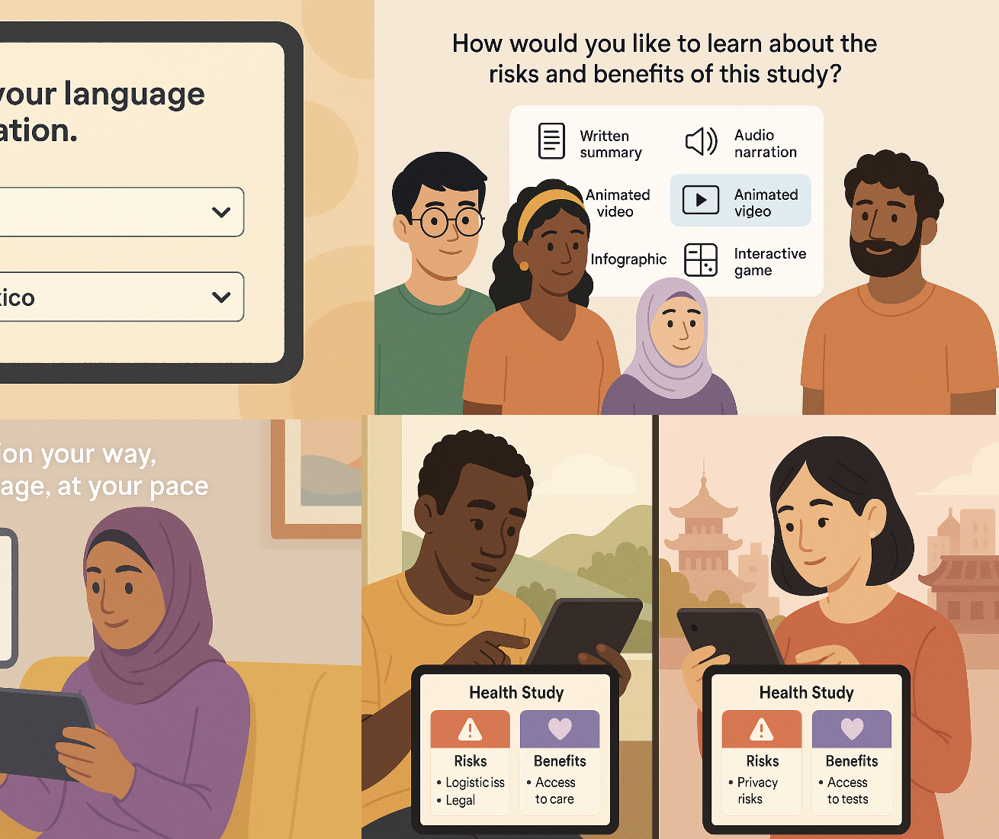
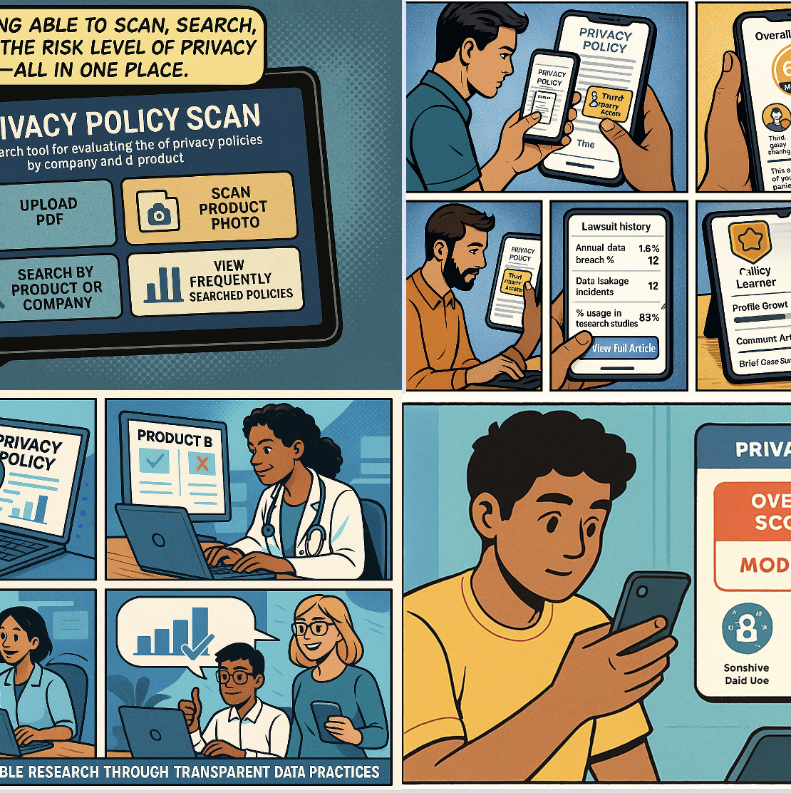
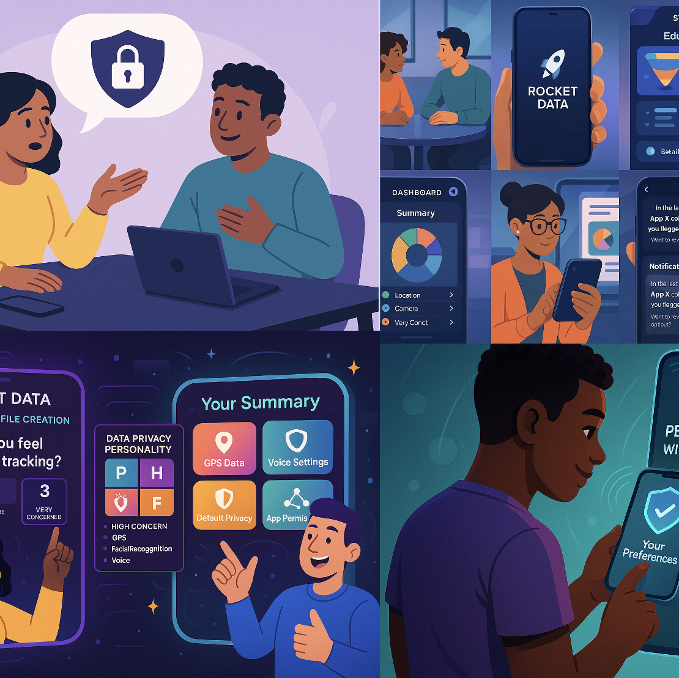
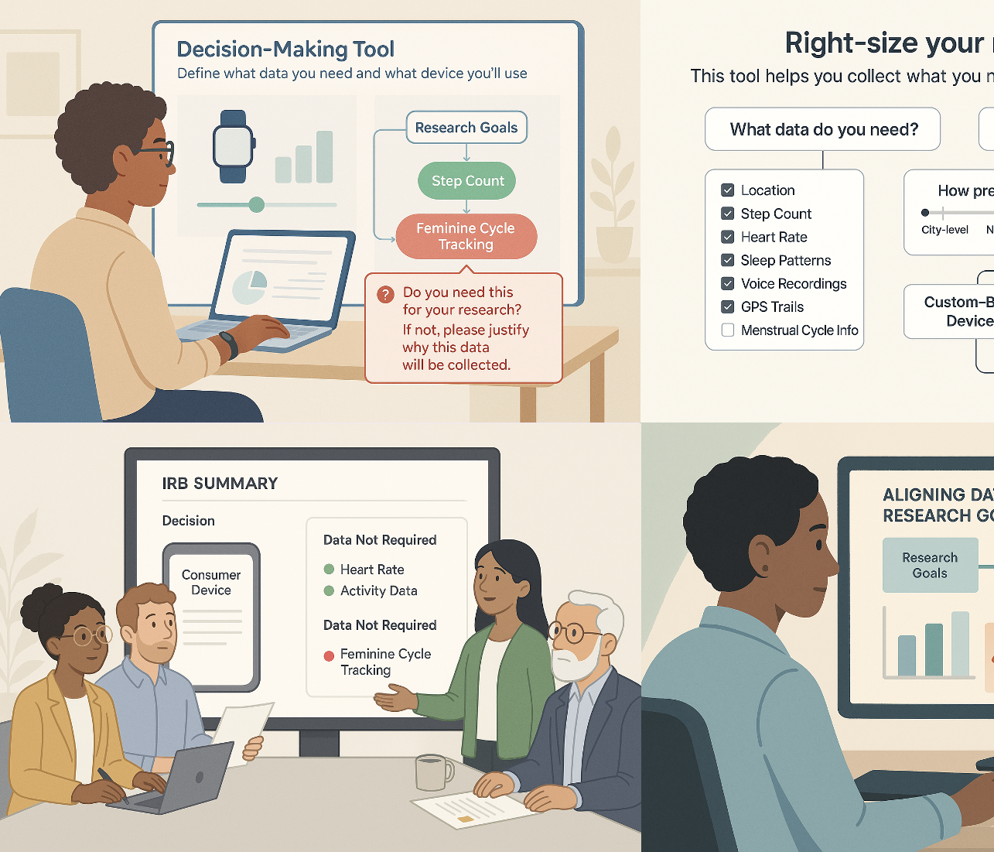
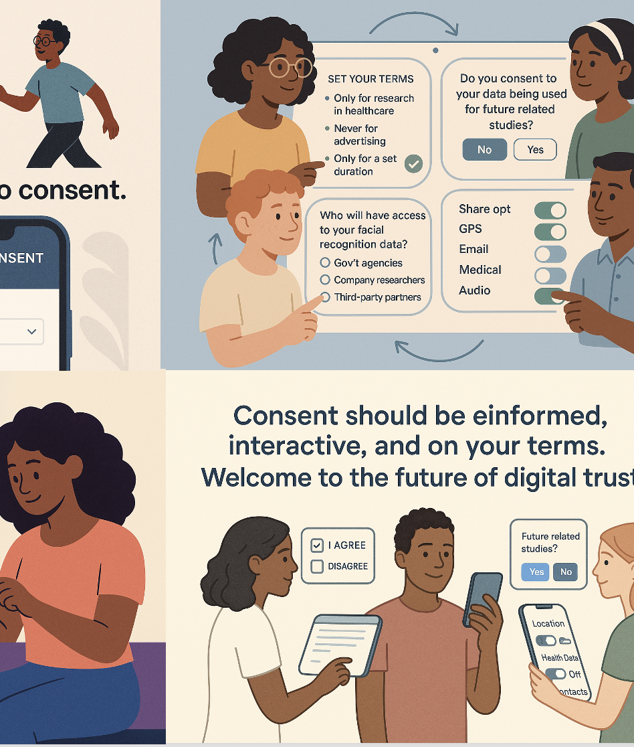
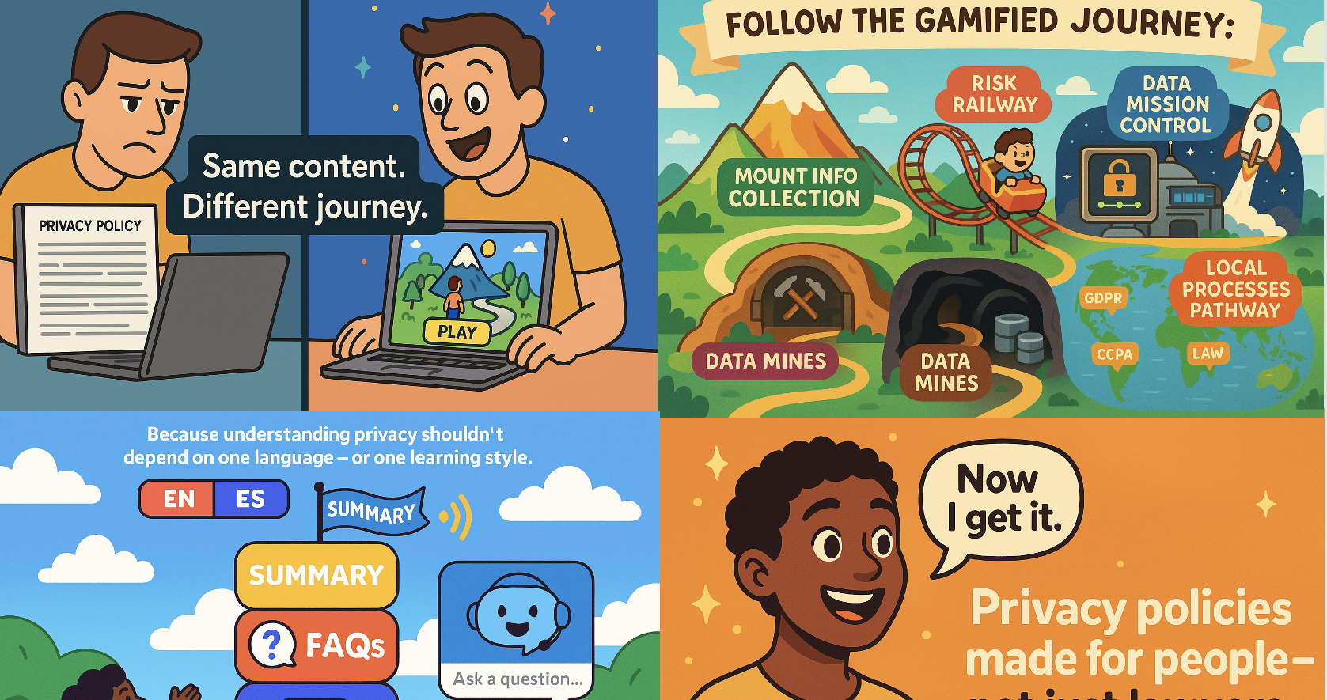
Prototype Ideas
A policy scoring app - transforming users from “Policy Learners” into “Policy Makers”
The Rocket Data app – facilitates creating a personalized “data risk profile”
A gamified experience inspired by platform games - navigating a game-based journey through core privacy topics
An interactive, closed-loop consent tool - outlines user rights, including real-time alerts and control over third-party data access (opt-in)
A tool presents risks and benefits through multiple formats – sensitive to risks and benefits variation across cultural and regional contexts
IRB workflow tool - helps researchers align data needs with device capabilities

Slide 35
Beta-Testing Reaching Calm: Exploring Digital Approaches to Address Suicide Risk in Obstetric Settings
“The platform we use to host the intervention is called the Computerized Intervention Authoring System (CIAS), the terms and conditions are here: https://www.cias.app/termsandcondition
Adaptive Testing Technologies (ATT) owns the CAT and scoring algorithms. The CAT is integrated into CIAS, so I’m reaching out to ATT to get a better understanding of whether this privacy policy applies. The ATT privacy policy is here: https://adaptivetestingtechnologies.com/privacy-policy/”
Laura Zimmerman

Slide 36
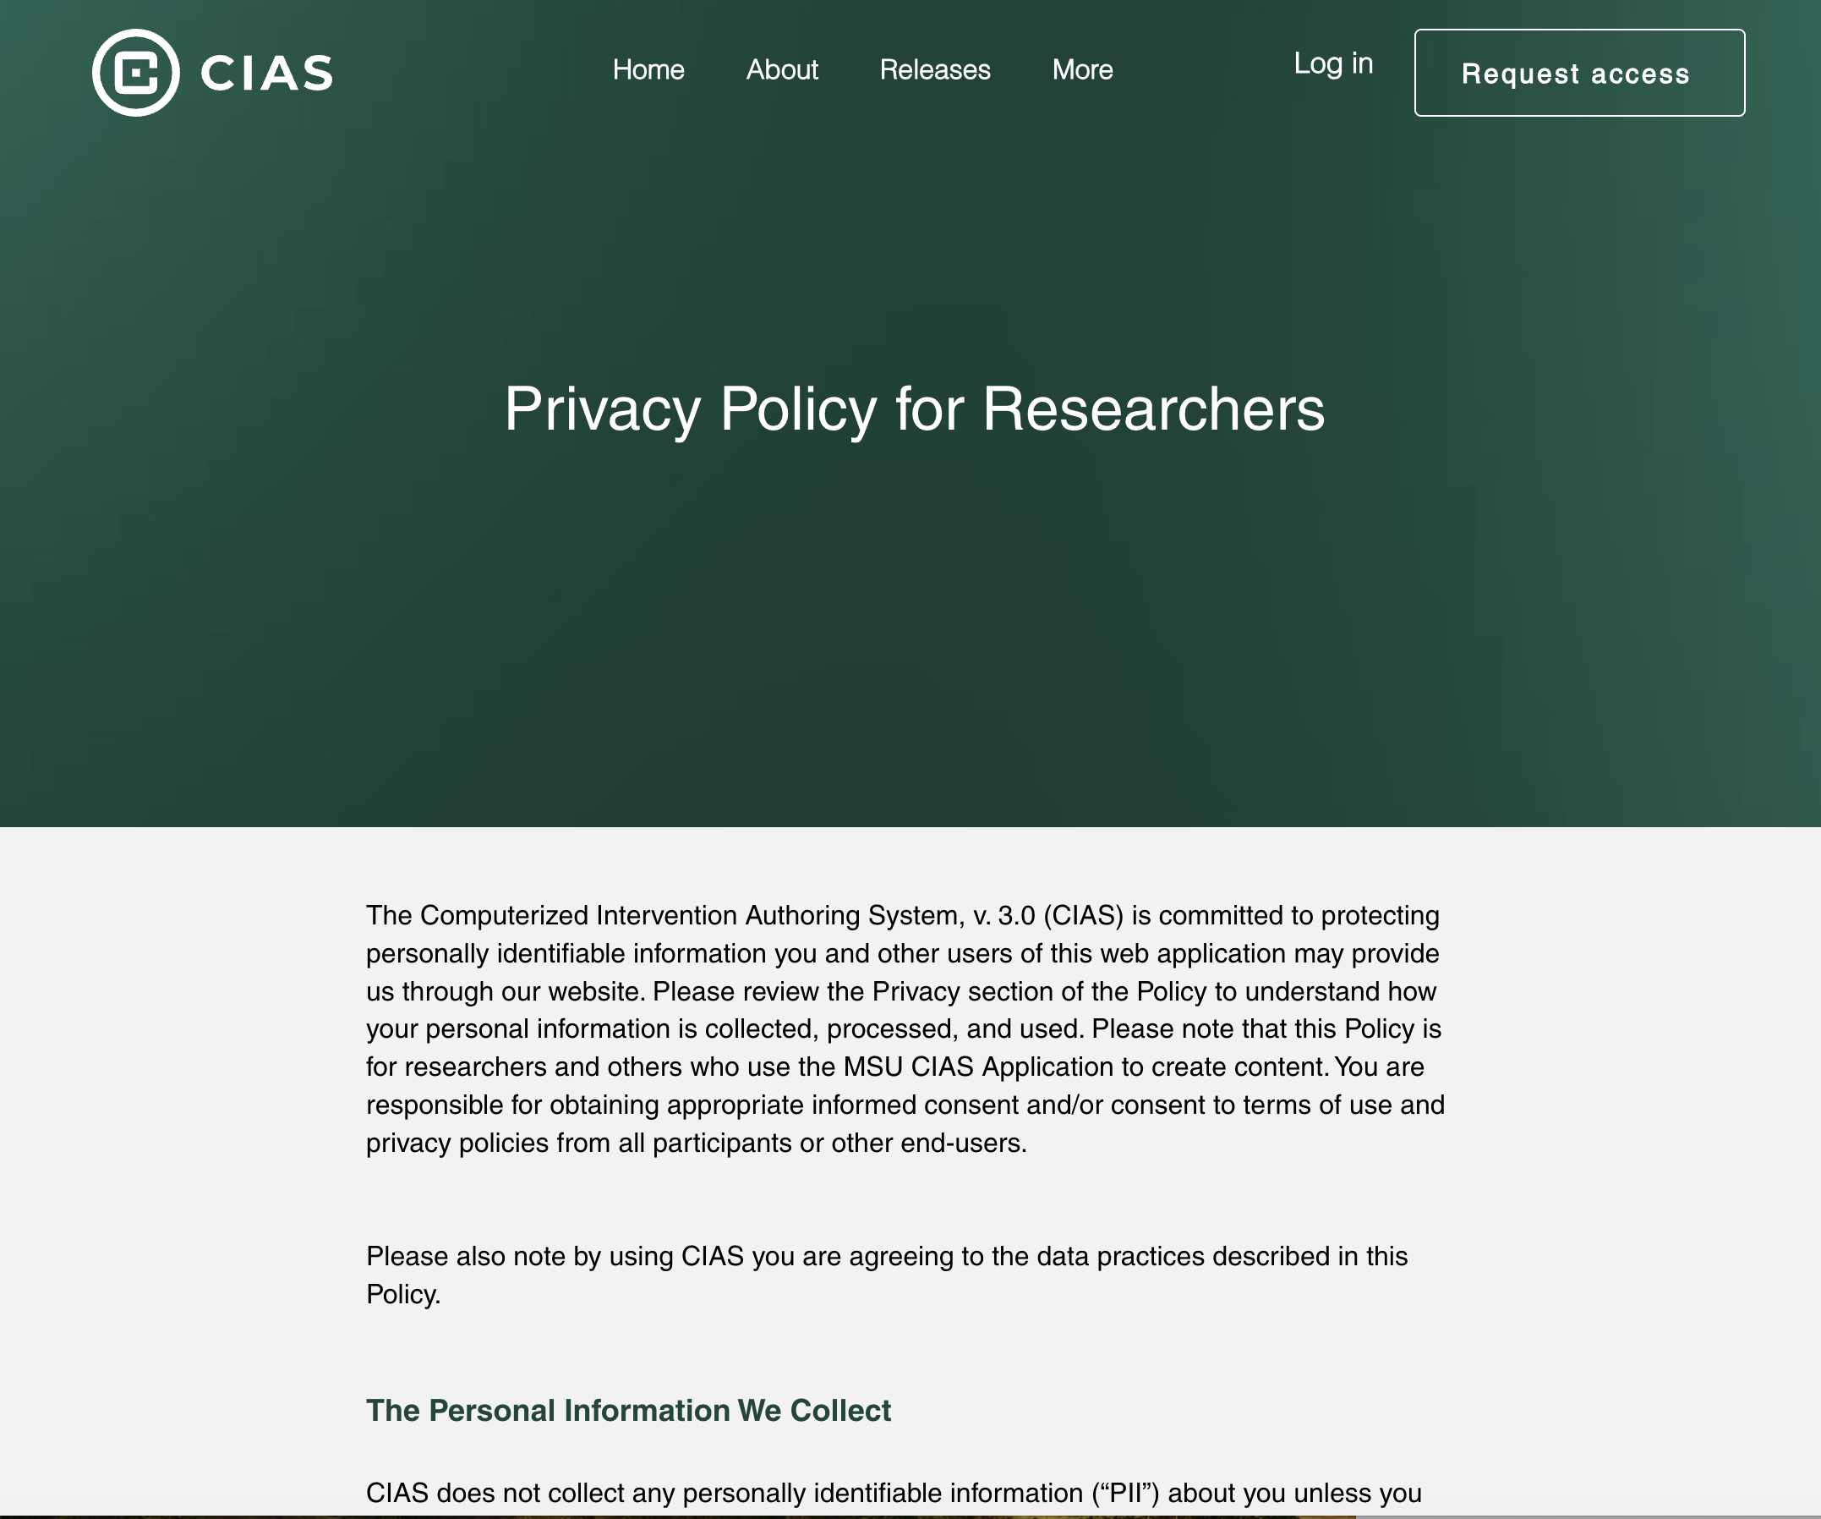
Applied to CAPES Research?

Slide 37
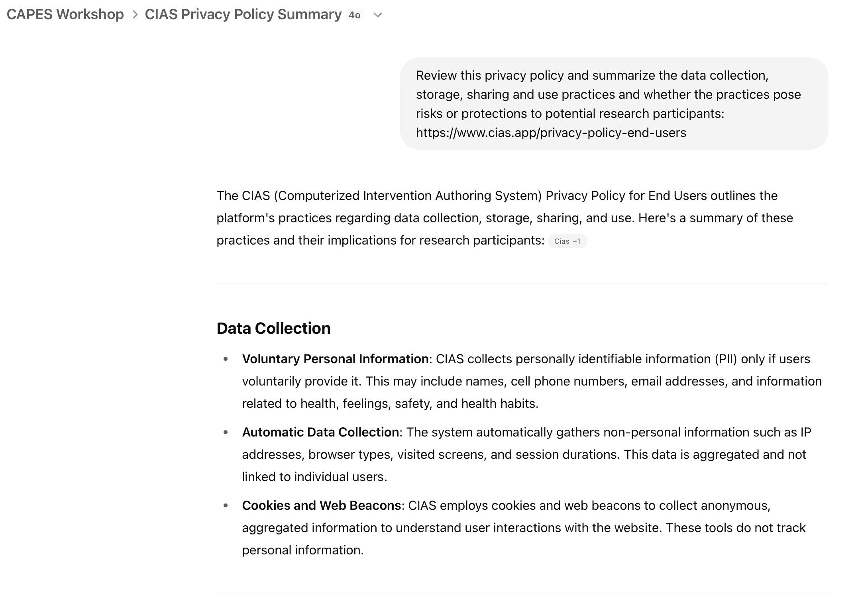
Ask GPT for a Summary

Slide 38
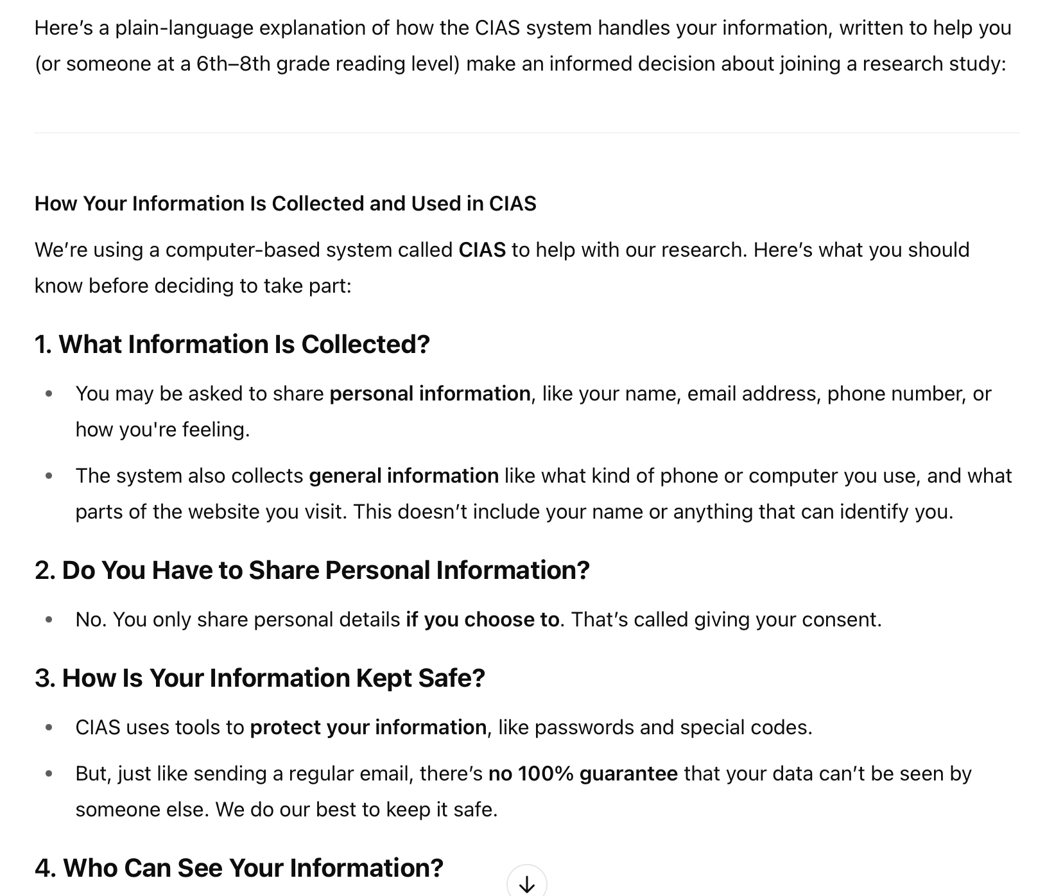
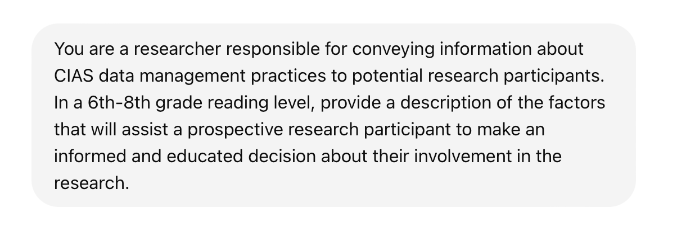
Ask for a Plain Language Summary

Slide 39
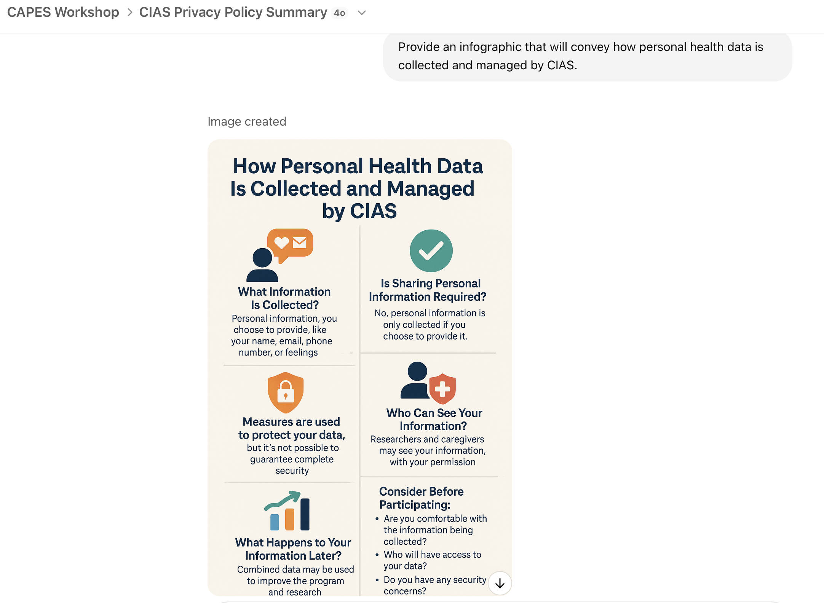
Ask for an Infographic

Slide 40
Questions
Thank you

