Slide 1

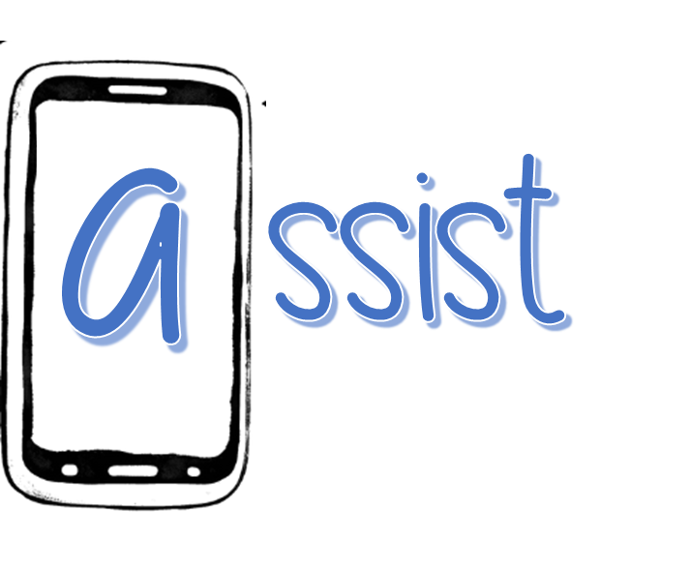

ASSIST: Advancing Student Suicide Interventions with Scalable Technologies
CAPES
Katherine Dixon-Gordon, Brooke Ammerman, &
Genesis Vergara

Slide 2







Our Team
Katie Dixon-Gordon, UMass
Brooke Ammerman, University of Wisconsin Madison
Genesis Vergara, UMass
Linda Dimeff, Jaspr Health

Slide 3

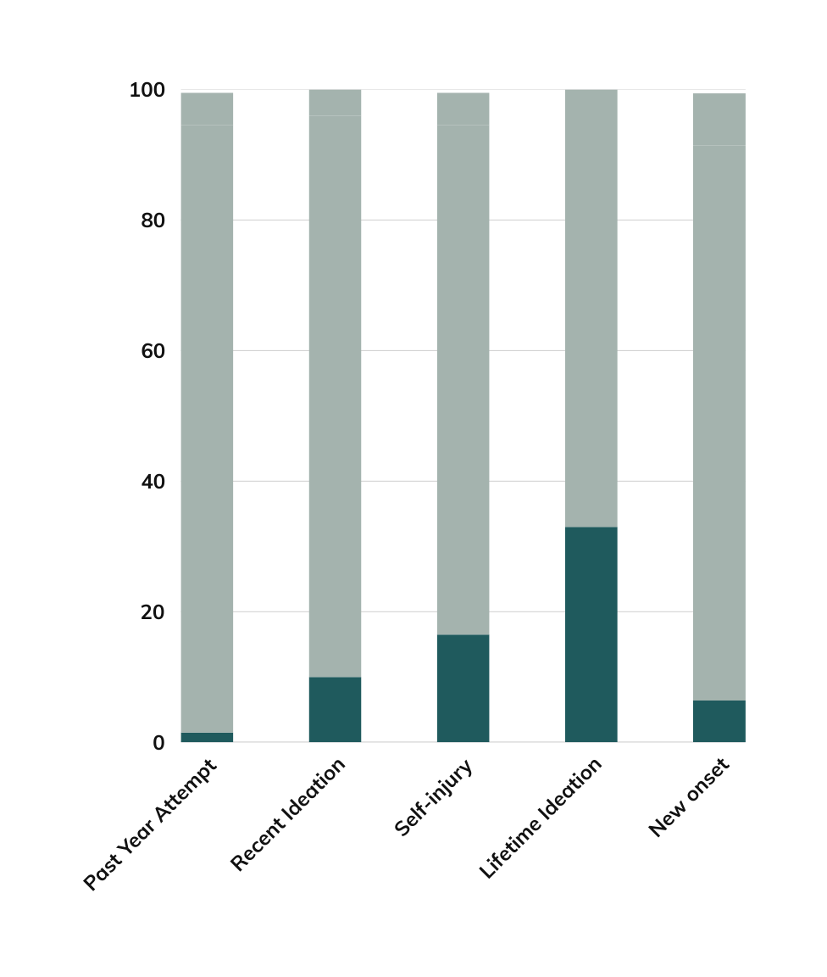
College is a risky time period
with potential for intervention
This time period has disproportionately high rates of attempts, ideation, and new onset ideation

Slide 4



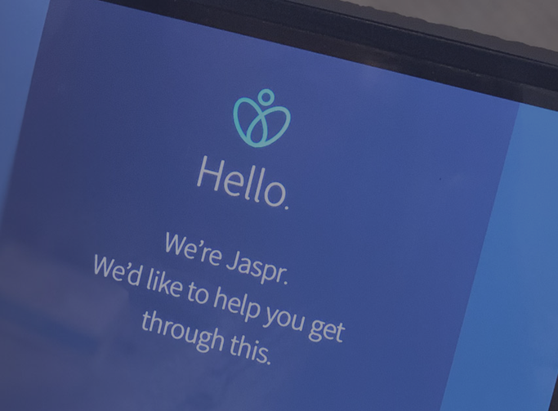

Technology Impact
Mobile-based applications can help
Mobile technology like Jaspr Health increases satisfaction and can be an accessible method for accessing evidence-based skills

Slide 5

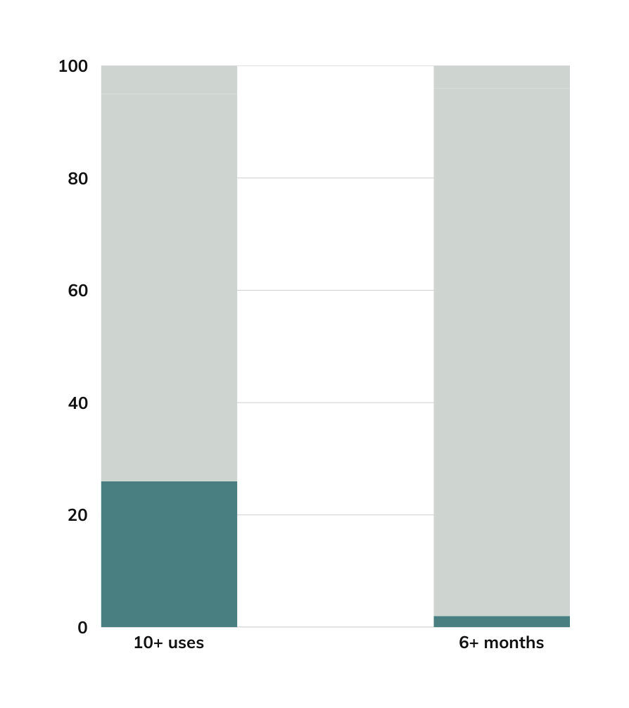
Technology is only as useful as it is accessed
User engagement remains a barrier
Aesthetics & functionality do not significantly help

Slide 6





Aims
We will use implementation science methods to identify barriers and facilitators to inform workflow implementation of Jaspr across 2 distinct college health counseling centers and inform future human-in-the-loop supports for Jaspr use (Jaspr+)
We will compare Jaspr+ to Jaspr alone to evaluate the utility of human-in-the-loop augmentation on implementation outcomes (i.e., relative acceptability, usability, preliminary effectiveness, app engagement).
We will examine the preliminary effectiveness of Jaspr across both conditions on outcomes (suicidal thoughts and behaviors, candidate mechanisms of self-stigma and coping skills) in college students.

Slide 7
Aim 1: Interviews with 9+ Informants
Table 1. Aim 1 Example EPIS Constructs, Elements, and Interview Questions
Construct | Elements | Definition | Example Interview Questions
Outer Context | Time, Resources, Support | How the presence or absence of sufficient time, resources, and support is affecting/affected by the ability of a specific recipient to implement innovation. | What kind of resources and support need to be provided to offer Jaspr? What factors influence your institution’s willingness to pay?
Inner Context | Absorptive capacity | How the organization identifies, acquires, assimilates, transforms, and/or applies new, valuable knowledge | What type of roles might be able to provide Jaspr orientations? How do staff learn new practices?
 | Past Experience with Innovations | How the organization has historically undertaken changes. | Tell me about when you tried a new form of patient care.
Bridging | Linkages | Bridging factors include structures and processes such as relations between policy and practice entities | How have new policies and interventions rolled out? How does feedback get shared with decision-makers?
Innovation | Relative Advantage | Comparison of the innovation with existing practice, and the degree to which one is more advantageous | How does Jaspr+ compare to how you currently treat suicidal ideation in your setting?

Slide 8
Aim 2: 50+ college students receive Jaspr or Jaspr+
Baseline Assessments
Weekly use of JasprAtHome
Download app & orientation
8 week follow-up
Table 2. Aim 2 and 3 Jaspr Implementation Outcomes
Construct | Definition | Measure | Time point
Reach | Degree to which patients were reached by Jaspr and engagement *Data collected via Jaspr backend | 1. Proportion who downloaded and registered app. 2. Weekly ratings (0–10) of degree of use of JasprAtHome. 3. Across aggregate of condition — number use of online resources | 1. ü Baseline 2. ü Over 8wk 3. ü Over 8wk
Effectiveness | Effectiveness of Jaspr+ vs. Jaspr | 1. C-SSRS^{95,96} screener past 2-week. 2. Candidate mechanisms: 17-item suicide-related coping,³⁴ ways of coping³⁵ and 16-item personal suicide stigma questionnaire³⁶ (PSSQ) | 1. ü Baseline 2. ü 8wk f/up
Adoption | Extent to which providers, patients, and staff perceive the use of Jaspr+ and Jaspr as acceptable or satisfactory | 1. Number and percent of staff signed up to learn about Jaspr. 2. Acceptability of Implementation Measure (AIM)³⁷ - 4-item measure to determine whether Jaspr is liked, appealing, welcomed and approved (patient and staff key informant¹⁰⁹) 3. Client Satisfaction Questionnaire – 8 (CSQ8^{38–40}) for patients | 1. ü 8wk f/up 2. ü 8wk f/up 3. ü 8wk f/up
Implementation | Fidelity of Jaspr+ implementation | 1. Jaspr+ checklist | ü 8wk f/up
Maintenance | Extent to which providers, patients, and staff can engage in Jaspr over time | 1. Jaspr patient attrition (days until nonuse of app) 2. Qualitative interviews with staff key informants about challenges | 1. ü Over 8wk 2. ü 8wk f/up
Feasibility and Appropriateness | Providers’ and staff perceived fit, relevance, or compatibility of Jaspr | 1. Intervention Appropriateness Measure (IAM)³⁷ - 4-item measure of suitability and match of Jaspr for staff key informants | ü 8wk f/up

Slide 9


Timeline
Launch Sept 2025??
Admin accounting setup ongoing
Jaspr customization ongoing
DSMB Review
Jan 2025
IRB submission Dec 2024, revisions ongoing

Slide 10




Reach out with Ideas!
EMAIL
katiedg@umass.edu

