Slide 1
Understanding the Process of Documenting Informed Consent
Anne Roussell, RN
Office of Clinical Research

Slide 2
QA Study Audits
The purpose:
provide principal investigators (PI) and study teams early detection regarding study conduct issues;
provide education to investigators and study teams about best practices related to institutional, regulatory and Good Clinical Practice standards; and
identify broad areas of need within UMMS related to education, training and resource development for the research community.

Slide 3
QA Study Audits
Findings | 2013-2014 | 2014-2015 | 2015-2016 | 2016-2017 | 2017-2018
# studies reviewed | 79 | 80 | 75 | 66 | 15*
Total # subjects | 5423 | 2640 | 3108 | 4523 | 303
IC/HIPAA | 3320 | 1047 | 635 | 318 | 44
Protocol Adherence | 74 | 60 | 24 | 0 | 2
IRB Documents | 56 | 15 | 34 | 3 | 7
Regulatory Documents | 17 | 28 | 10 | 0 | 17

Slide 4
Informed Consent/HIPAA Findings
Findings | 2013-2014 | 2014-2015 | 2015-2016 | 2016-2017 | 2017-2018
# IC Findings | 3320 | 1047 | 635 | 318 | 44
Missing IRB stamp | 1698 | 598 | 127 | 188 | 0
IC dated for subject | 384 | 144 | 113 | 11 | 9
Missing HIPAA | 359 | 86 | 141 | 7 | 0
Non-approved consenter | 24 | 26 | 20 | 2 | 0
Signature blocks not completed (if applicable) | 29 | 17 | 2 | 0 | 0

Slide 5
Informed Consent/HIPAA Findings (con’t)
Findings | 2013-2014 | 2014-2015 | 2015-2016 | 2016-2017 | 2017-2018
# IC Findings | 3320 | 1047 | 635 | 318 | 44
Dates don’t match | 54 | 23 | 3 | 2 | 4
Missing dates/signatures | 205 | 26 | 65 | 18 | 0
Incorrect version | 207 | 19 | 15 | 60 | 0
Assent not obtained | 43 | 2 | 0 | 0 | 0
White-out used | 45 | 1 | 0 | 0 | 0
Missing dates | 216 | 12 | 23 | 2 | 0
Missing Consents | 13 | 6 | 2 | 2 | 0
Missing pages | 0 | 62 | 107 | 25 | 6

Slide 6

Common Deficiencies
Can you spot the errors?

Slide 8
Approved UMass Medical School IRB: Do not sign this form after this date: 5/13/2014

Slide 9
Reasons For Missing eIRB Stamp
Study staff didn’t know it was required
Printed consent and HIPAA on wrong side of the eIRB protocol page
Printer or copy machine is cutting off the stamp
Staff turnover (back to reason 1)

Slide 10
IRB Guidance HRP-802
3.1. Obtain the IRB-approved consent document, short form consent document, or script, as applicable.
3.1.1. Verify that you are using the most current IRB-approved information.
Requirement also noted on the IRB approval letter.

Slide 11
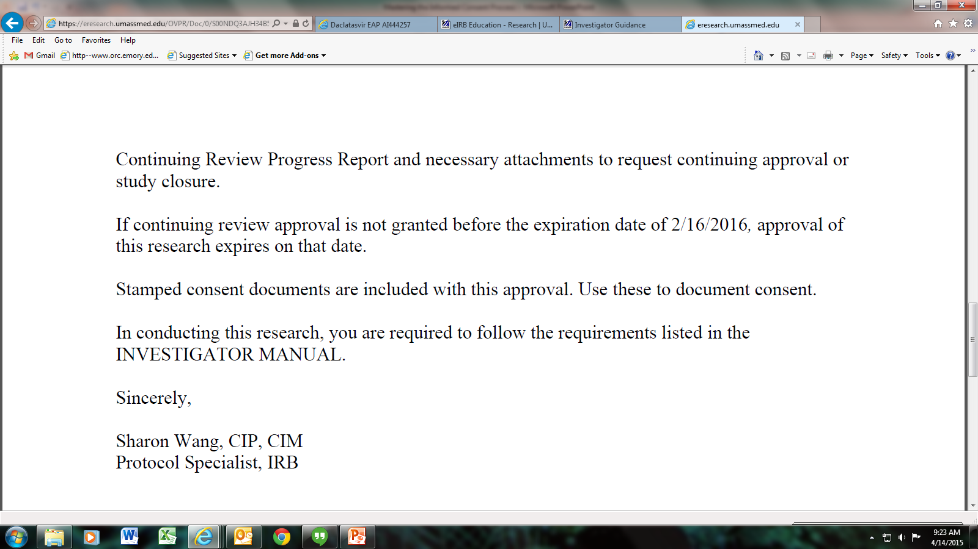

Slide 12
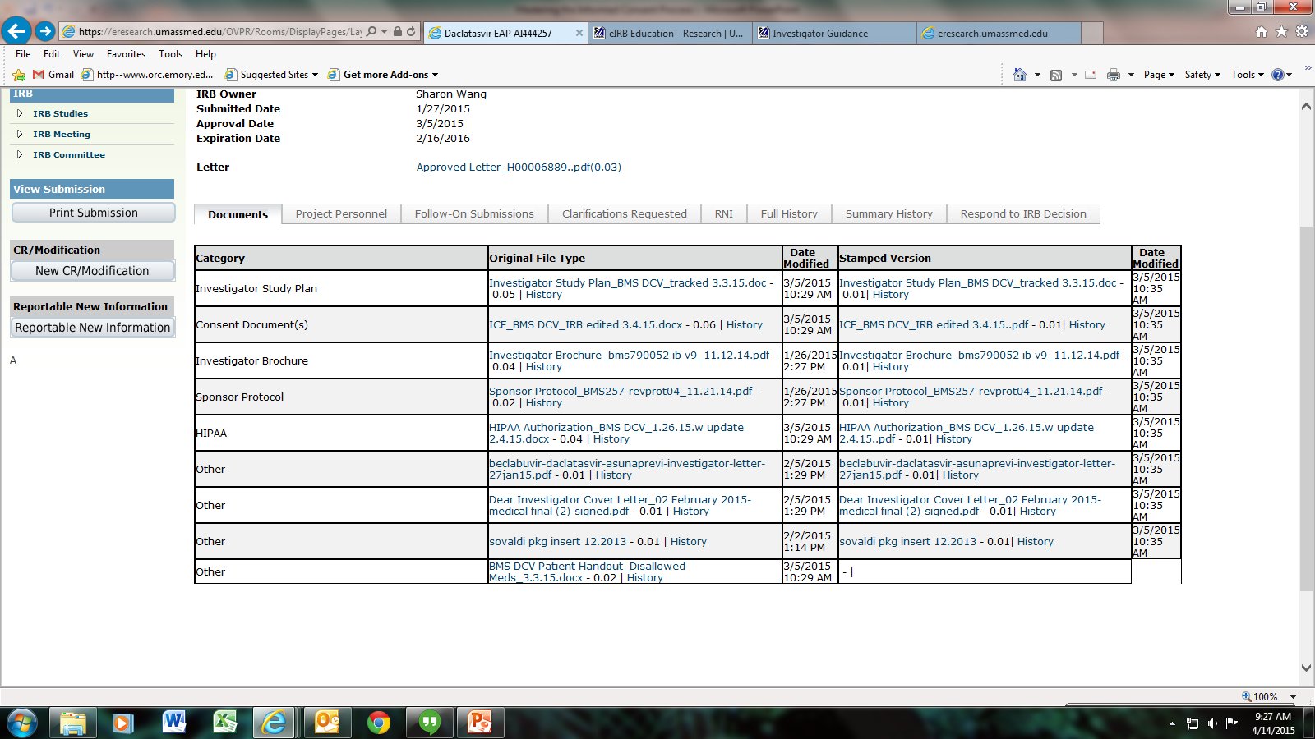

Slide 13
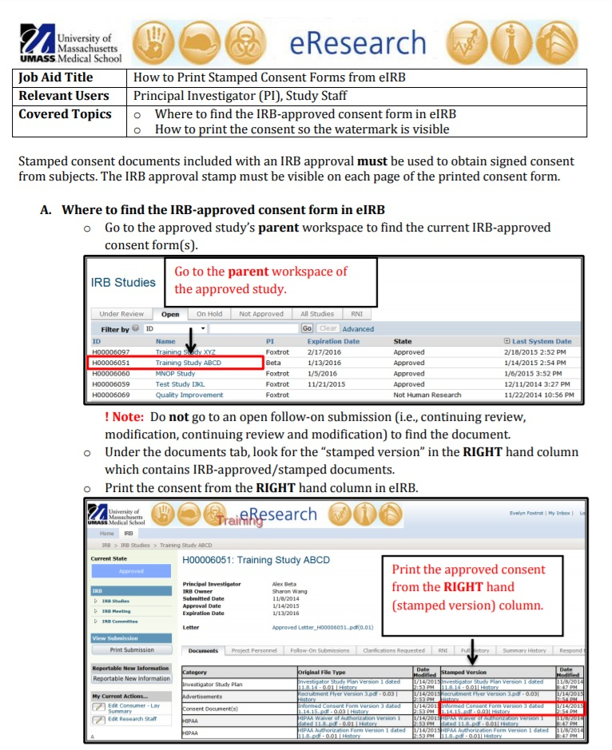

Slide 14
Approved UMass Medical School IRB: Do not sign this form after this date: 10/30/2015

Slide 15
Approved UMass Medical School IRB: Do not sign this form after this date: 10/29/2015

Slide 16
Approved UMass Medical School IRB: Do not sign this form after this date: 1/8/2015

Slide 17
IRB Guidance HRP-803
3.1.3. Have the following individuals personally sign and date the consent document:
3.1.3.1. Person giving consent (FDA 21 CFR 50.27)
3.1.3.2. Person obtaining consent

Slide 18
Approved UMass Medical School IRB: Do not sign this form after this date: 5/5/2015

Slide 19
Investigator Obligations HRP-800
2.10. Submit proposed modifications to the IRB prior to their implementation.
2.10.1. Do not make modifications to the research without prior IRB review and approval unless necessary to eliminate apparent immediate hazards to subjects.

Slide 20
Documenting consent process
“The case history for each individual shall document that informed consent was obtained prior to participation in the study”. (FDA 21 CFR 312.62(b))
Case history can be a progress note or other source document
What should be included:
Consent provided to subject and subject had a chance to read
Study team member explains study to subject
Subject had an opportunity to ask questions
Subject willing to participate and signed and dated the consent
Investigator or designee signed and dated the consent
Subject was given a copy of the signed and dated consent form
Notes:
ICH GCP E6 is silent on documenting consent process

Slide 22
Informed Consent Frequently Asked Questions

Slide 23
Informed Consent FAQs
How do you correct dating errors?
Missing dates or incorrect dates
FDA is silent. Sites can develop their own procedures
Never backdate a consent form!
Best practice recommendation: At the next subject visit, the subject should write a note and attach to the consent form stating that the form was originally signed on such and such a date before study procedures were initiated.

Slide 24
Informed Consent FAQs
Can you obtain consent over the phone, by fax or by electronic informed consent?
Methods must be approved by the IRB first.
If the ISP states consent will be in writing, then no, phone consent is not allowed
Subject can sign and fax back the consent
FDA accepts electronic signatures to document electronic informed consent. (FDA Guidance for Industry: Use of Electronic Informed Consent)
Notes:
According to the FDA, the consent form may be sent to the subject or the subject’s legally authorized representative by facsimile or e-mail, and the consent interview may then be conducted by telephone when the subject or subject’s legally authorized representative can read the consent form during the discussion. After the consent discussion, the subject or the subject’s legally authorized representative can sign and date the consent form and return the document to the clinical investigator by facsimile, scanning the consent form and returning it through a secure e-mail account, or by posting it to a secure internet address.

Slide 25
Informed Consent FAQs
Who can obtain consent?
ICH GCP 4.8.5 states the person conducting the informed consent discussion can be a “person designated by the investigator”.
FDA does not specify
Identify who will be obtaining consent in the eIRB system. (HRP-800:Investigator Obligations)

Slide 26
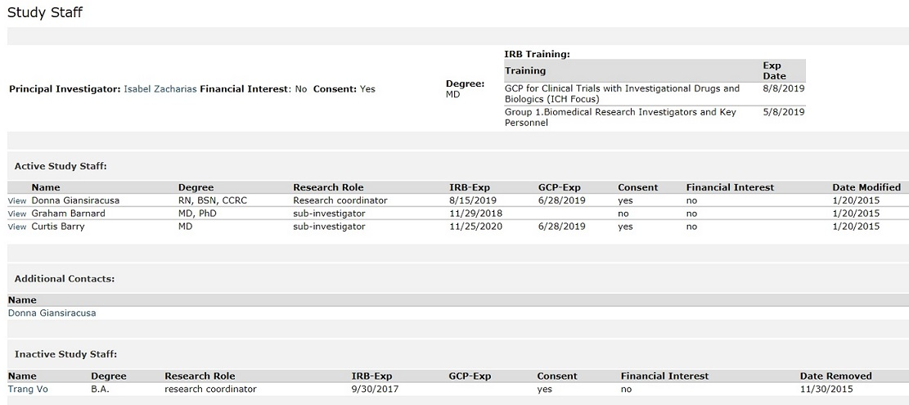

Slide 27
Informed Consent FAQs
What is an impartial witness?
Someone not associated with the trial
When should a witness be used?
ICH GCP 4.8.9: If a subject is unable to read or if a legally acceptable representative is unable to read, an impartial witness should be present during the entire informed consent discussion and sign and date the consent form.

Slide 28
Informed Consent FAQs
How long do you retain the informed consent and HIPAA documents?
Retain research records (including signed consent documents) for the greater of:
Three years after completion of the research
Maintain signed and dated consent documents for at least three years after completion of the research.
Maintain signed and dated HIPAA authorizations and consent documents that include HIPAA authorizations for at least six years after completion of the research.
(HRP-800: Investigator Obligations)

Slide 29
Informed Consent FAQs
Do copies of the informed consent need to be in the EMR?
If the research includes procedures which are or can affect clinical care, a copy of the signed consent form must be placed in the UMass Memorial medical record
(HRP-800: Investigator Obligations)
Scanned copies should be sent to:
epicmedicalrecordnumberissues@umassmemorial.org

Slide 30
UMass IRB Policies and Procedures
http://www.umassmed.edu/ccts/irb/investigator-guidance/
HRP-800: Investigator Obligations
HRP-802: Informed Consent
HRP-803: Documentation of Informed Consent

Slide 31
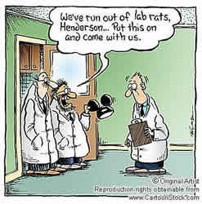
Questions?

