Slide 1
IRB Prompt Reporting Requirements
Allison Blodgett, PhD, CIP
Director of IRB Operations
UMass Medical School

Slide 2
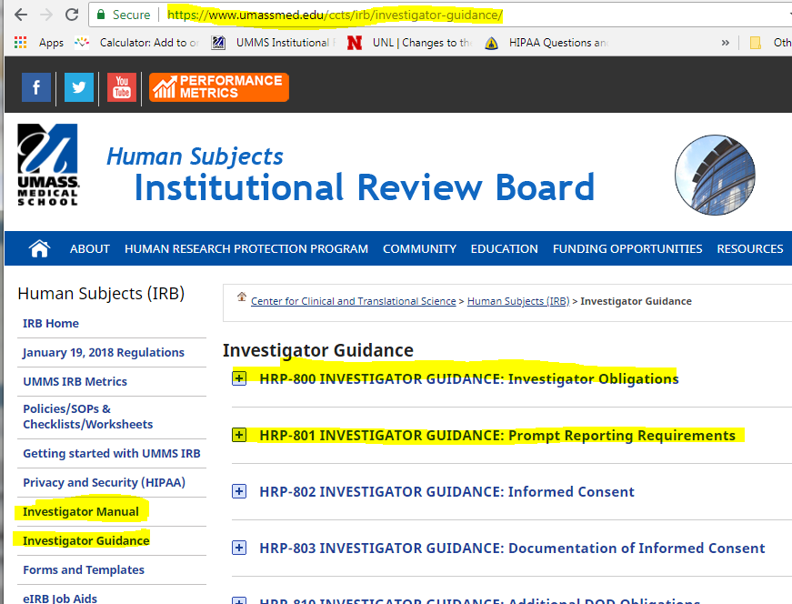
Investigators must know and adhere to prompt reporting requirements

Slide 3
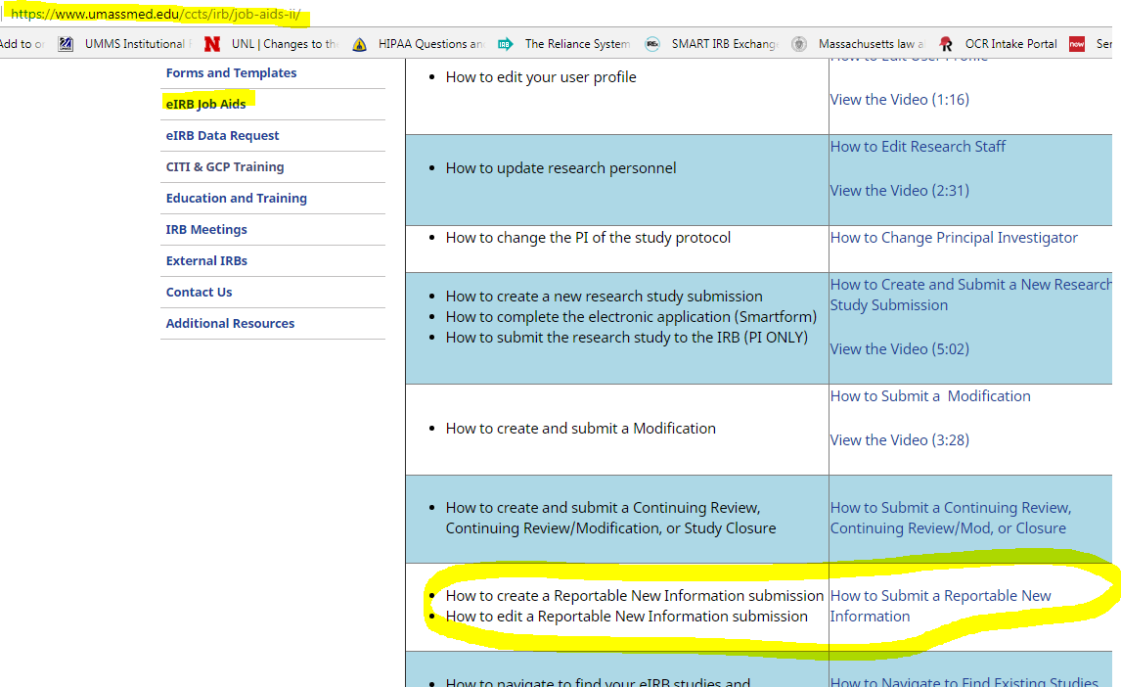
There’s an eIRB job aid that will walk you through the process

Slide 4

Reportable New Information (RNI)
Report the information items that fall into one or more of the following categories to the IRB within 5 business days of becoming aware of the event

Slide 5
Information that indicates a new or increased risk, or a safety issue
Any harm experienced by a subject or other individual, which in the opinion of the investigator is unexpected and probably related to the research procedures
Adverse event or IND safety report that requires a protocol or consent change
Unanticipated adverse device effect
Premature suspension or termination of the research by the sponsor or the investigator
Revised Investigator Brochure

Slide 6
Failure to follow the protocol due to the action or inaction of the investigator or research staff
Protocol deviation that harmed a subject or placed subject at risk of harm
Change to the protocol taken without prior IRB review to eliminate an apparent immediate hazard to a subject
Non-compliance with the federal regulations governing human research or with the requirements or determinations of the IRB, or an allegation of such non-compliance
Breach of confidentiality

Slide 7
Incarceration of a subject in a study not approved by the IRB to involve prisoners
Complaint of a subject that cannot be resolved by the research team
Audit, inspection, or inquiry by a federal agency, or its written report
State medical board or hospital medical staff actions

Slide 8
Submissions:
Subject 98657 was not given a serum x test.
Subject signed an outdated consent form.

Slide 9
Unanticipated problem involving risk to subjects or others:
Any unforeseen or unexpected incident that
adversely affects the rights, safety, or welfare of the subjects or others involved in the research; or
suggests that the research places subjects or others at a greater risk of harm related to the research than was previously known or recognized.

Slide 10
Serious adverse event:
Any adverse event that results in significant or increased risk to the subject such as an event which: results in death; is life threatening; requires inpatient hospitalization or prolongation of existing hospitalization; results in a persistent or significant disability/incapacity; results in a congenital anomaly/birth defect; or any other adverse event that, based upon appropriate medical judgment, may jeopardize the subject’s health and may require medical or surgical intervention.

Slide 11
Example 1
A subject participating in a phase 3, randomized, double-blind, controlled clinical trial comparing the relative safety and efficacy of a new chemotherapy agent combined with the current standard chemotherapy regimen, versus placebo combined with the current standard chemotherapy regimen, for the management of multiple myeloma develops neutropenia and sepsis.
The subject subsequently develops multi-organ failure and dies.

Slide 12
Example 1
Prolonged bone marrow suppression resulting in neutropenia and risk of life-threatening infections is a known complication of the chemotherapy regimens being tested in this clinical trial and these risks are described in the IRB-approved protocol and informed consent document.
The investigators conclude that the subject’s infection and death are directly related to the research interventions.
A review of data on all subjects enrolled so far reveals that the incidence of severe neutropenia, infection, and death are within the expected frequency.

Slide 13
Requires prompt reporting to IRB? NO
The occurrence of severe infections and death, in terms of nature, severity, and frequency, was expected

Slide 14
Example 2
Subjects with coronary artery disease presenting with unstable angina are enrolled in a multicenter clinical trial evaluating the safety and efficacy of an investigational vascular stent.
Based on prior studies in animals and humans, the investigators anticipate that up to 5% of subjects receiving the investigational stent will require emergency coronary artery bypass graft (CABG) surgery because of acute blockage of the stent that is unresponsive to non-surgical interventions.
The risk of needing emergency CABG surgery is described in the IRB-approved protocol and informed consent document.

Slide 15
Example 2
After the first 20 subjects are enrolled in the study, a DSMB conducts an interim analysis, as required by the IRB-approved protocol, and notes that 10 subjects have needed to undergo emergency CABG surgery soon after placement of the investigational stent.
The DSMB monitoring the clinical trial concludes that the rate at which subjects have needed to undergo CABG greatly exceeds the expected rate and communicates this information to the investigators.
.

Slide 16
Requires prompt reporting to IRB? YES
The frequency at which subjects have needed to undergo emergency CABG surgery was significantly higher than the expected frequency;
these events were related to participation in the research; and
these events were serious.

Slide 17
Example 3
A researcher is traveling home and stops at Dunkin Donuts to buy a medium iced coffee with skim milk and 12 Splendas.
While the investigator is inside ordering someone reaches into the car window and takes the laptop, which was on the passenger seat.
The laptop contained a list of subject names and information (including ss#).
The laptop was password protected AND there was a password for the specific file.

Slide 18
Ask yourself
EVENT/INFORMATION
Who needs to know? | Sponsor? | UMMS IRB? |  | External IRB?
 |  | UMMS IT?
 |  | Privacy?
 |  | Police?
How quickly? | 24 hours | 5 days | @ CR | “Promptly” | @ CR
How to communicate? | … | eIRB |  | …

Slide 19
Investigator Obligations:
Do not commence research until you have the IRB approval letter and obtained all other required approvals,
Radiation Safety, Biosafety, COI Committees
Protocol Review Committees (Cancer, or CCTS PRC for Investigator-Initiated greater than minimal risk research that would not otherwise be peer reviewed)
Approvals of departments or divisions that require approval
Comply with all requirements and determinations of the IRB.
Ensure that there are adequate resources to carry out the research safely. This includes, but is not limited to, sufficient investigator time, appropriately qualified research team members, equipment, and space.

Slide 20
Ensure that research staff are qualified (e.g., including but not limited to appropriate training, education, expertise, credentials, protocol requirements and, when relevant, privileges) to perform procedures and duties assigned to them during the study.
Investigators and research staff are required to complete initial training and continuing training at least every three years.
Personally conduct or supervise the research.
Conduct the research in accordance with the relevant current protocol approved by the IRB.

Slide 21
Unless the IRB affirmatively approved a protocol to include the following populations, such subjects may not be enrolled:
Adults unable to consent
Children
Neonates of uncertain viability
Nonviable neonates
Pregnant women
Prisoners
Individuals unable to speak English

Slide 22
When consent, permission, or assent are required by the IRB ensure that they are obtained and documented in accordance with the relevant current protocol as approved by the IRB.
Follow the [Organization’s] requirements to disclose financial interests.
Retain research records (including signed consent documents)
Employ sound study design in accordance with the standards of your discipline and design studies in a manner that minimizes risks to subjects.
Update the IRB with any changes to study personnel.

Slide 23
If you are the lead investigator of a multi-site study, ensure there is a plan to manage of information that is relevant to the protection of subjects, such as Unanticipated Problems Involving Risks to Subjects or Others, interim results, and protocol modifications, and submit that plan to the IRB with your protocol.
If you plan to conduct community-based participatory research, you may contact the Community Engagement Group for information.

Slide 24
Consequences of not Obtaining IRB Approval
Data collected may not be used.
Publication may be rejected.

Slide 25
Institutional Consequences
Jesse Gelsinger dies at 18 at UPenn.
Volunteered for gene transfer study.
What went wrong…(20 page FDA letter) Failed to …
Immediately report SAEs
Follow approved protocol
Incorporate FDA requests to consent form
Notify FDA of animal tests which suggest risk to humans
Ensure only eligible subjects were enrolled
Disclose conflict of interest

Slide 26
New York Times
WASHINGTON, Jan. 21— The Food and Drug Administration temporarily shut down human gene therapy experiments at the University of Pennsylvania today after an inspection uncovered ''numerous serious deficiencies'' in ensuring patient safety during a clinical trial that cost an 18-year-old Arizona man his life. The decision to place the entire program -- eight experiments, including five active clinical trials in diseases ranging from cystic fibrosis to breast cancer -- on ''clinical hold'' is highly unusual. The hold is indefinite, agency officials said, and will not be lifted until the agency is convinced that the university's Institute for Human Gene Therapy can follow federal rules designed to protect study volunteers from harm.

Slide 27
What do you do if you have questions whether IRB review is needed or if you think the research involving human subjects is not in compliance?
Contact the IRB.

Slide 28

Questions/Comments

