Slide 1
Responsibilities of the Principal Investigator
Anne Roussell, RN
[adapted from
MAGI/Complion Presentation
by Velma Marzinotto, RN
April 2018]

Slide 2
References
ICH E6 (R2): Good Clinical Practices (GCP)
Title 21 Code of Federal Regulations
UMMS eIRB support materials:
    HRP 800 - 816: Investigator Guidance

Slide 3
Definition ICH GCP E6(R2)1.34, 1.54, 1.56
Principal Investigator (PI)
Responsible for the conduct of the clinical trial at a trial site
Subinvestigator (Sub-I)
Perform critical trial-related procedures
Make important trial-related decisions

Slide 4
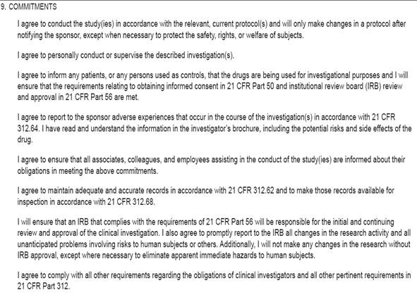
Signing the FDA 1572 Form
Statement of Investigator
What does it mean when you sign on the dotted line?
  Conduct study according to protocol
  Personally conduct or supervise study
  Ensure free and informed consent
  Report adverse events to sponsor
  Ensure all study personnel are trained
  Maintain adequate & accurate records
  Obtain IRB approval
  Comply with all other requirements

Slide 5
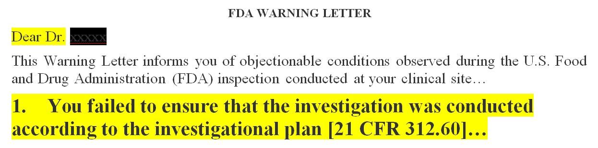
US FDA Regulated Trials
FDA Warning Letters publicly available:
Penalty for significant non-compliance:
  Disqualification / restrictions
    Criminal prosecution

Slide 6

KNOW YOUR
RESPONSIBILITIES
“Investigators and study staff should be fully informed of their
responsibilities under regulations. They should understand the protocol completely, especially with regard to inclusion / exclusion criteria, tests and observations to be made, and what study documentation is to be kept.”
Doreen M. Kezer, MSN, Senior Policy Analyst, FDA
As cited in ACRP blog “FDA Offers Pre-Inspection Tips”by Michael Causey, March 1, 2018

Slide 7


PI Responsibilities ICH GCP E6(R2) Section 4
Adequate resources to conduct study
All staff are qualified and trained
Appropriate delegation of all study tasks
Communication with the IRB
Ensure compliance with study protocol and all SOPs
Proper informed consent process
All trial-related medical decisions

Slide 8

PI Responsibilities ICH GCP E6(R2) Section 4
Randomization procedures and unblinding
Investigational Product(IP) accountability at site
Safety Reporting: assessment and grading of all adverse events; review of safety updates
Review all protocol deviations, if any
Records and Reports: data handling
Maintain Essential Documents

Slide 9





1. Adequate Resources ICH GCP E6(R2) 4.2
Adequate time, funds, staff, facilities, study participants

Slide 10

2. Qualifications/Training ICH GCP(R2) 4.1
Ensure all study staff qualifications and training are
up-to-date throughout the study
Qualifications
Curriculum Vitae (CVs), resumes
Licensures, certifications
Research Training
GCP, IRB, COI, etc.
All applicable regulations governing the trial

Slide 11



2. Study-Specific Training ICH GCP(R2) 4.2.4, 4.2.6
Study Protocol
Study protocol and all amendments
Study procedures i.e., study MRI
Investigator’s Brochure and all updates
Standard Operating Procedures (SOPs)
Implement systems and procedures that assure quality of every aspect of the trial
Focus SOPs on aspects essential to participant safety and study data reliability
DOCUMENT THE TRAINING!!!

Slide 12

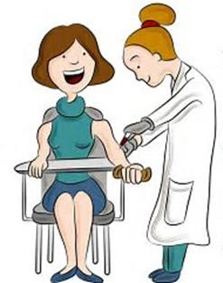
2. Qualifications/Training ICH GCP(R2) 4.2.5, 4.2.6
Training for service providers performing key study
tasks i.e., processing specimens, study MRI, etc.
Process in place to check qualifications/credentials
If any protocol changes are related to service provider’s study
tasks, communicate the changes and re-train as needed
If study task(s) considered part of professional practice i.e.,
drawing blood, protocol training is not required
Cardiology Technicians
Phlebotomists

Slide 13
2. Qualifications/Training ICH GCP(R2) 4.2.5, 4.2.6
Individual or Group Training Record /Delegation Log
Training Record
  Documents:
Protocol (including all amendments)
Procedures
CRFs
Subject questionnaires, diaries, etc.
Advertisement
Description of Training Materials

Slide 14
3. Study Task Delegation ICH GCP(R2) 4.1.5
PI Authorization:
Step 1: Confirm all qualifications (i.e. CVs) are available
Step 2: Confirm all training is complete (before signing and dating the Delegation Log)
Step 3: Delegate all study tasks prior to the start of the tasks

Slide 15
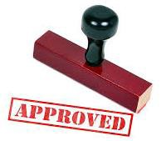

4. Communication with IRB ICH GCP(R2) 4.4
Documents requiring IRB approval:
  Study protocol and any amendments
Informed consent form(s) and any revisions
Any other written materials provided to study participants
Participant recruitment procedures i.e. advertisements
etc.

Slide 16
4. Communication with IRB ICH GCP(R2) 4.4
Documents requiring IRB review:
  Investigator’s Brochure (IB) and any revisions
  Continuing Review Form (annually)
  Reportable Serious Adverse Events
  Updated Safety Information
  Reportable Protocol Deviations

Slide 17

PI Responsibilities Prior to Study Start Recap
Ensure adequate resources
Confirm all staff qualifications and research training
Confirm all study-specific training: protocol, IB, SOPs
Appropriate delegation of study tasks
Obtain all ethics and regulatory approvals

Slide 18



5. PROTOCOL COMPLIANCE
Protocol Roadmap
GCP Guidebook
I have read the clinical study protocol and agree to personally
conduct the clinical study in accordance with the clinical study protocol.
Principal Investigator: _________________________________________
Name, Signature and Date

Slide 19
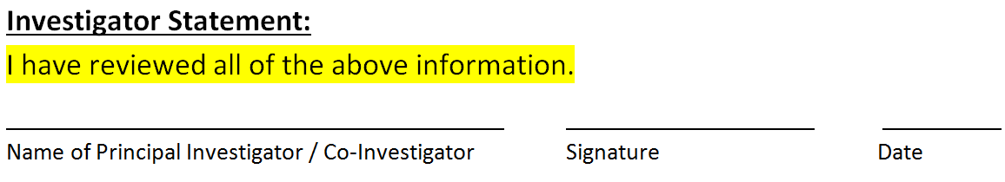

6. Informed Consent Process ICH GCP(R2) 4.8
Ensure free and informed consent of each participant
  Full explanation
  Adequate time
  Opportunity to ask questions
  IC form (ICF) personally signed and dated before study start
PI to document oversight of IC process: ICF, checklist, study note

Slide 20

7. Trial-Related Medical Decisions ICH GCP(R2) 4.3
Examples of MD Investigator decisions:
Confirming eligibility
  Review of concomitant meds: prior and during
  Randomization and emergency unblinding
  Study drug orders
  All study test orders as per protocol
  Review and interpretation of all study-related test results
  Assessment and grading of any adverse events
  Review and assessment of any protocol deviations

Slide 21

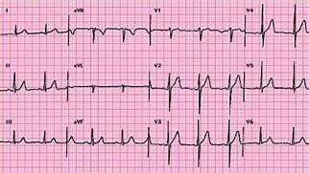
7. Confirming Eligibility ICH GCP(R2) 4.3.1
PI to review all source data to confirm eligibility:
  medical history, OR note, radiology reports, etc.
  inclusion / exclusion checklist
Ensure each criterion is within specified time parameters, for example:
  LVEF must be > 30 % within 6 months
  history of Type-2 diabetes with HbA1C ≥ 6.5 and < 10% within 30 days prior to randomization
  normal 12-lead ECG at baseline

Slide 22
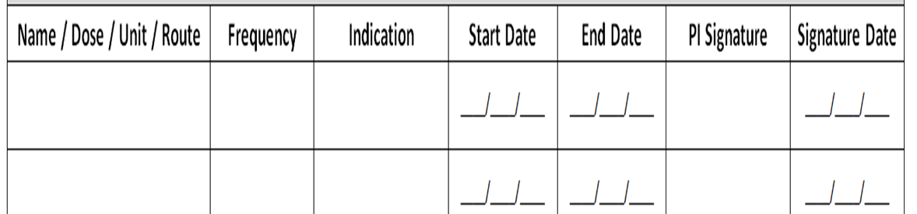

7. Review of Concomitant Meds ICH GCP(R2) 4.3
PI to review of all concomitant medications at:
  baseline screening
  prior to randomization
  any changes throughout the active study period
Ensure no prohibited or restricted medications
Concomitant Medication Log

Slide 23

8. Randomization and Unblinding ICH GCP(R2) 4.7
Randomization:
  PI to ensure study staff are trained in randomization procedure
  PI should sign and date confirmation of randomization
Emergency Unblinding Procedure:
  Study-specific procedure
  Access restricted

Slide 24

9. Study Drug Orders ICH GCP(R2) 4.6
PI to ensure study drug used only in accordance with protocol
  Study drug orders
  Study drug instructions
  Approve study drug dispensing before next dose

Slide 25
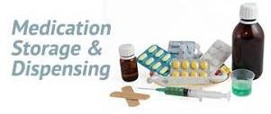
9. Handling Investigational Product ICH GCP(R2) 4.6
PI responsible for study drug at the site
May assign some or all duties to Research Pharmacy
PI to ensure all pharmacy staff are trained in protocol and SOPs
  i.e., pharmacy manual, and any updates throughout the study
Track overall inventory: receipt, storage, returns, destruction
Track all dispensing for each participant: date, amount, lot#/expiration date, unique code numbers

Slide 26
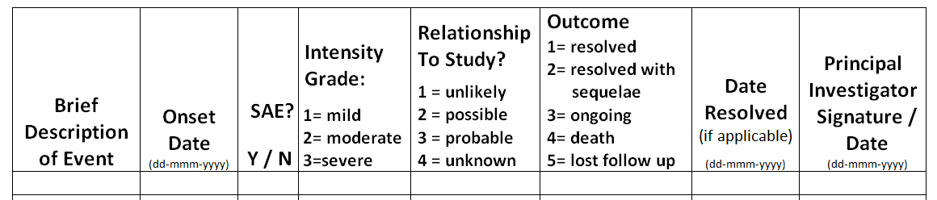

10. Safety Reporting ICH GCP(R2) Section 4.11, 4.3.2
PI or MD Sub-I must assess and grade all adverse events (AEs)
Ensure adequate medical care for any study-related AEs
Report all SAEs as per the protocol, Sponsor, IRB and regulatory
guidelines
PI and MD Sub-Is to review all safety reports
Adverse Event Log

Slide 27



10. Review/Interpret Study Test Results ICH GCP(R2) 4.3.1
PI to review and assess all study-related test
results i.e., ECG reports, CT scans, etc.
PI to determine if study test results are
“clinically significant(CS)” or “not clinically significant(NCS)”
Abnormal test results may be an AE i.e., K+ < 3.5 = hypokalemia
Sign and date in a timely manner!

Slide 28
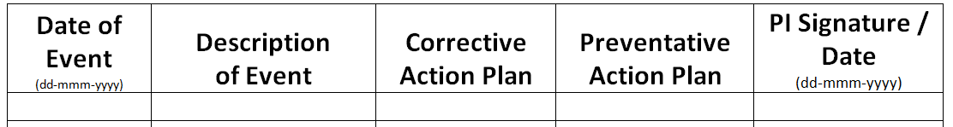

11. Protocol Deviations ICH GCP(R2) 4.5.3, 5.20.1
PI or MD Sub-I must review and assess all deviations from the
approved protocol and/or SOPs in a timely manner
Follow protocol, sponsor and IRB reporting requirements
If significant non-compliance, root cause analysis and CAPA
Protocol Deviation Log
Detailed Description (i.e., type of visit, out of window period, reason
  CAPA

Slide 29
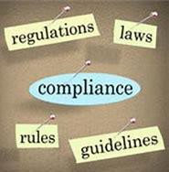
11. Protocol Compliance - Recap
PI Oversight:
Ensure that only eligible participants are enrolled
Document oversight of informed consent process
If blinded study, follow study-specific unblinding procedure
Review and sign-off study visit data before participant receives next dose of study drug
Evaluate all study test results
Assess and grade all adverse events
Review and assess all protocol deviations

Slide 30



12. Records and Reports ICH GCP E6(R2) 4.9
“During study conduct, …ensure that… all study activities
are meticulously documented.”
Doreen M. Kezer, MSN, Senior Policy Analyst, FDA
As cited in ACRP blog “FDA Offers Pre-Inspection Tips”
by Michael Causey, March 1, 2018

Slide 31
12. Records and Reports ICH GCP(R2) 4.9.0 & 8.1
ALCOA-C
A Attributable: who created the record; sign and date
L Legible: readable, clear, comprehensible
C Contemporaneous: record activity in a timely manner
O Original: source document or certified copy
A Accurate: exact, truthful, correct, verifiable
C Complete: capture all required data, no blank spaces
Changes to source documents should be traceable

Slide 32
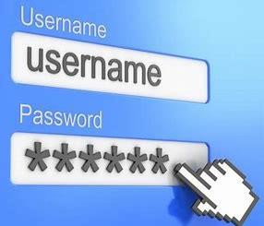

12. Electronic Trial Data Handling ICH GCP(R2) 5.5.3, 8.1
Electronic systems used for: participant registration,
randomization, unblinding, study database (e-CRF), etc.
PI and staff responsibilities with respect to using e-systems
must be clear
PI and delegated study staff must complete e-system training
After training, each user is given password-protected access to
e-system prior to use

Slide 33



12. CRF Sign-off ICH GCP(R2) 8.3.14
At end of study, PI is responsible for verifying that all data is:
    Accurate
  Consistent with source documents or discrepancies explained
  Attributable - who entered the data and/or made changes
  Complete
“I verify that the case report form accurately displays the results of tests, evaluations, procedures and treatments recorded within. I certify that this electronic signature is the legally binding equivalent of my handwritten signature.”
PI’s Username and Password Electronic Signature

Slide 34


13. Maintain Essential Documents ICH GCP(R2) 8.1
Plan for storage and archiving of all data generated during study
  Who? What? Where? When? How Long?
PI control of records generated by the PI/institution:
  Essential documents (Investigator Site File)
  Source documents i.e., medical records
  Study documentation
PI control of and continuous access to CRF data

Slide 35

Take Home Message
The PI is responsible for ensuring that the study is conducted according to the approved protocol, SOPs, GCP(R2) and all applicable regulations
The PI must ensure that documentation of study oversight is
done in a timely manner i.e., SIGN AND DATE and time, as required
The PI is responsible for ensuring that all study data is accurate,
complete and verifiable

Slide 36
Thanks for your time!

