Slide 1
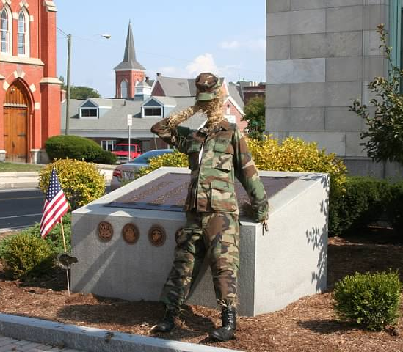
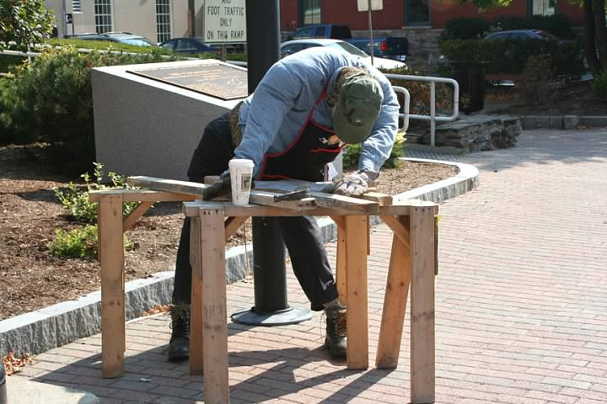
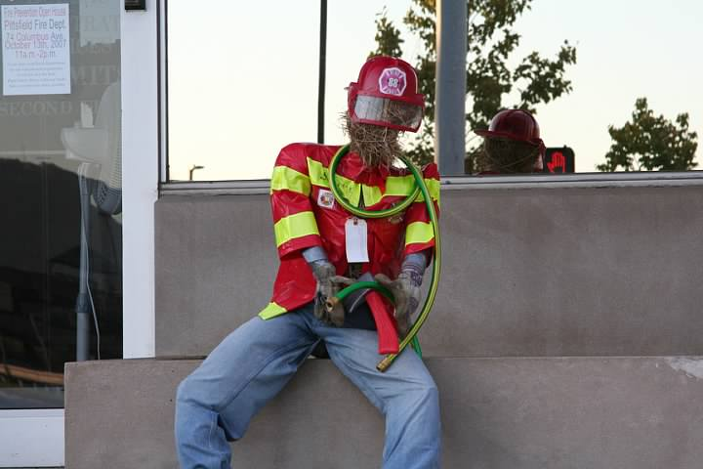
Introduction to Occupational and Environmental Medicine
Philip Adamo, M.D., MPH, FACOEM
October 2020

Slide 2
Our Discussion Today
Introductions
Questions to Raise an Interest
What Is Occupational and Environmental Medicine?
History of Occupational Medicine
Professional Organization
Regulatory and Government Agencies—Federal and State
A Brief Look at Worker’s Compensation
October 2020

Slide 3
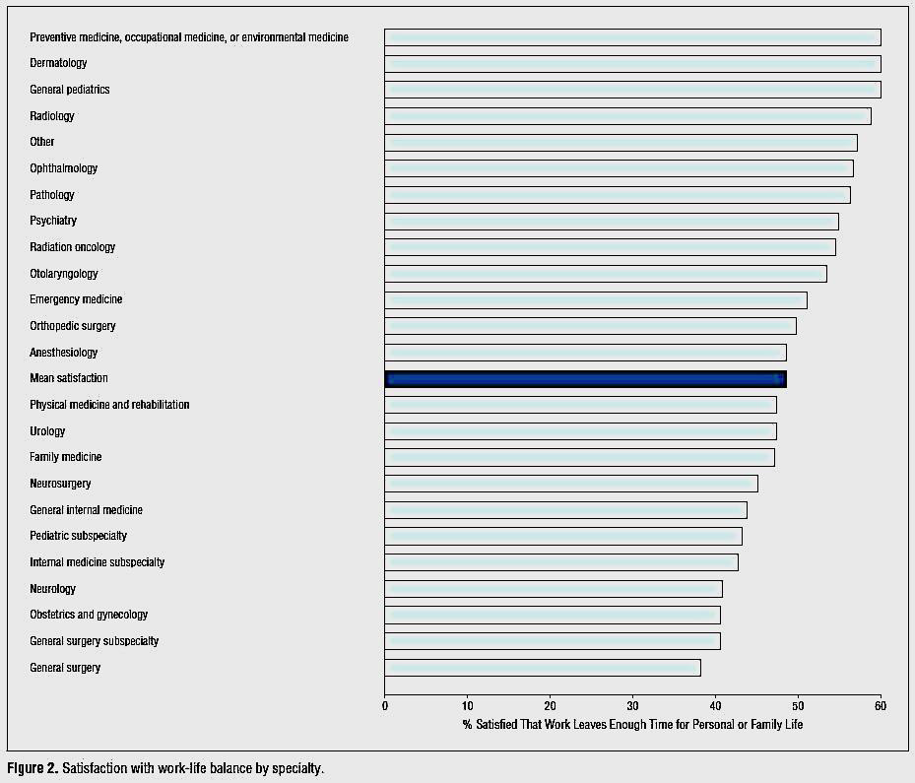
Who Am I and Who Are You?......And Are We Happy?
Archives of Internal Medicine, Published Online, August 20, 2012
October 2020

Slide 4
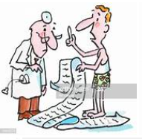
Questions from Patients
I have well-controlled seizures. Can I drive a Yellow Freight truck? The money is great!
I had an MI six weeks ago. When can I go back to work?
I have adult onset diabetes. Can I work swing shifts?
I hate my job…can’t you just write a note for me to miss a few days?
October 2020

Slide 5

More Questions from Patients
So doctor, what do you think is causing the numbness in my hands and feet?
I work in the OR, do you think it is safe for me? I want to have children some day.
Doctor, I had a needle stick last week at the hospital. The patient had AIDS and Hepatitis C. I do not want to tell my boss. She will fire me!
I have monocular vision. I have had it since birth. Can I apply for a job to drive for Yellow Freight ?
So doc, what do you think is causing my skin rash…and my asthma?…my cancer?
I have been hospitalized for depression. I want to go back to work. What do I tell my employer?
October 2020

Slide 6

Questions I Receive from Community Providers
How do I return my patient back to work after a long illness?
What is a DOT exam? What does it mean at the end of the form, “meets standards in 49 CFR 391.41 qualifies for a 2-year certificate?”
What is my obligation as a medical provider with my patients’ employer?
What is FMLA and ADA?
What do I do with all these forms?
October 2020

Slide 7

The Number 1 and Number 2 Burning Question
1. What is the impact of unhealthy behaviors and chronic illness on productivity in the workplace, especially:
Absenteeism?
Presenteeism?
2. Does a healthy and happy employee provide better care of our patients in the hospital?
Burnout in United States Healthcare
Professionals: A Narrative Review
Thomas P. Reith
School of Medicine, Medical College of Wisconsin, Milwaukee, USA
October 2020

Slide 8

With this Pen…
October 2020

Slide 9
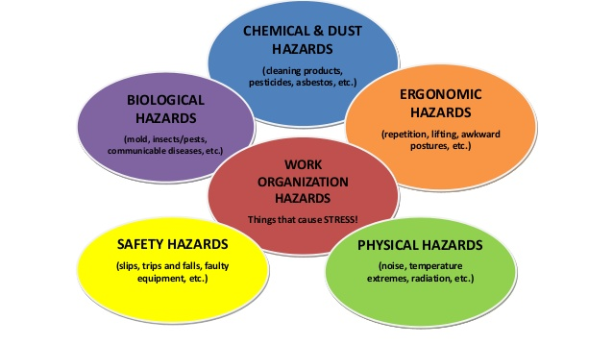
Occupational and Environmental Medicine
The multidisciplinary approach to the recognition, diagnosis, treatment and prevention of illnesses, injuries, and other adverse health conditions resulting from hazardous environmental exposures in the workplace, the home and the community.
Well-being
Belonging
COVID-19
WPV

Slide 10

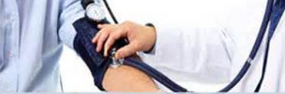
Occupational Medicine
Part of the American Board of Preventive Medicine.
There is a shortage in the field.
Many services are provided by primary care professionals; however, there must be knowledge of the patient’s job and regulations.
October 2020

Slide 11
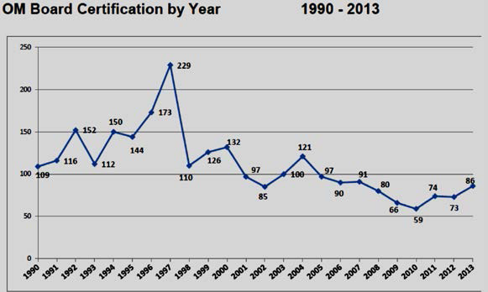
Is There a Residency / Fellowship in Occupational Medicine?
OM Board Certification by Year
1990–2013
October 2020

Slide 12

Occupational Medicine
The provider and patient are joined in a network of relationships:
Employer
♦
Workers’ Compensation Carrier (Insurer)
♦
Union / Union Lawyer
♦
Regulatory Agencies
***A subgroup of OM is Medical Center Occupational Health (MCOH)***
October 2020

Slide 13
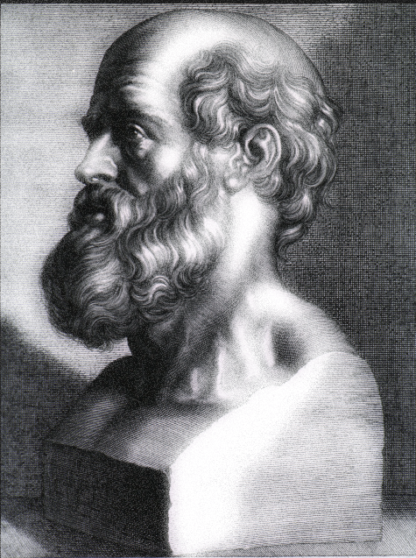

Occupational Medicine
Dates Back to Hippocrates – 4th Century BC - Lead Poisoning
Aims to prevent and treat illnesses that arise from work and to promote the general health of the workforce.
Also evaluate and treat the effect of environmental exposures.
What are the effects of lead?
October 2020

Slide 14
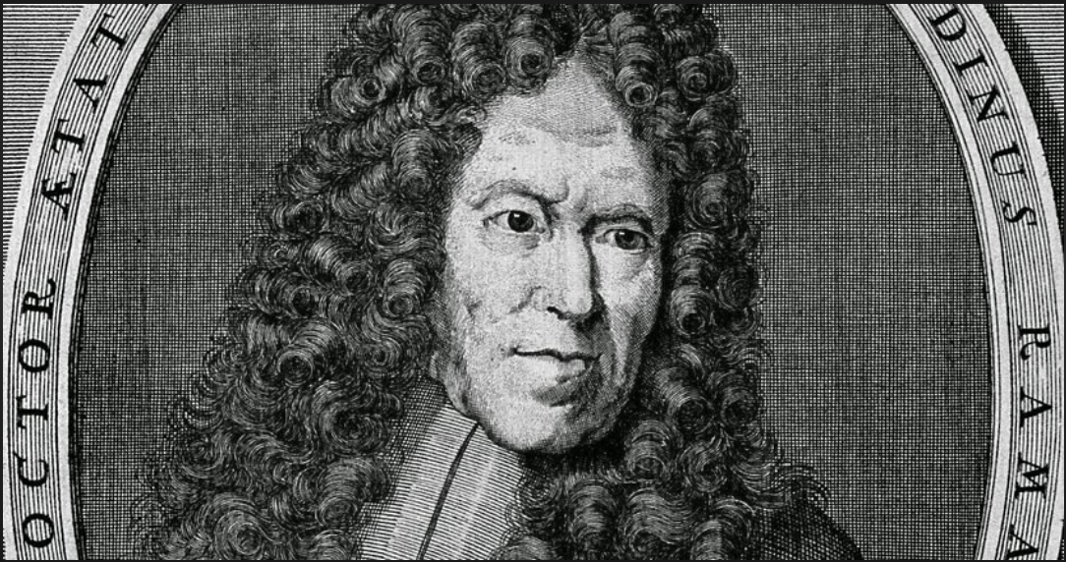
Father of Occupational Medicine
Bernardino Ramazzini
Born in Capri, Italy in 1633. While a medical student in Parma, he was drawn to diseases suffered by workers. Chair of theory of medicine at University of Modena in 1682.
De Morbis Artificum Diatriba [Diseases of Workers]; the first edition was printed in Modena in 1700 and the second in Padua in 1713.
October 2020

Slide 15
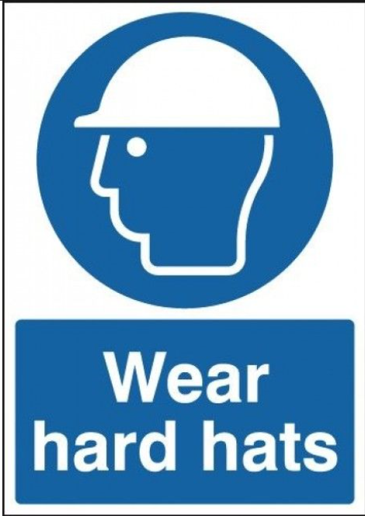
Occupational Medicine in the USA
How Did Occupational Medicine Evolve in the USA?
The aftermath of the industrial revolution in the 19th century
Unskilled labor force
Influx of immigrants
Urbanization
Bacteriologic evolution
Social Welfare
Current Day Occupational Medicine Involvement:
COVID-19
Workplace Violence (WPV)
Burnout/depression/anxiety
Put on your public health hat!
October 2020

Slide 16
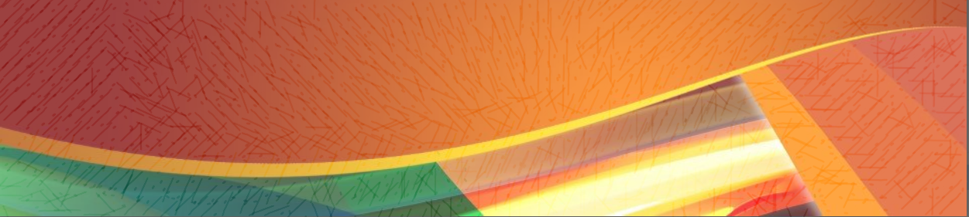
In the Arena of the Practice of Occupational Medicine
Prevention
Pre-Placement Evaluations
Medical Surveillance
Return to Work Evaluations
Fitness for Duty(physical, emotional, cognitive)
Drug and Alcohol Testing
Immunizations
When Prevention “Fails”
Injury / Illness Care
October 2020

Slide 17
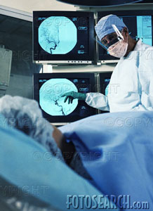
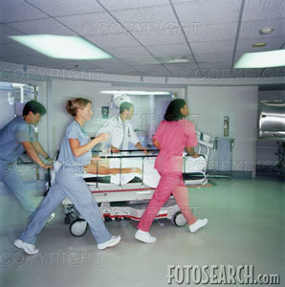
What About MCOH?
Bloodborne Pathogens/Sharps Injuries
Other Pathogens (airborne)
Ergonomics
Chemical, Physical, and Biological Exposures
Immunizations
COVID-19
Safety of Patients and Employees
October 2020

Slide 18

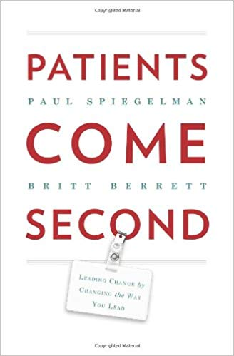
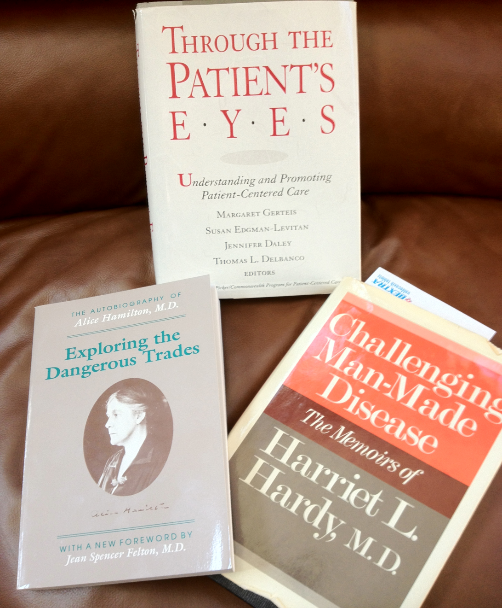
October 2020

Slide 19
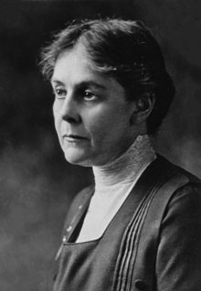
Pioneers in Science
At the beginning of the 20th century, there was greater participation in the sciences by woman. Dr. Alice Hamilton was one of these women who’s career started in research and academic medicine and transcended into taking a strong stand on social inequities and industrial caused morbidity and mortality with the industrial revolution.
Alice Hamilton
1869–1970
October 2020

Slide 20

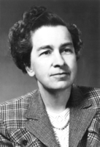
Harriet Hardy
Dr. Hardy worked as a country doctor in the Berkshires during the depression. She was the first woman professor at Harvard University.
1906–1993
October 2020

Slide 21
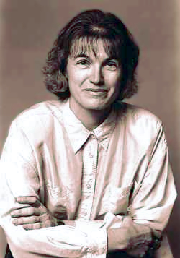
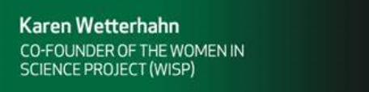
Does This Name Sound Familiar?
Dr. Karen Wetterhahn
American Professor of Chemistry
at Dartmouth College
Organic mercury compound dimethylmercury (Hg(CH₃)₂)
October 2020

Slide 22

OEM Core Competencies
Clinical Occupational and Environmental Medicine (OEM)
OEM-Related Law and Regulations
Environmental Health
Work Fitness and Disability Integration
Toxicology
Hazard Recognition, Evaluation, and Control
Disaster Preparedness and Emergency Management
Health and Productivity
Public Health, Surveillance, and Disease Prevention
OEM Related Management and Administration
October 2020

Slide 23


Professional Organizations
American College of Occupational and Environmental Medicine
New England College of Occupational and Environmental Medicine
October 2020

Slide 24

Vision: ACOEM is the pre-eminent organization of physicians who champion the health and safety of workers, workplaces, and environments.
Mission: ACOEM provides leadership to promote optimal health and safety of workers, workplaces, and environments by:
Educating health professionals and the public
Stimulating research
Enhancing the quality of practice
Guiding workplace and public policy
Advancing the field of OEM
October 2020

Slide 25

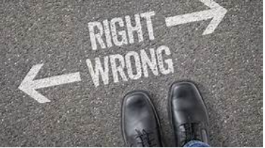
ACOEM Code of Ethical Conduct
The first value or belief is that the health professional’s role is primarily to do good for the patient.
The second fundamental bioethical value is that of autonomy.
The third important bioethical value underlying the ACOEM code is justice.
October 2020

Slide 26
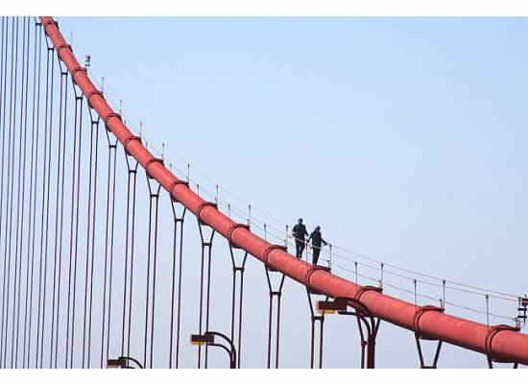
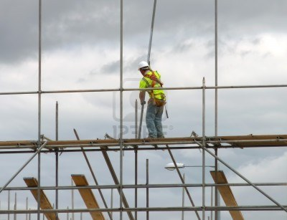
HEALTH
SAFETY
What does politics have to do with safety and health?
Is the CDC/FDA apolitical?
October 2020

Slide 27

DHHS Regulatory Agencies
Department of Health and Human Services
OSHA
www.osha.gov
NIOSH
www.cdc.gov/niosh
CDC
www.cdc.gov
ATSDR
www.atsdr.cdc.gov
APPOINTED by
the PRESIDENT
MDPH
www.mass.gov/eohhs/gov/departments/dph/
DIA
www.mass.gov/lwd/workers-compensation/
October 2020

Slide 28
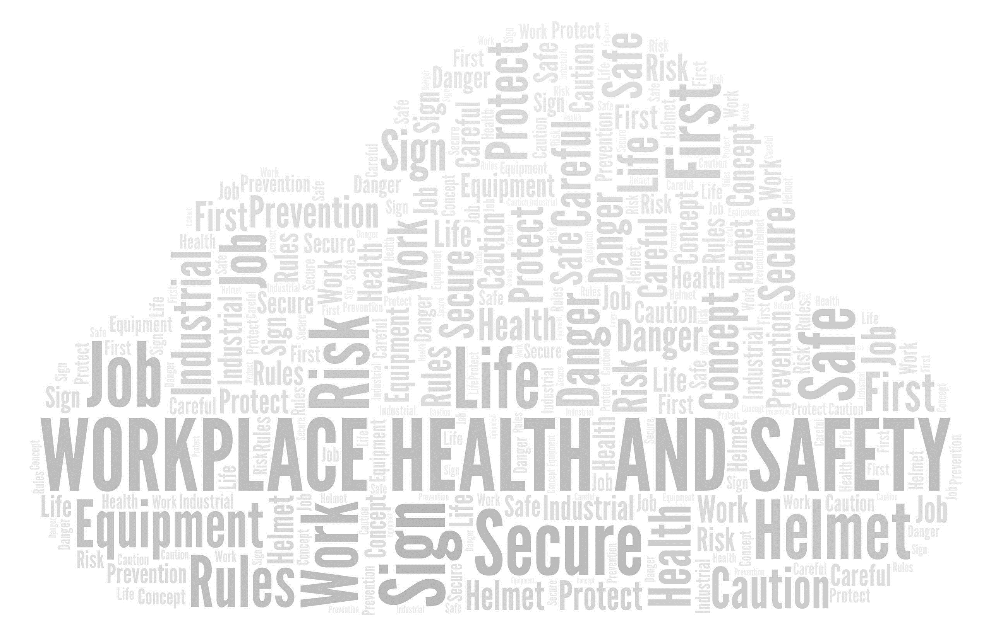
“Promoting Healthy Workplaces by Building Cultures of Health and Applying Strategic Communications,”
Kent, Karen MPH; Goetzel, Ron Z. PhD; Roemer, Enid C. PhD; Prasad, Aishwarya MPH, MBBS; Freundlich, Naomi MA
Journal of Occupational and Environmental Medicine: February 2016 - Volume 58 - Issue 2 - p 114–122
October 2020

Slide 29
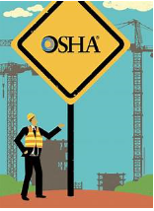
Occupational Safety and Health Administration (OSHA)
With the Occupational Safety and Health Act of 1970, Congress created the Occupational Safety and Health Administration (OSHA).
Assures a safe and healthful working conditions for working men and women by setting and enforcing standards and by providing training, outreach, education, and assistance.
Part of the Department of Labor.
The Occupational Safety and Health Act of 1970 created both NIOSH and the Occupational Safety and Health Administration (OSHA).
October 2020

Slide 30

General Duty Clause
Each employer: Shall furnish to each of his employees employment and a place of employment which are free from recognized hazards that are causing or are likely to cause death or serious physical harm to his employees. Shall comply with occupational safety and health standards promulgated under this Act.
Each employee:
Shall comply with occupational safety and health standards and all rules, regulations, and orders issued pursuant to this Act which are applicable to his own actions and conduct.
October 2020

Slide 31


Methods of Compliance
Work Practice Controls
Engineering Controls
Personal Protective Equipment
Example: Part Number:1910 Standard Number: 1910.1030 Title: Bloodborne Pathogens
October 2020

Slide 32
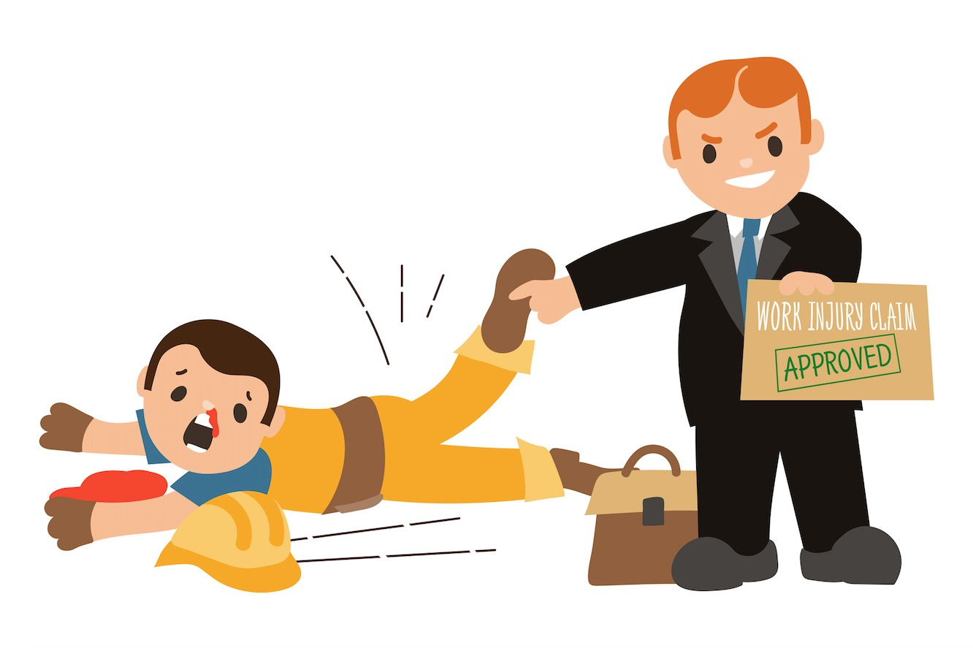
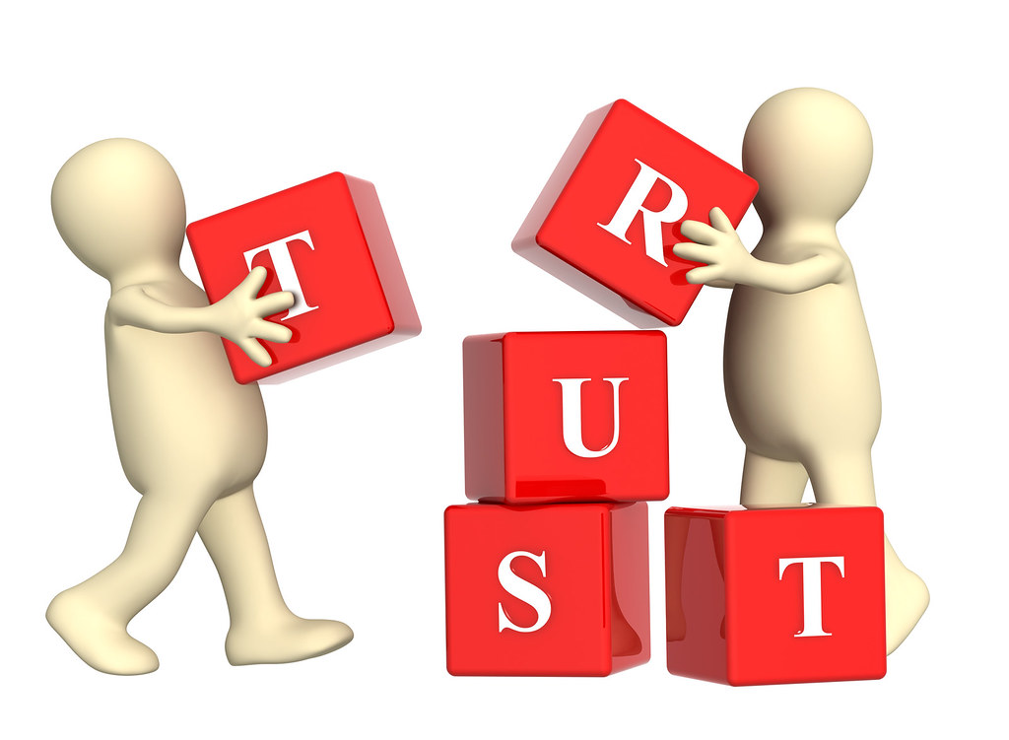
Why Is there Workers’ Compensation?
October 2020

Slide 33
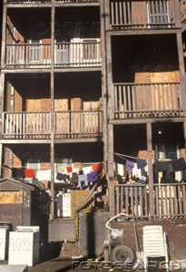
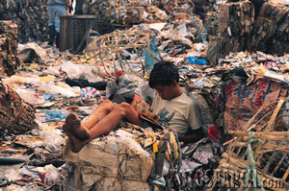
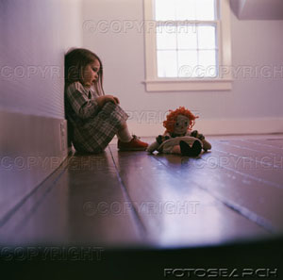
Workers’ compensation is important because it provides three important things for employees who are injured. It provides an income to help pay bills, it provides medical coverage to take care of the cost of recovering, and it opens up the door to other programs that can help an injured employee until they can get back to work.
October 2020

Slide 34
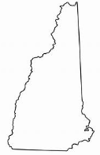
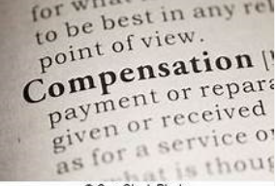
New Hampshire Department of Labor ‒ Division of Workers’ Compensation
CHAPTER 281-A: WORKERS’ COMPENSATION
Primarily a court system tasked with resolving disputed workers’ compensation claims.
Each state has their own workers’ compensation regulations, and then there is the District of Columbia.
October 2020

Slide 35
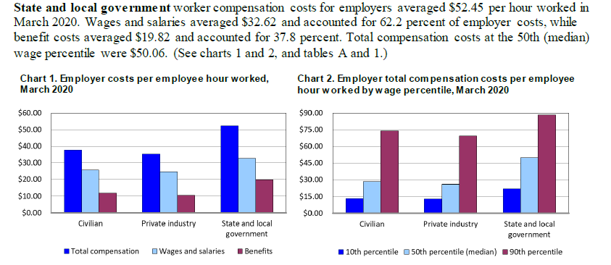
Cost of Injury / Illness in the Workplace
BLS Reports
October 2020

Slide 36
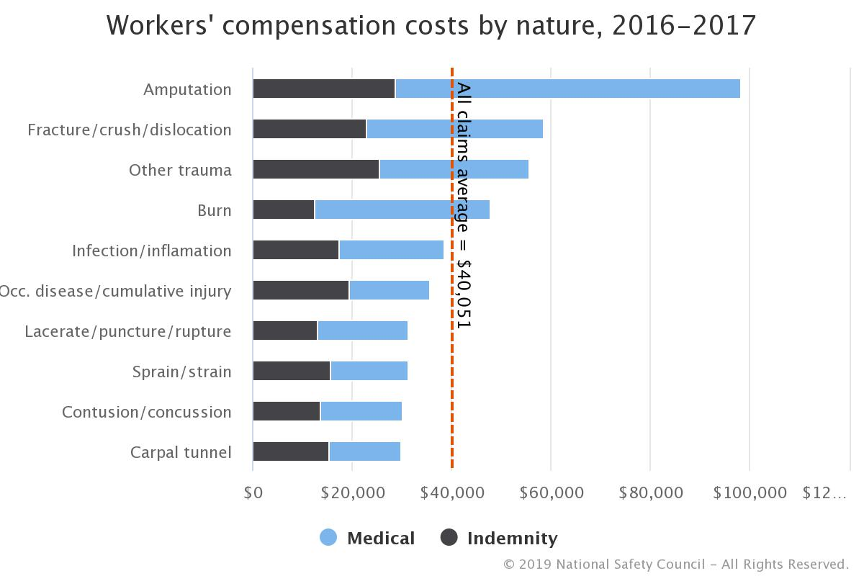
Cost of Injury / Illness in the Workplace
October 2020

Slide 37

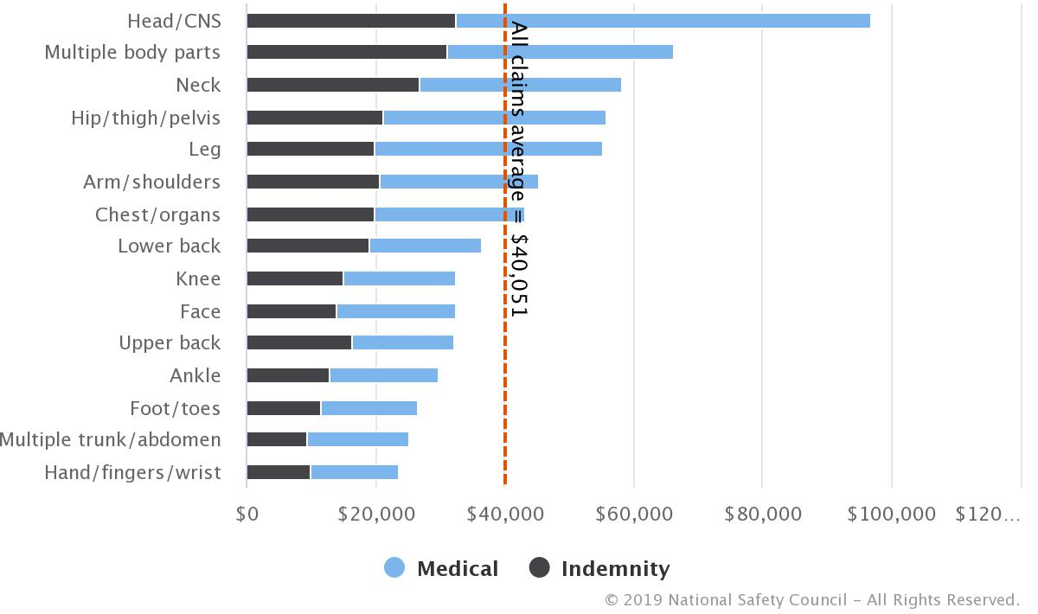
Costs by Part of Body
2016–2017
October 2020

Slide 38

The Challenges
Aging workforce.
An increasingly obese workforce with all the attendant medical manifestations of excess weight.
Influx of Veterans entering the workforce after suffering internal injuries from war. If it were not for modern medicine in the military, many of these would be fatalities.
October 2020

Slide 39
Nonfatal Injuries and Illnesses in Private Industry
Total Recordable Cases: 2,811,5000 in 2017
Cases Involving Days Away from Work | 882, 700
Median Days Away from Work | 8
Cases Involving Sprains, Strains, Tears: | 311,330
Cases Involving Injuries to the Back | 148,780
Cases Involving Falls, Slips, Trips | 227,760
October 2020

Slide 40
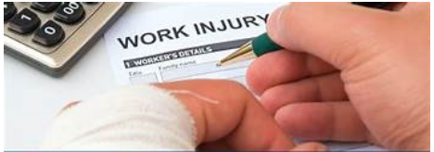
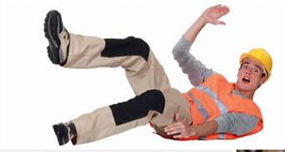
Fatal-Related Work Injuries in 2017*
Roadway incidents: 1,299
Falls, slips, trips: 887
Homicides: 458
TOTAL FATAL INJURIES in 2017: 5,147
*Data from All Sectors
October 2020

Slide 41


What Is an OSHA Recordable?
An OSHA recordable injury is an occupational injury or illness that requires medical treatment more than simple first aid and must be reported.
Any medical treatment that goes beyond first aid meets the general recording criteria and is thus recordable.
October 2020

Slide 42
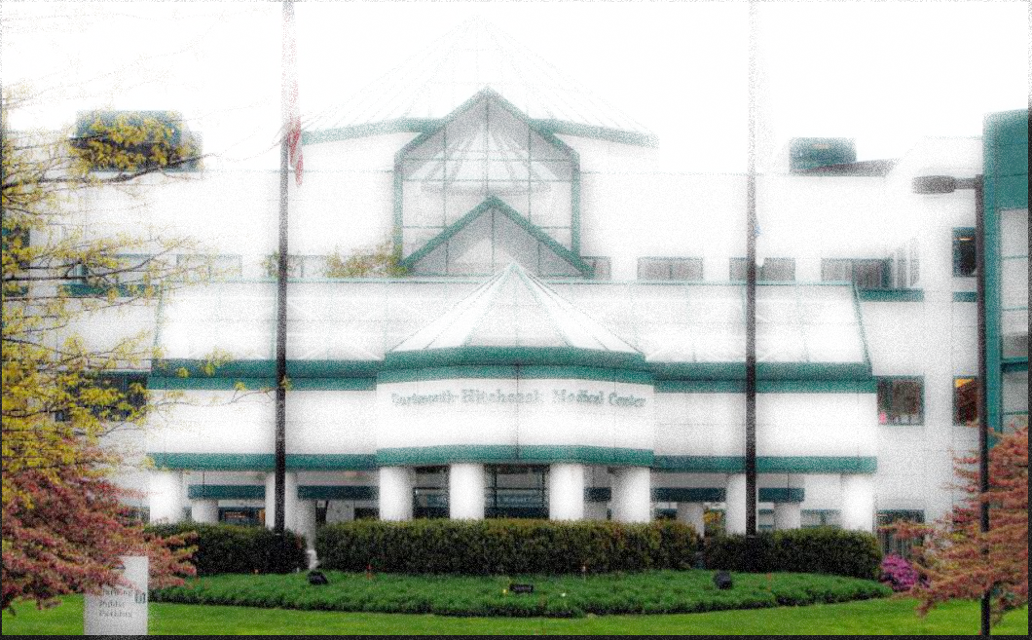
Hospital Workers
An assessment of occupational injuries and illnesses in private industry hospital workers exhibit a higher incidence of injury and illness—6.0 cases per 100 full-time workers—than employees working in other industries traditionally considered dangerous, such as manufacturing and construction.
Hospital workers routinely face hazards related to lifting, moving, or otherwise physically interacting with patients. Workplace injuries and illnesses among hospital workers reflect common risks of hospital jobs and differ by type of hospital.
In terms of employment, the healthcare and social assistance sector is one of the largest service-providing sectors in the U.S. economy. It is projected to be the fastest growing sector through 2024, with healthcare occupations expected to add more jobs than any other occupational group.
In addition to playing a significant role in national employment, the healthcare sector plays a vital role in promoting public health. Its services include treating illnesses and injuries, maintaining wellness, and managing disease.
October 2020

Slide 43
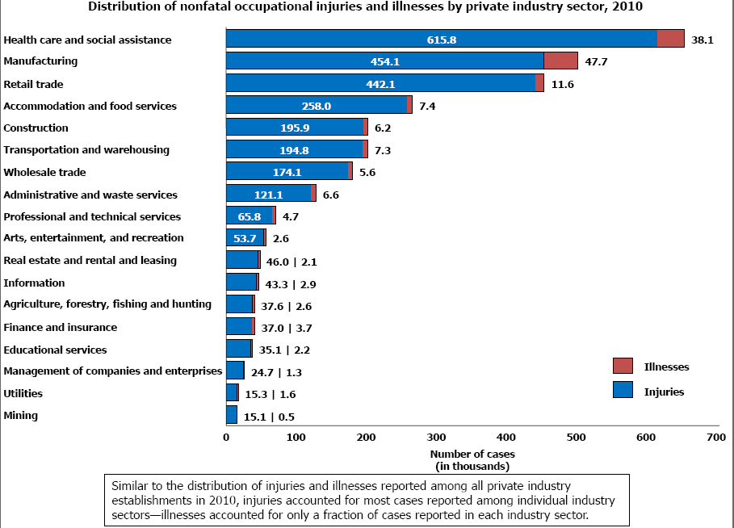
Nonfatal Occupational Injuries and Illnesses by Private Industry (2010)
October 2020

Slide 44
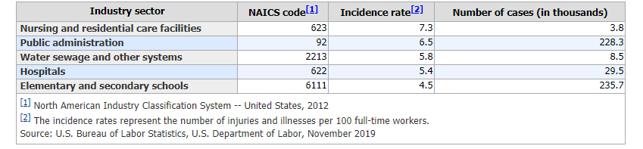
Incidence Rates and Numbers of Nonfatal Occupational Injuries and Illnesses (2018)
October 2020

Slide 45
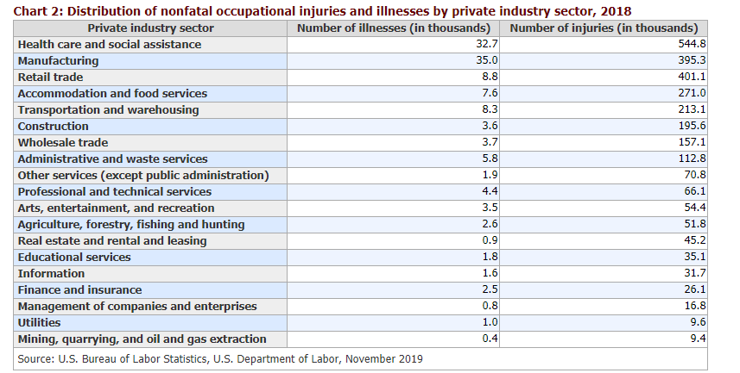
Distribution of Nonfatal Occupational Injuries and Illnesses by Private Industry (2018)
October 2020

Slide 46
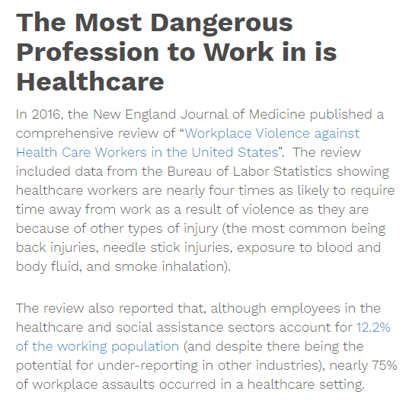
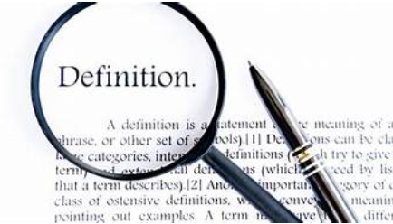
What’s Up with Workplace Violence?
“Workplace violence is any act or threat of physical violence, harassment, intimidation, or other threatening disruptive behavior that occurs at the work site. It ranges from threats and verbal abuse to physical assaults and even homicide.” According to the latest workplace violence statistics released by the National Safety Council, physical assaults in the workplace resulted in 20,790 injuries and 453 fatalities in 2018.
October 2020

Slide 47

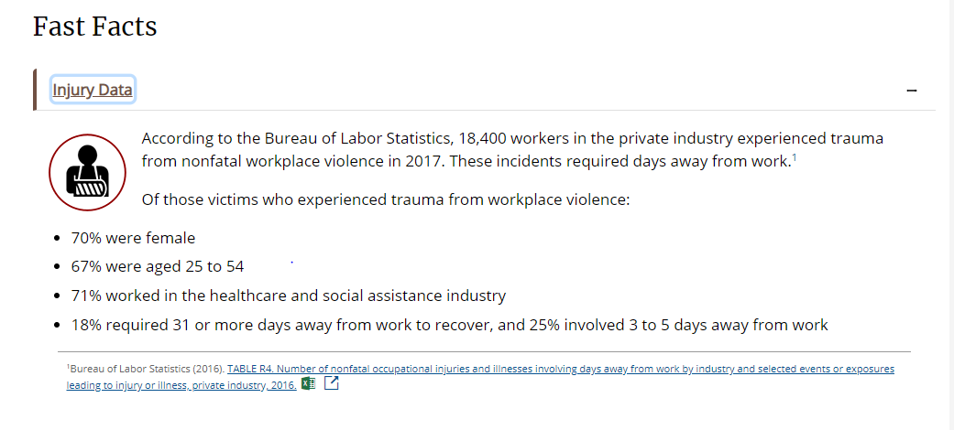
FAC T S
FAS T
October 2020

Slide 48
TYPE I
TYPE II
TYPE III
TYPE IV
Criminal Intent. In this kind of violent incident, the perpetrator has no legitimate relationship to the business or it’s employees
Customer / Client
Worker
on
Worker
Personal
Relationship
Workplace Violence Is Broken Down Into 4 Categories
October 2020

Slide 49
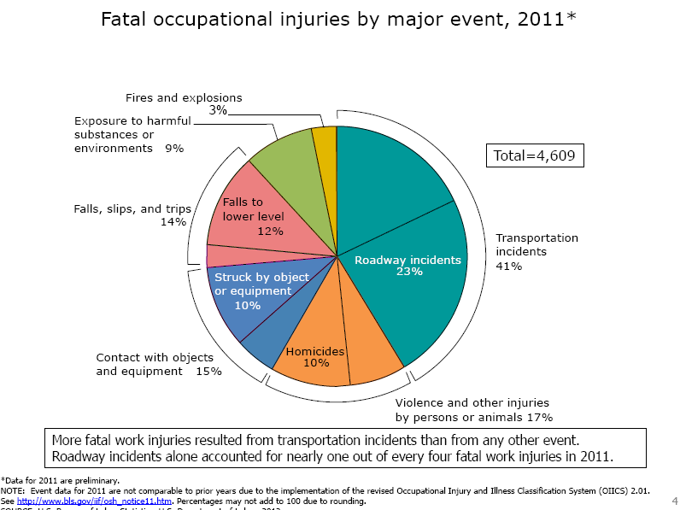
Fatal Occupational Injuries by Major Event (2011*)
October 2020

Slide 50
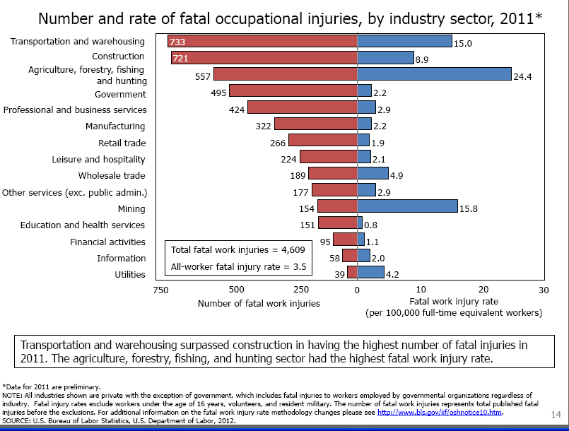
Number and Rate of Fatal Occupational Injuries by Industry (2011*)
October 2020

Slide 51
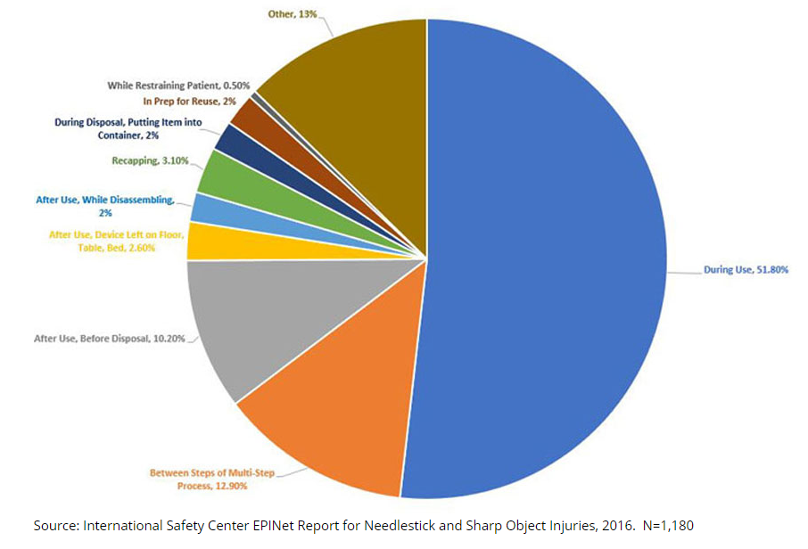
Activities Associated with Sharps Injuries
Under-reporting??
October 2020

Slide 52
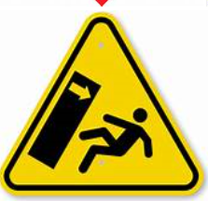
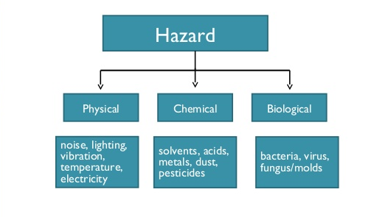
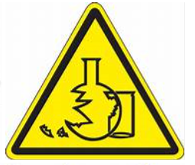

Hazards
Occupational side of environmental health.
Ergonomic-repetitive movement, poorly designed equipment.
October 2020

Slide 53

October 2020

