Slide 1


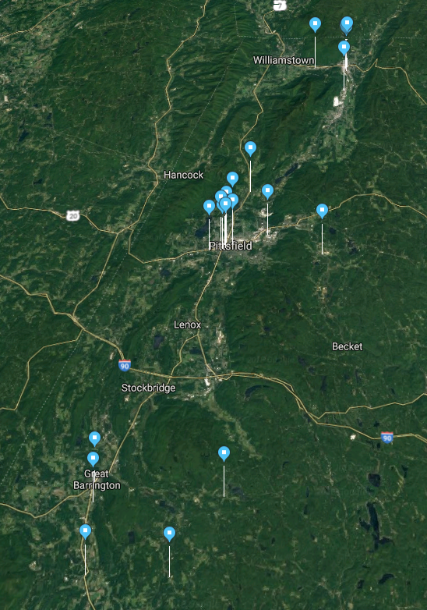
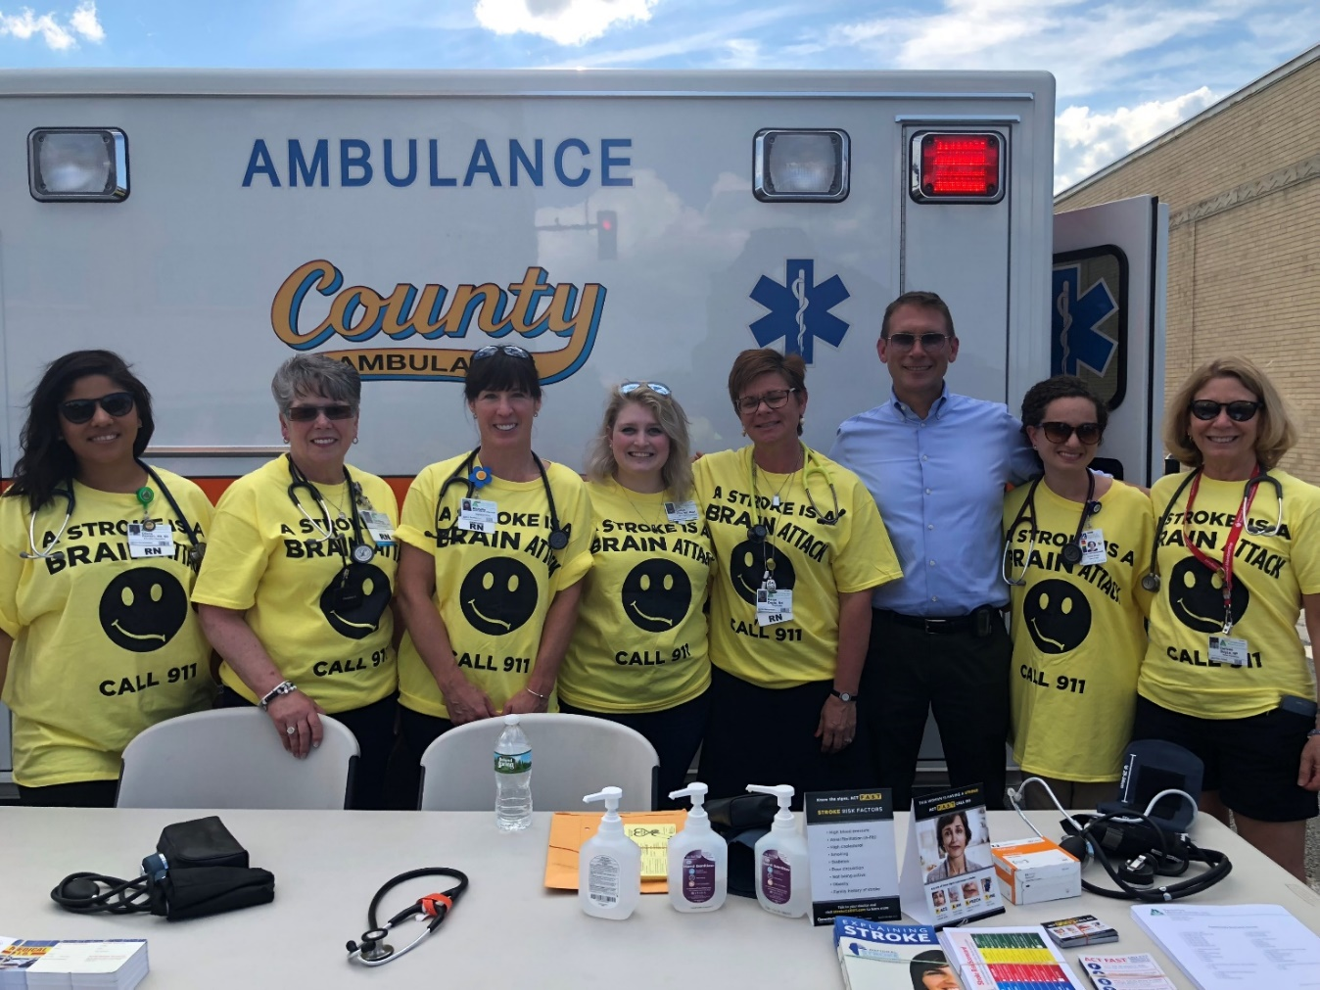
Stroke Awareness Community Outreach in Berkshire County
Julia Oppenheimer¹, Darlene Boyce, ANP-BC, ANVP-BC², Caitlyn Kline, MS, MAAT³, Karen Doyle, RN⁴, Laurence Ufford, MD²
¹University of Massachusetts Medical School, ²Neurology Department, Berkshire Medical Center (BMC), ³ Emergency Department, BMC, ⁴Quality Department, BMC
Project Background
Community Demographics
Stroke Knowledge
Berkshire Medical Center’s (BMC) Primary Stroke Service serves over 400 patients diagnosed with stroke or TIA every year.
<10% of BMC stroke patients receive tPA, a clot-busting medication known to reduce deficits, within three hours of symptom onset.
In 2016, only 6% of BMC stroke patients identified as African American, Hispanic, Asian, or American Indian/Alaskan Native.
Race disparities in cardiovascular health outcomes and quality of care are well known. African Americans are twice as likely to experience stroke and less likely to receive tPA when compared to whites.
Fear of discrimination, gaps in knowledge, and other social determinants of health may prevent individuals from seeking urgent care, which perpetuates health disparities.
Figure 2. Outreach Locations
Table 1. Participant Demographics
90% of participants felt that stroke is a medical emergency.
45% were aware of a medication and 54% of a procedure to treat strokes.
N=244 | N | %
Race
White | 215 | 88%
Hispanic | 13 | 5%
African American | 10 | 4%
Native American | 6 | 2%
Asian | 2 | 1%
Other | 2 | 1%
Blank | 3 | 1%
Household Income
< $40,000 | 151 | 62%
> $40,000 | 81 | 33%
Blank | 12 | 5%
Health Insurance
Private | 97 | 40%
Medicare | 129 | 53%
Medicaid | 67 | 27%
No coverage | 6 | 2%
Blank | 6 | 2%
Diagnoses
High Blood Pressure | 105 | 43%
High Cholesterol | 56 | 23%
Smoker | 52 | 21%
Diabetes | 45 | 18%
Atrial Fibrillation | 12 | 5%
Primary Care Provider
Yes | 216 | 89%
No | 26 | 11%
Blank | 2 | 1%
Primary Care Provider Last Seen In
≥ 3 years | 17 | 7%
2 years | 16 | 7%
1 year | 210 | 86%
Blank | 1 | 0%
Figure 5. Stroke Symptoms
Figure 6. Stroke Risk Factors
Project Goals
Figure 7. Barriers to Calling 911
Assess awareness of stroke risk factors, warning signs, and treatment.
Learn from the community about perceived barriers to seeking care.
Offer primary prevention and stroke education to improve knowledge.
Figure 3. Age of Participants
93% would call 911 first if they or someone they know had a stroke.
Community Outreach
The BMC Stroke Task Force developed a 16-item outreach survey to assess community demographics, stroke knowledge, and barriers to care.
June – August 2018
36 outreach events at 24 venues throughout Berkshire County.
Venues: Community fairs and events, food pantries, community meal sites, town halls, senior centers, public libraries, elderly and subsidized housing, and homeless shelters.
Outreach: Free blood pressure screening, stroke survey, stroke education with NSA handouts.
Conclusions and Future Directions
Perceived Barriers to Care
Treating high blood pressure continues to be key for reducing stroke risk.
Gaps in knowledge of stroke risk factors, warning signs, treatment options, and the need for rapid transportation may prevent patients from presenting to the hospital early enough to receive tPA.
Cost and transportation present barriers for seeking care.
Next steps: Develop an education program to address knowledge gaps. Review hospital stroke data retrospectively over the past 5 years, and collect data prospectively for one year to see if outreach was effective.
Figure 4. Barriers to Care
References
Figure 1. Third Thursday in Pittsfield
6% felt they may be discriminated against because of their race, if they seek treatment at the hospital, including 23% of African American, Hispanic, Native American, and Asian participants.
Nasr DM, et al. Racial and ethnic disparities in the use of intravenous recombinant tissue plasminogen activator and outcomes for acute ischemic stroke. J Stroke Cerebrovasc Dis. 2013 Feb;22(2):154-60.
Sorkin DH, Ngo-Metzger Q, De Alba I. Racial/Ethnic Discrimination in Health Care: Impact on Perceived Quality of Care. Journal of General Internal Medicine. 2010;25(5):390-396.
Acknowledgments
This project was supported by HRSA Grant No. U77HP03016.
Thank you to Nancy Slattery of the Berkshire Visiting Nurse Association, Meg McGonagle and Kayla Fappiano of the BMC Community Outreach Program, Michelle Dupont, Christine Kiernan, and Diane Romero of BMC, Brian Andrews of County Ambulance EMS, Stacey Charon of Elms College, and Heather-Lyn Haley and Suzanne Cashman of the UMMS Summer Assistantship Program. Thank you to the community partners who hosted and collaborated with us and to the National Stroke Association for providing educational materials.

