Slide 1

UMASS CHAN Graduate Medical Education
White Belt Quality Improvement/Lean Training
2023-2024 Academic Year
David Fish, MD SFHM
Med/Peds Hospitalist, Med/Peds Division Chief
Lean Green Belt
Mitchell J. Gitkind, MD
Assistant Dean of Health Systems Science
Lean Black Belt
Presenter Name(s) Here
Notes:
For green or black belt faculty, you can add your name and title above mine if you’d like…

Slide 2

Disclosures
  There is no commercial sponsorship or support for this program
  The planners and presenters have declared that no real or perceived conflicts of interest exist

Slide 3
Outline
About 60 minutes
ACGME quality improvement (QI) training expectations
True North and the UMass Memorial approach to QI
Work, waste, Lean, and the A3
3
Notes:
Just flash each item- ANIMATED–ask for questions and move on

Slide 4

ACGME QI-related expectations for residents and fellows
1. Educated about QI
2. Oriented to the clinical site’s QI priorities
3. Participate in QI projects
4. Understand underuse, misuse, and overuse of healthcare resources
5. Receive quality-related data
6. Participate in QI-related committees
Notes:
ANIMATED
It’s important that residents and fellows view QI as an integral part of training, not just something we’re adding on
Stress connection between our accreditation and provision of QI education
The two BOLDED items at the top are what will be covered today
Other things they should be hearing about from teaching faculty
Mention that QI and safety-related committee positions are made available to residents and fellows at the beginning of each year and that they should let their program directors know if they are interested

Slide 5


“We need an army of problem solvers and innovators”
Eric W. Dickson, MD
President & CEO
Notes:
Good to point out that this is where the direction to provide this kind of training originated
Make the point that UMass Memorial is the clinical partner of the school and the “clinical site” (ACGME terminology) for most of our GME programs
It’s a guiding principle of the clinical system and becoming more and more important for the school
I like to make the point that UMMHC employs 14,000 people and that a common language and approach around improvement is critical

Slide 6
What is this?
How does it relate to today’s training?
Notes:
This is the UMass Memorial Health “improvement pyramid” (new in 2023) that is designed to prioritize QI efforts in the organization. This replaced the older “True North” pyramid although the message is very similar. The next slide provides more detail --

Slide 7
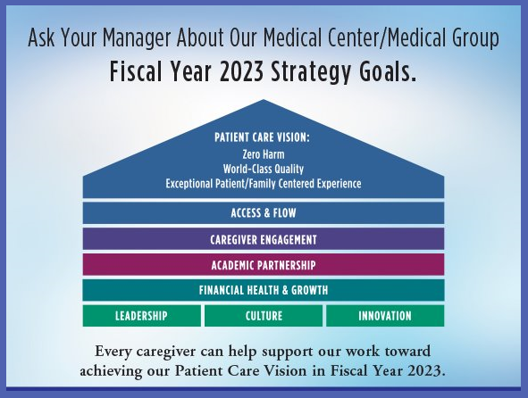
Notes:
Just make the point that the general priority guidance translates to some specific improvement targets.

Slide 8
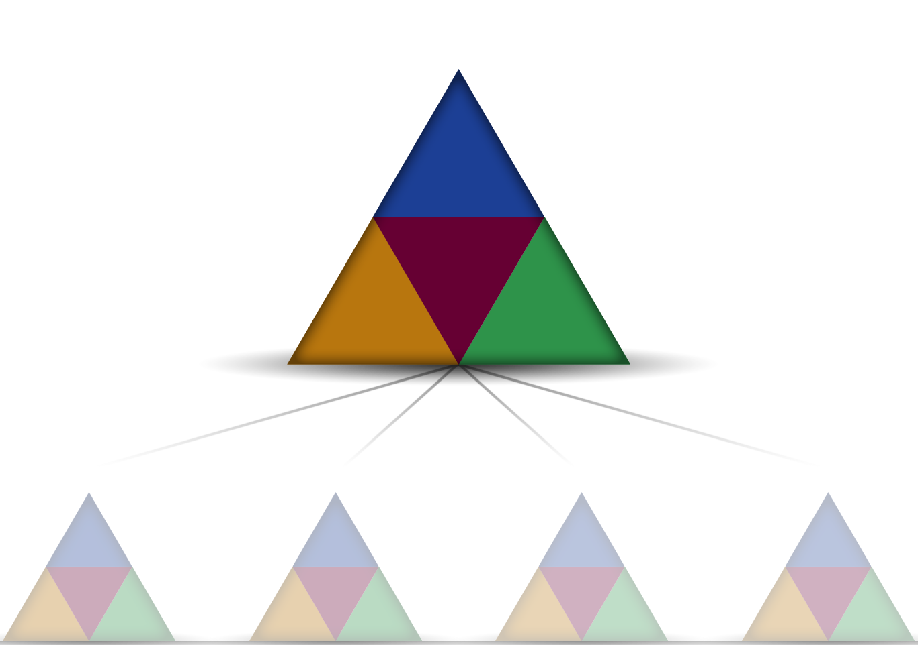
Our
Patients
Our
People
Our Discoveries
Our
Financial Health
ALIGNMENT
QI project A
Department W
QI project B
Department X
QI project C
Department Y
QI project D
Department Z
Notes:
The point here is that projects our trainees choose to work on should ALIGN with the system priorities– Emphasize that the reasons behind this include that they are most likely to find others interested in participating and also resources to help the project along
True North goals and metrics ultimately define the value we are committed to delivering to our customers: Patients, Employees, Physicians, the UMass System, and the Community

Slide 9

UMass Memorial improvement priorities
Improving patient experience
Improving access to ambulatory services
ED, inpatient, OR excellence
Keeping inpatient mortality at or below benchmarks
Decreasing inpatient length-of-stay
Reduce preventable harm events, striving for “zero harm”
Improving transitions of care, reducing hospital readmissions
Our
Patients
Our People
Our
Financial Health
Our
Discoveries
Notes:
Connecting to the previous slide, listed here are the top UMMH QI priorities (specifically, ACGME requires residents and fellows to know this). Can say something like: “This is what the hospital and our health care system are working on, using many of the same QI approaches we’ll be talking about today.
This is a more granular list on what the UMMH system and medical center prioritize for improvement– so resident/fellow projects ALIGNING with True North would as part of that are likely to connect in some way to one or more or more of these priorities. Facilitators can mention that more information about his is available on the “System Quality Goals” page reachable through The Hub.

Slide 10
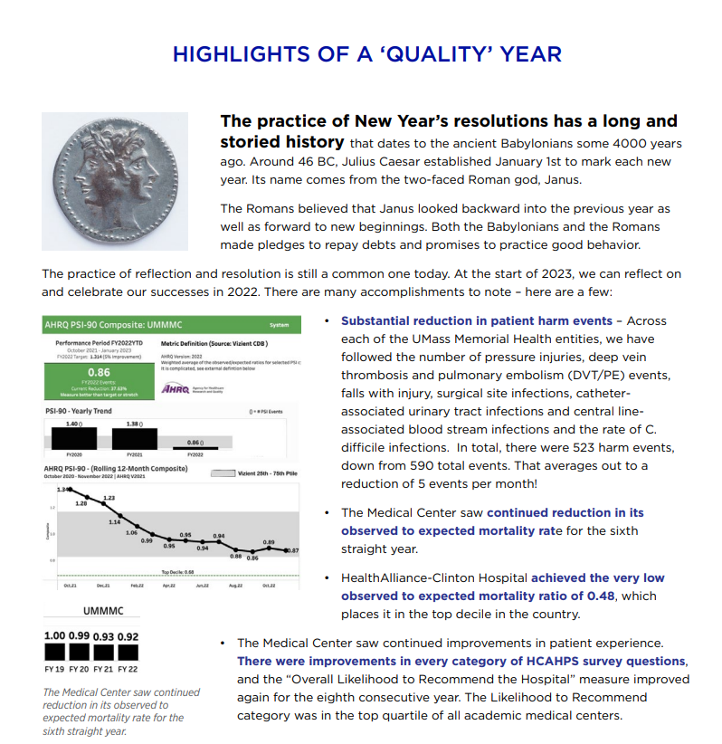
QI methodology in action at UMMMC 1/2023
Notes:
I added this in January 2023 just to make the point that the QI methodology we’re talking about today actually gets used every day within the clinical system. Other presenters are welcome to add other examples or swap this out with a Lean-based project connected to their specialty-specific settings

Slide 11
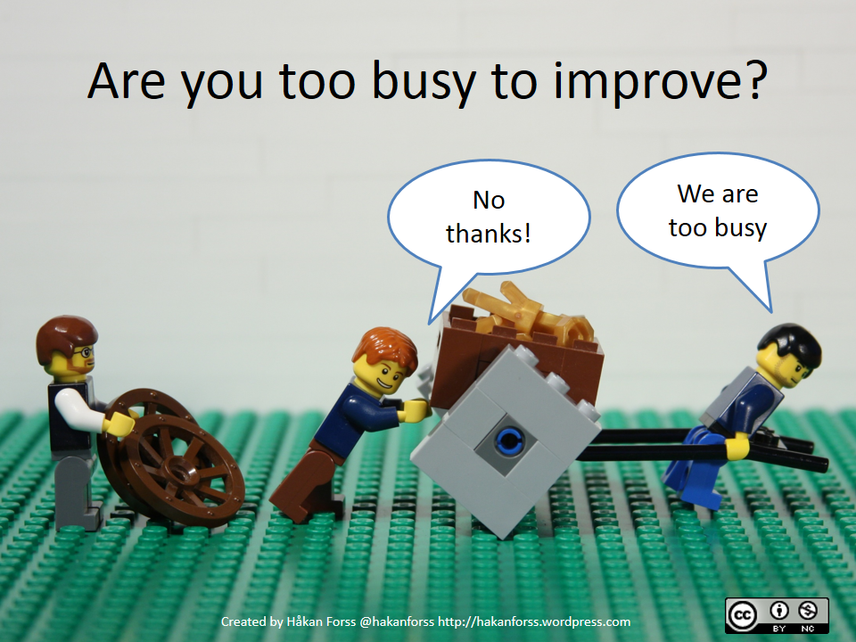

Examples of this you’ve seen?
Could you use these?
Notes:
Introduce the concept of resistance to improvement
I usually say something like “we get used to working within broken processes” – So used to it that we don’t see the importance of improvement work
Try to get the group talking about brokenness they’ve seen – Default example is our EHR situation before Epic and how people were accustomed to the brokenness of our “hybrid EHR” at the time.
This one usually sparks a lot of chatter although maybe less so as time goes by

Slide 12

Lean Is:
People working together
Leaders teaching/enabling
Blaming broken processes
Adding value
Removing waste
Staying patient focused
Lean Is Not:
People working alone
Leaders directing
Blaming individuals or groups
Prioritizing cost lowering over patients
Being overly focused on efficiency
Notes:
ANIMATED---I tend to focus on the list to the right and mainly that leaders take a back seat to frontline workers (including residents and fellows) in recognizing broken processes

Slide 13

Assuming you understand a problem without studying what is actually happening (sneak preview: we’ll call this the current condition)
Assuming you can fix a problem without figuring out what is causing it (sneak preview: we’ll be talking about root causes and countermeasures)
Assuming you’re improving without confirming it (sneak preview: PDSA cycles)
Assuming that any improvement will stick (sneak preview: PDSA includes how to sustain effective change)
Notes:
This is higher level and may be too high level for audiences that are really naïve to QI. Without reading it you can let them know this will connect to the content you’re getting to (ie the “sneak preview” material)

Slide 14




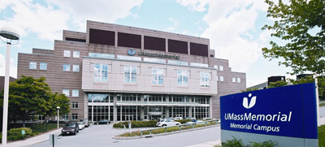



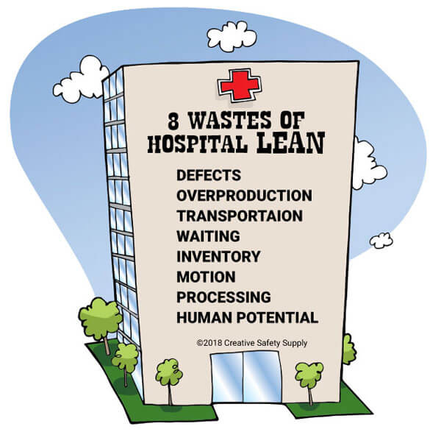



Notes:
ANIMATED– There are ten of these and animated just for engagement—
Point is that Lean in health care did not begin here, nor is it unique to UMMH, but we are considered a leader
Many people (me included) feel like the Lean/QI culture here is what made us as successful as we were during the worst of COVID
Emphasize that while Lean in different places has the similarities noted on the previous two slides, there can be differences in how these basic tenets are operationalized within actual QI work. This includes the details of the A-3 which will come up later in the presentation
I’ve updated this slide (just FYI for those who haven’t seen it in the past)

Slide 15

Problems known to top leaders
4%
Problems known to directors
9%
The “Awareness Iceberg”
Problems known to managers/supervisors
74%
Problems known to
people closest to the work
100%
Notes:
ANIMATED- RED CIRCLE ON BOTTOM LINE→Critical Lean concept– Again stress that residents and fellows are part of the “people closest to the work”
Emphasize that “problems” are “improvement opportunities” and that link will come up below

Slide 16
Types of Work
Value-added
Activities patients care about: Time with providers, clear communication, accurate diagnoses, proper treatment organized care plan
Value- added
Required non-value
Required non-value-added
No value in patient’s eyes, but can’t be avoided: Entering passwords, coding and billing, certain regulatory requirements
Waste
Waste
  Consumes resources but doesn’t add value:
  Looking for supplies, patient or staff waiting, repeating tests, unnecessary paper or computer work
Notes:
ANIMATED-- This is kind of a pivot point so if time allows I sometimes just ask if there are any questions to this point and try to pull them in to this new section (especially if we’re using Zoom)

Slide 17

Value-added work= what the patient sees value in
  What did you do during your most recent workday that was value-added work?
Notes:
Depending on the group and how I’m doing on time, I might just ask people to reflect on this themselves vs. having someone report to the group. If no one speaks up this is a situation where I will call on people until I get a good response.
Needless to say, if no one can come up with a good example of value-added work, that’s a problem!

Slide 18
Waste
The “DOWNTIME” acronym and examples
Anything worth improving connects to one or more of these wastes!
IT IS NOT important to figure out which bucket your observed waste goes into but IS important that all waste in a broken process is discovered.
Defects (unusable tissue specimens)
Overproduction (unnecessary or incorrect testing)
Waiting (patients and providers)
Not utilizing employees (“not my job”)
Transport (moving patients, equipment)
Inventory (too much or too little equipment on hand)
Motion (flow of patients, providers, equipment)
Extra processing (repeat testing, readmissions)
Notes:
This can be a bit overwhelming to people new to QI
They don’t need a deep understanding of every “bucket”
Try to give solid healthcare-related examples for at least a couple– I usually use “waiting,” “defects/re-dos,” and “motion” – More as shown on the slide
Introduce the concept of a “waste walk” (transition to next slide)

Slide 19

Waste
  What did you do during your most recent workday that was waste?
Notes:
As with the previous slide, depending on the group and how I’m doing on time, I might just ask people to reflect on this themselves vs. having someone report in the group

Slide 20
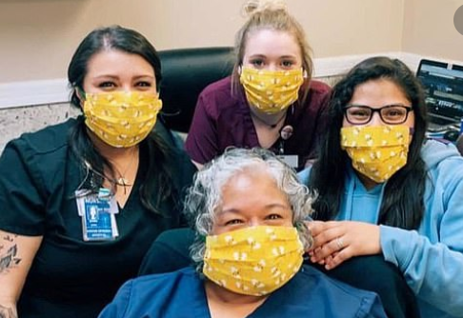

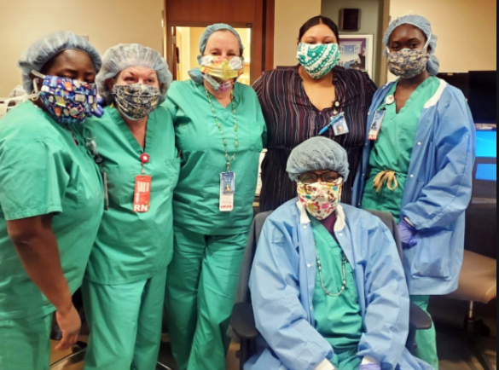
The “Gemba”
TO IMPROVE: Go to the places where value is created and waste happens:
  Ask questions, gain insight from people closest to the work
  DO NOT assume you know what is happening or what is broken…
Notes:
ANIMATION--I usually just say “what are these people doing? Where do you think these people are? What kind of work do you imagine they’re doing?”
It doesn’t really matter– Clockwise from left this could be an outpatient clinic, an OR, and an inpatient floor– The point being that there is WASTE everywhere, you just have to empower people to look for it

Slide 21
Value-added
Work that patients/families care about
INCREASE
Finding a diagnosis
Proper treatment
Required non-value-added
Work that can’t be avoided but doesn’t add value to the patient
MINIMIZE
Time to log into and navigate IT systems
Time and effort to obtain referrals from PCPs
Waste
Work that is a waste of time or resources
ELIMINATE
Waiting for a patient to arrive
Doing a task twice
Notes:
ANIMATION--Re-visiting/reinforcing the three kinds of work and how these connect to improvement in the right-hand column

Slide 22
Observe that two things are ALWAYS happening in any process…
    Things that should be happening
    Things that should not be happening
Value added
Waste
Before
Reduce waste
…And
Add value
The improved process
Time
Value-added work
Non-value-added work
Notes:
ANIMATION - Just a graphic way of showing what’s on the previous slide.
Can be a little hard to understand but make sure you’re clear before presenting this
A different way of telling the same story as the previous slide, so if you feel like you’ve made the point adequately already you can go though this one pretty quickly

Slide 23

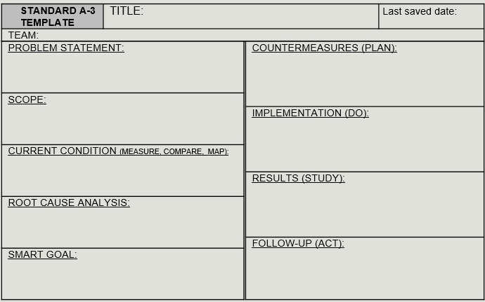
What is an A3?
Largest paper size that can be faxed…”legal size,” 11”x17”
A problem-solving approach
A way of structuring a group’s thinking about improvement
A summary of a problem and potential solution/s
A communication tool to report QI work to others who understand it
Notes:
ANIMATION-- Can spend more or less time on this depending on the audience and your interest level.
NOT necessary to get into the specifics of the A-3 within this slide

Slide 24
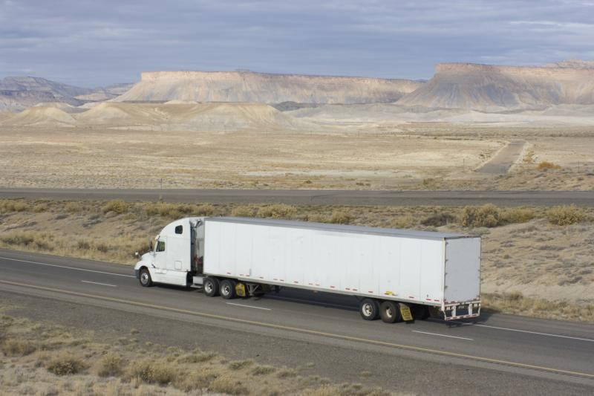

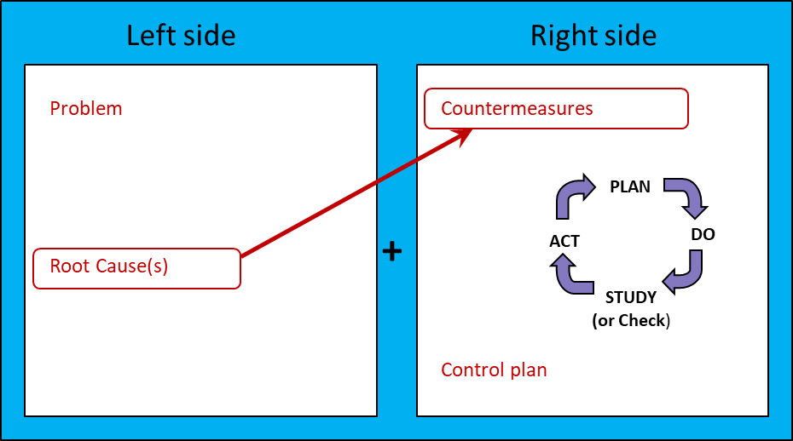
Decrease Waste
THIS WAY
ROAD TO LEAN PROCESS IMPROVEMENT
Notes:
The point here is that the A-3 is a vehicle to take us toward improvement. Just the key component steps common to all A-3s are shown on this particular depiction of it

Slide 25
Does every improvement project require an A3?
POSSIBLY NO
  “Do it now” or “Idea card level” problem
  Low level of root cause uncertainty
  Solid countermeasure ideas
  Narrow/local scope and impact
YES
  Most problems worthy of team-based QI project
  Uncertain/multiple possible root causes
  Countermeasures unclear
  Broader scope/impact
Notes:
ANIMATION-- Probably self-explanatory but this is meant to head off thoughts many trainees have at around this point, that “why can’t you just fix things without going through all these steps?” The answer gets clearer in the following slides as you’re showing the types of physician-led projects that have leveraged the Lean and the A-3

Slide 26
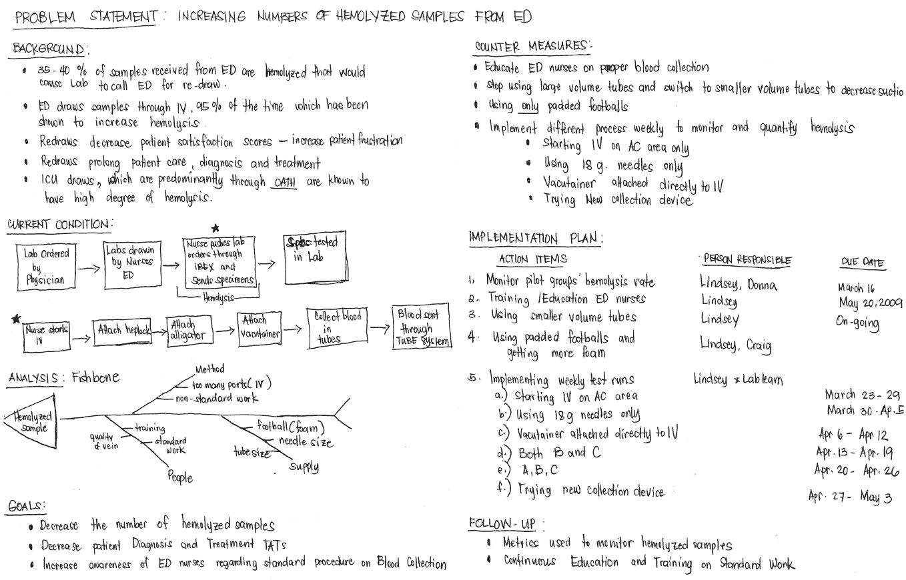
What catches your eye here?
Notes:
I like this as a “basic” A-3 and ask the audience to shout out what they see- usual responses (from them or I prompt):
Handwritten
Left side and right side
Series of steps – “order”
There will be plenty of opportunity in later slides to drill down so this one can be a transition

Slide 27
What is the significance of the graphs on the right side of the A-3 (inside red circle)?
Notes:
The point of calling out the graphs or run charts is that we don’t know how broken a process is until we measure it and we don’t know whether we’ve improved unless we measure change over time…
More A-3s follow here, all are physician-led projects
Facilitators can decide how much time to spend on the specifics of each one
I like to make (at least) the following points as I go through them:
Physician-led
Left side/right side
Series of steps
Data (where shown)
Graphics and photos (where shown)
Presented in a way that takes a “naïve audience” through the project and its results in an understandable way…

Slide 28
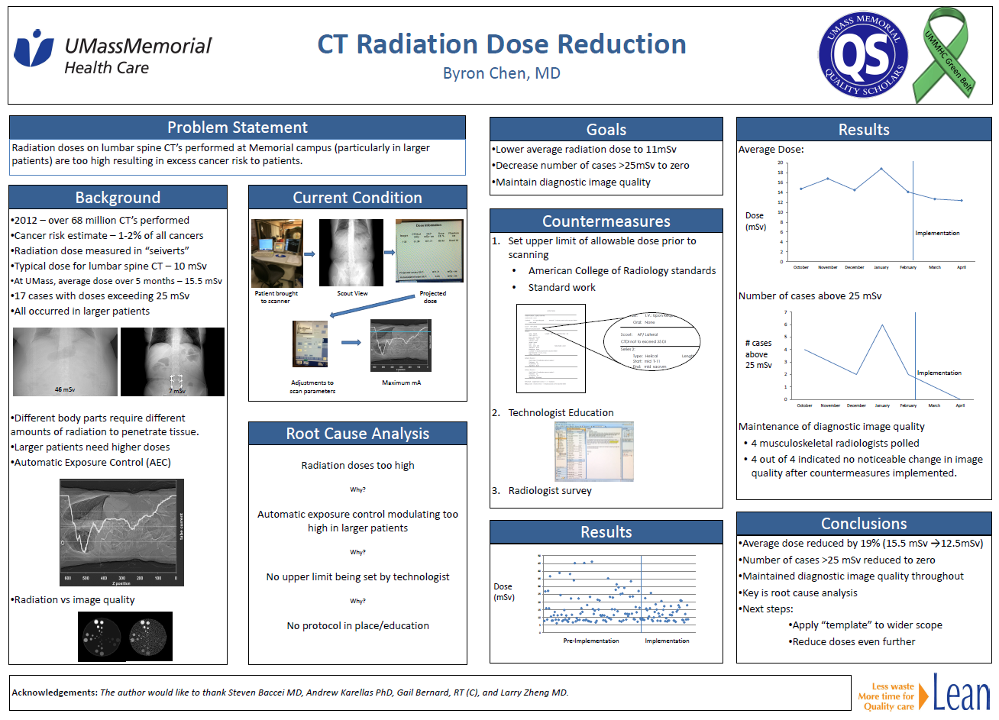
Notes:
I go through these four slides quickly, maybe saying things like “has a left side and a right side, goes through the same steps, has metrics…”

Slide 29
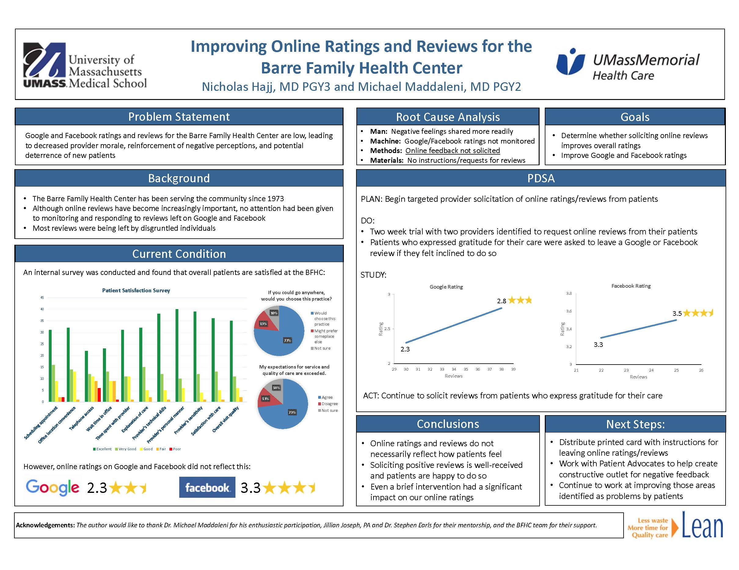

Slide 30
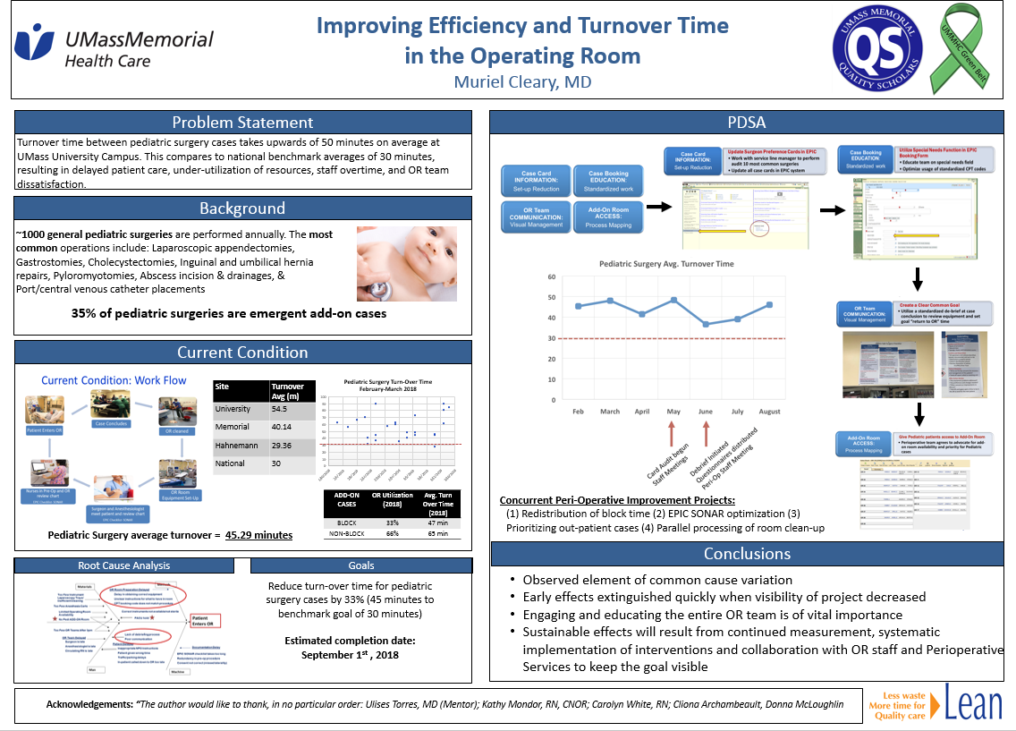

Slide 31
UMass Memorial
Standard A3 template
STANDARD A-3 TEMPLATE | TITLE: | Last saved date:
TEAM:
PROBLEM STATEMENT:
SCOPE:
CURRENT CONDITION (MEASURE, COMPARE, MAP):
ROOT CAUSE ANALYSIS:
SMART GOAL:
COUNTERMEASURES (PLAN):
IMPLEMENTATION (DO):
RESULTS (STUDY):
FOLLOW-UP (ACT):
Notes:
So here we see the changes in the A3 the UMMH system is now using. After much consideration, I’ve decided that for GME we will adopt this basic format, especially since faculty training to the green and black belt level will primarily be using this A3.
TWO SIGNIFICANT CHANGES RELATIVE TO OLDER A3s:
The BACKGROUND section disappears and the information that would have been there now becomes part of the CURRENT CONDITION, now identified as “measure and compare.” The “map” part of the CURRENT CONDITION is more-or-less what the entire CURRENT CONDITION was in the earlier A3.
2. The SMART GOAL section comes before the ROOT CAUSE ANALYSIS although the CITC trainers do sort of a “back-and-forth” with those cells so I’ve been teaching it that way also

Slide 32
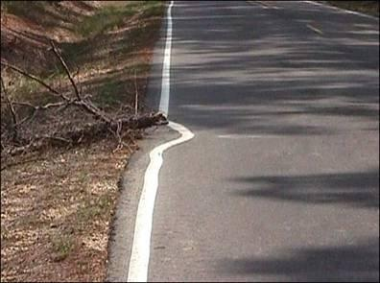
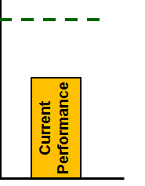
What is a “problem?”
A problem is a gap between:
Current condition or current state – what is actually happening now and
Goal or desired future state – what should be happening
Target
Gap = Problem/Opportunity
Notes:
Self-explanatory

Slide 33
A3 PROBLEM STATEMENT
SHOULD: Describe what is happening, where it’s happening, and at least one important consequence
SHOULD NOT: Imply a solution, the problem’s cause, or a goal
Notes:
ANIMATED

Slide 34
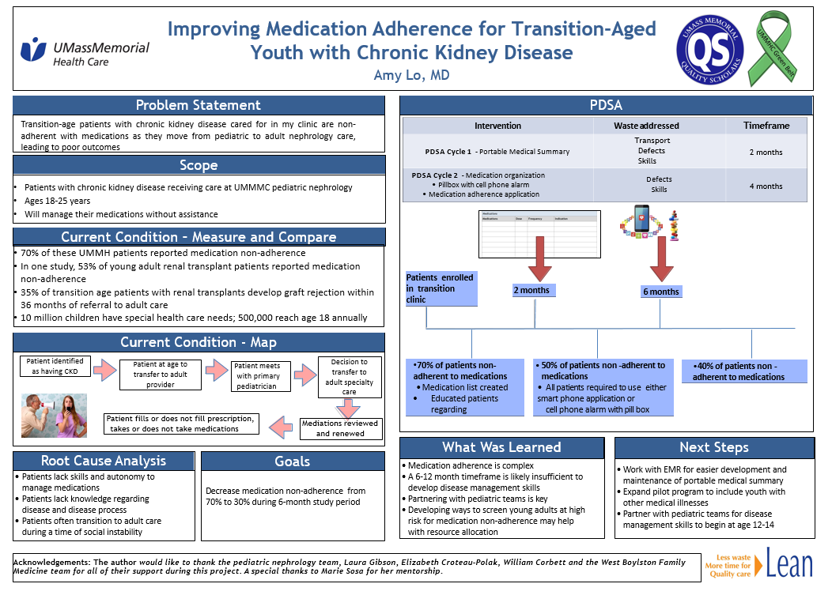

Slide 35

Example of a problem statement
Where?
What’s the what?
Transition-age patients with chronic kidney disease cared for in my clinic are non-adherent with medications as they move from pediatric to adult nephrology care, leading to poor outcomes
Important consequence?

Slide 36
A3: SCOPE
What’s in scope(what you’ll be working on)?
What’s out of scope (what you WON’T be working on)?
  Populations
    Pediatric vs. adult
    Inpatient vs. outpatient
  Locations
    One campus vs. multiple campuses
Where does the problem process start? Where does it end/stop?
  Process length
    Entire admission vs. just inpatient floor part
IN/OUT
START/STOP
Notes:
ANIMATION–
Should be self-explanatory

Slide 37
A3 Template: Current Condition
Notes:
For people who used the previous UMMH A-3, as noted above the BACKGROUND section has been absorbed into the CURRENT CONDITION section

Slide 38
Current Condition – “measure, compare, and map”
“Measure, compare:” Explain the depth, breadth, and frequency of your problem. Compare to benchmarks, policies, norms, similar settings. Use bulleted statements and graphics
“Map:” Create a visual depiction of the broken process as it’s happening now
Notes:
ANIMATED---So again this is a deviation from a prior A-3 format. I like to say “measure and compare” instead of just “measure” and it sticks more closely to the “Background” section some facilitators will be used to.

Slide 39
PROBLEM STATEMENT: Transition-age patients with chronic kidney disease cared for in my clinic are non-adherent with medications as they move from pediatric to adult nephrology care, leading to poor outcomes
Show depth, breadth, frequency and what, where, when, who…
CURRENT CONDITION-MEASURE AND COMPARE:
70% of patients reported medication non-adherence
In a study, 53% of young adult renal transplant patients reported medication non-adherence
35% of transition age patients with renal transplants develop graft rejection within 36 months of referral to adult care
10 million children have special health care needs; 500,000 reach age 18 annually
Include statements that compare the current state to benchmarks, norms, policies, similar settings –Answer questions like “how much” and “how many”
Notes:
Self-explanatory but make connections between the problem statement and how to create a strong “measure and compare” section.
Make the point that although the populations across the first three bullets isn’t identical, the 70% appears to be a significant problem
References could be cited but are not shown here

Slide 40
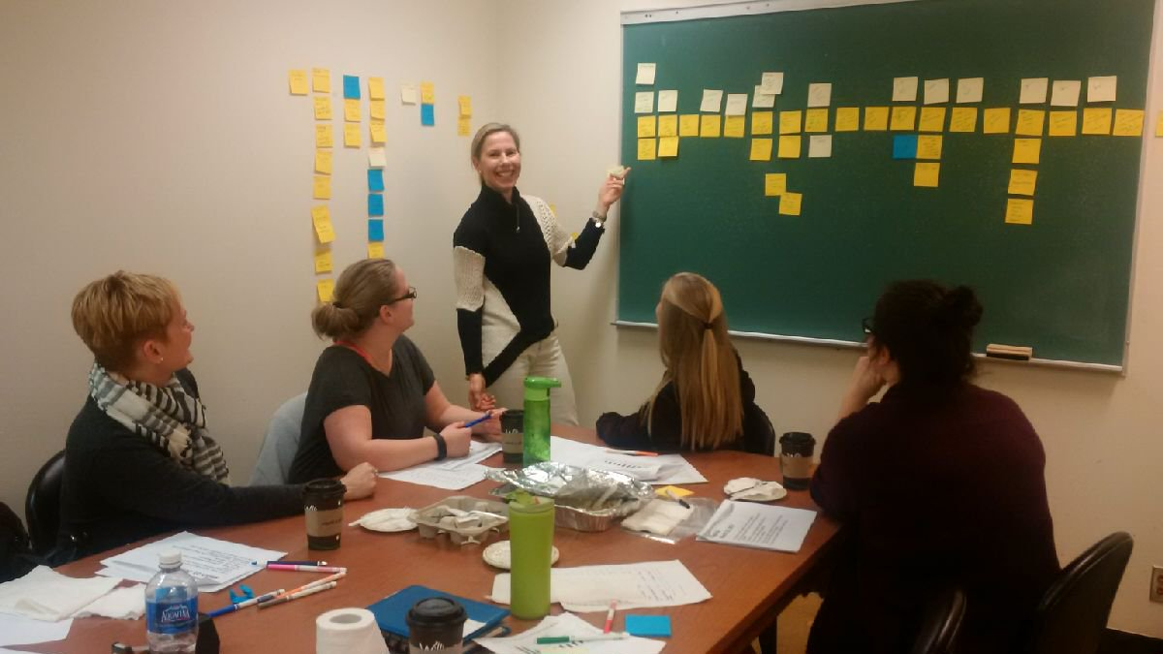
Current Condition mapping session
Notes:
I make the point here that doing a CCM is a group activity– I don’t spend a lot of time on the colors of stickies and exactly what’s going on, but I do emphasize the definition: a visual depiction of the broken process
This connects to another very common error I see in learners using the A-3– they see “current condition” as a prompt to explain what they think is happening now including what’s broken, so they will show bulleted lists and either miss steps or get way ahead of themselves into RCA territory…Explain that if this comes up, it can be bookmarked for later
The CCM is non-judgmental…if you have an advanced group you can talk about what to do if root causes or countermeasures come up during a CCM (ie, respectfully archive them for later)

Slide 41
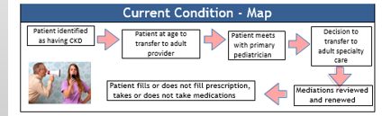
Current Condition “map”
Transition-age patients in my clinic with chronic kidney disease are non-adherent with medications as they move from pediatric to adult nephrology provider teams, leading to suboptimal care
Notes:
ANIMATION

Slide 42
Root Cause Analysis (RCA)
  A process of finding the underlying reason/s a problem is occurring
A team activity, always including front-line staff
RCA tools and mnemonics help force consideration of all possible root cause domains
Distills possibilities to a small number of strongest root causes
Notes:
ANIMATED---Because trainees are also exposed to patient safety training where the term “root cause analysis” comes up as a description of the entire event (ie “that med error led to an RCA”), I might make that point– these are related but different things…
Point out that there isn’t necessarily ONE root cause but that since this is another stepping stone, we need a finite number of possible root causes to bring to the next steps, and that it’s conceivable that we’ll come back to look at the RCA or even work at it more later if we go through a PDSA cycle and don’t get the result we want

Slide 43
Root Cause Analysis
Fishbone diagram example
Transition-age patients with chronic kidney disease in my clinic are non-adherent with medications as they move from pediatric to adult nephrology provider teams, leading to lapses in optimal care
Methods
Material
Process of med renewals
different between offices
Records not available
Medication
Non-adherence
PROVIDER
PATIENT
Cultural shift
Autonomy
Meds unfamiliar
Incomplete
records
Change in social situation
Pharmacy changes
Cost/insurance
Insurance information not updated
Lack of clear explanation of disease and meds
Limited understanding of
disease and meds
No prompt to renew meds
EMR ordering
Does not establish care
Man
Machine
Notes:
In this case, Amy’s team felt they had identified a pair of connected root causes they wanted to start working on…

Slide 44
A3 Template: SMART GOAL

Slide 45
SMART goals should describe the “future state” you want
Avoid vague goals like: “Improve med compliance”
Instead…
Specific
Measurable
Attainable
Realistic
Timebound
Transition-age patients with chronic kidney disease cared for in my clinic are non-adherent with medications as they move from pediatric to adult nephrology care, leading to poor outcomes
Goal:
Decrease medication non-adherence from 70% to 30% during 6-month study period
Notes:
ANIMATION

Slide 46
A3 Template: COUNTERMEASURES
Notes:
Explain the terminology and link between COUNTERMEASURES and the “PLAN” part of PDSA
The next slide goes over strengths of countermeasures

Slide 47

Countermeasures:
Link to root causes
Root Cause #1:
Suboptimal communication between providers and patients
Countermeasure #1:
Improve patient education materials
Root Cause #2:
Inconsistent medication refill process
Countermeasure #2:
Create standard process
Countermeasures are implemented in attempts to reach the project’s SMART goal, in this case:
Decrease medication non-adherence from 70% to 30% during 6-month study period
Notes:
Explain examples of linking countermeasures to root causes (relate but not specific to Amy Lo project)

Slide 48
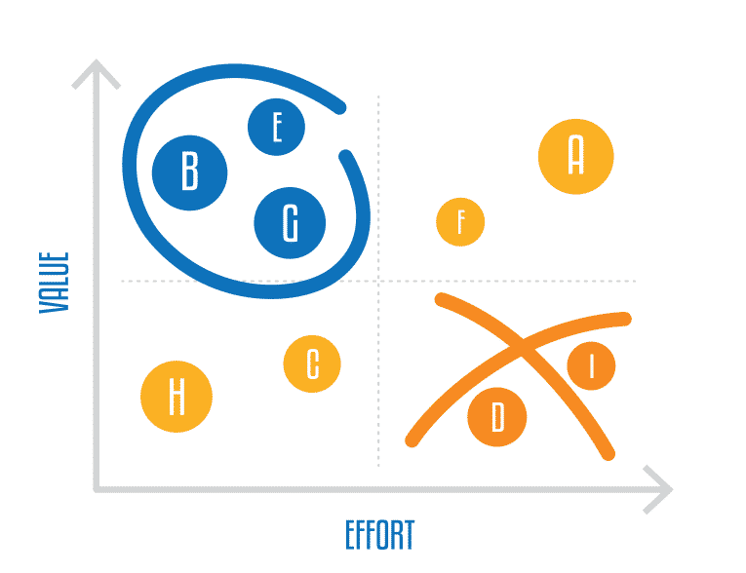
Consider Value and Effort in your RCA

Slide 49
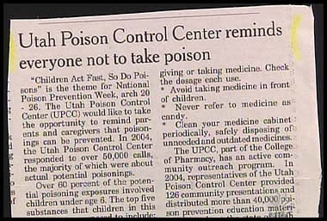
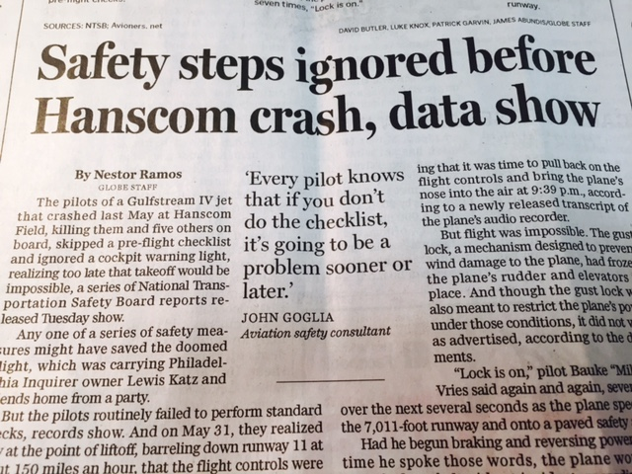
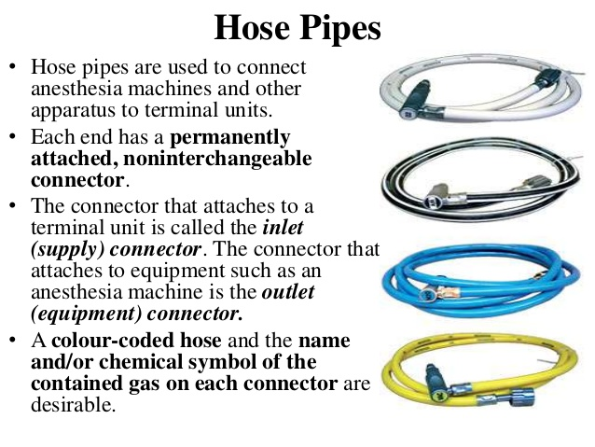
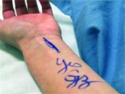
Strengths of Countermeasures
Weak
  Reminders
  Reeducation
Moderate
  Guidelines
  Order sets
Strong
  Hard Stops/forced functions
  Reengineered processes
  Simplified processes
  Automated/electronic processes
NOTE: Weaker countermeasures aren’t “bad,” but they are less likely to lead to lasting improvement.
Choose the strongest possible countermeasure!
Notes:
ANIMATION → A critical concept
Emphasize how we are inundated with reminders and education and how these are almost doomed to fail in bringing improvement
Explain process re-engineering and hard stops…

Slide 50
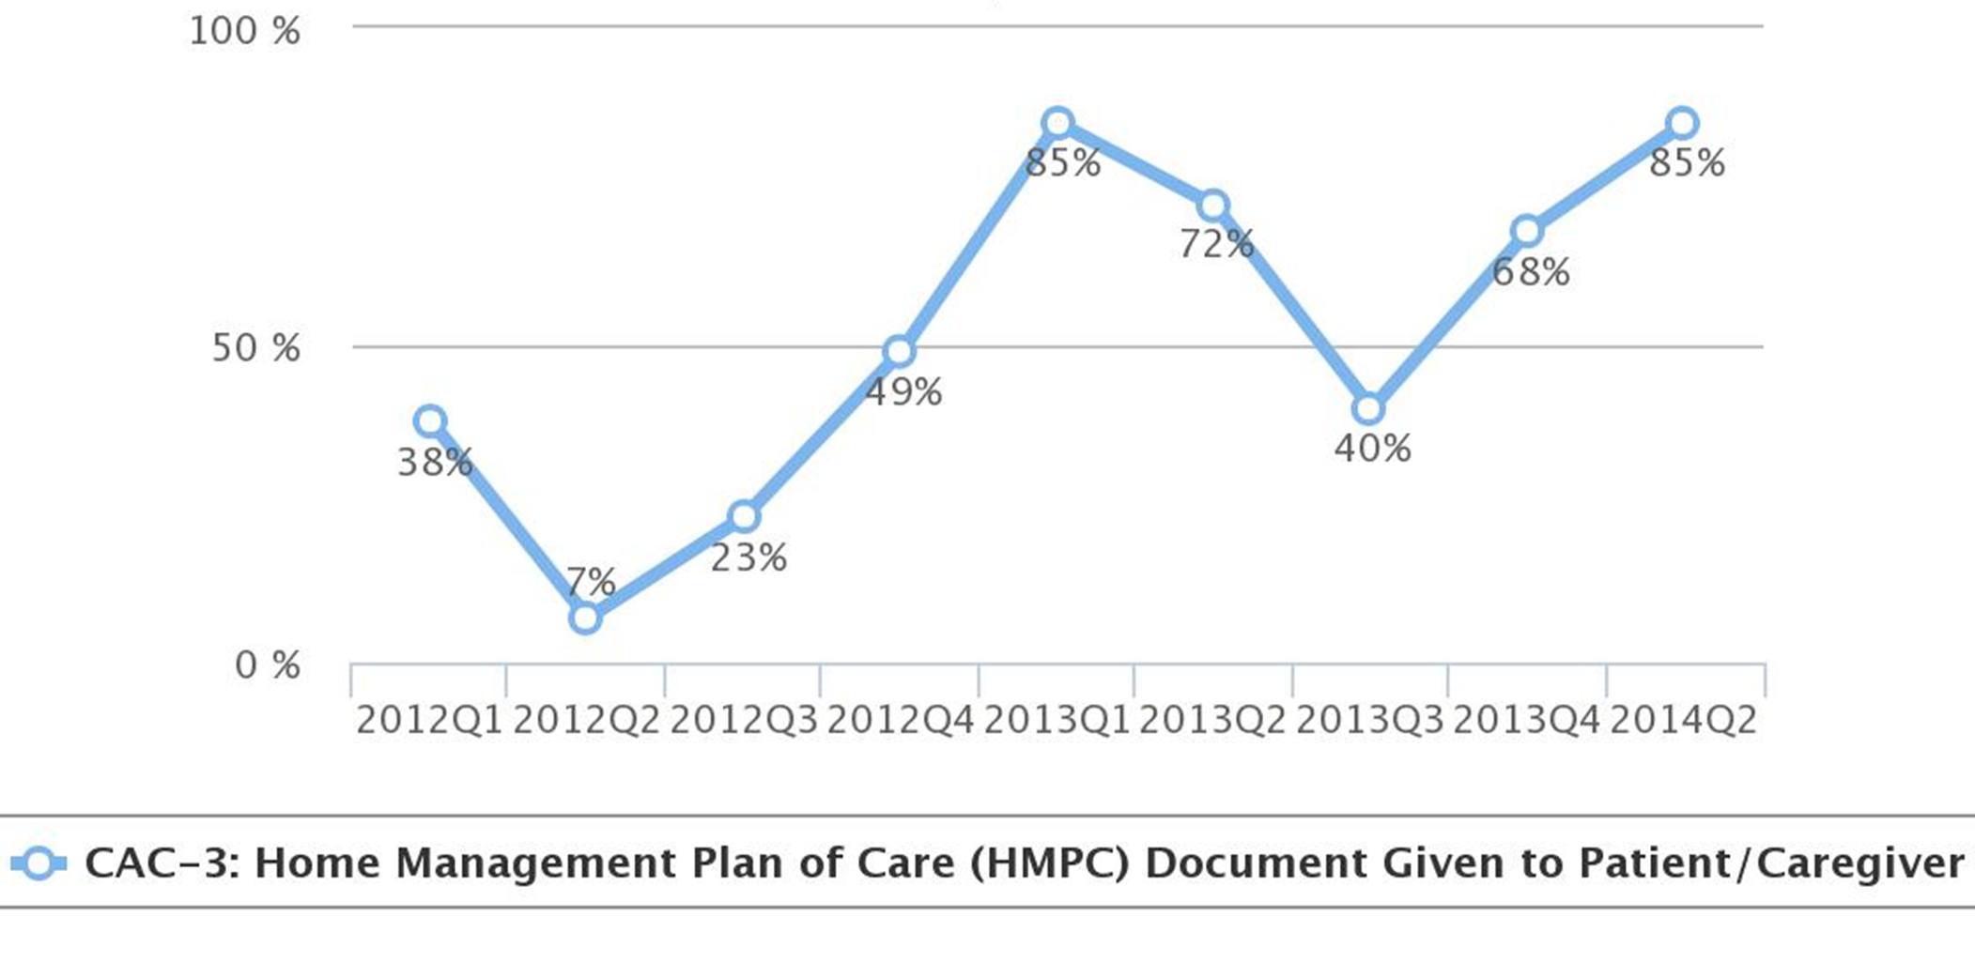
Education is Helpful…but a weak countermeasure

Slide 51
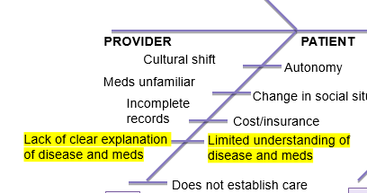
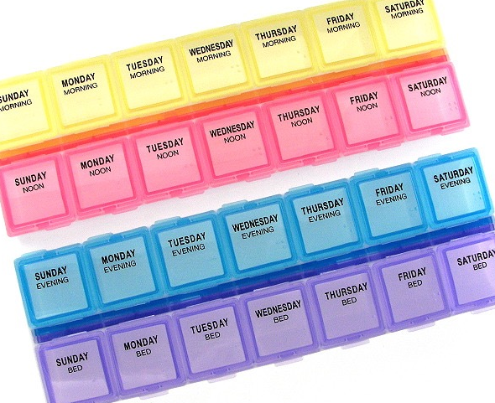

Transition-age patients with chronic kidney disease in my clinic are non-adherent with medications as they move from pediatric to adult nephrology provider teams, leading to lapses in optimal care
PROBLEM STATEMENT
ROOT CAUSES
COUNTERMEASURES
Pill box, text message prompts
Educational smartphone app
Notes:
I start this one with “Let’s re-visit Amy’s problem statement and look at the specific root causes Amy chose to link her initial countermeasures to”

Slide 52
The rest of the A3 right side
If your first countermeasure is ineffective, repeat the PDSA cycle until you’ve reached the level of improvement desired
Act
Plan
Study
Do
If your first countermeasure is effective, figure out how to sustain or “control” the effect

Slide 53
Transition-age patients with chronic kidney disease in my clinic are non-adherent with medications as they move from pediatric to adult nephrology provider teams, leading to lapses in optimal care
RESULTS (STUDY)
Countermeasure implementation
2 months
6 months
70% of patients non-adherent to medication
Medication list created
Educated patients regarding medications/ disease
50% of patients non-adherent to medication
All patients required to use either cell phone application or cell phone alarm with pillbox
40% of patients non-adherent to medication
Notes:
ANIMATION --- So back to Amy’s project and her “RESULTS” or “STUDY” step
Here is what she found. Did she reach her SMART goal? Yes!

Slide 54
Lean QI and the A3: A VERY Big Picture
You want/need to be here
Apply countermeasures to get to the future state
A P
S D
Future State
A P
S D
The A-3 guides your work and tells the story
You are here now-inside your broken process
A P
S D
A P
S D
Each step tries to reach a goal
Current Condition
Notes:
Attempt here to pull the whole training together
I say at the beginning that it’s the last slide to pull them in
I like to make the point that the PDSA wheels can roll backwards if a good plan to sustain change isn’t created and followed

Slide 55

Exercise – Coming Soon

Slide 56

Thanks for your participation!

