Slide 1
Financial Literacy and Wellness
Katie Yanagisawa, DO
MAY 7, 2025

Slide 2
Disclosures
I am not an expert, financial advisor, accountant, lawyer, or anything other than a pediatrician.
I just find financial education interesting and have read lots of books, listened to lots of podcasts, and taken several courses on financial literacy.
This is not personalized financial advice.

Slide 3
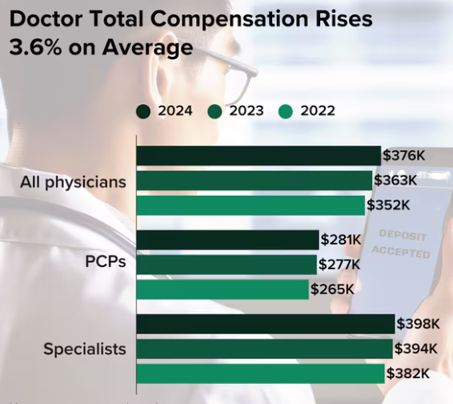

https://www.medscape.com/slideshow/2025-compensation-overview-6018103?ecd=WNL_physrep_250416_MSCPEDIT_comp-report_etid7364127&uac=234869BV&impID=7364127#2
Notes:
https://www.medscape.com/slideshow/2025-compensation-overview-6018103?ecd=WNL_physrep_250416_MSCPEDIT_comp-report_etid7364127&uac=234869BV&impID=7364127#2

Slide 4
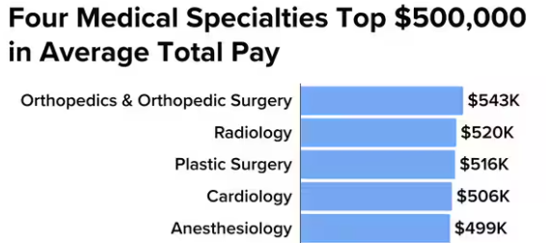
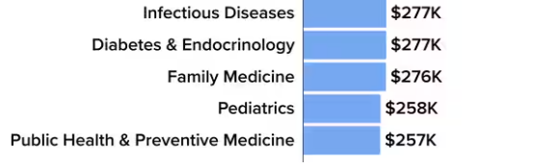
https://www.medscape.com/slideshow/2025-compensation-overview-6018103?ecd=WNL_physrep_250416_MSCPEDIT_comp-report_etid7364127&uac=234869BV&impID=7364127#3
Notes:
https://www.medscape.com/slideshow/2025-compensation-overview-6018103?ecd=WNL_physrep_250416_MSCPEDIT_comp-report_etid7364127&uac=234869BV&impID=7364127#3
https://www.census.gov/library/publications/2024/demo/p60-282.html

Slide 5

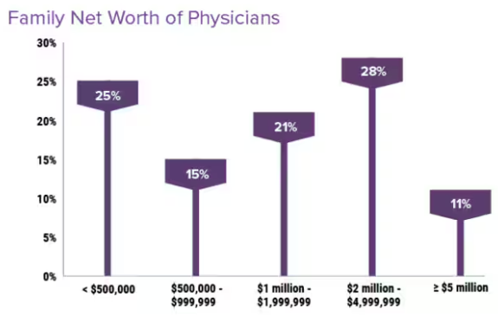
https://www.medscape.com/slideshow/2024-wealth-debt-6017160?_gl=1*1xi7yxf*_gcl_au*OTg3Mzc4MjYyLjE3NDQ4NDc4NDI.#2
Notes:
https://www.medscape.com/slideshow/2024-wealth-debt-6017160?_gl=1*1xi7yxf*_gcl_au*OTg3Mzc4MjYyLjE3NDQ4NDc4NDI.#2

Slide 6
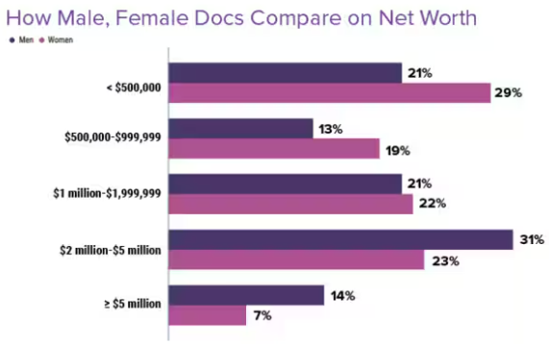
https://www.medscape.com/slideshow/2024-wealth-debt-6017160?_gl=1*1xi7yxf*_gcl_au*OTg3Mzc4MjYyLjE3NDQ4NDc4NDI.#4
Notes:
https://www.medscape.com/slideshow/2024-wealth-debt-6017160?_gl=1*1xi7yxf*_gcl_au*OTg3Mzc4MjYyLjE3NDQ4NDc4NDI.#4

Slide 7
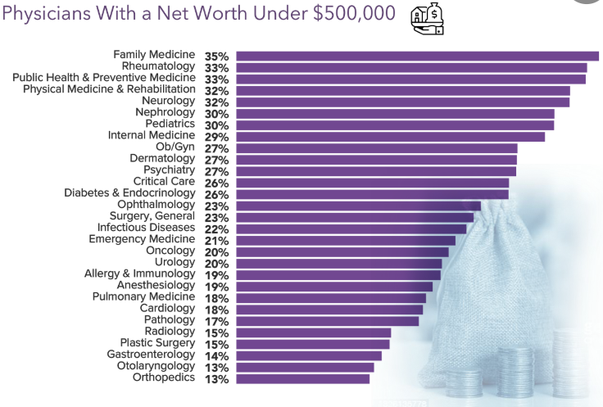

https://www.medscape.com/slideshow/2023-compensation-wealth-debt-6016481#5
Notes:
https://www.medscape.com/slideshow/2023-compensation-wealth-debt-6016481#5

Slide 8
So Why Is This?
high income potential comes later in life
high student debt
inadequate savings
failure to insure against financial catastrophe
inappropriate investment plan/strategy
lack of financial literacy

Slide 9
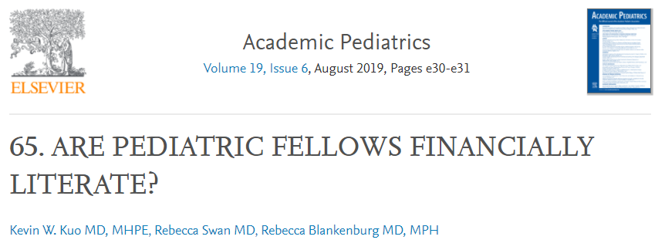
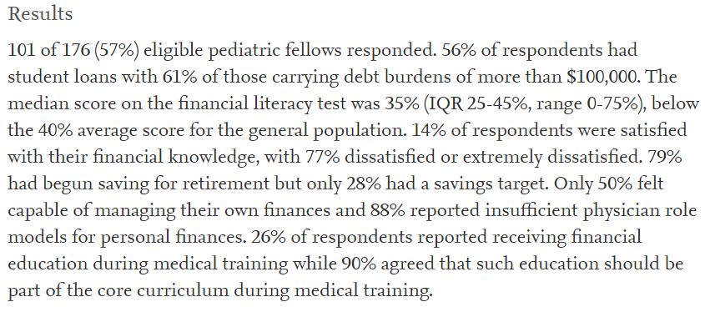

Slide 10
Are Pediatric Fellows Financially Literate?
presented at PAS 2019
given survey with financial literacy test
pediatric fellows scored 35%
general population scored 40%
77% were dissatisfied or extremely dissatisfied with their financial knowledge
90% agreed that financial education should be part of the core curriculum during medical training

Slide 11
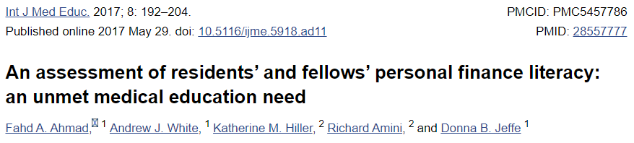
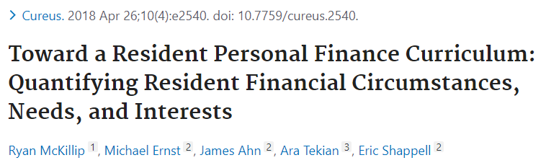
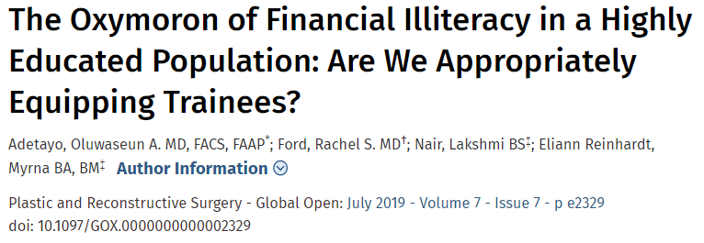
Poor Financial Literacy
Notes:
There are lots of studies showing that residents do poorly on financial literacy tests, as well as the need for financial education.
An Assessment of Residents’ and Fellows’ Personal Finance Literacy: An Unmet Medical Education Need – Residents and fellows’ mean quiz score was 52%. This study found that residents and fellows had low financial literacy and investment-risk tolerance, high debt, and deficits in their financial preparedness.
Toward a Resident Personal Finance Curriculum: Quantifying Resident Financial Circumstances, Needs, and Interests – This study had 75% IM, Peds, and EM residents and 25% other specialties. The results highlight the deficits in personal finance literacy among residents.
The Oxymoron of Financial Illiteracy in a Highly Educated Population: Are We Appropriately Equipping Trainees? – This study included plastic surgery residents and recent grads. “As a very literate group, there is an unacceptably high level of ‘illiteracy’ concerning financial education at an early stage.”
Adding personal financial education to the medical education curriculum can offer significant long-term benefits to trainees.

Slide 12
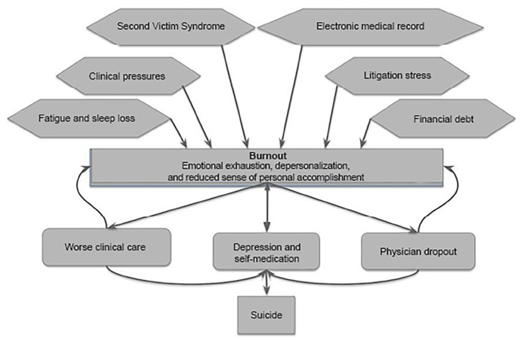
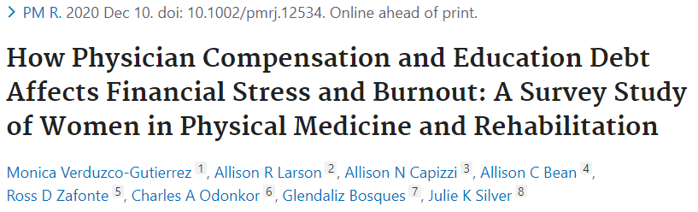
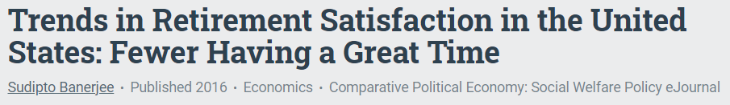
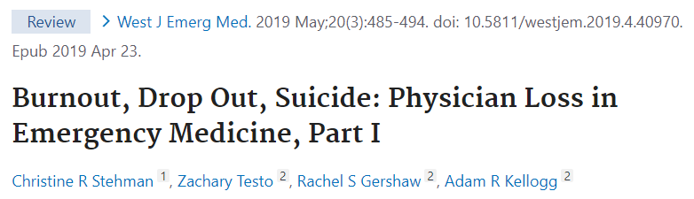
Burnout
Notes:
There are also many studies linking financial stress and burnout.
How Physician Compensation and Education Debt Affects Financial Stress and Burnout: A Survey Study of Women in Physical Medicine and Rehabilitation – This study examined women physiatrists’ perceptions of financial stress and found that greater education debt was associated with personal life dissatisfaction, career regret, and burnout.
Trends in Retirement Satisfaction in the States: Fewer Having a Great Time - Those having “very satisfying” retirements dropped from over 60% in 1998 to under 50% in 2012. If you’re healthy, then you’re more likely to be satisfied. And your net worth matters – if you have a higher net worth, then you’re more satisfied. This is obvious, but nice to see it quantified.
Burnout, Drop Out, Suicide: Physician Loss in Emergency Medicine - Chart that shows causes of burnout. There are MANY factors that contribute to burnout, but financial debt is part of that. And burned out doctors provide worse clinical care, are more depressed, may self-medication, may drop-out of the medicine altogether, and may commit suicide.

Slide 13
Financial Literacy Can Affect Wellness
decreases burnout
reduces suicide risk
increases career satisfaction
allows more autonomy
improves patient care

Slide 14
Why Should I Care as a Resident?
financial wellness decreases burnout
building good habits early
time is your greatest advantage
the power of compounding interest
things my co-workers wish they knew 10-25 years ago

Slide 15
WCI’s 4 Steps to Build Wealth
earn a lot of money
save a lot of money
invest that money in a reasonable way
insure against financial catastrophes

Slide 16
Principles
How Much You Earn Matters
  easier to build wealth on a higher income
  intra-specialty pay difference
High Income is Not Wealth
  net worth = assets – debts/liabilities
  convert your high income into high net worth
Career Longevity Matters
  working for longer making less money is better than working shorter and making more money
  more time for investments to compound
  less savings required
  need to combat burnout

Slide 17
Where Are You Today?
What is your current net worth?
Where did your money go last month?
Is your spending aligned with your goals?

Slide 18
Where Do You Want to Be?
What kind of lifestyle do you want?
How much income do you need to support this?
What if you didn’t need to work for this income?

Slide 19
Financial Independence (FI)
having enough money to pay your expenses for the rest of your life without having to work again
financial freedom
  better patient care
  work less
  more family time, vacation, etc.
  eliminate parts of your job that you don’t like
  missions or pro-bono work

Slide 20
Financial Independence (FI)
Trinity Study
FI = 25x desired spending
$100K spending per year requires a $2.5M portfolio

Slide 21
How Do I Reach FI?

Slide 22
High Yield Topics
long-term financial goals
budgeting
insurance
debt reduction/avoidance
retirement plans
investing
college savings
asset protection
estate planning

Slide 23
1. Long-Term Financial Goals
Where do you want to be financially in 5, 10, 20, and 30 years?
write down SMART goals = Specific, Measurable, Achievable, Relevant, and Time-bound

Slide 24
1. Long Term Financial Goals
“We will reach a net worth of $1 million not including home equity by 2/2025.”
“We will pay off our student loans by 7/2029.”
“We will pay off our mortgage by 6/2029.”
“We will become financially independent by 6/2034 or coast FI by 8/2030.”
“We will save at least 30% of our income every year.”
“We will max out our 403bs, backdoor Roth IRAs, and HSA each year.”

Slide 25
2. Budgeting
Where is your money going?
be intentional with your money
pay yourself first
spend on things that make you happy
consider apps: Mint, YNAB, EveryDollar
“A budget is telling your money where to go instead of wondering where it went.” – Dave Ramsey

Slide 26
3. Insurance
Disability
Life
Health
Malpractice
Car
Home/Renter’s
Umbrella
Emergency Fund

Slide 27
Disability Insurance
protects your most valuable asset
pays a monthly benefit if you become disabled for >90 days
generally insures up to 60-70% of your income
Who doesn’t need disability insurance?
  financially independent
  someone else will take care of you
When is the best time to buy it?
  the day before you get disabled

Slide 28
Disability Insurance
Who should you buy it from?
  independent agent – individual policy
  employer or society – group policy
can be expensive because it’s actually used
individual policy
  better coverage
  strong definition of disability
  more riders
  portable
  tax-free pay out
group policy
  cheaper
  better for those in poor health
  better for those with risky habits
  must take what is offered

Slide 29
Disability Insurance
buy an individual policy from an independent agent
  buy as much as you can afford
must be own-occupation and specialty-specific
riders:
  residual disability
  inflation protection
  future purchase option
Big 5: Guardian, Standard, Principal, Ameritas, and Mass Mutual
UMass has a Guaranteed Standard Issue (GSI) disability insurance policy

Slide 30
Life Insurance
recommended if someone else depends on your income
buy term life insurance
avoid whole life insurance
connect with an independent agent

Slide 31
Other Insurance
Health
  through your residency program or spouse’s work
  consider use of Health Savings Account (HSA) if you have a HDHP
Malpractice
  through your residency program
  look for tail coverage when applying for jobs
Car
  liability coverage up to $300K
  comprehensive coverage until vehicle is worth <$5-10K

Slide 32
Other Insurance
Home/Renter’s
  insure the replacement value of the home and its contents
Umbrella
  $1M of liability coverage stacked on top of car/home liability coverage
Emergency Fund
  fund with 3-6 months worth of expenses to cover any emergencies

Slide 33
4. Debt Reduction
can’t ignore debt
debt numb in medical school
high correlation between low debt and wealth

Slide 34
4. Debt Reduction
student loans
  mean educational debt in 2024: $260k for DOs and $207k for MDs
  Public Service Loan Forgiveness (PSLF) or pay off loans?
    remaining DIRECT federal student loans are forgiven TAX-FREE after you make 120 ON-TIME monthly payments in a QUALIFYING program while working FULL-TIME for a QUALIFYING employer
  Will you work for a 501c as an attending?
    yes/maybe/unsure → stay in government income-driven repayment (IDR) program for now
    no → compare the effective interest rates for government IDR program vs private refinancing
  ask your employer about loan forgiveness when negotiating your contract

Slide 35
4. Debt Reduction
credit cards
  pros: can be great for building credit, cash back, travel points
  cons: encourages overspending, crazy high interest rates, potential trap
  take home: if you’ve ever paid interest, credit cards are not for you
car loans
  don’t buy depreciating assets with debt
  you’re probably poor so drive like it
  average car payment in the US is $742 per month for new cars and $525 per month for used cars
  take home: drive a beater and fund a Roth IRA instead
“You can’t get ahead paying 18%.” – Charlie Munger

Slide 36
5. Retirement Accounts
IRA (Traditional or Roth): individual tax-advantaged retirement account
401k and 403b (Traditional or Roth): qualified tax-advantaged retirement plans
457: non-qualified tax-advantaged deferred-compensation retirement plan
HSA: health savings account
taxable account

Slide 37
Traditional vs. Roth
Traditional: contributions are made with pre-tax dollars so you don’t have to pay taxes now, but you have to pay taxes on money taken out later = up-front tax break
  the 2025 limit for 401k employee contributions is $23,500
  so if you make a salary of $223,500 and max out your 401k contribution, then you can defer taxes on that contribution and only pay taxes on your adjusted gross income of $200,000
Roth: contributions are made with after tax dollars so you pay taxes now, but the earnings grow tax free and you don’t pay taxes on the money when taken out later = tax-free withdrawal
  the 2025 limit for Roth IRA contributions is $7,000
  you will pay taxes on that $7,000 this year
you have to consider whether your tax rate will be higher or lower during retirement

Slide 38
5. Retirement Accounts
residents should ideally do the following every year:
  get the 401k/403b match if offered
  max out Roth IRAs - $7,000/$14,000
  max out HSA if available - $4,300/$8,550
super savers can also max out the (Roth) 401k/403b - $23,500

Slide 39
6. Investing
ignore that which is outside of your control
  market volatility, asset class returns, federal interest rates, politics, the economy, inflation, tax law
focus on things that are within your control
  your income, savings rate, asset allocation, asset location, investment expenses, legally minimizing taxes

Slide 40
Compound Interest
“Compound interest is the 8th wonder of the world. He who understands it, earns it…he who doesn’t…pays it.” – Albert Einstein

Slide 41
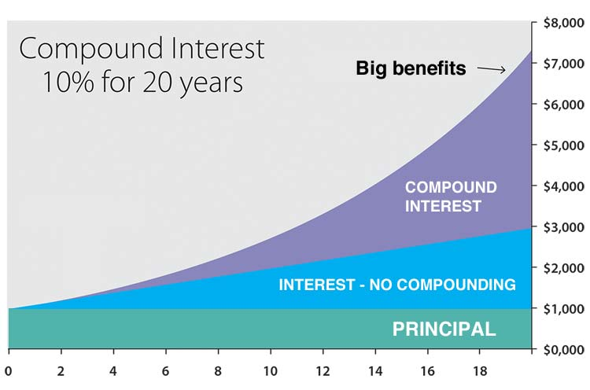
https://www.thecalculatorsite.com/finance/calculators/compoundinterestcalculator.php
Notes:
https://www.thecalculatorsite.com/finance/calculators/compoundinterestcalculator.php

Slide 42
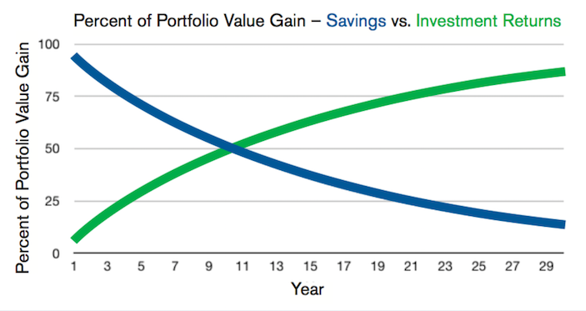
Savings Rate vs. Investment Returns
https://epmonthly.com/article/whats-important-savings-rate-investment-returns/
Notes:
https://epmonthly.com/article/whats-important-savings-rate-investment-returns/

Slide 43
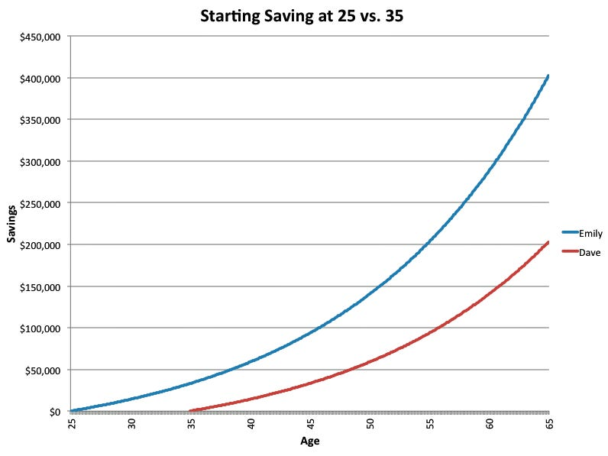
https://www.businessinsider.com/personal-finance/amazing-power-of-compound-interest-2014-7
Notes:
https://www.businessinsider.com/personal-finance/amazing-power-of-compound-interest-2014-7

Slide 44
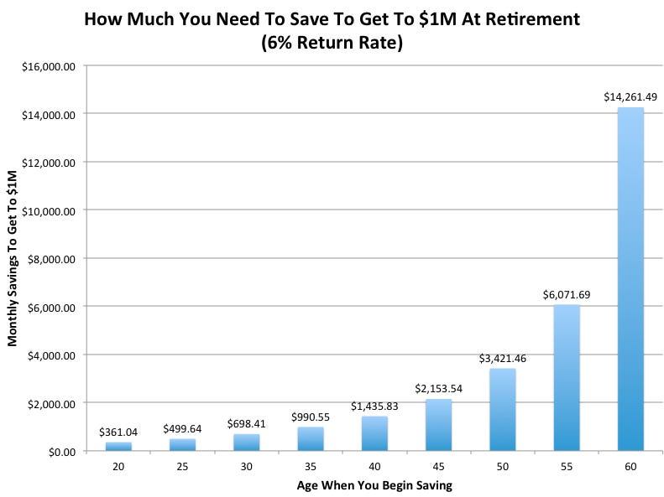
Compound Interest
https://www.businessinsider.com/personal-finance/amazing-power-of-compound-interest-2014-7
Notes:
https://www.businessinsider.com/personal-finance/amazing-power-of-compound-interest-2014-7

Slide 45
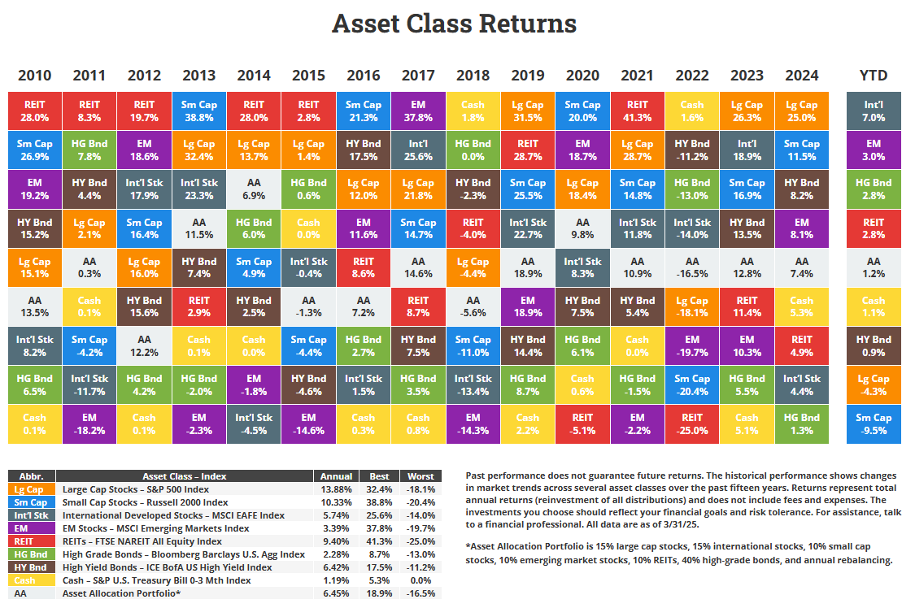
https://novelinvestor.com/asset-class-returns/
Notes:
https://novelinvestor.com/asset-class-returns/

Slide 46
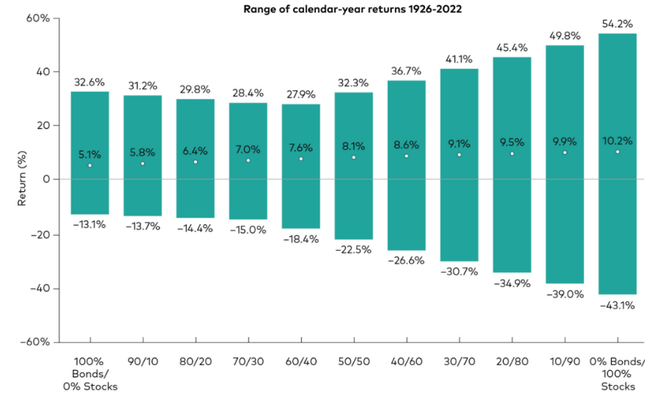
Asset Allocation
https://investor.vanguard.com/investor-resources-education/education/model-portfolio-allocation
Notes:
https://investor.vanguard.com/investor-resources-education/education/model-portfolio-allocation

Slide 47
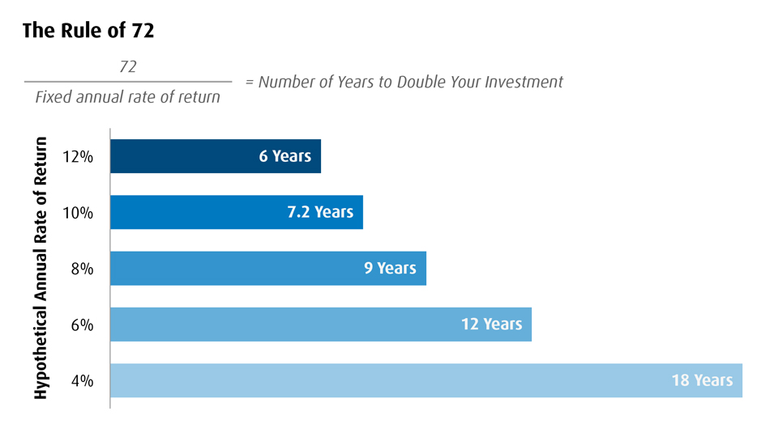
Rule of 72
https://www.bmogam.com/us-en/advisors/market-charts/the-rule-of-72/
Notes:
https://www.bmogam.com/us-en/advisors/market-charts/the-rule-of-72/

Slide 48
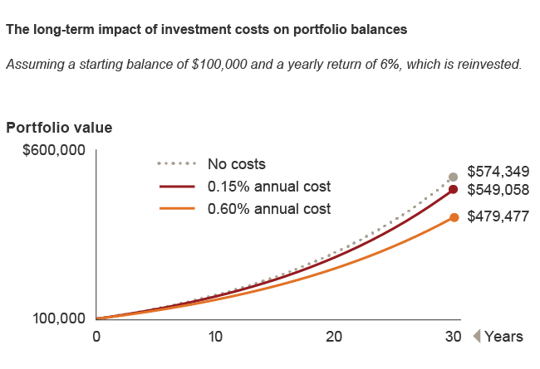
Fees Matter
“You get what you don’t pay for.” – John Bogle
https://about.vanguard.com/what-sets-vanguard-apart/the-benefits-of-lower-costs/
Notes:
https://about.vanguard.com/what-sets-vanguard-apart/the-benefits-of-lower-costs/

Slide 49
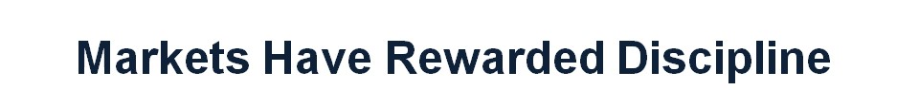
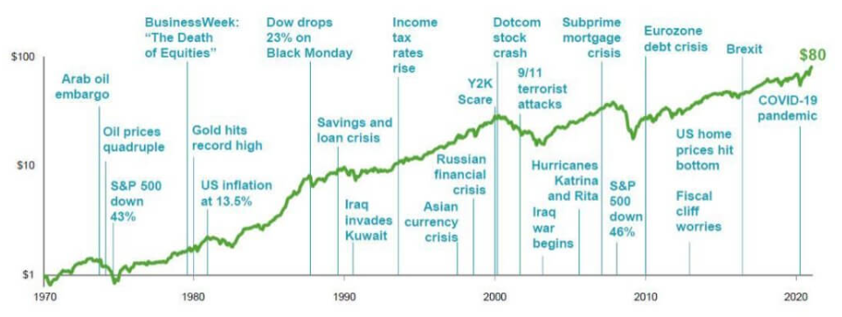
“The only way to get hurt on a roller coaster is to jump off.” – Dave Ramsey
https://rkcapital.com/articles/markets-have-rewarded-discipline/
Notes:
https://rkcapital.com/articles/markets-have-rewarded-discipline/

Slide 50
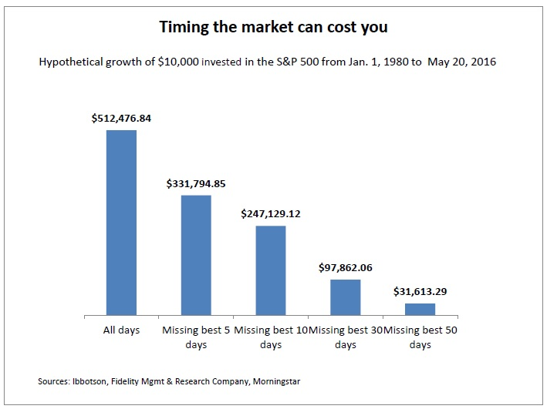
“Far more money has been lost by investors preparing for corrections, or trying to anticipate corrections, than has been lost in corrections themselves.” – Peter Lynch
https://www.arecainternational.com/market-timing-v-staying-invested-the-facts/
Notes:
https://www.arecainternational.com/market-timing-v-staying-invested-the-facts/

Slide 51
Easy Solution
invest all the money in “target retirement index funds”
  simple and cheap
  zero effort to maintain
  professionally designed and managed
  excellent rates of return
  elegant asset location
  automatically rebalanced
  allows you to focus on residency and early attending
  example: Vanguard Target Retirement 2060 Fund (VTTSX) or Fidelity Freedom Index 2060 (FDKLX)

Slide 52
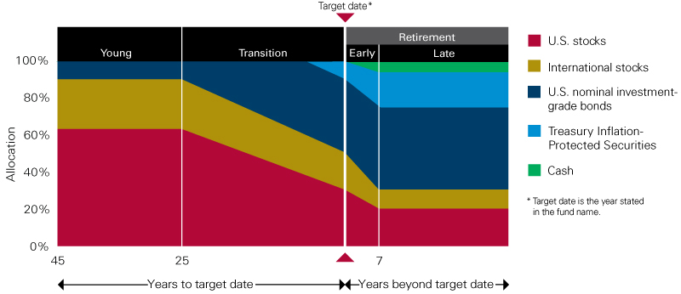
Vanguard Target Retirement Fund
https://retirementplans.vanguard.com/VGApp/pe/pubeducation/investing/LTgoals/TargetRetirementFunds.jsf
Notes:
https://retirementplans.vanguard.com/VGApp/pe/pubeducation/investing/LTgoals/TargetRetirementFunds.jsf

Slide 53
7. College Savings
college costs are ridiculous
contribute if you can afford it
PAY YOURSELF FIRST!
529 plans
  tax-advantaged savings plan designed to help pay for education
  grows tax-free and withdrawals are tax-free if spent on qualified higher education expenses
Massachusetts’ MEFA U.Fund 529
  BabySteps Saving Plan: free $50 deposit into the 529 within one year of birth/adoption
  state tax deduction for 529 contributions of up to $1,000 for single filers and $2,000 for married persons filing jointly

Slide 54
8. Asset Protection
asset protection laws are state dependent
investments in retirement accounts are usually 100% protected
taxable brokerage accounts are usually not protected
home equity protection varies by state
HSAs and 529s receive limited asset protection

Slide 55
8. Asset Protection
date night is the best asset protection
insurance is the first line of defense
  likelihood of exceeding that first line is very low
  most protection is cheap and simple
favor investments in retirement accounts
title your home as “tenants by the entirety” if your state allows
limit liability by not owning “dangerous” items and not getting into car accidents

Slide 56
9. Estate Planning
set beneficiaries on insurance policies and retirement accounts
  review and make updates when any family changes occur
create a will
  especially important if married and have children
  name a guardian, trustee, and executor
meet with an estate planning attorney as an attending

Slide 57
Financial Education
NOBODY CARES ABOUT YOU MORE THAN YOU!
NOBODY CARES ABOUT YOUR MONEY MORE THAN YOU DO!
If you launch on the right step, then you can live the lifestyle you and your family desire, practice medicine on your own terms, retire comfortably, and be outrageously generous with your money.

Slide 58
What To Do
Spend Time Learning about Finances
  you cannot win the game if you don’t learn the rules
  start with books, podcasts, blogs, etc.
  hire professionals to teach you, not just do it for you
Make a Plan
  a written plan is critical for success
  any reasonable plan will work
  pay yourself first with at least 20% of gross income for retirement
  you must take risks
  stay the course

Slide 59
What To Do
“Get Good Advice at a Fair Price”
  assume everyone is making money from you
  fees add up
  know what you’re paying for
  get advice when needed
Be Intentional
  it takes time and effort to earn, save, invest, spend, and give well
  align your time and money with your values

Slide 60
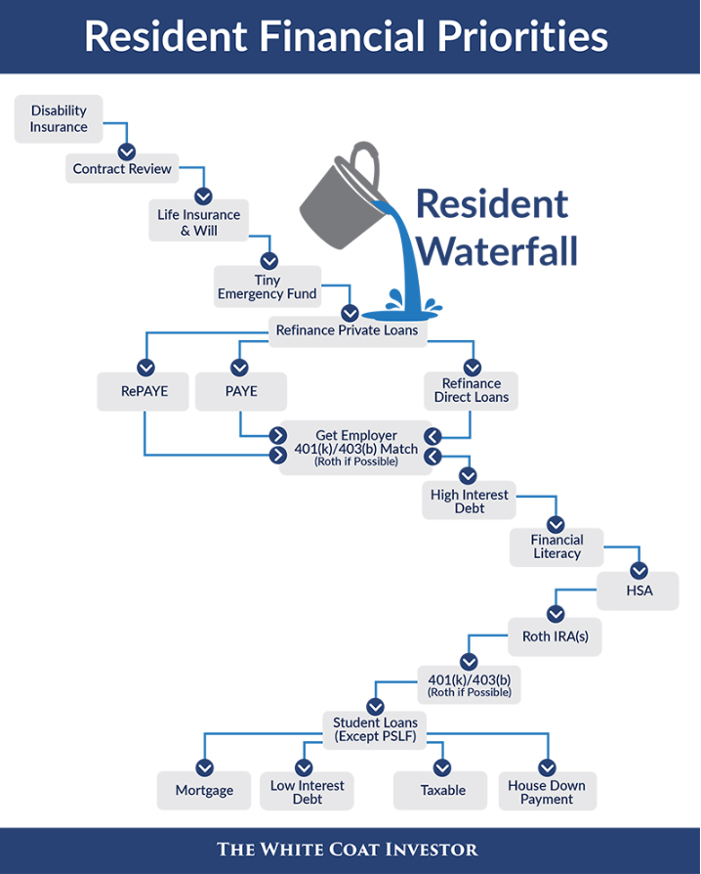
WCI’s Resident Waterfall
https://www.whitecoatinvestor.com/financial-waterfalls-for-new-residents-and-attendings/
Notes:
https://www.whitecoatinvestor.com/financial-waterfalls-for-new-residents-and-attendings/

Slide 61
Good Place to Start…
White Coat Investor books, course, blog, podcast
Bogleheads wiki and forum
The Physician Philosopher books
Money Meets Medicine podcast
If You Can by William Bernstein
The Simple Path to Wealth by JL Collins
The Millionaire Next Door by Tom Stanley

Slide 62
Resources
Adetayo O, Ford R, Nair L, Eliann Reinhardt M. The Oxymoron of Financial Illiteracy in a Highly Educated Population: Are We Appropriately Equipping Trainees? Plastic and Reconstructive Surgery – Global Open. 2019; 7(7):e2329.
Ahmad F, White A, Hiller K, Amini R, Jeffe D. An assessment of residents’ and fellows’ personal finance literacy: an unmet medical education need. International Journal of Medical Education. 2017; 8:192-204.
Banerjee S. Trends in Retirement Satisfaction in the United States: Fewer Having a Great Time. 2016; 37(4):1-12.
Boyd B. High-Yield Financial Topics Your Residents Need to Know. 2021 Continuing Financial Education. 2021.
Dahle J. The State of Physician Wellness: A Review of Literature. 2020 Continuing Financial Education. 2020.
Kuo K, Swan R, Blankenburg R. 65. Are Pediatric Fellows Financially Literate? Academic Pediatrics. 2019; 19(6):e30-e31.
McKenna J. Comparing Your Pay Against Your Peers’: Medscape Physician Compensation Report 2025. Medscape. 2025; https://www.medscape.com/slideshow/2025-compensation-overview-6018103?ecd=WNL_physrep_250416_MSCPEDIT_comp-report_etid7364127&uac=234869BV&impID=7364127#1.
McKenna J. Building a Financial Future: Medscape Physician Wealth & Debt Report 2024. Medscape. 2024; https://www.medscape.com/slideshow/2024-wealth-debt-6017160?_gl=1*1xi7yxf*_gcl_au*OTg3Mzc4MjYyLjE3NDQ4NDc4NDI.#1.
McKenna J. Medscape Physician Wealth & Debt Reports 2023: Do You Feel Rich Enough? Medscape. 2023; https://www.medscape.com/slideshow/2023-compensation-wealth-debt-6016481#5.
McKillip R, Ernst M, Ahn J, Tekian A, Shappell E. Toward a Resident Personal Finance Curriculum: Quantifying Resident Financial Circumstances, Needs, and Interests. Cureus. 2018; 10(4):e2540.
Richardson, T. Estimated Median Family Incomes for Fiscal Year (FY) 2021. U.S. Department of Housing and Urban Development. 2021; https://www.huduser.gov/portal/datasets/il/il21/Medians2021.pdf.
Stehman C, Testo Z, Gershaw R, Kellogg A. Burnout, Drop Out, Suicide: Physician Loss in Emergency Medicine, Part I. The Western Journal of Emergency Medicine. 2019; 20(3):485-494.
Verduzco-Gutierrez M, Larson A, Capizzi A, Bean A, Zafonte R, Odonkor C, Bosques G, Silver J. How Physician Compensation and Education Debt Affects Financial Stress and Burnout: A Survey of Women in Physical Medicine and Rehabilitation. PM&R. 2020.

Slide 63
Questions?
katie.yanagisawa@gmail.com

