Slide 1
Asthma Updates for Primary Care
Fei Jamie Dy, MD
Pediatric Pulmonary Medicine

Slide 2
A young child with a history of wheezing is more likely to have asthma if they have:
Take away points
1. Young age does not preclude an asthma diagnosis (also don't call it 'reactive airway disease')
2. Asthma can be diagnosed with history
3. Treatment is part of the diagnostic process
Wheezing or coughing that occurs with crying, laughing or exercise, or in the absence of an apparent upper respiratory infection.
A history of other allergic disease (eczema or allergic rhinitis), allergic sensitization or asthma in first-degree relatives
Clinical improvement during 2-3 months of low-dose inhaled corticosteroid (ICS) treatment plus as-needed short-acting beta-agonist (SABA) reliever, and possible worsening after cessation
Key recommendations for primary care from the 2022 Global Initiative for Asthma (GINA) update. Levy et al. Prim. Care Respir. Med. February 2023. https://doi.org/10.1038/s41533-023-00330-1

Slide 3
Questions To Determine Asthma Control
When your child seems healthy...
When your child gets sick...
Think about risk factors...
Does your child still cough or wheeze out of the blue?
Any symptoms at night?
Any symptoms with running, recess/gym, sports, climbing stairs or outdoor play?
Any symptoms with heightened emotions?
Any symptoms with allergies, weather extremes or temperature swings?
Any complaints from school or coaches?
Do caregivers micro-manage the child's activities or environment to avoid symptoms?
Does your child cough and wheeze intensely?
Does your child cough for weeks?
Is your child sick more days than he/she is healthy?
Do bronchodilators help your child, even temporarily?
How often does your child need oral/injected steroids to get better?
How often does your child need intensified treatments at urgent or emergency care?
How often does your child get hospitalized?
Do asthma flares occur rapidly or randomly?
Is viral transmission rate high?
Is the child at school or in daycare?
Was the child born prematurely?
Does the child have eczema and confirmed allergies?
Do parents have asthma?
Are living conditions ideal? (mold, rodents, smoke exposure)
Are there transport or financial barriers?
What are the household dynamics? (DCF, separated parents)

Slide 4


If the child is already on medication, is it taken consistently and correctly?
Are environmental factors ruled out?
(e.g. vaping, allergies)
START or Step UP therapy
Educate
and review
No
Yes
NO
ASSESS CONTROL
Is the child’s symptom and illness burden acceptable and manageable?
YES
Maintain until clinical stability is observed
Has the child experienced activities, illnesses, seasonal shifts and potential trigger events without problems?
No
Yes
Step DOWN therapy
How to step up and step down therapy

Slide 5

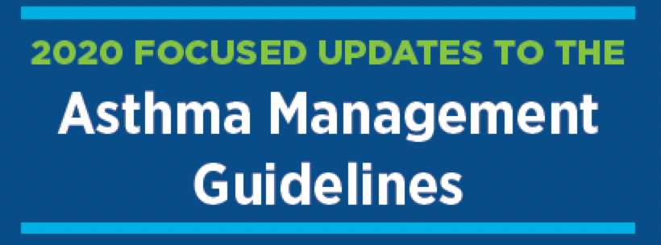
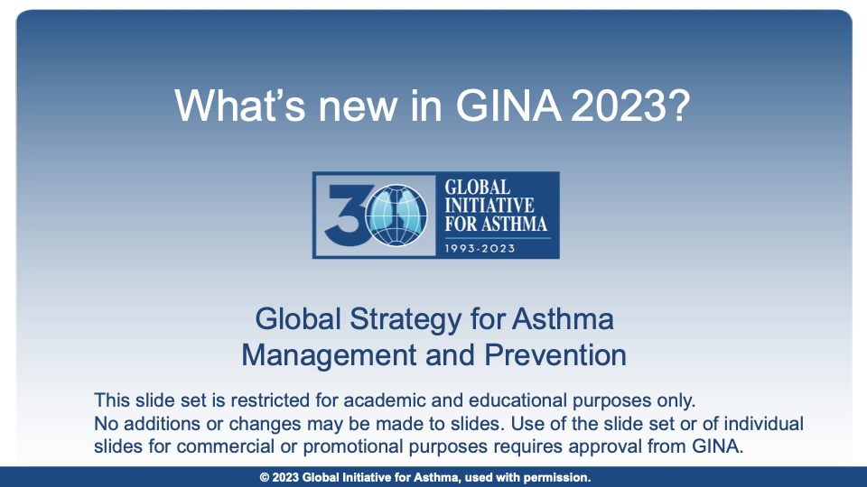
Key recommendations for primary care
Two references: focused guidelines from NAEPP/NHLBI (2020) and comprehensive guidelines Global Initiative for Asthma (updated yearly).
  These are not meant to be competing resources. Think of it as more options for tailored therapy.
Steps 1-3 of asthma management can be started in primary care
Even "mild" or "intermittent" asthma can produce severe exacerbations with the right trigger(s) e.g. severe or stacked viral infections, or allergies plus infection
  Consider as-needed inhaled steroids with illness in young children
You may see more patients with Single Maintenance and Rescue Therapy (SMART) - one inhaler for everything!

Slide 6
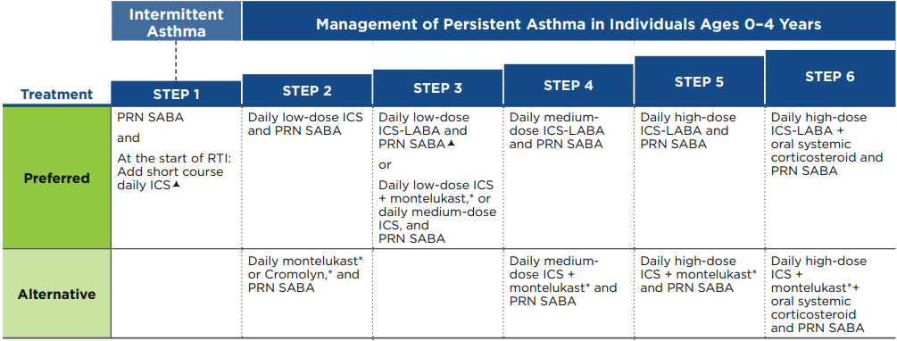
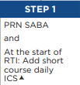
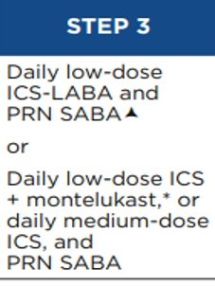
Guideline Highlights Age 0-4
1. Mild is a misnomer: Even patients with “mild intermittent” asthma are at risk for severe exacerbations
2. It is appropriate to start daily low-dose ICS in the primary care setting
It is not atypical for children with mild intermittent asthma to need hospital-level care for viral wheezing. These patients do not automatically need a pulmonary referral.
New Step 1 guidelines address this with recommending intermittent use of inhaled steroids:
Children with viral-induced wheezing (and no wheeze between illnesses): Intermittent ICS plus as-needed short-acting beta-agonist led to 33% reduced risk of asthma exacerbations requiring oral steroids.
3. Three options for step 3
Daily low-dose ICS + montelukast
Daily medium-dose ICS
Daily low-dose ICS-LABA
Notes:
3. JACI paper has 3 options. NAEPP publication has daily medium dose ICS only

Slide 7
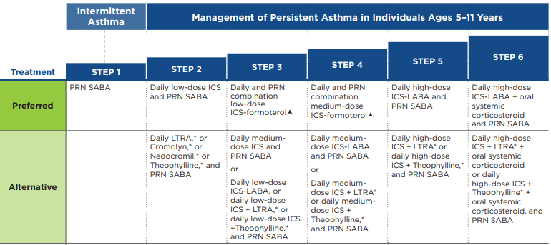
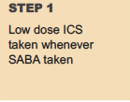
Guideline Highlights Age 5-11
2. Children using low-dose MART had significantly reduced risk of flares
1. NAEPP deemed there was insufficient evidence to recommend as-needed ICS in Step 1 for children age 5-11
It is still reasonable to consider as-needed low dose ICS in children who struggle with exacerbations but are otherwise asymptomatic for most of the year. Be aware that GINA (international) guidelines do recommend intermittent ICS for this age group
TREXA trial (Martinez et al, Lancet 2011): Inhaled corticosteroids as rescue medication with albuterol might be an effective step-down strategy for children with well controlled, mild asthma because it is more effective at reducing exacerbations than use of rescue albuterol alone (probability of exacerbation 35% vs 49%)
Prescribe or continue daily ICS at medium dose, or low dose ICS + montelukast, if this is keeping the child well-controlled.
Monitor for neuropsychiatric effects if using LTRA (montelukast)
Low-dose ICS-LABA for maintenance plus rescue (MART) is an option if flares are difficult to manage: Children using MART had 45% reduced risk of exacerbation compared to those using [ICS/LABA + SABA], and 47% reduced risk compared to those taking [high-dose ICS + SABA]

Slide 8
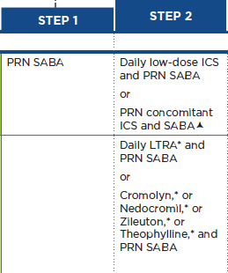

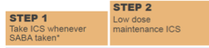
Guideline Highlights Age 12+
1. Patients who have mild intermittent or persistent asthma may still have significant exacerbations.
NAEPP update
"Mild" asthma accounts for 30-37% of acute asthma exacerbations in adults and 5-13% of deaths due to asthma
As-needed ICS-LABA¹ OR ICS with albuterol² is an option for Step 1 therapy in children age 12+ who struggle with exacerbations but are otherwise asymptomatic for most of the year. Be aware that GINA (international) guidelines DO recommend this.
¹ SYGMA 1 (O'Byrne et al NEJM 2018), Novel START (Beasly et al, NEJM 2019): Symptom driven use of ICS-LABA reduced risk of severe exacerbations by >60% compared to SABA alone; similar or lower risk of severe exacerbations compared to daily ICS + as-needed SABA
² BEST study (Papi et al, NEJM 2007), TREXA study (Martinez et al, Lancet 2011), ASIST study (Sumino et al, JACI 2020): Symptom driven use of ICS+SABA is as effective as regular use of ICS in reducing exacerbations
Intermittent or daily low-dose ICS can also be introduced at step 2
GINA guidelines 2023 (2 options)

Slide 9
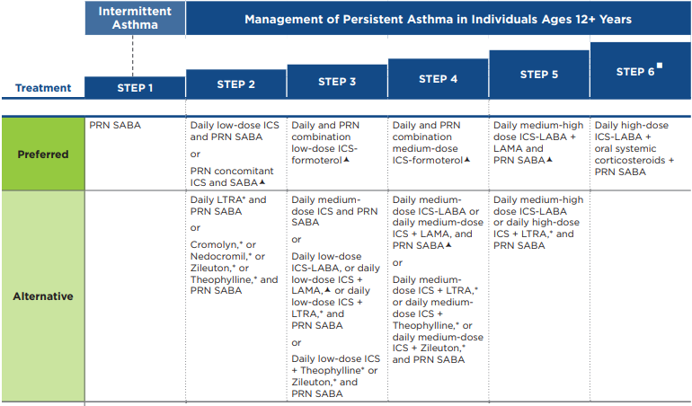
Guideline Highlights Age 12+
Children age 12+ using MART had lower risk of asthma exacerbations compared to those on same or higher-dose ICS + SABA
Prescribe or continue daily ICS at medium dose, or low dose ICS + montelukast if this is keeping the child well-controlled.
Monitor for neuropsychiatric effects if using LTRA (montelukast)
Low-dose ICS-formoterol for maintenance plus symptom relief is an option if flares are difficult to manage
  Sobieraj et al. JAMA 2018: Patients on MART decreased risk of asthma exacerbations compared with those on same-dose ICS controller (relative risk 0.64), and with those on higher-dose ICS controller (relative risk 0.59)
Notes:
https://www.jaci-inpractice.org/article/S2213-2198(23)00052-1/fulltext#secsectitle0095

Slide 10
NAEPP Asthma Guidelines Age 0-4
For age 4+ years, see Table for Ages 5–11 for Steps 3 onward
Can be initiated in primary care setting
Consider consultation
Consult with asthma specialist if Step 3 or higher is required.
See slide 17 for dosing
ICS – Inhaled corticosteroid
SABA – Short-acting beta-agonist
RTI – Respiratory tract infection
LABA – Long-acting beta-agonist
Notes:
Tidy up when to consult

Slide 11
NAEPP Asthma Guidelines Age 5-11
As-needed ICS proposed by GINA, see highlights
Can be initiated in primary care setting
Consider consultation
Consult with asthma specialist if Step 4 or higher is required.
See slide 18 for dosing
ICS – Inhaled corticosteroid
SABA – Short-acting beta-agonist
RTI – Respiratory tract infection
LTRA – leukotriene receptor antagonist
LABA – Long-acting beta-agonist

Slide 12
NAEPP Asthma Guidelines Age 12+
As-needed ICS proposed by GINAsee highlights
As-needed ICS-LABA proposed by GINA, see highlights
Can be initiated in primary care setting
See slide 19 for dosing
Consider consultation
Consult with asthma specialist if Step 4 or higher is required.
ICS – Inhaled corticosteroid
SABA – Short-acting beta-agonist
RTI – Respiratory tract infection
LTRA – Leukotriene receptor antagonist
LABA – Long-acting beta agonist
LAMA – Long-acting muscarinic antagonist

Slide 13
Age 0-4: Dosing chart for asthma medications
Adapted from NAEPP, GINA and UptoDate. Low and medium dose ranges are provided for each treatment step and categorized by type of inhaled medication.
Do NOT use dose ranges in actual prescriptions. Be precise in medication directions.
Consider starting with lowest dosing and titrate to achieve good asthma control (see slides 6-9). You can make dosing changes within or between each step to reach goals.
Stepwise Approach for Management of Asthma (based on 2020 updates)
Step 1 | Step 2 | Step 3 | Notes
SABA: Albuterol 2-4 puffs or 1.25-2.5mg nebulized every 4 to 8 hours PRN Intermittent ICS: Budesonide 1mg nebulized twice daily for 7 days at first sign of URI | Low-dose ICS: HFA (needs spacer) Fluticasone propionate (Flovent ®) 44 mcg/act 2 puffs 1-2 times daily with a spacer-mask Nebulized Budesonide nebulized 0.25mg twice a day or 0.5mg once daily | Low-dose ICS-LABA HFA (needs spacer) Budesonide/formoterol (Symbicort ®) 80/4.5 mcg/act 1 puff 1-2 times daily with a spacer mask Medium dose ICS: HFA (needs spacer) Fluticasone propionate (Flovent ®) 110 mcg/act 1 puff twice daily or 1 puff AM/2 puff PM with a spacer mask Nebulized Budesonide nebulized 0.5mg twice daily or 1mg once daily For age 4+, see step 3 for age 5-11 | 4 puffs of Albuterol mdi is equivalent to 2.5mg nebulized Be aware that GSK will cease manufacture of all brand Flovent products after Dec 2023 Generic fluticasone inhaler will be available without PA for MassHealth patients age <12 only. PA is require for age 12 and older. There are no meter-dose inhaler alternatives approved for age <5. Mometasone is not FDA approved for <5 years. Ciclesonide is not FDA approved for <12 years (although approved for >6 years in Canada and Europe) Dry powder inhalers (DPI) are NOT appropriate for this age group as they require tight seal around mouthpiece, deep and forceful inhalation, and breath hold.
Notes:
Kaiser SV, Huynh T, Bacharier LB, Rosenthal JL, Bakel LA, Parkin PC, Cabana MD. Preventing Exacerbations in Preschoolers With Recurrent Wheeze: A Meta-analysis. Pediatrics. 2016 Jun;137(6):e20154496. doi: 10.1542/peds.2015-4496. PMID: 27230765.
Age 0-4 Low-dose ICS-LABA for maintenance and rescue (MART) is also an option if flares are difficult to manage
Children using MART had less systemic steroid use, hospitalizations, ED visits, increase in ICS, or other medication doses (relative risk 0.6)
Budesonide/Formoterol (Symbicort ®) 80/4.5 mcg/act - Give 1 puff daily

Slide 14
Age 5-11: Dosing chart for asthma medications​
Adapted from NAEPP, GINA and UptoDate. Low and medium dose ranges are provided for each treatment step and categorized by type of inhaled medication. Do NOT use dose ranges in actual prescriptions. Be precise in medication directions.
Consider starting with lowest dosing and titrate to achieve good asthma control (see slides 6-9).
You can make dosing changes within or between each step to reach goals.
Stepwise Approach for Management of Asthma (based on 2020 updates)
Step 1 | Step 2 | Step 3 | Notes
SABA: Albuterol 2-4 puffs or 2.5mg nebulized every 4 to 8 hours PRN Intermittent low-dose ICS (GINA guideline) (Same dosing as step 2 low-dose ICS). Use for 7 days at first sign of URI. | Low dose ICS HFA (needs spacer) Fluticasone propionate (Flovent ®) 44mcg/act 1-2 puffs 2 times daily with a spacer Mometasone furoate (Asmanex ®) 50mcg/act 1 puff inhaled 1-2 times daily, or 100mcg/act 1 puff daily with a spacer Ciclesonide (Alvesco ®) 80mcg/act 1 puff daily with a spacer Nebulized Budesonide nebulized 0.5mg once daily Dry powder inhaler (needs sufficient lips seal/ inspiratory force/ breath hold, usually age 8+) *** Allergy alert Pulmicort ® Flexhaler 90mcg/act 1-2 inhalation twice daily Mometasone furoate (Asmanex ®) Twisthaler 110mcg/act 1 inhalation once daily Fluticasone furoate (Arnuity ® Ellipta) 50mcg/act 1-2 inhalations 1-2 times daily Beclomethasone (Qvar ® Redihaler) 40 mcg/puff 1-2 inhalations twice daily, or 80 mcg/puff 1-2 inhalations daily Fluticasone propionate diskus 100mcg/act 1 inhalation 1-2 times daily | Low-dose ICS-formoterol: HFA (needs spacer) Budesonide/formoterol (Symbicort ®) 80/4.5mcg/act 1 puff once daily, plus 1 puff as needed for rescue with a spacer (max 8 puffs daily) Medium dose ICS: HFA (needs spacer) Fluticasone propionate (Flovent ®) 110 mcg/act 1 puff twice daily or 1 puff AM/ 2 puff PM with a spacer Mometasone furoate (Asmanex ®) 50mcg/act 2-3 puff twice daily, or 100mcg/act 1 puff twice daily with a spacer Ciclesonide (Alvesco ® ) 80mcg/act 1 puff twice daily, or 160mcg/act 1 puff daily with a spacer Nebulized Budesonide nebulized 0.5mg twice daily or 1 mg once daily Dry powder inhaler (needs sufficient lip seal/ inspiratory force/ breath hold, usually age 8+) *** Allergy alert Pulmicort ® Flexhaler 180mcg/act 1-2 inhalations twice daily Mometasone furoate (Asmanex ®) Twisthaler 110mcg/act 1 inhalation twice daily, or 220mcg/act 1 inhalation daily Fluticasone furoate (Arnuity ® Ellipta) 50mcg/act 3-4 inhalations twice daily, 100mcg/act 1 inhalation AM/ 2 inhalations PM or 2 inhalations twice daily Beclomethasone (Qvar ® Redihaler) 40 mcg/puff 2-4 inhalations twice daily, or 80 mcg/puff 1-2 inhalations twice daily Fluticasone propionate diskus 100mcg/act 3 inhalations daily, or 2 inhalations twice a day | 4 puffs of Albuterol mdi is equivalent to 2.5mg nebulized Be aware that GSK will cease manufacture of all brand Flovent products after Dec 2023 Generic fluticasone inhaler may be available without PA for a limited period (MassHealth up to 12yo as of April 10, 2024); Ciclesonide is not FDA approved for <12 years (although approved for >6 years in Canada and Europe) *** Avoid in patients with severe protein allergy: very rare anaphylactic reactions have been reported with DPI formulations, which may include lactose as stabilizing excipient.
Notes:
Kaiser SV, Huynh T, Bacharier LB, Rosenthal JL, Bakel LA, Parkin PC, Cabana MD. Preventing Exacerbations in Preschoolers With Recurrent Wheeze: A Meta-analysis. Pediatrics. 2016 Jun;137(6):e20154496. doi: 10.1542/peds.2015-4496. PMID: 27230765.
Age 0-4 Low-dose ICS-LABA for maintenance and rescue (MART) is also an option if flares are difficult to manage
Children using MART had less systemic steroid use, hospitalizations, ED visits, increase in ICS, or other medication doses (relative risk 0.6)
Budesonide/Formoterol (Symbicort ®) 80/4.5 mcg/act - Give 1 puff daily

Slide 15
Age 12+: Dosing chart for asthma medications​
Adapted from NAEPP, GINA and UptoDate. Low and medium dose ranges are provided for each treatment step and categorized by type of inhaled medication.
Do NOT use dose ranges in actual prescriptions. Be precise in medication directions.
Consider starting with lowest dosing and titrate to achieve good asthma control (see slides 6-9). You can make dosing changes within or between each step to reach goals.
Stepwise Approach for Management of Asthma (based on 2020 updates)
Step 1 | Step 2 | Step 3 | Notes
SABA: 2-4 puffs as needed or 2.5mg nebulized every 4 to 8 hours PRN Intermittent ICS (GINA guideline) (Same dosing as step 2 low-dose ICS). Use for 7 days at first sign of URI. Intermittent ICS-LABA (GINA guideline) Budesonide-formoterol (Symbicort ®) 160/4.5mcg/act 1 puff as needed with a spacer (max 12 puff per day) | Low dose ICS: HFA (needs spacer) Fluticasone propionate (Flovent ®) 44mcg/act 2 puffs 1-2 times daily, or 110mcg/act 1 puff 1-2 times daily with a spacer Mometasone furoate (Asmanex ®) 100mcg/act 1 puff twice daily or 200mcg/act 1 puffs daily with a spacer Ciclesonide (Alvesco ® ) 80mcg/act 1 puff twice daily, or 160mcg/act 1 puff daily with a spacer Dry powder inhaler (needs sufficient lips seal/ inspiratory force/ breath hold) *** Allergy alert Pulmicort® Flexhaler 180mcg/act 1 inhalation 1-2 times daily, or 1 inhalation AM/ 2 inhalations PM Mometasone furoate (Asmanex ®) Twisthaler 110mcg/act 1 inhalation 1-2 times daily Fluticasone furoate (Arnuity ® Ellipta 100mcg/act 1 inhalation daily Beclomethasone (Qvar ® Redihaler) 40 mcg/puff 1-3 inhalations 2 daily, or 80 mcg/puff 1-3 inhalations daily Fluticasone propionate diskus 100mcg/act 1-3 inhalation daily, or 250mcg/act 1 inhalation daily Intermittent ICS-LABA (GINA guideline): HFA (needs spacer) Budesonide-formoterol (Symbicort ®) 160/4.5mcg/act 1 puff as needed with a spacer (max 12 puff per day) | Low-dose ICS-formoterol: HFA (needs spacer) Budesonide/formoterol (Symbicort®) 160/4.5mcg/act 1 puff 1-2 times daily, plus 1 puff as needed for rescue with a spacer (max 12 puffs daily) Medium dose ICS: HFA (needs spacer) Fluticasone propionate (Flovent ®) 110 mcg/act 1 puff AM/ 2 puff PM, or 2 puffs twice daily with a spacer Mometasone furoate (Asmanex®) 100mcg/act 2 puffs twice daily or 200mcg/act 1 puff twice daily with a spacer Ciclesonide (Alvesco ®) 160mcg/act 1 puff twice daily with a spacer Dry powder inhaler (needs sufficient lip seal/ inspiratory force/ breath hold) *** Allergy alert Pulmicort® Flexhaler 180mcg/act 2 inhalations twice daily Mometasone furoate (Asmanex®) Twisthaler 220mcg/act 1 inhalation twice daily Fluticasone furoate (Arnuity ® Ellipta 100mcg/act 1 inhalation twice daily Beclomethasone(Qvar® Redihaler) 80 mcg/puff 2-3 inhalations twice daily Fluticasone propionate diskus 100mcg/act 2 inhalations twice daily, or 250mcg/act 1 inhalation twice daily. | 4 puffs of Albuterol mdi is equivalent to 2.5mg nebulized Be aware that GSK will cease manufacture of all brand Flovent products after Dec 2023 Generic fluticasone inhaler may be available without PA for a limited period (MassHealth up to 12yo as of April 10, 2024) *** Avoid in patients with severe protein allergy: very rare anaphylactic reactions have been reported with DPI formulations, which may include lactose as stabilizing excipient.
Notes:
Kaiser SV, Huynh T, Bacharier LB, Rosenthal JL, Bakel LA, Parkin PC, Cabana MD. Preventing Exacerbations in Preschoolers With Recurrent Wheeze: A Meta-analysis. Pediatrics. 2016 Jun;137(6):e20154496. doi: 10.1542/peds.2015-4496. PMID: 27230765.
Age 0-4 Low-dose ICS-LABA for maintenance and rescue (MART) is also an option if flares are difficult to manage
Children using MART had less systemic steroid use, hospitalizations, ED visits, increase in ICS, or other medication doses (relative risk 0.6)
Budesonide/Formoterol (Symbicort ®) 80/4.5 mcg/act - Give 1 puff daily

Slide 16
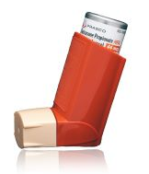
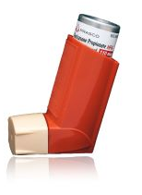

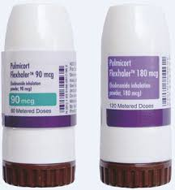
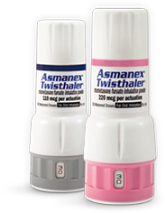
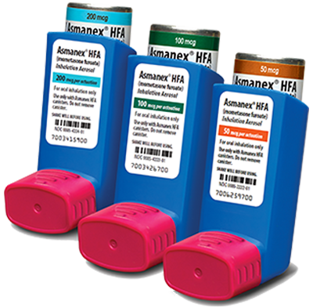
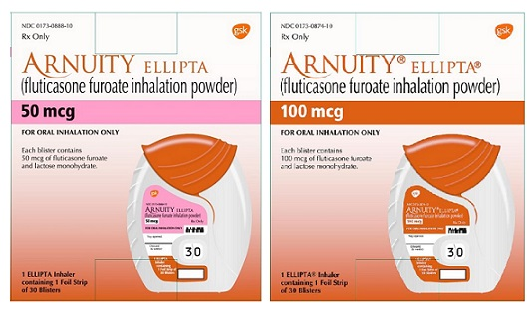
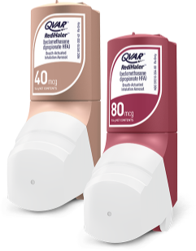
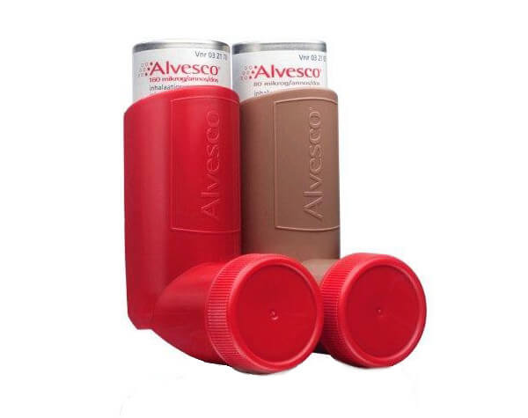
Meter-dose inhaler
Dry powder inhaler
Needs sufficient lip seal/ inspiratory force/ breath hold for 10 seconds
The ability to use this is not necessarily age dependent.
Generic fluticasone propionate (Prasco) 44/ 110/ 220 mcg/act
Asmanex (mometasone) ®
50/ 100/ 200 mcg/act
Pulmicort (Budseonide) ® Flexhaler 90 / 180 mcg/act
Asmanex (mometasone) ® Twisthaler 110 / 220 mcg/act
Breath-actuated HFA , use like DPI
Alvesco (ciclesonide) ®
80 / 160 mcg/act
Arnuity (fluticasone furoate) Ellipta ® 50 / 100/ 200 mcg/act
Qvar (beclomethasone) ® Redihaler
80 / 160 mcg/act
Common inhalers that are now approved

Slide 17
Preliminary Information on Insurance Coverage in 2024 (update April)
MassHealth (incl Tufts and Fallon Medicaid)
  Generic fluticasone will be available for children age <5 without prior authorization
  Effective April 10, 2024, generic fluticasone will be available without PA for patients <12 years. Will need PA for patients >12 years.
  Covered alternatives: Asmanex ® HFA, Asmanex ® Twisthaler 110mcg (age <12) 220mcg (age ≥12), Pulmicort ® Flexhaler, Budesonide neb suspension (age <13), Symbicort
Point32Health (Tufts / Harvard Pilgrim) will cover generic fluticasone for children until March 4, 2024 then will require prior authorization (and failure with at least two less costly alternatives, or unable to use dry powder inhaler due to coordination problems or developmental delay)
  Covered: Asmanex HFA, Arnuity Ellipta ®, Pulmicort ® Flexhaler
  PA required: fluticasone propionate HFA and diskus, Alvesco (ciclesonide), Qvar ® Redihaler, Asmanex Twisthaler 110mcg (<12 yo), 220mcg (>12 yo)
HNE
  Budesonide neb suspension, Pulmicort Flexhaler, Wixela (generic Advair),
BCBS coverage varies widely with plans. Some may cover generic fluticasone without age restriction (also see pharmacy benefits below)
  BCBS HMO: Breo Ellipta only
  BCBS PPO: Asmanex HFA or Twisthaler, Arnuity, Qvar
Wellsense
  Arnuity, Pulmicort Flexhaler, Asmanex, Fluticasone/salmeterol, Symbicort (brand), Dulera
United Healthcare
  Qvar ® Redihaler and Arnuity Ellipta ®
Cigna
  Alvesco, Asmanex ® HFA, Asmanex ® Twisthaler
Pharmacy Benefits (mail order) associated with certain insurance plans
Optum RX (BCBS MA HMO, Harvard Pilgrim)
  Arnuity Ellipta ® and Qvar ® Redihaler
Express Scripts (United Healthcare)
  Arnuity Ellipta ®, Asmanex HFA ®, Asmanex Twisthaler ®, Qvar Redihaler ®
Asmanex has been difficult to find but it is not listed as on backorder by manufacturer. Therefore some insurance plans are refusing to cover other options HFA like generic fluticasone even though patients cannot access medication.
Prior Authorizations need a reason
patient's inability to perform strong inhalation and breath hold necessary for DPI due to young age or developmental delay
treatment failure on insurance 'preferred'
medications

Slide 18
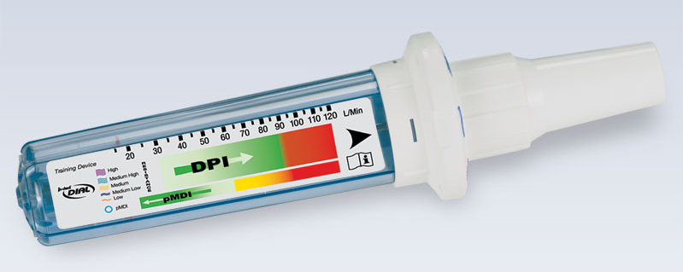
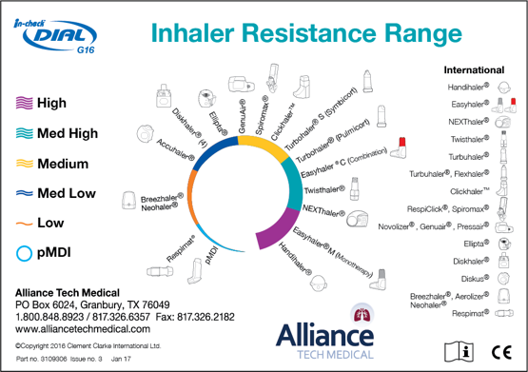
In-Check Dial G-16
(Alliance Tech Medical)
Use an inspiratory flow meter to assess whether a child can use a dry powder inhaler (DPI) correctly
The dial can be adjusted to simulate the resistance of dry powder inhalers (including Flexhaler®, Twisthaler®, Diskus®, Ellipta® etc).

Slide 19
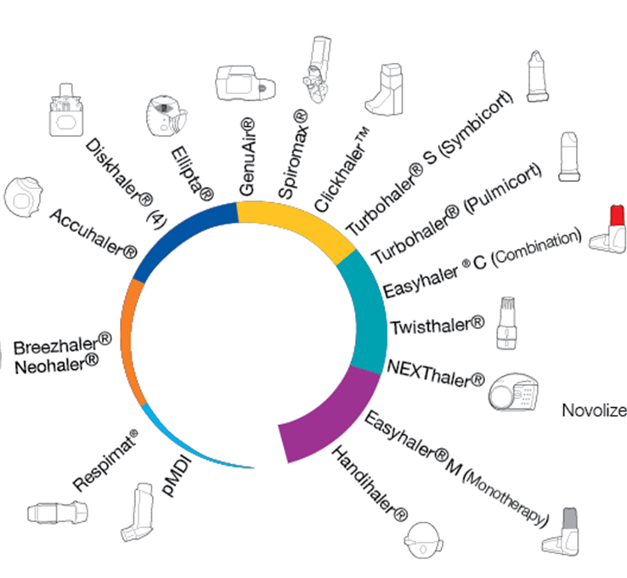
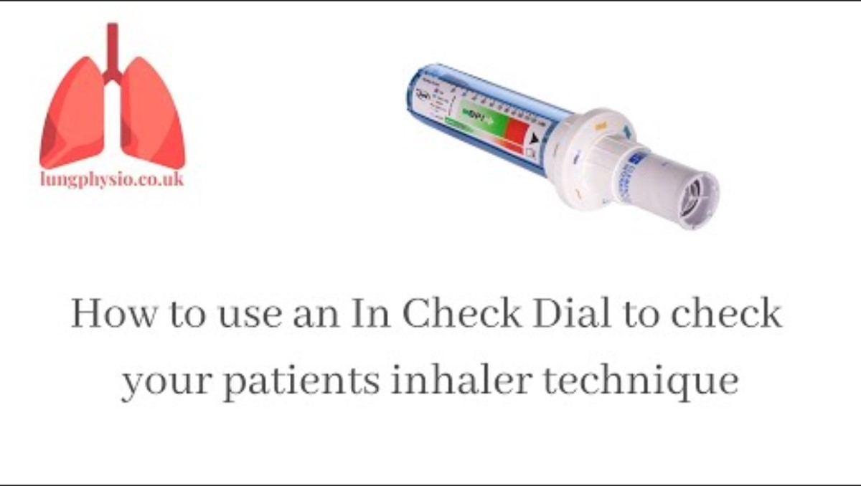
In-Check Dial G-16
e.g. Arnuity or Breo
e.g. Qvar
e.g. Advair or Wixela diskus
e.g. Asmanex
See product website or YouTube for instructional videos.
In-Check dial flow meter - $110.18 per unit
One-way valve inspiratory mouthpiece (disposable) - $132.50 per 200 pieces
Bacterial filtered mouthpiece (disposable, optional) - $132.50 per 100 pieces
Pediatric/small mouth adaptor (disposable) - $38.58 per 100 pieces
In-Check dial kit (dial, filters, mouthpiece) - $219.38

Slide 20
Breath-actuated inhaler demo
Patients and parents need help understanding how to use these
Asthma in Children | QVAR RediHaler® (beclomethasone dipropionate HFA)
How to use a Pulmicort Flexhaler | Boston Children's Hospital – YouTube
Wixela Inhub® (fluticasone propionate and salmeterol inhalation powder, USP) official site.

Slide 21
[Not guideline based]
Adding ipratropium to sick/yellow zone plans
With standard SABA/albuterol use
With single maintenance and reliever therapy (MART)
When child is receiving albuterol every 4 to 6 hours, add ipratropium to every other treatment. This augments bronchodilator therapy.
Example of patient instructions
Since patients are no longer supposed to use albuterol, they may feel greater reassurance with ipratropium for added bronchodilator therapy
Example of patient instructions
Early/mild illness: Start giving Ipratropium/ Albuterol (pre-mixed solution is called Duo-Neb) twice a day with inhaled steroid​
Peak illness: Alternate every 4 to 6 hours around the clock - Ipratropium/Albuterol (pre-mixed solution is called Duo-Neb) with Albuterol alone (2-4 puffs or 1 nebulizer treatment)
For example (every FOUR hours):
8am - give Duoneb in nebulizer machine;
12pm - give Albuterol (2-4 puffs from inhaler or 1 nebulizer treatment)
4pm - give Duo-neb in nebulizer machine
8pm - give Albuterol (2-4 puffs inhaler or 1 nebulizer treatment)
12am - give Duo-neb in nebulizer machine
4am - give Albuterol (2-4 puffs inhaler or 1 nebulizer treatment)
Everyday/maintenance: Take Symbicort 80/4.5 2 puff through spacer once a day
Sick plan:
(a) Take Symbicort 80/4.5 1-2 puff through spacer every 4 hours as needed after usual morning dose
age <12: max 8 puffs per day, age 12+ max 12 puffs per day)
(b) Take Ipratropium 0.5mg nebulized 3 times a day as needed
For example (every FOUR hours)
8am - Symbicort 1-2 puff through spacer [usual dose] ± ipratropium
12pm - Symbicort 1-2 puff through spacer
4pm - Symbicort 1-2 puff through spacer ± ipratropium
8pm - Symbicort 1-2 puff through spacer
12am - Symbicort 1-2 puff through spacer ± ipratropium
4am - Symbicort 1-2 puff through spacer
Writing out a neb schedule for parents is helpful. A useful analogy to help caregivers understand this plan is alternating Motrin and Tylenol for fevers. ​Duo-nebs are occasionally on backorder; ipratropium can be ordered separately and mixed with albuterol.​

Slide 22

[Not guideline based]
Consider the nose
Sometimes persistent cough is compounded by upper airway congestion and post-nasal drip
Ask about symptoms such as nasal discharge, congestion, mouth-breathing and snoring
Make sure allergies are treated
For copious clear rhinorrhea, consider nasal ipratropium (0.06% 2 sprays 2-3 times daily as needed with colds)
For young children, use nasal saline mist or sprays with nasal aspirator (e.g. Nose Frida)
Keep humidity 40-50% for breathing comfort

Slide 23

Common findings with Pulmonary referrals
Primary care or home caregivers are reluctant to label a child with asthma diagnosis, despite multiple flares responding to typical treatment, and other atopic risk factors.
Patients are sometimes not offered step 2-3 therapy, even though asthma is uncontrolled.
There is no adult supervision for inhaler use.
Metered-dose inhaler is prescribed with no spacer, or spacer is provided without mask a for young children (mask interface must be specified in prescription heading)
Caregivers are not given any spacer instructions, or believe that children can "outgrow" their use.
Caregivers identify inhalers by color instead of name, and misidentifies their use (e.g. patient has both Ventolin and Proair inhalers and believes one is for maintenance and the other for rescue).
Caregivers do not understand to refill their daily maintenance medications once a month.
Caregivers are reluctant to use standing doses of Albuterol, or start rescue therapy too late.
Patients cannot access inhalers because of "insurance issues" (e.g. certain insurances require brand-inhaler plus DAW when placing order).

Slide 24

Practical tips for education
Use goal-directed language to explain therapy.
Label inhalers with stickers to help caregivers differentiate between maintenance vs rescue
Every child is different – some are more tolerant of nebulized treatments while others do better with inhaler delivery.
  Children with sensory and behavioral difficulties are especially challenging to treat.
  Discuss distraction techniques and how to normalize therapy with play.
  Some younger children need access to both nebulized and inhaler therapies, to be used interchangeably.
Ask about out of pocket costs and travel barriers to get refills.
Ask about school and work schedules and adjust medication schedule accordingly.
  Many caregivers struggle to give medications when preparing their families for school/work in the morning
  Many caregivers work hours that prevent them from supervising their child's inhaler use
When Albuterol is labeled as an "emergency" medication, some caregivers/ patients will only use it with significant distress, or they are hesitant to use it on a scheduled basis when sick. Educate your patient/caregiver on safe use.
When a patient is already experiencing a mild asthma flare – exposure to intense exertion, extreme temperatures or indoor pollution (smoking, cooking fumes) can further exacerbate symptoms. Educate your patient/caregiver on ways to avoid relapse.

Slide 25






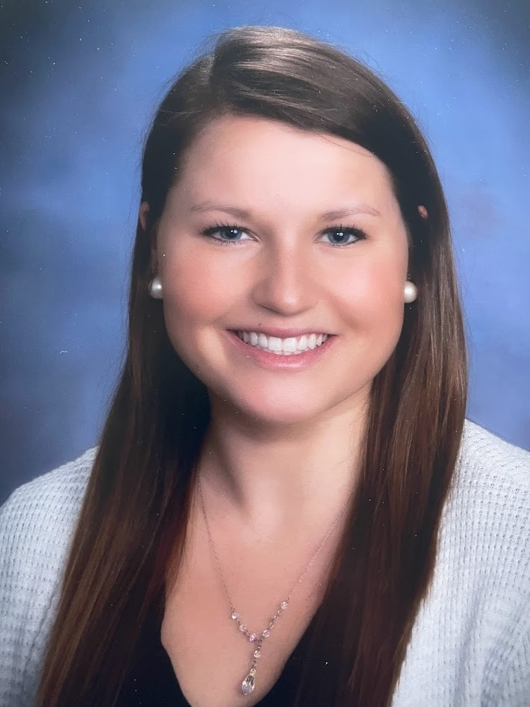
UMass Pediatric Pulmonary Medicine
774-441-8086
Terence R. Flotte, MD
Celia and Isaac Haidak Professor
Dean, School of Medicine
Lawrence Rhein, MD MPH
Associate Professor
Chair, Department of Pediatrics
Ted Kremer, MD
Associate Professor of Pediatrics
Chief, Division of Pediatric Pulmonary Medicine
Michelle Trivedi, MD
Associate Professor
Pediatric Pulmonology
Fei Jamie Dy, MD
Assistant Professor
Pediatric Pulmonology
LEAVING JUNE 2024
Emily Young, PNP
Pediatric Pulmonology and Sleep
Stephanie Storro, RN, BSN, AE-C
Pediatric Pulmonology
New providers expected (summer 2024)
Dr Kristen Richard (full-time)
Dr Catherine Naber (part-time)

