Slide 1
Adult Community Clinical Services (ACCS)
Coaching: A Strengths-Based Approach

Slide 2

Presenter
Colleen McKay, MA, CAGS
UMass Chan Medical School
Implementation Science and Practice Advances Research Center (iSPARC)
Assistant Professor

Slide 3
Today’s Webinar
Information needed to implement effective coaching strategies to better support persons with lived experience
What coaching is (and is not) and its benefits
Established coaching models and frameworks relevant to mental health service providers
Strategies for integrating coaching into their organization to address issues and foster growth
Integrating the GROW Coaching Framework in Adult Community Clinical Services (ACCS) Settings
Explore using tools and methods to measure the success and impact of coaching such as Goal Attainment Scaling (GAS)

Slide 4

“Partnering with clients in a thought-provoking and creative process that inspires them to maximize their personal and professional potential” (The International Coaching Federation, 2020).
High-performing individuals obtain support to perform even better (International City/County Management Organization [ICMA], 2024).
A process for helping staff as they hone their skills for working with persons served (ACCS Provider Survey)
Process of helping staff implement a new program or practice through regular feedback and support (Fixsen & Blaise)
Defining Coaching

Slide 5
Main Principles of Learning and Coaching
Adults need to know.
Adults are self-directed.
Adults have a wealth of prior experience.
Adults learn when they have a need to learn.
Adults are relevancy-oriented.
Adults are internally motivated.
(Cox, Bachkirova, & Clutterbuck, 2018; Cox 2006)

Slide 6
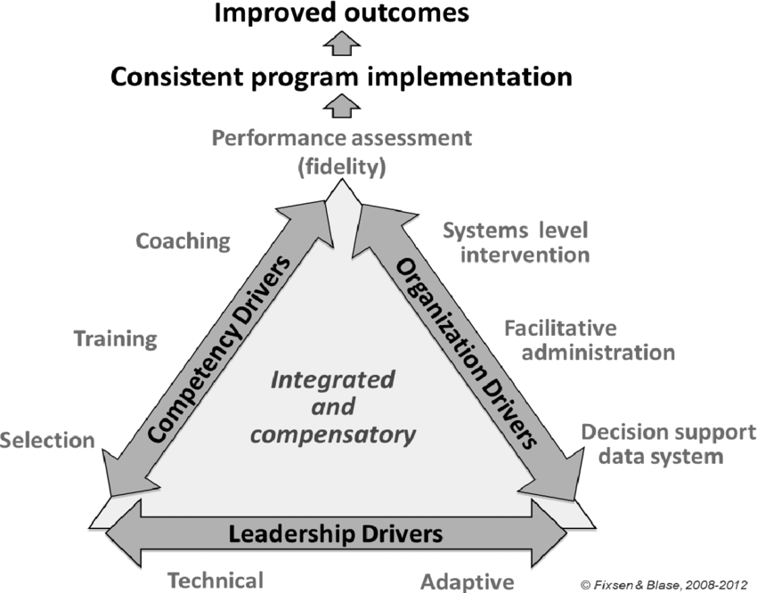
Why Consider Coaching?
Coaching May Have Numerous Benefits
Active Implementation Frameworks™
Helping staff become less overwhelmed by workloads
Developing strategies to deal with frustrations
Quantifying measures of success that may lead to an improved work environment
Increases in motivation and morale
Developing skills that may promote career advancement (ICMA, 2024)
Ensuring evidence-based practices are delivered as intended (Fixsen et al., 2018)

Slide 7
Why Coaching?
Effective way to improve performance to achieve positive outcomes.
    Goals that are defined and understood.
    Alignment of expectations between the team leader and team members.
    Transfer of knowledge on a “just-in-time” basis (training at the point of need, rather than “just in case”).
    A more adaptive and reactive team.
    Early identification of unforeseen barriers to performance.
    Commitment to continual learning and improvement.
    Movement to superior team performance.
    (Agency for Healthcare Research and Quality, 2023)
    Resources: tsonlinemodule9.pptx (live.com)
    The Four Pillars Of Effective Team Leadership Coaching: The L.I.A.M. Framework (forbes.com)

Slide 8
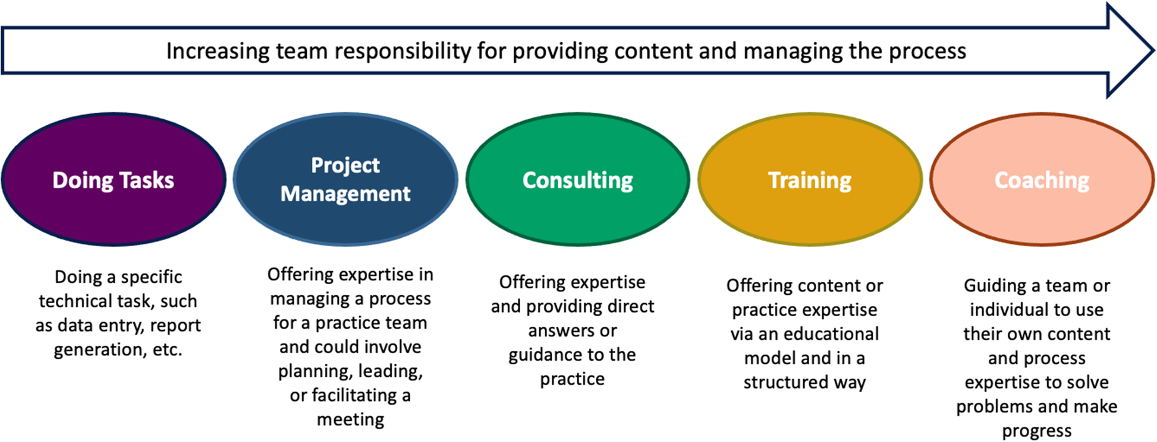
What Coaching is NOT
Training
Teaching
Consulting
Managing
Intended to “fix”
someone
Discipline (ICMA, 2024)
(Walunis et al., 2021)

Slide 9

How Supervision Differs from Coaching
Directs subordinates' work schedules and daily activities
Sets performance expectations, rates performance
Focus is on meeting agency expectations, following agency procedures (Flesher, 2020)

Slide 10

Coach Characteristics
Experienced with the specific coachable skill
Committed to continuous learning & improvement
Available
Accessible
Skilled at building rapport
Assertive yet not "pushy'
(Gunderson et al., 2018)

Slide 11
Assessing Coaching
There is someone accountable for the coaching of staff who will carry out the program or practice
Coaching is provided to improve the competency of staff who carry out the program or practice
Agency staff uses a coaching service delivery plan
Agency staff regularly assess coaching effectiveness

Slide 12

Poll
Do you engage in:
1. Coaching
2. Supervision
3. Combination of both

Slide 13
Coaching Environment
Face-to-Face
Virtual
Hybrid
Monthly
Weekly
Quarterly
Individual
Group-Based
*Based on Individual Needs
Increased frequency of sessions and number of coaching hours are not linked to greater outcomes (Cannon-Bowers et al., 2023).

Slide 14
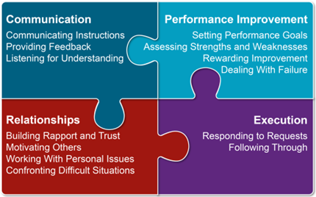
Coaching Competencies
The Association for Talent Development identified 13 competencies coaches should exhibit.
These competencies can be organized into four clusters.
(Agency for Healthcare Research and Quality, 2023)
Resource: Implementation Coaching. Content last reviewed June 2023. Agency for Healthcare Research and Quality, Rockville, MD.
https://www.ahrq.gov/teamstepps-program/curriculum/implement/activity/coach.html

Slide 15
Coaching as a Strengths-Based Approach
Focused psychological approach aimed at facilitating goal achievement, well-being, and positive changes
Focusing on personal strengths leads to positive:
Individual Outcomes
Organizational Outcomes
talent retention
employee engagement
customer satisfaction
financial benefits
improved performance
self-efficacy
life satisfaction
self-confidence
(Madden et al., 2011; Peláez et al., 2020)

Slide 16
Personal Strengths
For those that may need assistance with determining their own personal strengths
StrengthsFinder
Strengthscope
Values in Action Inventory of Strengths (VIA-IS)
Personality Tests (i.e., Meyers-Briggs)
(Burke & Passmore, 2019; The Meyers-Briggs Company, 2024; VIA Institute on Character, 2024)

Slide 17
Key traits of a good workplace coach
Understands mental health, ethics, and challenges professionals face
Helps providers manage stress and prevent burnout
Nurtures professional growth and reminds providers to prioritize self-care
Prepares professionals with strategies for tough situations
Offers fresh perspectives and alternative approaches for challenging cases
Ensures ethical standards are upheld
Promotes teamwork, sharing knowledge and support

Slide 18

Categories and Components of Active Implementation Drivers
Competency Drivers to develop, improve & sustain one’s ability to use an intervention as intended
Organization Drivers to create and sustain hospitable organizational and system environments for full & effective use of intended services
Leadership Drivers to provide the right leadership strategies for the types of leadership challenges (e.g., decision making, providing guidance, & supporting organization functioning).
Active Implementation Frameworks™

Slide 19
Coaching Models and Frameworks
Active Implementation Frameworks™
ACHIEVE
FUEL
GROW
  CIGAR
  CLEAR
  GENIUS
OSKAR
POSITIVE
PRACTICE
SOLVE
STEPPA
The 5 C’s

Slide 20
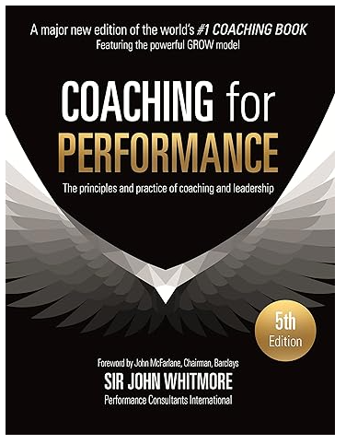
The GROW Coaching Framework
Developed in England in the mid 1980s
Mostly used in corporate coaching with executives and leaders
First published in 1992 in Coaching for Performance

Slide 21
GROW: Goal, Reality, Options, & Way Forward (or Will)
Goals*
What do you want to achieve?
Reality
What is happening? What is getting in the way of the goal?
Options
What are some things that can be done to work towards goal?
Way Forward or Will Do
What actions will be taken to move forward?

Slide 22
GROW: Goal, Reality, Options, & Way Forward (or Will) (continued)
Pros | Cons
Can be used in a variety of settings (one-on-one coaching, group coaching, or business meetings) | Coach may not be aware of full reality
Focuses on setting goals (SMART Goals) | Action can be over-emphasized - may not place enough emphasis on exploring awareness and understanding
Structured | Coach guides the conversation
Task oriented | Some coaches will not have or be interested in the will to get things done & prefer to maintain the current situation.
Resources:
https://www.youtube.com/watch?v=f2M1GuhilR0
https://www.youtube.com/watch?v=7JM1gXkzrnk
https://www.youtube.com/watch?v=_zVUltSayok

Slide 23
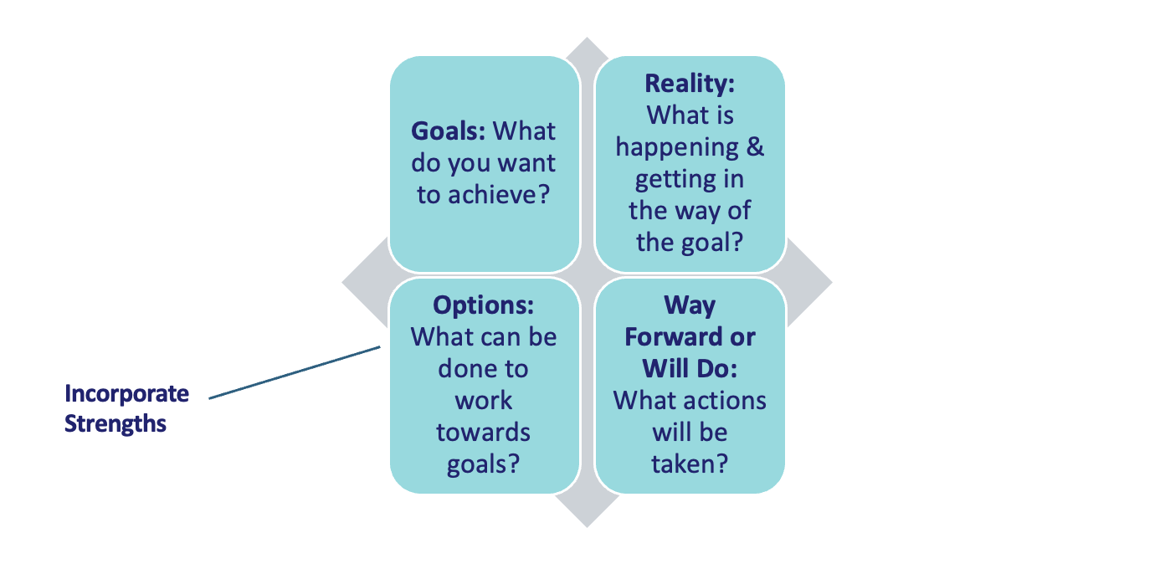
Grow Coaching Framework
A coaching framework is a structured process designed to guide coaching processes and ensure efficiency and consistency when coaching individuals (Co-Active Training Institute, 2022).
(Adapted from Wong, 2006)

Slide 24
S.M.A.R.T. Goal
Format
Specific
Measurable
Attainable
Relevant
Time-bound

Slide 25
Example Utilization of the GROW Coaching Framework in ACCS Settings
Case 1
John, an ACCS housing coordinator, is struggling to assist persons served with determining their barriers to housing to develop appropriate planning. John is quiet, prefers written versus oral communication, and would like to develop his ability to successfully engage in motivational interviewing with clients. John’s supervisor, Tom, recommended that he participate in coaching sessions with an experienced housing coordinator, Jim. John recognizes that he has many strengths, such as self-regulation of his emotions, the ability to understand the perspectives of others, and he is always curious about ways that he can best meet the needs of everyone he works with.

Slide 26
1.Example of Utilization of the GROW Coaching Framework in ACCS Settings
Goal(s) (using S.M.A.R.T. format): I will apply motivational interviewing skills during interactions with at least 50% of persons served within one month. | 2. Reality:
3. Options (Include Strengths & How They Might Influence Success): | 4. Way Forward/Will Do:

Slide 27
2. Example of Utilization of the GROW Coaching Framework in ACCS Settings
Goal(s) (using S.M.A.R.T. format): I will apply motivational interviewing skills during interactions with at least 50% of persons served within one month. | 2. Reality: John typically meets with persons served in a group-based setting, reducing the amount of time he speaks. As a result, he infrequently asks open-ended questions, often relying on others to set the pace for meetings.
3. Options (Include Strengths & How They Might Influence Success): | 4. Way Forward/Will Do:

Slide 28
3. Example Utilization of GROW in ACCS Settings
Goal(s) (using S.M.A.R.T. format): I will apply motivational interviewing skills during interactions with at least 50% of persons served within one month. | 2. Reality: John typically meets with persons served in a group-based setting, reducing the amount of time he speaks. As a result, he infrequently asks open-ended questions, often relying on others to set the pace for meetings.
3. Options (Include Strengths & How They Might Influence Success): John recognizes that his ability to self-regulate his emotions facilitates his calmness during stressful discussions. He can understand how others feel by easily re-stating what persons served mentioned during housing conversations and demonstrating a level of empathy and understanding. His curiosity helps him ask questions that others might not even consider. John feels that he must improve his ability to verbally ask questions by focusing on these strengths. | 4. Way Forward/Will Do:

Slide 29
4. Example Utilization of GROW in ACCS Settings
Goal(s) (using S.M.A.R.T. format): I will apply motivational interviewing skills during interactions with at least 50% of persons served within one month. | 2. Reality: John typically meets with persons served in a group-based setting, reducing the amount of time he speaks. As a result, he infrequently asks open-ended questions, often relying on others to set the pace for meetings.
3. Options (Include Strengths & How They Might Influence Success): John recognizes that his ability to self-regulate his emotions facilitates his calmness during stressful discussions. He can understand how others feel by easily re-stating what persons served mentioned during housing conversations and demonstrating a level of empathy and understanding. His curiosity helps him ask questions that others might not even consider. John feels that he must improve his ability to verbally ask questions by focusing on these strengths. | 4. Way Forward/Will Do: John has decided that, with the assistance of his coach, he will lead meetings/questioning regarding barriers to housing for persons served to practice elicitation of open-ended questions and establish better communication practices as part of motivational interviewing.

Slide 30
Let’s Practice
Notes:
Will have all handouts ahead of time

Slide 31
Case 2
As an ACCS licensed practitioner of the healing arts (LPHA), Mary is prescriptive and rigid in developing goals in treatment plans, not giving persons served the opportunity to explore their individual needs. Mary realizes that she may need a better understanding of how to engage in person-centered planning. Mary has always looked up to the way her co-worker, Jean, a registered nurse, engages persons served in person-centered planning regarding medication usage and administration. Mary asked Jean if she would coach her on improving her ability to engage with persons served in the person-centered planning process. Mary acknowledges that she has many personal strengths such as honesty, a sense of responsibility, and focus.
Use previously provided Form A: Coaching Model to guide your discussion

Slide 32
Results via practice
Goals (using S.M.A.R.T. format):Practice asking questions about interests and values from co-workers 3 questions per day by July 1st. | 2. Reality: Mary cares about her job but she is not as effective with persons served as she would like and she is willing to be more effective
3. Options (Include Strengths & How They Might Influence Success): Mary works well with a prescriptive style, focused, driven. | 4. Way Forward/Will Do: Coach would model to validate strengths, and offer feedback Coach would explain process to Mary

Slide 33
Goal Attainment Scaling
Goal Attainment Scaling (GAS) documents goals and scores the extent to which they are attained.
A person-centered and collaborative approach
Promotes involvement of persons served
Goals are unique to the individual and their situation
Goals are set using the S.M.A.R.T. criteria (specific, measurable, achievable, relevant and timebound)
Allows you to calculate the extent of whether goals are being met

Slide 34
Goal Attainment Scaling (GAS)
A flexible method that is goal focused that provides a structured way to measure whether specific, individualized goals are achieved
    - Allows for qualitative and quantitative assessment to evaluate progress & outcomes.
Define Goals: Collaboratively set clear, specific, and measurable goals that are tailored to one’s unique needs and circumstances.
Use a Scale that outlines possible outcomes for each goal
Track Progress: Periodically assess based on progress towards the goals
Evaluate Results to determine final position on the scale to quantify success &/or identify areas needing further work/growth

Slide 35

Coaching Measures via Goal Attainment Scaling
The Goal Attainment Scaling approach requires the delineation of specific skill-development goals for the individual (Kiresuk & Sherman, 1968).
Skill-development goal setting works best when the staff person sets goals collaboratively with a coach to ensure goals are meaningful, valid, and S.M.A.R.T.
Each area of skill development is measured on a 5-point scale to operationalize progress.
Progress can be measured monthly, every 6 weeks, quarterly, or at a specific timeframe agreed upon by the individual and their coach.
Note: This coaching process, including goal attainment scaling, is designed to be confidential and not shared with others outside of this one-on-one or group coaching environment.

Slide 36
Coaching Measures via Goal Attainment Scaling – Level 2
Level | Descriptor | Impact
5 | Much higher/much more than anticipated outcome | Strong Impact
4 | Higher/somewhat more than anticipated outcome | Moderate impact
3 | Projected level of performance | Mild impact
2 | Somewhat less than anticipated outcome | Baseline
1 | Much less that than anticipated outcome | No impact
Individuals should be provided with a blank coaching measure document so that they, along with their coach, can input their specific goals, utilizing the S.M.A.R.T. goal format.
Typically, 3-4 goals are selected.

Slide 37
Coaching Measures via Goal Attainment Scaling
Statement: I want to improve my ability to apply trauma-informed care when working with persons served.
Level | Descriptor | S.M.A.R.T. Goal Format | Impact
5 | Much more than anticipated outcome |  | High Impact
4 | Somewhat more than anticipated outcome |  | Moderate Impact
3 | Projected level of performance |  | Mild Impact
2 | Somewhat less than anticipated outcome |  | Baseline
1 | Much less than anticipated outcome |  | No Progress

Slide 38
Coaching Measures via Goal Attainment Scaling – S.M.A.R.T. Goal Format
Statement: I want to improve my ability to apply trauma-informed care when working with persons served.
Level | Descriptor | S.M.A.R.T. Goal Format | Impact
5 | Much more than anticipated outcome |  | High Impact
4 | Somewhat more than anticipated outcome |  | Moderate Impact
3 | Projected level of performance |  | Mild Impact
2 | Somewhat less than anticipated outcome | I am not demonstrating the ability to promote a sense of safety and trustworthiness by being respectful, honest, clear, and responsive to persons served and I am using these skills less than 50% of the time as evidenced by my supervisor. | Baseline
1 | Much less than anticipated outcome |  | No Progress
Scores for each goal may stand alone (level) as seen here or they may be grouped to determine an overall score. Using this example, we are showing that we always start with where the individual is at their described baseline.

Slide 39
Coaching Measures via Goal Attainment Scaling - Baseline
Level | Descriptor | S.M.A.R.T. Goal Format | Impact
5 | Much more than anticipated outcome | I will/currently promote a sense of safety and trustworthiness by being respectful, honest, clear, and responsive to persons served and I use these skills 90-95% of the time as evidenced by my supervisor. | High Impact
4 | Somewhat more than anticipated outcome | I will/currently promote a sense of safety and trustworthiness by being respectful, honest, clear, and responsive to persons served and I use these skills 70-89% of the time as evidenced by my supervisor. | Moderate Impact
3 | Projected level of performance | I will/currently promote a sense of safety and trustworthiness by being respectful, honest, clear, and responsive to persons served and I use these skills at least 50% of the time as evidenced by my supervisor. | Mild Impact
2 | Somewhat less than anticipated outcome | I am not demonstrating the ability to promote a sense of safety and trustworthiness by being respectful, honest, clear, and responsive to persons served and I am using these skills less than 50% of the time as evidenced by my supervisor. | Baseline
1 | Much less than anticipated outcome | I am not willing/not able to promote a sense of safety and trustworthiness by being respectful, honest, clear, and responsive to persons served as evidenced by my supervisor. | No Progress
Statement: I want to improve my ability to apply trauma-informed care when working with persons served.
Notes:
Once each goal is determined, the coach should ask the individual to describe their current level of performance. This is then written in the corresponding box (typically at baseline), individualized to where the person categorizes themself. An exception to this would be if there is no worse outcome than their current status.
An important feature of goal attainment scaling is its “a priori” establishment of criteria for a “successful outcome.” Criteria are agreed upon by both the individual and the coach so that everyone has a realistic expectation of what is likely to be achieved. For example, considering an individual’s current baseline level of performance (2), S.M.A.R.T. goals should be written at each level to determine what would reflect both improvements (i.e., “3” or “4”) and lack of progress/regression (“1”).

Slide 40
Coaching Measures via Goal Attainment Scaling – Baseline continued
Statement: I want to improve my ability to apply trauma-informed care when working with persons served.
Once each goal is determined, the coach should ask the individual to describe their current level of performance. This is then written in the corresponding box (typically at baseline), individualized to where the person categorizes themself. An exception to this would be if there is no worse outcome than their current status.
An important feature of goal attainment scaling is its “a priori” establishment of criteria for a “successful outcome.” Criteria are agreed upon by both the individual and the coach so that everyone has a realistic expectation of what is likely to be achieved. For example, considering an individual’s current baseline level of performance (2), S.M.A.R.T. goals should be written at each level to determine what would reflect both improvements (i.e., “3” or “4”) and lack of progress/regression (“1”).

Slide 41
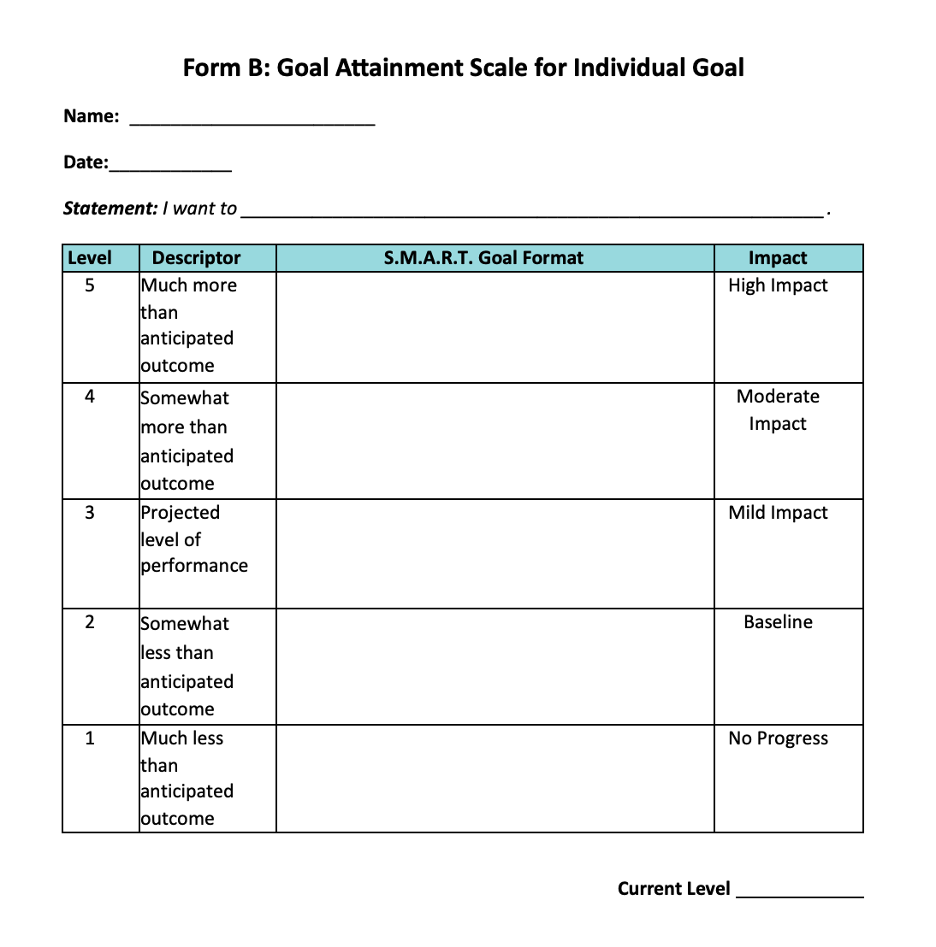
Form for Individual Goal
For multiple goals, you can take the average of all scores when meeting to discuss progress or lack thereof.

Slide 42
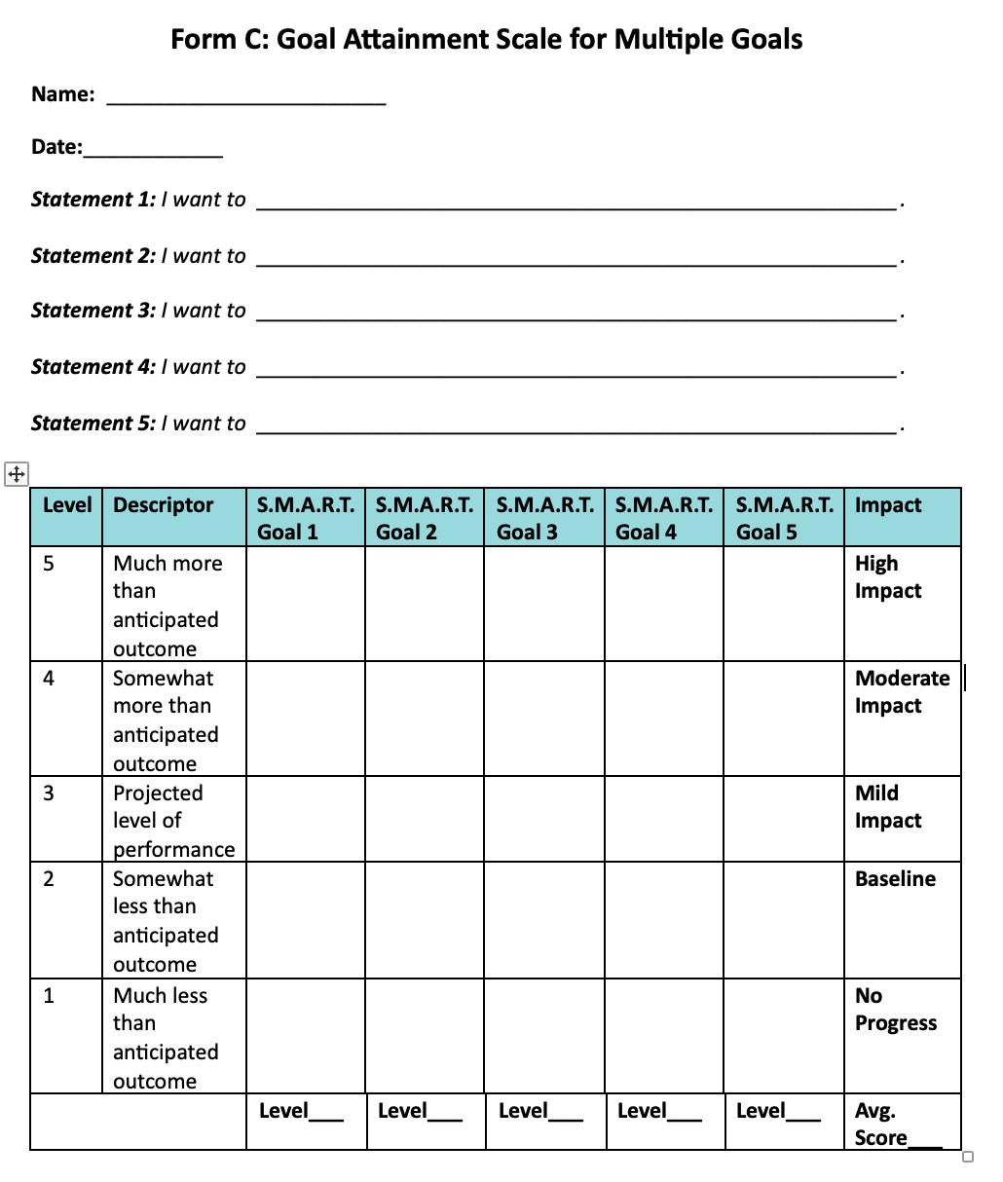
Form for Multiple Goals

Slide 43
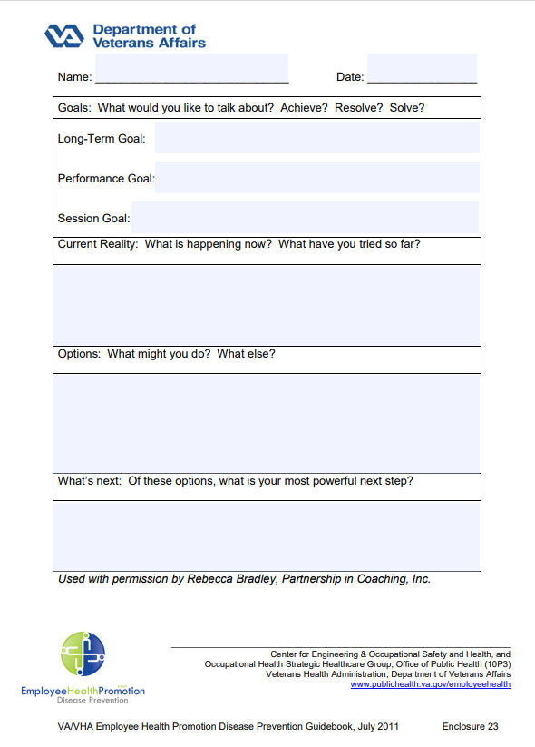
Resources
Veteran’s Affairs GROW Model Template:
https://www.publichealth.va.gov/docs/employeehealth/23-GROW-Template.pdf
Coaching Others for Front-Line Managers Course - Online Video Lessons | Study.com​
Overcoming Barriers to Organizational Change | Examples & Methods - Lesson | Study.com

Slide 44
Resources and Evidence for Coaching
Coaching. An International Journal of Theory, Research, and Practice
Gil Bozer & Rebecca J. Jones (2018) Understanding the factors that determine workplace coaching effectiveness: a systematic literature review, European Journal of Work and Organizational Psychology, 27:3, 342-361, DOI: 10.1080/1359432X.2018.1446946
Walker, J. S., & Baird, C. (2019). Using “remote” training and coaching to increase providers' skills for working effectively with older youth and young adults with serious mental health conditions. Children and Youth Services Review, 100, 119-128. DOI: https://doi.org/10.1016/j.childyouth.2019.02.040
Kretlow, A. G., & Bartholomew, C. C. (2010). Using Coaching to Improve the Fidelity of Evidence-Based Practices: A Review of Studies. Teacher Education and Special Education, 33(4), 279-299. https://doi.org/10.1177/0888406410371643
Snyder, P. A., Hemmeter, M. L., & Fox, L. (2015). Supporting Implementation of Evidence-Based Practices Through Practice-Based Coaching. Topics in Early Childhood Special Education, 35(3), 133-143. https://doi.org/10.1177/0271121415594925 Greif, S., Möller, H., Scholl, W., Passmore, J., & Müller, F. (Eds.). (2022). International handbook of evidence-based coaching: theory, research and practice. Springer Nature.
Schultz, B.K., Arora, P. & Mautone, J.A. Consultation and Coaching to Increase the Uptake of Evidence-Based Practices: Introduction to the Special Issue. School Mental Health 7, 1–5 (2015). https://doi.org/10.1007/s12310-015-9142-3
Coaching Others for Front-Line Managers Course - Online Video Lessons | Study.com (Need to join to see full resource)
Overcoming Barriers to Organizational Change | Examples & Methods - Lesson | Study.com (Need to join to see full resource)
Leadership Skills Questionnaire: 24173_P81_82.pdf (sagepub.com)

Slide 45
For more information contact the Technical Assistance team at sparc@umassmed.edu or visit us to request technical assistance at https://www.umassmed.edu/sparc/sparc-ta
A copy of Adult Community Clinical Services (ACCS)Coaching: A Strengths-Based Approach can be found at https://www.umassmed.edu/sparc/sparc-ta/
Questions?
For More Information

Slide 46
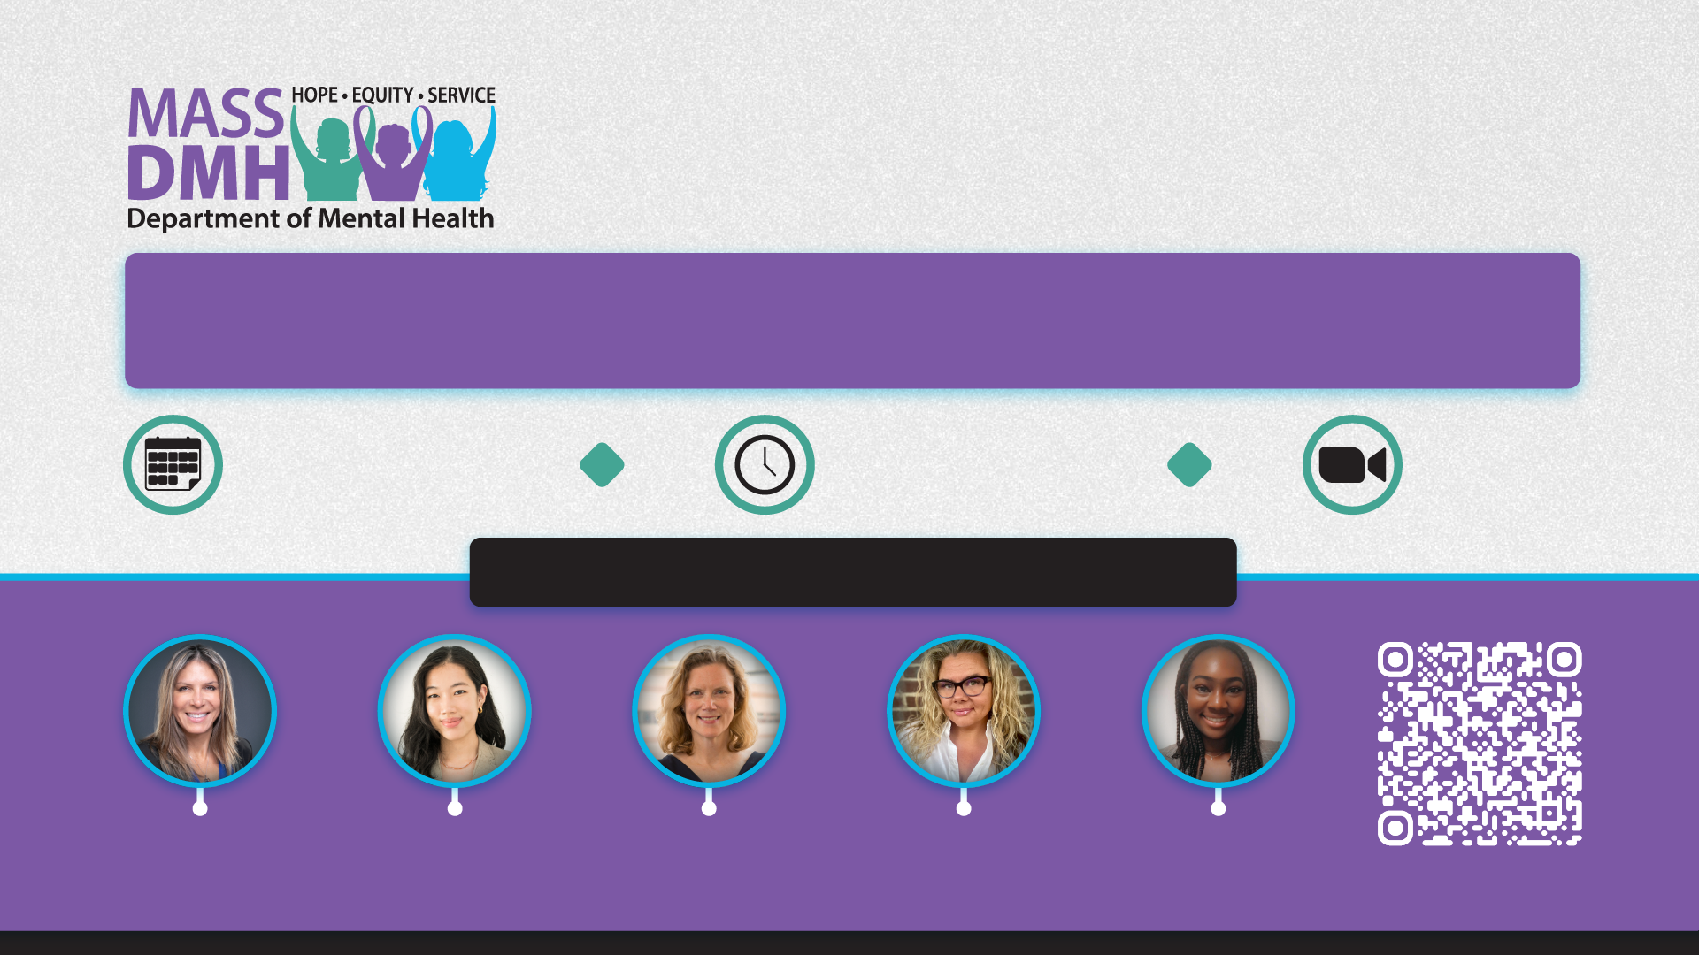
Research Centers of Excellence Conference
2025 ANNUAL
Promoting Youth Mental and Behavioral Health
Understanding and Addressing Risk and Protective Factors to Improve Youth Well-Being and Outcomes
Thursday
May 29, 2025
12:30 –
4:30 PM EDT
Zoom
Meeting
Featured Speakers & Registration
Gina
Vincent, PhD
UMass Chan
Medical School
Cheryl Y.S.
Foo, PhD
Mass General Brigham &
Harvard Medical School
Daphne
Holt, MD, PhD
Mass General Brigham &
Harvard Medical School
Michelle
Mullen, PhD
UMass Chan
Medical School
Vanessa
Iroegbulem, BA
Mass General
Brigham
https://umassmed.zoom.us/meeting/register/Ko0Fga0QRyuHIzLnxihWrQ
Notes:
Registration link: https://umassmed.zoom.us/meeting/register/Ko0Fga0QRyuHIzLnxihWrQ

Slide 47
References
Burke, J., Passmore, J. (2019). Strengths Based Coaching - A Positive Psychology Intervention. In: Van Zyl, L., Rothmann Sr., S. (eds) Theoretical Approaches to Multi-Cultural Positive Psychological Interventions. Springer, Cham. https://doi.org/10.1007/978-3-030-20583-6_21
Cannon-Bowers, J. A., Bowers, C. A., Carlson, C. E., Doherty, S. L., Evans, J., & Hall, J. (2023). Workplace coaching: A meta-analysis and recommendations for advancing the science of coaching. Frontiers in Psychology, 14, 1204166. https://doi.org/10.3389/fpsyg.2023.1204166
Co-Active Training Institute. (2022). Coaching frameworks: which model is right for you? https://coactive.com/resources/blogs/coaching-frameworks-which-model-is-right-for-you
Cox, E.G., Bachkirova, T., & Clutterbuck, D. (2018). The Complete Handbook of Coaching.
Cox, E. (2006). An Adult Learning Approach to Coaching. Evidence based coaching handbook: putting best practices to work for your clients. Hoboken.
Fixsen, D. L., Ward, C., Blase, K., Naoom, S., Metz, A., & Louison, L. (2018). Assessing drivers best practices. Chapel Hill, NC: Active Implementation Research Network, https://www.activeimplementation.org.

Slide 48
References (continued…)
Flesher, J. (2020). Coach vs. supervisor – What’s the difference? Wolters Kluwer. https://www.wolterskluwer.com/en/expert-insights/coach-supervisor-difference
Gunderson, L. M., Willging, C. E., Trott Jaramillo, E. M., Green, A. E., Fettes, D. L., Hect, D. B., & Aarons, G. A. (2018). The good coach: Implementation and sustainment factors that affect coaching as evidence-based intervention fidelity support. Journal of Children's Services, 13(1), 1–17. https://doi.org/10.1108/JCS-09-2017-0043
Implementation Coaching. Content last reviewed June 2023. Agency for Healthcare Research and Quality, Rockville, MD. https://www.ahrq.gov/teamstepps-program/curriculum/implement/activity/coach.html
International City/County Management Organization. (2024). What coaching is and isn’t. https://icma.org/articles/article/what-coaching-and-isnt
International Coaching Federation. (2020). ICF competencies. https://coachingfederation.org/credentials-and-standards/core-competencies
Kiresuk, T. J., & Sherman, R. E. (1968). Goal attainment scaling: A general method for evaluating comprehensive community mental health programs. Community Mental Health Journal, 4(6), 443–453. https://doi.org/10.1007/BF01530764

Slide 49
References (cont…)
Madden W., Green S., Grant A. M. (2011). A pilot study evaluating strengths-based coaching for primary school students: enhancing engagement and hope. International Society for Coaching Psychology Rev. 6, 71–83.
Peláez, M. J., Coo, C., & Salanova, M. (2020). Facilitating work engagement and performance through strengths-based micro-coaching: A controlled trial study. Journal of Happiness Studies, 21(4), 1265-1284.
The Myers-Briggs Company. (2024). MBTI. https://www.mbtionline.com/
Walunas, T. L., Ye, J., Bannon, J., Wang, A., Kho, A. N., Smith, J. D., & Soulakis, N. (2021). Does coaching matter? Examining the impact of specific practice facilitation strategies on implementation of quality improvement interventions in the Healthy Hearts in the Heartland study. Implementation Science, 16, 1-12. https://doi.org/10.1186/s13012-021-01100-8
Wong, Y. J. (2006). Strength-centered therapy: A social constructionist, virtues-based psychotherapy. Psychotherapy: Theory, Research, Practice, Training, 43(2), 133-146.

