Slide 1
2025 DMH Research Centers of Excellence​
Promoting Youth Mental and Behavioral Health: Understanding and Addressing Risk and Protective Factors to Improve Youth Well-Being and Outcomes
May 29, 2025​

Slide 2
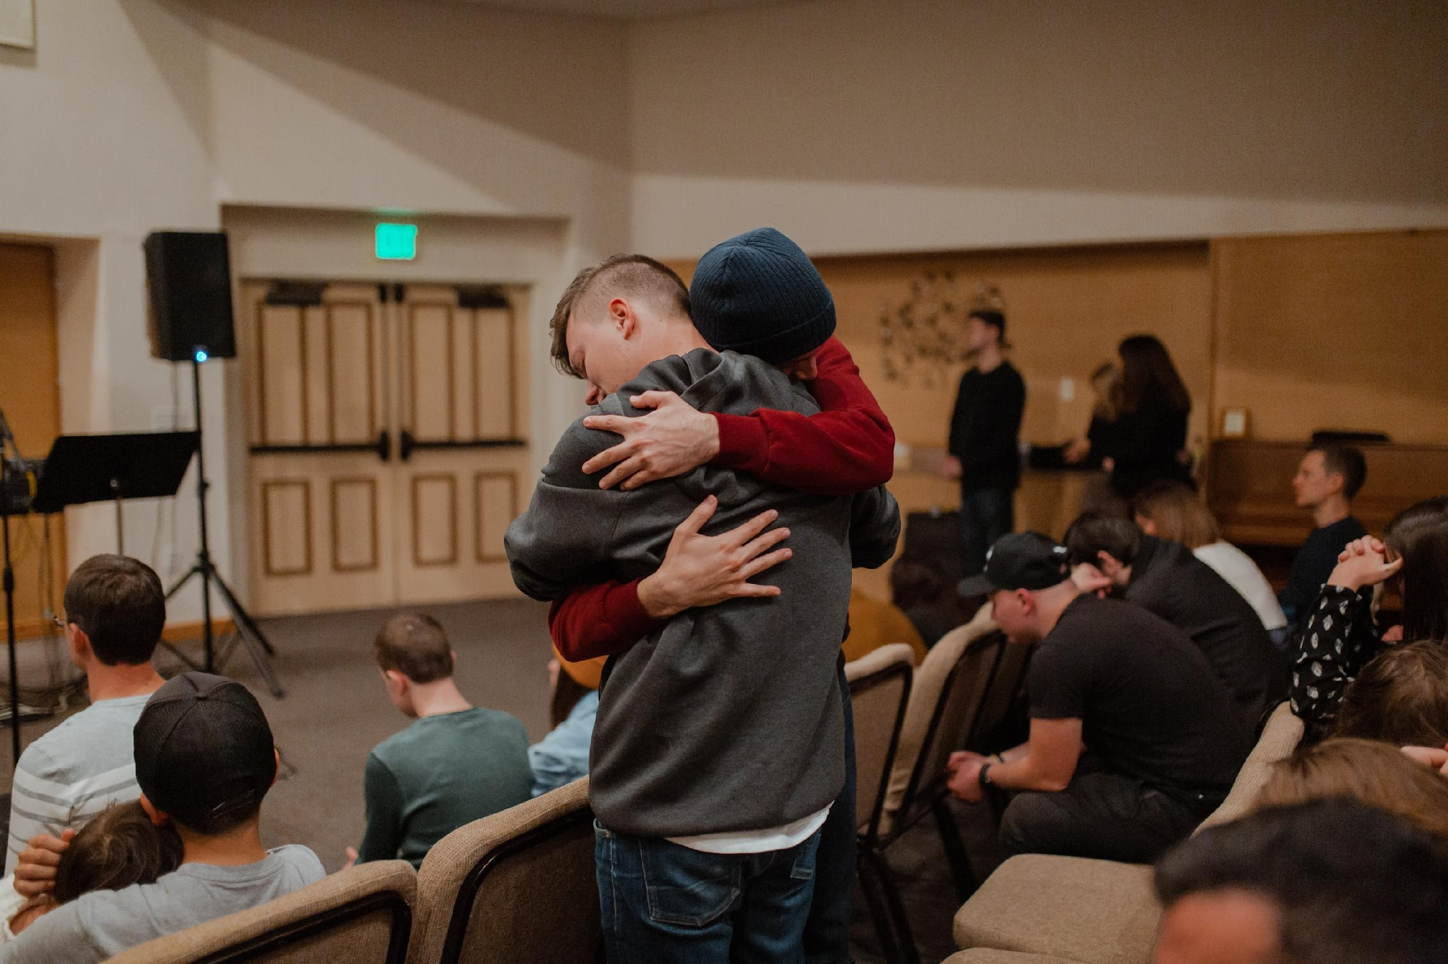





Living In Families with Emotions (LIFE): training community organizations to deliver a resilience-enhancing intervention for youth
Daphne Holt, MD, PhD
Director, MGH Resilience and Prevention Program and
Co-Director, Psychosis Clinical and Research Program
Associate Professor, Harvard Medical School
Annual Conference of the Department of Mental Health Centers of Excellence
May 29th, 2025

Slide 3
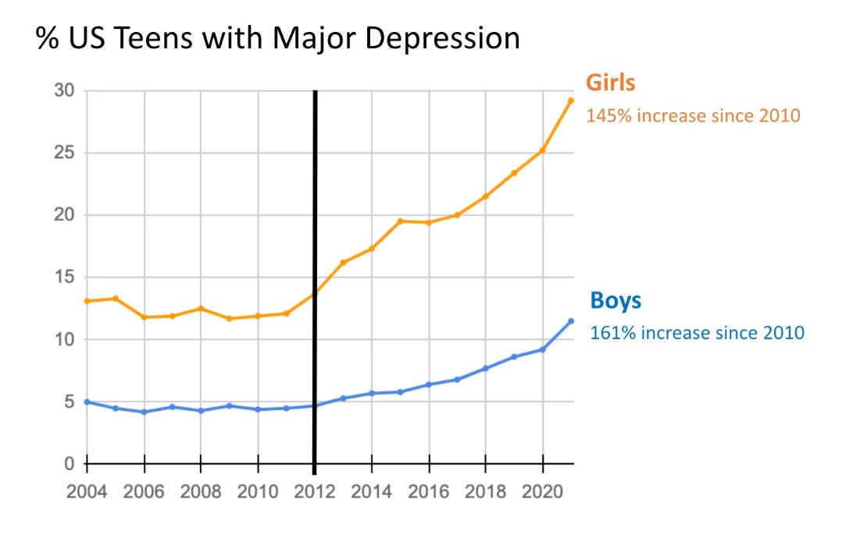
Child Mental Health Crisis
  A child and adolescent mental health national emergency declared in late 2021, by the American Academy of Pediatrics, the American Academy of Child and Adolescent Psychiatry, and the Children’s Hospital Association
  Double the rates (compared to the previous 10 years) of pediatric emergency department mental health visits
  A 5-fold increase in visits specifically related to suicide in young people
Source: National Survey on Drug Use and Health (NSDUH)
Notes:
https://www.afterbabel.com/p/international-mental-illness-part-one

Slide 4
The Resilience and Prevention Program: Our Overall Mission
Crisis
Levels of distress, symptoms
STRESS
Ongoing mental health
challenges, Illness
Prevention (by increasing resilience)
Resilience
Time
Goal
Protect mental health by increasing the ability to manage stress (resilience) → promoting well-being before mental health challenges develop
Innovation
    Integrates evidence-based behavioral interventions with insights from cognitive neuroscience
    Uses a “transdiagnostic” approach

Slide 5

The LIFE Program
A manualized behavioral intervention for middle school-aged adolescents
A workshop focused on teaching skills that will increase emotional resilience, via improving emotion recognition and regulation skills
Run by 1-2 facilitators for 7-12 adolescents, and one or more of their caregivers in the 2 caregiver sessions
In-person or virtual
2 format options for the adolescent sessions:
  8 (90 min) sessions OR
  16 (45 min) sessions (1x or 2x weekly)
Caregiver Sessions: 2 (90 min) sessions
Notes:
First deployed in MGH Chelsea Pediatrics, then in Medford middle school students during the pandemic (by zoom) – showed evidence that it reduced psychiatric symptoms in adolescents
In partnership with DMH, we developed a training program that teaches staff of community-based organizations who work with adolescents to lead LIFE workshops

Slide 6
Building Blocks of LIFE for Psychological Resilience
Emotional Awareness
Emotional Regulation
Mindfulness
Self and Other Compassion
Social Skills
Values
Notes:
Presenter notes:
could make reference to APA https://uca.edu/bewell/files/2020/12/Resilience-What-Is-It-and-How-Do-I-Build-It.pdf
Emotional Awareness (identifying, understanding emotions, as well as how emotions interact with thoughts, physical sensations and behaviors)
Emotional Regulation (coping with difficult emotions)
Self and Other Compassion (developing compassionate relationship towards self and others)
Mindfulness (paying attention to present experience)
Social and Communication Skills (establishing and maintaining positive relationships with others)
Values (identifying valued and living a value-driven life)

Slide 7
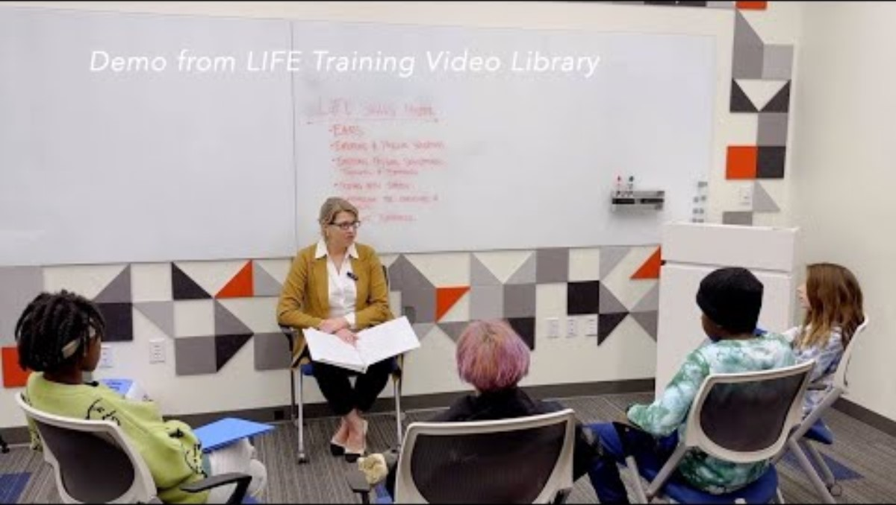
Demo from LIFE Training

Slide 8
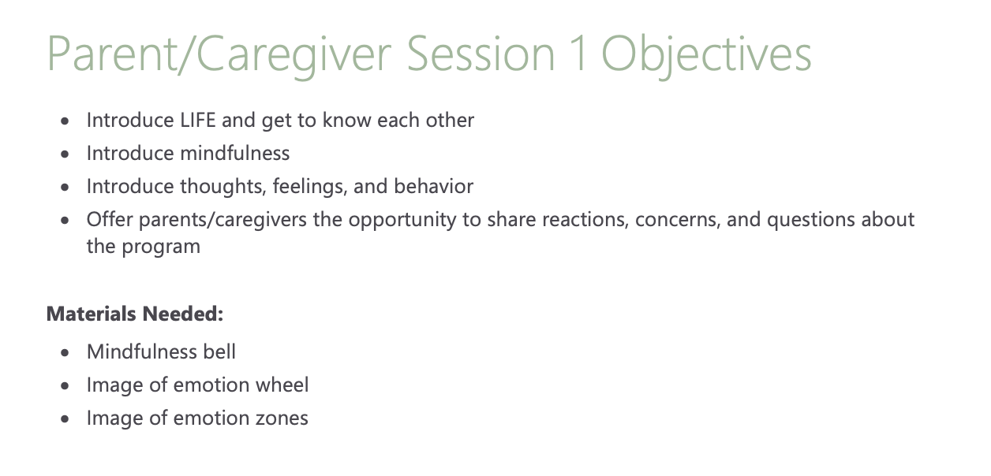
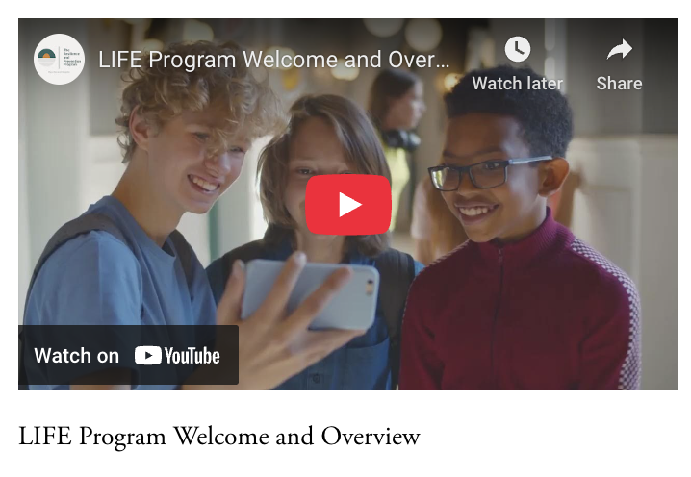

Parent/Caregiver Sessions of LIFE
Overall goal is to expose parents/caregivers to psychological resilience skills of LIFE
Two 90-minute facilitator-led support/psychoeducational sessions
Can be conducted in English or Spanish
Additional Video Library highlighting skills to be used between sessions (Spanish subtitles available)

Slide 9
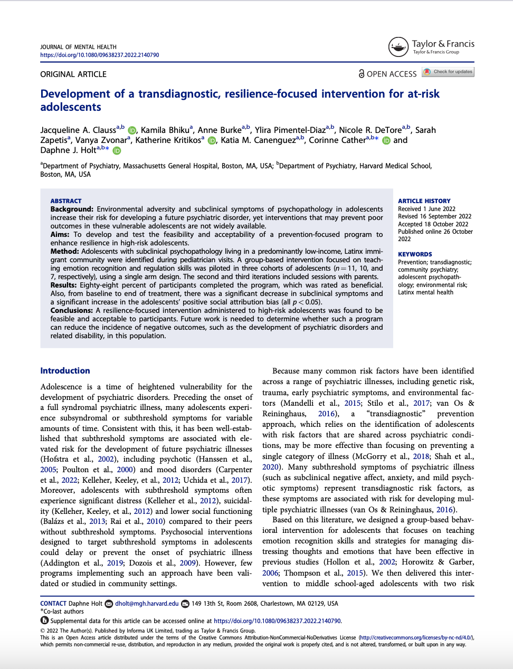
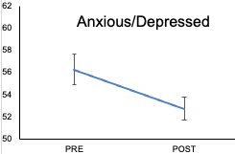

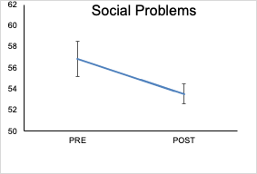
First Research Study of LIFE
Latino immigrant children in a community pediatrics clinic
Notes:
LIFE was designed by clinical staff (psychologists and a psychiatrist) of the MGH Resilience and Prevention Program
In Chelsea: parent/caregiver sessions delivered in Spanish by bilingual bi-cultural therapists
LIFE is feasible and acceptable among adolescents and their parents/caregivers with high attendance, and high ratings of enjoyment and benefit
Parents reported that their children were less anxious and had better social interactions after LIFE
Adolescents were better able to identify emotions by observing facial expressions after LIFE, a skill that can help improve social functioning

Slide 10
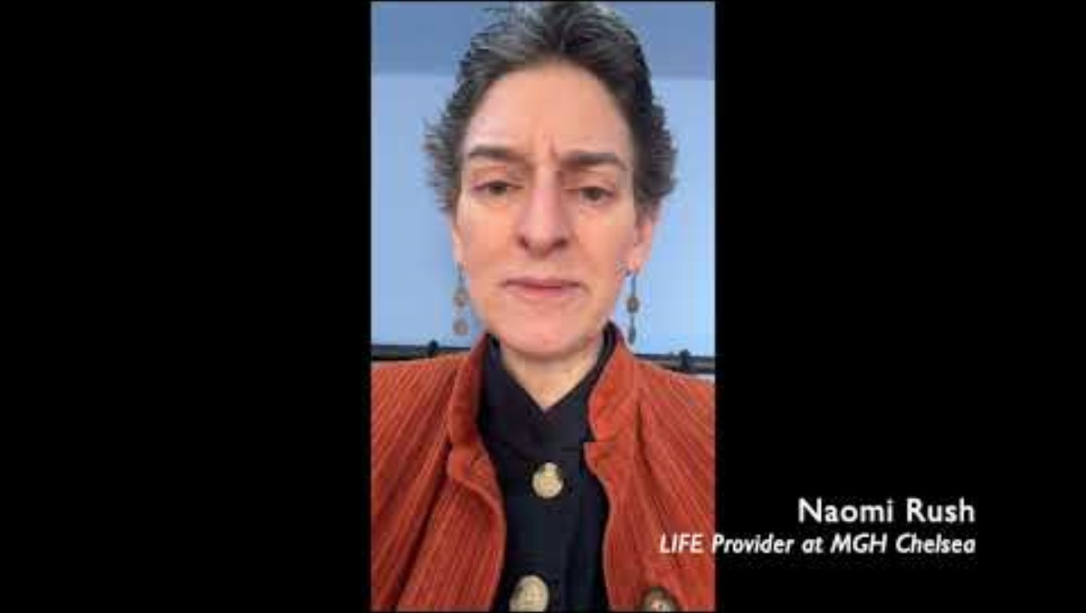
Naomi and Kyle talking about Chelsea
Notes:
Naomi and Kyle talking about Chelsea
Behavioral Health Unit waitlist
Families representing 6 countries

Slide 11
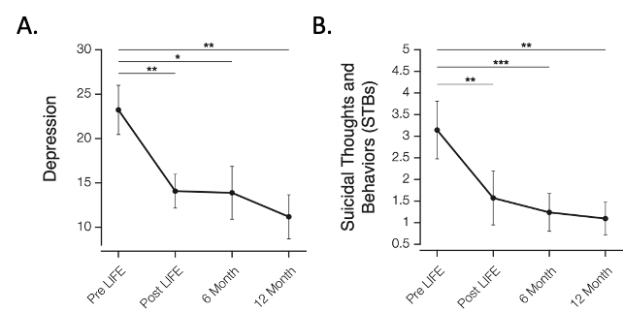
Second Research Study of LIFE: Reductions in depression and suicidal thoughts and behaviors were sustained over the following year
Caregiver/parent feedback
about how LIFE affected their child:
“She is not as immediately stressed when a situation arises.”
“I see less outbursts and better mood regulation.”
“He has been a bit less reactive. Takes time to reflect and is more open for conversations.”
“She’s eating more, laughing, and sleeping more than before.”
“I think her attitude and coping skills have improved.”

Slide 12
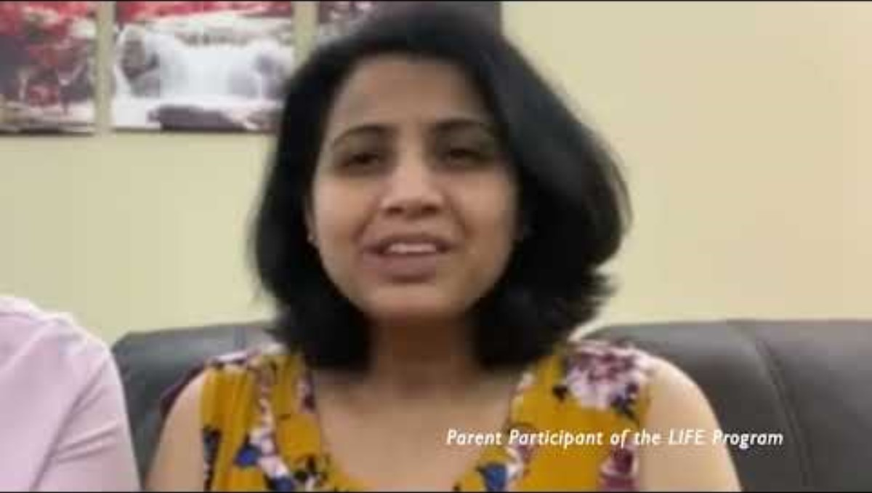
Parent Testimonial

Slide 13






Who can learn to lead the LIFE program?
Notes:
teachers, parent volunteers, coaches, peer coordinators, school counselors, and administrative leaders

Slide 14
LIFE program training
Orientation meeting
  1-hour orientation to LIFE over Zoom
Watch videos
  Watch brief videos (less than 2 hours altogether) that introduce the LIFE sessions over a two-week period
  One 5-hour training workshop with demonstrations, role plays, discussion, facilitation training and Q & A about LIFE program
Live training
Consultation/
Support
  1-hour, optional weekly group consultation with licensed clinician (LIFE expert) for 1-6 months. Includes pre-implementation planning meetings.
You can become a certified LIFE program facilitator

Slide 15
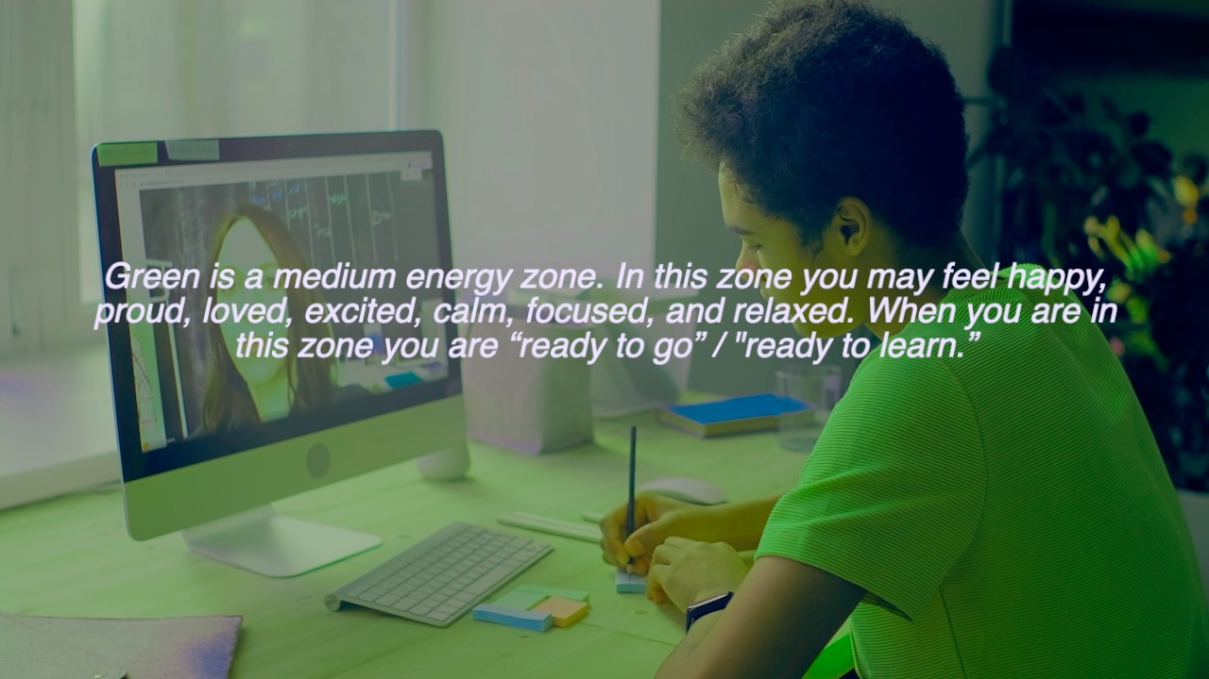
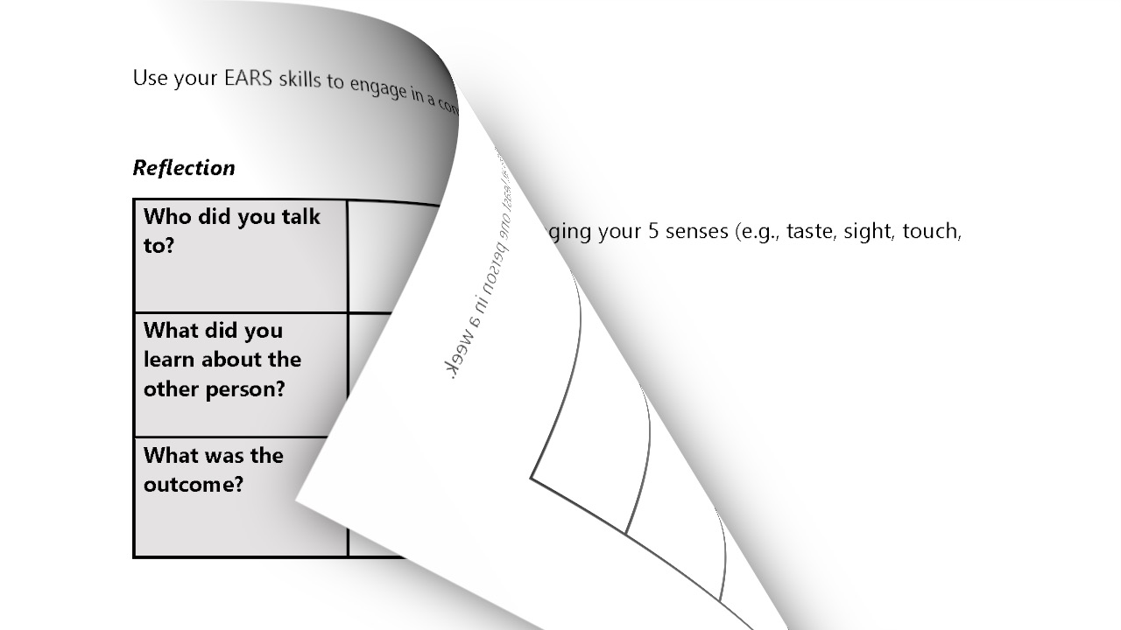
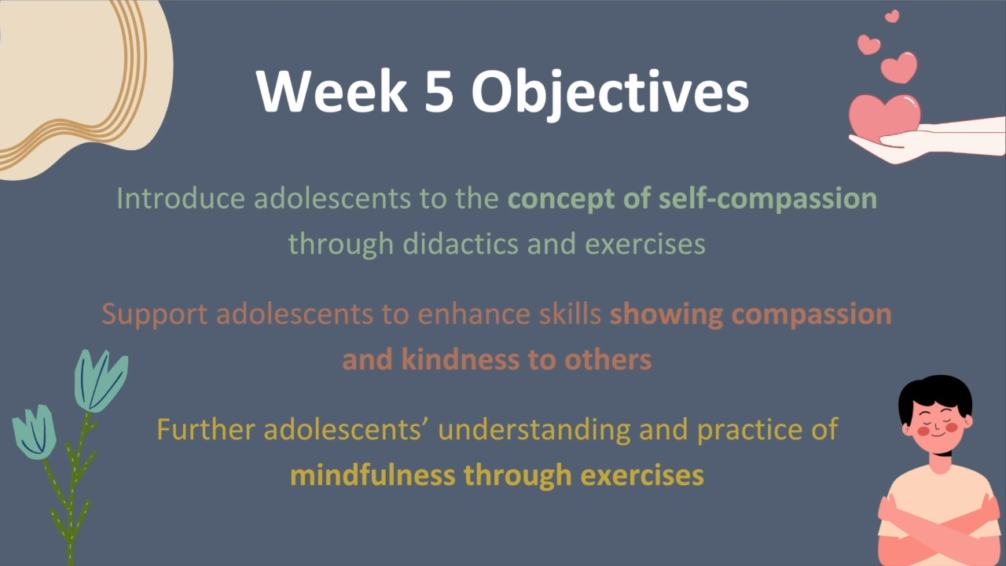
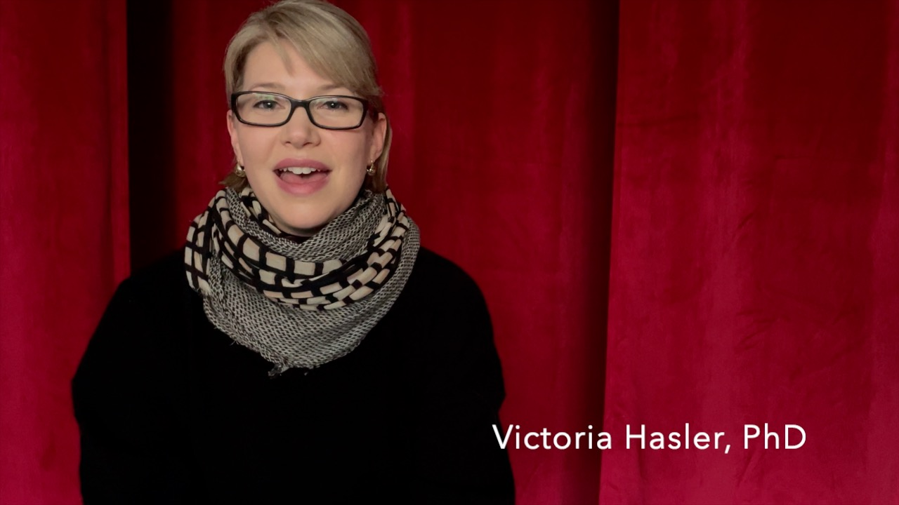
LIFE Trainee Videos: Online video library preview
Notes:
Trainees are sent a direct link to our video library website and the password
Here trainees will view each of the 8 session specific videos, following along with their manual
Anything that is not shown in the video (content or activities) will be reviewed and practiced in our in-person training

Slide 16
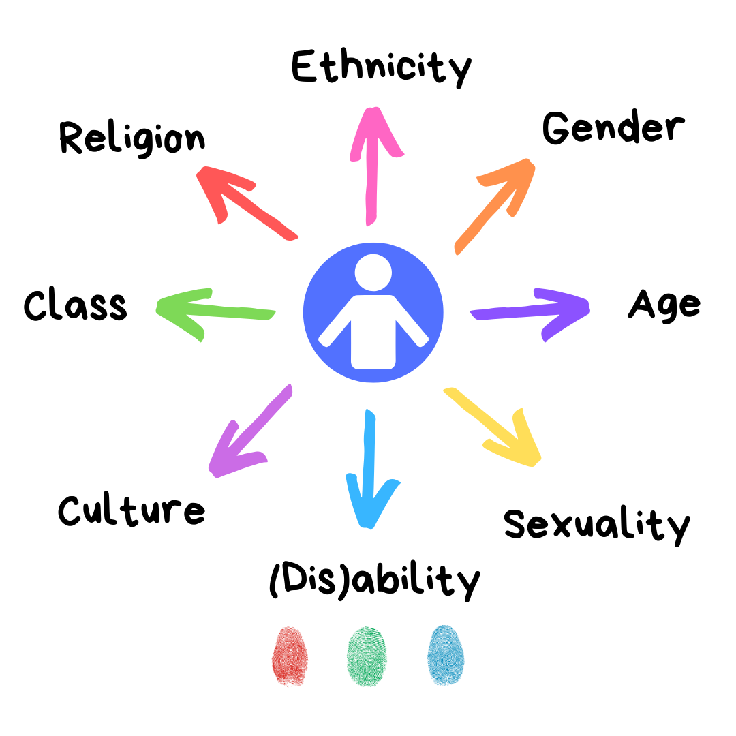
The LIFE training program
Introduces the concepts taught in the LIFE program: emotion identification and regulation, mindfulness, self-compassion, and social skills
Emphasis on cultural humility
Facilitator skills, group management strategies
Understanding youth development and family needs
Trauma-informed practice
Self-care strategies for facilitators

Slide 17

The LIFE Manual
Cover Page, Table of Contents, Introductory Page

Slide 18
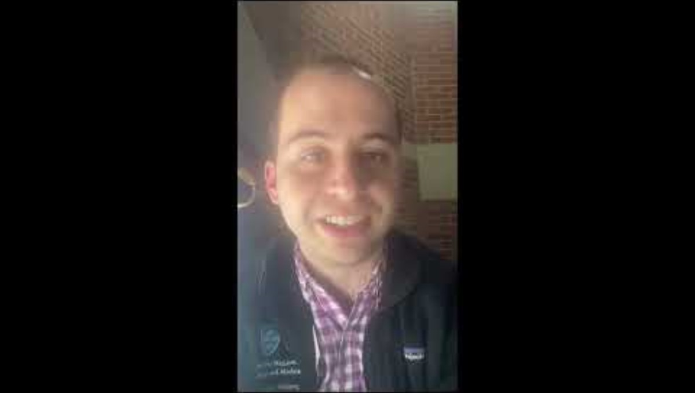
Data outcomes from LIFE trainings
Relevance, Usefulness, and Satisfaction
Items were rated from 1-5, with 5 as the best

Slide 19



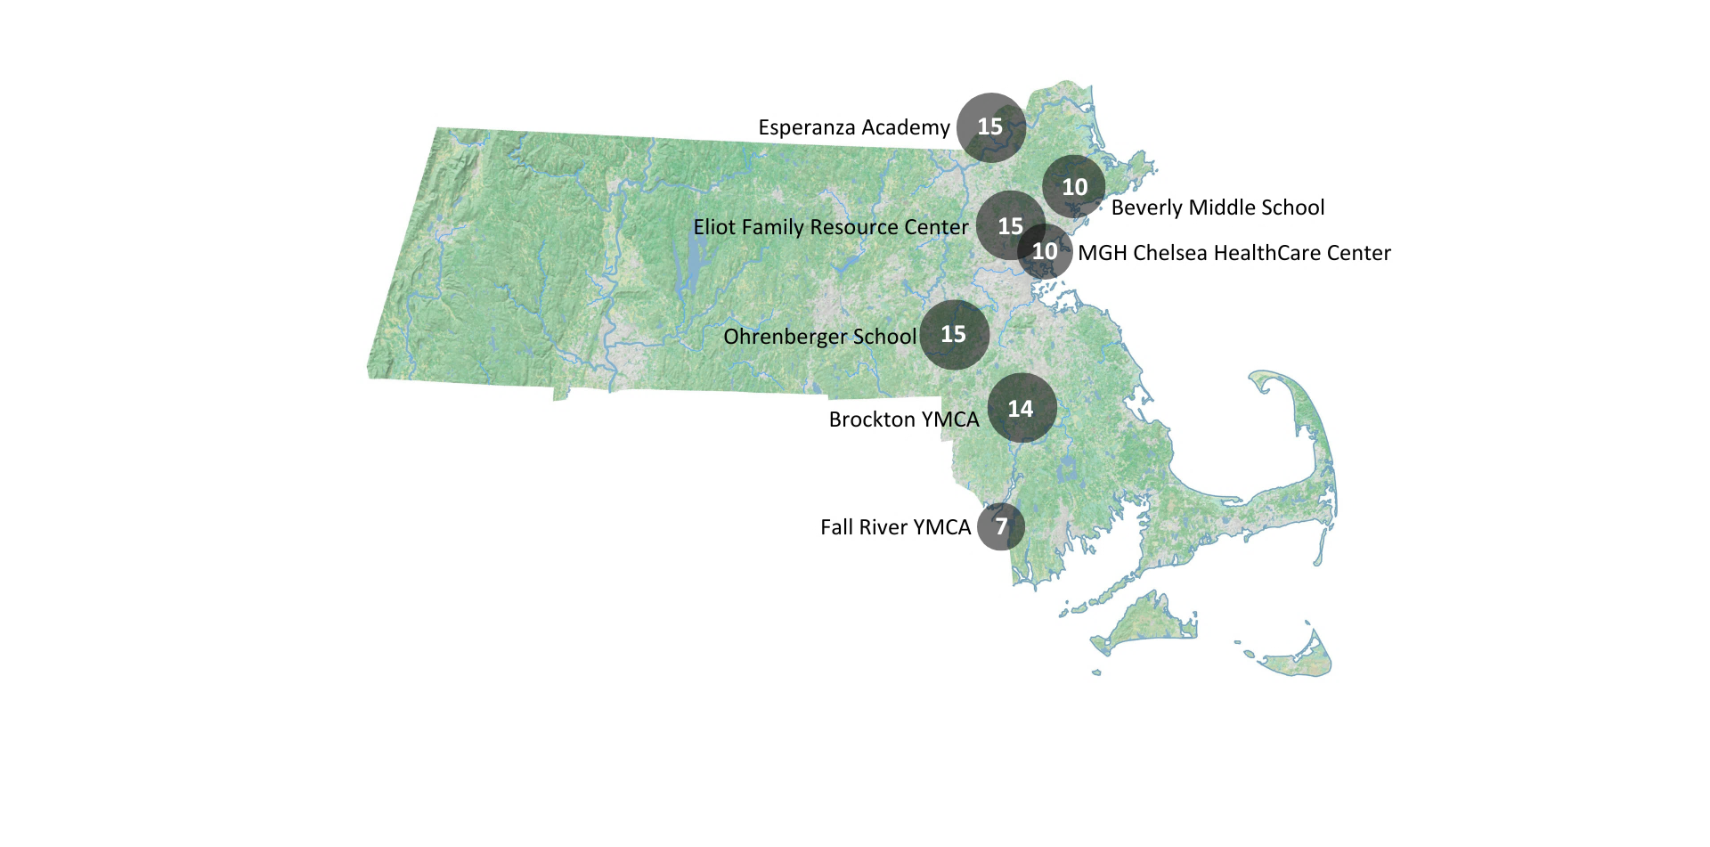






LIFE trainees in Massachusetts
Notes:
We have also expanded our training and implementation reach. RAPP conducted four LIFE training workshops (two in-person, one virtual, and one hybrid (including asynchronous learning and a 1-day in-person workshop) this past year, during which 58 teachers, parent volunteers, peer coordinators, school counselors, and administrative leaders from 8 community partner organizations attended the training workshop to facilitate LIFE. Expanding and adapting the LIFE school/program leadership to continue delivering LIFE in their institutions. By mid-2025, more than ten LIFE groups would be provided in schools (Beverly Middle School, Ohrenberger Middle School, Esperanza Academy), family resource centers (Connections, Eliot), YMCA organizations (Brockton, New Bedford), and healthcare centers (MGH Chelsea), reaching over 100 adolescents.
We focused on providing trainings to community partners located in under-served and under-insured areas of the state, including those officially designated as Health Professional Shortage Areas (HPSAs) (e.g., Chelsea/Everett/Revere, Lawrence)
17 trainee-providers from a total of 9 community organizations have subsequently implemented or are currently implementing LIFE in Massachusetts.

Slide 20
Expanding network of LIFE trainees
Boston
Boston
New Bedford
Roxbury
Roxbury
Brighton
Boys and Girls Clubs
Boston Public Schools
Brockton
Dorchester
Fall River
Jamaica
Plan
Lynn
Lowell
Mattapan
Hyde Park
Taunton
Brockton
New Bedford
YMCA
Fall River
Stoughton

Slide 21
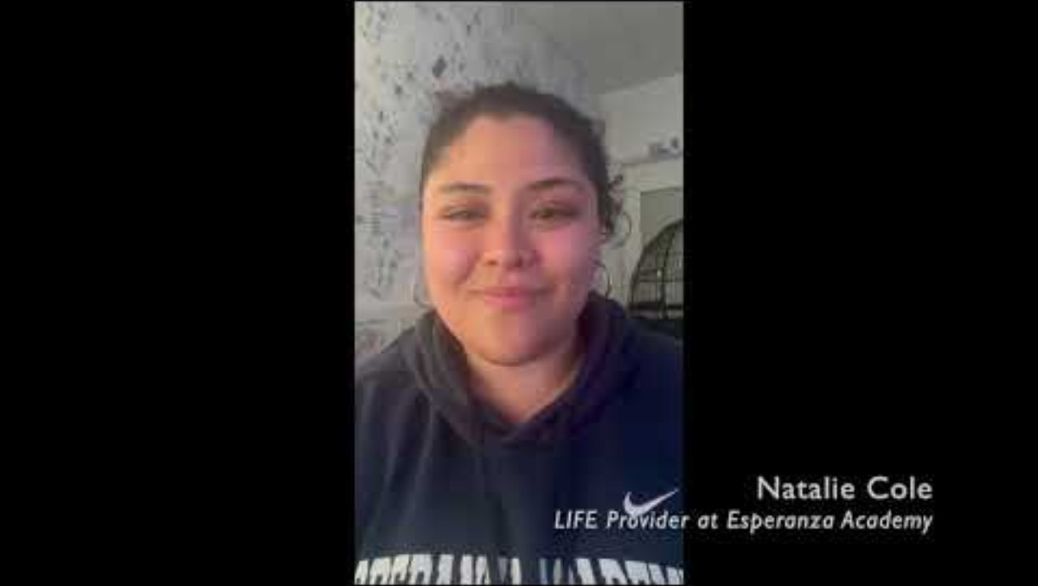
Natalie Cole video

Slide 22
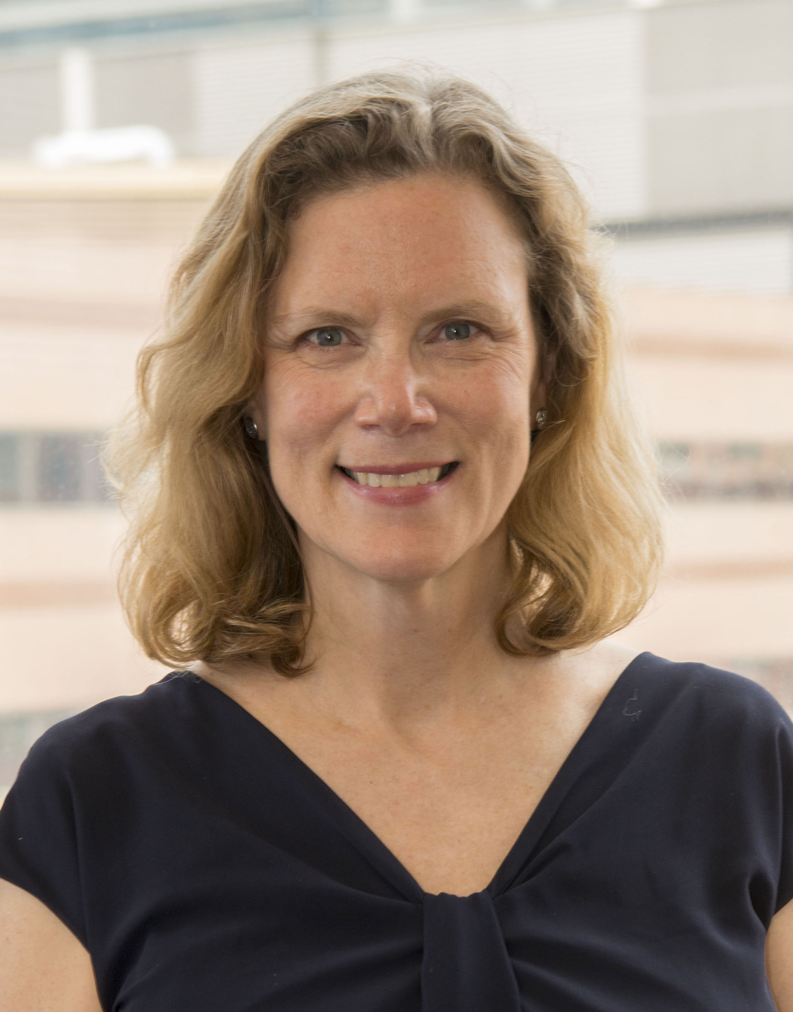
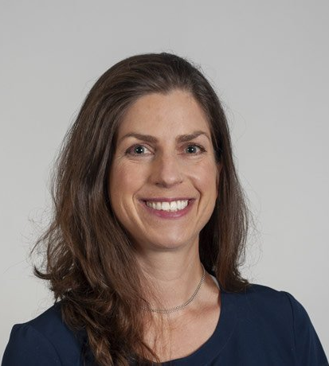
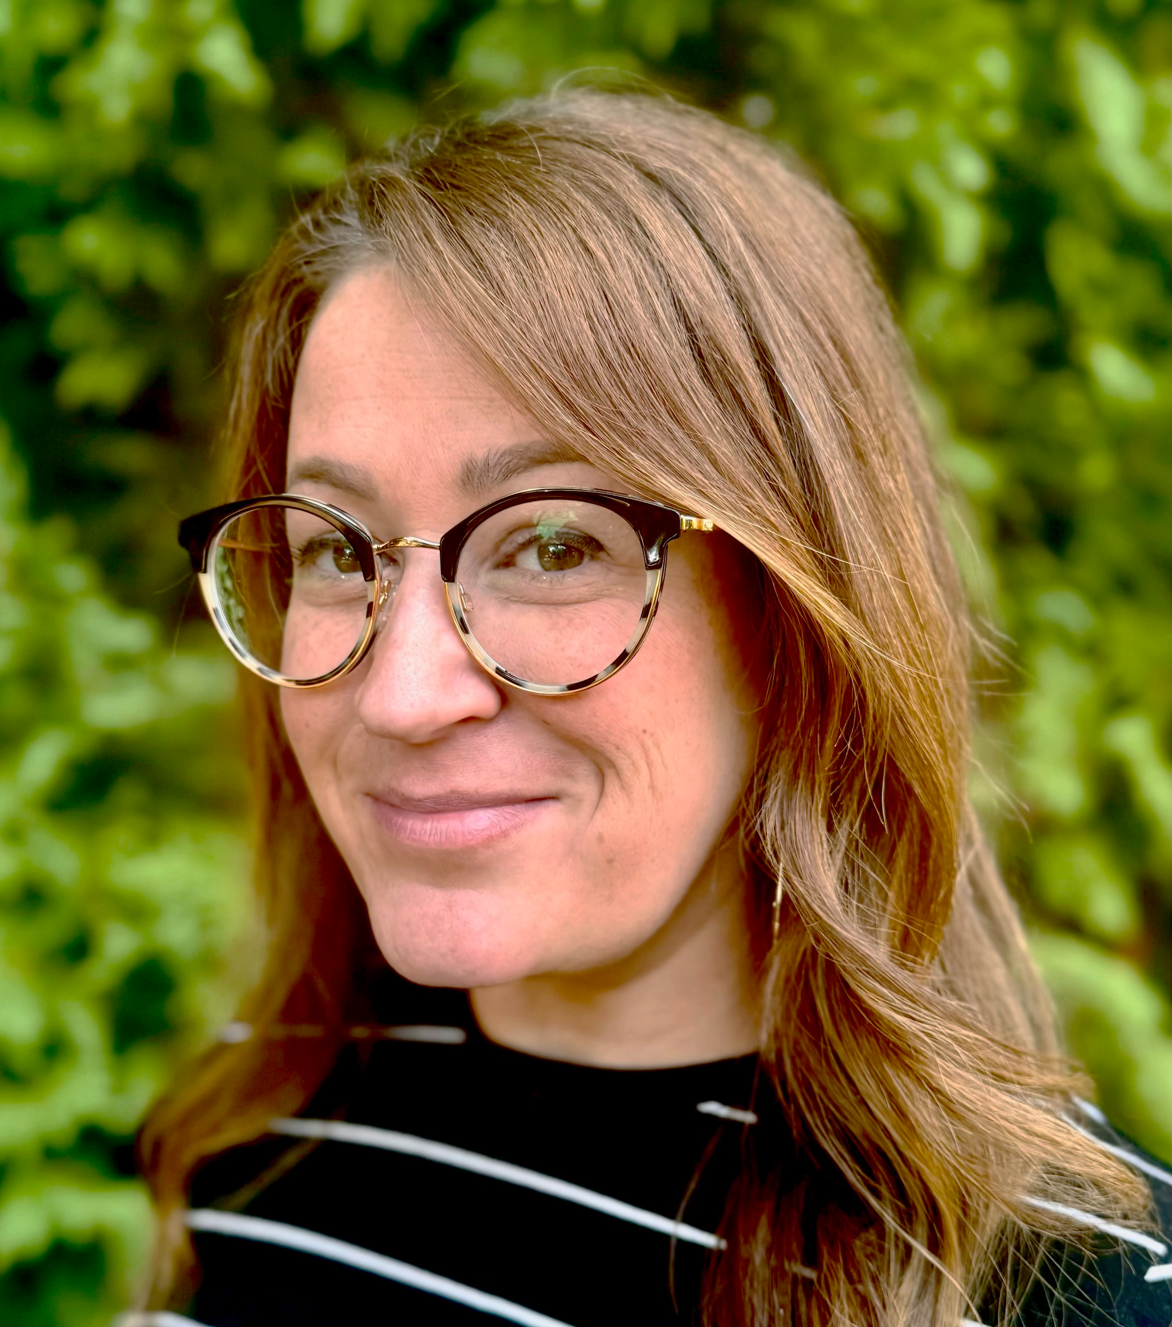
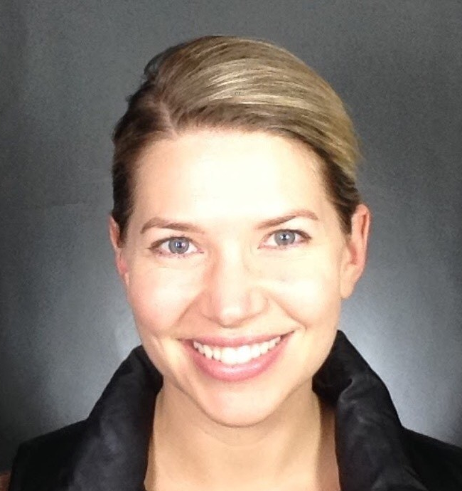
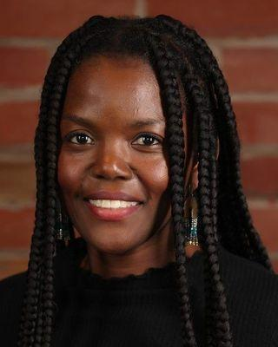
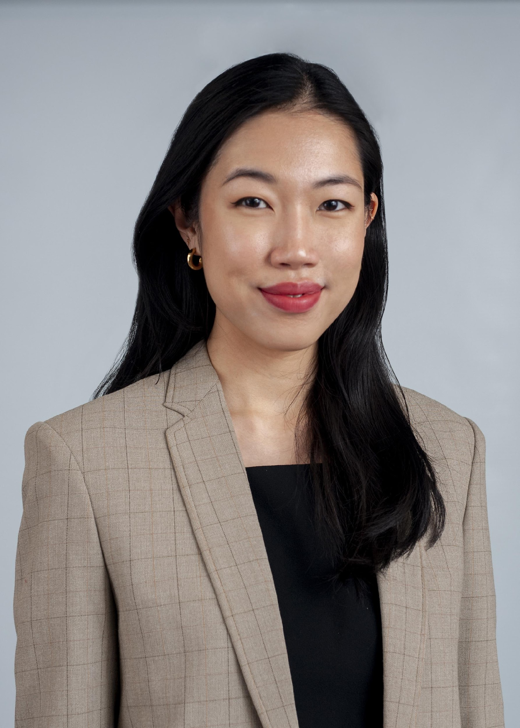
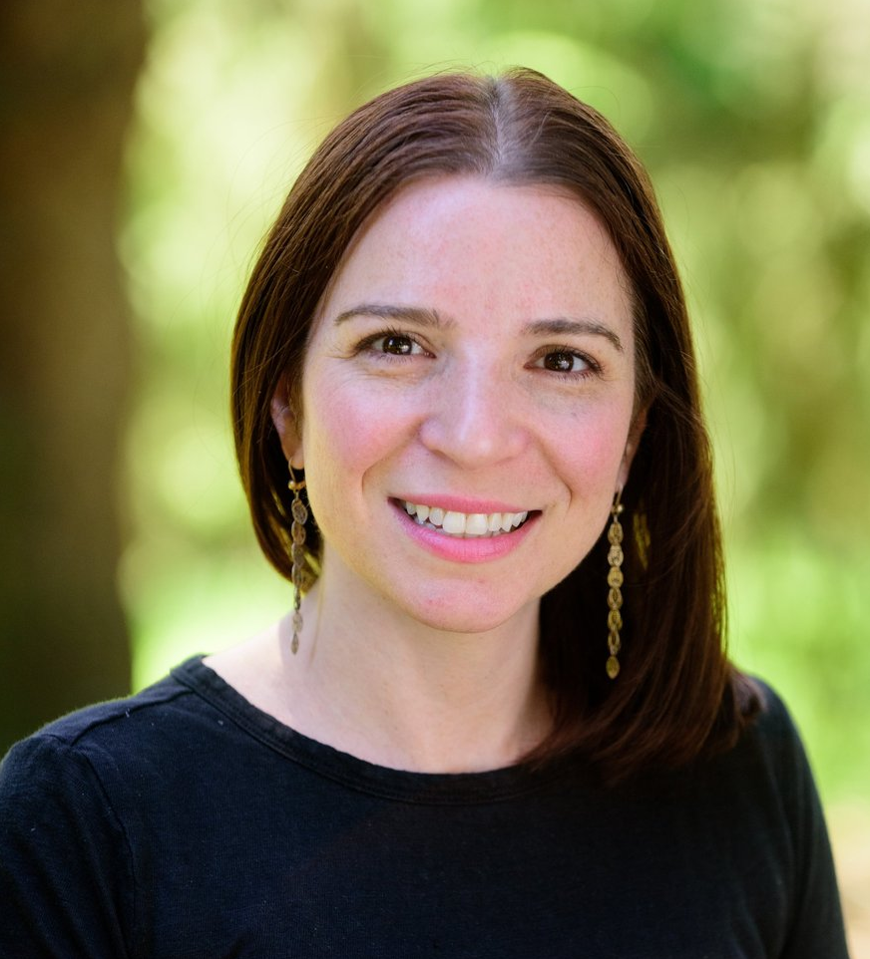
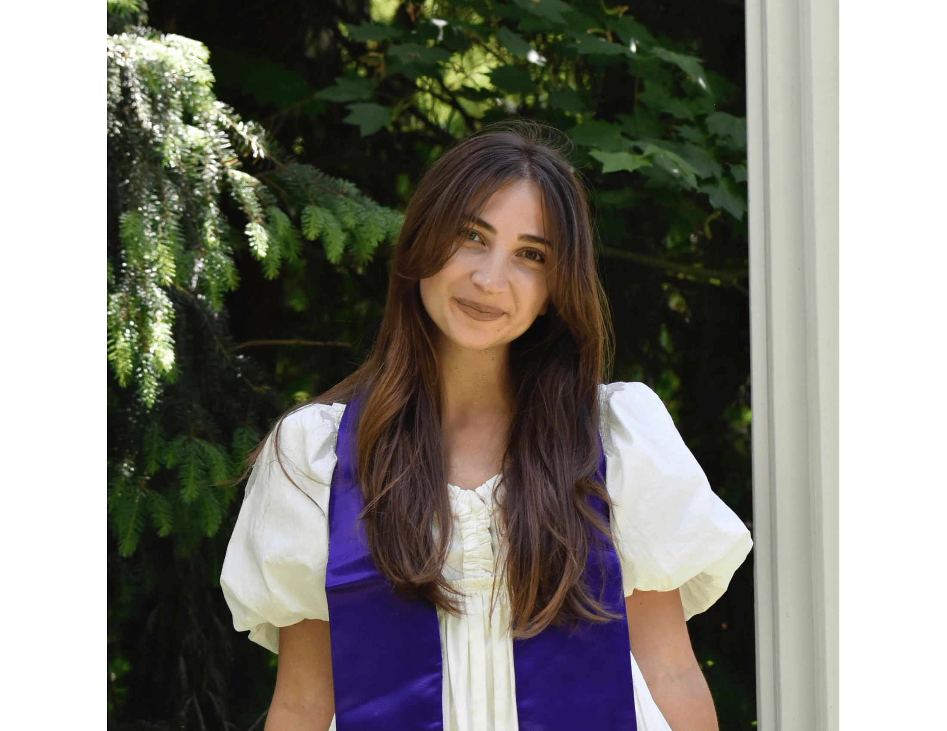

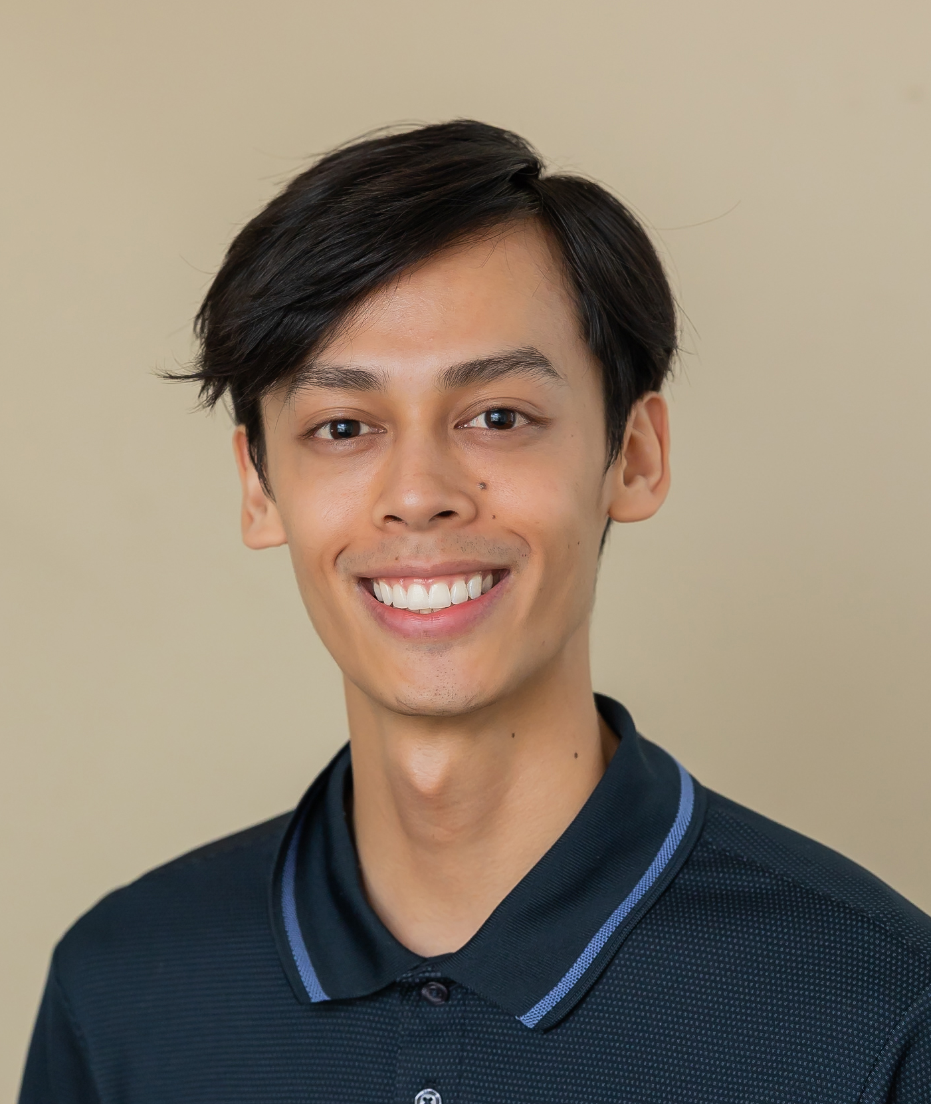
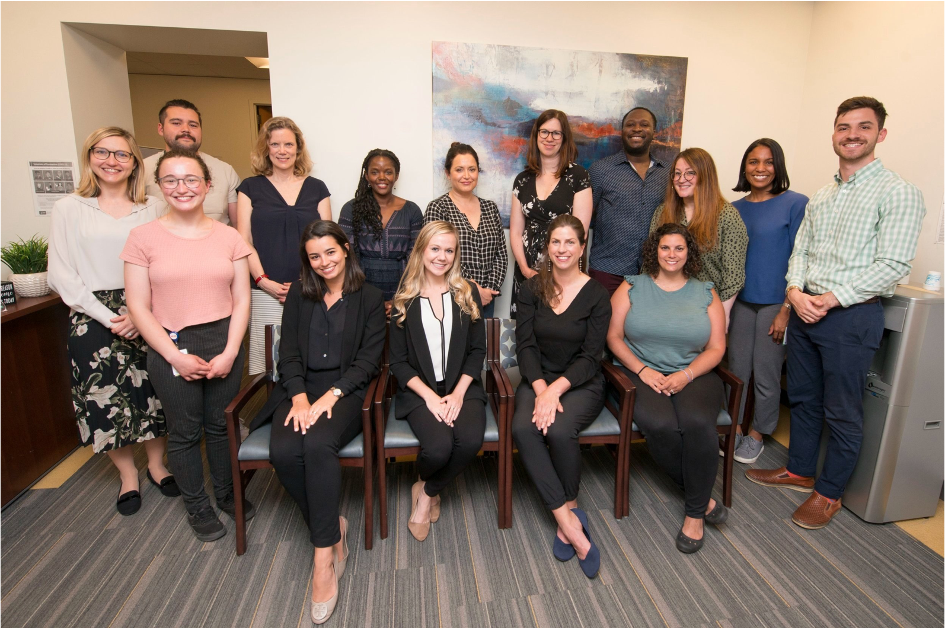
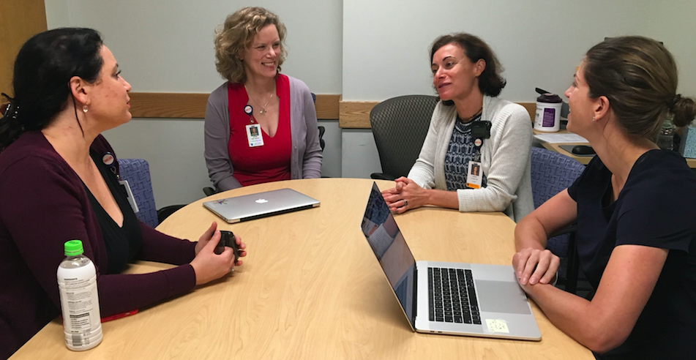
The MGH Resilience and Prevention Program
Daphne Holt, MD, PhD
Annie Burke, PhD
Nicole DeTore, PhD
Victoria Hasler,
PhD
Oyenike Balogun- Mwangi, PhD
https://www.resilienceandprevention.com
Cheryl Foo, PhD
Emily Kline,
PhD
Emma Mirhashemi,
BS
Molly Hart,
BS
Mitchell Chan,
BA

Slide 23
Questions?

Slide 24
EXTRA SLIDES
(for answering questions)

Slide 25
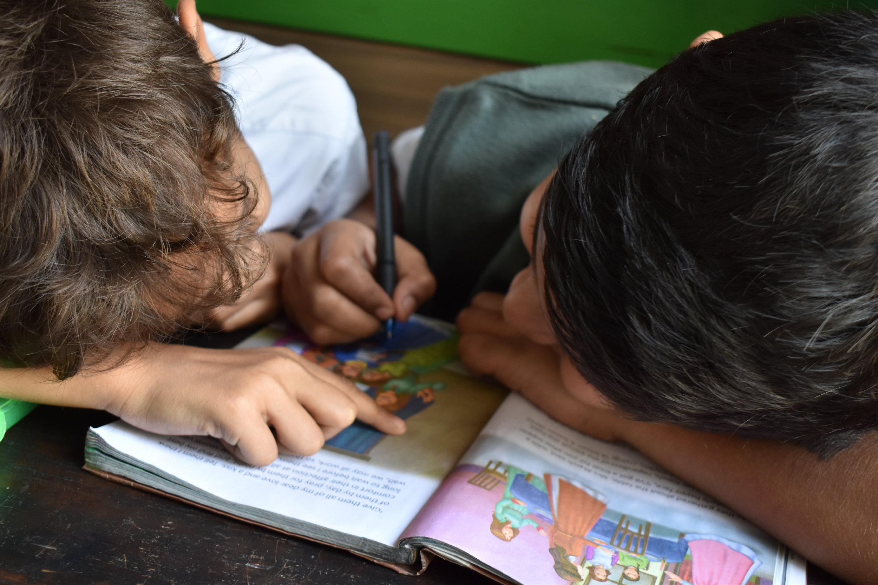
8-Session Format Outline
90 minutes each adolescent LIFE session
Session 1: Getting to Know Each Other
Session 2: Identifying Emotions and Physical Sensations
Session 3: Emotions, Thoughts, Behaviors, and Physical Sensations
Session 4: Managing Stress
Session 5: Compassion for Ourselves and Others
Session 6: Support Networks
Session 7: Dealing with Conflict and Rejection
Session 8: End of Workshop – Celebrate!!
Notes:
Notes:
We build on topics and skills each week.

Slide 26

16-Session Manual Format
45 minutes each adolescent LIFE session
Week #A
  Introduction, Mindfulness Bodies, Icebreaker, Homework Practice Review, Topic of the Week (part I), Collect Binders and Cards
Week #B
  Introduction, Mindful Bodies, Icebreaker, Topic of the Week (part II), Weekly Wrap-Up, Assign Home Practice, Collect Binders
  Weekly Wrap-Up: Closing Mindfulness activity, LIFE Poster and Cards, Feedback

Slide 27

Structure of Adolescent Sessions:
Begin with Introduction & Mindful Bodies to settle the group and focus for the session
Build Community with Icebreaker Activity
Check-in with Home Practice Review
Teach Topic of the Day
Complete Weekly Wrap Up
  Close group with a mindfulness exercise to cool down
  Reinforcement of skills throughout using coping skills poster/coping cards
  Enhance motivation, engagement, and build positive learning community through feedback
6. Assign Home Practice to build skills
Collect Binders and Cards
*Movement breaks provided throughout

Slide 28
Thank You!
For Attending

