Slide 1
2025 DMH Research Centers of Excellence​
Promoting Youth Mental and Behavioral Health: Understanding and Addressing Risk and Protective Factors to Improve Youth Well-Being and Outcomes
May 29, 2025​

Slide 2




Treating Nicotine Dependence in Youth: Assessing Pharmacotherapy & CBT Strategies for Vaping Cessation
Vanessa Iroegbulem, BA
Notes:
I dont think integrating pharmacotherapy and cbt strategies quite captures what the trial was, it was really assessing the effect of pharmacotherapy in the setting of CBT, or assessing the effects of cbt with and without pharmacotherapy

Slide 3
Nicotine Vaping in Youth
E-cigarettes remain the most commonly used nicotine product in U.S. youth since 2014
  In 2024…
    1.63 million U.S. youth reported current use of e-cigarettes
    More than 1 in 4 youth use daily
72% of youth and young adults under 25 who report current e-cigarette use had never smoked cigarettes
Harris, E. (2023). Most young adults who use e-cigarettes have never smoked. JAMA, 330(21), 2045-2045.
Jamal, A. (2024). Tobacco product use among middle and high school students—National Youth Tobacco Survey, United States, 2024. MMWR. Morbidity and Mortality Weekly Report, 73.
Winickoff, J. P., Evins, A. E., & Levy, S. (2024). Vaping in youth. JAMA, 332(9), 749-750.
Notes:
Current use = past 30 days
That is 1 out of every 29 middle school students and 1 of every 13 high school students
Maybe say more than one in 4 youth who use use daily…

Slide 4
Harmful Effects of Youth Nicotine Vaping
Nicotine addiction
Increases risk for tobacco smoking and other substance use
Nicotine vaping poses unique risks to youth because of their developing brains
E-cigarette vapor exposes youth to harmful chemicals
U.S. Department of Health and Human Services. E-Cigarette Use Among Youth and Young Adults: A Report of the Surgeon General. Centers for Disease Control and Prevention; 2016. Accessed Feb 14, 2024.
Yuan, M., Cross, S. J., Loughlin, S. E., & Leslie, F. M. (2015). Nicotine and the adolescent brain. The Journal of Physiology, 593(16), 3397-3412.
Notes:
Youth who vape are more likely to smoke cigarettes in the future and are at increased risk for future addiction to other substances
Nicotine vaping during adolescence harms the parts of adolescent’s brain that control attention, learning, mood, and impulse control
E-cigarette aerosol contain cancer-causing chemicals; heavy metals such as nickel, tin, and lead; tiny particles are inhaled deep into the lungs; contains volatile organic compounds; flavorings like diacetyl (chemical linked to a serious lung disease) found in vapes are harmful to inhale

Slide 5
Youth Vaping Cessation Efforts
Over two thirds of youth (64%) youth who currently vape nicotine want to quit or reduce their use
  Nearly 70% reported trying to quit in the last year
Lack of pharmacotherapy trials for youth vaping cessation
Mixed efficacy of quitlines and text-message-based for youth vaping cessation
New data suggests varenicline (Chantix) is well-tolerated and associated with significant positive effects on secondary tobacco abstinence
Zhang, Lei, Andrea Gentzke, Katrina F. Trivers, and Brenna VanFrank. "Tobacco cessation behaviors among US middle and high school students, 2020." Journal of Adolescent Health 70, no. 1 (2022): 147-154.
Notes:
Secondary tobacco abstinence: aims to minimize risks associated with tobacco use, rather than complete abstinence

Slide 6
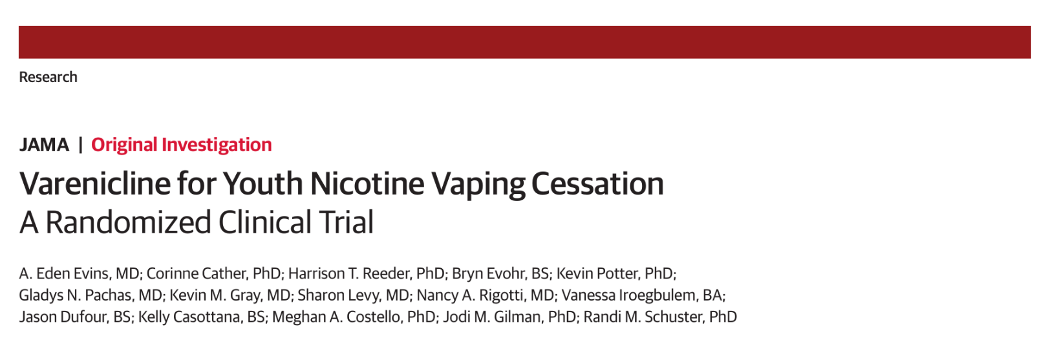
Varenicline for Youth Nicotine Vaping Cessation: A Randomized Controlled Trial
MPIs: Eden Evins, MD, MPH and Randi Schuster, PhD
Primary Study Aim:
Does varenicline increase 4-week continuous vaping abstinence rates at end of treatment vs. placebo in youth?
Notes:
You can put the title page from the paper showing the title and authors here if you like

Slide 7
Interventions
Double Blind Comparison: 2 Arms
  12 weeks of varenicline or identical appearing placebo, standard dosing
  Weekly 20-minute manualized, virtual vaping cessation counseling session via Zoom with young adult lay counselors
  Referral to TIQ
Single Blind Enhanced Usual Care Arm
  Referral to TIQ only
Notes:
Regular use: ≥5 days/week
Exclusion:
Use of smoking cessation medication in past month
Inpatient psych hospitalization or suicide attempt in past 6 months
Renal failure or unstable medical condition
Lay counselor: no formal clinical training

Slide 8
Medication Adherence
Incentivized Documentation of Medication Adherence
  Participants were incentivized to upload video-recording of themselves taking their study medication through a HIPAA compliant smartphone app
Notes:
Participants assigned to a medication arm incentivized for uploaded smartphone app video-recording of medication adherence
In an increasingly digitize world emocha was appealing

Slide 9

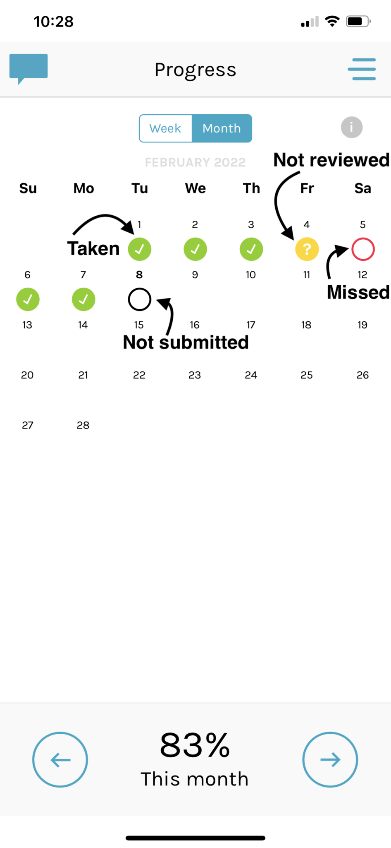
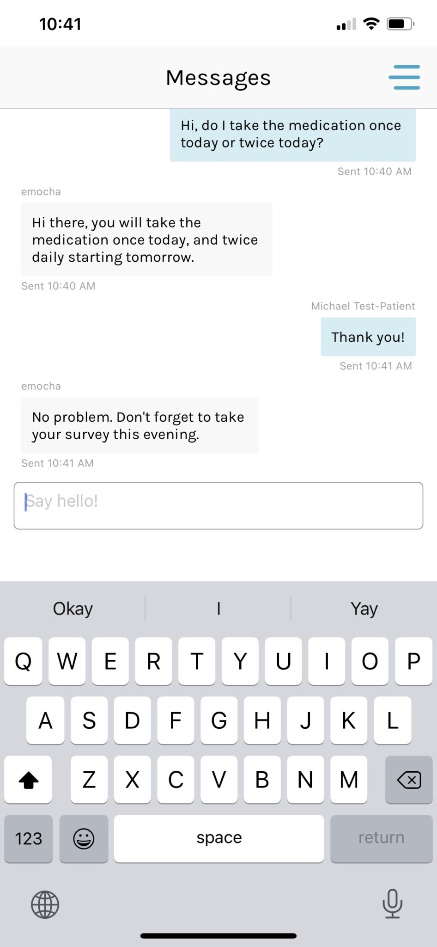
Medication Adherence
Notes:
Participants assigned to a medication arm incentivized for uploaded smartphone app video-recording of medication adherence
In an increasingly digitize world emocha was appealing

Slide 10
Measures
Weekly assessments
  Adverse events, vaping use, vaping cravings, withdrawal symptoms, salivary cotinine if reporting abstinence, study meds adherence, any other medications
Assessments collected virtual via computer or smartphone with live assessor
Salivary cotinine assay used to confirm self-reported vaping abstinence
Notes:
Treatment-emergent and neuropsychiatric adverse events, con-meds, timeline followback (TLFB), weekly and daily vaping use, vaping cravings, nicotine withdrawal symptoms (MNWS), salivary cotinine, study meds adherence
Salivary cotinine: colorimetric assay via videoconference

Slide 11
Participant Characteristics
Vaping ≥5 days/week in past 90-days
E-cigarette Dependence Inventory (ECDI) score ≥4 or evidence of prior failed cessation attempts
No prior regular tobacco smoking
Interest in quitting or reducing nicotine vaping in the next month
Notes:
Regular use: ≥5 days/week
Exclusion:
Use of smoking cessation medication in past month
Inpatient psych hospitalization or suicide attempt in past 6 months
Renal failsure or unstable medical condition

Slide 12
Baseline Demographics
 | Varenicline (n=88) | Placebo (n=87) | EUC (n=86)
Age, mean (SD), y | 21.6 (2) | 21.4 (2.1) | 21.4 (2)
Female (%) | 53% | 54% | 54%
Race (%)
Asian | 15% | 18% | 19%
Black | 5% | 8% | 5%
Multi-racial | 11% | 12% | 12%
White | 64% | 54% | 64%
Hispanic or Latino(a) ethnicity (%) | 19% | 21% | 9%
Notes:
Primary efficacy analyses included all 261 randomized participants. Safety analyses included the 260 participants who attended at least one post-baseline study visit.
Sample population: 16-25

Slide 13

Baseline Nicotine Vaping and Smoking
 | Varenicline (n=88) | Placebo (n=87) | EUC (n=86)
E-cigarettes
Vaping Days per week | 6.7 (0.7) | 6.8 (0.8) | 6.8 (0.6)
ECDI Nicotine Dependence Severity | 12.5 (3.8) | 13.7 (4) | 12.8 (3.8)
Motivation to quit vaping; (1-10 scale) | 7.1 (1.7) | 6.7 (1.8) | 7.1 (1.6)
Nicotine Withdrawal Symptom Severity MNWS | 17.2 (10.8) | 17.8 (11.2) | 18.4 (10.2)
Nicotine Craving Severity QVC Total Score | 41.3 (11.5) | 42.3 (13.1) | 38.5 (13.8)
Combusted tobacco
Any tobacco smoking past 90 days (%) | 7% | 8% | 9%
Average days smoking per week past 90 days | 0 (0.1) | 0 (0.1) | 0 (0.1)
Tobacco smoking ≥5 days/week past 90 days (%) | 0% | 0% | 0%
Smoked ≥100 cigarettes lifetime (%) | 10% | 8% | 6%

Slide 14
QuitVaping Behavioral Intervention
12-weekly 20-minute sessions led by a young adult lay counselor
Each session includes a check-in, a short educational video, and a discussion to reinforce material and its importance
Topics include but are not limited to quitting strategies (e.g., 4Ds), neurobiology, industry tactics, refusal skills, and establishing healthy habits
Participants set a quit day by Session 3 and create personalize quit plan with support from counselor
Notes:
12-weekly 20-minute sessions delivered in-person or via video-conference by non-clinical staff
Each session includes a check-in, a short educational video related to the topic/skill of the week, and a discussion to reinforce material/skill and its importance

Slide 15
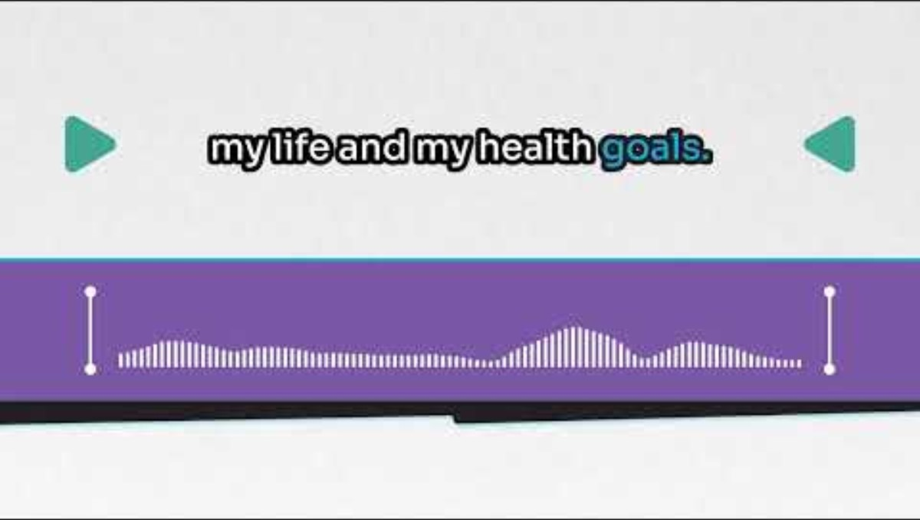
QuitVaping Participant Shares Her Experience

Slide 16
Abstinence Outcomes: Varenicline vs Placebo
 | No. (%) |  |  | V+BC vs. P+BC
 | V+BC (n=88) | P+BC (n=87) | EUC (n=86) | OR (95% CI) | p-value
Primary Outcome:
Continuous Abstinence Treatment Weeks 9-12 | 51% | 14% | 6% | 6.5 (3.0, 13.9) | p < 0.001
Secondary Outcomes:
Continuous Abstinence Weeks 9-24 | 28% | 7% | 4% | 5.6 (2.0, 15.6) | p = 0.001
7-day Point Prevalence Abstinence at Week 12 | 68% | 25% | 15% | 6.2 (3.1, 12.3) | p < 0.001

Slide 17
Adherence to Study Interventions
 | Varenicline | Placebo | EUC
Study Drug Adherence by Pill Counts | 73% of doses | 64% of doses | ----------
Study Drug Adherence by Video | 52% of doses | 42% of doses | ----------
CBT Attendance Percent of Sessions | 83.8% | 65.8% | ----------
CBT Attendance ≥80% of Sessions | 78% | 60% | ----------
Enrollment in TIQ | 41% | 36% | 74.4%

Slide 18
Other Significant Outcomes
Greater decline in withdrawal symptoms in V+BC vs. P+BC (β = −2.74, (−4.41, −1.07), p = .001)
Greater decline in cravings in V+BC and P+BC compared to EUC (β= -6.97, (-9.24, 4.69), p< .001)
Greater decline in mood and anxiety symptoms in V+BC and P+BC compared to EUC (β= -1.5, (-4.34, 1.34), p=0.3)
Notes:
Withdrawal symptoms: minnesota nicotine withdrawal scale (MNWS)
Questionnaire for Vaping Craving (QVC)
Mood and anxiety symptoms: mood and anxiety symptoms questionnaire (MASQ)

Slide 19
Varenicline for Youth Nicotine Vaping Cessation:
A Randomized Controlled Trial
MPIs: Eden Evins, MD, MPH and Randi Schuster, PhD
Main Outcome:
Varenicline, added to brief, remotely-delivered behavioral counseling is well tolerated and promotes vaping cessation compared with placebo in youth with moderate to severe addiction to vaped nicotine.

Slide 20
Discussion: Varenicline vs. Placebo
Varenicline more than tripled abstinence rates at the end of treatment
  51% vs 14% (OR=6.46, 95% CI: 3.0, 13.88)
Week 9-24 continuous abstinence rates were four times higher with varenicline
  28% vs 7% (OR=5.59, 95% CI: 2.0, 15.64)

Slide 21
Discussion: Varenicline vs. Placebo
Side effects were similar to previous studies–mostly mild to moderate (e.g., nausea, vivid dreams, insomnia).
  No increase in serious adverse events reported
Poor response to TIQ notable

Slide 22
Considerations
Over half of participants reported a mental health disorder
Majority of participants reported concurrent cannabis or alcohol use
Replicated prior findings in youth
  No difference in reported neuropsychiatric adverse events between varenicline and placebo group
High retention for youth sample

Slide 23
Thank You!
Vanessa Iroegbulem, BA
viroegbulem@mgh.harvard.edu
Notes:
I dont think integrating pharmacotherapy and cbt strategies quite captures what the trial was, it was really assessing the effect of pharmacotherapy in the setting of CBT, or assessing the effects of cbt with and without pharmacotherapy

Slide 24
References
Evins, A. E., Cather, C., Reeder, H. T., Evohr, B., Potter, K., Pachas, G. N., ... & Schuster, R. M. (2025).
Varenicline for Youth Nicotine Vaping Cessation: A Randomized Clinical Trial. JAMA.
Harris, E. (2023). Most young adults who use e-cigarettes have never smoked. JAMA, 330(21), 2045-2045.
Jamal, A. (2024). Tobacco product use among middle and high school students—National Youth Tobacco
Survey, United States, 2024. MMWR. Morbidity and Mortality Weekly Report, 73.
Winickoff, J. P., Evins, A. E., & Levy, S. (2024). Vaping in youth. JAMA, 332(9), 749-750.
U.S. Department of Health and Human Services. E-Cigarette Use Among Youth and Young Adults: A Report
of the Surgeon General. Centers for Disease Control and Prevention; 2016. Accessed Feb 14, 2024.
Yuan, M., Cross, S. J., Loughlin, S. E., & Leslie, F. M. (2015). Nicotine and the adolescent brain. The Journal
of Physiology, 593(16), 3397-3412.
Zhang, Lei, Andrea Gentzke, Katrina F. Trivers, and Brenna VanFrank. "Tobacco cessation behaviors among
US middle and high school students, 2020." Journal of Adolescent Health 70, no. 1 (2022): 147-154.

Slide 25
Thank You!
For Attending

