Slide 1

Office for Refugees and Immigrants (ORI)
Know Your Rights (Updated)
Q&A on Immigration
This presentation is for informational purposes only. For legal advice, please contact an attorney.

Slide 2
Overview of Department of Homeland Security
Immigration & Customs Enforcement
Customs & Border Protection
U.S. Citizenship & Immigration Services
Immigration Police / Enforcement, Detention & Deportation, representing the DHS in immigration proceedings.
Enforcement at the border and within 100 miles of the border, checkpoints, and ports of entries.
Adjudicates petitions for immigration benefits (asylum, green cards, citizenship, special visas).
2

Slide 3

Interactions with Immigration Enforcement

Slide 4
Overview of ICE Authority
ICE is subject to different, but similar, rules as other Law Enforcement.
ICE is a federal law enforcement agency.
ICE’s authority is generally limited to immigration related enforcement, unless acting in concert with federal or state law enforcement, or investigating crimes through ICE criminal investigative units.
When carrying out its enforcement activities, ICE officers must follow different, but similar rules as other law enforcement agencies.
ICE officers must adhere to constitutional restrictions, as well as restrictions set by statutes, regulations and policies.
Individuals engaging with ICE have rights including: (i) the right to remain silent; and (ii) the right to an attorney – though ICE is not required to provide one.

Slide 5
Basic Rules Surrounding ICE Authority
ICE can demand identification:
ICE can interrogate:
  Immigrants often must carry identification on them, including copies of a green card and/or proof of registration.
  Depending on the facts and circumstances, ICE officers, when they have probable cause to believe a person is here unlawfully, can ask for identification.
  ICE officers may interrogate a noncitizen or person believed to be a noncitizen as to their “right to be, or to remain in the United States” without a warrant. (NOTE: individuals have a right to remain silent and to a lawyer even if undocumented).
  ICE cannot approach any individual based on race or nationality alone. However, ICE can approach a person based on factors unknown to the interrogated person.
5

Slide 6
Rules Surrounding ICE warrants
Rules differ depending on location of arrest
ICE has warrant requirements and warrant exceptions

Slide 7
ICE Warrant Requirements – Basic Rules
This presentation is for informational purposes only. For legal advice, please contact an attorney.
01
ICE need only have reasonable suspicion to stop a car where they believe the driver or the passenger is a person present unlawfully.
02
ICE must have a judicial warrant to enter a home.
*NOTE – the administration is currently challenging this rule in the context of final orders of removal*
03
ICE must have an administrative warrant to arrest someone on the streets if they do not have evidence to believe the person is a flight risk.
7

Slide 8
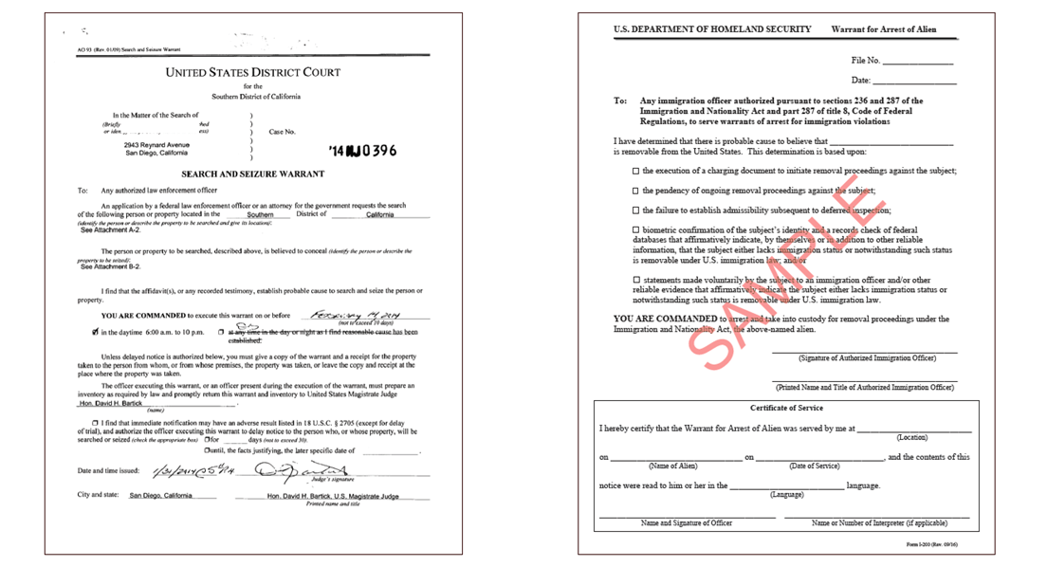
Judicial Warrants versus ICE Administrative Warrants
EXAMPLE OF ICE ADMINISTRATIVE WARRANT: SHOULD NOT GIVE IMMIGRATION PERMISSION TO ENTER HOME
EXAMPLE OF WARRANT SIGNED BY A JUDGE
8

Slide 9
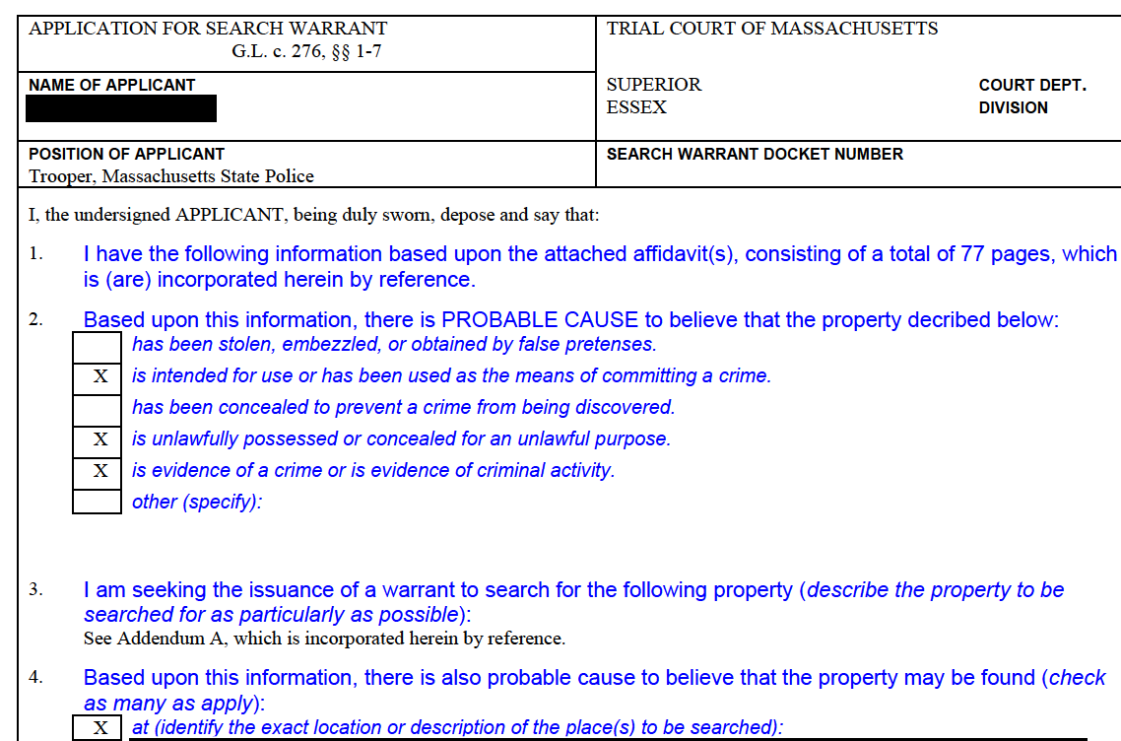
State Judicial Warrants
State Judicial Warrants can be “arrest” or “search”.
Issued by State Courts:
  Boston Municipal Court
  District Court
    (ex: Waltham, Wareham)
  Superior Court
    (ex: Middlesex, Suffolk)
  NOTE Subpoena & Summons
    are very different!

Slide 10
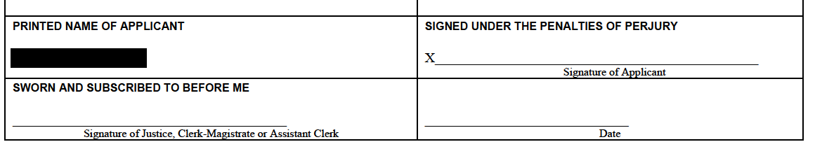
State Judicial Warrants - (continued)
Must be signed by Judge, Clerk Magistrate or Assistant Clerk.

Slide 11

If Immigration Comes to Your Home
Stay calm, take a deep breath
Legally, you do not need to open the door unless the officer provides you with a warrant signed by a judge.
You may ask officers to identify themselves (agency, name, ID).
You may ask if they have a warrant signed by a judge.
You may assert your right to remain silent and to an attorney, including if arrested by ICE. If you choose to invoke that right, state to officers “I request my right to silence and to an attorney”.
One way to assert these rights is to slide a “Know Your Rights” card under the door.
For help, call a US citizen friend, family member or an attorney.
11

Slide 12
General Rules & Requirements of ICE
The rules differ based on where ICE is trying to arrest the person.
ICE Car Stops With an Administrative Warrant:
  ICE officers are only required to have “reasonable suspicion” of an immigration violation to initiate a car stop.
Wearing a Mask:
  No known prohibitions.
Showing a Badge:
  As soon as practicable and safe to do so during arrest.
  Interpreted often as at end of arrest.
ICE Arrests With an Administrative Warrant (NOT IN A HOME):
  ICE must have probable cause to believe the person is here in violation of the laws of the United States.

Slide 13
ICE arrests Outside a Home, Without a Warrant
ICE may make arrests outside the home, in certain circumstances, without a warrant.
NOTE: ICE sometimes has a warrant, even if they will not show it to a bystander.
  The Right to Arrest Without a Warrant (NOT IN A HOME):
    To arrest a person on the streets or in a car, without a warrant, ICE must have “reason to believe” the individual is
      (i) in the US in violation of immigration laws and
      (ii) “likely to escape before an arrest warrant can be obtained.”

Slide 14
Does ICE have to show an administrative warrant?
Regulations refer to ICE “serving” the administrative warrant on the immigrant, but do not directly order the service. 8 C.F.R. sec. 236.1(b).
Who can issue an administrative warrant? The list is long, but includes:
  Supervisory deportation officers;
  Supervisory detention and deportation officers;
  Immigration Enforcement Agents; or
  Other duly authorized officers or employees of the Department of Homeland Security or the United States who are delegated the authority as provided in 8 CFR 2.1 to issue warrants of arrest, and who have successfully completed any required immigration law enforcement training.

Slide 15
Massachusetts State Executive Orders on Civil ICE Enforcement
The Governor signed Executive Order 650 on Thursday, January 29th, guidance will follow.
Prohibits warrantless immigration arrests in nonpublic areas of state Executive Agency facilities.
Prohibits use of state resources to stage civil enforcement efforts.
Prohibits future “287g” agreements with state agencies without approval and showing of public safety need.

Slide 16
Key Definitions
Recent ICE memos indicated an intent to enter into private spaces without a warrant. EO650 limits that authority in Executive State facilities.
  State facility: “any building, or part thereof, owned, leased, occupied, controlled by, or used for business by an office or agency of the Executive Department, either directly or indirectly, including but not limited to entities providing direct services on behalf of offices or agencies, but not including state-owned property leased to a federal entity.”
    Key factors
      Used by an agency of the Executive Department or providing direct services on behalf of Executive offices or agencies.
      “owned, leased occupied, controlled by or used for business…either directly or indirectly” is quite broad but still limited to Executive Agencies.
      Does not include sheriffs, locally controlled facilities.
  Non-public areas of state facilities:
    private offices;
    internal areas of administrative offices;
    places where employees must swipe a badge to enter;
    patient rooms and admitted hospital floors, and
    areas where access is limited to clients, patients or other visitors of the agency or office.

Slide 17
Rights and Responsibilities of Bystanders
You may bear witness to a public arrest.
Physically interfering with ICE could have adverse consequences.
Rights and Assistance of Bystanders.
  You can help by keeping calm and promoting calm.
  Massachusetts law allows for videotaping, if using sound must be open and obvious.
  You can offer to help remaining family members by preparing bond packet, offering support.
17

Slide 18
Helpful Bystander Actions
Think: Who, What, Where, Why, When, How, Describe
Bystander first amendment rights:
Videotaping:
  Car license plates (Victim & Police)
  Vests of Officers (FBI? ATF? HSI?)
  Arrest & Placement in car
  Any audio
  Bystanders' impressions (after they leave)
Notetaking after the fact:
  Who was there
  How many people, How long
  Describe the officers
  Describe number of cars
  Any damage to cars/people
If you Choose to help the person arrested:
  Ask the person being arrested: Who can we call.
  Ask if they have an Attorney, get name and number.
  Ask if they have a spouse or child, can you call them, get name and number.
  Ask them what the language is of the person you are calling and have a translator.
  PERMISSIONS are important: do I have your permission to call your spouse, your lawyer, can the video be shared?
  REMIND people they have rights, read Red cards to the person.
  TIME is very important. Tell them you want to call someone fast.

Slide 19

See Something, Say Something
Lawyers and media outlets need specific, verified information.
WHAT ARE THEY LOOKING FOR?
  Random stops, non-targeted enforcement
  Violence against immigrant
  Harm, mistreatment to children
  Harm, mistreatment to pregnant women
  Long term residents, green card holders, those without any criminal record
  Demeaning or outrageous behavior
  Violence against bystanders.
REPORTS:
  ACLU: 617-482-3170
  AG: https://www.mass.gov/forms/federal-action-story-collection-form
  LUCE: 617-370-5023

Slide 20
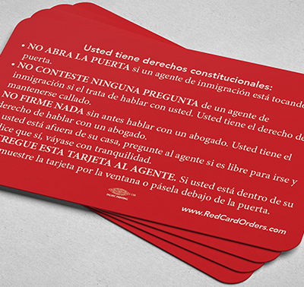
Know Your Rights Cards
Multilingual Infographic for Using Rights Card.
Asserting the right to remain silent can be difficult.
It is helpful for people to have a rights card in their wallets that they can pull out and give to immigration agents or police.
The Right to Remain Silent and an Attorney applies to ALL law enforcement encounters.
Visit: Red Cards
20

Slide 21
ORI Legal Services
21

Slide 22

Habeas Background
What is the Process when a family files for Habeas?
Habeas is filed in Federal Court
Venue & Jurisdiction required
All individuals concerned about status should: (a) consult with an immigration lawyer now, and (b) if pursuing legal representation, have a signed G28 on file with a lawyer
Mass Specific 48 hour hold rule
      Should prevent removal “from jurisdiction” for 48 hours.
22

Slide 23
Habeas Project
The Habeas Project allows for expedited filing of Habeas petitions in Federal Court.
What?
Who?
How?
Eligibility
Provides support for immigrants facing unlawful detention.
Office for Refugees and Immigrants (ORI).
MA Law Reform Institute (MLRI).
Over 300 Volunteer Federal Litigators.
Email: immigrationhabeasproject@gmail.com
A secure intake form will follow.
This inbox is monitored Monday thru Friday, 9am to 9pm (excluding holidays).
The initiative serves unlawfully detained migrants who reside in or are detained in MA, NH and ME.
Assistance for those detained throughout New England, including VT, ME, NH, RI and some CT.
23

Slide 24
Legal Representation Fund
The Legal Representation Fund is used for emergency detention cases.
What?
Who?
How?
Eligibility
  Initiative to help fund free legal representation to detained immigrants who are eligible to request an immigration bond.
  Greater Boston Accompaniment Network (BIJAN).
  Attorney General’s Office.
  Office for Refugees and Immigrants.
  Detained Hotline: (617) 637-8195
  Family & Friends Hotline: (617) 396-7143
  Individuals who are:
    Detained
    Eligible for bond without significant criminal charges
    Have ties to MA
24

Slide 25
MA Access to Counsel Initative (MACI)
The Legislature appropriated funds for Immigrant Legal Services in FY 2026.
What?
Who?
How?
Eligibility
Initiative to support detained and non-detained individuals in Massachusetts facing immigration court proceedings by providing full legal representation.
MA Immigrant and Refugee Advocacy Coalition (MIRA).
Network of Legal Providers.
Call the MACI intake line at (508) 505-4588.
Individuals who:
  Live, work or study in Mass.
  In Removal Proceedings.
  Meet Income Guidelines.
  Do not have serious criminal convictions.
25

Slide 26
For Families at risk of Homelessness or Homeless: Virtual Legal Consultations
Virtual Legal Consultations may also include assistance with application filing.
What?
  Virtual legal consultations and assistance with legal service providers.
Who?
  Immigration Legal Service Providers contracted by ORI.
How?
  Eligible individuals need to fill out this form:
  Immigration Legal Helpdesk Screening.
Eligibility
  Current Emergency Assistance Family Shelter Resident;
  Left Emergency Assistance Family Shelter in the last 12 months; or
  Current enrollment in the HomeBASE program.
26

Slide 27
Other Questions
Locating Family members can take 36-48 hours.
How do I locate my family member?
  Go to Google
  Type “ICE online detainee locator”
  You will see this website: Online Detainee Location System
  Put in family members name, country of origin and A number.
NOTE: Maine is different
NOTE: Wrong spelling, etc can delay

Slide 28
Protecting your assets: Homes, Bank Accounts and Businesses
A Limited Power of Attorney gives someone power to act on your behalf.
What is a Limited Power of Attorney?
  It gives a trusted person that you choose the power to access your bank accounts, sell your home, rent your home, engage other employees and generally manage your affairs if you are deported.
Can I have a Limited Power of Attorney drafted overseas?
  You can use delivery services such as DHL to send the original document back to the agent.
  You can use a notary overseas, however you need an apostle and it is very complicated.
What if I want to revoke the POA?
  That can be written into the language of the document.
What about my bank accounts?
  You can allow a co-signer to access your bank accounts.
  Alternatively, allow the agent of the POA.

Slide 29

At risk? Make A Safety Plan
Consider giving to relevant people:
Airport Pickup (if you must travel)
  “Sharing” your location
  Name & cell of your lawyer, close family members and G28
  Permission to Represent.
  Have LPR or US citizen pick you up @ airport
  Text when you land, make sure lawyer is on call
  Have copies of your G28 and make sure family does.
29

Slide 30
Basics of Family Preparedness
Consider:
  Obtaining a Caregiver Affidavit
  Deciding who can care for your children if you are unable to
  Ensuring school pickup lists are updated
  Obtaining passports for all children (especially US or your home country)
Write down instructions if your child has any medical conditions and/or takes any medications.
Keep Important documents in one area (including but not limited to):
Passports, birth certificates, work history, taxes, immigration paperwork, legal documents, marriage certificates and divorce decrees.
30

Slide 31

Resources
Many family planning documents can be done without an attorney.
Family Planning: Resources for Immigrants in Massachusetts | Mass.gov – MA AGO’s office website about family planning and non-discrimination, including worker’s rights.
ORI’s toolkit: Community Resource Toolkit | Mass.gov – Spanish, Haitian Creole, Portuguese family planning forms.
Community Support Initiative: Schedule a meeting between the community members you support, ORI and pro bono probate and immigration lawyers by clicking the link that says “Request a Meeting” Community Resource Toolkit | Mass.gov

Slide 32
Additional Immigration Legal Resources
It may take time to find a provider, please use trusted providers and check references.
Legal Services Directory in Massachusetts:
  Massachusetts Legal Resource Finder
  City of Boston free consultations
  MIRA immigration helpline
Legal Services Directory Outside of Massachusetts:
  Immigration Advocates Network Legal Directory

Slide 33
Thank you

