Slide 1


Learning Series
Massachusetts Health Care Training Forum
Health Connector and MassHealth Updates
Fall 2025

Slide 2
MA Health Care Learning Series
Background
The MA Health Care Learning Series provides regular updates and presentations from Health Connector and MassHealth staff, to educate those who help Massachusetts residents in applying, getting and keeping their health coverage through MassHealth, the Health Connector and Health Safety Net via MAhealthconnector.org.

Slide 3
Agenda
Health Connector Updates
  Preparing for Open Enrollment 2026
  Health and Dental Plan Offerings for 2026
  Shopping Considerations and Tools
  Key Takeaways for Plan Year 2026
  Questions

Slide 4
Preparing for
Open Enrollment 2026

Slide 5
Open Enrollment 2026
  Open Enrollment 2026 is November 1, 2025, to January 23, 2026.
  Due to the uncertainty related to enhanced premium tax credits, it is critical that applicants and members stay up to date with any communications sent from the Health Connector.
  Members should pay close attention to notices and make any updates to their application as needed, to ensure they are receiving the coverage they qualify for.
  To stay informed on Federal policy changes related to Health Connector coverage bookmark the Updates – Massachusetts Health Connector page.
  Visit Updates – Massachusetts Health Connector to stay informed about Federal changes
Notes:
Open Enrollment for plan year 2027 will be shortened to November 1, 2026 to December 31, 2026, for all State-based Marketplaces and the Federally-facilitated Marketplace.

Slide 6


Open and Closed Enrollment
Closed Enrollment January 24th through October 31st
Open Enrollment November 1st through January 23rd

Slide 7
Open Enrollment Review
Open Enrollment is the time when anyone can apply for new coverage for the coming year, renew their coverage or shop for a new plan.
  During Open Enrollment, individuals can review the available health plan choices for coverage to begin on January 1, 2026
  Health Connector coverage begins on the first day of each month
  Anyone seeking coverage for January 1st must enroll in and pay for coverage by December 23rd

Slide 8
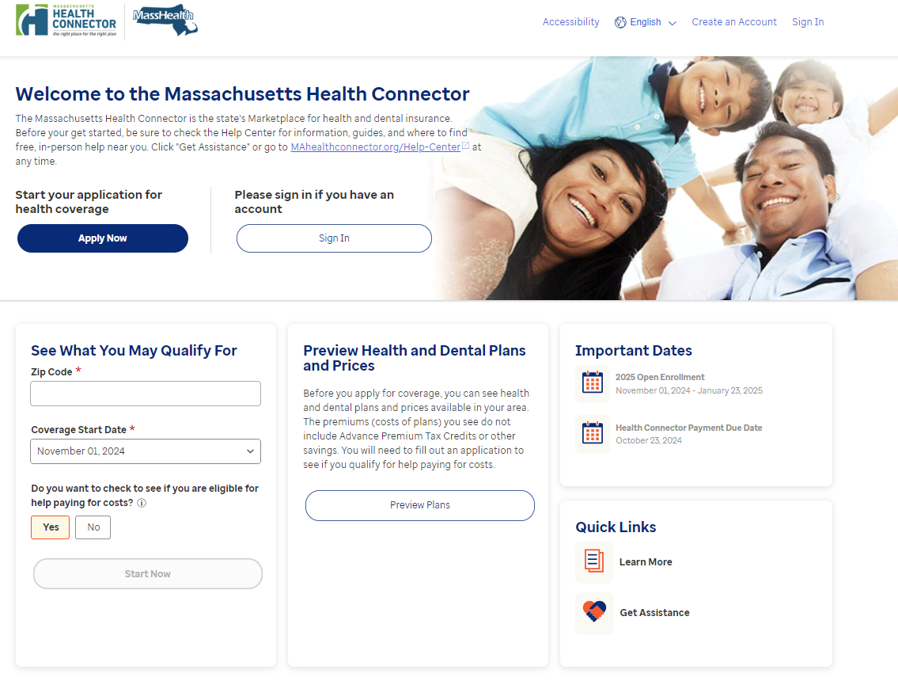
Application for Individuals and Families
Whether you’re an existing member or newly applying, you can access the application from:
MAhealthconnector.org
Spanish
MAhealthconnector.org/es
Portuguese
MAhealthconnector.org/pt/
One application for the
Health Connector, help paying,
and MassHealth

Slide 9
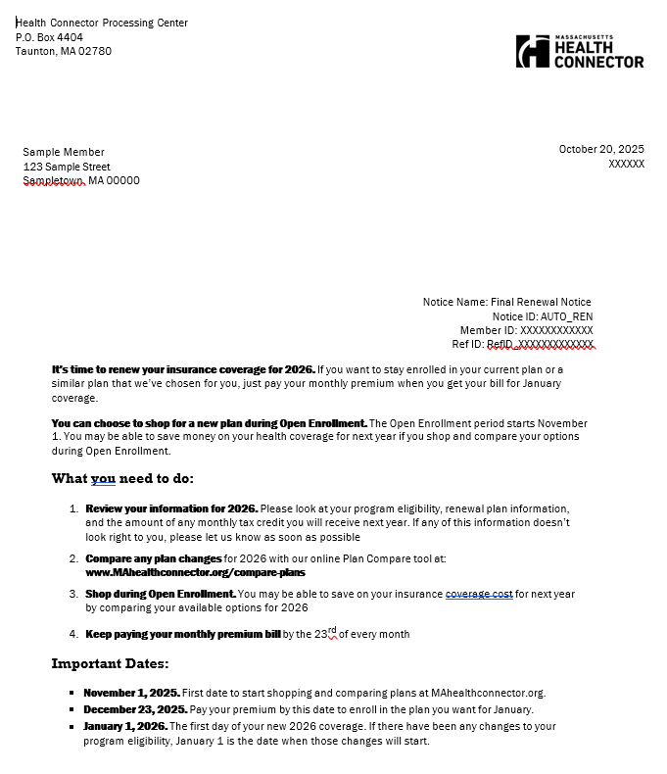
Final Eligibility Notice
In advance of November 1st, the Health Connector mails a final eligibility notice to all members. It contains important information including:
- Current plan
- New plan for 2026
- New monthly premium based on final eligibility

Slide 10
Final Eligibility Notice Details
Monthly health plan details for 2026
2026 Monthly Health Plan Cost: $XXX.XX (amount you will pay each month)
Health Insurance Renewal Information
Household Member | Date of Birth | Program Name | Current Health Plan Name | 2026 Renewal Health Plan Name | Same plan as 2025? | Date Coverage Renews
Sample Member | June 12, 1972 | Health Connector Plan (No financial help) | HEALTH PLAN NAME ConnectorCare 3 | Standard High Silver: HEALTH PLAN NAME | No | January 1, 2026
This is the amount your household will pay each month if you stay enrolled in the 2026 health insurance renewal plan listed above. Your program eligibility will change for 2026
Notes:
In this example, you can see that this member was enrolled in a ConnectorCare plan for 2025. Next year they are not.

Slide 11
Existing Members vs. New Applicants
    Both current members and new applicants can shop and enroll in a new plan that starts on Jan 1st
Actions | Existing Member | Newly Applying
1. Update or submit an application | Update application (don’t create a new one) report any income changes, household size or other life changes (ex. move, new job, birth etc.) | Complete an online application
2. Review program eligibility | If there are any document proofs that are owed, submit by the deadline requested (90 days) | If there are any document proofs that are owed, submit by the deadline requested (90 days)
3. Shop, compare and enroll in a plan | Complete plan selection and pay premium (if one is owed) by December 23 for coverage to start on January 1, 2026 | Complete plan selection and pay premium (if one is owed) by December 23 for coverage to start on January 1, 2026

Slide 12
Health Connector Plan Offerings for 2026

Slide 13
Seal of Approval
Each year, the Health Connector conducts a comprehensive review of Health and Dental Plans proposed by health and dental carriers to be sold in the upcoming year on MAhealthconnector.org. This review and process is known as the Seal of Approval process.
  The Health Connector works closely with the MA Division of Insurance, who is responsible for reviewing the rates (premiums) for each plan sold through the Health Connector, among other responsibilities related to ensuring that health insurance plans are acceptable to sell on Exchange.

Slide 14



2026 Health Connector Overview
48 Individual plans
All existing carriers responded to the 2026 SOA RFR, and no new carriers responded
Plan offerings and service areas remain steady
56 Small Group plans
12 Individual and Small Group Dental plans

Slide 15
2026 Qualified Health Plan Rates
Rates for 2026 reflect challenging provider dynamics and rising prescription drug costs amid uncertain policy changes.
Merged market rates increases were higher than last year’s 7.9 percent and are at higher levels across carriers than seen in recent years
Plans | All Plans | Unsubsidized Medical Plans² | ConnectorCare Base Silver Medical Plans³ | Dental Plans⁴
# of members | Merged Market Total¹ | 55,698 members⁵ | 328,609 members | 178,654 members
Rate Increase % | 11.5% | 13.7% | 12.4% | 5.6%
¹ For 2026, the total Division of Insurance merged market enrollment-weighted base rate change without member aging for 2025 non-group and Q1 2025 small group, inclusive of the Health Connector, is 11.5%
² Enrollment-weighted non-group premium change without member aging , assumes mapping to 2026 renewal plan
³ Enrollment-weighted non-group premium change from 2025 base silver plan to 2026 base silver plan without member aging; premium increases not directly reflected in ConnectorCare enrollee contributions.
⁴ Enrollment-weighted non-group average premiums without member aging
⁵ Enrollment data as of September 2025, including PT1 and PT3D

Slide 16
Changes to GLP 1 Drugs
All Health Connector carriers will no longer cover GLP-1 drugs for the diagnosis of obesity.
Carriers are sending notices to members to inform them that while these drugs may be covered for some diagnoses according to the carrier’s coverage policies, they will not be covered for a diagnosis of obesity as of January 1st, 2026.

Slide 17
Unsubsidized Non-Group Premium Changes
Unsubsidized non-group members will experience an average 13.7 percent increase before aging.
Unsubsidized Average Changes in Premium by Tier, before Subsidies: 2025 to 2026 ^{1,2}
Unsub Average Premium Changes By Metallic Tier | Platinum | Gold | Silver | Bronze | Catastrophic | Total
Members | 2,668 | 7,182 | 19,334 | 26,115 | 399 | 55,698
All Plans without “aging” | 10.4% | 10.2% | 13.3% | 16.2% | 8.7% | 13.7%
All Plans with “aging” | 12.3% | 12.0% | 15.0% | 18.0% | 10.4% | 15.4%
Average 2026 per member per month premium after aging | $1,117 | $891 | $673 | $600 | $389 | $686
¹ Non-group enrollment data from September 2025 – includes previous APTC only population
² Enrollment-weighted premium change with and without member aging (1.8%); assumes mapping to 2026 renewal plan

Slide 18
Changes to ConnectorCare Program for 2026
Starting January 1st, individuals and families will no longer be eligible for ConnectorCare Plan Types 1 or 3D as a result of federal policy.
​With the change in eligibility for federal PTC subsidies for individuals under 100 percent of the federal poverty level (“FPL”) and the expiration of enhanced premium tax credit (ePTC) subsidies for individuals between 400 percent and 500 percent of the FPL, eligibility for Connector Care has changed for 2026
  Individuals with incomes between 300 percent and 400 percent will continue to be eligible for the ConnectorCare pilot
  Should federal subsidies be reinstated for individuals between 400 and 500 percent of the FPL, these individuals would again be eligible for the ConnectorCare Pilot program
  Otherwise, individuals with incomes above 400 percent of the FPL may shop for unsubsidized plans through the Health Connector

Slide 19
ConnectorCare Program Design
Contributions for ConnectorCare types 2A through 3C include a moderate increase from 2025 to 2026.
Robust options with ~4 to 8 available carriers in each region
Subgroups | Plan Type 2A | Plan Type 2B | Plan Type 3A | Plan Type 3B | Plan Type 3C
Income range (% FPL) | 100-150% | 150.01-200% | 200.01-250% | 250.01-300% | 300.01-400%
2025 Minimum enrollee contribution | $0 | $51 | $99 | $147 | $226
2026 Minimum enrollee contribution | $0 | $53 | $103 | $152 | $235
Notes:
These contributions moderate the impact of inflation on the poverty guidelines, which will increase by 3.9 percent in 2026

Slide 20
ConnectorCare: Plan Designs
Covered Service | Plan Types 2A & 2B | Plan Types 3A, 3B, 3C
Medical Maximum Out-of-Pocket (Individual/ Family) | $750/$1,500 | $1,500/$3,000
Prescription Drug Maximum Out-of-Pocket (Individual/ Family) | $500/$1,000 | $750/$1,500
Preventive Care/Screening/Immunization | $0 | $0
Primary Care visit to treat injury or illness (exc. Well Baby, Preventive and X-rays) | $0 | $0
Specialist Office Visit | $18 | $22
Mental/Behavioral Health and Substance Abuse Disorder Outpatient Services | $0 | $0
Rehabilitative Speech Therapy | $10 | $20
Rehabilitative Occupational and Rehabilitative Physical Therapy | $10 | $20
Emergency Room Services | $50 | $100
Urgent Care | $18 | $22
Outpatient Surgery | $50 | $125
All Inpatient Hospital Services (including Mental/Behavioral Health and Substance Abuse Disorder Services) | $50 | $250
High-Cost Imaging (CT/PET Scans, MRIs, etc.) | $30 | $60
Laboratory Outpatient and Professional Services | $0 | $0
X-Rays and Diagnostic Imaging | $0 | $0
Skilled Nursing Facility | $0 | $0
Retail Prescription Drugs: Generics | $10 | $12.50
Retail Prescription Drugs: Preferred Brand Drugs | $20 | $25
Retail Prescription Drugs: Non-Preferred Brand Drugs | $40 | $50
Retail Prescription Drugs: Specialty High-Cost Drugs | $40 | $50

Slide 21
ConnectorCare Enrollee Contributions
The Health Connector is introducing a new, interactive ConnectorCare map for use among the community:
ConnectorCare Enrollee Contribution Dashboard - Family Size
This map allows people to:
  Review the ConnectorCare enrollee contributions for specified zip codes and regions
  Review different enrollee contributions in different areas
  Save and print maps specific to geographic areas of interest

Slide 22
Health Connector Dental Plans

Slide 23
2026 Plan Options – New Dental Plan
A new richer dental plan will be offered in 2026 by both dental carriers,
Altus and Delta Dental.
Plan Feature/ Service | Standard Family Plus NEW | Standard Family High | Standard Family Low | Standard Pediatric-Only
Plan Year Deductible | $50/$150 | $50/$150 | $50/$150 | $50/individual
Deductible Applies to | Major and Minor Restorative | Major & Minor Restorative | Major & Minor Restorative | Major & Minor Restorative
Plan Year Max (>=19 only) | $1,750 | $1,250 | $750 | N/A
Plan Year MOOP <19 Only | $350 (1 child) $700 (2+ children) | $350 (1 child)/ $700 (2+ children) | $350 (1 child)/ $700 (2+ children) | $350
Preventive & Diagnostic Co-Insurance In/out-of-Network | 0%/20% | 0%/20% | 0%/20% | 0%/20%
Minor Restorative Co-Insurance In/out-of-Network | 20%/40% | 25%/45% | 25%/45% | 25%/45%
Major Restorative Co-Insurance In/out-of-Network | 50%/70% | 50%/70% | 50%/70% No Major Restorative >=19 | 50%/70%
Medically Necessary Orthodontia, <19 only, In/out-of-Network | 50%/70% | 50%/70% | 50%/70% | 50%/70%

Slide 24
Overview of Qualified Dental Plans (QDP)
The standardized 2026 dental offering is consistent with 2025, except for a new enhance benefit plan offered.
Plan Year 2025
Carriers | Non-Group | Small Group | Plus (NEW) | High | Low | Pedi | Total
Altus Dental | ü | ü | 1 | 1 | 1 | 1 | 4
Delta Dental of MA | ü | ü | 1 | 2 | 3 | 4 | 10
TOTAL |  |  | 2 | 3 | 4 | 5 | 14

Slide 25
2026 QDP Standardized Designs
Plan Feature/ Service | Standard Family Plus (NEW) | Standard Family High | Standard Family Low | Standard Pediatric-Only
Plan Year Deductible | $50/$150 | $50/$150 | $50/$150 | $50/individual
Deductible Applies to | Major and Minor Restorative | Major & Minor Restorative | Major & Minor Restorative | Major & Minor Restorative
Plan Year Max (>=19 only) | $1,750 | $1,250 | $750 | N/A
Plan Year MOOP <19 Only | $350 (1 child) $700 (2+ children) | $350 (1 child)/ $700 (2+ children) | $350 (1 child)/ $700 (2+ children) | $350
Preventive & Diagnostic Co-Insurance In/out-of-Network | 0%/20% | 0%/20% | 0%/20% | 0%/20%
Minor Restorative Co-Insurance In/out-of-Network | 20%/40% | 25%/45% | 25%/45% | 25%/45%
Major Restorative Co-Insurance In/out-of-Network | 50%/70% | 50%/70% | 50%/70% No Major Restorative >=19 | 50%/70%
Medically Necessary Orthodontia, <19 only, In/out-of-Network | 50%/70% | 50%/70% | 50%/70% | 50%/70%

Slide 26
Health Connector Standalone Dental Plans for 2026 Applications
This Open Enrollment, applicants and members will be able to shop for a Health Connector standalone dental plan within the HIX online application, as they do for a health plan.
Shopping for standalone dental plans will be available on 11/1/2025 as part of Open Enrollment, for coverage beginning January 1, 2026.
  If members are seeking to enroll in a dental plan only for any part of 2025, customer service agents will still need to help them.
Note: Although MassHealth members have dental benefits available to them. They do have the option to purchase an additional dental plan through the Health Connector.
Notes:
The biggest enhancement in this release is that as of 1/1/2026, non-HIX dental plans will no longer exist, and agents will no longer use the Member Portal to enroll members in non-HIX dental plans for the 2026 plan year. Users and agents will be able to shop for a standalone dental plan within the HIX application, as they do for a health plan.
If members are seeking to enroll in a dental plan only for any part of 2025, agents will still need to use the non-HIX dental application and functionality in the Member Portal. Standalone dental shopping for 2026 dental plans will begin in HIX as of 11/1/2025.
Note: A more thorough training on standalone dental eligibility, enrollment, mixed household, retro, etc., will be provided before Open Enrollment.

Slide 27
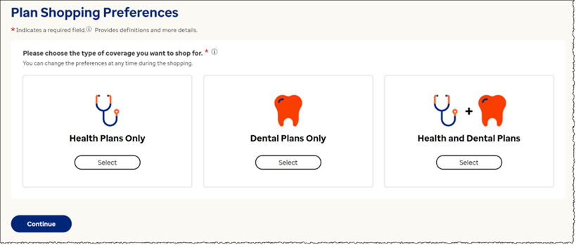
Online Application Updates- Standalone Dental
  Individuals and Families that are enrolling in dental-only coverage can now select 'Dental Plans Only,' or 'Health and Dental Plans.'

Slide 28
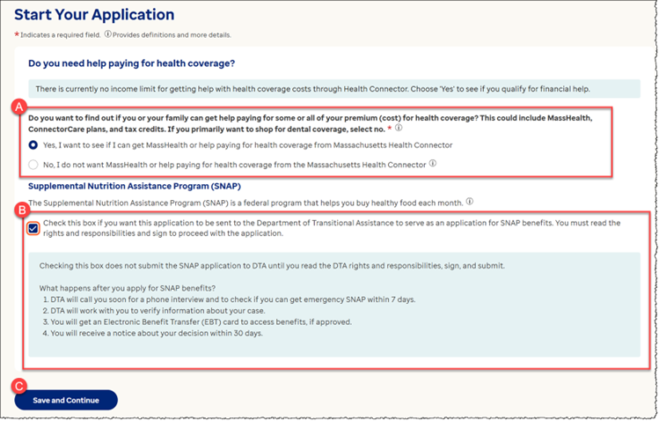
Health Connector Standalone Dental Plans for
2026 Applications
You will notice new text on the Financial Assistance question on the “Start Your Application” screen.
The updated text will read “If you primarily want to shop for dental coverage, select no.”
This will help members seeking a standalone dental plan to skip the financial assistance sections, and it shortens the application by removing unnecessary steps for those not seeking health coverage.
Notes:
As part of the standalone dental plan enhancement, Users will notice a new text on the Financial Assistance question on the “Start Your Application” screen. The updated text will read “if you primarily want to shop for a dental coverage, select no.”
This will help members seeking a standalone dental plan to skip the financial assistance sections, and it shortens the application by removing unnecessary steps for those not seeking health coverage. This change streamlines the process that makes the dental-only shopping experience more efficient.

Slide 29
Compare Health Connector Plans

Slide 30




What to consider when shopping
There are considerations when shopping for health insurance coverage and MAhealthconnector.org has tools to help you compare your options.
Premium
Covered Benefits
Out of Pocket Costs
Network
monthly amount members pay
services covered by plans
amount members pay for each service
doctors, specialists, hospitals and other facilities

Slide 31
Online Tools available from the Health Connector
Tool | Purpose | Website
Get an Estimate | See what plans are available in your area and estimates what your savings may be | Get an Estimate – Massachusetts Health Connector (betterhealthconnector.com)
Plan Comparison | Find out if preferred providers and facilities and covered through a specific plan. | Massachusetts Plan Comparison Tool 2025 (checkbookhealth.org)
Plan Finder | See if preferred providers and facilities are covered through specific plans and see the monthly cost | This tool is available when you are in “your” application on mahealthconnector.org
Whether you’re newly applying or a member who is shopping, go to MAhealthconnector.org/renew
Notes:
During Open Enrollment or anytime of the year members can log on to the HeathConnector site and use the Get an Estimate tool.
The Estimate tool is a good way to give member a general idea of what they may pay for a plan based on basic information. This tool can also give them a look at what Carrier option may be available to them before they fill out an application.

Slide 32
Enrollment, Billing and Payment
Enrollment into a health plan is not complete until premium payment has been received and processed
Anyone seeking coverage for January 1 must enroll in and pay for coverage by December 23rd
If a member received a bill for a premium they were not expecting, you still have until December 23rd to make a change

Slide 33
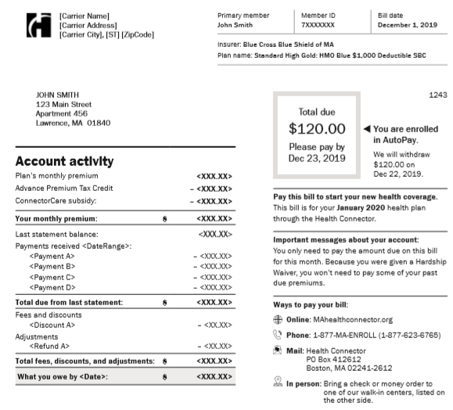
Payment Reminders
Payment for coverage starting on January 1st is due on December 23rd
Premium payments can be made:
  Online through the payment center
  By mail
  By phone (new: pay by phone option)
  For more information on how to make a
  Health Connector payment go to:
  https://www.mahealthconnector.org/how-to-pay

Slide 34
Key Takeaways for
Plan Year 2026

Slide 35
Key Takeaways for OE 2026
  Open Enrollment 2026 is November 1, 2025, to January 23, 2026.
  Due to the uncertainty related to enhanced premium tax credits, it is critical that applicants and members stay up to date with any communications sent from the Health Connector.
    Members should pay close attention to their notices and make any updates to their application as needed, to ensure they are receiving the coverage they qualify for.
  Based on federal policy, the ConnectorCare program will be available for individuals and families with income between 100 and 400 percent of the FPL

Slide 36
Plan Options for 2026
  There will be a broad choice of carriers and plans for individuals eligible for unsubsidized plans and small group enrollees, with 8 medical carriers and 2 dental carriers
  4 to 8 ConnectorCare carriers in each region
  Member premiums will increase for 2026, with the rates for unsubsidized and APTC-only plans increasing on average, 11.5 percent for 2026
  There is a new dental plan option, Standard Family Plus, for 2026
  This Open Enrollment, applicants can shop for and enroll into Dental plans online through MAhealthconnector.org

Slide 37
Available Online Tools for OE 2026
  There are many online tools and educational resources that can help members and those who are assisting them with their coverage decisions for January 1, 2026.
  A new, interactive ConnectorCare enrollee contribution map is available ConnectorCare Enrollee Contribution Dashboard - Family Size
  After November 1, updates resources will be available from the Health Connector’s Resource Download Center https://www.mahealthconnector.org/help-center/resource-download-center
  Stay up to date on Federal Policy changes that may impact Health Connector members at Updates – Massachusetts Health Connector.

Slide 38
Questions?

Slide 39
Appendix

Slide 40
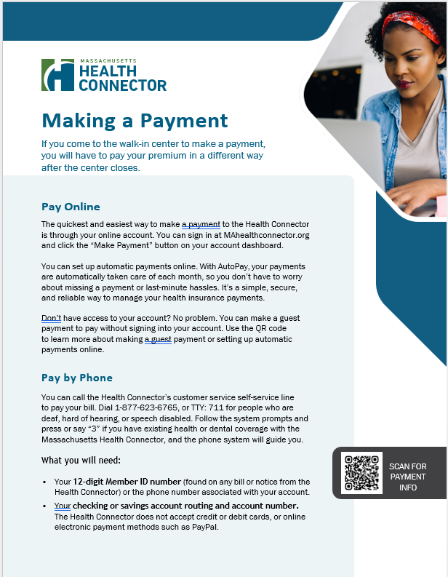
Health Connector Payment Guidelines
  Individuals previously using Walk-In Centers to make payments may be looking for guidance to make premium payments.
Visit our website: www.mahealthconnector.org/how-to-pay, for details on submitting payments.
There are three ways to submit payments:
  Online
  By phone
  By mail

Slide 41
Payment Guidelines - Pay Online
  Online payments are the quickest and easiest way for members to make payments.
Members paying online can do so by either:
  Logging into their online account at MAhealthconnector.org, or
  Visiting the Guest Portal, where members can make payments without being logged into their account.
    Remember, when paying through the Guest Portal, new enrollees will have to wait 4 hours after enrolling before they can make a payment.
    There is no wait time for submitting payments when members are logged into their account.

Slide 42
Payment Guidelines - Pay by Phone
  Members can make a payment over the phone, using our self-service payment feature.
Members must call the Health Connector at 1-877-623-6765, and then proceed with the following steps:
  Press “3” and then “1” to access the self-service features
  Enter Health Connector member ID number (12-digit number found on bills and notices)
  Enter banking and routing information
  Note: Credit, debit, or other electronic payment systems are not accepted.

Slide 43
Payment Guidelines - Pay by Mail
  Members can make payments by mailing a check or money order to this address:
Health Connector
P.O. BOX 412612
Boston, MA 02241-2612
Members should be sure to include the payment coupon with any mailed payment to ensure it will be correctly applied to their account.
  Payment coupons are included with mailed monthly invoices and are also available in the Member Portal.
  If a payment coupon is not available, include the subscriber’s full name, member ID, and mailing address on the memo line.

Slide 44
Payment Guidelines - AutoPay
  Members can enroll to have automatic monthly withdrawals (AutoPay) taken from their accounts to pay for their monthly premium(s).
Members can enroll in AutoPay by following these steps:
  Logging into their online account at MAhealthconnector.org and going to the Member Portal
  Clicking on the “AutoPay” option under “Payments” on the Main Menu, then select, “Set up new AutoPay”
  The member will need to provide their checking or savings, bank routing, and full name of their account.

