Slide 1

Learning Series
Massachusetts Health Care Training Forum
Health Connector and MassHealth Updates
Summer 2025

Slide 2
MA Health Care Learning Series
Background
The MA Health Care Learning Series provides regular updates and presentations from Health Connector and MassHealth staff, to educate those who help Massachusetts residents in applying, getting and keeping their health coverage through MassHealth, the Health Connector and Health Safety Net via MAhealthconnector.org.

Slide 3
Agenda
Health Connector
Overview of the 2025 Marketplace Integrity and Affordability Final Rule and Federal Budget Bill Provisions
Annual Health Connector Redeterminations & Renewals Process
Reminder: Walk-in Center Closures and Payment Guidelines
System Updates
Enhancements to the Online Application at MAhealthconnector.org

Slide 4
Overview of the 2025 Marketplace Integrity and Affordability Final Rule and Federal Budget Bill Provisions

Slide 5
2025 Marketplace Integrity and Affordability Final Rule and Federal Budget Bill Provisions
  CMS issued the 2025 Marketplace Integrity and Affordability Final Rule on June 25, 2025, and the Federal budget bill was signed into law on July 4, 2025.
    The Final Rule makes some changes for Exchanges, including the Health Connector. Some changes begin 60 days after the publication of the Final Rule (August 25, 2025) and other changes having a longer implementation timeframe.
    The Budget bill has several provisions that also have impacts for Health Connector programs.
    This overview provides insight into those changes that will take effect in the more immediate future.

Slide 6
Open Enrollment
  The Final Rule maintains the Open Enrollment timeframe for 2026, with a shorter Open Enrollment for 2027.
    Open Enrollment for plan year 2026 will be November 1, 2025, to January 23, 2026.
    Open Enrollment for plan year 2027 will be shortened to November 1, 2026, to December 31, 2026, for all State-based Marketplaces and the Federally-facilitated Marketplace.

Slide 7
Final Rule Changes: 60 Day Implementation (slide 1 of 4)
There are several changes that the Final Rule makes that will take effect on August 25, 2025.
These changes include:
Deferred Action for Childhood Arrivals (DACA) recipients no longer eligible for Marketplace coverage, including any subsidies.

Slide 8
Final Rule Changes: 60 Day Implementation (slide 2 of 4)
There are several changes that the Final Rule makes that will take effect on August 25, 2025.
These changes include:
Removing the automatic 60-day extension to resolve income inconsistencies.

Slide 9
Final Rule Changes: 60 Day Implementation (slide 3 of 4)
There are several changes that the Final Rule makes that will take effect on August 25, 2025.
These changes include:
End the availability of the monthly Special Enrollment Period (SEP) for individuals/families with income at or below 150% FPL.
However, other SEPs including the SEP for ConnectorCare are still in place. We encourage individuals to enroll when first eligible for the ConnectorCare SEP so they can continue to access Advanced Premium Tax Credits (APTCs) if they're eligible.

Slide 10
Final Rule Changes: 60 Day Implementation (slide 4 of 4)
There are several changes that the Final Rule makes that will take effect on August 25, 2025.
These changes include:
Require income verification when tax data is unavailable.

Slide 11
Final Rule Changes: 2026 Implementation
Other changes will be effective January 1, 2026, including:
Denying APTC after 1 year of failing to file taxes and reconcile APTCs.
  Members have until January 2026 to reconcile all previous tax years to maintain APTCs in 2026.
  Example: Someone who did not file and reconcile their taxes for 2024 will be denied APTC when applying for 2026 coverage.

Slide 12
Final Rule Changes: 2026 Implementation (continued)
Other changes will be effective January 1, 2026, including:
Prohibition on gender affirming care as an Essential Health Benefit.

Slide 13
Additional Provisions
There are a few more provisions that will impact eligibility and processes for plan year 2026.
We will provide more details once the Health Connector has finalized implementation details.

Slide 14
Annual Health Connector
Redeterminations & Renewals Process

Slide 15
Annual Health Connector
Redeterminations & Renewals Process
The Health Connector’s Redetermination and Renewal Processes are a set of activities that happen each year before and during the Health Connector’s Open Enrollment period.
  Those with health insurance coverage through the Health Connector have their eligibility redetermined so that they can be renewed into coverage for the upcoming plan year.
  In August through September, the Health Connector starts preliminary eligibility determinations for actively enrolled Health Connector members.

Slide 16

Annual Health Connector Annual
Redeterminations & Renewals Process
Be on the look out for more information (Assister email updates, meetings and MTF webinars) about any changes to these processes or plan changes that may be occurring for coverage starting January 1, 2026.
8
Final Eligibility Determination & Renewal Notice
October
Preliminary Eligibility Determination
August - September
Preliminary Eligibility Notice and Review Period
August - October
Renewal into a Health Connector Plan
November
Billing and Payment for January 1 Coverage
December

Slide 17
Reminder: Walk-in Center Closures and Payment Guidelines

Slide 18
Walk-In Center Closures
  The Health Connector closed all three Walk-In Centers.
  Below are the closure dates for each Walk-In Center:
Springfield: March 28, 2025
Worcester: May 23, 2025
Boston: June 27, 2025
See additional reminders in the appendix of this slide deck.

Slide 19
MAhealthconnector.org System Updates

Slide 20
Online Application Updates
  The online application at MAhealthconnector.org will be updated in mid August of 2025. Updates include:
MassHealth Retroactive Eligibility
Standalone Dental Shopping
Tax Filer Dependent Status
Multi-language Email Invitation
User Feedback Survey
User Experience: RefID Changes

Slide 21

MassHealth Start Date Rule
Currently, MassHealth eligibility start date is 10 days retroactive to the date of the application receive date.
Effective August 12, 2025, MassHealth eligibility start date will be the first of the month in which the eligibility determination was made – including approval and when a member is eligible for a richer benefit.
Scenario: Jenny, age 36, submitted an ACA-3 application on 8/15. She is eligible and approved for MassHealth benefits on 8/25. Her coverage start date is 8/1.

Slide 22

MassHealth Three-Month Retroactive Coverage
Effective August 12, 2025, all applicants for comprehensive MassHealth coverage have the option to request retroactive coverage for up to three months prior to their date of application.
Applicants can request three-month retro by answering the question: Do you or anyone on this application have bills for medical services they got in the three months before submitting this application?
  If YES, MassHealth may be able to pay for these bills if you were eligible during the requested time period. You may need to give MassHealth proof of income, family size, address, disability, or health insurance during the requested time period.
  Please list any individuals requesting payment of previous medical bills.
This does not apply to:
  Health Safety Net (HSN)
  Children's Medical Security Plan (CMSP), or
  the Health Connector

Slide 23
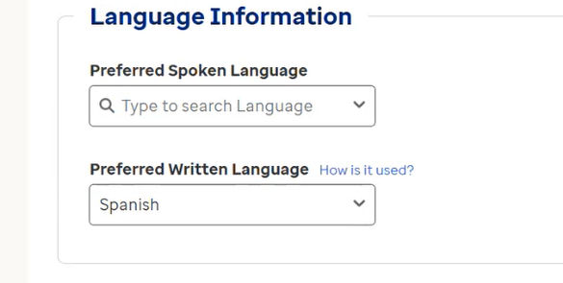
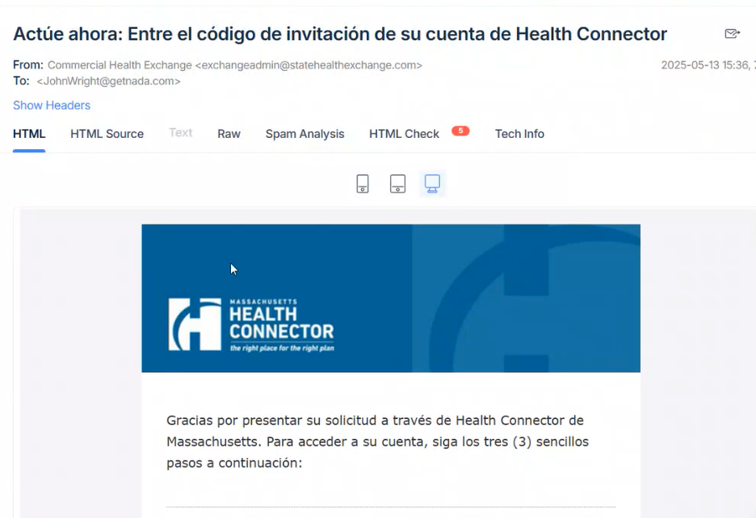
Multi-Language Support for Invite Client
Before, all Health Insurance Exchange (HIX) email invitations sent to member emails were sent in English only, no matter what the individual's preferred written language was.
Now, if the individual has selected Spanish as their preferred written language, the invitation will be sent in Spanish.

Slide 24
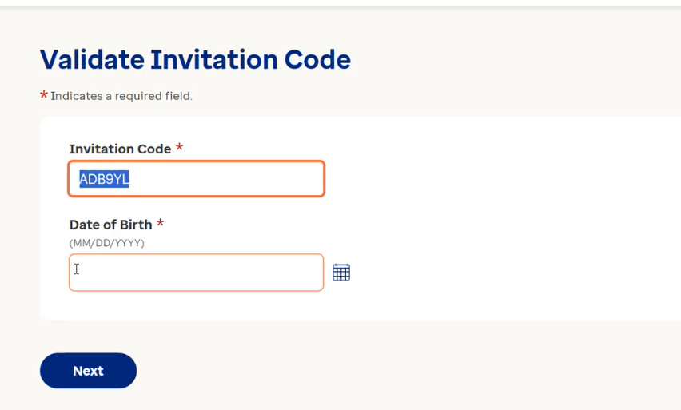
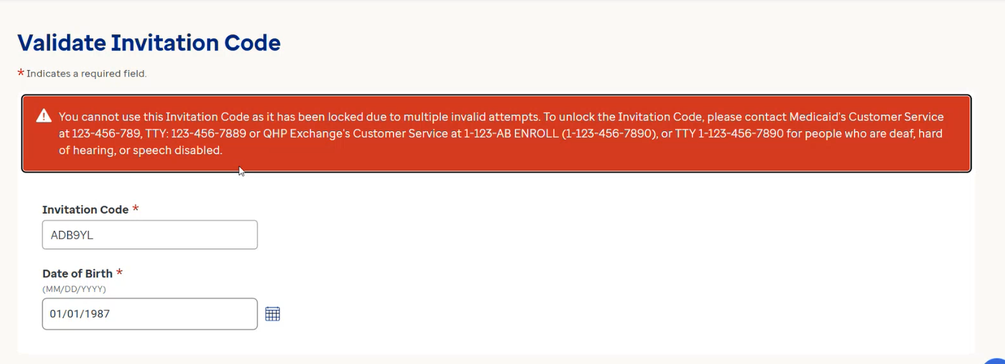
Validate Invitation Code
Before, members could try multiple combinations of their date of birth to access the account, even if the information was incorrect.
Now, there is a restriction placed on the number of attempts allowed. If the member enters the incorrect information three times, they will be locked out and must contact customer service.

Slide 25
Health Connector Standalone Dental Plans for 2026 Applications
This Open Enrollment, applicants and members will be able to shop for a Health Connector standalone dental plan within the HIX online application, as they do for a health plan.
If members are seeking to enroll in a dental plan only for any part of 2025, customer service agents will still need to help them.
Shopping for standalone dental plans will be available on 11/1/2025 as part of Open Enrollment, for coverage beginning January 1, 2026.
Note: MassHealth members have dental benefits available to them. They do have the option to purchase a dental plan through the Health Connector.

Slide 26
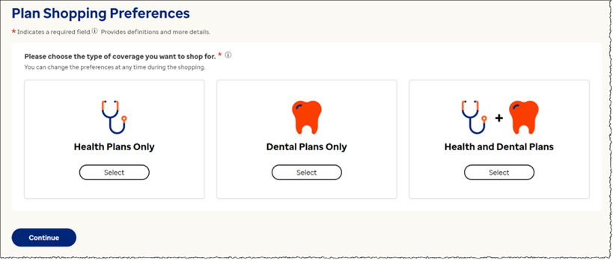
Online Application Updates - Standalone Dental
  Individuals and Families that are enrolling in dental-only coverage can now select 'Dental Plans Only,' or 'Health and Dental Plans.'

Slide 27
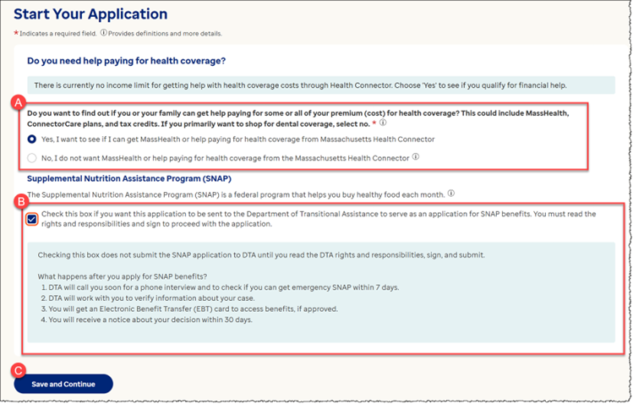
Health Connector Standalone Dental Plans for
2026 Applications
You will notice new text on the Financial Assistance question on the “Start Your Application” screen.
The updated text will read “If you primarily want to shop for dental coverage, select no.”
This will help members seeking a standalone dental plan to skip the financial assistance sections, and it shortens the application by removing unnecessary steps for those not seeking health coverage.

Slide 28
Tax Filer/Tax Dependent Status
Currently, the online application allows someone to enter an invalid tax filing combination without any warning.
Scenario: John Doe (Head of Household (HOH)), Jane Doe (Spouse), and Martha Doe (John’s mother). While completing the tax filing section in the application, John indicates he is married, filing jointly with Jane, but he also says that he is being claimed as a dependent by Martha.
This combination is generally not valid where a person who is married filing jointly cannot usually be claimed as a dependent by someone else, unless they're filing only to claim a refund and owe no taxes.

Slide 29
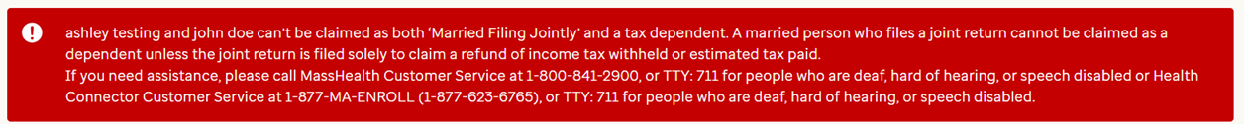
Tax Filer/Tax Dependent Status (continued)
With the new enhancement, if an applicant selects both married filing jointly and also indicates that they are claimed as a dependent, an error message will appear explaining that the selected tax relationships are not valid and prompt the applicant to review and correct their answers before they can continue with the application.
This enhancement helps ensure that tax household information is accurate on the application. This will help prevent confusion and ensure the applicants receive the correct eligibility results based on their tax filing status.

Slide 30

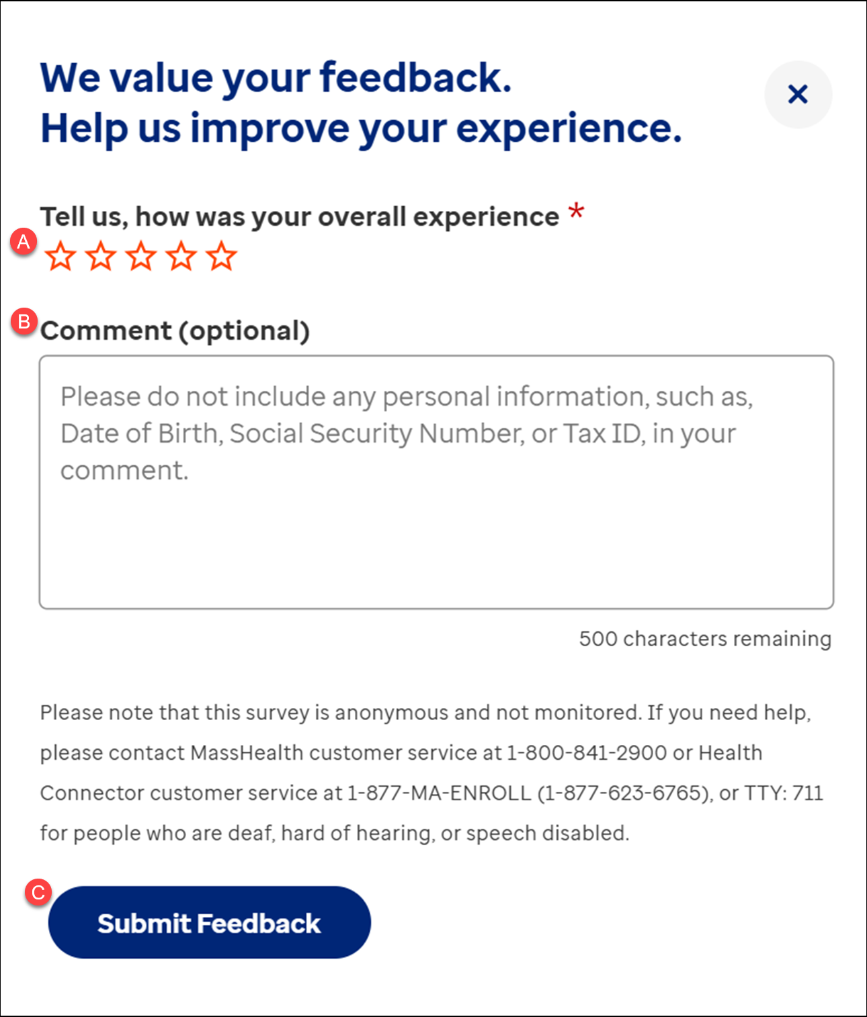
User Feedback Survey
The online application will soon have an option to provide feedback about the user's experience with the online application at any point during the application and/or enrollment process.
After an application is completed, the user will be prompted to take the survey.
The survey will only be visible to individual/members. Agents and Assisters cannot submit on behalf of members.
Members who complete the survey will not be contacted directly because the information captured is deidentified.
Note: You cannot type numbers into the survey to help prevent from adding Protected Health Information (PHI) / Personally Identifiable Information (PII).

Slide 31
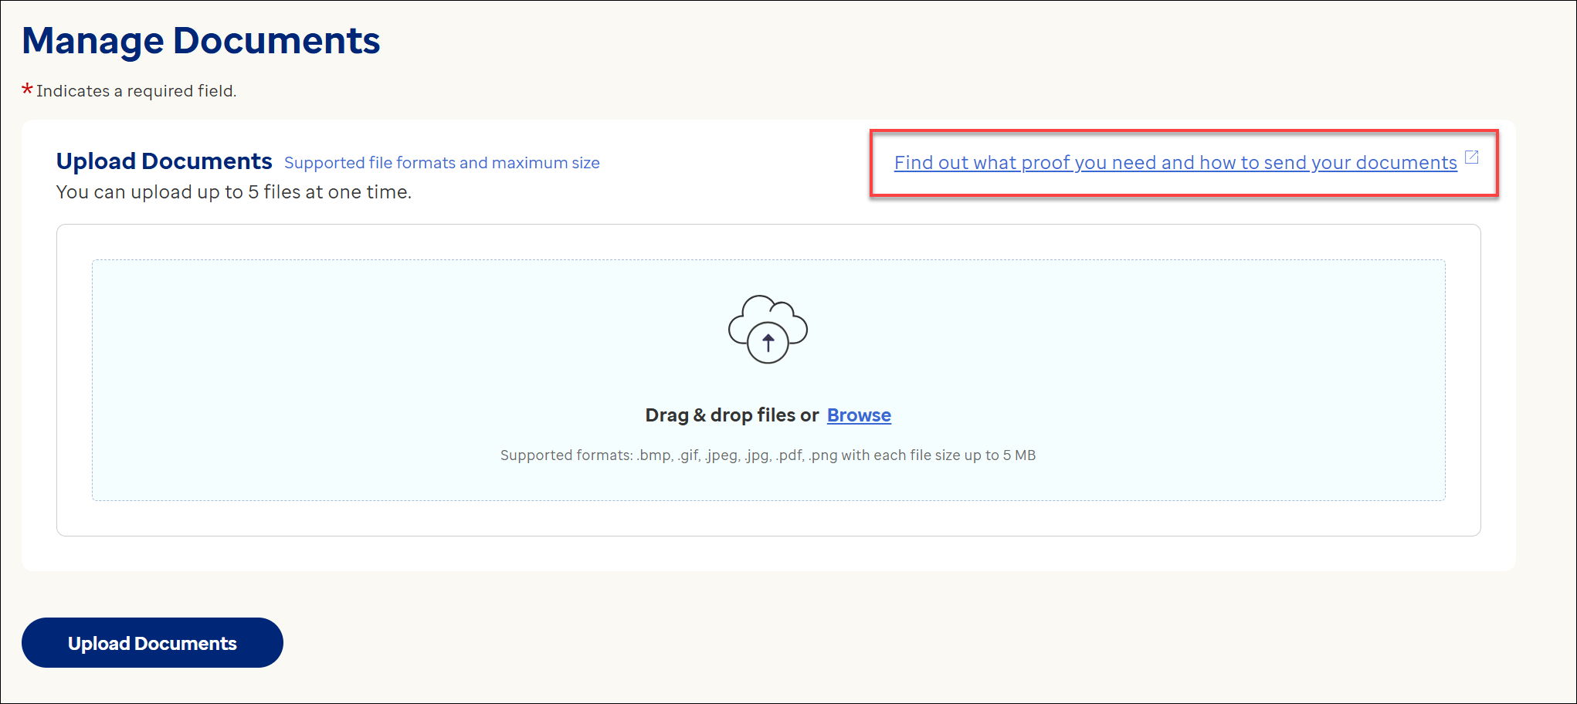
User Experience Improvements
Renamed the hyperlink on the Upload Documents page.

Slide 32
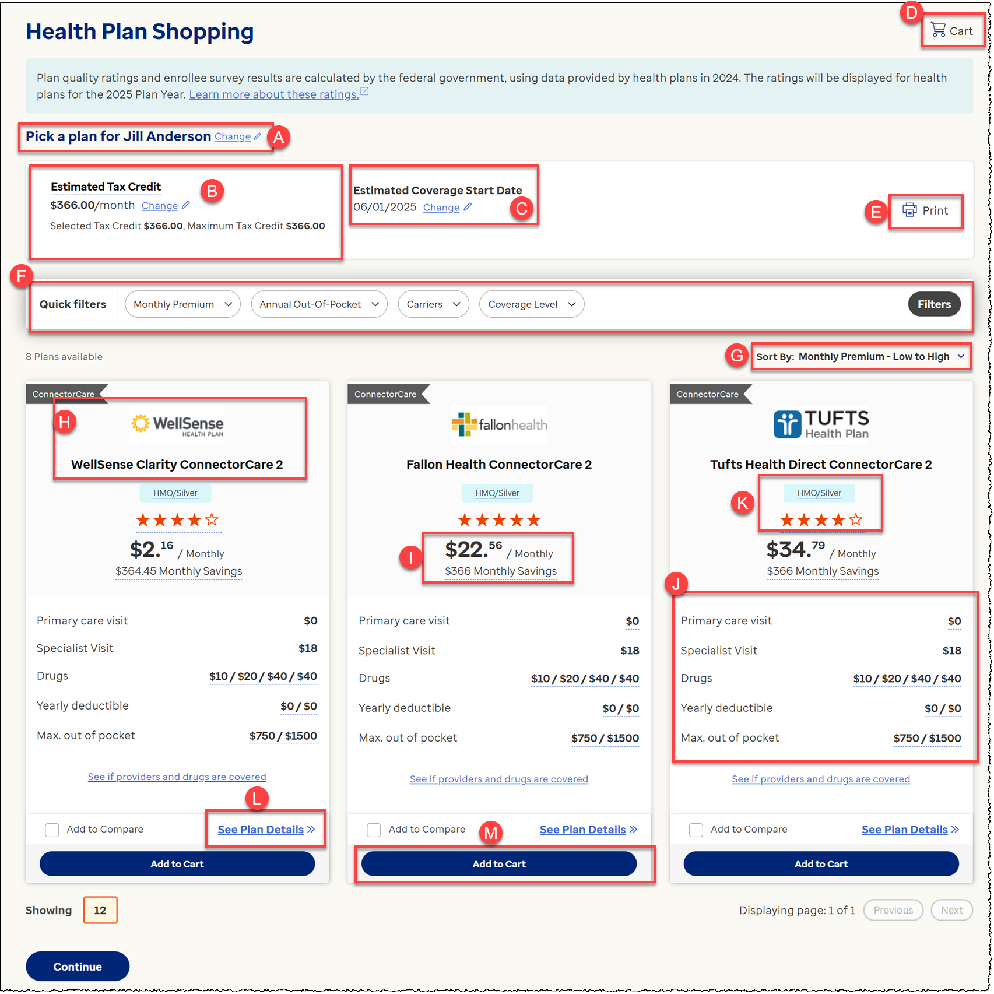
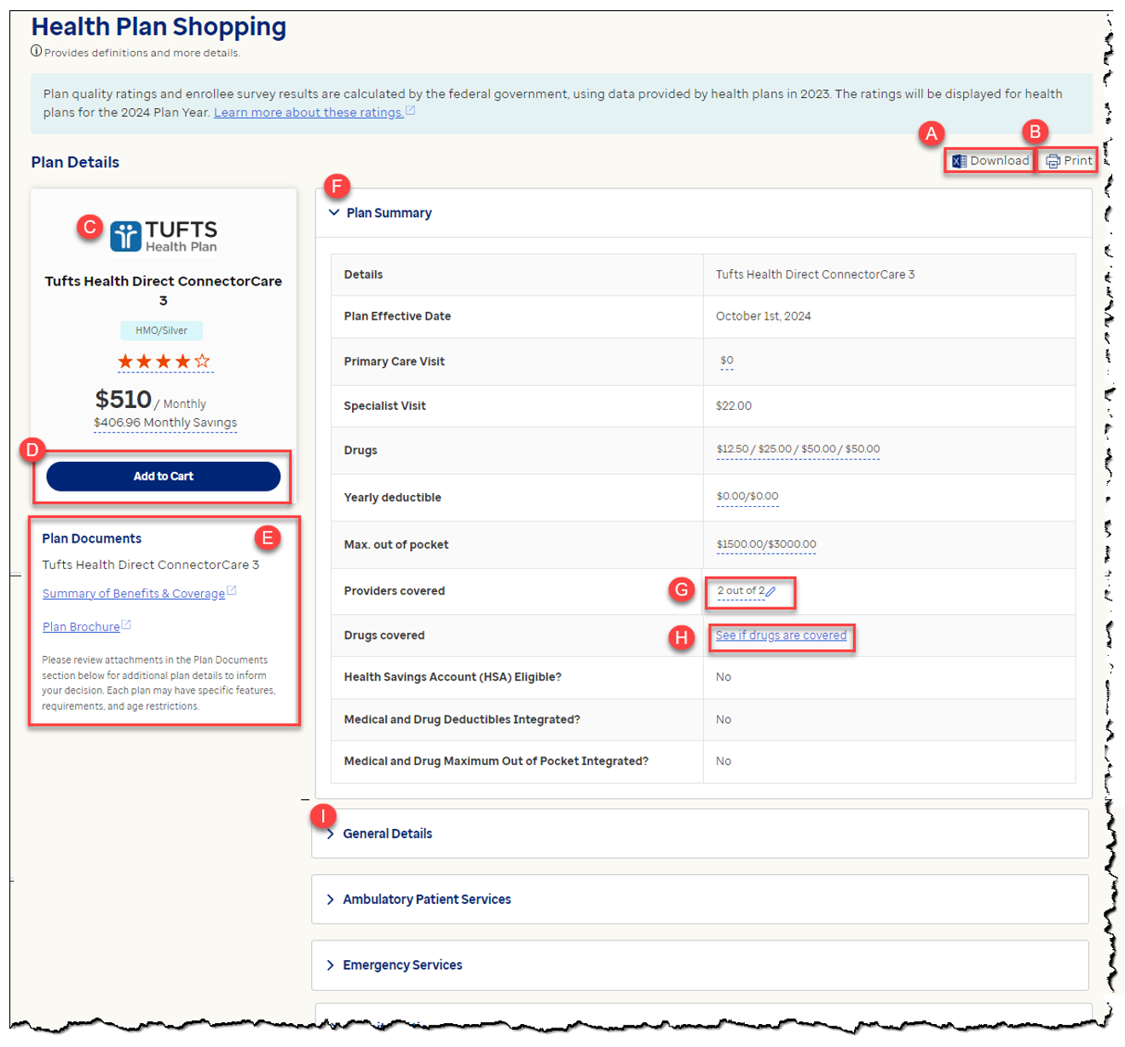
User Experience Improvements (continued)
Shopping Page – Monthly Savings
Shopping Page – Cents Not Displayed

Slide 33
Online Application Updates - User Feedback Survey and RefID
  Certified Assisters will no longer need to include "RefID" when searching for applicants/members on the Assister Portal.
  Assisters can simply type in the numbers that come after the RefID to search for existing applicants and members.

Slide 34
Appendix

Slide 35
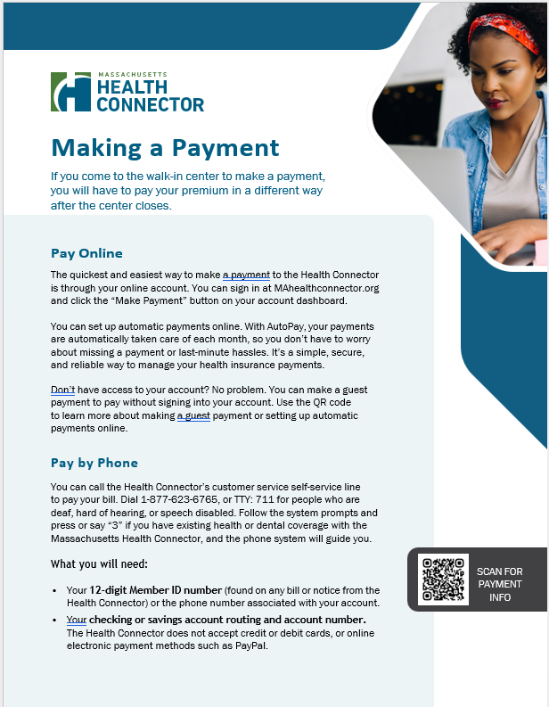
Health Connector Payment Guidelines
  Individuals previously using Walk-In Centers to make payments may be looking for guidance to make premium payments.
Visit our website: How To Pay - Pay Today - Massachusetts Health Connector, for details on submitting payments.
There are three ways to submit payments:
  Online
  By phone
  By mail

Slide 36
Payment Guidelines - Pay Online
  Online payments are the quickest and easiest way for members to make payments.
Members paying online can do so by either:
  Logging into their online account at MAhealthconnector.org, or
  Visiting the Guest Portal, where members can make payments without being logged into their account.
    Remember, when paying through the Guest Portal, new enrollees will have to wait 4 hours after enrolling before they can make a payment.
    There is no wait time for submitting payments when members are logged into their account.

Slide 37
Payment Guidelines - Pay by Phone
  Members can make a payment over the phone, using our self-service payment feature.
Members must call the Health Connector at 1-877-623-6765, and then proceed with the following steps:
  Press “3” and then “1” to access the self-service features
  Enter Health Connector member ID number (12-digit number found on bills and notices)
  Enter banking and routing information
  Note: Credit, debit, or other electronic payment systems are not accepted.

Slide 38
Payment Guidelines - Pay by Mail
  Members can make payments by mailing a check or money order to this address:
Health Connector
P.O. BOX 412612
Boston, MA 02241-2612
Members should be sure to include the payment coupon with any mailed payment to ensure it will be correctly applied to their account.
  Payment coupons are included with mailed monthly invoices and are also available in the Member Portal.
  If a payment coupon is not available, include the subscriber’s full name, member ID, and mailing address on the memo line.

Slide 39
Payment Guidelines - AutoPay
  Members can enroll to have automatic monthly withdrawals (AutoPay) taken from their accounts to pay for their monthly premium(s).
Members can enroll in AutoPay by following these steps:
  Logging into their online account at MAhealthconnector.org and going to the Member Portal
  Clicking on the “AutoPay” option under “Payments” on the Main Menu, then select, “Set up new AutoPay”
  The member will need to provide their checking or savings, bank routing, and full name of their account.

Slide 40
Thank you!

