Slide 1



Learning Series
Massachusetts Health Care Training Forum
Health Connector and MassHealth Updates
Winter 2025

Slide 2
MA Health Care Learning Series
Background
The MA Health Care Learning Series provides regular updates and presentations from Health Connector and MassHealth staff, to educate those who help Massachusetts residents in applying, getting and keeping their health coverage through MassHealth, the Health Connector and Health Safety Net via MAhealthconnector.org.

Slide 3
Agenda
Health Connector
Health Connector Special Enrollment Period (SEP) Review
End of Year Tax Filing Reminders
MassHealth
MassHealth Member Renewal Updates
System Updates
New changes to the Online Application at MAhealthconnector.org

Slide 4
Health Connector
Special Enrollment Period (SEP) Review

Slide 5
Health Connector Open and Closed Enrollment
When coverage is needed outside of Open Enrollment, encourage people to apply and see if they qualify for a Special Enrollment Period
Depending on their eligibility, they may find out they qualify for MassHealth which has different start rules and start dates
Open Enrollment for plan year 2025 ended on Thursday, January 23rd

Slide 6
Special Enrollment Periods (SEP)
  If an individual qualifies for a SEP, they can enroll in or change health insurance plans outside the annual Open Enrollment period.
Changes that allow an individual to qualify for a SEP are called Qualifying Events, and may include:
    Changes in household composition, income, immigration status, or address
    Certain life changes, like getting married, having a baby, or losing job-based health insurance
    All Qualifying Events should be reported as soon as possible

Slide 7
SEP Timeline Considerations
  A SEP gives someone 60 days from the date of the qualifying event to select a new plan
    Individuals may pay after the 60-day window, but they must submit a plan selection in the shopping process within 60 days—a plan in their shopping cart is not enough
    Payment and enrollment deadlines still apply during a SEP

Slide 8
Qualifying Events
  Below are a subset of life events that would allow for an SEP. A detailed list within the Health Connector’s Policy on Qualifying Life Events
  Loses minimum essential coverage (MEC) for a reason other than failure to pay premiums or fraud
Moves to Massachusetts or gains access to new plans as a result of a permanent move (including release from incarceration)
  Is determined newly eligible for ConnectorCare
  or has a ConnectorCare plan type change
  NOTE: A new applicant who applies during closed enrollment and is determined eligible for tax credits only and who doesn’t meet another qualifying event above, does NOT qualify for an SEP as a result
  Is a victim of domestic abuse or spousal abandonment
  Is enrolled in Health Connector coverage and becomes newly eligible or ineligible for APTCs
  Becomes a Lawfully Present individual

Slide 9
ConnectorCare SEPs
  Becoming newly eligible for ConnectorCare gives someone 60 days to enroll from the date of the eligibility determination. This includes people who become eligible for ConnectorCare due to the FPL limit increase to 500%.
    The online system looks at any existing eligibility to determine if someone is newly eligible
    ConnectorCare members cannot change plans outside of Open Enrollment unless they experience a new qualifying event, which includes a change of plan type or the start or end of a ConnectorCare premium waiver

Slide 10
ConnectorCare SEP Example
    Example: Maria applies for coverage on 2/13 and is determined ConnectorCare eligible. They have 60 days to shop and enroll into coverage. They pick a plan and pay their first premium by the due date and is enrolled in a ConnectorCare plan for March 1
    In July, Maria reports an income change to their application that results in a ConnectorCare Plan Type change. Maria is eligible to change plans, as a ConnectorCare Plan Type change is a qualifying event

Slide 11
Health Connector Policies
To find any Health Connector policy, go to the Policy Center on MAhealthconnector.org: Policies – Massachusetts Health Connector (mahealthconnector.org)
To review the complete policy on qualifying events for individuals and families go to: Policy NG-5 Mid-Year Life Events or Qualifying Events (mahealthconnector.org)

Slide 12

End of Year Tax Filing Reminders

Slide 13
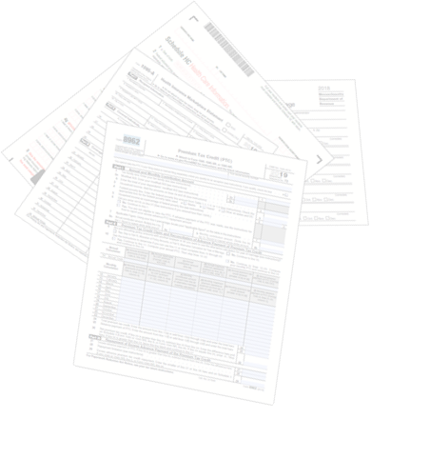
Health Coverage and Taxes
Health insurance information is needed for federal and state taxes for two reasons:
Determining subsidy eligibility
Meeting coverage requirements, both
Federal and State

Slide 14
Federal Tax Filing Requirements
Health Connector members that receive federal advance premium tax credits (APTCs) must file and reconcile them on their federal tax return to continue to be eligible for them in future years.
For members re-enrolling in coverage for 2025, individuals who do not file their taxes and reconcile their APTCs for two consecutive years, will NOT qualify for APTCs
      As an example, someone you are helping is a ConnectorCare member and received APTCs for coverage years 2022 and 2023. They did not file taxes or reconcile their premium tax credits for 2022 or 2023
      When shopping for 2025 coverage, they will NOT have access to APTC

Slide 15
State Tax Filing: Important Facts
The Massachusetts Individual Mandate is still in effect, requiring most adults 18 and over to purchase health insurance if it is affordable to them and meets Minimum Creditable Coverage (MCC) standards.
  Consumers will have to provide proof of their enrollment in health coverage on their state taxes
    Failure to have health insurance for the entire year may result in a state tax penalty
    Certain individuals are exempt and not subject to the state individual mandate tax penalty. For example, individuals with income under 150% of FPL
  For more details visit: What to do if you did not have health coverage for part or all of 2024 – Massachusetts Health Connector

Slide 16
Health Connector Member Forms
Members will receive a 1095 and 1099-HC to be used when they file their Massachusetts State Taxes and Federal Taxes.
Program | 1095 info | 1099-HC info
ConnectorCare | 1095-A from the Health Connector | 1099-HC from their health plan (carrier)
QHP with APTC or unsub | 1095-A from the Health Connector | 1099-HC from their health plan (carrier)
Catastrophic plan | 1095-B from their health plan (carrier) | 1099-HC from their health plan (carrier)
Health Connector for Business | 1095-B from their health plan (carrier) | 1099-HC from their health plan (carrier)

Slide 17
MassHealth Member Forms
Members will receive a 1095-B and 1099-HC from MassHealth
Program | 1095 info | 1099-HC info
Standard | 1095-B from MassHealth | 1099-HC from MassHealth, unless member was 18 years or older and was <150% FPL all year
CarePlus | 1095-B from MassHealth | 1099-HC from MassHealth, unless member was <150% FPL all year
CommonHealth | 1095-B from MassHealth | 1099-HC from MassHealth, unless member was <150% FPL all year
Family Assistance (Direct Coverage) | 1095-B from MassHealth | 1099-HC from MassHealth, unless member was <150% FPL all year
Health Safety Net | No form – not MEC | No form – not MCC
Limited | No form – not MEC | No form – not MCC
  For questions about why members received the Form MA 1099-HC or Form 1095-B from MassHealth, or if members want a duplicate copy of either form, contact the MassHealth Customer Service Center at (866) 682-6745, TTY: 711 for people who are deaf, hard of hearing, or speech disabled.

Slide 18
Important Timelines & Dates for
Tax Year 2024
Dates | Action
Mid-Late January | 1095-A forms sent to all Health Connector members enrolled in a QHP (including ConnectorCare members).
January | 1095-B forms will be sent to certain MassHealth Members.
March 1 – 18 | Individuals are asked to report any corrections to 1095 or 1099-HC forms to the Health Connector and/or MassHealth as soon as possible, to allow new forms to be sent out prior to the tax filing deadline.
April 15th | State and Federal Tax filing deadline.

Slide 19
Free Tax Assistance
  VITA: The Volunteer Income Tax Assistance (VITA) program offers free tax help to people who generally make $67,000 or less, persons with disabilities and limited English speaking taxpayers who need assistance in preparing their own tax returns. IRS-certified volunteers provide free basic income tax return preparation with electronic filing to qualified individuals
  TCE: The Tax Counseling for the Elderly (TCE) program offers free tax help for all taxpayers, particularly those who are 60 years of age and older, specializing in questions about pensions and retirement-related issues unique to seniors. The IRS-certified volunteers who provide tax counseling are often retired individuals associated with non-profit organizations that receive grants from the IRS
  AARP Foundation Tax-Aide: offers free tax help to anyone especially for those age 50 and older who can’t afford a tax preparation service. IRS-certified volunteers understand that retirement or other life changes may make tax filing a little more complicated. AARP membership is not required

Slide 20
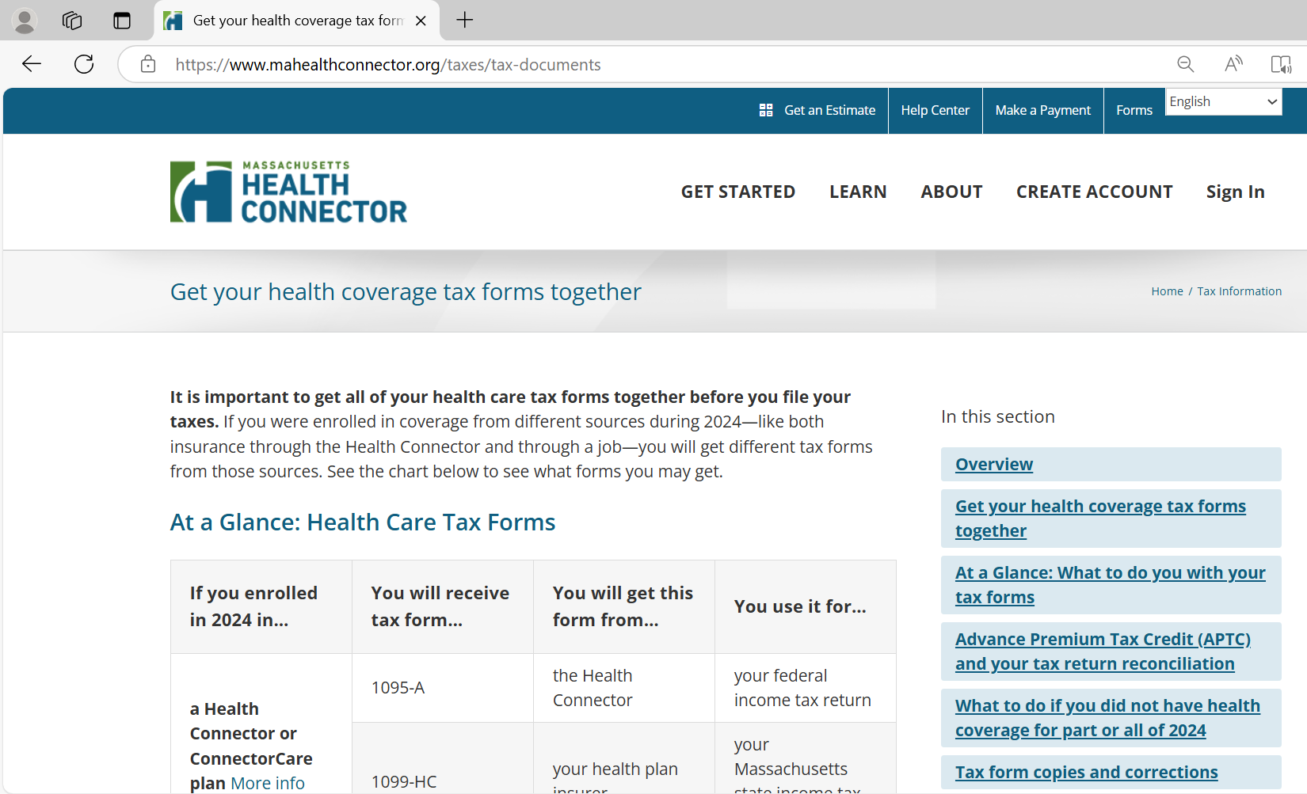
Helpful Tax Resources
The Health Connector has gathered a links and resources on:
https://www.mahealthconnector.org/taxes

Slide 21
MassHealth Renewals

Slide 22
MassHealth Redetermination and Renewal Process
MassHealth is federally required to renew members annually.
  Automatic and prepopulated renewals may be completed for eligible members
Before January of 2025, MassHealth renewed members at the household level.
  Clarifying guidance from the Center for Medicare and Medicaid (CMS): Effective January 2025, MassHealth must conduct renewals at the individual level
What does this mean?
  This will result in changes to the member renewal experience
    This applies to ALL members

Slide 23
Renewal and Redetermination Process
Non – Auto Renewal
2
Auto renewals
1
MassHealth needs more information from the member in order to complete the renewal
Members will receive a blue envelope containing renewal instructions
After members respond to the blue envelope, they may receive a Request for Verification (RFI or VC) if MassHealth needs more information from them
MassHealth is able to automatically renew a member based on information that can be verified by state and federal data sources
Members that can be auto renewed will be sent a notice in the mail notifying them of their automatic renewal

Slide 24
Auto Renewal Criteria
Whenever possible, MassHealth will attempt to automatically process a member’s renewal through multiple avenues.
A member is auto renewed if they meet the following criteria:
  All information in their application is considered verified
  The member would receive the same or a more comprehensive MassHealth benefit

Slide 25
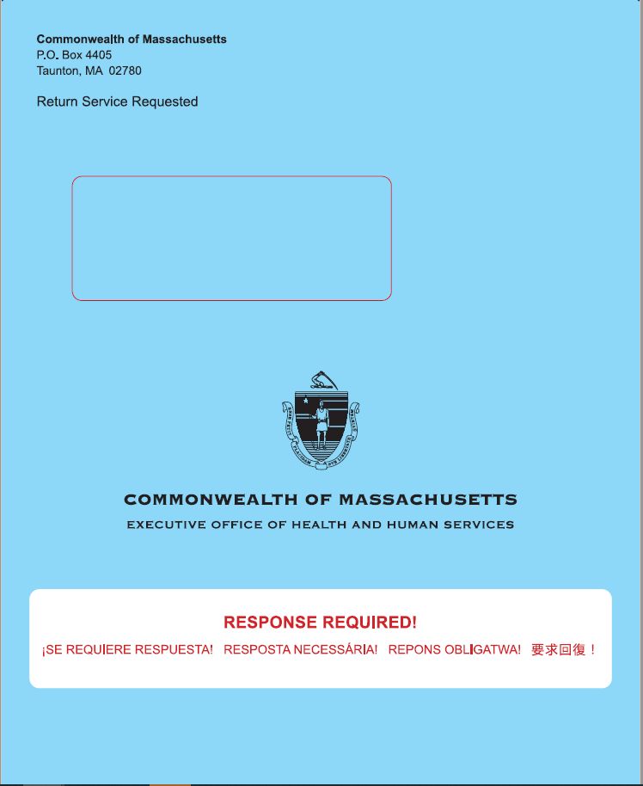
Non-Autorenewal: Renewal Blue Envelope
Content of the blue envelope:
  Renewal form
  Cover letter
  Babel sheet (translation information)
  Declination form
  Voter registration

Slide 26
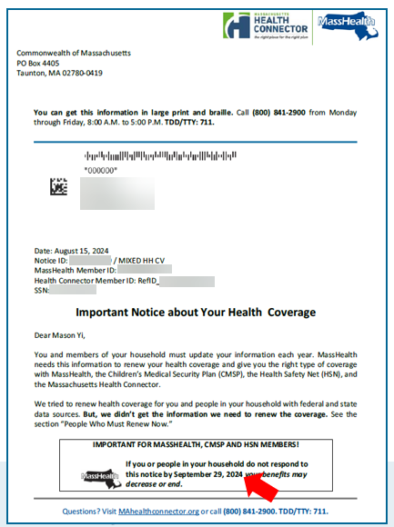
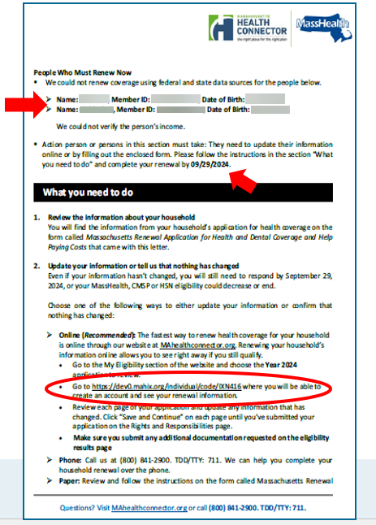
Sample Mixed Household Renewal Notice

Slide 27
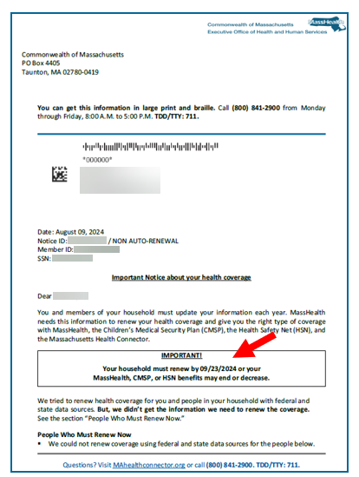
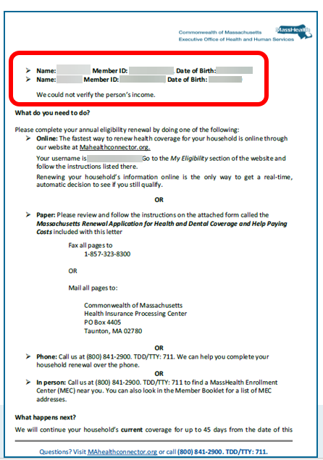
Sample MassHealth Renewal Notice

Slide 28
Renewing via MAhealthconnector.org
  The online application at MAhealthconnector.org will renew for each member of a household instead of for the combined household
    Individual members may have different renewal dates
    Notices, banners and messages on pages showing renewal information will specify which household member(s) are in a renewal period (Also see slide 39)

Slide 29
MassHealth
Renewals Scenario

Slide 30
Scenario: MassHealth Members
Joanna
Mark
Joanna (age 29) and Mark (age 30), are married and file their taxes jointly. Mark is the head of household. Joanna is pregnant and both submitted their application in March of 2024. They are both under the MassHealth income threshold.
  Program determination:
        Joanna is determined eligible for Standard and continuous eligibility
        Mark is eligible for CarePlus

Slide 31
Scenario: MassHealth Member Renewals
Joanna
Mark
One year later: March 2025, Joanne and Mark are up for renewal
Qualified member: Individual members selected for MassHealth’s renewal process
  Joanna and Mark are qualified members as they both are selected for renewal
  MassHealth pings state and federal data sources to verify information
    Results:
      Household income for Joanna and Mark is at 175% FPL

Slide 32
Scenario #1
Joanna
Mark
Joanna was auto-renewed:
  She is pregnant
  Income threshold is under 200% FPL
  Continues to be eligible for MassHealth Standard
Joanna
Mark
Mark was not auto-renewed
  Income went up, above CarePlus’ threshold

Slide 33
Question
Mark receives the blue renewal package from MassHealth, from what you already know, who will need to complete the renewal?
Both, Mark and Joanna need to complete their renewal
Only Joanna
Only Mark
They do not need to complete a renewal as they were auto-renewed for coverage
I’m not sure

Slide 34
Answer
Mark receives the blue renewal package from MassHealth, from what you already know, who will need to complete the renewal?
Answer: C
c) Only Mark

Slide 35
Scenario #1: Possible Outcome #1
Joanna
Mark
  As head of household Mark will be mailed the blue renewal notice
  Renewal notice will state:
  Joanna was auto-renewed and eligible for MassHealth Standard
  Mark needs to complete his renewal
    Mark responds to his renewal on time where he restates their original pre-renewal self-attested income and no other changes are reported
    Mark sent an RFI for income and responds to his renewal on time
  Result: Joanne remains on Standard and Mark remains on CarePlus

Slide 36
Scenario #1: Possible Outcome #2
Joanna
Mark
  Mark did not respond to his renewal on time:
      Result: Joanna remains eligible for Standard
        Using the information matched for Mark through data sources, Mark is determined eligible for the Health Connector (depending on income: ConnectorCare or QHP with HSN)
          Mark will receive a notice from the Health Connector and a denial notice from MassHealth
      New Renewal Dates:
        Joanna’s renewal date will be March 2026
        Mark selects and pays the Health Connector plan premium; he will be renewed during the next Health Connector’s renewal process in the fall of 2025

Slide 37
Scenario #1: Possible Outcome #3
Joanna
Mark
Joanne was auto-renewed, and Mark is a QHP member.
It is fall 2025 and Mark is up for renewal through the Health Connector’s renewal process
  What we know:
    Joanna will continue to be eligible for MassHealth Standard as she’s continuously eligible and her next renewal is March 2026.
    Mark will receive his renewal notice from the Health Connector and will need to respond and can pick a plan during Open Enrollment for 1/1/2026 effective date

Slide 38
MAhealthconnector.org System Updates

Slide 39
MAhealthconnector.org System Updates (R.30)
January 30, 2025, Release 30 (R30) will be deployed in the online system at MAhealthconnector.org or commonly known as HIX.
The updates will include the following:
  New Premium Waiver for Health Connector option for Document Upload on the Manage Documents page
  Minimum Value Attestation Question for Employer Sponsored Plans
  HRA Enhancements
  Ability to see "Denial" reasons for coverage
  MassHealth Renewal Display Enhancement
39

Slide 40
R.30 System Updates (slide 1 of 2)
  New Premium Waiver for Health Connector option for Document Upload on the Manage Documents page
    Account holders can now upload the Health Connector's premium waiver
    Account holders will see this as a new option when selecting an option from the drop down in Document Upload
  Applicants can see the reason for a denial if they are not eligible for MassHealth or a Qualified Health Plan
    There is link, "see denial reason," displayed next to the Program Eligibility that provides the reason for the denial

Slide 41
R.30 System Updates (slide 2 of 2)
  Minimum Value Attestation Question for Employer Sponsored Plans
    Additional question asking if the ESI plan meets minimum value standards for the entire family
    Only appears if there is another family member covered by the policy
  Health Reimbursement Account (HRA) Enhancements
    If there is an HRA reported on the application, it is no longer required to include an end date for HRA

Slide 42
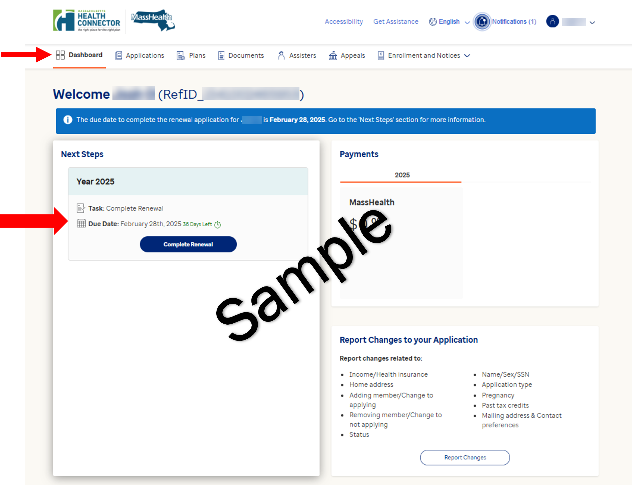
R.30 System Updates: MassHealth Individual Renewal
  Sample MassHealth Individual Redetermination and Renewal

Slide 43
Thank You!

