Slide 1


MA Health Care Learning Series
Massachusetts Health Care Training Forum
Health Connector and MassHealth Updates
Winter 2026

Slide 2
Disclaimer:
Some slides from the live presentation were adjusted to improve accessibility; however, the content remains unchanged. Because this disclaimer slide was added, the slide numbers in the video may not match the slide numbers in the printable PowerPoint or PDF file.

Slide 3
MA Health Care Learning Series
Background
The MA Health Care Learning Series provides regular updates and presentations from Health Connector and MassHealth staff, to educate those who help Massachusetts residents in applying, getting and keeping their health coverage through MassHealth, the Health Connector and Health Safety Net via MAhealthconnector.org.

Slide 4
Agenda
Health Connector Background
  Federal Policy Changes
    Helping former PT1 members access services
  End of Open Enrollment and Special Enrollment (SEP) rules
  MassHealth and Health Connector Member Tax Filing Rules
  Questions

Slide 5
Health Connector Background

Slide 6

What is the Health Connector?
The Massachusetts Health Connector is the State’s health insurance Marketplace. It offers individuals, families, and small employers access to affordable health insurance coverage.
People who don’t get health insurance through their job or other sources may apply
Many people who apply qualify for help paying
People can also buy dental insurance through the Health Connector
Small employers with less than 50 full-time employees can offer health and dental plans through Health Connector for Business

Slide 7




Health Connector Offerings
Subsidized
Plans
Dental
Plans
Small Group Plans
Unsubsidized
Plans
ConnectorCare health plans offer reduced premiums and lower plan costs based on eligibility for Advance Premium Tax Credits (APTC).
A form of insurance designed to pay a portion of the costs associated with
dental care.
Full cost health insurance plans from leading Massachusetts carriers.
Health Connector for Business plans are available to MA employers with less than 50 employees.
Notes:
The Health Connector offers 4 different kinds of insurance plans depending on your needs
Subsidized Plans: Health insurance plan with reduced premiums and lower plan costs. Some plans are available with no deductibles & low co-pays.
Unsubsidized Plans: Full cost health insurance plans.
Dental Plans: A form of health insurance designed to pay a portion of the costs associated with dental care.
Small Business: Insurance available to Employers with less than 50 employees.
Small businesses with up to 50 employees have no mandate to provide health care coverage; however, if they choose to provide insurance, they may be eligible to receive a small business tax credit.

Slide 8
Plan Offerings for Individuals and Families
Subsidized
Plans
Dental
Plans
Unsubsidized
Plans
ConnectorCare health plans offer reduced premiums and lower plan costs based on eligibility for Advance Premium Tax Credits (APTC).
A form of insurance designed to pay a portion of the costs associated with
dental care.
Full cost health insurance plans from leading Massachusetts carriers.
Notes:
The Health Connector offers 4 different kinds of insurance plans depending on your needs
Subsidized Plans: Health insurance plan with reduced premiums and lower plan costs. Some plans are available with no deductibles & low co-pays.
Unsubsidized Plans: Full cost health insurance plans.
Dental Plans: A form of health insurance designed to pay a portion of the costs associated with dental care.
Small Business: Insurance available to Employers with less than 50 employees.
Small businesses with up to 50 employees have no mandate to provide health care coverage; however, if they choose to provide insurance, they may be eligible to receive a small business tax credit.

Slide 9
Plan Offerings for Small Employers
Dental
Plans
Small Group Plans
A form of insurance designed to pay a portion of the costs associated with
dental care.
Health Connector for Business plans are available to MA employers with less than 50 employees.
Notes:
Subsidized Plans: Health insurance plan with reduced premiums and lower plan costs. Some plans are available with no deductibles & low co-pays.
Unsubsidized Plans: Full cost health insurance plans.
Dental Plans: A form of health insurance designed to pay a portion of the costs associated with dental care.
Small Business: Insurance available to Employers with less than 50 employees.
Small businesses with up to 50 employees have no mandate to provide health care coverage; however, if they choose to provide insurance, they may be eligible to receive a small business tax credit.

Slide 10
Federal Policy Changes

Slide 11

Health Savings Account (HSA)
For the first time in 2026, Health Savings Accounts (HSAs) can be used with all individual plans on the Health Connector’s Bronze tier and Catastrophic plans.
  HSAs let people set money aside to help pay out-of-pocket health care costs through an account that lets them save money at tax time. Most larger banks and personal finance companies offer quick and easy HSA options with information about how to deduct HSA contributions at tax time.
Health Savings Accounts (HSAs) - Massachusetts Health Connector
Notes:
Yes. Yes. You can open and contribute to the plan at any time during the calendar year or up until the federal filing deadline of the following year (e.g., April 15th) as long as you are enrolled in a compatible plan during that year. Just note that if enrolled for only part of the year, the amount you can contribute would be prorated.
You can open and contribute to the plan at any time during the calendar year or up until the federal filing deadline of the following year (e.g., April 15th) as long as you are enrolled in a compatible plan during that year. Just note that if enrolled for only part of the year, the amount you can contribute would be prorated.

Slide 12
January 1, 2026, ConnectorCare Changes
Due to federal policy changes, there are two major impacts to the ConnectorCare program for Plan Year 2026. ConnectorCare Plan Type 1 and Plan Type 3D have been eliminated.
ConnectorCare eligibility includes a requirement that individuals are also eligible for APTC. Since APTCs are only available for individuals earning 100 to 400 percent of the federal poverty level:
  Individuals and families with incomes under 100 percent of the federal poverty level (FPL) are no longer eligible for advance premium tax credits (APTCs) – PT1
  As federal enhanced APTCs expired at the end of 2025, those with income above 400 percent (FPL) are not eligible for APTCs or ConnectorCare
Stay up to date on federal policy changes by visiting our dedicated webpage: Updates – Massachusetts Health Connector.

Slide 13
ConnectorCare Considerations
With the expiration of enhanced premium tax credit (ePTC) subsidies for individuals above 400 percent of the FPL, eligibility for the ConnectorCare program has changed for 2026.
Individuals with incomes between 300 percent and 400 percent will continue to be eligible for the “ConnectorCare expansion pilot” program
Otherwise, individuals with incomes above 400 percent of the FPL may shop for unsubsidized plans through the Health Connector

Slide 14
Ending ConnectorCare Plan Type 1 and How to Help Members Access Services
  Many ConnectorCare Plan Type 1 members, who are no longer eligible for help paying for their coverage, because of citizenship and immigration status will be eligible for MassHealth Limited and the Health Safety Net.
  Together, MassHealth Limited and the Health Safety Net help qualified Massachusetts residents can get the essential health care services they need.
  MassHealth Limited provides emergency health services to people who have an immigration status that keeps them from getting more services.
  The Health Safety Net pays community health centers and most hospitals for certain essential health care services provided to qualified uninsured and underinsured Massachusetts residents.

Slide 15
Helping Massachusetts Residents Get
Essential Care
  Where Can These Individuals Receive Services?
  Members with MassHealth Limited can receive emergency services at any emergency room and from certain providers providing emergency services outside of a hospital.
  The Health Safety Net (HSN) can only pay for services provided by acute care hospitals and community health centers in Massachusetts. You can download a list of HSN providers from the Information for Patients page.
  Members should report changes to their address, citizenship or immigration status, income, adding a new member, email, or phone number to MassHealth as soon as possible, but no later than 10 days from the date of the change.

Slide 16
Health Connector Members in Delinquency
Health Connector members that are enrolled in a plan for January but have not yet paid for that coverage are considered delinquent. This may include individuals that lost access to premium tax credits or ConnectorCare coverage for Plan Year 2026 and are enrolled in unsubsidized Health Connector coverage for January.
Members enrolled in an unsubsidized plan that do not make a payment by January 23, 2026, will have coverage terminated retroactively to December 31, 2025.
  If they qualify for a Special Enrollment Period (SEP) at a future date, they would be able to come back into coverage with the Health Connector without being required to pay any previously past due premiums.
  ConnectorCare members that have not yet paid their monthly premium for January would also be in a delinquent status. These members have a grace period of three months to continue their ConnectorCare enrollment. For more information on delinquency processes for both unsubsidized and ConnectorCare members, please review the Health Connector’s policy: Termination of Coverage – Non-Payment of Premium.

Slide 17
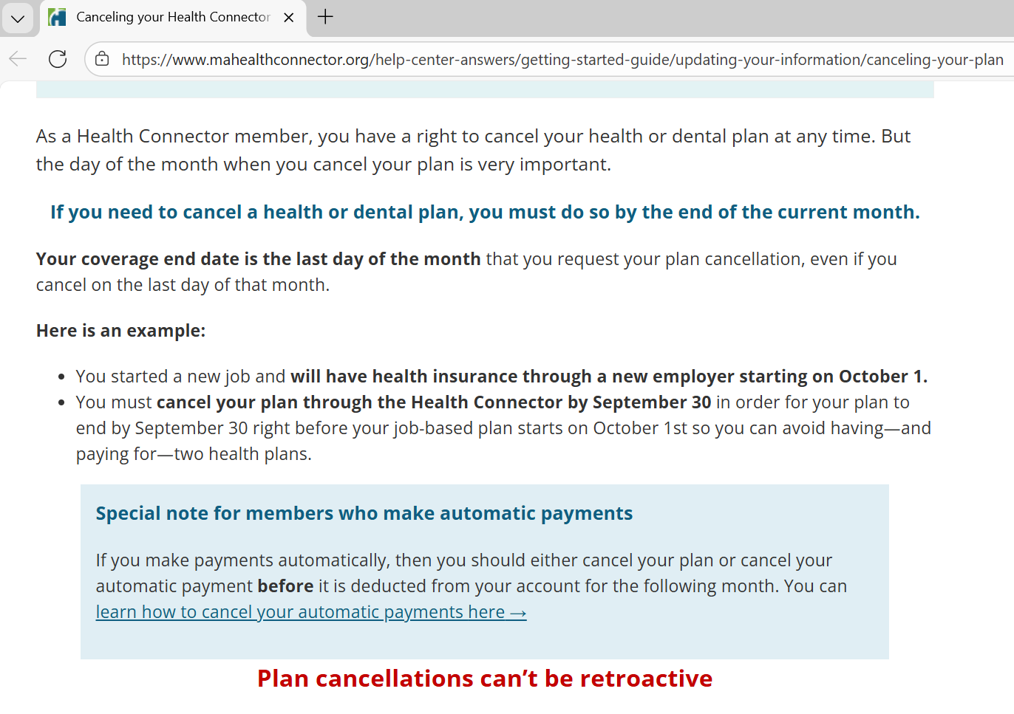
Disenrolling from Health Connector Coverage
Individuals enrolled in coverage that do not wish to continue their plan enrollment may cancel their enrollment in their online account or by contacting customer service.
For more information on how to cancel coverage, including the steps to cancel coverage online, please visit: Canceling your Health Connector health or dental plan - Massachusetts Health Connector

Slide 18
Closed Enrollment and Special Enrollment Periods (SEPs)

Slide 19


Open and Closed Enrollment
Closed Enrollment January 24th through October 31st
Open Enrollment November 1st through January 23rd
Notes:
Open Enrollment for plan year 2025 ended on Thursday, January 23rd
When coverage is needed outside of Open Enrollment, encourage people to apply and see if they qualify for a Special Enrollment Period
Depending on their eligibility, they may find out they qualify for MassHealth which has different start rules and start dates

Slide 20
The Health Connector's Open Enrollment ended Friday, January 23, 2026
During Closed Enrollment consumers can still apply for health benefits; however, they can only enroll in Health Connector coverage if they qualify for a Special Enrollment Period (SEP).
If someone qualifies under the rules of a SEP, they have up to 60 days to enroll in a Qualified Health Plan (QHP).
  Those who are newly determined eligible for ConnectorCare on or before January 23rd will automatically get a SEP to ensure they have 60 days from the date of their eligibility determination to enroll.
This means that some ConnectorCare eligible individuals can enroll in a plan or make a change to their enrollment beyond the Open Enrollment period.
Special Enrollment Period (SEP) rules will be in effect for Health Connector plans starting Saturday, January 24, 2026. Read more about the Health Connector’s policy at Special Enrollment Period - Massachusetts Health Connector

Slide 21
Special Enrollment Periods (SEP)
  If an individual qualifies for a SEP, they can enroll in or change health insurance plans outside the annual Open Enrollment period.
    Changes that allow an individual to qualify for a SEP are called Qualifying Events, and may include certain life changes, like getting married, having a baby, or losing job-based health insurance and should be reported as soon as possible
    A SEP gives someone 60 days from the date of the qualifying event to select a new plan.
    Payment and enrollment deadlines still apply during a SEP
      Individuals may pay after the 60-day window, but they must submit a plan selection in the shopping process within 60 days—a plan in their shopping cart is not enough
Notes:
Income, immigration status, or change of address may not necessarily trigger a SEP. for example, if your income is changed but there is no change in plan type, there would be no SEP. If you change your address, but are in the same region where your current plan is, there is no SEP. But a permanent move to MA would qualify and a change in income that changes Plan Types would.
Similarly, if a change in immigration status alone doesn’t qualify you for a SEP - it would be a change that became newly lawfully present and now qualify. I may just cut this first bullet and leave the second one.
(Still, people should report changes in the first bullet in case they update eligibility.)

Slide 22
Qualifying Events
  Below are a subset of life events that would allow for an SEP. A detailed list within the Health Connector’s Policy on Qualifying Life Events
  Loses minimum essential coverage (MEC) for a reason other than failure to pay premiums or fraud
Moves to Massachusetts or gains access to new plans as a result of a permanent move (including release from incarceration)
  Is determined newly eligible for ConnectorCare
  or has a ConnectorCare plan type change
  Is a victim of domestic abuse or spousal abandonment
  Is enrolled in Health Connector coverage and becomes newly eligible or ineligible for APTCs
  Becomes a Lawfully Present individual
  NOTE: A new applicant who applies during closed enrollment and is determined eligible for tax credits only and who doesn’t meet another qualifying event above, does NOT qualify for an SEP as a result.

Slide 23
ConnectorCare SEPs
  Becoming newly eligible for ConnectorCare gives someone 60 days to enroll from the date of the eligibility determination.
    Anyone newly determined eligible for ConnectorCare on, before, or after January 23rd will automatically get a SEP to ensure they have 60 days from the date of their eligibility determination to enroll
    The online system looks at any existing eligibility to determine if someone is newly eligible
    ConnectorCare members cannot change plans outside of Open Enrollment unless they experience a new qualifying event, which includes a:
      Change of ConnectorCare plan type (e.g. moving from ConnectorCare plan type 2B to 3A)
      Start or end of a ConnectorCare premium waiver

Slide 24
ConnectorCare Qualifying Event and SEP Example
    Example: Maria applies for coverage on 2/13 and is determined eligible for plan type 2B. They have 60 days to shop and enroll into coverage. They pick a plan and pay their first premium by the due date and is enrolled in a ConnectorCare plan for March 1.
    In July, Maria reports an income change to their application that results in a change from ConnectorCare plan type 2B to 3A. Maria is eligible to change plans, as a ConnectorCare plan type change is a qualifying event.

Slide 25
End of Year Tax Filing

Slide 26
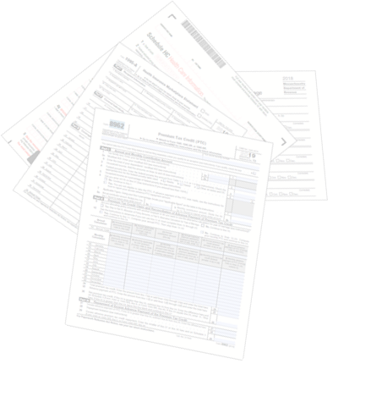
Health Coverage and Taxes
Health insurance information is needed for federal and state taxes for two reasons:
    Determining subsidy eligibility
    Meeting coverage requirements, both
    Federal and State

Slide 27
Federal Tax Filing Requirements
Health Connector members that receive federal advance premium tax credits (APTCs) must file and reconcile them on their federal tax return for each year they receive APTC
    An applicant’s tax filing status also impacts their eligibility for receiving tax credits.
    As an example, married couples must file taxes jointly, except for victims of domestic abuse or spousal abandonment, to receive access to APTCs.

Slide 28
State Tax Filing: Important Facts
The Massachusetts Individual Mandate is still in effect, requiring most adults 18 and over to purchase health insurance if it is affordable to them and meets Minimum Creditable Coverage (MCC) standards.
    Consumers have to provide proof of their enrollment in health coverage on their state taxes and failure to have health insurance for the entire year may result in a state tax penalty
    Certain individuals are exempt and not subject to the state individual mandate tax penalty. For example, individuals with income under 150% of FPL.
    For more details visit: What to do if you did not have health coverage for part or all of 2025 - Massachusetts Health Connector

Slide 29
Health Connector Member Forms
Members will receive a 1095 and 1099-HC to be used when they file their Massachusetts State Taxes and Federal Taxes
Program | 1095 info | 1099-HC info
ConnectorCare | 1095-A from the Health Connector | 1099-HC from their health plan (carrier)
QHP with APTC or unsub | 1095-A from the Health Connector | 1099-HC from their health plan (carrier)
Catastrophic plan | 1095-B from their health plan (carrier) | 1099-HC from their health plan (carrier)
Health Connector for Business | 1095-B from their health plan (carrier) | 1099-HC from their health plan (carrier)

Slide 30
MassHealth Member Forms
Members will receive a 1095-B and 1099-HC from MassHealth
Program | 1095 info | 1099-HC info
Standard | 1095-B from MassHealth | 1099-HC from MassHealth, unless member was 18 years or older and was <150% FPL all year
CarePlus | 1095-B from MassHealth | 1099-HC from MassHealth, unless member was <150% FPL all year
CommonHealth | 1095-B from MassHealth | 1099-HC from MassHealth, unless member was <150% FPL all year
Family Assistance (Direct Coverage) | 1095-B from MassHealth | 1099-HC from MassHealth, unless member was <150% FPL all year
Health Safety Net | No form – not MEC | No form – not MCC
Limited | No form – not MEC | No form – not MCC
  For questions about why members received the Form MA 1099-HC or Form 1095-B from MassHealth, or if members want a duplicate copy of either form, contact the MassHealth Customer Service Center at (866) 682-6745, TTY: 711 for people who are deaf, hard of hearing, or speech disabled

Slide 31
Important Timelines & Dates for
Tax Year 2025
Dates | Action
Mid-Late January | 1095-A forms sent to all Health Connector members enrolled in a QHP (including ConnectorCare members)
Late- January | 1095-B forms will be sent to certain MassHealth Members
March 1 – 18 | Individuals are asked to report any corrections to 1095 or 1099-HC forms to the Health Connector and/or MassHealth as soon as possible, to allow new forms to be sent out prior to the tax filing deadline
April 15th | Important: State and Federal Tax filing deadline

Slide 32
Free Tax Assistance
  VITA: The Volunteer Income Tax Assistance (VITA) program offers free tax help to people who generally make $69,000 or less, persons with disabilities and limited English speaking taxpayers who need assistance in preparing their own tax returns. IRS-certified volunteers provide free basic income tax return preparation with electronic filing to qualified individuals.
  TCE: The Tax Counseling for the Elderly (TCE) program offers free tax help for all taxpayers, particularly those who are 60 years of age and older, specializing in questions about pensions and retirement-related issues unique to seniors. The IRS-certified volunteers who provide tax counseling are often retired individuals associated with non-profit organizations that receive grants from the IRS.
  AARP Foundation Tax-Aide: offers free tax help to anyone especially for those age 50 and older who can’t afford a tax preparation service. IRS-certified volunteers understand that retirement or other life changes may make tax filing a little more complicated. AARP membership is not required.

Slide 33
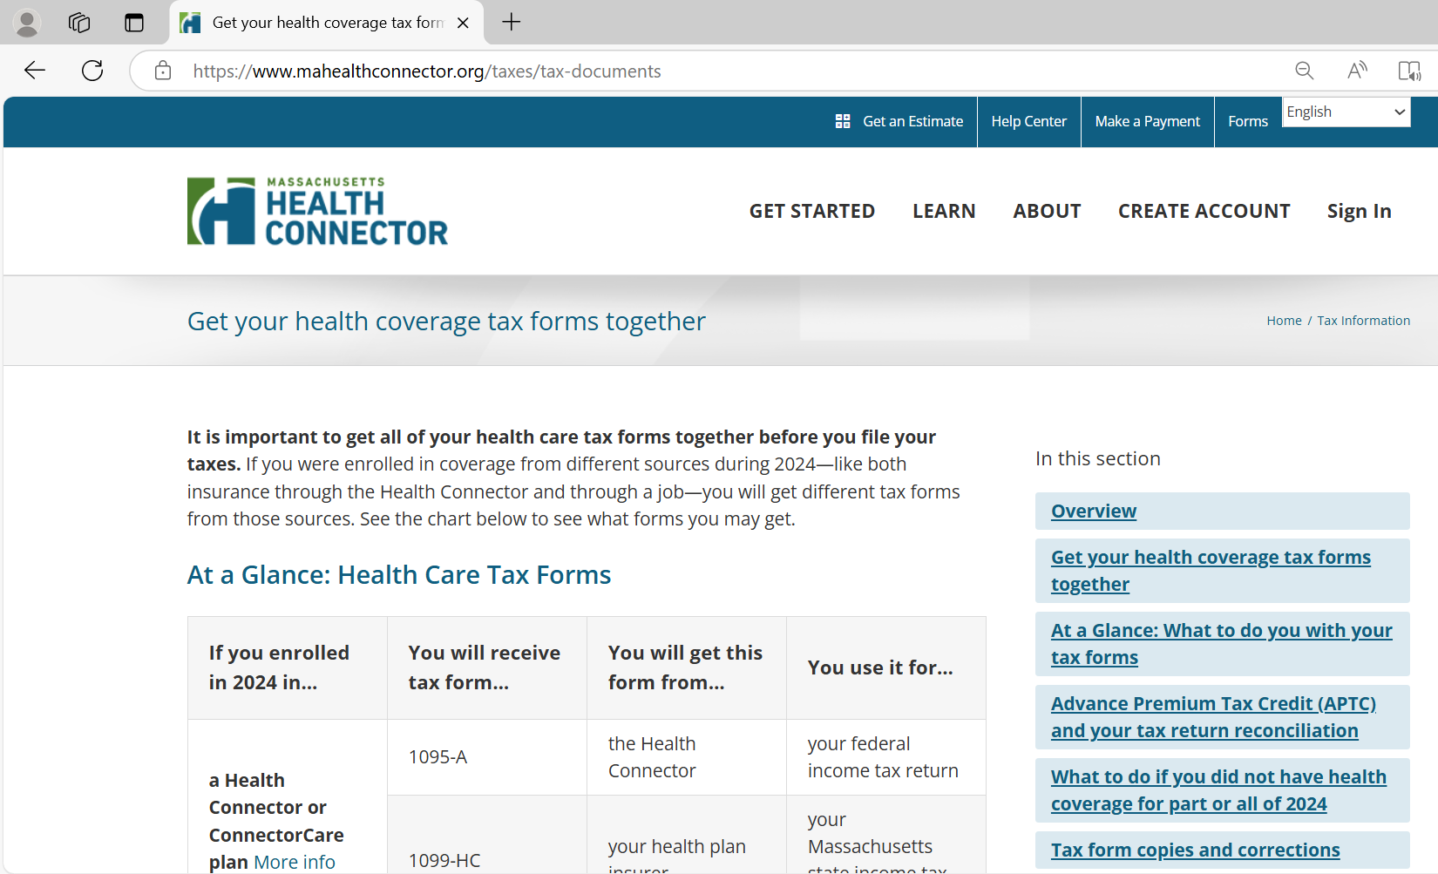
Helpful Tax Resources
The Health Connector has gathered links and resources on:
https://www.mahealthconnector.org/taxes

Slide 34
Thank You!

Slide 35
Appendix

Slide 36
Available Online Tools for OE 2026
  There are many online tools and educational resources that can help members and those who are assisting them with their coverage decisions for January 1, 2026.
  A new, interactive ConnectorCare enrollee contribution map is available ConnectorCare Enrollee Contribution Dashboard - Family Size
  After November 1, updates resources will be available from the Health Connector’s Resource Download Center https://www.mahealthconnector.org/help-center/resource-download-center
  Stay up to date on Federal Policy changes that may impact Health Connector members at Updates – Massachusetts Health Connector

Slide 37
ConnectorCare Program Design for 2026
Plan Type | FPL Range | 2025 Minimum Monthly Premium | 2026 Minimum Monthly Premium
2A | 100.01-150% | $0 | $0
2B | 150.01-200% | $51 | $53
3A | 200.01-250% | $99 | $103
3B | 250.01-300% | $147 | $152
3C | 300.01-400% | $226 | $235
Visit the Resource Download center for updated materials including Connector Care program rates for 2026: Resource Download Center - Health Connector Shopping Guide

Slide 38
ConnectorCare Enrollee Contributions
The Health Connector is introducing a new, interactive ConnectorCare map for use among the community:
ConnectorCare Enrollee Contribution Dashboard - Family Size
This map allows people to:
  Review the ConnectorCare enrollee contributions for specified zip codes and regions
  Review different enrollee contributions in different areas
  Save and print maps specific to geographic areas of interest

Slide 39
Understanding the ConnectorCare Program FPL Limits
Household Size | 100% | 133% | 150% | 200% | 250% | 300% | 350% | 400%
1 | $15,650 | $20,814.50 | $23,475 | $31,300 | $39,125 | $46,950 | $54,775 | $62,600
2 | $21,150 | $28,129.50 | $31,725 | $42,300 | $52,875 | $63,450 | $74,025 | $84,600
3 | $26,650 | $35,444.50 | $39,975 | $53,300 | $66,625 | $79,950 | $93,275 | $106,600
4 | $32,150 | $42,759.50 | $48,225 | $64,300 | $80,375 | $96,450 | $112,525 | $128,600
5 | $37,650 | $50,074.50 | $56,475 | $75,300 | $94,125 | $112,950 | $131,775 | $150,600
6 | $43,150 | $57,389.50 | $64,725 | $86,300 | $107,875 | $129,450 | $151,025 | $172,600
7 | $48,650 | $64,704.50 | $72,975 | $97,300 | $121,625 | $145,950 | $170,275 | $194,600
8 | $54,150 | $72,019.50 | $81,225 | $108,300 | $135,375 | $162,450 | $189,525 | $216,600
For each additional person, add | $5,500 | $7,315 | $8,250 | $11,000 | $13,750 | $16,500 | $19,250 | $22,000
Note: This table will be used to determine Health Connector plan FPLs for the 2026 benefit year, January 1 through December 31, 2026, only.
39

