Slide 1

Health Safety Net
Information and Updates
October 2025

Slide 2
Health Safety Net Agenda
  New Dental Administrator
  Dental Prior Authorization Waiver
  Emergency Regulation Changes
  Health Safety Net Updates
    Resweep of Claims
    Claim Adjustment Reason Code (CARC) updates
  Fiscal Year Updates
  Submission of Protected Health Information (PHI)
  HSN Pharmacy Formulary Changes
  General Information
  Questions

Slide 3
New Dental Administrator
The Executive Office of Health and Human Services will transition administrators for dental services starting in 2026. DentaQuest will provide as the third-party administrator for MassHealth, the Children’s Medical Security Plan (CMSP), and the Health Safety Net (HSN) dental services. BeneCare, which did become the Third-Party Administrator (TPA), was transitioned on March 31, 2025, for dental services. There is no precise date as of when DentaQuest will transition to the Third-Party Administrator (TPA). This will not affect members eligibility, nor the rates set for dental services.
For participating providers and members:
  No action is needed at this time and there are no immediate changes in MassHealth Dental operations.
  As of April 1, 2025, please visit massdhp.org, call 844-MH-DENTL ((844) 643-3685), or email providerrelations@massdhp.com for your MassHealth dental program needs. To receive future messages from BeneCare and the MassHealth Dental Program, please subscribe at FAQ.massdhp.org
For more information, please visit the MassHealth bulletin:
  MassHealth Dental Program Updates | Mass.gov

Slide 4
HSN Dental Prior Authorization Waiver
Please be advised that EOHHS has posted Administrative Bulletin 25-24 announcing the temporary suspension of dental prior authorization requirements for Health Safety Net (HSN).
  PA requirements for HSN dental services are temporarily suspended effective for dates of service on or after October 1, 2025 until March 1, 2026, as ongoing systemic and operational limitations are addressed.
  This temporary suspension of PA requirements applies to acute care hospitals and community health centers that are HSN dental service providers.

Slide 5
Emergency Regulation Updates
Health Safety Net has updated the regulations @ 101 CMR 614.000 including:
Updates shortfall allocation beginning FY25 for Disproportionate Share Hospitals (DSH) to set a uniform payment percentage subject to available funding when demand exceeds the HSN trust fund’s ability to pay providers at 85% of Demand.
Disproportionate Share Hospital (DSH) definition change.
  Updates definition of DSH to minimum 63% public payor mix (no longer including subsidized connector care utilization), more closely aligns with High Public Payor CHIA definition
  Data is connected to 2022
Removes references to Surcharge as it’s been replaced by Managed Care Payor Assessment regulations @ 101 CMR 515.000.

Slide 6
HSN Updates
Resweep of Current Procedural Terminology (CPT) Codes
  The Health Safety Net identified certain claims billed with procedure code 90671 as well as T1040.
Claim Adjustment Reason Code (CARC) Updates
  CARC codes 6, 8, and 45 will no longer be reimbursable for secondary claim submissions to align with existing regulations.
CPT Code | Number of Claims
90671 | 92
T1040 | 61

Slide 7
Fiscal Year Updates
Fiscal Year 2026 Rates
  Health Safety Net is actively formulating the outpatient hospital rates for fiscal year 2026 which started October 1, 2025, and continues until September 30, 2026.
  The rates will be published on the HSN website and emailed with an update as soon as the rates are finalized.
Fiscal Year 2023 Claims
  The Health Safety Net will be soon beginning final payment reconciliation for HSN Fiscal Year 2023. Providers are urged to submit any outstanding claims for FY23 prior to closure date.

Slide 8
Submission of PHI
  Protected Health Information (PHI) refers to any individually identifiable health information that is created, received, used, maintained, or transmitted by a covered entity or business associate. This includes information related to an individual’s physical or mental health condition, treatment, or payment for healthcare services. Under Health Insurance Portability and Accountability Act (HIPAA), PHI encompasses a wide range of identifiers, including names, addresses, and any other information that can be used to identify an individual.
  Health Safety Net has been receiving data and client inquires by email which contains PHI in a non-secure manner.
  If requesting or supplying client information or any details that would consist of PHI please ensure the transmission of the data is secure. If the data is not considered secure the transmission will be returned and may delay the timeliness of processing the request.

Slide 9
Upcoming Changes to Health Safety Net (HSN) Pharmacy Reimbursable Services

Slide 10
HSN Pharmacy Formulary
Currently: HSN pharmacy coverage largely matches the MassHealth formulary as listed on the MassHealth Drug List (MHDL). MassHealth covers all drugs that participate in the Medicaid Drug Rebate Program.
Effective January 12, 2026, HSN pharmacy coverage will no longer match MassHealth coverage.
Coverage will shift to a largely "generic" formulary, allowing the Commonwealth to maintain access to cost-effective care, while ensuring the long-term sustainability of the HSN program.
Rationale: Significant HSN shortfall. Significant uncertainty ahead given anticipated federal changes to health coverage.
Reducing pharmacy expenditures while maintaining access to cost-effective care is critical to maintaining the sustainability of the HSN program.

Slide 11
HSN Pharmacy Formulary (continued)
Generally reimbursable without PA: | Generally reimbursable with PA:
Generic medications (including unbranded biosimilars). Select brand name medications on the MassHealth Brand Over Generic List (BOGL) on the MHDL* Select non-drug products (i.e., alcohol swabs, lancets, pens needles, syringes, urine glucose test strips, ketone test strips). Preferred diabetes test strips within quantity limits. Vaccines. *Exceptions apply, subject to change | Preferred non-drug products (e.g., continuous glucose monitors, continuous subcutaneous insulin infusion devices). Brand medications not listed on the MassHealth BOGL. Other medications when clinically necessary.

Slide 12
HSN Pharmacy Formulary: Branded Products
  Branded medications not on MassHealth BOGL will require PA in January 2026.
Branded medications will require PA looking for the following:
  Appropriate diagnosis
  One of the following:
    Trial with all clinically appropriate covered alternatives
    Medical necessity for the branded agent instead of covered alternatives
  One of the following:
    Manufacturer does not offer a patient assistance program (PAP)
    Documentation of submission to PAP but decision is pending
    Documentation that coverage through PAP has been denied
Provisional approval (while awaiting PAP decision): one month, up to three times
Initial Approval: 6 months
Recertification: Require trials with all clinically appropriate covered alternatives or medical necessity for continued use of branded agent.

Slide 13
HSN Pharmacy Formulary: Preferred Durable Medical Equipment
Preferred DME products will require PA with criteria matching MassHealth.
Continuous glucose monitors (CGMs) and continuous subcutaneous insulin infusion (CSIIs) devices will require PA with approval criteria matching current MassHealth criteria.
  CGM criteria generally requires appropriate diagnosis, rationale for use of CGM (e.g., requires insulin or problematic hypoglycemia), and within quantity limits.
  CSII criteria generally requires diagnosis of diabetes, age, three times daily use of insulin, blood glucose testing, and within quantity limits or rationale to exceed limits.
Non-preferred DME products will not be covered by HSN unless otherwise specified (i.e., alcohol swabs, lancets, pens needles, syringes, urine glucose test strips, ketone test strips).

Slide 14
HSN Pharmacy Formulary: Other Pharmacy Coverage Changes
Existing PAs for medications will be terminated, effective January 12, 2026.
HSN will cost-avoid at the point-of-sale for patients with other insurance coverage (e.g., Medicare or third-party liability insurance) to ensure HSN is the payer of last resort.
Emergency overrides will be limited to a 72-hour supply of medication.
Vacation overrides will no longer be available.
Changes to the HSN formulary will impact pharmacy coverage.
No changes in coverage of medications administered in the outpatient or hospital settings are anticipated.

Slide 15
General Information
Health Safety Net eligible service regulations
Health Safety Net eligible payment and funding regulations
Health Safety Net Reimbursable Services
Learn about HSN-INET | Mass.gov
Information about HSN Provider Guides and Billing Updates | Mass.gov

Slide 16
MassHealth Updates

Slide 17
MassHealth Agenda
Continuous Eligibility for Over 65 Applicants and Members
Changes to MassHealth Premiums and MassHealth’s Universal Eligibility Requirement
MassHealth Health Plan Update (ACOs, MCOs, & PCC Plans)
2026 One Care Plans
Senior Care Option (SCO) Program and 2026 Plans
MassHealth Dental Plan Update
MassHealth’s My Account Page (MAP) for Members
MassHealth Coverage of Vaccine
Health Connector Updates

Slide 18
MassHealth Continuous Eligibility Coverage for Individuals 65 Years of Age and Older

Slide 19
Continuous Eligibility for Individuals 65 and Over (CE) (slide 1 of 2)
Continuous eligibility (CE) means that members retain coverage for the appointed period even if they experience changes in their circumstances that would otherwise affect eligibility.
Continuous Eligibility (CE) is a valuable tool that helps states ensure that certain populations stay enrolled in the health coverage for which they are eligible and have consistent access to needed health care services.
CE promotes health equity by limiting gaps in coverage.
We are excited to extend CE to:
    Individuals verified chronically homeless.

Slide 20
Continuous Eligibility for Individuals 65 and Over (CE) (slide 2 of 2)
Benefits of Continuous Eligibility
Drives more efficient health care spending
Improved health status and wellbeing in the short and longer term
Mitigates the impact of income volatility on families
Promotes health equity
Reduces administrative burden and costs
Enhances the ability to fully measure the quality of care
Provides states with better tools to hold health plans accountable for quality and improved health outcomes

Slide 21
Continuous Eligibility (CE)
Verified Chronically Homeless Adults (October 2025)
  Provides 24-months continuous eligibility to adults 65 years of age and older upon verified of homeless.
Reasons for possible ineligibility for CE:
  Moves out of state
  Voluntarily withdraws
  Deceased
  Erroneous initial eligibility

Slide 22
Continuous Eligibility (CE) (continued)
The CE period for new applicants begins on the effective date of eligibility
  Note: Chronically homeless needs to be verified from the state system, therefore the CE date will happen post eligibility.
Renewal and Redetermination: MassHealth will apply continuous eligibility for the appropriate time periods when a member is renewed.
Regardless of change(s) in circumstance, members with CE will not lose coverage during the designation time period.
CE is unique to the individual within the household and does not apply to the entire household.
Household members without CE still need to report changes, respond to Request for Information (RFIs), and complete renewals or they will risk losing coverage.

Slide 23
Member Scenarios: Chronically Homeless
Applicant applies for MassHealth and deemed eligible, coverage begins
One year after CE initial eligibility, renewal is sent (changes will not affect CE)
November
2025
November 2026
November 2027
MassHealth receives report that member has been experiencing homeless for >6 months, CE is applied
CE ends

Slide 24
Updates to MassHealth Premiums

Slide 25
Updates to MassHealth Premium
Certain MassHealth members may be charged a monthly premium if they are:
  MassHealth Standard, CommonHealth or Family Assistance members who have income above 150% of the federal poverty level (FPL).
Calculation of premium amounts.
  Premium amounts are calculated based on a member’s household modified adjusted gross income (MAGI) and their household size and the premium billing family group (PBFG).
What’s changing
MassHealth will annually adjust and publish the monthly premium amount for each coverage type starting in calendar year 2026.

Slide 26
Update to MassHealth’s Universal Eligibility Requirement

Slide 27
MassHealth Eligibility
Six universal requirements that all members and applicants must meet (130 CMR 503.000 & 130 CMR 517.000):
  Massachusetts residency
  Social Security Number (SSN), if applicable
  Assignment of Rights to Medical Support & Third-Party Payments: cooperating with those that may be legally obligated for someone to pay for their care
    Good Cause for Non-Cooperation
  Assignment for Third Party Recovery: an applicant or member must inform MassHealth when any such individual is involved in an accident, or suffers from an illness or injury, or other loss that has resulted or may result in a lawsuit or insurance claim
  Potential Sources of Healthcare & Utilization of Potential Benefits: MassHealth is payor of last resort
  Utilization of Potential Benefits

Slide 28
Elimination of Utilization of
Potential Other Benefits Requirement
MassHealth will eliminate the requirement that individuals apply for other cash benefits for which they may be entitled as a condition of Medicaid eligibility (e.g., Social Security, retirement benefits, etc.).
Applicants and members must still obtain and maintain other health insurance available to them at no additional cost, including Medicare.
Failure to do so may result in loss or denial of eligibility.

Slide 29
MassHealth Health Plan Update

Slide 30
Polling Question
Who’s eligible to enroll in MassHealth ACO, MCO, or PCC health plans?
  Members younger than 65, no third-party liability (TPL) (including Medicare)
  Members who live in the community (for example, not in a nursing facility)
  Members eligible for one of MassHealth’s comprehensive coverage types
  Seniors over age 65
  Members Dually eligible for MassHealth and Medicare
  None of the above
  a, b, and c
  I don’t know

Slide 31
Polling Answer
Who’s eligible to enroll in MassHealth ACOs, MCO, or PCC health plans?
Answer: G: a, b and c
  Members younger than 65, no third-party liability (TPL) (including Medicare)
  Members who lives in the community (for example, not in a nursing facility).
  Members eligible for one of MassHealth’s comprehensive coverage types.

Slide 32

Who’s Eligible to Enroll?
MassHealth members eligible to enroll in a MassHealth ACO, MCO, or PCC Plan:
  Under 65, no third-party liability (TPL) (including Medicare)
  Live in the community (for example, not in a nursing facility)
  In the following MassHealth coverage types:
    MassHealth Standard
    MassHealth CommonHealth
    MassHealth CarePlus
    MassHealth Family Assistance
For additional details see 130 CMR 508.001-002

Slide 33
ACO Changes Starting 1/1/2026
Service Area Changes
WellSense Care Alliance will no longer be offered in the following service areas:
  Brockton
  Haverhill
Provider Changes
As of January 1, 2026, 30 providers are joining or moving in the MassHealth ACO program. These moves will affect approximately 20,000 members
Hospital Changes
As of January 1, 2026, 2 ACOs will make changes to their hospital network. However, in an emergency, members can go to any hospital. Members do not need to worry about which health plan they have

Slide 34
ACO Hospital Network Changes
Plan Name | Will add the following hospital to its network
Mass General Brigham Health Plan with Mass General Brigham ACO | Mercy Medical Center (Trinity Health of New England), Springfield
Plan Name | Has removed the following hospital from its network
Fallon Atrius | Baystate Medical Center (Baystate Health), Springfield
Mass General Brigham Health Plan with Mass General Brigham ACO | Holyoke Medical Center, Holyoke

Slide 35
Hospital Name Changes
Hospital | New Name
Morton Hospital (Lifespan Health Systems), Taunton | Morton Hospital (Brown University Health)
Saint Anne’s Hospital (Lifespan Health Systems), Fall River | Saint Anne’s Hospital (Brown University Health)
St. Elizabeth’s Medical Center, Brighton | Boston Medical Center – Brighton
Good Samaritan Medical Center, Brockton | Boston Medical Center – South Brockton

Slide 36
Changes to Available Health Plans in 2026
On January 1, 2026, the Tufts Health Together Managed Care Organization (MCO) will be discontinued.
This will affect approximately 25,000 members.
Members currently enrolled in the Tufts Health Together MCO will be re-assigned to the health plan that their primary care provider (PCP) will be participating in moving forward, if possible.
  Members will receive a notification letter about their new health plan assignment and providing additional information about their options, including how to change health plans.
Leading up to January 1, 2026, MassHealth will work with the Tufts Health Together MCO and the members’ future health plans to coordinate transitions of care, including exchanging information about prior authorizations and referrals.

Slide 37
2026 Health Plan Options for
Individuals Younger than 65 (slide 1 of 2)
Accountable Care (ACO) Partnership Plans (ACPP)
Fallon Health - Atrius Health Care Collaborative
Berkshire Fallon Health Collaborative
Fallon 365 Care
BeHealthy Partnership Plan
Wellsense Beth Isreal Lahey Health (BILH) Performance Network ACO
Wellsense Community Alliance
Wellsense Boston Children's ACO
East Boston Neighborhood Health Wellsense Alliance
Wellsense Mercy Alliance
Wellsense Signature Alliance
Managed Care Organizations (MCO) Plan
WellSense Essential MCO
Primary Care Clinician (PCC) Plan
Primary Care ACO Plans (PCACO)
Community Care Cooperative (C3)
Revere Health Choice

Slide 38
2026 Health Plan Options for
Individuals Younger than 65 (slide 2 of 2)
Accountable Care (ACO) Partnership Plans (ACPP)
Wellsense Southcoast Alliance
Wellsense Care Alliance
Mass General Brigham Health Plan with Mass General Brigham ACO
Tufts Health Together with Cambridge Health Alliance (CHA)
Tufts Health Together with UMass Memorial Health

Slide 39
Continuity of Care Period
The Continuity of Care (CoC) period for medical and behavioral health services will be from January 1, 2026 to March 31, 2026 (90 days).
Need help accessing pharmacy or specialty networks?
  Members can seek assistance from their health plan. Each plan can help with any access-to-care issues regarding pharmacy and specialty network issues during this period.

Slide 40
Plan Selection and Fixed Enrollment Period
Plan Selection Period
Fixed Enrollment Period
Members enrolled in a MassHealth MCO or ACO health plan will have a 90-day Plan Selection Period every year.
During this time, members can enroll or switch their health plans for any reason.
If members are happy with their current health plan, they do not need to take action. They will remain in their current plan.
After the 90-day Plan Selection Period has ended, members will enter a Fixed Enrollment Period.
Once in their Fixed Enrollment Period, the member cannot move to another health plan until the next Plan Selection Period, unless MassHealth determines that one of the fixed enrollment period exceptions applies.
Members can always call MassHealth for more information about their Plan selection Period and Fixed Enrollment Period.

Slide 41

Resources
Learn, Compare, Enroll at MassHealthChoices.com
MassHealth Enrollment Guide 2026
Call MassHealth at (800) 841-2900; TTY: 711

Slide 42
2026 One Care Plans

Slide 43
One Care Program and Plans
One Care combines MassHealth & Medicare benefits into one plan with one card and one care team. One Care covers medical, mental health, and prescription medications, plus support for daily tasks and independent living.
Care Coordinators help members stay healthy and get the services they need.
Available since 2013.
Who’s eligible to enroll in a One Care Plan?
Dual eligible adults with disabilities:
  Ages 21-64 at the time of enrollment
  Have both MassHealth Standard or CommonHealth and Medicare (Parts A and B and are eligible for Part D)

Slide 44
One Care Plans Available 1/1/2026
Commonwealth Care Alliance (CCA)
Mass General Brigham Health Plan (MGBHP) NEW FOR 2026
MolinaOne Care NEW FOR 2026
Tufts (Point32Health)
UnitedHealthcare (UHC)
Disclaimer: Enrollment in the plan depends on the plan executing a Medicare Contract in September 2025

Slide 45
2026 One Care Plans: New Statewide Availability
One Care Plan/ County | CCA | MGBHP | Molina | Tufts | United | # One Care Plans in County
Barnstable | Y | N | N | Y | N | 2
Berkshire | Y | N | N | N | N | 1
Bristol | Y | Y | Y | Y | Y | 5
Dukes | N | Y | N | N | N | 1
Essex | Y | Y | Y | Y | Y | 5
Franklin | Y | N | N | N | N | 1
Hampden | Y | N | Y | Y | Y | 4
Hampshire | Y | N | Y | Y | Y | 4
Middlesex | Y | Y | Y | Y | Y | 5
Nantucket | N | Y | N | N | N | 1
Norfolk | Y | Y | Y | Y | Y | 5
Plymouth | Y | Y | Y | Y | Y | 5
Suffolk | Y | Y | Y | Y | Y | 5
Worcester | Y | N | Y | Y | Y | 4
Legend
Y = County offered by One Care Plan
County would be newly covered by Plan or would be a new option in One Care
N = County not offered by One Care Plan

Slide 46
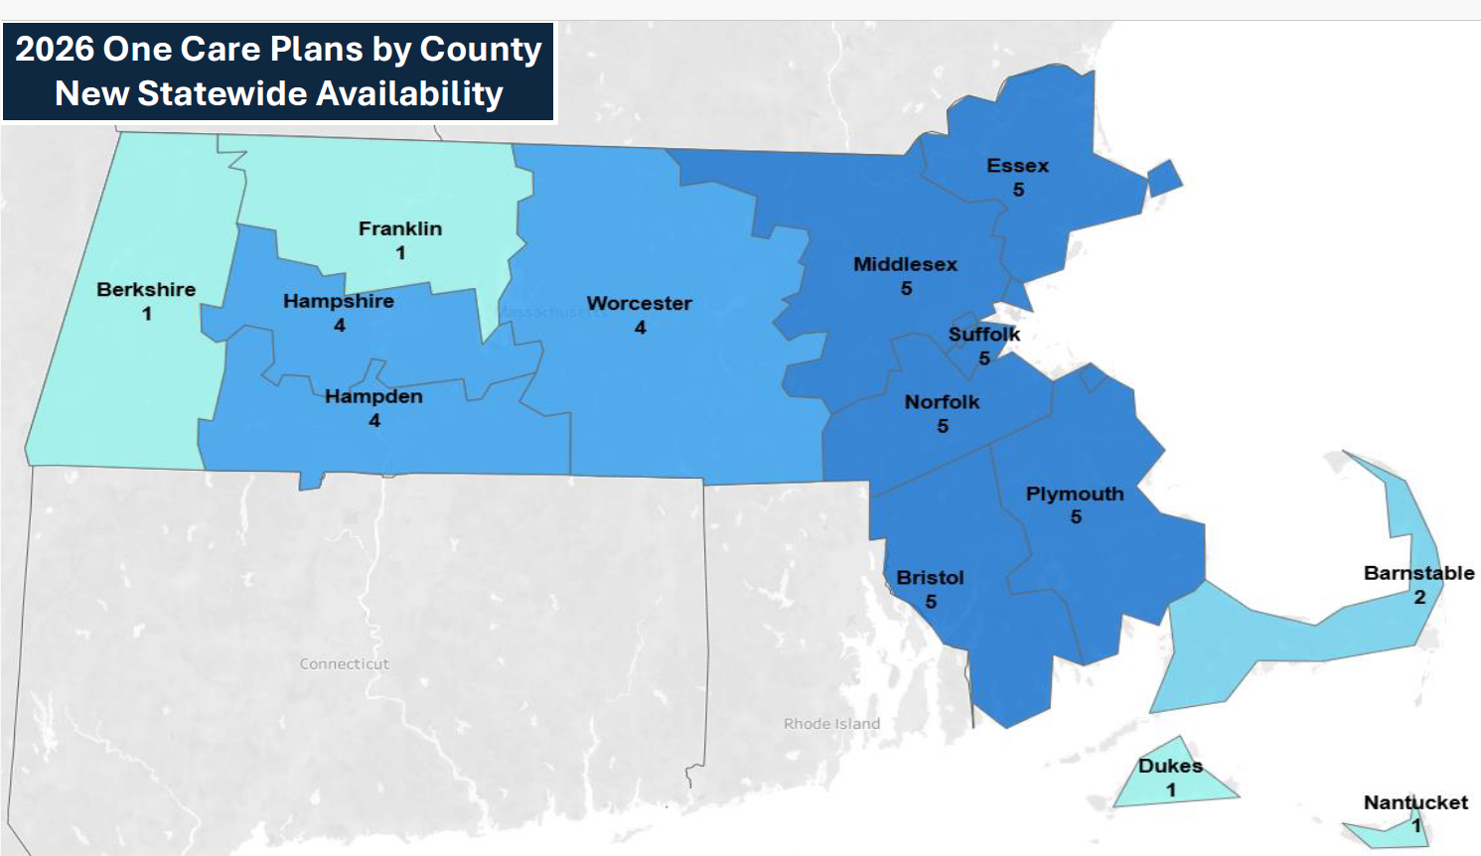
Map of One Care Plans in 2026

Slide 47
Senior Care Option (SCO) Program and Plan Updates

Slide 48

Senior Care Options (SCO) Program
Senior Care Option (SCO) Program (Available since 2004)
SCO combines MassHealth & Medicare benefits into one plan with one card and one care team. SCO covers medical, mental health, and prescription medications, plus specialized geriatric support services.
Care coordinators help members stay healthy and get the services they need.

Slide 49
2026 SCO Eligibility Changes
Managed Care Entity Bulletin 131 describes new eligibility requirements for individuals enrolled in or seeking to enroll in Senior Care Options (or “SCO”) plans. Please note the following key changes:
Effective August 1, 2025, only MassHealth Standard Members who are also enrolled in Medicare Parts A and B are allowed to newly enroll in Senior Care Options (SCO) plans.
Effective January 1, 2026, any person enrolled in a SCO plan who is NOT enrolled in Medicare Parts A and B will be transitioned from their SCO plan to MassHealth Fee-For- Service (FFS).
For more information, visit our MassHealth 2026 SCO Eligibility Changes Website

Slide 50
SCO Plans for 2026
Commonwealth Care Alliance (CCA)
Fallon Health NaviCare
Mass General Brigham Health Plan (MGBHP) NEW FOR 1/1/2026
Senior Whole Health (SWH)
Tufts (Point32Health)
UnitedHealthcare (UHC)
Disclaimer: Enrollment in the plan depends on the plan executing a Medicare Contract in September 2025

Slide 51
2026 SCO Plans: New Statewide Availability
SCO Plan/ County | CCA | Fallon | MGBHP | SWH (Molina) | Tufts | United | # SCO Plans in County
Barnstable | N | Y | N | N | Y | N | 2
Berkshire | N | Y | N | N | N | N | 1
Bristol | Y | Y | Y | Y | Y | Y | 6
Dukes | N | N | Y | N | N | N | 1
Essex | Y | Y | Y | Y | Y | Y | 6
Franklin | Y | Y | N | N | N | N | 2
Hampden | Y | Y | N | Y | Y | Y | 5
Hampshire | Y | Y | N | Y | Y | Y | 5
Middlesex | Y | Y | Y | Y | Y | Y | 6
Nantucket | N | N | Y | N | N | N | 1
Norfolk | Y | Y | Y | Y | Y | Y | 6
Plymouth | Y | Y | Y | Y | Y | Y | 6
Suffolk | Y | Y | Y | Y | Y | Y | 6
Worcester | Y | Y | N | Y | Y | Y | 5
Legend
Y = County offered by SCO Plan
County would be newly covered by Plan or would be a new option in SCO
N = County not offered by SCO Plan

Slide 52
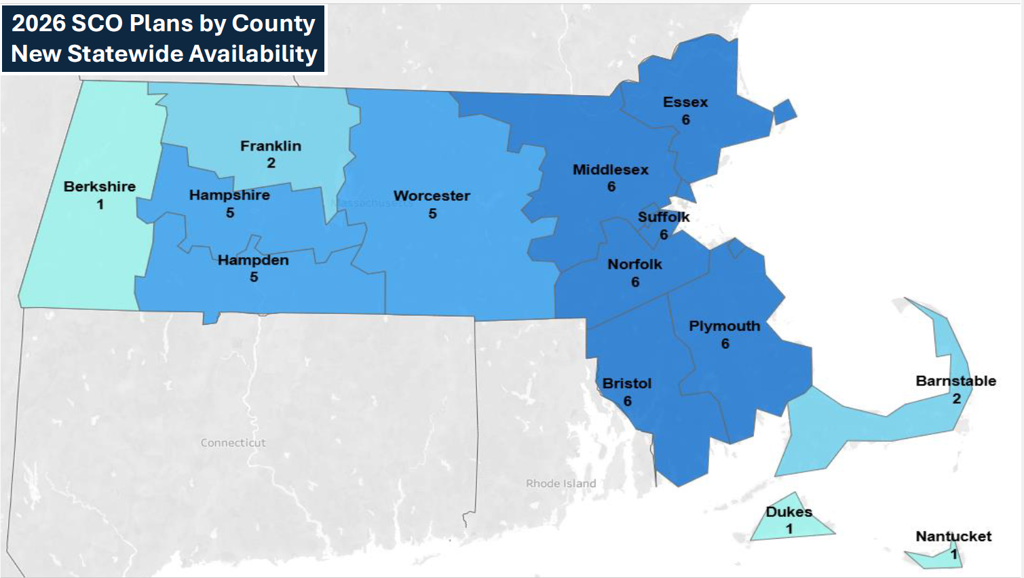
Map of SCO Plans by County 2026

Slide 53
Key Dates
October 2025
Open Enrollment:
October 15 – December 7, 2025
Expected MassHealth Website Updates
  2026 One Care and SCO plan contact information (e.g., enrollment services contact numbers, plan website links, and member portal resources)
  One Care and SCO program benefit tables
One Care and SCO: Members can enroll in a new One Care or SCO plan for coverage starting on January 1, 2026. Members should contact the plan directly.
Disclaimer: Enrollment in the plan depends on the plan executing a Medicare Contract in September 2025

Slide 54
Provider Billing & Enrollment Information
For One Care and SCO plan enrollees, providers should coordinate with the enrollee’s plan for:
  Authorizations
  Billing: Providers bill the plan for both Medicare and Medicaid services
  Provider Rates: Plans generally have discretion in setting provider rates (including value-based payments)
  Network enrollment: Providers would connect with One Care and SCO Plans directly to join their networks
Member Eligibility and Plan Enrollment information is available in EVS (POSC): (see next slide)

Slide 55
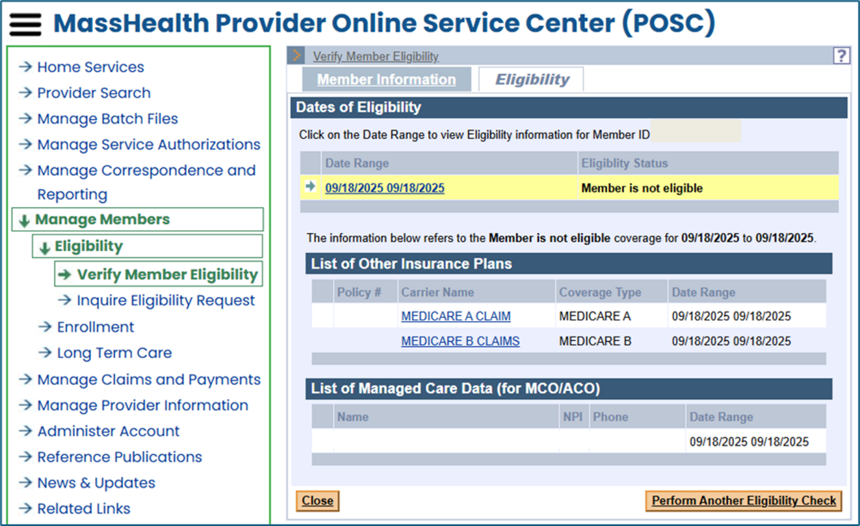
MassHealth Provider Online Service Center
Providers should check the POSC regularly for member eligibility and plan enrollment
  Click “Manage Members” → “Eligibility” → “Verify Member Eligibility”
  Input Member Information
  If eligible for One Care or SCO, the plan name will appear under “List of Managed Care Data (for MCO/ACO)”

Slide 56
MassHealth Dental Plan Update

Slide 57
MassHealth Dental Update for 2026
MassHealth’s Dental Third-Party Administrator (TPA) will be transitioning back to DentaQuest in early 2026.
  BeneCare will continue to provide services as our Dental TPA through the transition period.
  MassHealth members do not need to take any action at this time and can continue to seek dental care.
  Visit Learn about MassHealth dental benefits | Mass.gov to review covered dental services, find a dentist, FAQs, and more.
MassHealth is committed to processing all claims and service authorizations correctly and will be working diligently with BeneCare and providers to resolve any issues over the next few months.
  If you have questions or want to stay informed, visit MassHealth Dental Program Updates | Mass.gov to learn more and review the FAQs.

Slide 58
MassHealth’s My Account Page (MAP) for Members

Slide 59
Virtual Gateway My Account Page (MAP)
The current Virtual Gateway My Account Page (MAP) portal provides members and applicants older than age 65 with access to their MassHealth information, including notices and account details.
MAP for members portal will be decommissioned in April 2026.
Members can go to MyServices to access their information, and view certain notices.
  MyServices is available in: English, Spanish, Chinese, Haitian Creole, Brazilian Portuguese, and Vietnamese
What members need to do:
If they do not already have a MyServices account, they will need to create an account
If an account exists, they can log in at MyServices
If members have a MyMassGov account, MyServices uses MyMassGov to allow them to sign in to their account.

Slide 60

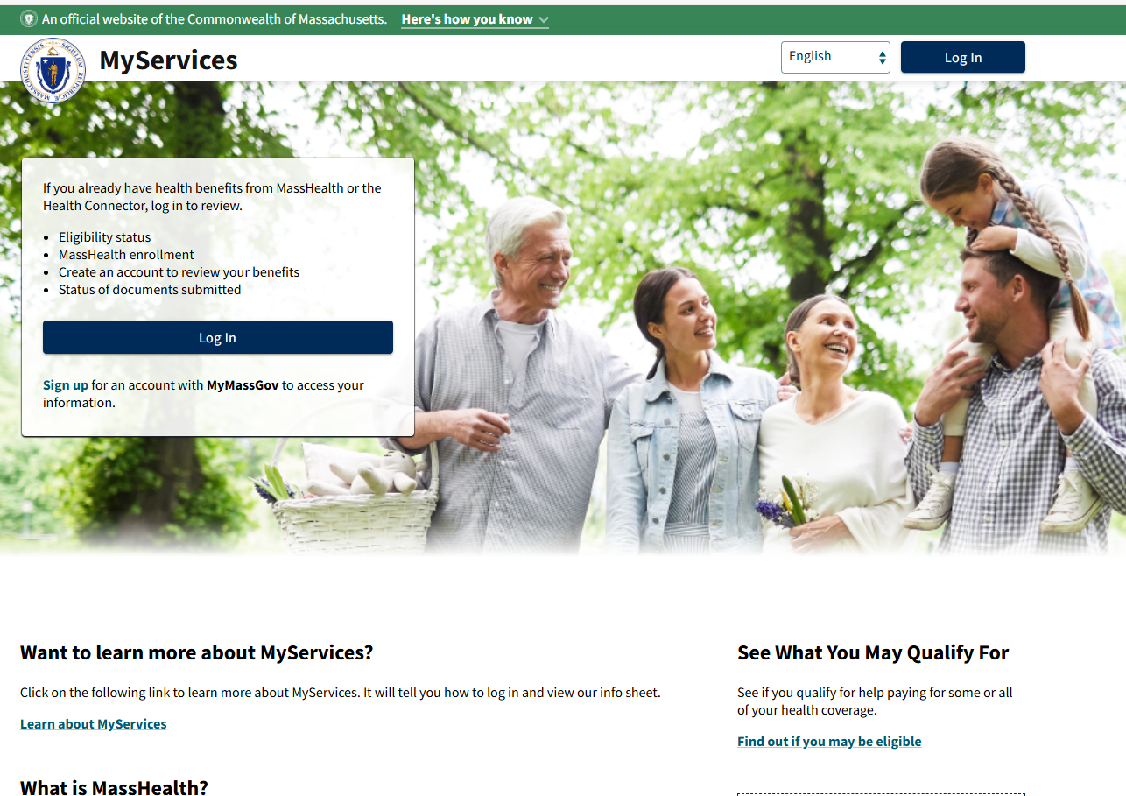
MyServices Member Portal
* Note: MyServices is a member ONLY portal

Slide 61
MassHealth Enrollment Center (MEC) – Springfield

Slide 62
Springfield MEC Has MOVED
As of October 24, 2025, the Springfield MEC’s New Address is:
243 Cottage Street
Springfield, MA 01104
Parking is available
Accessible by Pioneer Valley Bus Transportation

Slide 63
MassHealth Coverage of Vaccine

Slide 64


Covered Vaccinations
MassHealth and its affiliated health plans continue to cover COVID vaccinations and all other medically necessary vaccinations recommended by the Massachusetts Department of Public Health (MDPH).
These vaccines are available at no cost to members.
All individuals over six months of age are eligible to receive the COVID-19 vaccine in MA.
MassHealth providers will continue to be reimbursed for administering vaccinations recommended by the MDPH to MassHealth members.
MA residents can make appointments for the COVID-19 vaccine with their health care provider, or at their local pharmacy as of September 5, 2025.

Slide 65
Covered Vaccinations (continued)
MA residents may also choose to get their COVID-19 vaccine at another health care provider or facility outside of a pharmacy.
  Pediatricians’ offices are the best option for accessing COVID-19 vaccines for children between 6 months and 5 years.
Pharmacies are currently able to bill for COVID vaccines for Fee For Service members.
MassHealth managed care entities (MCEs) are working to update their pharmacy processing systems to allow for billing of the 2025-2026 COVID-19 vaccines.
Pharmacies experiencing any issues billing the 2025-2026 COVID-19 vaccines should contact the appropriate MCE’s pharmacy help desk for assistance with claim adjudication, including overrides.
  Appropriate pharmacy help desk numbers can be found in Pharmacy Facts 236

Slide 66

Health Connector Updates

Slide 67
ConnectorCare Program Changes
Due to federal policy changes, there are two major impacts to the ConnectorCare program for Plan Year 2026:
ConnectorCare Plan Type 1 will be eliminated
    Individuals and Families with incomes under 100 percent of the federal poverty level (FPL) will no longer be eligible for advance premium tax credits (APTCs) starting on January 1, 2026.
  ConnectorCare Plan Type 3D will be eliminated
    ConnectorCare eligibility includes a requirement that individuals are also eligible for APTC. The current federal enhanced APTCs are set to expire at the end of 2025.
    If these enhanced APTCs do not continue, APTCs will only be available for individuals earning up to 400 percent of the federal poverty level. Therefore, ConnectorCare Plan Type 3D will be eliminated.
    Visit Updates – Massachusetts Health Connector to stay informed about Federal changes

Slide 68
ConnectorCare Program Design for 2026
The Health Connector made a final decision and shared rate information about each of the carriers and plans available in each region of Massachusetts during the September board meeting.
Plan Type | 2A | 2B | 3A | 3B | 3C
% FPL | 100.01-150% | 150.01-200% | 200.01-250% | 250.01-300% | 300.01-400%
2025 Minimum Monthly Premium | $0 | $51 | $99 | $147 | $226
2026 Minimum Monthly Premium | $0 | $53 | $103 | $152 | $235
Visit the Resource Download center for updated materials including Connector Care program rates for 2026: Resource Download Center - Health Connector Shopping Guide

Slide 69
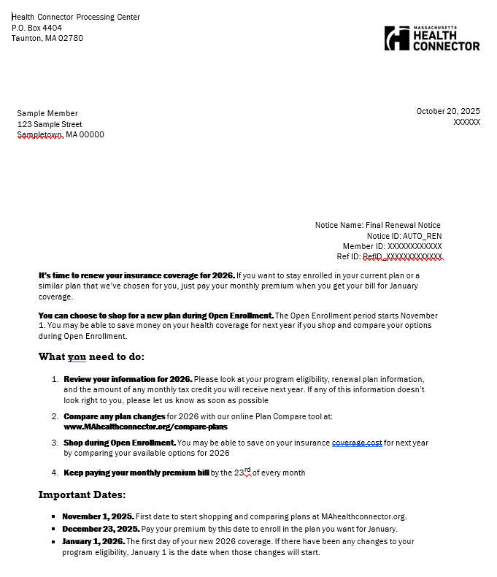
Health Connector Final Eligibility Notice
In advance of November 1st, the Health Connector mails a final eligibility notice to all members. It contains important information including:
Current plan
New plan for 2026
New monthly premium based on final eligibility

Slide 70
Health Connector
Final Eligibility Notice Details
Monthly health plan details for 2026
2026 Monthly Health Plan Cost: $XXX.XX (amount you will pay each month)
Health Insurance Renewal Information
Household Member | Date of Birth | Program Name | Current Health Plan Name | 2026 Renewal Health Plan Name | Same plan as 2025? | Date Coverage Renews
Sample Member | June 12, 1972 | Health Connector Plan (No financial help) | HEALTH PLAN NAME ConnectorCare 3 | Standard High Silver: HEALTH PLAN NAME | No | January 1, 2026
This is the amount your household will pay each month if you stay enrolled in the 2026 health insurance renewal plan listed above. Your program eligibility will change for 2026

Slide 71
Key Takeaways for OE 2026
  Open Enrollment 2026 is November 1, 2025, to January 23, 2026.
  Due to the uncertainty related to enhanced premium tax credits, it is critical that applicants and members stay up to date with any communications sent from the Health Connector.
    Members should pay close attention to their notices and make any updates to their application as needed, to ensure they are receiving the coverage they qualify for
  Based on federal policy, the ConnectorCare program will be available for individuals and families with income between 100 and 400 percent of the FPL.

Slide 72
Health Connector Plan Options for 2026
  There will be a broad choice of carriers and plans for individuals eligible for unsubsidized plans and small group enrollees, with 8 medical carriers and 2 dental carriers.
  4 to 8 ConnectorCare carriers in each region.
  Member premiums will increase for 2026, with the rates for unsubsidized and APTC-only plans increasing on average, 11.5 percent for 2026.
  There is a new dental plan option, Standard Family Plus, for 2026.
  This Open Enrollment, applicants can shop for and enroll into Dental plans online through MAhealthconnector.org

Slide 73
Available Online Health
Connector Tools for OE 2026
  There are many online tools and educational resources that can help members and those who are assisting them with their coverage decisions for January 1, 2026.
  A new, interactive ConnectorCare enrollee contribution map is available ConnectorCare Enrollee Contribution Dashboard - Family Size
  After November 1, updates resources will be available from the Health Connector’s Resource Download Center
  Stay up to date on Federal Policy changes that may impact Health Connector members at Updates – Massachusetts Health Connector.

Slide 74

Thank You!

Slide 75
APPENDIX
New Webpage for Caring for Pregnant and Postpartum MassHealth Members
MassHealth Health Plan 2026 PCP Changes

Slide 76

Update: New Webpage and Flyers
MassHealth is excited to share a new webpage for providers, such as OB/GYNs, midwives, primary care providers, pediatricians, and others, caring for pregnant and postpartum MassHealth members: Mass.gov/perinatalproviders
The page includes detailed information and resources across several topics:
Eligibility and covered services
Managed care information and supports
MassHealth doula benefit
Behavioral health
Breast pumps and lactation support
Family planning
Prenatal screening/diagnosis and vaccines
Social determinants of health (SDOH)
Patient-facing materials in multiple languages, including new pregnancy checklists for members

Slide 77
Update: Highlights from MassHealth All Provider Bulletin 405 Published on August 19, 2025 (slide 1 of 2)
Screening tools
For providers serving perinatal members, a list of approved validated tools can be found at http://www.mass.gov/info-details/perinatal-mood-anxiety-disorders-screening-tools-training-and-continuing-education.
Pediatric care providers should use a standardized screening tool such as the Edinburgh Postpartum Depression Scale (EPDS) or any of the recommended screening tools listed in the Bright Futures Toolkit under maternal depression at Bright Futures Toolkit: Links to Commonly Used Screening Instruments and Tools | AAP Toolkits | American Academy of Pediatrics.
Resources
Emergency or Crisis Concerns:
Massachusetts Behavioral Health Help Line (833-773-2445): Talk to a trained mental health professional for real-time clinical assessment and direct access to community mental health resources
Community Behavioral Health Centers: One-stop-shops for psychiatric evaluation and ongoing mental health and substance use services with urgent and walk-in appointments available

Slide 78
Update: Highlights from MassHealth All Provider Bulletin 405 Published on August 19, 2025 (slide 2 of 2)
Non-emergency Concerns:
MCPAP for Moms: Provider-to-provider consultation from a perinatal mental health professional and referral to perinatal mental health services or other supports
National Maternal Mental Health Hotline: Perinatal mental health resources
Postpartum Support International of Massachusetts: Perinatal mental health resources and provider directory

Slide 79
MassHealth Health Plan 2026 PCP Changes

Slide 80
Primary Care Provider Changes
(slide 1 of 7)
# | Primary Care Provider | Address | will move from | to
1 | Bellingham Medical Associates | 1003 S Main St Bellingham, MA 02019 | Mass General Brigham Health Plan With Mass General Brigham ACO | Tufts Health Together with UMass Memorial Health
2 | Blackstone Valley Family Physicians | 100 Commerce Drive Northbridge, MA 01534 | Mass General Brigham Health Plan With Mass General Brigham ACO | Tufts Health Together with UMass Memorial Health
3 | Carlos Moreno MD PC | 128 Carnegie Row Ste 106 Norwood, MA 02062 | Tufts Health Together MCO | WellSense Beth Israel Lahey Health (BILH) Performance Network ACO
4 | Center for Adolescent and Young Adult Health | 100 Medway Rd Ste 204 Milford, MA 01757 | Mass General Brigham Health Plan With Mass General Brigham ACO | Tufts Health Together with UMass Memorial Health

Slide 81
Primary Care Provider Changes
(slide 2 of 7)
# | Primary Care Provider | Address | will move from | to
5 | Children’s Health Care - Haverhill | 600 Primrose St Haverhill, MA | Revere Health Choice | WellSense Boston Children’s ACO
6 | Children’s Health Care – Newburyport | 257 Low St Newburyport, MA 01950 | Revere Health Choice | WellSense Boston Children’s ACO
7 | Community Pediatrics of Medway | 68A Main St Ste 1010 Medway, MA 02053 | Mass General Brigham Health Plan With Mass General Brigham ACO | Tufts Health Together with UMass Memorial Health
8 | Community Pediatrics of Milford | 229 East Main St Milford, MA 01757 | Mass General Brigham Health Plan With Mass General Brigham ACO | Tufts Health Together with UMass Memorial Health
9 | Davis Square Family Practice | 255 Elm St Ste 301 Somerville, MA 02144 | Primary Care Clinician (PCC) Plan and Tufts Health Together MCO | WellSense Care Alliance

Slide 82
Primary Care Provider Changes
(slide 3 of 7)
# | Primary Care Provider | Address | will move from | to
10 | Family Medicine Associates | 68A Main St Medway, MA 02053 | Mass General Brigham Health Plan With Mass General Brigham ACO | Tufts Health Together with UMass Memorial Health
11 | Family Practice Group, P.C. | 11 Water St Ste 1A Arlington, MA 02476 | Primary Care Clinician (PCC) Plan and Tufts Health Together MCO | WellSense Care Alliance
12 | Franklin Family Practice | 1280 W Central St Ste 202 Franklin, MA 02038 | Mass General Brigham Health Plan With Mass General Brigham ACO | Tufts Health Together with UMass Memorial Health
13 | Franklin Pediatrics | 1280 W Central St Ste 201 Franklin, MA 02038 | Mass General Brigham Health Plan With Mass General Brigham ACO | Tufts Health Together with UMass Memorial Health
14 | Franklin Primary Care | 1280 W Central St Ste 301 Franklin, MA 02038 | Mass General Brigham Health Plan With Mass General Brigham ACO | Tufts Health Together with UMass Memorial Health

Slide 83
Primary Care Provider Changes
(slide 4 of 7)
# | Primary Care Provider | Address | will move from | to
15 | Franklin Wrentham Family Medicine | 440 E Central St Franklin, MA 02038 | Mass General Brigham Health Plan With Mass General Brigham ACO | Tufts Health Together with UMass Memorial Health
16 | Gloria Moussa-Gabour | 20 E Emerson St Melrose, MA 02176 | Primary Care Clinician (PCC) Plan and Tufts Health Together MCO | WellSense Care Alliance
17 | HealthFirst Family Care Center, Inc. | 387 Quarry St Ste 100 Fall River, MA 02723 | WellSense Community Alliance ACO | Community Care Cooperative
18 | Hopkinton Family Practice | 77 W Main St Ste 204 Hopkinton, MA 01748 | Mass General Brigham Health Plan With Mass General Brigham ACO | Tufts Health Together with UMass Memorial Health

Slide 84
Primary Care Provider Changes
(slide 5 of 7)
# | Primary Care Provider | Address | will move from | to
19 | Hopkinton Internal Medicine and Pediatrics | 1 Lumber St Hopkinton, MA 01748 | Mass General Brigham Health Plan With Mass General Brigham ACO | Tufts Health Together with UMass Memorial Health
20 | Hopkinton Primary Care | 169 W Main St Hopkinton, MA 01748 | Mass General Brigham Health Plan With Mass General Brigham ACO | Tufts Health Together with UMass Memorial Health
21 | Mcgrath Medical Group | 117 Water St Milford, MA 01757 | Mass General Brigham Health Plan With Mass General Brigham ACO | Tufts Health Together with UMass Memorial Health
22 | Mendon Internal Medicine | 12 Uxbridge Rd Mendon, MA 01756 | Mass General Brigham Health Plan With Mass General Brigham ACO | Tufts Health Together with UMass Memorial Health

Slide 85
Primary Care Provider Changes
(slide 6 of 7)
# | Primary Care Provider | Address | will move from | to
23 | Oak Pediatrics | 198 Littleton Road Ste 204 Westford, MA | Tufts Health Together MCO | WellSense Care Alliance
24 | Pediatric Associates of Wellesley, Inc | 266 Main St Ste 18 Medfield, MA 02052 | Primary Care Clinician (PCC) Plan | Mass General Brigham Health Plan With Mass General Brigham ACO
25 | Pediatric Associates of Wellesley, Inc | 134 South Avenue Weston, MA 02493 | Primary Care Clinician (PCC) Plan | Mass General Brigham Health Plan With Mass General Brigham ACO
26 | Pelham Healthcare Associate (site 1) | 49 Atwood Road Ste 1 Pelham, NH 03076 | Tufts Health Together MCO | WellSense Care Alliance
27 | Pelham Healthcare Associates DBA Westford Primary Care (site 2) | 198 Littleton Road Ste 203 Westford, MA 01886 | Tufts Health Together MCO | WellSense Care Alliance

Slide 86
Primary Care Provider Changes
(slide 7 of 7)
# | Primary Care Provider | Address | will move from | to
28 | Primary Care Physicians | 221 East Main St Milford, MA 01757 | Mass General Brigham Health Plan With Mass General Brigham ACO | Tufts Health Together with UMass Memorial Health
29 | Robert F. Commito MD PC | 311 Washington St Brighton, MA 02135 | Tufts Health Together MCO | WellSense Care Alliance
30 | Somerville Family Practice | 1020 Broadway Somerville, MA 02144 | Primary Care Clinician (PCC) Plan and Tufts Health Together MCO | WellSense Care Alliance

Slide 87
In The Loop – MA:
A Community Just for Enrollment Assisters
Health Care For All
October 2025

Slide 88
Polling Question #1
Are you signed up to access the In The Loop (ITL) website or the In The Loop newsletter?
  Yes, just the ITL website
  Yes, just the ITL newsletter
  Yes, both
  No, what are those?

Slide 89
About ITL– MA
A private online community run by Health Care For All for enrollment assisters to connect, learn, and collaborate
Anyone supporting health coverage enrollment in MA can join!
  Navigators, CACs, SHINE counselors, CHC and hospital staff helping with enrollment
  Staff at legal aid, consumer protection, and advocacy organizations
  Health and consumer advocates

Slide 90
Polling Question #2
How connected do you feel to other enrollment assisters across the state?
  Very connected
  Somewhat connected
  Not very connected
  Not connected at all

Slide 91
Why join ITL-MA ?
Interact with other enrollment specialists to share successes, challenges, and lessons learned
Troubleshoot problems, ask questions, and learn how others have solved similar issues
Receive updates and access a library of resources from HCFA

Slide 92
Polling Question #3
If you’re already a Looper (member of ITL), what do you benefit the most from? If you haven’t joined ITL yet, what do you look forward to the most?
  Updates and resources
  Problem-solving help
  Peer connections
  Training opportunities

Slide 93
How to Join
Visit our website and click on the Sign-up button to gain access to the ITL website: In the Loop Massachusetts
If you want to sign-up for the ITL newsletter, go to Register – In the Loop Massachusetts

