Slide 1

Health Safety Net
Information and Updates
April and May 2025

Slide 2
Agenda – Health Safety Net
  Covered Code List and New PPS Rates
  2025 Hospital Rates
  New Dental Administrator
  Anti-Obesity Medication Changes
  Health Safety Net Updates
  Special Circumstances
    Medical Hardship
    Bad Debt
  General Information
  Questions

Slide 3
2025 Prospective Payment System (PPS) Rates
Community Healthcare Centers covered code list can be found with the link below:
Payment Information for CHCs | Mass.gov
Patient Type | Rest of Massachusetts | Metro Boston
New Patient | $282.21 | $303.14
Established Patient | $210.35 | $225.95
Prospective Payment System

Slide 4
2025 Hospital
ACUTE CARE HOSPITALS
The updated non-covered procedure code list for Acute Outpatient Hospitals can be found in the below link:
HSN Information for Hospitals | Mass.gov
The updated 2025 Hospital Rates for Outpatient Primary, Outpatient Bad Debt, as well as the Payment on Account Factor ratio:
Hospital Payment Information | Mass.gov

Slide 5
New Dental Administrator
The Executive Office of Health and Human Services has transitioned to a new administrator for dental services starting on April 1,2025. BeneCare Dental Plans will provide as the third-party administrator for MassHealth, the Children’s Medical Security Plan (CMSP), and the Health Safety Net (HSN) dental services. DentaQuest, which was the Third-Party Administrator (TPA), has transitioned on March 31, 2025, for dental services. This will not affect members eligibility, nor the rates set for dental services.
For participating providers and members:
  No action is needed at this time and there are no immediate changes in MassHealth Dental operations.
  As of April 1, 2025, please visit massdhp.org, call 844-MH-DENTL, (844) 643-3685, or email providerrelations@massdhp.com for your MassHealth dental program needs. To receive future messages from BeneCare and the MassHealth Dental Program, please subscribe at FAQ.massdhp.org.

Slide 6
Anti-Obesity Medication Changes
  Health Safety Net Program Changes to Management of Anti-Obesity Medications
  In accordance with Health Safety Net (HSN) regulations at 101 CMR 613.03(2)(e), the HSN does not pay for drugs used for the treatment of obesity. Effective April 15, 2025, the following drugs will no longer be payable for HSN patients for weight loss. Existing prior authorizations will be payable through May 15, 2025.
  Impacted Anti-Obesity Agents
  benzphetamine
  diethylpropion, diethylpropoin extended-release
  Saxenda® (liraglutide)
  Xenical (orlistat)
  phendimetrazine, phendimetrazine extended-release
  Lomaira®, Adipex-P® (phentermine capsule, tablet)
  Wegovy® (semaglutide)
  Zepbound® (tirzepatide)

Slide 7
Anti-Obesity Medication Changes (continued)
  Any drug being used off-label for weight loss is not payable for HSN patients.
  HSN patients stable on an anti-obesity agent, including patients with existing prior authorizations for anti-obesity agents, will be able to continue getting the drug through May 15, 2025.
  Wegovy® (semaglutide) and Zepbound® (tirzepatide) may still be payable for other medically accepted indications. A new prior authorization will be required to review for medical necessity.
  Patients with diabetes may be switched to Victoza® (liraglutide) which is available without prior authorization. Prior authorization status and criteria for other diabetic GLP-1 medications can be found on the MassHealth Drug List.
  Providers should work with patients to transition to alternative therapies where appropriate.
  MassHealth Drug List can be found using the following link: http://www.mass.gov/masshealth/pharmacy

Slide 8
HSN Updates
Inpatient Hospital Claim Reprocessing
  HSN’s February remits and payments include two significant claim reprocessing efforts. HSN has adjusted all primary inpatient claims, for HSNFY23, HSNFY24, and YTD HSNFY25 to pay at the Medicare Severity Diagnostic Related Group (MS-DRG) payment rate through the 3M/Solventum pricing grouper. In addition, HSN adjusted FY24 primary outpatient claims to pay at their FY24 payment rates. For facilities who utilize Billing Intermediaries, please notify your BI that there will be additional remits for FY23, FY24 and FY25.

Slide 9
HSN Updates (continued)
CHC Resolved Denial Remits for Pay Periods 202410 and 202411
  Through INET, facilities may find two postings of the October 2024 and November 2024 CHC Resolved Denial Remits. Due to an internal issue, HSN identified the CHC Resolved Denial Remits dated 12.12.2024 (October remits) and 01.14.2025 (November remits) may not have included all information needed for facilities to post payments accurately.
  HSN has updated the remits with dates of 02.12.2025 and 02.19.2025. Please notify your BI they should download the most up to date CHC Resolved Denial remits (dated 02.12.2025 and 02.19.2025) to you have the most up to date payment information.

Slide 10
Special Circumstances
Medical Hardship Assistance
A Massachusetts Resident at any Countable Income level may qualify for Medical Hardship if allowable medical expenses exceed a certain percentage of his or her Countable Income as specified in 101 CMR 613.05(1)(c). A determination of Medical Hardship is a onetime determination and not an ongoing eligibility category. An applicant may submit no more than two Medical Hardship applications within a 12-month period.
Income Level FPL | Percentage of Countable Income
0 – 205% | 10%
205.1 – 305% | 15%
305.1 – 405% | 20%
405.1 – 605% | 30%
>605.1% | 40%

Slide 11
Special Circumstances
Bad Debt
Bad Debt is an account receivable based on services furnished to a Patient that is:
  (a) regarded as uncollectible, following reasonable collection efforts consistent with the requirements in 101 CMR 613.06;
  (b) charged as a credit loss;
  (c) not the obligation of a governmental unit or the federal government or any agency thereof; and
  d) not a Reimbursable Health Service
Providers are charged with making reasonable attempts in obtaining and verifying the patient’s or guarantors supplied and financial information.
Reasonable collection efforts must be taken before a bad debt claim can be made which would include documentation of billings, calls, notices and any other notifications.
The bad debt must be unpaid after a period of 120 days of continuous collection action.
In accordance with 101 CMR 613.000, a recipient can continue to be billed if the date of service is outside of the eligibility period for low-income patient status. These bills can be submitted as evidence to satisfy bad debt application requirements.

Slide 12
Special Circumstances
Bad Debt (continued)
Patient Identifiers:
Name
Address
Phone#
DOB
SSN#
TCN
Med Record#
MassHealth# (RID and/or RHN)
Date of Service
Total Charge for Services
Net Charge submitted to Health Safety Net
Evidence of Reasonable Collection Efforts:
Date of Initial Bill
Date of Second Bill
Date of Third Bill
Date of Fourth Bill
Date of Returned Mail
Date of Certified Letter for accounts over $1,000
Date of Initial Phone Contact
Date of Follow up Phone Contact
Dates of Other Efforts (other phone calls, letters to Patient, attorney or referral to collection agency)
Date Account was submitted to Health Safety Net Office

Slide 13
General Information
Health Safety Net eligible service regulations
Health Safety Net eligible payment and funding regulations
Health Safety Net Reimbursable Services
Learn about HSN-INET | Mass.gov
Information about HSN Provider Guides and Billing Updates | Mass.gov
The Health Safety Net is working on internal claims editing, code, and payment rate updates. HSN will instruct providers through billing update of any necessary payment resweeps due to these updates.

Slide 14
HSN Help Desk
Health Safety Net Help Desk inquiries should be addressed to HSNHelpDesk@massmail.state.ma.us and not an individual member of the Help Desk team.
If you feel the matter remains unresolved, please contact the Help Desk Supervisor for assistance.

Slide 15
MassHealth Updates

Slide 16
Agenda - MassHealth
Updates to the MassHealth Applications (ACA-3 and SACA-2)
MassHealth Health Plan Update: Tufts Health Together MCO Plan
MassHealth plus Medicare Savings Program (MSP) Update

Slide 17
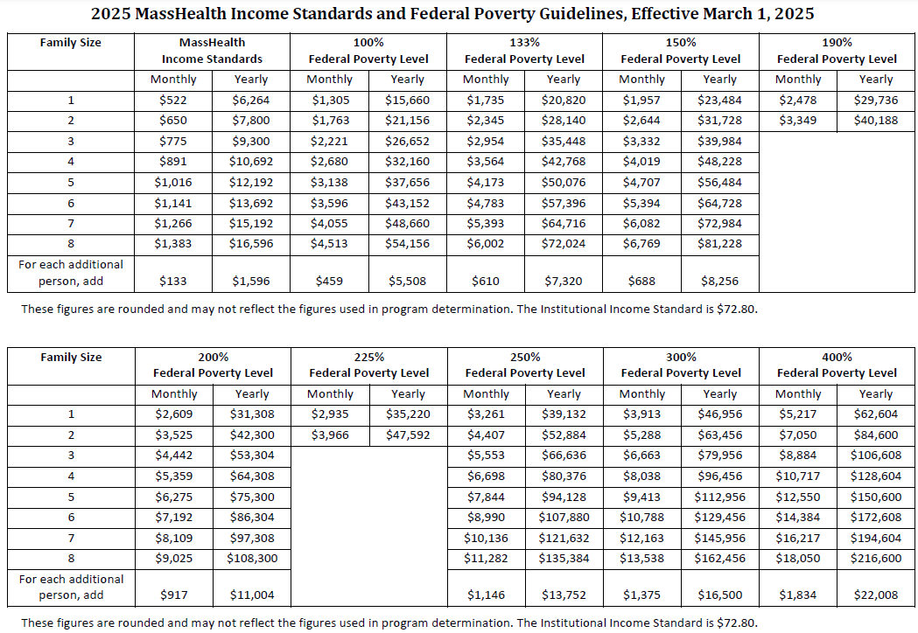
MassHealth 2025 Income
Standards and Federal Poverty Guide
On March 1, 2025, the Federal Poverty Level (FPL) standards increased
  100% FPL for one individual is $1,305
  The 2025 FPL chart: 2025 MassHealth Income Standards and Federal Poverty Guidelines
Note: The FPL percentages in the online application at MAhealthconnector.org will be updated for MassHealth purposes

Slide 18
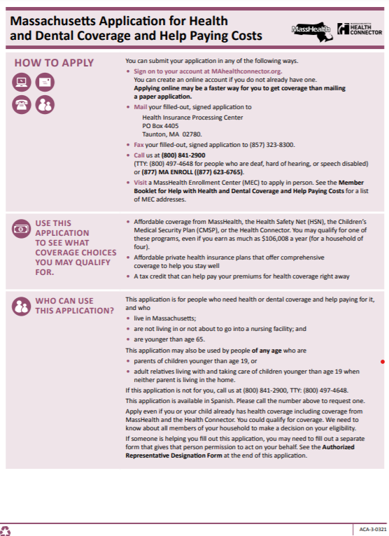
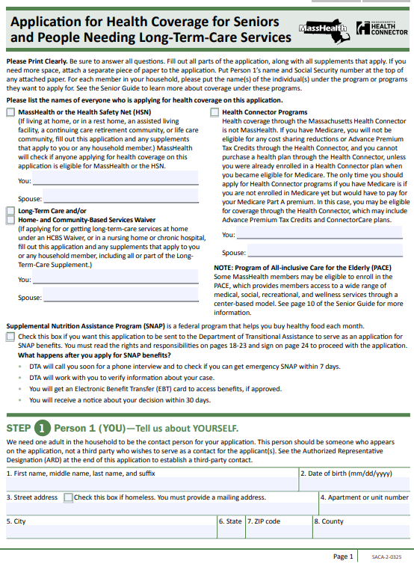

ACA-3 and SACA-2 Application Updates
The Massachusetts Application for Health and Dental Coverage and Help Paying Cost (ACA-3) & Application for Health Coverage for Seniors and People Needing Long-Term-Care Services (SACA-2) applications and member booklet have been updated
  Updates reflect the 2025 Federal Poverty Level (FPL) guidelines

Slide 19
Changes in the ACA-3
Changes in the March 2025 version of the ACA-3:
  Updated SNAP checkbox language to facilitate processing
  Updated language on question 11 to conform to the online application
  Added language to Step 5: “Your Household’s Health Coverage” about information sharing requirements
  Removed language about a state employee benefit plan that is no longer available
  Added new language about estate recovery to numbers 10 and 11 of Step 8 (signature page)
  Added new language about information sharing to number 13 of Step 8 (signature page)
  Updated immigration document types to conform to the online application

Slide 20
Changes in the SACA-2
Changes in the March 2025 version of the SACA-2:
  Removed questions regarding Third Party Recovery
  Updated the Immigration Documents list
  Updated the Department of Transitional Assistance Rights and Responsibilities language for the SNAP program and the applicable checkbox
  Updated language on Step 9 regarding Breast and Cervical Cancer
  Added language to Step 5: “Your Household’s Health Coverage” about information sharing requirements
  Added new language about estate recovery to number 12 of Step 8 (signature page)

Slide 21
ACA-3 and SACA-2 Application Updates
March 2024 versions of ACA-3 and SACA-2 applications will be accepted.
ACA-1 and SACA-1 booklets available in Arabic, Brazilian Portuguese, Chinese, Haitian Creole, Khmer, Russian, Vietnamese, or in Braille.
Ordering Materials:
  Call: 1-800-841-2900
  Fax a request: 617-988-8973

Slide 22
Social Security Fairness Act
Social Security Fairness Act & Retroactive, Lump sum Social Security Payments
The Social Security Fairness Act ended the Windfall Elimination Provision (WEP), and Government Pension Offset (GPO).
  Many beneficiaries will receive a one-time, retroactive, lump-sum payment. It is anticipated that many of these payments will be received by the end of March 2025.
  People who will benefit from the new law include some teachers, firefighters, and police officers in many states; federal employees covered by the Civil Service Retirement System; and people whose work had been covered by a foreign social security system.

Slide 23
Social Security Fairness Act (continued)
  These retroactive, lump sum payments are not countable in an asset calculation in the month of receipt and continue to be noncountable assets for nine months after the month of receipt.
    The lump sum funds must be identifiable and verified as retro SSA payments and must be deposited into a separately identifiable account.
MassHealth regulation at 130 CMR 520.007(H): Countable Assets: Retroactive SSI and RSDI Benefit Payments

Slide 24
MassHealth Health Plan Update: Tufts Health Together MCO Plan

Slide 25
Tufts Health Together MCO Plan
Point32Health has decided to no longer offer the Tufts Health Together MCO Plan (Tufts MCO), effective Jan. 1, 2026.
This does not impact any of the other Tufts Health Together plans. Tufts will continue to operate both of its Accountable Care Organizations (ACOs), Tufts - Cambridge Health Alliance (Tufts-CHA) and Tufts – UMass Memorial Health (Tufts-UMMH), as well as its One Care plan and Senior Care Options plan.
The Tufts MCO will continue to serve members until December 31, 2025. MassHealth members can continue to see their Tufts MCO primary care provider and receive services from the Tufts MCO.
Point32Health and MassHealth’s highest priority is maintaining member relationships with their primary care providers and member access to current services and benefits.

Slide 26
Transition Timeline and Process
April 2025: Communications to MassHealth members about this transition will follow the initial notifications to the provider network.
MassHealth members do not need to take any action at this time and can continue seeing their current providers.
Fall 2025: MassHealth will work with Tufts MCO and the MassHealth member’s future health plan to coordinate transitions of care including sharing of active prior authorizations of services, care management enrollments, etc.

Slide 27
MassHealth plus Medicare Savings Program (MSP) Update

Slide 28
Medicare Savings Program (MSP)
Medicare Savings Programs (MSP) are programs that pay for some or all of Medicare beneficiaries’ premiums, deductibles, copays, and co-insurance. MSPs are not health insurance plans.
  Enrollment in any of the MSPs also automatically provides drug coverage with low copays through Medicare Extra Help program and lets Medicare beneficiaries sign up for Medicare Part B at any point in the year without paying any financial penalties for signing up late.
  The level of benefits an applicant can get depends only on their countable income and Medicare eligibility. There is no asset limit or asset check.
Program Types
  Qualified Medicare Beneficiary (QMB) (formerly known as MassHealth Senior Buy-In):
    Pays for the Medicare Part A premium, if they have one, and the Medicare Part B premium and cost sharing.

Slide 29
MSP Types: QMB
  Comes with Health Safety Net (HSN) coverage at acute care hospitals and community health centers.
  If a member has QMB, medical providers are not permitted to bill the for Medicare copays and deductibles. However, QMB members may still be charged for pharmacy copays.
  QMB members receive a MassHealth card.
  The QMB start date is the first day of the calendar month following the date of the MassHealth eligibility determination.
Type | If applicant is | And monthly income is*
QMB | Single or a married couple | Less than or equal to 190% of FPL

Slide 30
MSP Types: SLMB and QI
Specified Low-Income Medicare Beneficiary and Qualifying Individual (QI): MassHealth pays for the Medicare Part B premium, helps with prescription drug costs by automatically enrolling members in Medicare Part D Extra Help, and comes with Health Safety Net (HSN) coverage at acute care hospitals and community health centers.
  There is no MassHealth card.
  SLMB and QI coverage begins with the month of application and may be retroactive up to three calendar months before the month of application.
* Income limits change yearly
Type | If applicant is* | And monthly income is
SLMB | Single or a married couple | Above 190% of FPL and less than or equal to 210% of FPL
QI | Single or a married couple | Above 210% of FPL and less than or equal to 225% of FPL

Slide 31
MassHealth plus MSP
An applicant or member may be able to get both an MSP and Standard coverage if:
  countable income and assets (if applicable) are under the MassHealth limits for the program they are applying for
  AND
  their countable income is also within the MSP program limits
How to Apply
  Submit a SACA-2 or ACA-3 application

Slide 32
CommonHealth plus MSP
An applicant or member may be able to get both an MSP and CommonHealth coverage if:
  they are eligible for Medicare
  AND
  their income is less than or equal to 225% of FPL
MassHealth CommonHealth members will receive benefits from the MSP program that aligns with their FPL: QMB, SLMB, or QI. These members do not need to take additional action or submit an MHBI application to receive an MSP benefit in addition to CommonHealth if their FPL is below 225%.
Members will receive an approval notice with appropriate start date.
If MassHealth members exceed the 225% FPL limit, they will receive a notice informing them they are not eligible for MSP with a termination date.

Slide 33

Thank You!

