Slide 1

Health Safety Net
Information and Updates
July 2025

Slide 2
Agenda – Health Safety Net
  New Dental Administrator
  Anti-Obesity Medication Changes
  Health Safety Net Updates
    Inpatient Hospital Claims Pricing Adjustment
    99211 Claims Resweep
    June 2025 Duplicate Pharmacy Claims
    July 2025 Interim Dental RHS
  General Information
  Questions

Slide 3
New Dental Administrator
The Executive Office of Health and Human Services has transitioned to a new administrator for dental services starting on April 1,2025. BeneCare Dental Plans will provide as the Third-Party Administrator for MassHealth, the Children’s Medical Security Plan (CMSP), and the Health Safety Net (HSN) dental services. DentaQuest, which was the Third-Party Administrator (TPA), has transitioned on March 31, 2025, for dental services. This will not affect members eligibility, nor the rates set for dental services.
For participating providers and members:
  No action is needed at this time and there are no immediate changes in MassHealth Dental operations.
  As of April 1, 2025, please visit massdhp.org, call 844-MH-DENTL (844) 643-3685), or email providerrelations@massdhp.com for your MassHealth dental program needs. To receive future messages from BeneCare and the MassHealth Dental Program, please subscribe at FAQ.massdhp.org.

Slide 4
Anti-Obesity Medication Changes
  Health Safety Net Program Changes to Management of Anti-Obesity Medications
  In accordance with Health Safety Net (HSN) regulations at 101 CMR 613.03(2)(e), the HSN does not pay for drugs used for the treatment of obesity. Effective April 15, 2025, the following drugs will no longer be payable for HSN patients for weight loss. Existing prior authorizations will be payable through May 15, 2025.
  Impacted Anti-Obesity Agents
  benzphetamine
  diethylpropion, diethylpropoin extended-release
  Saxenda® (liraglutide)
  Xenical (orlistat)
  phendimetrazine, phendimetrazine extended-release
  Lomaira®, Adipex-P® (phentermine capsule, tablet)
  Wegovy® (semaglutide)
  Zepbound® (tirzepatide)

Slide 5
Anti-Obesity Medication Changes (continued)
  Any drug being used off-label for weight loss is not payable for HSN patients.
  HSN patients stable on an anti-obesity agent, including patients with existing prior authorizations for anti-obesity agents, will be able to continue getting the drug through May 15, 2025.
  Wegovy® (semaglutide) and Zepbound® (tirzepatide) may still be payable for other medically accepted indications. A new prior authorization will be required to review for medical necessity.
  Patients with diabetes may be switched to Victoza® (liraglutide) which is available without prior authorization. Prior authorization status and criteria for other diabetic GLP-1 medications can be found on the MassHealth Drug List.
  Providers should work with patients to transition to alternative therapies where appropriate.
  MassHealth Drug List

Slide 6
HSN Updates
Inpatient Hospital Claim Reprocessing
HSN’s February remits and payments include two significant claim reprocessing efforts. HSN has adjusted all primary inpatient claims, for HSNFY23, HSNFY24, and YTD HSNFY25 to pay at the Medicare Severity Diagnostic Related Group (MS-DRG) payment rate through the 3M/Solventum pricing grouper. In addition, HSN adjusted FY24 primary outpatient claims to pay at their FY24 payment rates. For facilities who utilize Billing Intermediaries, please notify your BI that there will be additional remits for FY23, FY24 and FY25.
99211 Resweep
The Health Safety Net identified certain claims billed with procedure code 99211 inadvertently denied at HSN for dates of service FY2023 through 2024. HSN has identified the impacted claims and will reprocess these claims for re-adjudication. These claims are anticipated to be included in either the July or August payment remits.

Slide 7
HSN Updates (continued)
June Remits- Potential Duplicate Dental Claims Payments
HSN has identified an issue where certain providers were paid twice for the same dental service. HSN is identifying the extent of the issue and will be working on recovering potential duplicate payments. More information will be provided in an upcoming billing update.
Interim Dental RHS
Beginning with the July payments, the Health Safety Net will be setting dental RHS for Community Health Centers at their average monthly FY24 payment amount. HSN will be sending payment agreements to each impacted community health center with their proposed interim dental RHS. HSN will continue with interim dental RHS until it’s dental administrator is able to process outstanding Health Safety Net dental claims.

Slide 8
General Information
Health Safety Net eligible service regulations
Health Safety Net eligible payment and funding regulations
Health Safety Net Reimbursable Services
Learn about HSN-INET | Mass.gov
Information about HSN Provider Guides and Billing Updates | Mass.gov

Slide 9
MassHealth Updates

Slide 10
Agenda - MassHealth
Discontinuation of Certain Flexibilities
MassHealth Eligibility Start Date Rule
MassHealth Health Plan Update
Enrolling QMB-Eligible Members into Medicare
Estate Recovery Update
Update: MassHealth Operations

Slide 11
Discontinuation of Certain MassHealth Flexibilities.

Slide 12
Discontinuation of Certain MassHealth Flexibilities
During the COVID-19 public health emergency unwinding period, certain flexibilities under Section 1902(e)(14)(A) of the Social Security Act were offered to states as optional ways to help eligible members keep their health coverage during this period.
Some waiver strategies were meant to be longstanding under other federal authorities, such as the elimination of pharmacy copays for all members, including HSN and CMSP. However, the following flexibilities expired as of June 30, 2025:
  Reconsideration Period
  Streamlining Asset Determinations
  Authorized Representative Designation (ARD) for CACs

Slide 13
Discontinuation of Certain Flexibilities: Reconsideration Period
Reconsideration period: a 90-day period where members could submit their renewal after their coverage was terminated for not submitting the renewal form or did not respond to a verification request related to a renewal by the original due date.
  Submitted renewals within 90 days would have reinstate the member back to the date of termination if they continue to be eligible once the renewal and any VCs/RFIs related to that renewal were complete.
This flexibility ended as of June 30, 2025.

Slide 14
Streamline Asset Determinations and Temporary ARD for CACs
Streamline Asset Determinations
During the unwinding period, states were permitted to renew Medicaid eligibility without regard to the asset test for nonmodified adjusted gross income (non-MAGI) beneficiaries who were successfully renewed through ex parte (electronic data matching).
After June 30, 2025, ex parte renewals for non-MAGI members will include the asset test for those who are subject to one.
Temporary ARD for Certified Application Counselors (CACs)
During the unwinding period, states were permitted to allow beneficiaries to designate an authorized representative to sign their application or renewal form over the telephone without a signed designation from the applicant or beneficiary.
After June 30, 2025, the applicant’s or beneficiary’s signature must be included in order for an authorized representative to sign an application on their behalf.

Slide 15
Retroactive Eligibility for applicants Younger than 65

Slide 16

MassHealth Start Date Rule
Currently, MassHealth eligibility start date is 10 days retroactive to the date of the application receive date.
Effective August 18, 2025, MassHealth eligibility start date will be the first of the month in which the eligibility determination is made – including approval and when a member is eligible for a richer benefit.​
Scenario: Jenny, age 36, submitted an ACA-3 application on 8/12. She is eligible and approved for MassHealth benefits on 8/24. Her coverage start date is 8/1.

Slide 17

MassHealth Three-Month Retroactive Eligibility
Effective August 18, 2025, all applicants for comprehensive MassHealth coverage have the option to request retroactive coverage for up to three months prior to their date of application. ​
Applicants can request three-month retro by answering the application question: Do you or anyone on this application have bills for medical services they got in the three months before submitting this application? ​
  If YES, MassHealth may be able to pay for these bills if you were eligible during the requested time period. You may need to give MassHealth proof of income, family size, address, disability, or health insurance during the requested time period. ​
This does not apply to:​
  Health Safety Net (HSN) ​
  Children's Medical Security Plan (CMSP), or ​
  the MA Health Connector​

Slide 18
MassHealth Health Plan Update
Ending the Suspension of Primary Care Clinician Plan & Primary Care ACO Referrals
On August 1, 2025, MassHealth will reinstate referral requirements for services provided to members enrolled in the PCC plan or a Primary Care ACO, as outlined in 130 CMR 450.118(J): Referral for Services and 130 CMR 450.119(I): Referral for Services.
Read on at All Provider Bulletin 403: Ending the Suspension of Primary Care Clinician Plan & Primary Care ACO Referrals and Updating Referral Requirements for Urgent Care Services.
Find job aids on how to submit, update, or inquire on a referral at: Job aids for the Provider Online Service Center | Mass.gov.

Slide 19
Enrolling QMB-Eligible MassHealth Members into Medicare

Slide 20
Background
MassHealth is the payer of last resort and pays for health care and related services only when no other source of payment is available, except when required by federal law​.
Every applicant and member must obtain and maintain health insurance available to them at no additional cost, including Medicare, in accordance with 130 CMR 517.008. Failure to do so may result in loss or denial of eligibility.
Qualified Medicare Beneficiaries (QMB)* are eligible to enroll in Medicare at no cost to them. They are also allowed to enroll outside of the usual enrollment periods and have late enrollment penalties waived​.
Today, MassHealth asks QMB members to enroll in Medicare if they are eligible to do so at no additional cost. MassHealth partners with UMass’ Medicare Outreach and Enrollment Initiative to help members enroll.
*QMB stands for Qualified Medicare Beneficiary, which is a tier within the Medicare Savings Program (MSP). Individuals must have income at or below 190% FPL and there is no asset test. QMB is not subject to estate recovery.

Slide 21
What’s Changing for QMB Members
To ensure that MassHealth is the payor of last resort, MassHealth will begin enforcing the requirement for members to enroll in Medicare if they can do so at no additional cost.
  This will only apply to QMB-eligible* members 65 and older, which includes individuals with no premiums or premiums where MassHealth would pay 100% on their behalf.
MassHealth is putting supports in place to ensure that members can successfully enroll in Medicare. Supports include:
  Individualized help from UMass, including UMass assisting with scheduling SSA appointments.
*QMB stands for Qualified Medicare Beneficiary, which is a tier within the Medicare Savings Program (MSP). Individuals must have income at or below 190% FPL and there is no asset test. QMB is not subject to estate recovery.

Slide 22
What’s Changing for QMB Members (continued)
  Multiple outreach attempts, including multiple notices, at least one live phone call, and a text.
If, after multiple rounds of outreach by MassHealth, a member chooses not to apply for Medicare, they will lose their MassHealth coverage.
  However, the member can re-join MassHealth coverage once they call UMass to schedule an appointment with the SSA to apply for Medicare.

Slide 23
Outreach Strategies: Initial Outreach
MassHealth members who are QMB-eligible will receive letters in a yellow envelope from the UMass Medicare Outreach and Enrollment Project team, explaining that they may be eligible for Medicare and that they are required to make an appointment to apply for Medicare​.
As part of its outreach, UMass will:​
  Send each member three notices over the course of 60 days; and​
  Make at least one initial outbound call.​
Members who receive a notice in a yellow envelope will be instructed to call UMass directly. When members speak with UMass, they will be offered application support, as well as general information about applying for Medicare.
  UMass will offer to call the SSA on behalf of the member to make an appointment​.

Slide 24
Outreach Strategies: Initial Outreach (continued)
Continued…
  Members who prefer to schedule appointments on their own must follow up with UMass and verify that they initiated the application process and provide the date of their SSA appointment.
Individuals who report that they were denied Medicare must provide UMass a copy of their denial letter via email, mail, or fax.​
  Members can call their local SSA office and request a copy of their denial letter.
  Once proof of denial is received, the member will be removed from additional project outreach.
Note: To keep their MassHealth coverage, members must call UMass within 60 days to set up an appointment to apply for Medicare.

Slide 25
Outreach Strategies: Reminders and Follow-Up
~1 Week before scheduled SSA appointment, UMass will call the member to help remind them of the appointment.
~1 Week after scheduled SSA appointment, UMass will call the member to ask for an update.
6 months after the scheduled SSA appointment, MassHealth will check Medicare enrollment databases to confirm whether the member has been enrolled in Medicare.
  This enrollment confirmation relies on available databases and requires no action from the member.
  If the member has enrolled in Medicare, UMass will remove them from the list and the member will not need to take any further action.

Slide 26
Outreach Strategies: Reminders and Follow-Up (continued)
Continued…
  If the member is not yet enrolled in Medicare, UMass will send a follow-up notice asking the member to contact them.
    Note, if a member fails to respond to this notice, their coverage will not change at this time; however, UMass will use this follow-up as an opportunity to offer the member assistance, if needed.
    If a member is denied for Medicare, they will be asked to provide proof of their denial. After verifying that they are not eligible for Medicare, the member will be removed from the list and the member will not need to take any further action.
  At least 9 months after the scheduled SSA appointment, UMass may attempt another round of communication to members for whom we are unable to confirm successful enrollment or ineligibility.

Slide 27
Outreach Strategies
Initial Outreach, requiring members to schedule SSA appointment through UMass over 60 days
3 notices sent over 60 days
1st Notice (Day 1)
sent to eligible members, ARDs, PSIs
2nd Notice (Day 25)
sent to eligible members, ARDs, PSIs
3rd Notice (Day 45)
sent to eligible members, ARDs, PSIs
At least one outreach call attempted over 60 days
Text campaign
If failure to apply after 60 days
Eligibility termination for failure to comply
Termination Notice sent to eligible members, ARDs, PSIs
Notice contains appeal rights
Members can return to MassHealth if they take action to apply
27

Slide 28
Outreach Strategies (continued)
Reminders and follow-up after SSA appointment scheduled
Outreach call attempted around SSA appointment date
~1 week before appointment
Reminder phone call
~1 week after appointment
Status update
If no Medicare enrollment 6 months after SSA appointment
Notice sent to ask for
status update
No earlier than 9 months
after SSA appointment,
Cycle may restart
Notice sent to members, ARDs, PSIs
Individuals who report that they were denied and provide proof of denial will not be terminated and will be removed from additional project outreach
28

Slide 29
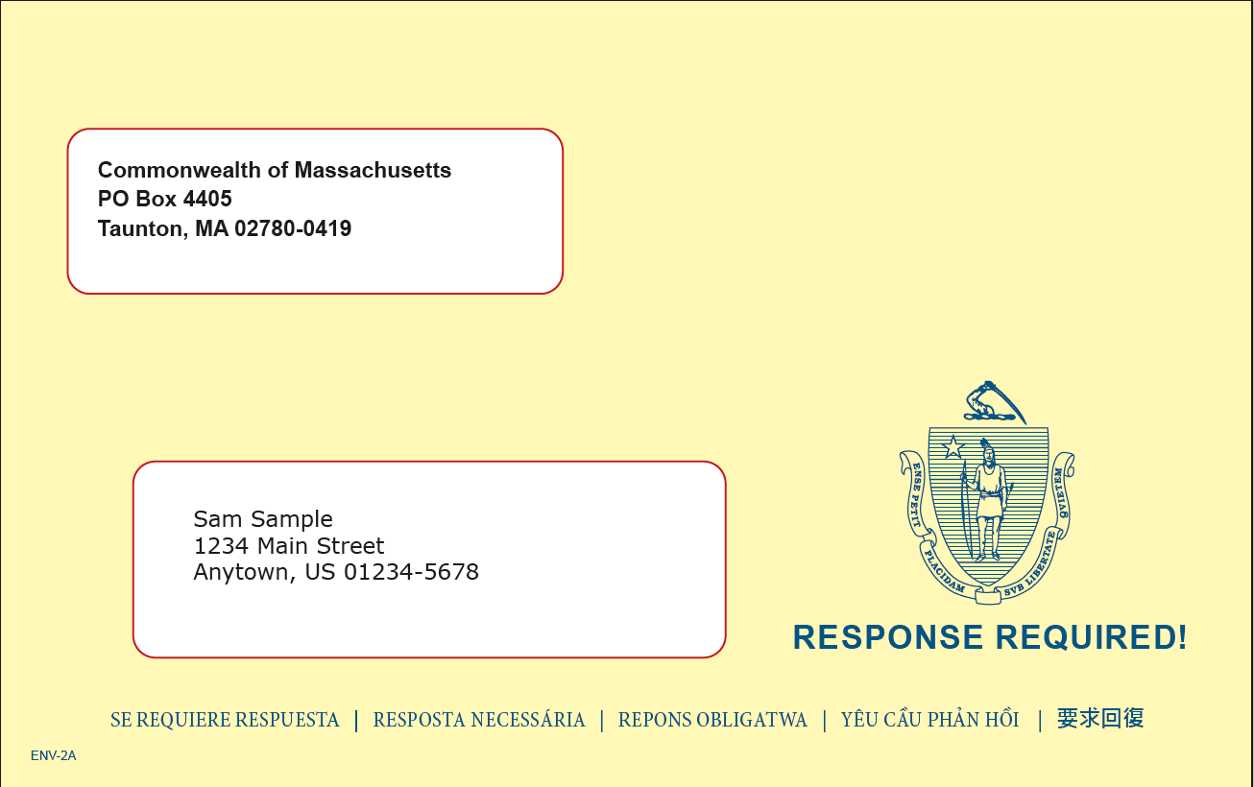
Member Communication: Sample Yellow Envelope
All outreach from the UMass Medicare Outreach and Enrollment Project will be sent in a 6x9.5 yellow envelope.

Slide 30
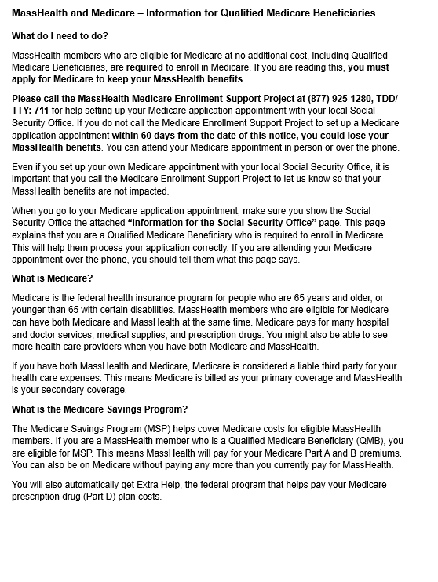
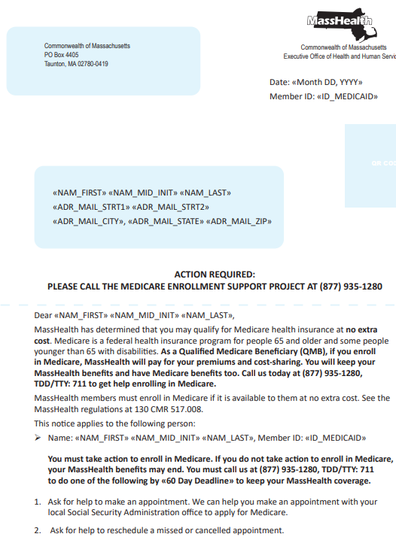
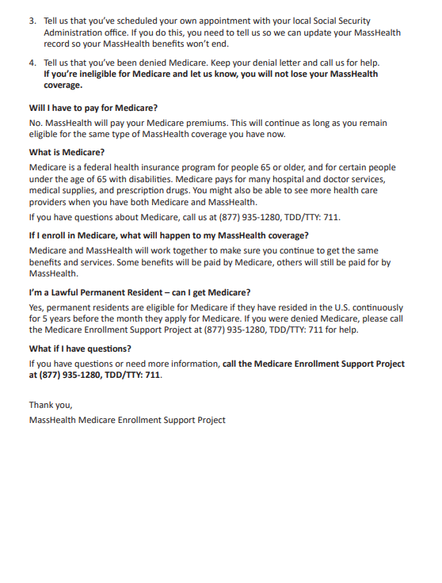
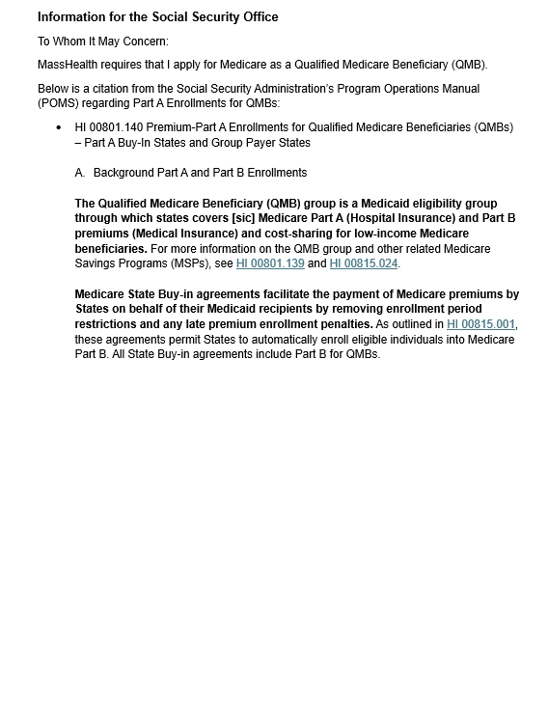
Member Communications: Sample Outreach Notice
All outreach notices sent by UMass will be sent to members in their preferred written language: 6 languages (English + Top 5 languages).
Note: Outreach notices will not be visible on MyServices.

Slide 31

Member Communication:
Text Message
A text from MassHealth will be sent to members with a cell phone.
Text message language.
MASSHEALTH: This is a notice from MassHealth of the Commonwealth of Massachusetts. Check your mail for a notice from us in a yellow envelope. You must apply for Medicare within 60 days. For help call (877) 925-1280 TDD/TTY:711.

Slide 32
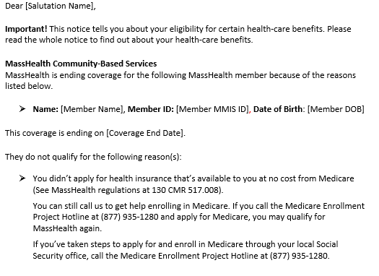
Member Communication: Sample Notice
Individuals who are closed after 60 days for failure to apply for Medicare will be sent an Eligibility Termination Notice from MassHealth.
The appealable notice will be sent to members and their ARDs and PSIs.
Termination notice will be in member’s MyServices account.

Slide 33
Outreach to Member by Additional Stakeholders
MassHealth has partnered with SCO plans, PACE orgs, and other stakeholders to contact members and help them navigate the process.
SCO plans, PACE orgs, and nursing facilities began outreaching members this spring.
If members have received communications from their SCO, PACE, or nursing facility, they should contact the person who sent the communication for assistance with Medicare enrollment.
At this time, the Medicare Enrollment Support Project team only provides support for members receiving letters in a yellow envelope from MassHealth.
Members who are only outreached by their SCO, PACE, or nursing facility to enroll in Medicare will not lose eligibility for MassHealth​.
  Only members who are outreached by the UMass Medicare Outreach and Enrollment Project team will lose eligibility if they fail to apply within 60 days​.

Slide 34
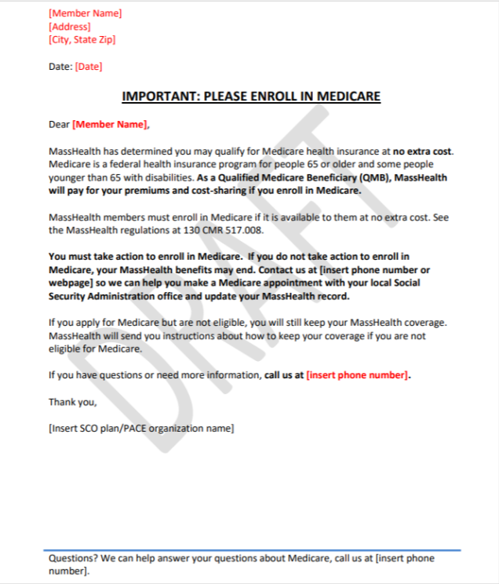
Member Communication by Stakeholders: Sample Outreach Letter
Members and their contacts may be outreached to by their SCO, PACE organization, or nursing facility.

Slide 35
Customer Service
UMass
Medicare Outreach and Enrollment Project
877-935-1280
Members and their ARDs and PSIs may call to:
Ask about Medicare Enrollment Support Project for individuals who have been outreached by Medicare Outreach and Enrollment Project (received a yellow envelope)
Get help making an appointment with SSA to apply for Medicare
Ask for help to reschedule a missed or cancelled appointment
Inform us if they have already made an appointment with SSA
Tell us they have been denied Medicare
Ask for help questions about Medicare coverage

Slide 36
Customer Service (continued)
MassHealth Customer Service
800-841-2900
Members and their ARDs and PSIs may call to:
Ask about eligibility for MassHealth and MSP programs, including questions about start and end dates for coverage and eligibility requirements
Report an eligibility change , such as new income, assets, or a change of address

Slide 37
Estate Recovery Update

Slide 38
Overview
Federal and state law require MassHealth to have an estate recovery program. The estate recovery program requires MassHealth to seek recovery from the estates of certain MassHealth members after their death, unless exceptions apply.
Estate recovery only occurs after the death of a MassHealth member.
Estate Recovery seeks to obtain repayment of the cost of certain services once a MassHealth member dies.
Most members are not impacted by estate recovery. Only MassHealth members age 55 or older, and members of any age who receive long-term care in a nursing home or other medical institution may be impacted by estate recovery.

Slide 39


Estate Recovery and the LTC Act
In September 2024, Governor Healey signed into law an Act to Improve Quality and Oversight of Long-Term Care (the “LTC Act”).
The LTC Act changed the scope of Estate Recovery for MassHealth members who died on or after August 1, 2024.

Slide 40

Estate Recovery and the LTC Act (continued)
Pre-LTC Act Policy
LTC Act16
State law required MassHealth to go beyond the federal minimum*
New state law limits Estate Recovery to federal minimum*
For members dying on/after 8/1/24, MassHealth may only recover costs for which MassHealth is federally required to recover:
Only costs associated with Long-Term Services and Supports (LTSS) for members 55+; and
All medical assistance for members of any age who were in LTC facility for a period long enough that they were assessed a Patient Pay Amount (PPA)
MassHealth was required to recover:
All medical assistance paid for members 55+; and
All medical assistance paid for members of any age who were in LTC facility for a period long enough that they were assessed a Patient Pay Amount (PPA)
LTC Act limits the scope of Estate Recovery for individuals 55+
*Federal law (42 U.S. Code § 1396p) requires states to seek recovery from probate estates for the cost of Long-Term Services and Supports (LTSS) provided to members age 55 and older or institutionalized.

Slide 41
MassHealth Operations

Slide 42

New MassHealth Webpages
New webpage for Providers caring for pregnant and postpartum MassHealth members, such as OB/GYNs, midwives, primary care providers, pediatricians, and others.
Includes detailed information and resources across several topics:
  Eligibility and covered services
  Managed care information and supports
  MassHealth doula benefit
  Behavioral health
  Breast pumps and lactation support
  Family planning
  Prenatal screening/diagnosis and vaccines
  Social determinants of health (SDOH)
  Patient-facing materials
Visit Mass.gov/perinatalproviders

Slide 43
New Flyers for Pregnant Members
New flyers with a checklist of important actions for MassHealth pregnant members. The flyers are linked below and available to download and print in several languages at Providers caring for pregnant and postpartum MassHealth members | Mass.gov
English
Brazilian Portuguese
Haitian Creole
Simplified Chinese
Spanish
Vietnamese

Slide 44

MassHealth Member Customer Service Center Hours
Contact us if you need help with:
  Eligibility
  MassHealth benefits
  Replacing your MassHealth card
  Enrolling in a health plan
  Getting a MassHealth application
  Update your information
  MassHealth and Children's Medical Security Plan premiums
Hours: Self-service available 24 hrs a day/7 days a week in English and Spanish.
Other services available Mon-Fri 8 a.m. to 5 p.m.; Interpreter service available.
(800) 841-2900, TDD/TTY: 711

Slide 45
MassHealth Appointment Reminders
Schedule an appointment with a MassHealth representative
Appointment Reminder Outreach: Robocall: On July 14th, MassHealth began robocall to outreach to individuals who have signed up for an in-person appointment at the Springfield MEC reminding them of their appointment and informing them that they can also walk into any of the other enrollment centers.
  Recipients are instructed to cancel their appointment online using their confirmation number (which was emailed to them) if they would like to walk into a MEC closer to their location.
This robocall will be in the top six languages and will be sent the business day immediately following when the appointment was booked.

Slide 46
MassHealth Appointment Reminders: Message
The message will read as follows:
Hello, this is MassHealth calling with a reminder that [Name] is scheduled for an in-person appointment at the MassHealth Springfield Enrollment Center on [date] at [time]. As a reminder, all of our enrollment centers are open without an appointment. We have offices in Charlestown, Chelsea, Quincy, Taunton, Tewksbury, and Worcester. If you would like to visit an enrollment center closer to your home without an appointment, please visit mass.gov/mhappointment with your confirmation number and cancel your scheduled appointment.

Slide 47
How to Report a Change:
Including Updating an Email Address
To update your: address, email address, phone number, income, add or remove a new household member. Report changes as soon as possible but no later than 10 days from the date of the change.
Online: If you are younger than 65 years old, go to MAhealthconnector.org to access your online account. You can also update your preference to be contacted by text, or email.
  If you are 65 or older, fill out a MassHealth Report a Change Form online or mail or fax the form.
Phone: Call MassHealth customer service
Mail: Commonwealth of Massachusetts
    Health Insurance Processing Center
    PO Box 4405
    Taunton, MA 02780
Fax: By faxing a document or handwritten note to 857-323-8300
In-Person: Local MassHealth Enrollment Center (MEC) or video appointment or with a Certified Assister

Slide 48
Questions
How to enroll in a Senior Care Option (SCO) Plan? Can members enroll online?
  The SCO program currently provides seniors with the option to enroll in one of six Senior Care Organizations.
  To enroll, members can contact MassHealth Customer Service or the individual Senior Care Organization to learn about which plan is best for them and to request enrollment.

Slide 49
Thank you!

