Slide 1

Health Safety Net
Information and Updates
Winter 2025

Slide 2
Agenda
  Claims Reprocessing
    MMIS System
    HSN System
  Covered Code List and New Rates
  HSN Reminders
  New Dental Administrator
  Health Connector Notices
  Special Circumstances
    Medical Hardship
    Bad Debt
  General Information
  Questions

Slide 3
Resweeps of Procedure Codes (slide 1 of 2)
MMIS Claims Re-processing
The following codes were inappropriately denied in MMIS as a non-covered procedure code for the Health Safety Net benefit plan(s). The following codes have recently reprocessed in MMIS for adjudication and potential adjudication/payment through the Health Safety Net payment systems.
90671 (For Dates of Services through 1/1/2023)
90677 (For Dates of Services through 1/1/2023)
19325 (For Dates of Services through 1/1/2023- Hospital Only Claims)
49591 (For Dates of Services through 1/1/2023- Hospital Only Claims)
73522 (For Dates of Services through 1/1/2023- Hospital Only Claims)
95708 (For Dates of Services through 1/1/2023- Hospital Only Claims)
G2066 (For Dates of Services through 1/1/2023- Hospital Only Claims)

Slide 4
Resweeps of Procedure Codes (slide 2 of 2)
HSN Claims Resweep
Claims billed with Procedure code 99211 were inappropriately paid at a $0.00 rate for Community Health Center providers in the Health Safety Net system. HSN has identified impacted claims and have reprocess claims in the HSN system for payment at the PPS rate in the September remits.

Slide 5
2025 PPS Rates
Community Healthcare Centers covered code list can be found with the link below:
Payment Information for CHCs | Mass.gov
Patient Type | Rest of Massachusetts | Metro Boston*
New Patient | $270.52 | $290.63
Established Patient | $201.64 | $216.63
* Metro Boston refers to Middlesex, Norfolk, and Suffolk Counties only.
Acute Care Hospitals
The updated non-covered procedure code list for acute outpatient hospitals can be found in the below link:
HSN Information for Hospitals | Mass.gov

Slide 6
HSN Reminders
Duplicate claims
Under no circumstances should duplicate claims ever be submitted. Resubmission of previously paid claims should always be submitted as an adjustment, never as an original claim, and should occur only when a change to submitted claims data is warranted.
Frequency Codes
HSN claims will only be accepted and processed based on the following claim frequency codes. Use of other codes will result in claims being denied.
XX1 = Original Claim
XX7 = Replacement Claim
XX8 = Void Claim 5

Slide 7
HSN Reminders (part II)
TCN/Patient Account Number
As a reminder, providers must not enumerate the reported TCN/Patient Account Number when correcting claims. Any billing system enumeration should be suppressed. Additionally, when sending information or claim reviews to HSN, Providers must send in the entire TCN/Patient Account Number, including any leading zeroes and any prefix or suffix that is part of that identifier.
Include the corresponding ICN for the claim in question.
HSN Secondary Claims
Providers MUST when sending HSN secondary claims include all service lines that are part of the total charges. No service lines should be deleted. Additionally, Providers must give HSN the information on any prior payments, denials, or contractual adjustments. This includes any Mass Health payments, other government payers and commercial payers etc.
Reports available to assist in follow-up for claim status
MassHealth/MMIS RA’s 835
HSN validation/error reports
HSN remits

Slide 8
HSN Reminders (part III)
Remediated Remits in INET
Please note that your facility may have more than one payment remit in INET due to HSN processing claims from prior years. Going forward, HSN will continue to process current year’s remits as well as previous year’s dates of service. For facilities who utilize Billing Intermediaries, please notify your BI that going forward, there may be multiple remits for your facility.

Slide 9
New Dental Administrator
Due to unforeseen MassHealth technical issues, the transition to the new dental administrator, BeneCare, is delayed and is no longer February 1, 2025. The new anticipated operational start date will be announced in the coming weeks.
For more information on the delayed start date, please see Dental Bulletin 51.
For participating providers and members:
  No action is needed at this time and there are no immediate changes in MassHealth Dental operations
  Please continue to contact MassHealth DentaQuest Customer Service at 800-207-5019 for questions or support until the transition to BeneCare (new start date TBD).

Slide 10
HSN and Health Connector Redetermination Notices
If recipients have been determined eligible for ConnectorCare, they have 90 days of HSN medical eligibility, starting on the date of application, to enroll in a ConnectorCare plan.
If recipients do not enroll within this time period, they will no longer be eligible for HSN medical services.
Failure to pay ConnectorCare premiums will result in ineligibility for HSN medical service reimbursement. Recipients may be able to work out a payment plan with the Health Connector, even after termination.
ConnectorCare recipients may still be eligible for allowable dental services from an eligible HSN provider.
Any questions related to the ConnectorCare should be directed to the Health Connector at 1-877-MA-ENROLL for more information.

Slide 11
Special Circumstances
Medical Hardship Assistance
A Massachusetts Resident at any Countable Income level may qualify for Medical Hardship if allowable medical expenses exceed a certain percentage of his or her Countable Income as specified in 101 CMR 613.05(1)(c). A determination of Medical Hardship is a onetime determination and not an ongoing eligibility category. An applicant may submit no more than two Medical Hardship applications within a 12-month period.
Income Level FPL | Percentage of Countable Income
0-205% | 10%
205.1 – 305% | 15%
305.1 – 405% | 20%
405.1 – 605% | 30%
>605.1% | 40%

Slide 12
Special Circumstances
Bad Debt
Bad Debt is an account receivable based on services furnished to a Patient that is:
  (a) regarded as uncollectible, following reasonable collection efforts consistent with the requirements in 101 CMR 613.06;
  (b) charged as a credit loss;
  (c) not the obligation of a governmental unit or the federal government or any agency thereof; and
  d) not a Reimbursable Health Service
Providers are charged with making reasonable attempts in obtaining and verifying the patient’s or guarantor’s supplied and financial information.
Reasonable collection efforts must be taken before a bad debt claim can be made which would include documentation of billings, calls, notices and any other notifications.
The bad debt must be unpaid after a period of 120 days of continuous collection action.

Slide 13
Special Circumstances
Bad Debt continued
Patient Identifiers:
Name
Address
Phone#
DOB
SSN#
TCN
Med Record#
MassHealth# (RID and/or RHN)
Date of Service
Total Charge for Services
Net Charge submitted to Health Safety Net
Evidence of Reasonable Collection Efforts:
Date of Initial Bill
Date of Second Bill
Date of Third Bill
Date of Fourth Bill
Date of Returned Mail
Date of Certified Letter for accounts over $1,000
Date of Initial Phone Contact
Date of Follow up Phone Contact
Dates of Other Efforts (other phone calls, letters to Patient, attorney or referral to collection agency)
Date Account was submitted to Health Safety Net Office

Slide 14
General Information
Health Safety Net eligible service regulations can be found at:101 CMR 613.00: Health Safety Net Eligible Services | Mass.gov
Health Safety Net eligible payment and funding regulations can be found at: 101 CMR 614.00: Health Safety Net Payments and Funding | Mass.gov
Health Safety Net Reimbursable Services located at: https://www.mass.gov/doc/hsn-chc-billable-procedure-codes/download
Health Safety Net INET located at: Learn about HSN-INET | Mass.gov
Billing updates are posted and can be found at: Information about HSN Provider Guides and Billing Updates | Mass.gov
The Health Safety Net is working on internal claims editing, code, and payment rate updates. HSN will instruct providers through billing update of any necessary payment resweeps due to these updates.

Slide 15
HSN Help Desk
Health Safety Net Help Desk inquiries should be addressed to HSNHelpDesk@massmail.state.ma.us and not an individual member of the Help Desk team.
If you feel the matter remains unresolved, please contact the Help Desk Supervisor for assistance.

Slide 16
MassHealth Updates

Slide 17
Agenda
MassHealth Redetermination and Renewal
Children’s Medical Security Plan Elimination of Premiums and Copays
MassHealth Dental Provider Update
2025 CAC Recertification

Slide 18
MassHealth Redetermination and Renewal Update

Slide 19
MassHealth Redetermination and Renewal Process
MassHealth is federally required to renew members annually.
  Automatic and prepopulated renewals may be completed for eligible members
Before January of 2025, MassHealth renewed members at the household level
Clarifying guidance from the Center for Medicare and Medicaid (CMS): Effective January 2025, MassHealth must conduct renewals at the individual level
What does this mean?
  This will result in changes to the member renewal experience
    This applies to ALL members

Slide 20
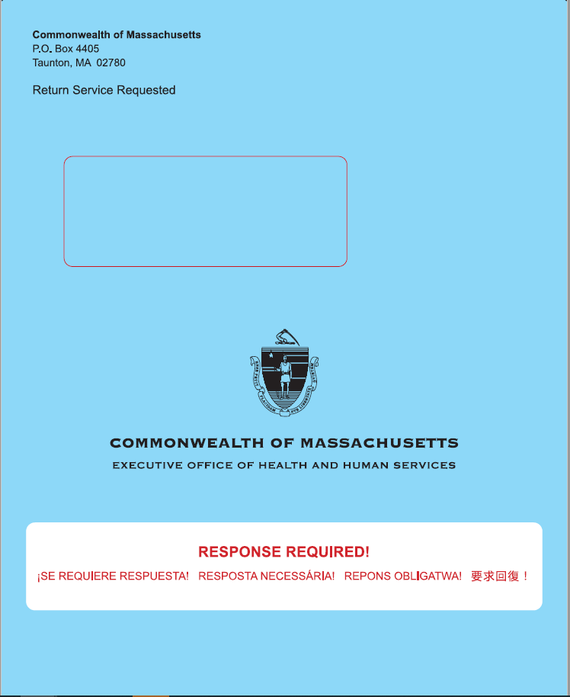
Non-Auto Renewals:
Renewal Blue Envelope
Content of the blue envelope:
  Renewal form
  Cover letter
  Babel sheet (translation information)
  Declination form
  Voter registration

Slide 21
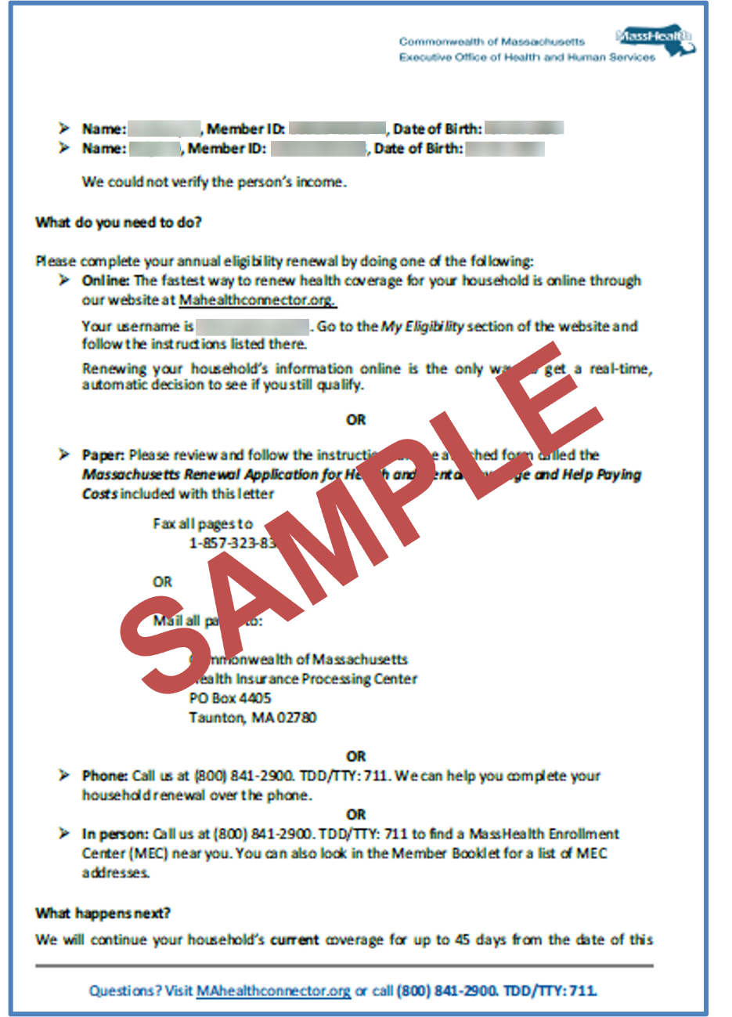
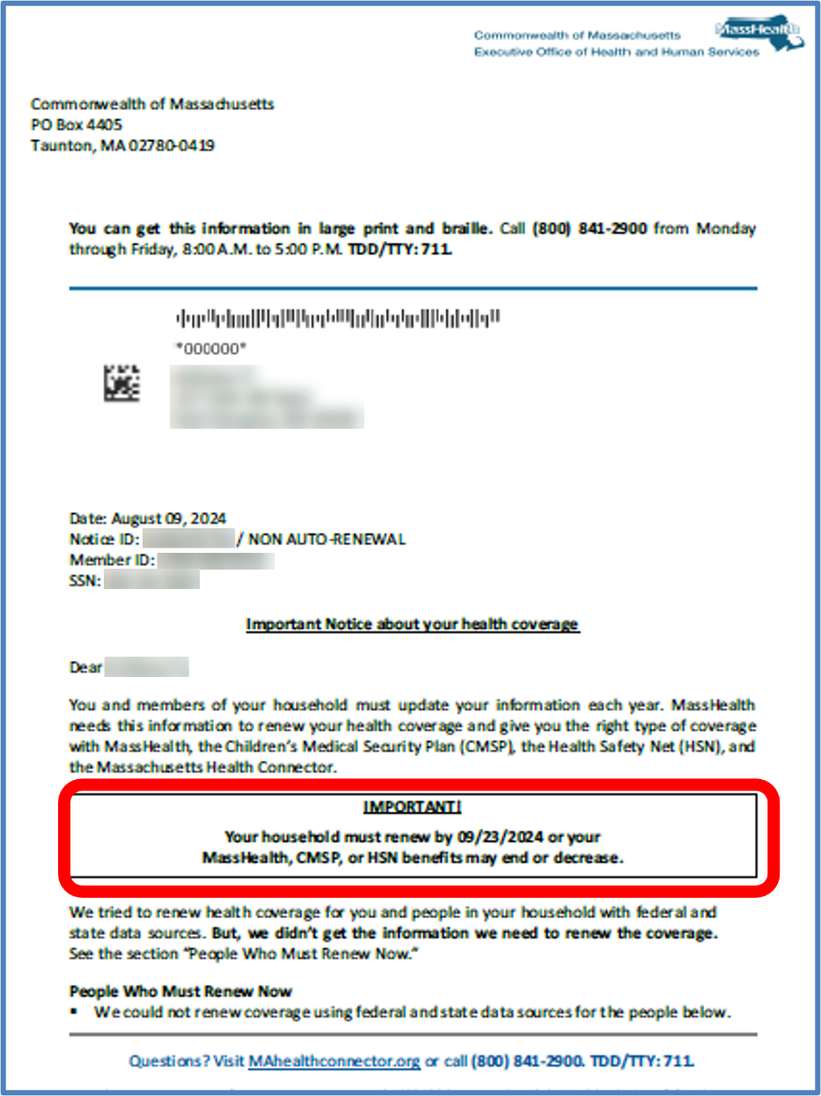
Renewal Notice
Cover notice is mailed to the head of household
Each household member will be identified if they need to complete their annual renewal

Slide 22
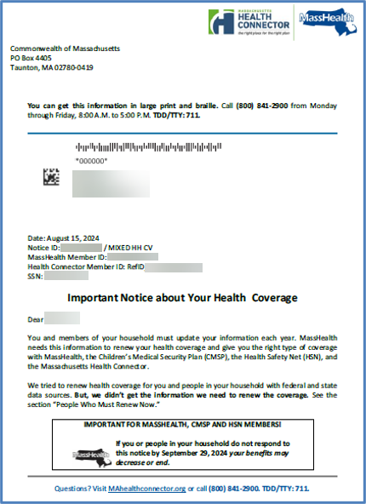
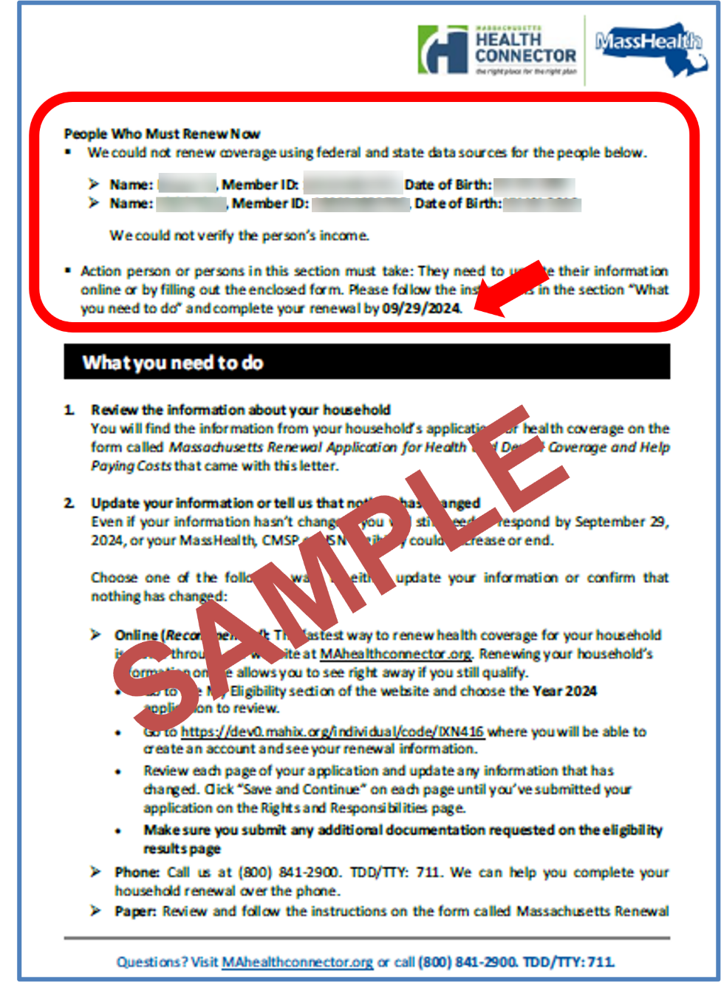
Sample Renewal Notice for Mix Household

Slide 23
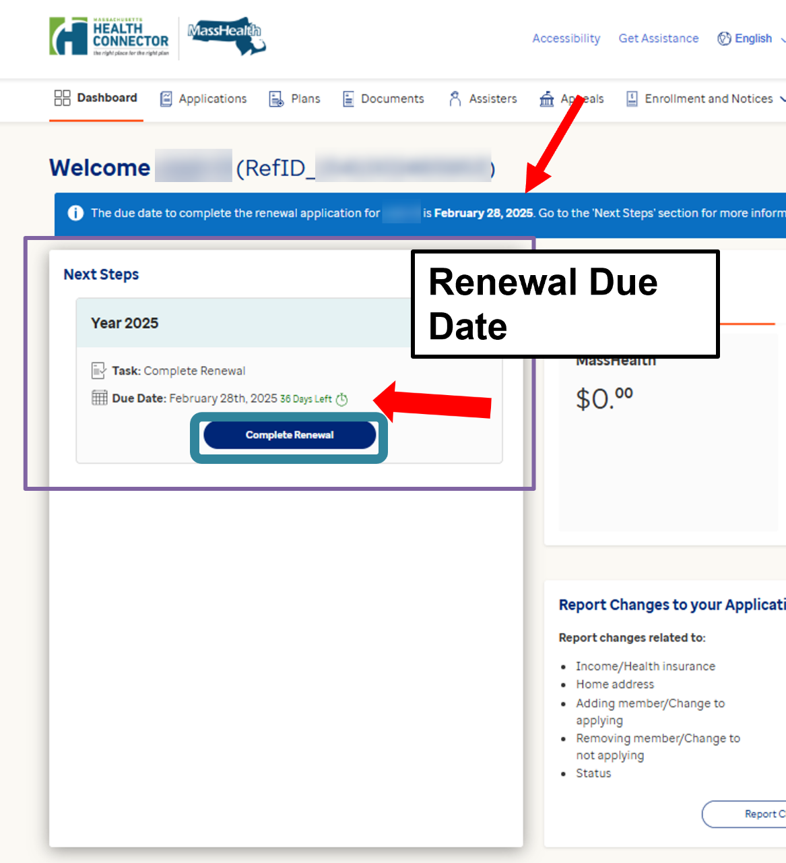
Renewing via MAhealthconnector.org
  Enhancements: On January 30, 2025, the online application at MAhealthconnector.org available to applicants younger than 65, will renew for each member of the household instead of the combined household
    New banner messages showing renewal information will specify which household members are in a renewal period
    Individual members may have different renewal dates

Slide 24
Scenario

Slide 25
Scenario:
MassHealth Members
Joanna
Mark
Joanna (age 29) and Mark (age 30), are married and file their taxes jointly. Mark is the head of household. Joanna is pregnant and both submitted their application in March of 2024. They are both under the MassHealth income threshold.
  Program determination:
        Joanna is determined eligible for Standard and continuous eligibility
        Mark is eligible for CarePlus

Slide 26
Scenario:
MassHealth Member Renewals
Joanna
Mark
One year later: March 2025, Joanna and Mark are up for renewal
Qualified member: Individual members selected for MassHealth’s renewal process
  Joanna and Mark are qualified members as they both are selected for renewal
  MassHealth pings state and federal data sources to verify information
    Results:
      Household income for Joanna and Mark is at 175% FPL

Slide 27
Scenario #1
Joanna
Mark
Joanna was auto-renewed:
  she is pregnant
  income threshold is under 200% FPL
  Continues to be eligible for MassHealth Standard
Joanna
Mark
Mark was not auto-renewed
  income went up, above CarePlus’ threshold

Slide 28
Question
Mark receives the blue renewal package from MassHealth, from what you already know, who will need to complete the renewal?
Both, Mark and Joanna need to complete their renewal
Only Joanna
Only Mark
They do not need to complete a renewal as they were auto-renewed for coverage
I’m not sure

Slide 29
Answer
Mark receives the blue renewal package from MassHealth, from what you already know, who will need to complete the renewal?
Answer: C
Only Mark

Slide 30
Scenario #1: Possible Outcome #1
Joanna
Mark
  As head of household Mark will be mailed the blue renewal notice
    Renewal notice will state:
      Joanna was auto-renewed and eligible for MassHealth Standard
      Mark needs to complete his renewal
        Mark responds to his renewal on time where he restates their original pre-renewal self-attested income and no other changes are reported
        Mark is sent an RFI for income and responds
      Result: Joanna remains on Standard and Mark remains on CarePlus

Slide 31
Scenario #1: Possible Outcome #2
Joanna
Mark
  Mark did not respond to his renewal on time:
      Result: Joanna remains eligible for Standard
        Using the information matched for Mark through data sources, Mark is determined eligible for the Health Connector (depending on income: ConnectorCare or QHP with HSN)
          Mark will receive a notice from the Health Connector and a denial notice from MassHealth
      New Renewal Dates:
        Joanna’s renewal date will be March 2026
        Mark selects and pays the Health Connector plan premium, he will be renewed during the next Health Connector’s renewal process in the fall of 2025

Slide 32
Scenario #1: Possible Outcome #3
Joanna
Mark
Joanna was auto-renewed, and Mark is a QHP member. It is fall 2025 and Mark is up for renewal through the Health Connector’s renewal process
  What we know:
    Joanna will continue to be eligible for MassHealth Standard as she’s continuously eligible and her next renewal is March 2026
    Mark will receive his renewal notice from the Health Connector and will need to respond and can pick a plan during Open Enrollment for 1/1/2026 effective date

Slide 33

Key Takeaways
Renewals will no longer be completed at the household level
Renewals will now happen individually via autorenewals or pre-populated forms (PPF) or a SACA renewal form
Members of the same household may have different renewal dates
There will be new notice language reflecting these changes
RAC or changes in circumstances submitted by a household member could affect other household members not up for renewal

Slide 34
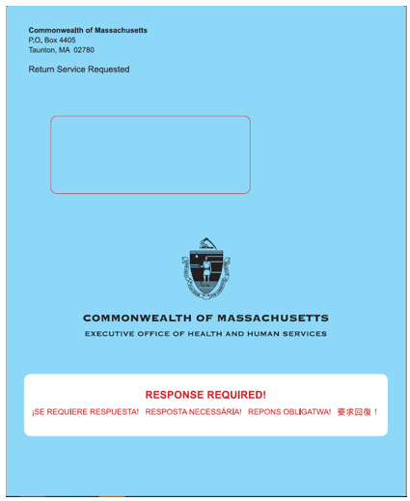



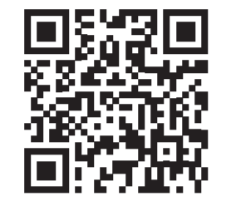

Ways to Renew Benefits
Online at Massachusetts Health Connector for those younger than 65 years of age
By phone: (800)841-2900; TDD/TTY: 711
  Monday – Friday: 8:00 am – 5:00 pm
Fax or Mail: Health Insurance Processing Center
  P.O. Box 4405
  Taunton, MA 02780
In person at a local MassHealth Enrollment Center (MEC) or go to Schedule an appointment with a MassHealth representative to schedule a phone or video appointment or scan the QR code
E-Submission – Certain members 65 and older, the renewal notice may have an e-Submission number
Resource: Renew your MassHealth coverage

Slide 35
Children’s Medical Security Plan (CHIP) Premiums and Copays

Slide 36

Elimination of Premiums and Copays
Effective January 1, 2025, MassHealth eliminated premiums charged to children enrolled in the Children’s Medical Security Plan (CMSP) up to 300% of the Federal Poverty Level (FPL)
MassHealth is also eliminating copays for all children enrolled in CMSP, regardless of household income
Since April 1, 2024, MassHealth eliminated copays for MassHealth members and Health Safety Net patients
Learn more about MassHealth Copay

Slide 37
MassHealth Dental Provider Update

Slide 38
MassHealth Dental Provider Update: Third-party Administrator
MassHealth will be transitioning to a new dental third-party administrator for MassHealth, the Children’s Medical Security Plan, and Health Safety Net.
The anticipated operational start date for the new dental administrator, BeneCare, is delayed and is no longer February 1, 2025. The new anticipated operational start date will be announced in the coming weeks.
The current MassHealth dental administrator, DentaQuest, will continue until the transition to BeneCare.
For more information on the delayed start date, please see Dental Bulletin 51.

Slide 39
For Participating Providers and Members
For participating providers and members:
  No action is needed at this time and there are no immediate changes in MassHealth dental operations
  Please continue to contact MassHealth DentaQuest Customer Service at 800-207-5019 for questions or support until the transition to BeneCare (new start date TBD).
How can I find out more about the upcoming MassHealth dental administrator transition?
  An initial list of frequently asked questions about the upcoming transition to BeneCare is available at FAQ.massdhp.org
    The FAQs will continue to be updated as more information is available.

Slide 40
How to Stay Updated
How can I sign up to receive future email updates about the MassHealth dental administrator transition?
  Sign up for the transition email list at: Provider Survey
  Please note that individuals and parties who are interested in transition updates but are not providers are also welcome to sign up for the email list. Please use the same sign-up form and enter your organization or n/a under “Dental Practice Name”.
For questions regarding the upcoming MassHealth dental administrator transition, please email the MassHealth Dental Provider Relations team, supported by BeneCare, at providerrelations@massdhp.com.
For general information about the dental services available to MassHealth adults and kids, please visit Learn about MassHealth dental benefits | Mass.gov.

Slide 41
2025 CAC Recertification

Slide 42
2025 CAC Recertification Period
Current certificates are set to expire April 30, 2025
Recertification period will begin March 1st and run to April 30th
Recertification will include an exam along with the other required courses:
  Revised: MassHealth Redetermination and Renewal and MassHealth and Disability
Failure to recertify will result in losing access to the LMS, Assister Portal, and Assister Line

Slide 43

Thank You!

