Slide 1
Massachusetts Healthcare Training Forum
February 2026
Executive Office of Health & Human Services

Slide 2
Disclaimer
Some slides from the live presentation were adjusted to improve accessibility; however, the content remains unchanged. Because this disclaimer slide was added, the slide numbers in the video may not match the slide numbers in the printable PowerPoint or PDF file.

Slide 3
Agenda
Welcome and Agenda Overview
Primary Care Clinician Plan / Primary Care ACO Referrals
Advancing Interoperability and Improving Prior Authorization Processes
POSC User Access, Virtual Gateway/POSC User Updates
Provider Online Service Center (POSC) User Access
Office of Accountable Care and Behavioral Health (ACBH) Updates
Fee-for-Service Provider Directory Mass.gov Improvements
Mass.gov Improvements
Long-Term Services and Supports
MassHealth Dental Program Vendor Transition
Payment Error Rate Measurement (PERM) RY 2026
MassHealth Updates
  Training Opportunities​
  Bulletins

Slide 4
Primary Care Clinician Plan / Primary Care ACO Referrals
Presented by – Nestor Rivera, Sr. Provider Relations Specialist, MassHealth Business Support Services

Slide 5
Overview
On March 20th, 2020, as part of MassHealth’s COVID-19 response, the Executive Office of Health and Human Services suspended referral requirements for MassHealth covered services for the Primary Care Accountable Care Organizations (PCACO) and the Primary Care Clinician (PCC) Plan.
As announced in All-Provider Bulletin 403, MassHealth is reinstated referral requirements for date(s) of service on or after August 1st, 2025, for members enrolled in the PCACOs and the PCC Plan.
All Provider Bulletin 409 announced additional exceptions to the Referral Requirements for Services through the PCACO and PCC plans.

Slide 6
PCC Plan –
Referrals for Services
All services provided by a clinician or provider other than the PCC Plan member’s primary care clinician require a referral from the member’s PCC on file in MMIS/POSC, unless the service is exempted under 130 CMR 450.118(J)(5).
Whenever possible, the primary care clinician should make the referral before the member’s receipt of the service. However, the primary care clinician may issue a referral retroactively (for up to a year after the date of service) if the primary care clinician determines that the service was medically necessary, and they were the PCC on file for the date of service.
See 130 CMR 450.000: Administrative and Billing Regulations

Slide 7
Primary Care ACO –
Referrals for Services
All services provided by a clinician or provider other than the Primary Care ACO member's primary care provider (PCP) or referral circle require a referral from the member’s PCP on file in MMIS/POSC to be payable, unless the service is exempted under 130 CMR 450.119(I).
Whenever possible, the PCP should make the referral before the member’s receipt of the service. However, the PCP may issue a referral retroactively (for up to a year after the date of service) if the PCP determines that the service was medically necessary, and they were the PCP on file for the date of service.
See 130 CMR 450.000: Administrative and Billing Regulations

Slide 8
Payment for Services Requiring a Referral
Failure to obtain a referral, when required, will result in non-payment of claims. Note that a referral is different from a Prior Authorization.
Payment for services is subject to all conditions and restrictions of MassHealth, including but not limited to, the scope of covered services for a member’s coverage type, service limitations, and prior-authorization requirements.
See 130 CMR 450.000: Administrative and Billing Regulations

Slide 9
Referring Provider Requirements
Claims submitted to MassHealth for services that require a referral must include the National Provider Identifier (NPI) of an authorized individual referring provider.
When the PCC Plan and Primary Care ACO Plan referrals are reinstated, billing providers must include the NPI of an authorized, enrolled referring provider on every claim for a service for which a referral is required for the claim to be payable.
See All-Provider Bulletin 286 (with updated information provided in All Provider Bulletins 361, 376, 380, and 391), for details on Ordering, Referring, & Prescribing (ORP) requirements, including the list of individual provider types that are considered authorized referring providers.

Slide 10
Urgent Care Services
Urgent care services, as defined in M.G.L. ch. 118E, s. 10N, will not require a referral in order to be payable.
Urgent care facilities, as defined in M.G.L. ch. 118E, s. 10N, that render urgent care services must bill in a manner to indicate that the service was urgent.
For professional claims, providers must bill with place of service 20
For institutional claims, providers must bill with admit code 02

Slide 11
Primary Care Provider Role
Reinstating referrals will allow providers to:
Maintain active engagement with members' care​
Provide care team with better management and coordination of members' care
Facilitate and improve care planning for members
Improve communication between primary care and specialty services​
Provide a single point of contact of accountability for ensuring that necessary medical and other services are accessed coordinated and delivered

Slide 12
Advancing Interoperability and Improving Prior Authorization Processes
Presented by – Nestor Rivera, Sr. Provider Relations Specialist, MassHealth Business Support Services

Slide 13
Interoperability 2026
As announced in APB 413: Interoperability - Prior Authorization Process Changes for the MassHealth Medical Benefit, the following went into effect on January 1st, 2026:
Prior Authorizations
  Standard PA requests: MassHealth will adjudicate standard prior authorization requests within 7 calendar days once all necessary documentation has been received
  Expedited PA requests: A decision will be provided within 72 hours when the member’s clinical condition requires urgent attention and a delay in processing could negatively affect health outcomes
System Modifications
  Updates have been made to the POSC to reflect the above changes. A new PA Classification field has been added to the POSC and allows providers to submit standard PAs or requests to expedite a PA
Mass.gov
  MassHealth’s Implementation of Interoperability and Prior Authorization Requirements webpage is now available here: https://www.mass.gov/masshealths-implementation-of-interoperability-and-prior-authorization-requirements
Metrics Reporting
  On track for March 31st, 2026

Slide 14
Virtual Gateway (VG)/Provider Online Service Center (POSC) User Updates
Presented by – Nestor Rivera, Sr. Provider Relations Specialist, MassHealth Business Support Services

Slide 15
VG/POSC Accounts
VG’s terms and conditions state that accounts not used regularly may be revoked.
  Policies and procedures further define the circumstances under which MassHealth will revoke access.
Do not re-use another person’s user account by over typing their information with new user information.
  This is a violation of the VG Terms and Conditions resulting in accounts being disabled.

Slide 16
VG/POSC Account Generic User IDs
Use the individual’s legal first and last name when creating the user ID
  This ensures the user ID accurately represents the individual and is essential for maintaining the integrity of the end-user’s identity
Do not create generic user IDs, for example
    First Name: Front
    Last Name: Desk
    Creating a user ID of desk
  This creates the appearance that the user ID is shared across multiple users

Slide 17
Primary User Reminders
Presented by – Nestor Rivera, Sr. Provider Relations Specialist, MassHealth Business Support Services

Slide 18
Primary User Policy
The Executive Office of Health and Human Services (EOHHS) MassHealth Provider Online Service Center (POSC) Primary User Policy, available on mass.gov, explains who Primary Users are, what they are responsible for, and how they must manage user access.
The policy outlines an enrolled provider’s responsibilities for managing access to its information within the Provider Online Service Center (POSC).
  This includes the requirement to designate Primary User(s) and defines the responsibilities associated with that role.
  Each provider may designate no more than two Primary Users per Provider ID/Service Location (PID/SL).
  The designated Primary User(s) serve as the Provider Organization’s system administrators and are responsible for managing user access to the Provider Organization’s information in the POSC.

Slide 19
Primary User Policy (continued)
Ineffective management of this information may allow staff or affiliate organizations to retain access to a provider’s information and continue submitting transactions on the provider’s behalf after an individual has left employment, changed roles, or after contractual relationships have ended.
  This creates a risk of unauthorized activity, exposing providers to potential fraud and enabling individuals or entities to misuse the organization’s information for personal gain or the benefit of other organizations.
  Lack of compliance with the Primary User Policy will result in termination of user access by MassHealth

Slide 20
Responsibilities of Provider Organizations
Each MassHealth enrolled provider organization must have processes in place to protect its information and control who can access it.
Provider Organizations must update user access promptly when an employee’s role changes, when access to POSC services should be added or removed, or when a relationship with an affiliated organization changes.
  This applies to all users, including Primary Users
Provider Organizations must conduct a semi-annual or annual review of all POSC user access to confirm that only individuals with a legitimate business need can view, submit, or receive information on the organization’s behalf.
  The POSC includes tools to help organizations complete this review.
  While MassHealth does not routinely require organizations to submit documentation of these reviews, MassHealth may request this information if there is a suspected security risk or breach.

Slide 21
Responsibilities of Provider Organizations (continued)
Provider Organizations must ensure that both a Primary User and a Backup Primary User are designated at all times and that these individuals actively manage access to the organization’s information.
Only the designated Primary User and Backup Primary User may manage access to the organization’s data, for a maximum of two individuals.
Primary Users can now view which users are assigned the Primary User role and must confirm that no more than two users have this access.
Provider Organizations should plan to maintain continuous coverage. If a Primary User or Backup Primary User leaves the provider organization or is expected to leave, a replacement must be designated as soon as possible.

Slide 22
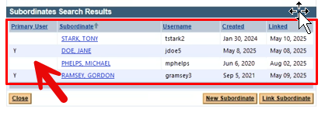
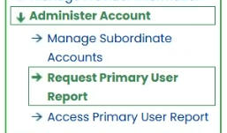
Options for Updating Primary User Assignments (slide 1 of 3)
Primary Users can manage this internally in the POSC.
Under Manage Subordinate Accounts search results will now identify the Primary User(s) via a sortable Indicator in the panel.
If the user is no longer at the organization, simply unlink them from the PID/SL.
If the user is still at the organization but should not have the role, simply remove the role.
A primary user can also generate an Excel spreadsheet showing this data.

Slide 23
Options for Updating Primary User Assignments (slide 2 of 3)
Primary Users can submit an Existing Provider Modification Data Collection Form to update the primary user on the account.
If the PID/SL already has more than two Primary Users, it will be rejected and you will need to use one of the other two options.
If the PID/SL already has two Primary Users, you MUST check off the Replace option and indicate which current primary user is being replaced.
DCF FAQ Page: MassHealth Data Collection Form FAQ | Mass.gov

Slide 24
Options for Updating Primary User Assignments (slide 3 of 3)
Submit a Primary User Modification Form when there are too many PID/SLs or if there are not any current primary users in the organization.
  Every PID/SL must have a POSC User ID
  The two Primary Users you want to keep are placed on the form
  MassHealth Primary User Modification form
  Submit form to Functional.Coordination@mass.gov
For questions please contact:
Long-Term Services and Supports:
Phone: (844) 368-5184 (toll free)
Email: support@masshealthltss.com
Fax: 888-832-3006
All Other Provider Types:
Phone: (800) 841-2900; TTY: 711
Email: provider@masshealthquestions.com

Slide 25
Office of Accountable Care and Behavioral Health (ACBH) Updates
Presented by- Michael Gilleran, Provider Operations Specialist, MassHealth Operations

Slide 26
ACO Changes Effective January 1, 2026

Slide 27
ACO Changes Effective January 1, 2026
Service Area Changes
The following health plan is no longer offered by MassHealth in the following service areas since January 1, 2026
Plan Name | Service Area Removal
WellSense Care Alliance | Brockton Haverhill
Provider Changes
As of January 1, 2026, 30 providers joined or moved in the MassHealth ACO program. These moves affected approximately 20,000 members.
Hospital Changes
As of January 1, 2026, 2 ACOs made changes to their hospital network. However, in an emergency, members can go to any hospital. Members do not need to worry about which health plan they have.
The Enrollment Guide was updated to reflect changes starting January 1, 2026.
If you want to learn more about the health plans options, you can:
  Visit www.MassHealthChoices.com; or
  Call MassHealth Customer Service at (800) 841-2900, TDD/TTY: 711.
  MassHealth Customer Service is open Monday thru Friday, 8 am to 5 pm.

Slide 28
ACO Changes Effective January 1, 2026 (continued)
Changes to Available Health Plans in 2026
As of January 1, 2026, the Tufts Health Together Managed Care Organization (MCO) is discontinued. This affected approximately 20,000 members. Members previously enrolled in the Tufts Health Together MCO were re-assigned to the health plan that their primary care provider (PCP) is participating in, if possible. Members received a notification letter about their new health plan assignment, providing additional information about their options, including how to change health plans. Leading up to January 1, 2026, MassHealth worked with the Tufts Health Together MCO and the members’ future health plans to coordinate transitions of care, including exchanging information about prior authorizations and referrals.
The Enrollment Guide was updated to reflect changes starting January 1, 2026.
If you want to learn more about the health plans options, you can:
  Visit www.MassHealthChoices.com; or
  Call MassHealth Customer Service at (800) 841-2900, TDD/TTY: 711.
  MassHealth Customer Service is open Monday thru Friday, 8 am to 5 pm.

Slide 29
Primary Care Provider Changes
(slide 1 of 9)
# | Primary Care Provider | Address | Moved from | to
1 | Bellingham Medical Associates | 1003 S Main St Bellingham, MA 02019 | Mass General Brigham Health Plan With Mass General Brigham ACO | Tufts Health Together with UMass Memorial Health
2 | Blackstone Valley Family Physicians | 100 Commerce Drive Northbridge, MA 01534 | Mass General Brigham Health Plan With Mass General Brigham ACO | Tufts Health Together with UMass Memorial Health
3 | Carlos Moreno MD PC | 128 Carnegie Row Suite 106 Norwood, MA 02062 | Tufts Health Together MCO | WellSense Beth Israel Lahey Health (BILH) Performance Network ACO
The Enrollment Guide was updated to reflect changes starting January 1, 2026.
If you want to learn more about the health plans options, you can:
  Visit www.MassHealthChoices.com; or
  Call MassHealth Customer Service at (800) 841-2900, TDD/TTY: 711.
  MassHealth Customer Service is open Monday thru Friday, 8 am to 5 pm.

Slide 30
Primary Care Provider Changes
(slide 2 of 9)
# | Primary Care Provider | Address | Moved from | to
4 | Center for Adolescent and Young Adult Health | 100 Medway Rd Suite 204 Milford, MA 01757 | Mass General Brigham Health Plan With Mass General Brigham ACO | Tufts Health Together with UMass Memorial Health
5 | Children’s Health Care - Haverhill | 600 Primrose St Haverhill, MA | Revere Health Choice | WellSense Boston Children’s ACO
6 | Children’s Health Care – Newburyport | 257 Low St Newburyport, MA 01950 | Revere Health Choice | WellSense Boston Children’s ACO
7 | Community Pediatrics of Medway | 68A Main St Suite 1010 Medway, MA 02053 | Mass General Brigham Health Plan With Mass General Brigham ACO | Tufts Health Together with UMass Memorial Health
The Enrollment Guide was updated to reflect changes starting January 1, 2026.
If you want to learn more about the health plans options, you can:
  Visit www.MassHealthChoices.com; or
  Call MassHealth Customer Service at (800) 841-2900, TDD/TTY: 711.
  MassHealth Customer Service is open Monday thru Friday, 8 am to 5 pm.

Slide 31
Primary Care Provider Changes
(slide 3 of 9)
# | Primary Care Provider | Address | Moved from | to
8 | Community Pediatrics of Milford | 229 East Main St Milford, MA 01757 | Mass General Brigham Health Plan With Mass General Brigham ACO | Tufts Health Together with UMass Memorial Health
9 | Davis Square Family Practice | 255 Elm St Suite 301 Somerville, MA 02144 | Primary Care Clinician (PCC) Plan and Tufts Health Together MCO | WellSense Care Alliance
10 | Family Medicine Associates | 68A Main St Medway, MA 02053 | Mass General Brigham Health Plan With Mass General Brigham ACO | Tufts Health Together with UMass Memorial Health
11 | Family Practice Group, P.C. | 11 Water St Suite 1A Arlington, MA 02476 | Primary Care Clinician (PCC) Plan and Tufts Health Together MCO | WellSense Care Alliance
The Enrollment Guide was updated to reflect changes starting January 1, 2026.
If you want to learn more about the health plans options, you can:
  Visit www.MassHealthChoices.com; or
  Call MassHealth Customer Service at (800) 841-2900, TDD/TTY: 711.
  MassHealth Customer Service is open Monday thru Friday, 8 am to 5 pm.

Slide 32
Primary Care Provider Changes
(slide 4 of 9)
# | Primary Care Provider | Address | Moved from | to
12 | Franklin Family Practice | 1280 W Central St Suite 202 Franklin, MA 02038 | Mass General Brigham Health Plan With Mass General Brigham ACO | Tufts Health Together with UMass Memorial Health
13 | Franklin Pediatrics | 1280 W Central St Suite 201 Franklin, MA 02038 | Mass General Brigham Health Plan With Mass General Brigham ACO | Tufts Health Together with UMass Memorial Health
14 | Franklin Primary Care | 1280 W Central St Suite 301 Franklin, MA 02038 | Mass General Brigham Health Plan With Mass General Brigham ACO | Tufts Health Together with UMass Memorial Health
The Enrollment Guide was updated to reflect changes starting January 1, 2026.
If you want to learn more about the health plans options, you can:
  Visit www.MassHealthChoices.com; or
  Call MassHealth Customer Service at (800) 841-2900, TDD/TTY: 711.
  MassHealth Customer Service is open Monday thru Friday, 8 am to 5 pm.

Slide 33
Primary Care Provider Changes
(slide 5 of 9)
# | Primary Care Provider | Address | Moved from | to
15 | Franklin Wrentham Family Medicine | 440 E Central St Franklin, MA 02038 | Mass General Brigham Health Plan With Mass General Brigham ACO | Tufts Health Together with UMass Memorial Health
16 | Gloria Moussa-Gabour | 20 E Emerson St Melrose, MA 02176 | Primary Care Clinician (PCC) Plan and Tufts Health Together MCO | WellSense Care Alliance
17 | HealthFirst Family Care Center, Inc. | 387 Quarry St Suite 100 Fall River, MA 02723 | WellSense Community Alliance ACO | Community Care Cooperative
The Enrollment Guide was updated to reflect changes starting January 1, 2026.
If you want to learn more about the health plans options, you can:
  Visit www.MassHealthChoices.com; or
  Call MassHealth Customer Service at (800) 841-2900, TDD/TTY: 711.
  MassHealth Customer Service is open Monday thru Friday, 8 am to 5 pm.

Slide 34
Primary Care Provider Changes
(slide 6 of 9)
# | Primary Care Provider | Address | Moved from | to
18 | Hopkinton Family Practice | 77 W Main St Suite 204 Hopkinton, MA 01748 | Mass General Brigham Health Plan With Mass General Brigham ACO | Tufts Health Together with UMass Memorial Health
19 | Hopkinton Internal Medicine and Pediatrics | 1 Lumber St Hopkinton, MA 01748 | Mass General Brigham Health Plan With Mass General Brigham ACO | Tufts Health Together with UMass Memorial Health
20 | Hopkinton Primary Care | 169 W Main St Hopkinton, MA 01748 | Mass General Brigham Health Plan With Mass General Brigham ACO | Tufts Health Together with UMass Memorial Health
The Enrollment Guide was updated to reflect changes starting January 1, 2026.
If you want to learn more about the health plans options, you can:
  Visit www.MassHealthChoices.com; or
  Call MassHealth Customer Service at (800) 841-2900, TDD/TTY: 711.
  MassHealth Customer Service is open Monday thru Friday, 8 am to 5 pm.

Slide 35
Primary Care Provider Changes
(slide 7 of 9)
# | Primary Care Provider | Address | Moved from | to
21 | Mcgrath Medical Group | 117 Water St Milford, MA 01757 | Mass General Brigham Health Plan With Mass General Brigham ACO | Tufts Health Together with UMass Memorial Health
22 | Mendon Internal Medicine | 12 Uxbridge Rd Mendon, MA 01756 | Mass General Brigham Health Plan With Mass General Brigham ACO | Tufts Health Together with UMass Memorial Health
23 | Oak Pediatrics | 198 Littleton Road Suite 204 Westford, MA | Tufts Health Together MCO | WellSense Care Alliance
24 | Pediatric Associates of Wellesley, Inc | 266 Main St Suite 18 Medfield, MA 02052 | Primary Care Clinician (PCC) Plan | Mass General Brigham Health Plan With Mass General Brigham ACO
The Enrollment Guide was updated to reflect changes starting January 1, 2026.
If you want to learn more about the health plans options, you can:
  Visit www.MassHealthChoices.com; or
  Call MassHealth Customer Service at (800) 841-2900, TDD/TTY: 711.
  MassHealth Customer Service is open Monday thru Friday, 8 am to 5 pm.

Slide 36
Primary Care Provider Changes
(slide 8 of 9)
# | Primary Care Provider | Address | Moved from | to
25 | Pediatric Associates of Wellesley, Inc | 134 South Avenue Weston, MA 02493 | Primary Care Clinician (PCC) Plan | Mass General Brigham Health Plan With Mass General Brigham ACO
26 | Pelham Healthcare Associate (site 1) | 49 Atwood Road Suite 1 Pelham, NH 03076 | Tufts Health Together MCO | WellSense Care Alliance
27 | Pelham Healthcare Associates DBA Westford Primary Care (site 2) | 198 Littleton Road Suite 203 Westford, MA 01886 | Tufts Health Together MCO | WellSense Care Alliance
The Enrollment Guide was updated to reflect changes starting January 1, 2026.
If you want to learn more about the health plans options, you can:
  Visit www.MassHealthChoices.com; or
  Call MassHealth Customer Service at (800) 841-2900, TDD/TTY: 711.
  MassHealth Customer Service is open Monday thru Friday, 8 am to 5 pm.

Slide 37
Primary Care Provider Changes
(slide 9 of 9)
# | Primary Care Provider | Address | Moved from | to
28 | Primary Care Physicians | 221 East Main St Milford, MA 01757 | Mass General Brigham Health Plan With Mass General Brigham ACO | Tufts Health Together with UMass Memorial Health
29 | Robert F. Commito MD PC | 311 Washington St Brighton, MA 02135 | Tufts Health Together MCO | WellSense Care Alliance
30 | Somerville Family Practice | 1020 Broadway Somerville, MA 02144 | Primary Care Clinician (PCC) Plan and Tufts Health Together MCO | WellSense Care Alliance
The Enrollment Guide was updated to reflect changes starting January 1, 2026.
If you want to learn more about the health plans options, you can:
  Visit www.MassHealthChoices.com; or
  Call MassHealth Customer Service at (800) 841-2900, TDD/TTY: 711.
  MassHealth Customer Service is open Monday thru Friday, 8 am to 5 pm.

Slide 38
Hospital Changes (slide 1 of 3)
# | Plan Name | has added the following hospitals to its network
1 | Mass General Brigham Health Plan with Mass General Brigham ACO | Mercy Medical Center (Trinity Health of New England), Springfield
The Enrollment Guide was updated to reflect changes starting January 1, 2026.
If you want to learn more about the health plans options, you can:
  Visit www.MassHealthChoices.com; or
  Call MassHealth Customer Service at (800) 841-2900, TDD/TTY: 711.
  MassHealth Customer Service is open Monday thru Friday, 8 am to 5 pm.

Slide 39
Hospital Changes (slide 2 of 3)
# | Plan Name | has removed the following hospitals from its network
1 | Fallon Atrius | Baystate Medical Center (Baystate Health), Springfield
2 | Mass General Brigham Health Plan with Mass General Brigham ACO | Holyoke Medical Center, Holyoke
The Enrollment Guide was updated to reflect changes starting January 1, 2026.
If you want to learn more about the health plans options, you can:
  Visit www.MassHealthChoices.com; or
  Call MassHealth Customer Service at (800) 841-2900, TDD/TTY: 711.
  MassHealth Customer Service is open Monday thru Friday, 8 am to 5 pm.

Slide 40
Hospital Changes (slide 3 of 3)
The following hospitals have changed their names:
Morton Hospital (Lifespan Health Systems), Taunton has changed to Morton Hospital (Brown University Health) Saint Anne’s Hospital (Lifespan Health Systems), Fall River has changed to Saint Anne’s Hospital (Brown University Health) St. Elizabeth’s Medical Center, Brighton is now Boston Medical Center – Brighton, Brighton Good Samaritan Medical Center, Brockton is now Boston Medical Center – South, Brockton
The Enrollment Guide was updated to reflect changes starting January 1, 2026.
If you want to learn more about the health plans options, you can:
  Visit www.MassHealthChoices.com; or
  Call MassHealth Customer Service at (800) 841-2900, TDD/TTY: 711.
  MassHealth Customer Service is open Monday thru Friday, 8 am to 5 pm.

Slide 41
Continuity of Care
Continuity of Care
The Continuity of Care (CoC) period for medical and behavioral health services ranges from January 1, 2026 to March 31, 2026 (90 days post go-live)
Escalation Process
Each health plan will have an escalation process in place for any access-to-care issues for members regarding pharmacy and specialty network issues during this period.
The Enrollment Guide will be updated to reflect changes starting January 1, 2026.
If you want to learn more about the health plans options, you can:
  Visit www.MassHealthChoices.com; or
  Call MassHealth Customer Service at (800) 841-2900, TDD/TTY: 711.
  MassHealth Customer Service is open Monday thru Friday, 8 am to 5 pm.

Slide 42
WellSense In-House Transition of the Behavioral Health Benefit

Slide 43
WellSense In-House Transition of the Behavioral Health Benefit
On 1/1/26, WellSense took over the operations of its behavioral health benefit from its previous vendor, Carelon.
WellSense's 8 ACOs and MCO are impacted by this transition.
There will be a 90-day continuity of care period from 1/1/26-3/31/26, during which all prior authorizations will be honored.
All claims will be paid for medically necessary Behavioral Health services rendered between 1/1/26-3/31/26, regardless of provider contracting status.
All claims for dates of service prior to 1/1/26 should be submitted to Carelon, per the previously established process.
All claims for dates of service on or after 1/1/26 should be submitted to WellSense.
WellSense's FAQ page at Behavioral health insourcing FAQs | WellSense Health Plan
contains further information on credentialing, contracting, using the provider portal for claims submission and PA requests, along with additional resources.
Questions and contracting inquiries can be directed to bhproviders@wellsense.org

Slide 44
Fee-for-Service Provider Directory
Presented by- Michael Gilleran, Provider Operations Specialist, MassHealth Operations

Slide 45
FFS Directory Updates
In accordance with the Consolidated Appropriations Act (CAA 2023), MassHealth has expanded the Provider Directory data elements.
Data elements include languages spoken by providers, website URLs, accessibility accommodations, telehealth availability, and whether new patients are being accepted.
Cultural capabilities were also added to the Provider Directory search results page but are currently on hold until further guidance from the Center for Medicare and Medicaid Services (CMS).
CMS requires that Provider Directory data elements remain current and accurate.

Slide 46
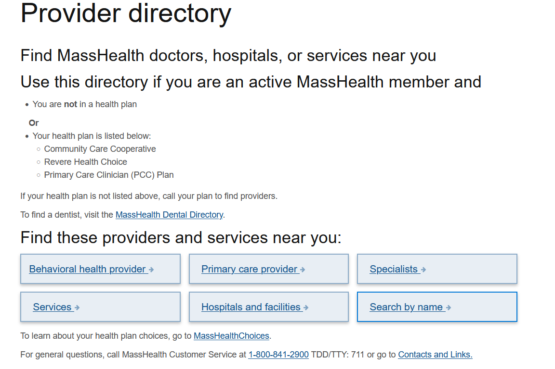
Directory on Mass.gov
MassHealth members may utilize the provider directory on Mass.gov, using a variety of search criteria.
Providers can be sorted by the most essential services needed, such as primary care providers, behavioral health, hospitals, etc.
Visit: Provider Directory

Slide 47
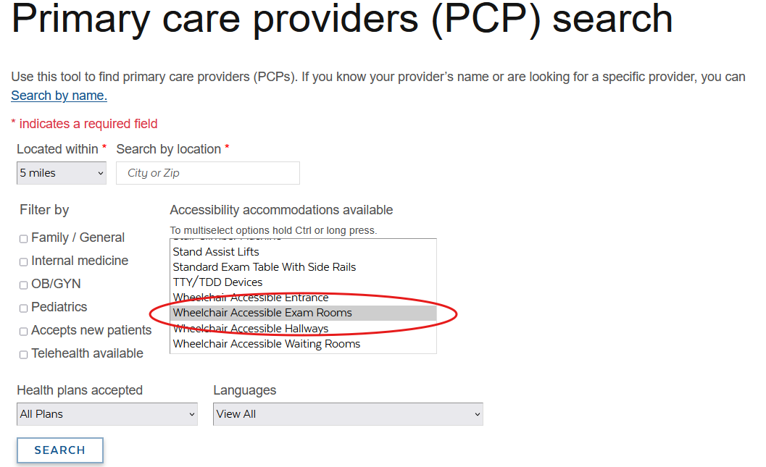
Directory on Mass.gov (continued)
Searches can be narrowed down even further once a category of provider has been chosen.
Using the newly required data elements, MassHealth members could narrow their search to find a location that accommodates their health needs.

Slide 48
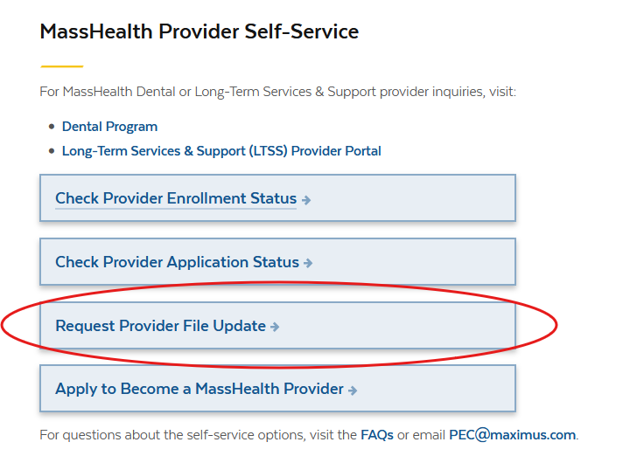
Maintaining Directory Information:
Provider Self-Service
The “Provider Directory Information” update request is scheduled to go live on January 30, 2026.
All providers are required to maintain accurate profiles and update their Directory information when changes occur.
Additionally, providers who have not provided any Directory information to date will be required to do so using the new self-service optionTo review or request an update to your Provider Directory information, visit Provider Self-Service and select “Request Provider File Update”.
Visit: MassHealth Provider Self-Service

Slide 49
Maintaining Directory Information: Revalidation
Provider Directory data capture will soon be added to the Revalidation process for all providers.
During revalidation, contacts will be required to review and update (if applicable) Provider Directory data for each provider via a secure link.
Capturing directory data during revalidation helps ensure missed updates are addressed; however, providers should continue updating their information promptly when changes occur.
The new revalidation process is expected to take effect in early Spring of 2026.

Slide 50
Mass.gov Improvements
Presented by- Michael Gilleran, Provider Operations Specialist, MassHealth Operations

Slide 51
Application Changes
Due to the expanded data elements that will be added to the Provider Directory, provider applications will be modified to include questions that collect this information.
The data elements will now include languages spoken by providers, website URLs, accessibility accommodations, telehealth services, and whether new patients are being accepted.
Cultural capabilities were also added to the Provider Directory search results page. MassHealth is currently evaluating how to best collect this data and providers are encouraged to begin tracking this information in preparation for future updates.

Slide 52
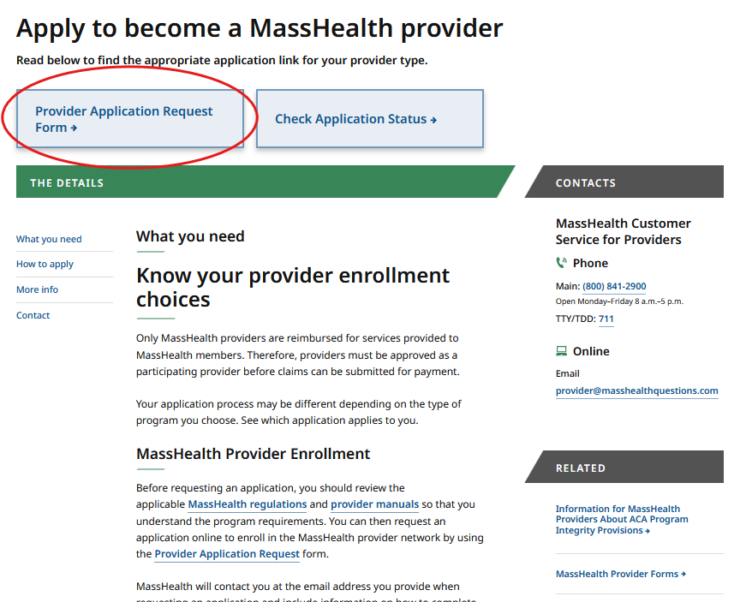
Application Requests on Mass.gov
Providers are reminded that they may request a FFS application on Mass.gov.
The applications can be sent digitally, or by mail, and will include the provider directory field mentioned previously.
Visit: Apply to become a MassHealth provider

Slide 53
Updating Provider Files
MassHealth providers are advised that any changes to their information will require they submit an update request. This will ensure their provider file is accurate, per MassHealth regulations.
Provider files should be updated whenever there is a modification to information such as addresses, employers, or any information that differs from when the application was first processed.
Visit: MassHealth Provider Self Service

Slide 54
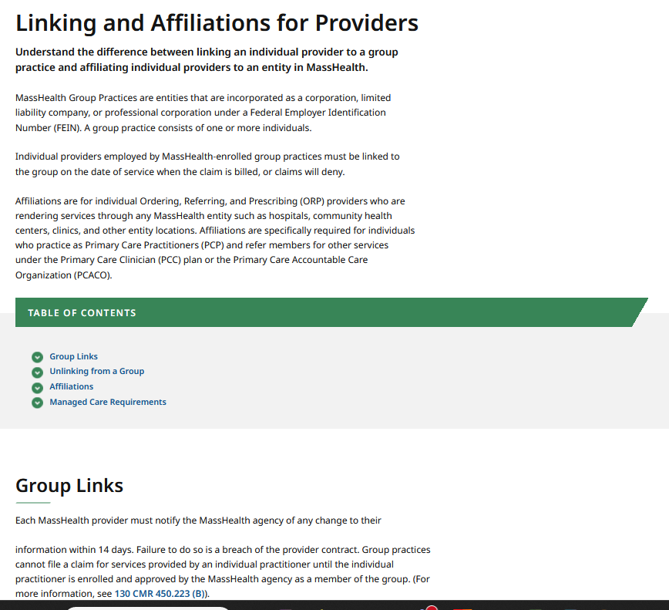
Mass.gov Updates – Group Links/Affiliations
In February 2025, MassHealth introduced a page dedicated to articulating the differences between linking and affiliations.
This page offers insight into the way providers are listed in the MassHealth program, as well as directs to Provider Self-Service which enables providers to verify group linkages.
Visit: Linking and Affiliations for Providers

Slide 55
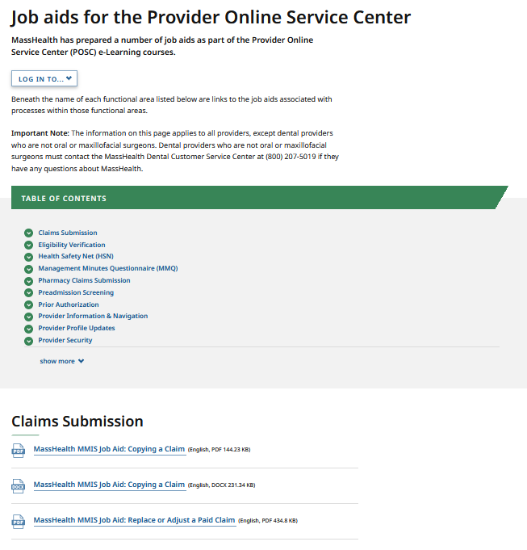
Mass.gov Updates – Job Aids
In 2025, MassHealth Job Aids for the Provider Online Service Center (POSC) underwent some new additions and modifications.
Updates specifically involve the guidance on how to request that a provider be linked/unlinked from a group practice, as well as updated images and written instructions.
Visit: Job aids for the Provider Online Service Center

Slide 56
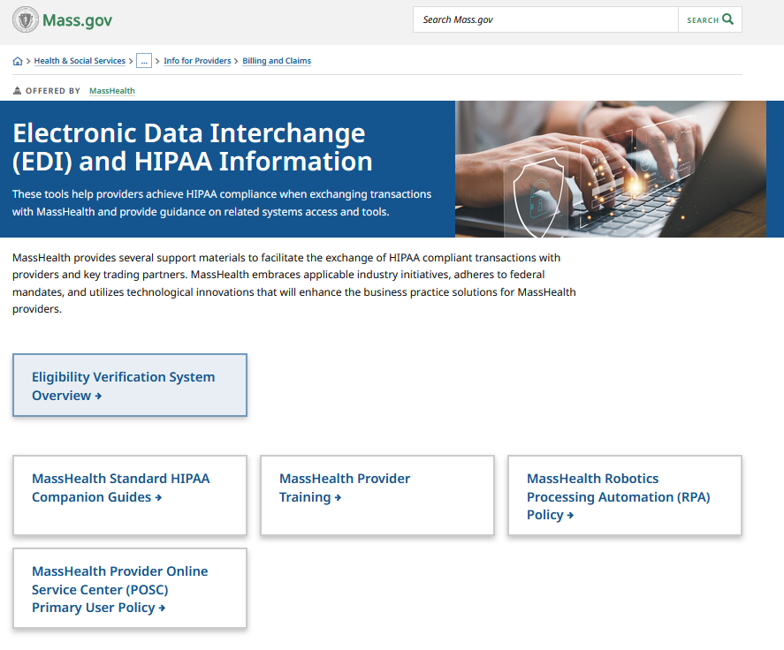
Mass.gov Updates – EDI Request Form
Electronic Data Interchange (EDI) facilitates the exchange of HIPAA files as electronic transactions; many written resources are currently available on Mass.gov relating to EDI transactions.
MassHealth offers an online inquiry form to enable more in-depth assistance for providers who are experiencing issues with EDI/HIPAA files.
Visit: Electronic Data Interchange EDI and HIPAA Information

Slide 57
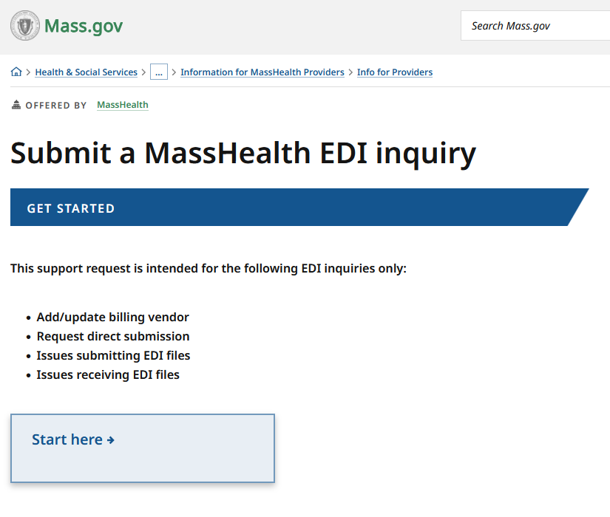
Mass.gov Updates – EDI Request Form (continued)
The Electronic Data Interchange (EDI) Inquiry form specifically offers support for:
  Updating/Adding a billing vendor
  Setting up EDI transactions
  Address issues submitting EDI transactions
  Address issues receiving EDI transactions
Visit: Submit a MassHealth EDI Inquiry

Slide 58
Long-Term Services and Supports
Presented by – Lindsey Klauka Associate Director of Provider Enrollment Revalidation Training Team

Slide 59
LTSS Provider Communications (slide 1 of 2)
The MassHealth LTSS Provider Service Center utilizes provider data to identify behavior trends for areas of targeted training via email. These emails may contain attached job aids or links to additional educational resources via the LTSS Provider Portal.
Areas of focus for these communications include but are not limited to:
High claims denials for specific error codes ​
High prior authorization denials or administrative holds, and/or
Audit findings/SURs reports
The goal of each communication is to assist the Provider in reducing their administrative errors in billing and prior authorization.

Slide 60
LTSS Provider Communications (slide 2 of 2)
Over the last 3 months, Optum has sent over 83 email communications via our LTSS support inbox to LTSS Providers.
There have been 16 provider bulletins published on the MassHealth website: MassHealth Provider Bulletins
If you have not received or wish to begin receiving these communications, you may do so by following steps:
For the LTSS support box communications, please reach out to the LTSS Provider Service Center and we can help ensure your inclusion in future communications.
For communications from MassHealth on mass.gov, follow this link:
Email Notifications for MassHealth Provider Bulletins and Transmittal Letters

Slide 61
LTSS Provider Trainings and Quality Forums
Training or Quality Forums for MassHealth LTSS Providers:
Trainings:
  Continuous Skilled Nursing Training: 1/16/2026
  Home Health Agency Applicant Orientation Training: 4/13/2026
Quality Forums:
  Group Adult Foster Care: 1/21/2026

Slide 62
Nursing Facilities Ownership Disclosure Form
The current supplemental form for Nursing Facilities is being expanded to include ownership information and meet requirements set forth in 101 CMR 206.08(1)(d).
Nursing Facility Providers will be required to review and update the form on an annual basis. At the time of annual review, the Nursing Facility Ownership Disclosure Form will be accessed from Provider Profile. *Providers who are newly enrolled in the last 6 months will not need to complete the annual update.
Annually, existing providers (*excluding those enrolled in the last 6 months) will receive three reminder emails as the annual review date is approaching. An initial reminder email will be sent 30 days prior to required annual review date with reminder emails following at 10-day intervals.
Upon implementation, existing providers will be notified via email that an updated form is available and must be completed within 30 days. Optum will send an initial email identifying the regulation and requirement to complete the form within 30 days. Two follow up reminder emails will be sent.

Slide 63
Nursing Facilities Ownership Disclosure Form (continued)
The Nursing Facility Ownership Disclosure Form will have 11 Sections:
Supplemental Information
Organizational Structure
Board of Directors
Parent Company
Operating Company
Property Company
Management Company
Nursing Facility LLC
Financing/Leasing Subsidiary
Third Party Vendors
Attestation
The information will be retained, and the provider will only have to update information as needed during there yearly review. They will not have do the whole form over again.

Slide 64
MassHealth Dental Program Vendor Transition
Presented by – Michelle Croy, Sr. Provider Relations Specialist, MassHealth Business Support Services

Slide 65
MassHealth Dental Program Vendor Transition
MassHealth Dental Program is transitioning back to DentaQuest on 2/1/2026.
Providers may log into DentaQuest’s website at www.masshealth-dental.org on 2/1/2026 to resume all dental functions.
DentaQuest’s new call center number 866-616-2699.

Slide 66
MassHealth Dental Program Vendor Transition (continued)
Providers may submit all claims and prior authorization to DentaQuest at www.masshealth-dental.org on 2/1/2026.
DentaQuest customer call-center will open on Monday 2/2/2026.
Providers using clearinghouse to submit claims do not need to take any action; claims will route to DentaQuest.

Slide 67
Where to get more information?
The new webpage is now live here: MassHealth Dental Program Updates | Mass.gov.
  Sign up for email updates
  Frequently asked questions
The alert has been published on the following pages:
  Learn about MassHealth dental benefits | Mass.gov
  Information for MassHealth Providers | Mass.gov
  MassHealth | Mass.gov

Slide 68
Payment Error Rate Measurement (PERM) RY 2026
Presented by – Michelle Croy, Sr. Provider Relations Specialist, MassHealth Business Support Services

Slide 69

PERM RY 2026
MassHealth is part of the CMS Payment Error Rate Measurement (PERM) audit for RY 2026. The PERM audit measures improper payments in Medicaid and CHIP programs and produces improper payment rates for each program.
PERM Cycle RY2026 Claim Review Period: July 1, 2024 to June 30, 2025
Timeframe for Medical Records Request Outreach: April 1, 2025 to April 15, 2026

Slide 70
PERM RY 2026 Provider Responsibilities
As part of the CMS PERM RY26 cycle, medical records requests will start going out to providers in the coming months. Providers are responsible for providing the requested documentation to the audit contractor timely.
When submitting records, providers must ensure the records are for the right patient and right date of service.
Records must be legible with no highlights or marking that would obscure important facts.
Make sure double-sided documents include both sides.
All supporting documents for the claim identified must be included in the submission.
Visit: CMS PERM Provider Required Document List

Slide 71
PERM RY 2026 Provider Documentation Errors
Please remind providers they must send all applicable documents related to the claim for the member/procedure/date of service. Current issues found so far include:
The provider did not submit the required general anesthesia documentation for the sampled date of service to support payment.
The provider did not submit the required diagnostic study results and physician's order for the sampled date of service to support payment.
The provider did not submit the required physician's order for the sampled date of service to support payment.

Slide 72
PERM RY 2026 Resources
Information on the CMS PERM Audit can be found on the CMS website.
These materials are currently available on the Providers page of the CMS PERM website (link: https://www.cms.gov/data-research/monitoring-programs/improper-payment-measurement-programs/payment-error-rate-measurement-perm/providers).
CMS PERM Overview for Providers slide deck
CMS PERM Provider Education FAQ document
Note: Failure to respond to the audit request will result in the claim being voided and the payment recouped.

Slide 73
MassHealth Updates
Presented by – Michelle Croy, Sr. Provider Relations Specialist, MassHealth Business Support Services

Slide 74
All Provider Bulletins
Below is a list of bulletins that have been released since the previous Provider Association Forum.
All Provider Bulletin 411:Documentation Required for Review of Unlisted CPT Codes
All Provider Bulletin 412:Changes in Exclusion of Designated 340B Drugs for MassHealth
All Provider Bulletin 413:Interoperability - Prior Authorization Process Changes for the Medical Benefit

Slide 75

Provider Education LMS
The MassHealth Provider Learning Management System (LMS) for Non-OLTSS providers is a system providers can use 24/7 as an educational resource.
The Provider LMS delivers:
Previous live training presentations
New on demand training courses
Resources
Course surveys
If you are currently a registered user but have forgotten your user-name or password, you can retrieve it from the sign-in screen.
New Users can create a profile and begin using the system immediately.
Visit: MassHealth BSS Provider Training portal
OLTSS and Dental providers should visit their respective vendor site for training opportunities.

Slide 76
Trainings
New Provider Orientation: This session will introduce to MassHealth to Providers and will supply information on key terminology and resources, along with general requirements for all MassHealth providers. Training 3/5/26 and 3/24/26.
Claim Denial Reasons and Resolutions: This session will cover the most common claim denials that MassHealth providers experience and will provide instruction on how to potentially resolve these denials, including the following edits: 1945, 2502, 2020, 850, and 1010. Training 2/10/26.
Office Hours Billing and Claims: This session will be an open forum for providers to ask general billing and claims questions show you online tools to help you with claims questions. Please note that questions specific to your organization may need to be addressed individually. Training 3/3/26 and 4/7/26.
Office Hours Enrollment and Revalidation: This session will provide background information on MassHealth Provider Enrollment for both ORP, FFS, and Group practice providers as well as detail the requirements for enrollment. This presentation is also designed to assist providers in working through the Revalidation process. Most of the webinar will be devoted to live Q&A where attendees may ask the host any questions they have regarding enrollment and revalidation. Training 3/17/26.

Slide 77
Resources
Provider Email Alerts
Sign up to receive email alerts when MassHealth issues new bulletins and transmittal letters, fill out the Email Notification Request for Providers on Mass.gov.
MassHealth New Bulletin and Transmittal Letters
MassHealth Website
Bulletins are Available on Mass.gov
MassHealth Providers web page
The ACA ORP Requirements for MassHealth Providers

Slide 78
Thank you!

