Slide 1

MassHealth Training Forum Provider Updates
October 2025
Executive Office of Health & Human Services

Slide 2
Agenda
Welcome and Agenda Overview
ACO/MCO Changes 2026
Fee-for-Service Provider Directory
Dental Update
Standardized Encounter Data Program (SendPro)
Advancing Interoperability and Improving Prior Authorization Processes
POSC User Functionality Updates
Reinstatement of Primary Care Clinician Plan / Primary Care ACO Referral Requirements
Long-Term Services and Supports
Application and Mass.gov Changes
Self-Service Resources on Mass.gov/MassHealth
Payment Error Rate Measurement (PERM) RY 2026
Perinatal and Maternal Health Overview
MassHealth Brief Reminders

Slide 3
ACO/MCO Changes 2026
Presented by Michelle Croy,
Senior Provider Relations Specialist,
MassHealth Business Support Services

Slide 4
ACO Changes Starting January 1, 2026 (slide 1 of 2)
Service Area Changes
The following health plan will no longer be offered by MassHealth in the following service areas starting on January 1, 2026
Plan Name | Service Area Removal
WellSense Care Alliance | Brockton Haverhill
Provider Changes
As of January 1, 2026, 30 providers are joining or moving in the MassHealth ACO program. These moves will affect approximately 20,000 members.
Hospital Changes
As of January 1, 2026, 2 ACOs will make changes to their hospital network. However, in an emergency, members can go to any hospital. Members do not need to worry about which health plan they have.

Slide 5
ACO Changes Starting January 1, 2026 (slide 2 of 2)
Changes to Available Health Plans in 2026
As of January 1, 2026, the Tufts Health Together Managed Care Organization (MCO) will be discontinued. This will affect approximately 25,000 members. Members currently enrolled in the Tufts Health Together MCO will be re-assigned to the health plan that their primary care provider (PCP) will be participating in moving forward, if possible. Members will receive a notification letter about their new health plan assignment and providing additional information about their options, including how to change health plans. Leading up to January 1, 2026, MassHealth will work with the Tufts Health Together MCO and the members’ future health plans to coordinate transitions of care, including exchanging information about prior authorizations and referrals.
The Enrollment Guide will be updated to reflect changes starting January 1, 2026.
If you want to learn more about the health plans options, you can:
  Visit www.MassHealthChoices.com; or
  Call MassHealth Customer Service at (800) 841-2900, TDD/TTY: 711.
  MassHealth Customer Service is open Monday – Friday, 8 am to 5 pm.

Slide 6
Primary Care Provider Changes
(slide 1 of 9)
# | Primary Care Provider | Address | will move from | to
1 | Bellingham Medical Associates | 1003 S Main St Bellingham, MA 02019 | Mass General Brigham Health Plan With Mass General Brigham ACO | Tufts Health Together with UMass Memorial Health
2 | Blackstone Valley Family Physicians | 100 Commerce Drive Northbridge, MA 01534 | Mass General Brigham Health Plan With Mass General Brigham ACO | Tufts Health Together with UMass Memorial Health
3 | Carlos Moreno MD PC | 128 Carnegie Row Ste 106 Norwood, MA 02062 | Tufts Health Together MCO | WellSense Beth Israel Lahey Health (BILH) Performance Network ACO
The Enrollment Guide will be updated to reflect changes starting January 1, 2026.
If you want to learn more about the health plans options, you can:
  Visit www.MassHealthChoices.com; or
  Call MassHealth Customer Service at (800) 841-2900, TDD/TTY: 711.
  MassHealth Customer Service is open Monday – Friday, 8 am to 5 pm.

Slide 7
Primary Care Provider Changes
(slide 2 of 9)
# | Primary Care Provider | Address | will move from | to
4 | Center for Adolescent and Young Adult Health | 100 Medway Rd Ste 204 Milford, MA 01757 | Mass General Brigham Health Plan With Mass General Brigham ACO | Tufts Health Together with UMass Memorial Health
5 | Children’s Health Care - Haverhill | 600 Primrose St Haverhill, MA | Revere Health Choice | WellSense Boston Children’s ACO
6 | Children’s Health Care – Newburyport | 257 Low St Newburyport, MA 01950 | Revere Health Choice | WellSense Boston Children’s ACO
7 | Community Pediatrics of Medway | 68A Main St Ste 1010 Medway, MA 02053 | Mass General Brigham Health Plan With Mass General Brigham ACO | Tufts Health Together with UMass Memorial Health
The Enrollment Guide will be updated to reflect changes starting January 1, 2026.
If you want to learn more about the health plans options, you can:
  Visit www.MassHealthChoices.com; or
  Call MassHealth Customer Service at (800) 841-2900, TDD/TTY: 711.
  MassHealth Customer Service is open Monday – Friday, 8 am to 5 pm.

Slide 8
Primary Care Provider Changes
(slide 3 of 9)
# | Primary Care Provider | Address | will move from | to
8 | Community Pediatrics of Milford | 229 East Main St Milford, MA 01757 | Mass General Brigham Health Plan With Mass General Brigham ACO | Tufts Health Together with UMass Memorial Health
9 | Davis Square Family Practice | 255 Elm St Ste 301 Somerville, MA 02144 | Primary Care Clinician (PCC) Plan and Tufts Health Together MCO | WellSense Care Alliance
10 | Family Medicine Associates | 68A Main St Medway, MA 02053 | Mass General Brigham Health Plan With Mass General Brigham ACO | Tufts Health Together with UMass Memorial Health
11 | Family Practice Group, P.C. | 11 Water St Ste 1A Arlington, MA 02476 | Primary Care Clinician (PCC) Plan and Tufts Health Together MCO | WellSense Care Alliance
The Enrollment Guide will be updated to reflect changes starting January 1, 2026.
If you want to learn more about the health plans options, you can:
  Visit www.MassHealthChoices.com; or
  Call MassHealth Customer Service at (800) 841-2900, TDD/TTY: 711.
  MassHealth Customer Service is open Monday – Friday, 8 am to 5 pm.

Slide 9
Primary Care Provider Changes
(slide 4 of 9)
# | Primary Care Provider | Address | will move from | to
12 | Franklin Family Practice | 1280 W Central St Ste 202 Franklin, MA 02038 | Mass General Brigham Health Plan With Mass General Brigham ACO | Tufts Health Together with UMass Memorial Health
13 | Franklin Pediatrics | 1280 W Central St Ste 201 Franklin, MA 02038 | Mass General Brigham Health Plan With Mass General Brigham ACO | Tufts Health Together with UMass Memorial Health
14 | Franklin Primary Care | 1280 W Central St Ste 301 Franklin, MA 02038 | Mass General Brigham Health Plan With Mass General Brigham ACO | Tufts Health Together with UMass Memorial Health
The Enrollment Guide will be updated to reflect changes starting January 1, 2026.
If you want to learn more about the health plans options, you can:
  Visit www.MassHealthChoices.com; or
  Call MassHealth Customer Service at (800) 841-2900, TDD/TTY: 711.
  MassHealth Customer Service is open Monday – Friday, 8 am to 5 pm.

Slide 10
Primary Care Provider Changes
(slide 5 of 9)
# | Primary Care Provider | Address | will move from | to
15 | Franklin Wrentham Family Medicine | 440 E Central St Franklin, MA 02038 | Mass General Brigham Health Plan With Mass General Brigham ACO | Tufts Health Together with UMass Memorial Health
16 | Gloria Moussa-Gabour | 20 E Emerson St Melrose, MA 02176 | Primary Care Clinician (PCC) Plan and Tufts Health Together MCO | WellSense Care Alliance
17 | HealthFirst Family Care Center, Inc. | 387 Quarry St Ste 100 Fall River, MA 02723 | WellSense Community Alliance ACO | Community Care Cooperative
The Enrollment Guide will be updated to reflect changes starting January 1, 2026.
If you want to learn more about the health plans options, you can:
  Visit www.MassHealthChoices.com; or
  Call MassHealth Customer Service at (800) 841-2900, TDD/TTY: 711.
  MassHealth Customer Service is open Monday – Friday, 8 am to 5 pm.

Slide 11
Primary Care Provider Changes
(slide 6 of 9)
# | Primary Care Provider | Address | will move from | to
18 | Hopkinton Family Practice | 77 W Main St Ste 204 Hopkinton, MA 01748 | Mass General Brigham Health Plan With Mass General Brigham ACO | Tufts Health Together with UMass Memorial Health
19 | Hopkinton Internal Medicine and Pediatrics | 1 Lumber St Hopkinton, MA 01748 | Mass General Brigham Health Plan With Mass General Brigham ACO | Tufts Health Together with UMass Memorial Health
20 | Hopkinton Primary Care | 169 W Main St Hopkinton, MA 01748 | Mass General Brigham Health Plan With Mass General Brigham ACO | Tufts Health Together with UMass Memorial Health
The Enrollment Guide will be updated to reflect changes starting January 1, 2026.
If you want to learn more about the health plans options, you can:
  Visit www.MassHealthChoices.com; or
  Call MassHealth Customer Service at (800) 841-2900, TDD/TTY: 711.
  MassHealth Customer Service is open Monday – Friday, 8 am to 5 pm.

Slide 12
Primary Care Provider Changes
(slide 7 of 9)
# | Primary Care Provider | Address | will move from | to
21 | Mcgrath Medical Group | 117 Water St Milford, MA 01757 | Mass General Brigham Health Plan With Mass General Brigham ACO | Tufts Health Together with UMass Memorial Health
22 | Mendon Internal Medicine | 12 Uxbridge Rd Mendon, MA 01756 | Mass General Brigham Health Plan With Mass General Brigham ACO | Tufts Health Together with UMass Memorial Health
23 | Oak Pediatrics | 198 Littleton Road Ste 204 Westford, MA | Tufts Health Together MCO | WellSense Care Alliance
The Enrollment Guide will be updated to reflect changes starting January 1, 2026.
If you want to learn more about the health plans options, you can:
  Visit www.MassHealthChoices.com; or
  Call MassHealth Customer Service at (800) 841-2900, TDD/TTY: 711.
  MassHealth Customer Service is open Monday – Friday, 8 am to 5 pm.

Slide 13
Primary Care Provider Changes
(slide 8 of 9)
# | Primary Care Provider | Address | will move from | to
24 | Pediatric Associates of Wellesley, Inc | 266 Main St Ste 18 Medfield, MA 02052 | Primary Care Clinician (PCC) Plan | Mass General Brigham Health Plan With Mass General Brigham ACO
25 | Pediatric Associates of Wellesley, Inc | 134 South Avenue Weston, MA 02493 | Primary Care Clinician (PCC) Plan | Mass General Brigham Health Plan With Mass General Brigham ACO
26 | Pelham Healthcare Associate (site 1) | 49 Atwood Road Ste 1 Pelham, NH 03076 | Tufts Health Together MCO | WellSense Care Alliance
27 | Pelham Healthcare Associates DBA Westford Primary Care (site 2) | 198 Littleton Road Ste 203 Westford, MA 01886 | Tufts Health Together MCO | WellSense Care Alliance
The Enrollment Guide will be updated to reflect changes starting January 1, 2026.
If you want to learn more about the health plans options, you can:
  Visit www.MassHealthChoices.com; or
  Call MassHealth Customer Service at (800) 841-2900, TDD/TTY: 711.
  MassHealth Customer Service is open Monday – Friday, 8 am to 5 pm.

Slide 14
Primary Care Provider Changes
(slide 9 of 9)
# | Primary Care Provider | Address | will move from | to
28 | Primary Care Physicians | 221 East Main St Milford, MA 01757 | Mass General Brigham Health Plan With Mass General Brigham ACO | Tufts Health Together with UMass Memorial Health
29 | Robert F. Commito MD PC | 311 Washington St Brighton, MA 02135 | Tufts Health Together MCO | WellSense Care Alliance
30 | Somerville Family Practice | 1020 Broadway Somerville, MA 02144 | Primary Care Clinician (PCC) Plan and Tufts Health Together MCO | WellSense Care Alliance
The Enrollment Guide will be updated to reflect changes starting January 1, 2026.
If you want to learn more about the health plans options, you can:
  Visit www.MassHealthChoices.com; or
  Call MassHealth Customer Service at (800) 841-2900, TDD/TTY: 711.
  MassHealth Customer Service is open Monday – Friday, 8 am to 5 pm.

Slide 15
Hospital Changes (slide 1 of 3)
# | Plan Name | has added the following hospitals from its network
1 | Mass General Brigham Health Plan with Mass General Brigham ACO | Mercy Medical Center (Trinity Health of New England), Springfield
The Enrollment Guide will be updated to reflect changes starting January 1, 2026.
If you want to learn more about the health plans options, you can:
  Visit www.MassHealthChoices.com; or
  Call MassHealth Customer Service at (800) 841-2900, TDD/TTY: 711.
  MassHealth Customer Service is open Monday – Friday, 8 am to 5 pm.

Slide 16
Hospital Changes (slide 2 of 3)
# | Plan Name | has removed the following hospitals from its network
1 | Fallon Atrius | Baystate Medical Center (Baystate Health), Springfield
2 | Mass General Brigham Health Plan with Mass General Brigham ACO | Holyoke Medical Center, Holyoke
The Enrollment Guide will be updated to reflect changes starting January 1, 2026.
If you want to learn more about the health plans options, you can:
  Visit www.MassHealthChoices.com; or
  Call MassHealth Customer Service at (800) 841-2900, TDD/TTY: 711.
  MassHealth Customer Service is open Monday – Friday, 8 am to 5 pm.

Slide 17
Hospital Changes (slide 3 of 3)
The following hospitals have changed their names:
Morton Hospital (Lifespan Health Systems), Taunton has changed to Morton Hospital (Brown University Health) Saint Anne’s Hospital (Lifespan Health Systems), Fall River has changed to Saint Anne’s Hospital (Brown University Health) St. Elizabeth’s Medical Center, Brighton is now Boston Medical Center – Brighton, Brighton Good Samaritan Medical Center, Brockton is now Boston Medical Center – South, Brockton
The Enrollment Guide will be updated to reflect changes starting January 1, 2026.
If you want to learn more about the health plans options, you can:
  Visit www.MassHealthChoices.com; or
  Call MassHealth Customer Service at (800) 841-2900, TDD/TTY: 711.
  MassHealth Customer Service is open Monday – Friday, 8 am to 5 pm.

Slide 18
Continuity of Care
Continuity of Care
The Continuity of Care (CoC) period for medical and behavioral health services ranges from January 1, 2026 to March 31, 2026 (90 days post go-live)
Escalation Process
Each health plan will have an escalation process in place for any access-to-care issues for members regarding pharmacy and specialty network issues during this period.
The Enrollment Guide will be updated to reflect changes starting January 1, 2026.
If you want to learn more about the health plans options, you can:
  Visit www.MassHealthChoices.com; or
  Call MassHealth Customer Service at (800) 841-2900, TDD/TTY: 711.
  MassHealth Customer Service is open Monday – Friday, 8 am to 5 pm.

Slide 19
Resources (ACO/MCO)
The Enrollment Guide will be updated to reflect changes starting January 1, 2026.
If you want to learn more about the health plans options, you can:
Visit www.MassHealthChoices.com
Or
Call MassHealth Customer Service at
(800) 841-2900, TDD/TTY: 711

Slide 20
Fee-for-Service Provider Directory
Presented by Michelle Croy,
Senior Provider Relations Specialist, MassHealth Business Support Services

Slide 21
FFS Directory Updates
In accordance with the Consolidated Appropriations Act (CAA 2023), MassHealth has been instructed to expand the data elements of the Provider Directory
The data elements will now include languages spoken by providers, website URLs, accessibility accommodations, telehealth availability, and whether new patients are being accepted
Cultural capabilities were also added to the Provider Directory search results page, but are currently on hold until further guidance from the Center for Medicare and Medicaid Services (CMS)

Slide 22
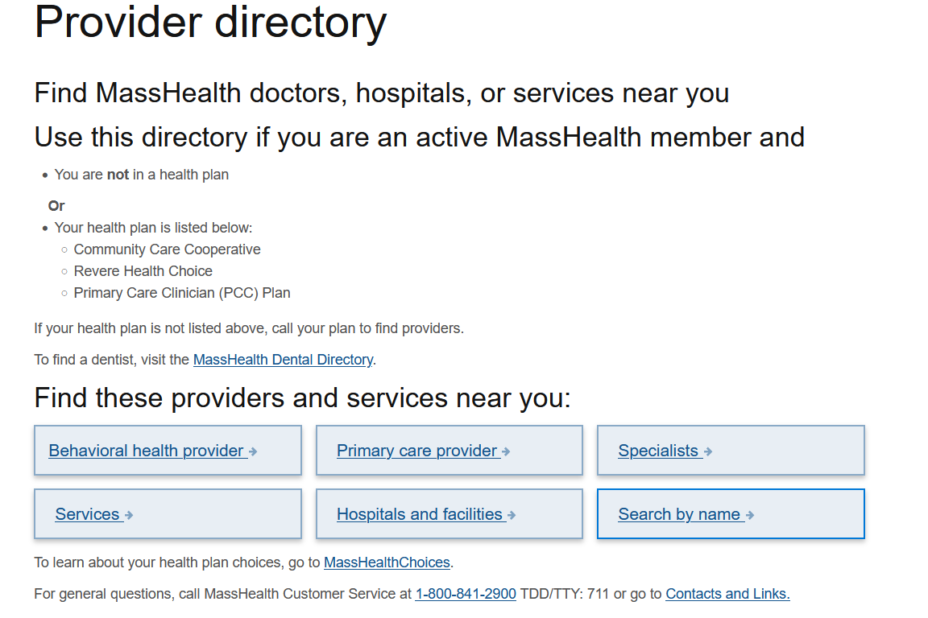
Directory on Mass.gov
MassHealth members may utilize the provider directory on Mass.gov, using a variety of search criteria
Providers can be sorted by the most essential services needed, such as primary care providers, behavioral health, hospitals, etc.
Visit the MassHealth Provider Directory

Slide 23
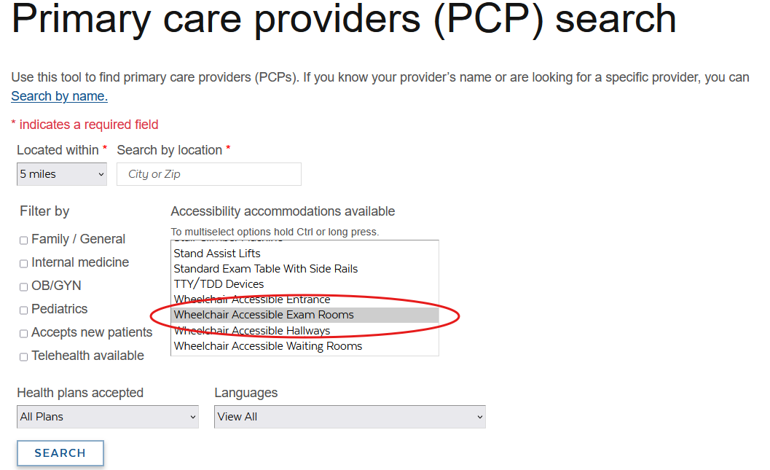
Directory on Mass.gov (continued)
Searches can be narrowed down even further once a category of provider has been chosen
Using the newly required data elements, MassHealth members could narrow their search to find a location that accommodates their health needs
Visit the MassHealth Provider Directory

Slide 24
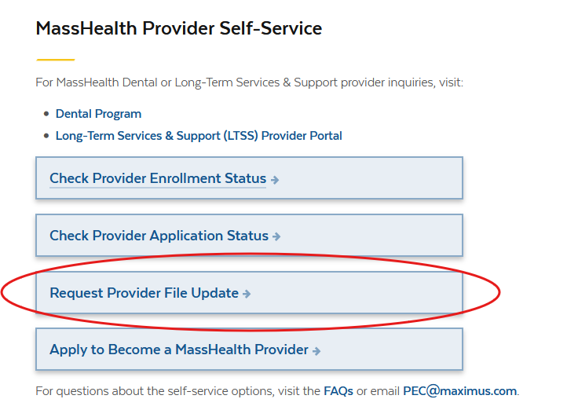
Updating Directory Information
MassHealth providers are advised that any changes to their information, such as linking to a new group practice or moving addresses, are required they be updated. This information will be reflected in the directory for accuracy
The provider directory file update request is targeted to go live by November 2025
Providers can update their directory related information, and any other changes, by initiating an update request using MassHealth Provider Self-Service (PSS)
Visit the MassHealth Provider Directory

Slide 25
Dental Updates
Presented by Michelle Croy,
Senior Provider Relations Specialist, MassHealth Business Support Services

Slide 26
Dental TPA Vendor Transition Update
The anticipated operational start date for the new Dental TPA is delayed and is no longer February 1, 2026. The new anticipated operational start date will be announced in the coming weeks in a future communication from EOHHS

Slide 27
What does this mean?
The current MassHealth Dental Program TPA, BeneCare will continue as the Dental TPA for MassHealth until the transition to DentaQuest. Please conduct business as usual until otherwise specified
Provider training dates, contact information and any other operational considerations related to this transition will be announced in a subsequent correspondence in early 2026
Frequently asked questions regarding the transition
Continue to contact Tuyen Vu for any dental inquiry at Tuyen.vu@mass.gov

Slide 28
Standardized Encounter Data Program (SENDPro)
Presented by Augustus Matekole,
Data Quality Manager - Strategy & Partnerships, MassHealth Data Integrity Team

Slide 29
SENDPro: Basics (slide 1 of 3)
Currently, Managed Care Entities (MCEs) submit post-adjudicated claims, or encounters, to MassHealth using a unique flat file data process. Starting in 2026 the current flat file format will be phased out in favor of standardized Electronic Data Interchange (EDI) files:
  the 837 PACDR (Post-Adjudicated Claims Data Reporting) for medical and dental encounters, and
  NCPDP (National Council of Prescription Drug Program) v51 for pharmacy encounters
The new process complies with federal mandates, enhances MassHealth data compliance controls and validation, and improves data accuracy and integrity

Slide 30
SENDPro: Basics (slide 2 of 3)
Who is impacted by this change:
Types of Managed Care Entities | Names of Managed Care Entities (submitting encounters):
Accountable Care Organizations (ACOs) Managed Care Organizations (MCOs) Senior Care Options (SCOs) One Care (ICO) Massachusetts Behavioral Health Vendor | Commonwealth Care Alliance (CCA) Fallon Health Health New England (HNE) Massachusetts Behavioral Health Partnership (MBHP) Mass General Brigham Health Plan (MGB) Molina HealthCare/Senior Whole Health (SWH) Point32 Health United Health Care (UHC) WellSense

Slide 31
SENDPro: Basics (slide 3 of 3)
All MCEs are participating in functionality testing with MassHealth. Testing has identified common encounters rejections within the new SENDPro system
Though most missing/invalid data field values are required in the current Legacy flat file encounter data submission process, some are not actively enforced
For SENDPro, it is critical that providers submit required data fields and associated values to MCEs through the provider claims submission process
MassHealth has communicated requirements to the MCEs and will continue to work closely with MCEs as they communicate these requirements to their network and out-of-network providers

Slide 32
Initial Encounter Submission Findings (slide 1 of 4)
Although not comprehensive, this is the list of priority areas that require attention from MCEs and their providers in preparation for SENDPro go-live:
Completeness of Provider Taxonomies:
  MCEs must include provider taxonomies on medical and dental encounter submissions (pharmacy is not included). Therefore, providers must include provider taxonomies in appropriate data elements on all claim types except for pharmacy. For a list of valid taxonomies refer to the National Uniform Claim Committee’s Health Care Provider Taxonomy Code Set, version 25.1 at taxonomy.nucc.org
Completeness of Provider National Provider Identifiers (NPIs):
  MCEs must include the provider’s NPI on all encounter submissions. Therefore, all provider claims must include valid NPI in the appropriate data element of the claim for all provider types (e.g. billing, attending, referring, rendering, operating), with the exception of atypical providers.

Slide 33
Initial Encounter Submission Findings (slide 2 of 4)
Validation of Attending Provider ID:
  MCEs must include NPI values for attending provider in the appropriate data element in all 837 I encounter submissions. Therefore, providers must include a valid NPI for the attending provider in the appropriate data element for all inpatient provider claims.
Submission of Hospital Admission Date and Time:
  MCEs must include a valid admission hour in all encounters submitted via 837 I. Therefore, providers must include a valid admission hour and date for all inpatient provider claims. There are exceptions for certain bill types, see the 837 I Companion Guide for the list.
Submission of Hospital Discharge Hour:
  MCEs must include a valid discharge hour in all encounter submitted via 837 I. Therefore, providers must include a valid discharge hour and date for all inpatient provider claims. There are exceptions for certain bill types, see the 837 I Companion Guide for the list.

Slide 34
Initial Encounter Submission Findings (slide 3 of 4)
Completeness of Provider Identification / Service Location (PID/SL):
  MCEs must include PID/SL identifiers in provider-related data fields for all encounters.
  MCEs must accurately report all PID/SLs to MassHealth on the enhanced provider file.
  PID/SLs are not required on provider-submitted claims, but providers must at minimum correctly include the following data elements for MCEs to accurately map the PID/SL for each provider:
    Provider name
    Provider address
    Taxonomy
    NPI
  It is critical that providers acquire a PID/SL from MassHealth’s provider enrollment team, if they do not already have one.

Slide 35
Initial Encounter Submission Findings (slide 4 of 4)
Procedure Codes and Modifiers, Diagnosis Codes, and Any Standardized Codes:
  MCEs and providers must use standardized code sets as per EDI implementation guide/MassHealth specifications and requirements. Typos and invalid codes will be rejected in the SENDPro system.
  It is critical that MCEs and providers comply with all requirements for claims and encounter submissions. Failure to populate required fields may result in rejection, exclusion from settlement, and exclusion from rate setting

Slide 36
SENDPro: Communication & Resources
In the upcoming transition to SENDPro, MCEs are responsible for
  Communicating key timelines and expectations to network and out-of-network providers
  Explaining new EDI file and provider claim data submission requirements to providers
  Working with providers to submit complete, accurate and timely claims data to MCEs
MassHealth has issued two SENDPro Managed Care Entity bulletins on the mass.gov website with additional detail to support MCEs and providers as they prepare for SENDPro implementation
Although this guidance is for plans, information in the bulletins is also helpful for providers. SENDPro bulletins are posted here: 2025 MassHealth Provider Bulletins (May)
  First SENDPro Managed Care Entity Bulletin – Bulletin 129
  Second SENDPro Managed Care Entity Bulletin – Bulletin 133

Slide 37
Additional Information & Resources
Additional Information
MassHealth companion guides (CGs) are a supplement to the mandated X12 Implementation Guide/Technical Report (IG/TR3) and NCPDP Post Adjudication Standard Implementation Guide. The companion guides provide additional specifications on MassHealth business needs and cannot replace or include X12 requirements due to licensing copyright laws.
  Visit the latest draft companion guides
MCEs are responsible for communicating to their network and out-of-network providers how CG requirements may affect provider submission guidelines
SENDPro provider related information will continue to be shared through MassHealth MCE bulletins at: MassHealth Provider Bulletins

Slide 38
Advancing Interoperability
and Improving Prior Authorization Processes
Presented by Nestor Rivera,
Senior Provider Relations Specialist,
MassHealth Business Support Services

Slide 39
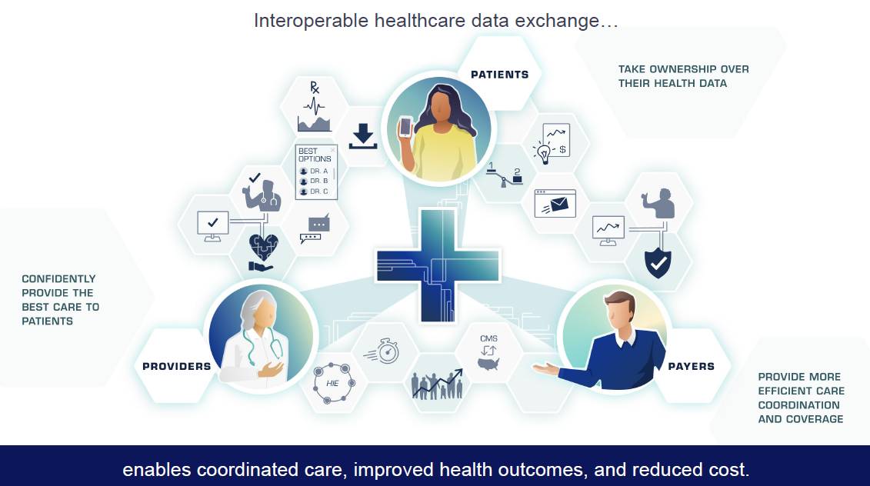
CMS INTEROPERABILITY

Slide 40
HIGH-LEVEL SUMMARY (slide 1 of 5)
The CMS Advancing Interoperability and Improving Prior Authorization Processes rule requires that Medicaid and CHIP FFS programs, their managed care plans, and other entities (e.g., Medicare Advantage, QHP) to comply with the Final Rule.
Medicaid/CHP FFS: Effective date of rule
Medicaid Mgd. Care entities: Effective rate year
Requirement | Description | Implementation Date 1/1/26 | Implementation Date 3/31/26 | Implementation Date 1/1/27 | 1-Year Extension | Exemp.
Patient Access API (Application Programming Interface) | Expands upon the Patient Access API finalized in the Interoperability and Patient Access Final Rule to include information related to the patient’s prior authorizations | No | No | Yes | No | No
Patient Access API (Application Programming Interface) | Annually provide metrics in the form of aggregated, de-identified data to CMS about patient use of the Patient Access API | No | Yes | No | No | No
Key Fact: Final Rule excludes pharmacy Prior Authorizations (prescriptions)
Business & Systems Integration
* States must contact CMS by 4/1/25 if unable to meet PA disposition standard

Slide 41
HIGH-LEVEL SUMMARY (slide 2 of 5)
The CMS Advancing Interoperability and Improving Prior Authorization Processes rule requires that Medicaid and CHIP FFS programs, their managed care plans, and other entities (e.g., Medicare Advantage, QHP) to comply with the Final Rule.
Medicaid/CHP FFS: Effective date of rule
Medicaid Mgd. Care entities: Effective rate year
Requirement | Description | Implementation Date 1/1/26 | Implementation Date 3/31/26 | Implementation Date 1/1/27 | 1-year extension | Exemp.
Provider Access API | Impacted payers must implement and maintain a Provider Access API to share patient data with in-network (enrolled) providers with whom the patient has a treatment relationship (includes patient attribution and “Opt Out” procedures); Requires impacted payers to provide “plain language” resources to providers and patients re: the benefits, utilization and related processes | No | No | Yes | Yes | Yes
Key Fact: Final Rule excludes pharmacy Prior Authorizations (prescriptions)
Business & Systems Integration
* States must contact CMS by 4/1/25 if unable to meet PA disposition standard

Slide 42
HIGH-LEVEL SUMMARY (slide 3 of 5)
The CMS Advancing Interoperability and Improving Prior Authorization Processes rule requires that Medicaid and CHIP FFS programs, their managed care plans, and other entities (e.g., Medicare Advantage, QHP) to comply with the Final Rule.
Medicaid/CHP FFS: Effective date of rule
Medicaid Mgd. Care entities: Effective rate year
Requirement | Description | Implementation date 1/1/26 | Implementation date 3/31/26 | Implementation date 1/1/27 | 1-year extension | Exemp.
Payer to Payer API | Impacted payers must implement and maintain a Payer-to-Payer API to make available claims and encounter data (excluding provider remittances and enrollee cost-sharing information), and information about prior authorizations (excluding those for drugs and those that were denied); includes patient “Opt In” procedures; Requires impacted payers to provide “plain language” resources to providers and patients re: the benefits, utilization and related processes | No | No | Yes | Yes | Yes
Key Fact: Final Rule excludes pharmacy Prior Authorizations (prescriptions)
Business & Systems Integration
* States must contact CMS by 4/1/25 if unable to meet PA disposition standard

Slide 43
HIGH-LEVEL SUMMARY (slide 4 of 5)
The CMS Advancing Interoperability and Improving Prior Authorization Processes rule requires that Medicaid and CHIP FFS programs, their managed care plans, and other entities (e.g., Medicare Advantage, QHP) to comply with the Final Rule.
Medicaid/CHP FFS: Effective date of rule
Medicaid Mgd. Care entities: Effective rate year
Requirement | Description | Implementation date 1/1/26 | Implementation date 3/31/26 | Implementation date 1/1/27 | 1-year extension | Exemp.
Prior Authorization API, Processes, and Metrics | Impacted payers must implement and maintain a Prior Authorization API to exchange prior authorization requests, responses, and information with providers; | No | No | Yes | Yes | Yes
Prior Authorization API, Processes, and Metrics | *Send standard prior authorization decisions within 7 calendar days and expedited prior authorization decisions within 72 hours; | Yes | No | No | No | No
Key Fact: Final Rule excludes pharmacy Prior Authorizations (prescriptions)
Business & Systems Integration
* States must contact CMS by 4/1/25 if unable to meet PA disposition standard

Slide 44
HIGH-LEVEL SUMMARY (slide 5 of 5)
The CMS Advancing Interoperability and Improving Prior Authorization Processes rule requires that Medicaid and CHIP FFS programs, their managed care plans, and other entities (e.g., Medicare Advantage, QHP) to comply with the Final Rule.
Medicaid/CHP FFS: Effective date of rule
Medicaid Mgd. Care entities: Effective rate year
Requirement | Description | Implementation date 1/1/26 | Implementation date 3/31/26 | Implementation date 1/1/27 | 1-year extension | Exemp.
Prior Authorization API, Processes, and Metrics | Report metrics about prior authorization processed on a public website on an annual basis. | No | Yes | No | No | No
Key Fact: Final Rule excludes pharmacy Prior Authorizations (prescriptions)
Business & Systems Integration
* States must contact CMS by 4/1/25 if unable to meet PA disposition standard

Slide 45
Patient Access API
Scope: Update the Patient Access API mandated under the CMS Interoperability and Patient Access Final Rule to include the following Prior Authorization (PA) information:
Status of the member’s PA request and disposition date (pending, active, denied, expired, and approved)
Clinical/supporting documentation submitted by the provider (Not required to support unstructured docs unless payer has formatted/structured them in their system)
Date or circumstances under which the authorization ends
Services and items that are approved & Specific reasons for denial
Effective 4/8/24 CMS deleted the requirement to make clinical data & lab results available in API; must now include all data classes and data elements included in USCDI v1 or v3 (e.g., clinical notes, demographic data, etc.); must ensure that all USCDI data maintained by MassHealth is available via the existing API by April 8, 2024
Eff: 1/1/27
Metrics: 3/31/26
DATA EXCHANGE
Data must be made available within 1 business day after receipt of request, or change in status
Data must be available via API for at least 1 year after the status change, denial, or expiration of a PA request
Provide information for all active PAs for Dates of Service (DOS) on or after 1/1/2016
Support these data exchange parameters regardless of submission method (e.g., DDE POSC)
Business & Systems Integration

Slide 46
Patient Access API (continued)
Report aggregate, deidentified metrics on the patient access API as follows:
METRIC REPORTING | METHOD | DUE DATE | PARAMETER
Total # of unique patient’s data transferred to a health app of their choice Total # of unique patient’s data transferred more than once to a health app of their choice | Submit to CMS annually | 3/31/26 | Format & submission requirements = TBD; CMS will confirm later
Business & Systems Integration

Slide 47
Prior Authorization API, Processes, and Metrics (slide 1 of 4)
Effective 1/1/26, send standard prior authorization decisions within
7 calendar days and expedited prior authorization decisions within 72 hours:
Expedited requests* - As expeditiously as the patient’s health condition requires, but no later than 72 hours
Standard requests* - As expeditiously as the patient’s health condition requires, but no later than 7 days
If additional information is required, the PA resolution timeframe can be extended for up to an additional 14 days; can also be extended at the request of the provider or the patient
States must contact CMS by 4/1/25 if unable to meet standards
Effective 1/1/26 EOHHS must provide a specific reason for PA denials to providers, regardless of the PA submission method used by a provider
Eff: 1/1/26 & 1/1/27
Metrics: 3/31/26
DATA EXCHANGE
Provide disposition of PA requests as follows:
  Expedited requests – 72 hrs
  Standard requests – 7 days
Business & Systems Integration

Slide 48
Prior Authorization API, Processes, and Metrics (slide 2 of 4)
Effective 4/8/24, CMS adopts clarifications to Medicaid Beneficiary Notice and Fair Hearing Regulations​:
Regulation has been updated to further explain operational requirements but does NOT change the requirements. Clarifies that beneficiary notices require clear statement of specific reasons for the action (e.g., a PA denial). ​
Includes minor terminology changes, etc.
Business & Systems Integration

Slide 49
Prior Authorization API, Processes, and Metrics (slide 3 of 4)
Scope continued…
Effective 3/31/26 report metrics about prior authorizations processed on a public website on an annual basis.
Provide aggregate data for all items and services
Metrics are reported at a state level
Managed care plans report at a plan level
Eff: 1/1/26 & 1/1/27
Metrics: 3/31/26
DATA EXCHANGE
None identified
Business & Systems Integration

Slide 50
Prior Authorization API, Processes, and Metrics (slide 4 of 4)
METRIC REPORTING | METHOD | DUE DATE | PARAMETER
A list of all items and services that require prior authorization % of standard PA requests that have been approved and denied % of standard PA requests approved after appeal % of PA requests for which the review timeframe was extended and then approved % of expedited PA requests that have been approved and denied Average time elapsed between the submission of a PA request and the decision by the payer for both standard and expedited PA requests | Post on public website | 3/31/26 | None defined
Business & Systems Integration

Slide 51
What Providers Can Expect (slide 1 of 4)
Item | Description of Change
Prior Authorizations | Effective January 1, 2026, MassHealth will adjudicate standard prior authorization requests within 7 calendar days once all necessary documentation has been received. This includes all relevant member information about the member, clinical attachments and any additional notes required to demonstrate compliance with the prior authorization submission standards. Additionally, MassHealth will evaluate requests to expedite prior authorization requests within 72 hours.
System Modifications | MassHealth is updating its Medicaid Management Information System (MMIS) Provider Online Service Center (POSC) to allow providers to select the option to request an expedited prior authorization. POSC job aid available on mass.gov will be updated with instructions on how to select an expedited prior authorization.
Business & Systems Integration

Slide 52
What Providers Can Expect (slide 2 of 4)
Item | Description of Change
Metrics Reporting | Effective March 31, 2026, MassHealth will post prior authorization metrics to Mass.gov. The metrics will be updated on an annual basis. The following aggregated prior authorization metrics for all items and services will be available: A list of all items and services that require prior authorization. The percentage of standard prior authorization requests that were approved The percentage of standard prior authorization requests that were denied The percentage of standard prior authorization requests that were approved after appeal The percentage of prior authorization requests for which the timeframe for review was extended, and the request was approved
Business & Systems Integration

Slide 53
What Providers Can Expect (slide 3 of 4)
Item | Description of Change (continued)
Metrics Reporting | Effective March 31, 2026, MassHealth will post prior authorization metrics to Mass.gov. The metrics will be updated on an annual basis. The following aggregated prior authorization metrics for all items and services will be available: The percentage of expedited prior authorization requests that were approved The percentage of expedited prior authorization requests that were denied The average and median time that elapsed between the submission of a request and a determination by the payer, plan, or issuer, for standard prior authorizations The average and median time that elapsed between the submission of a request and a decision by the payer, plan, or issuer, for expedited prior authorizations
Business & Systems Integration

Slide 54
What Providers Can Expect
(slide 4 of 4)
Item | Description Item
mass.gov website | New section specific to CMS Interoperability Requirements
Provider Bulletin | To be released in November that will communicate background info related to the CMS requirements effective 1/1/2026 and 3/31/2026, how MassHealth plans to comply with the requirements and changes providers can expect to see
Banner Messaging | Initial messaging to communicate CMS requirements requiring MassHealth to adjudicate Prior Authorization requests (excluding drugs) within 7 calendar days, or 72 hours for expedited requests (1/1/2026 effective date) MassHealth will post prior authorization metrics to mass.gov and update on an annual basis (3/31/2026 effective date). Impacted payers to implement and maintain a Patient Access Application Programming Interface (API), a Provider Access API, a Payer-to-Payer API, and a Prior Authorization API (1/1/2027 effective date).
Information Sessions | MassHealth will conduct a series of information sessions in November and December 2025, to provide an overview of the upcoming changes to the prior authorization processes and MMIS POSC modifications. MassHealth providers impacted by these are encouraged to participate in the information sessions. Please continue to monitor MassHealth communications for information regarding the sessions.
Business & Systems Integration

Slide 55
Provider Online Service Center (POSC) User Functionality Updates
Presented by Nestor Rivera,
Senior Provider Relations Specialist,
MassHealth Business Support Services

Slide 56
Overview (POSC)
Effective September 15, 2025, the Provider Online Service Center (POSC) will be updated with the following functionality:
All users
  POSC User Roles – allows users to see POSC User roles and descriptions
  Primary User Search - allows users to identify the Primary User(s) for their assigned PIDSLs
Primary Users
  Manage Subordinate Accounts - view linked vs. unlinked subordinate accounts
  Primary User Report - allows the Primary User to generate and export a report that contains all users for a given PIDSL

Slide 57
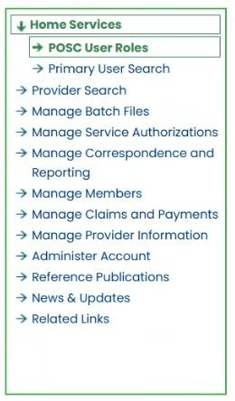
POSC User Roles
This is a read-only function available to all users upon login
The purpose of the function is informational and will allow users to see available roles that may be assigned to a POSC account
Additionally, each role will display a description for what abilities this role will grant the user

Slide 58
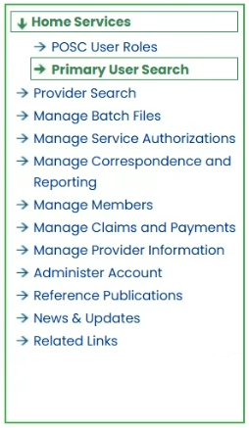
Primary User Search
The Primary User Search function is available to all users upon login
This function provides the ability for users to view the Primary User(s) for each of their assigned PIDSLs
The purpose is to allow users to identify the appropriate contact, the Primary User, for access issues on the POSC; thereby eliminating the need to contact customer service for this information

Slide 59
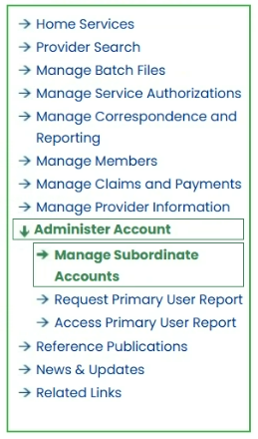
Manage Subordinate Accounts
The Manage Subordinate Accounts service has been updated to allow primary users to filter between:
Currently linked accounts
Previously linked accounts
This will allow Primary Users to better manage subordinate account access

Slide 60
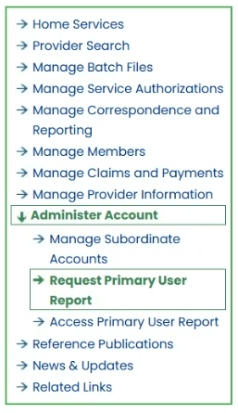
Primary User Reports
Primary Users can now generate reports for user accounts associated with a given PIDSL or multiple PIDSLs
These reports provide an alternative way to track user account access
The reports may be downloaded from the POSC for ease of access
Report options include currently linked users vs. previously linked users

Slide 61
Reinstatement of Primary Care Clinician Plan / Primary Care ACO Referral Requirements
Presented by Nestor Rivera,
Senior Provider Relations Specialist,
MassHealth Business Support Services

Slide 62
Overview
On March 20th, 2020, as part of MassHealth’s COVID-19 response, the Executive Office of Health and Human Services suspended referral requirements for MassHealth covered services for the Primary Care Accountable Care Organizations (PCACO) and the Primary Care Clinician (PCC) Plan.
As announced in All Provider Bulletin 403, MassHealth is reinstated referral requirements for date(s) of service on or after August 1st, 2025, for members enrolled in the PCACOs and the PCC Plan.
All Provider Bulletin 409 announced additional exceptions to the Referral Requirements for Services through the PCACO and PCC plans.

Slide 63
PCC Plan – Referrals for Services
All services provided by a clinician or provider other than the PCC Plan member’s primary care clinician require a referral from the member’s PCC on file in MMIS/POSC, unless the service is exempted under 130 CMR 450.118(J)(5).
Whenever possible, the primary care clinician should make the referral before the member’s receipt of the service. However, the primary care clinician may issue a referral retroactively (for up to a year after the date of service) if the primary care clinician determines that the service was medically necessary, and they were the PCC on file for the date of service.
See 130 CMR 450.000: Administrative and Billing Regulations

Slide 64
Primary Care ACO – Referrals for Services
All services provided by a clinician or provider other than the Primary Care ACO member's primary care provider (PCP) or referral circle require a referral from the member’s PCP on file in MMIS/POSC to be payable, unless the service is exempted under 130 CMR 450.119(I).
Whenever possible, the PCP should make the referral before the member’s receipt of the service. However, the PCP may issue a referral retroactively (for up to a year after the date of service) if the PCP determines that the service was medically necessary, and they were the PCP on file for the date of service.
See 130 CMR 450.000: Administrative and Billing Regulations

Slide 65
Payment for Services Requiring a Referral
Failure to obtain a referral, when required, will result in non-payment of claims. Note that a referral is different from a Prior Authorization.
Payment for services is subject to all conditions and restrictions of MassHealth, including but not limited to, the scope of covered services for a member’s coverage type, service limitations, and prior-authorization requirements.
See 130 CMR 450.000: Administrative and Billing Regulations

Slide 66
Referring Provider Requirements
Claims submitted to MassHealth for services that require a referral must include the National Provider Identifier (NPI) of an authorized individual referring provider.
When the PCC Plan and Primary Care ACO Plan referrals are reinstated, billing providers must include the NPI of an authorized, enrolled referring provider on every claim for a service for which a referral is required for the claim to be payable.
See All Provider Bulletin 286 (with updated information provided in All Provider Bulletins 361, 376, 380, and 391), for details on Ordering, Referring, & Prescribing (ORP) requirements, including the list of individual provider types that are considered authorized referring providers.

Slide 67
Urgent Care Services
Urgent care services, as defined in M.G.L. ch. 118E, s. 10N, will not require a referral in order to be payable.
Urgent care facilities, as defined in M.G.L. ch. 118E, s. 10N, that render urgent care services must bill in a manner to indicate that the service was urgent.
For professional claims, providers must bill with place of service 20
For institutional claims, providers must bill with admit code 02

Slide 68
Primary Care Provider Role
Reinstating referrals will allow providers to:
Maintain active engagement with members' care​
Provide care team with better management and coordination of members' care
Facilitate and improve care planning for members
Improve communication between primary care and specialty services​
Provide a single point of contact of accountability for ensuring that necessary medical and other services are accessed coordinated and delivered

Slide 69
Office Hours – Primary Care Referral Reinstatement
The MassHealth Business Support Services (BSS) Provider Relations team will be hosting a webinar on the reinstatement of primary care referral on November 5th, 2025. This session is intended for Primary Care Clinician (PCC) Plan & Primary Care ACO (PCACO) Plan providers and non-LTSS Fee-for-Service (FFS) providers.
The session will provide the following:
Overview of primary care referral requirements
Overview of payment/claim requirements for services requiring a referral and/or a referring provider.
Denial edits that may occur when referral requirements are not met
Provider Online Service Center (POSC) walkthrough on:
  Inquiring on a referral (all providers)
  Submitting a referral (primary care providers)

Slide 70
Long-Term Services and Supports
Presented by Sarah Westring,
Senior Provider Enrollment Specialist, Optum

Slide 71
LTSS Provider Communications (slide 1 of 2)
The MassHealth LTSS Provider Service Center utilizes provider data to identify behavior trends for areas of targeted training via email. These emails may contain attached job aids or links to additional educational resources via the LTSS Provider Portal.
Areas of focus for these communications include but are not limited to:
high claims denials for specific error codes ​
high prior authorization denials or administrative holds, and/or
audit findings/SURs reports
The goal of each communication is to assist the Provider in reducing their administrative errors in billing and prior authorization.

Slide 72
LTSS Provider Communications (slide 2 of 2)
Over the last 3 months, Optum has sent over 91 email communications via our LTSS support inbox to LTSS Providers.
There have been 6 provider bulletins published on the MassHealth website
If you have not received or wish to begin receiving these communications, you may do so by following steps:
For the LTSS support box communications, please reach out to the LTSS Provider Service Center and we can help ensure your inclusion in future communications
For communications from MassHealth on mass.gov, follow this link:
Email Notifications for MassHealth Provider Bulletins and Transmittal Letters

Slide 73
LTSS Provider Trainings and Quality Forums
Training or Quality Forums for MassHealth LTSS Providers:
  Trainings:
    Continuous Skilled Nursing Training: 10/2/2025
    Home Health Agency Applicant Orientation Training: 10/17/2025
  Quality Forums:
    Home Health Agency: 10/27/2025

Slide 74
LTSS Application & Revalidation Provider Support
MassHealth LTSS continues to work on the provider experience with applications and revalidations to help with the process and ensure providers have easy access to the resources that will help provide quality care for members.
The following three updates were made recently:
  Independent Nurse Application includes General Education training in our Learning Center
  Streamlined revalidations for Group Practices and Therapists
  Added Fiscal Soundness to HHA, CSN, AFC, & GAFC revalidations to minimize the outreach during the annual requirement

Slide 75
Independent Nurse Application
To help navigate Independent Nurses to resources that will help them be successful and knowledgeable about record keeping, claims, updates and more we have included the General Education as part of the application process for this application type
Once an Independent Nurse’s starts the application they will be notified to look out for a link that will grant access to the learning center where they will complete the General Education course
Once it is completed, the provider will sign an attestation confirming they have completed the General Education, and their application will be fully processed

Slide 76
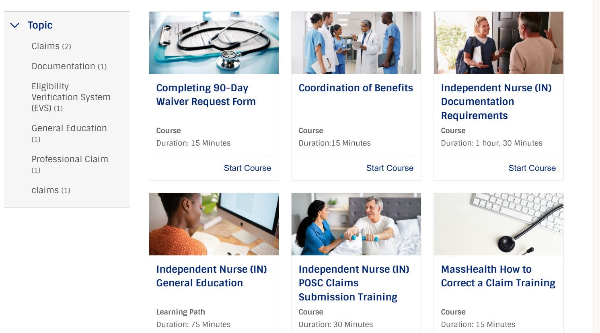
Independent Nurse Application (continued)
As shown below, they not only have access to the General Education but many other topics that will help them throughout their enrollment with MassHealth.

Slide 77
Revalidations for Group Practices & Independent Therapist
To efficiently complete revalidations for both Group Practices and the Independent Therapist that are associated with them. The LTSS enrollment team has been grouping the facilities and therapist together that are associated with one another and due in the current year.
The Enrollment Team will contact the Credentialing Specialist for the facility with a list of locations and therapists that are due for revalidation. They will confirm which therapists are still actively working at their facility. If they have left to work elsewhere, an email or phone number will be provided to for MassHealth to get in contact with the therapist for their due revalidation.
Once verification is completed, we will load their revalidations on the LTSS portal for them to complete. This reduces the outreach by staff to find the therapist or point of contact and has also reduced the time to process the revalidations.

Slide 78
Fiscal Soundness
MassHealth requires Adult Foster Care, Group Adult Foster Care, Home Health Agencies, and Continuous Skilled Nursing providers have to submit annually a statement of fiscal soundness attesting to the financial viability of the agency
  All Adult Foster Care Providers and Group Adult Foster Care providers must complete a Statement of Fiscal Soundness Attestation at time of enrollment, by October 1st of each year, or during their revalidation
  All Home Health Agency and Continuous Skilled Nursing providers must complete a Statement of Fiscal Soundness Attestation at time of enrollment, by May 31st of each year, or during their revalidation
Again, to reduce the multiple outreaches to providers to submit in a timely manner, LTSS now includes the Fiscal Soundness form for providers that are due during their revalidation within 6 months of the due date for the Fiscal Soundness
This has reduced the outreach to notify and remind providers to login and complete the required form by phone, email, and mail

Slide 79
Application and Mass.gov Changes
Presented by Michael Gilleran,
Senior Provider Relations Specialists, MassHealth Business Support Services

Slide 80
Application Changes
Due to the expanded data elements that will be added to the Provider Directory, provider applications will be modified to include questions that collect this information
The data elements will now include languages spoken by providers, website URLs, accessibility accommodations, telehealth services, and whether new patients are being accepted
Cultural capabilities were also added to the Provider Directory search results page. MassHealth is currently evaluating how to best collect this data and providers are encouraged to begin tracking this information in preparation for future updates

Slide 81
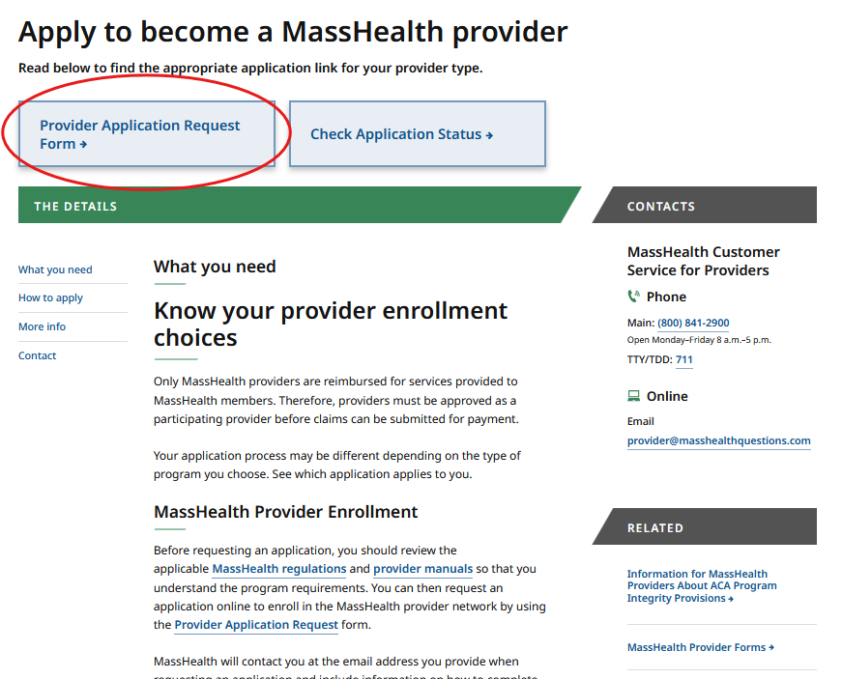
Application Requests on Mass.gov
Providers are reminded that they may request a FFS application on Mass.gov
The applications can be sent digitally, or by mail, and will include the provider directory field mentioned previously
Visit Apply to Become a MassHealth Provider

Slide 82
Updating Provider Files
As mentioned previously, MassHealth providers are advised that any changes to their information will require they submit an update request. This will ensure their provider file is accurate, per MassHealth regulations
Provider files should be updated whenever there is a modification to information such as addresses, employers, or any information that differs from when the application was first processed
Requests can be initiated by using MassHealth Provider Self-Service (PSS)

Slide 83
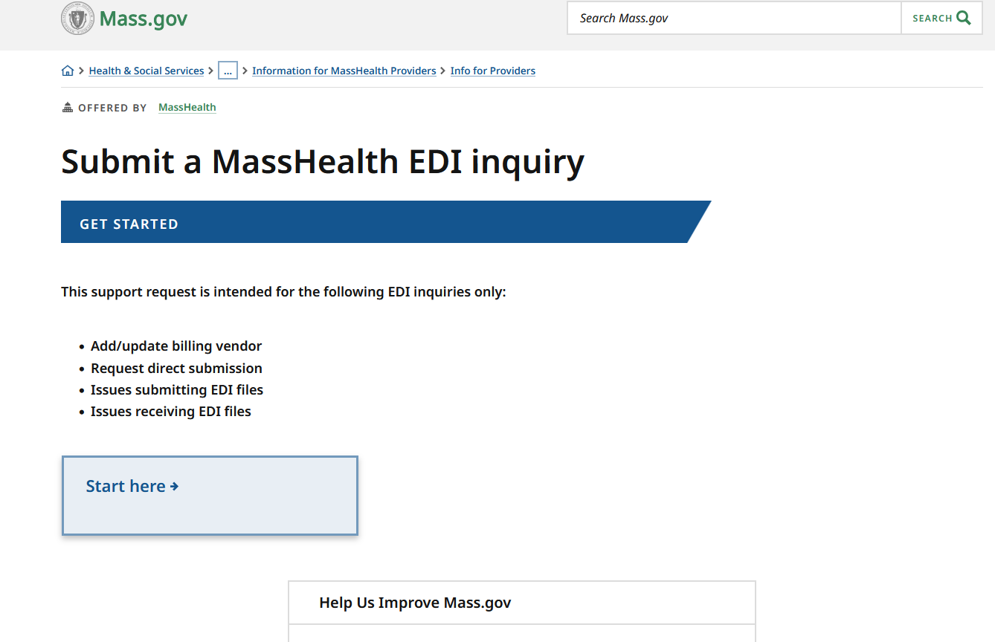
Upcoming Mass.gov Changes
Electronic Data Interchange (EDI) facilitates the exchange of HIPAA files as electronic transactions; many written resources are currently available on Mass.gov relating to EDI transactions
MassHealth is developing an online inquiry form to enable more in-depth assistance for providers who are experiencing issues with EDI/HIPAA files
Visit Electronic Data Interchange FAQ

Slide 84
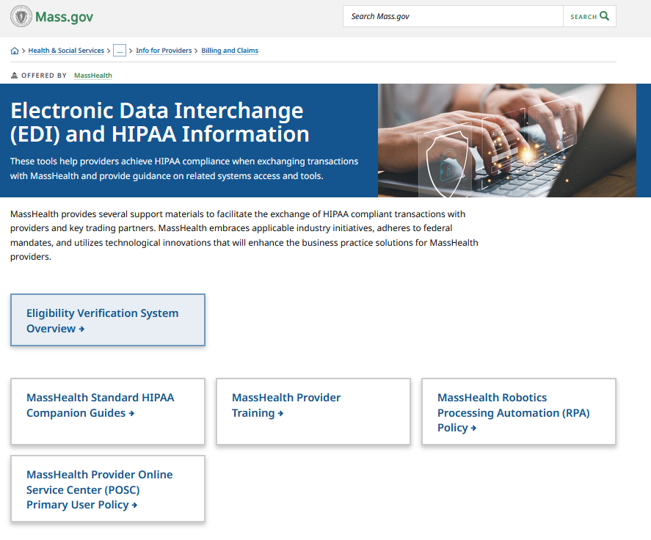
Upcoming Mass.gov Changes (continued)
The Electronic Data Interchange (EDI) Inquiry form will specifically offer support for:
  Updating/Adding a billing vendor
  Setting up EDI transactions
  Address issues submitting EDI transactions
  Address issues receiving EDI transactions
The planned go-live date for this online resource is Fall 2025
Visit Electronic Data Interchange (EDI) and HIPAA Information

Slide 85
Provider Self-Service Resources on Mass.gov/MassHealth
Presented by Michael Gilleran,
Senior Provider Relations Specialist,
MassHealth Business Support Services

Slide 86
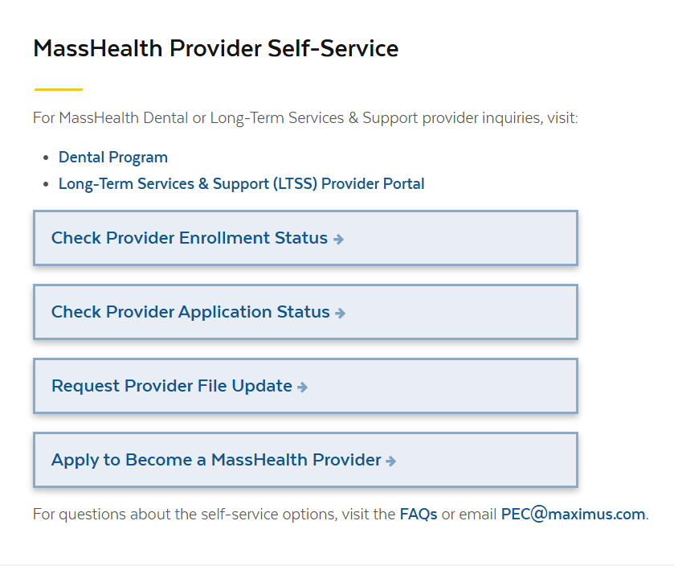
Self-Service Options for MassHealth Providers
The Request Provider File Update option has been updated to allow requests for the following information:
Bank Information (EFT)
Disenrollment requests
CLIA
Specialties
Certifications/accreditations
Medicare
NPI
Managed Care:
  ACO update
  ACO PCP Affiliation
  PCC update
  PCC Affiliation
Provider Self-Service Webpage

Slide 87

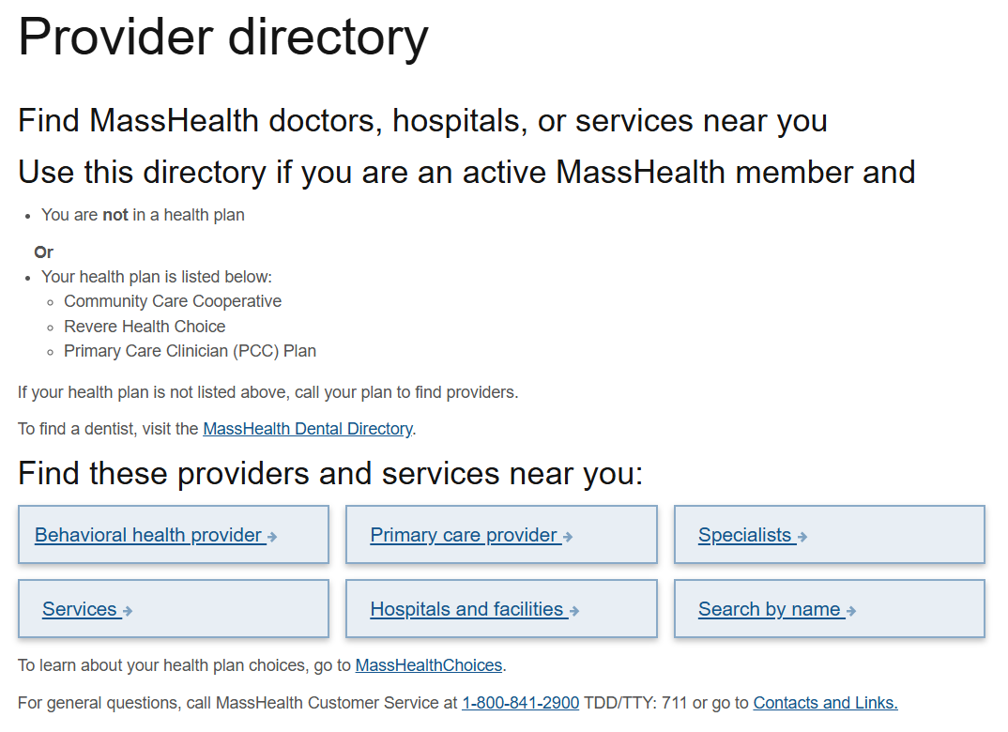
Coming Soon: Provider Directory Updates
A new provider file update is being added to the Provider Self-Service Portal to capture required CMS data elements for the Fee-for-Service Provider Directory.
The Provider Directory file update is targeted to go live in November 2025 and will allow updates to the following provider file information:
  Telehealth
  Accepts new patients
  Languages
  Accessibility accommodations
  Website URLs

Slide 88
Provider File Update Reminders
Enrolled providers must notify MassHealth within 14 days of any changes in their information, as stated in 130 CMR 450.223(B). Failure to do so constitutes a breach of the provider contract which may result in fines or termination
Secure file upload is only available for the following providers:
  Fee-for-Service (FFS)
  Ordering, Referring, and Prescribing (ORP)
Effective October 1st, 2025, provider file update requests for non-LTSS and non-dental MassHealth providers will no longer be accepted via fax
  Only updates submitted to Provider Enrollment and Credentialing (PEC) through self-service and by mail will be accepted
Note: Applications for non-LTSS and non-dental providers can still be faxed or mailed at this time.

Slide 89
Payment Error Rate Measurement (PERM) RY 2026
Presented by Michael Gilleran,
Senior Provider Relations Specialists,
MassHealth Business Support Services

Slide 90

PERM RY 2026
MassHealth is part of the CMS Payment Error Rate Measurement (PERM) audit for RY 2026. The PERM audit measures improper payments in Medicaid and CHIP programs and produces improper payment rates for each program.
PERM Cycle RY2026 Claim Review Period: July 1, 2024 to June 30, 2025
Timeframe for Medical Records Request Outreach: April 1, 2025 to April 15, 2026

Slide 91
PERM RY 2026 Provider Responsibilities
As part of the CMS PERM RY26 cycle, medical records requests will start going out to providers in the coming months. Providers are responsible for providing the requested documentation to the audit contractor timely.
When submitting records, providers must ensure the records are for the right patient and right date of service
Records must be legible with no highlights or marking that would obscure important facts
Make sure double-sided documents include both sides
All supporting documents for the claim identified must be included in the submission
Visit CMS PERM Provider Required Document List

Slide 92
PERM RY 2026 Provider Documentation Errors
Please remind providers they must send all applicable documents related to the claim for the member/procedure/date of service. Current issues found so far include:
The provider did not submit the required general anesthesia documentation for the sampled date of service to support payment
The provider did not submit the required diagnostic study results and physician's order for the sampled date of service to support payment
The provider did not submit the required physician's order for the sampled date of service to support payment

Slide 93
PERM RY 2026 Resources
Information on the CMS PERM Audit can be found on the CMS website.
These materials are currently available on the Providers page of the CMS PERM website
CMS PERM Overview for Providers slide deck
CMS PERM Provider Education FAQ document
Note: Failure to respond to the audit request will result in the claim being voided and the payment recouped

Slide 94
MassHealth Maternal Health Overview and Perinatal Depression Screening Policy Update
Presented by Sarah Krinsky, Deputy Director of Perinatal and Maternal Health Policy, MassHealth
and
Swathi Damodaran, Associate Medical Director for Psychiatry MassHealth Office of Accountable Care and Behavioral Health

Slide 95
Background: MassHealth Eligibility & Coverage For Pregnant & Postpartum Members
MassHealth covers about 40% of birthing people (~25,000 annual births) in Massachusetts
While there are some exceptions, most pregnant and postpartum MassHealth members are eligible for MassHealth Standard coverage and enrollment in a managed care plan as long as they report their pregnancy status to MassHealth
All pregnant members should self-report pregnancy status to MassHealth to ensure they receive all the benefits they're eligible for, including 12 months of continuous postpartum coverage
  Coverage includes undocumented perinatal members
  Includes all pregnancy outcomes
  There are several options for reporting pregnancy outlined below and at Information for Pregnant MassHealth Members
If you see pregnant patients, we encourage you to keep the printed notification of pregnancy form available so members can complete the form during their first prenatal care visit. The completed form can then be mailed or faxed to MassHealth by the provider office.

Slide 96
Background: MassHealth Eligibility & Coverage For Pregnant & Postpartum Members (continued)
Options for reporting pregnancy status to MassHealth:
BY PHONE
IN PERSON
Call the MassHealth
Customer Service Center:
(800) 841-2900
TDD/TTY: 711
Monday-Friday 8AM-5PM
Interpreter services available
Go to your local
MassHealth Enrollment Center
Make an appointment
MAIL/FAX/DROP-OFF
ONLINE
Update your pregnancy status
in the MassHealth member portal
Mail, fax, or drop off a completed
notification of pregnancy form

Slide 97
Background: Managed Care For Pregnant & Postpartum Members
The majority of pregnant and postpartum MassHealth members in managed care plans are enrolled in an accountable care organization (ACO), managed care organization (MCO), or primary care clinician (PCC) plan
  There are two different types of ACOs: Accountable Care Partnership Plans (ACPPs) and Primary Care ACOs (PCACOs)
  Members and providers can learn more about ACOs, MCOs, and the PCC Plan at masshealthchoices.com
Some pregnant and postpartum members with a disability may be in an integrated care plan called One Care
Other members may have MassHealth fee-for-service (FFS) coverage
  Members on FFS are not eligible for managed care services
As their provider, you should encourage your patients to contact their managed care plan, if they have one, since they may be eligible to receive additional supports such as care management, housing and nutrition supports, free car seats, and more.
  If a member isn’t sure what managed care plan they have, or if they are eligible for managed care, they should call the MassHealth customer service center at (800) 841-2900, TDD/TTY: 711
  For extra support understanding their coverage, members can also contact My Ombudsman

Slide 98
Background: Managed Care For Pregnant & Postpartum Members (continued)
Covered services for pregnant and postpartum MassHealth members include but are not limited to:
Prenatal, labor and delivery, and postpartum care through 12 months, including care in hospitals and freestanding birth centers
Sexual and reproductive health care including many family planning services
Doula services
Behavioral health care including mental health and substance use disorder treatment
Dental care including checkups, cleanings, fillings, crowns, and root canals
  Practice guidelines for oral health in pregnancy
Transportation for eligible members when needed
One free breast pump per pregnancy, milk storage bags, replacement parts as needed, hospital-grade breast pump rentals as needed
Prenatal screening, ultrasounds, and vaccines
Prenatal vitamins
  MassHealth members can get prenatal vitamins free of charge at their local pharmacy without a prescription from their provider because of MassHealth’s standing order
Remote patient monitoring during pregnancy through 12 months postpartum (for example, remote blood pressure monitoring)

Slide 99

Background: MassHealth Doula Program
As of December 8, 2023, MassHealth covers doula services for MassHealth members during pregnancy, labor and delivery, and through 12 months following delivery, inclusive of all pregnancy outcomes.
As of late 2024, adoptive parents are also eligible through the infant’s first year of life.
Visit: MassHealth Doulas
Examples of how doulas can help members
Overview of MassHealth covered doula services
  Labor and delivery support
  Up to 8 hours of perinatal visits (more visits can be requested through prior authorization)
How to find a MassHealth doula provider
Spreadsheet updated regularly with more detailed self-reported information about doulas (race/ethnicity, language(s), regions, etc.)
MassHealth has a diverse network of about 350 doula providers:
About 39% of doulas identify as Black or African American
About 22% of doulas identify as Hispanic or Latinx
About 43% of doulas speak at least 1 other language besides English
18+ different languages spoken by doulas
Doulas available across every region of MA

Slide 100
Background: MassHealth Doula Program (continued)
Join MassHealth’s listserv to receive updates about the MassHealth doula services program:
Send a blank email to: Join MassHealth Doula Program Listserv
IMPORTANT: The subject link and email body must be completely empty, make sure to remove any email signatures
After sending the email, you should get an automatic response indicating that you’ve successfully joined the listserv

Slide 101

Update: New Webpage and Flyers
MassHealth is excited to share a new webpage for providers, such as OB/GYNs, midwives, primary care providers, pediatricians, and others, caring for pregnant and postpartum MassHealth members: Perinatal Providers
The page includes detailed information and resources across several topics:
Eligibility and covered services
Managed care information and supports
MassHealth doula benefit
Behavioral health
Breast pumps and lactation support
Family planning
Prenatal screening/diagnosis and vaccines
Social determinants of health (SDOH)
Patient-facing materials in multiple languages, including new pregnancy checklists for members

Slide 102
Update: MassHealth Perinatal Depression Screening Policy
Background
Perinatal depression is one of the most common complications during pregnancy and the postpartum period, affecting about 1 in 5 new parents. If left untreated, it can increase the risk of poor prenatal care, suicide, substance use, and pregnancy complications
The Massachusetts maternal mortality and morbidity review committee found that mental health conditions likely contributed to 44% of pregnancy-related deaths based on the most recently available data
The MA Department of Public Health requires providers to submit annual postpartum depression screening data (Chapter 313 of the Acts of 2010)
In August 2024, Governor Healey signed into law Chapter 186 of the Acts of 2024 (“the maternal health bill”) which included requirements for providers related to screening for depression during and after pregnancy
Update
MassHealth published All Provider Bulletin 405 on August 19, 2025, with requirements, recommendations, and resources related to depression screening of perinatal members and infant caregivers

Slide 103
Update: Highlights from MassHealth All Provider Bulletin 405 published on August 19, 2025 (slide 1 of 3)
Postpartum depression (PPD) screening requirements
MassHealth requires primary care providers, obstetricians, gynecologists, certified nurse midwives, and pediatric providers to offer postpartum depression screening to members during the 12 months following the end of pregnancy and take certain actions for positive screens
For those who have a positive screen for depression, providers should discuss available treatments for perinatal depression or major depressive disorder, including pharmacological options, and a referral to a mental health clinician, when clinically appropriate
Screening the infant’s parent(s) or caregiver(s), including paternal, adoptive, and non-birthing caregivers, for postpartum depression or major depressive disorder is required at every pediatric preventive health care visit from the one-month visit to the 12-month visit
MassHealth payment for screenings
MassHealth pays for all perinatal depression screenings that occur during pregnancy through 12 months following the end of the pregnancy, inclusive of all pregnancy outcomes, as clinically appropriate.
  Consistent with guidelines from the American College of Obstetricians and Gynecologists, MassHealth recommends that OB/GYNs screen for perinatal depression at the initial prenatal visit, later in pregnancy, and at postpartum visits at a minimum
MassHealth pays for depression screenings for infant caregivers that occur at any pediatric visit up to the 12-month pediatric preventive health care visit, as clinically appropriate.

Slide 104
Update: Highlights from MassHealth All Provider Bulletin 405 published on August 19, 2025 (slide 2 of 3)
For rates for these billing codes, see 101 CMR 317.00: Rates for Medicine Services
Code | Visit type | Description | Modifiers
S3005 | Perinatal member visit | Prenatal and Postpartum Depression Screening | U1 – Positive Screen U2 – Negative Screen
96110 + UD | Infant pediatric visit | Depression Screening for Infant Caregivers | U1 – Positive Screen U2 – Negative Screen

Slide 105
Update: Highlights from MassHealth All Provider Bulletin 405 published on August 19, 2025 (slide 3 of 3)
Screening tools
For providers serving perinatal members, a list of approved validated tools can be found at Perinatal mood & anxiety disorders screening tools, training, and continuing education
Pediatric care providers should use a standardized screening tool such as the Edinburgh Postpartum Depression Scale (EPDS) or any of the recommended screening tools listed in the Bright Futures Toolkit under maternal depression
Resources
Emergency or Crisis Concerns:
Massachusetts Behavioral Health Help Line (833-773-2445): Talk to a trained mental health professional for real-time clinical assessment and direct access to community mental health resources
Community Behavioral Health Centers: One-stop-shops for psychiatric evaluation and ongoing mental health and substance use services with urgent and walk-in appointments available
Non-emergency Concerns:
MCPAP for Moms: Provider-to-provider consultation from a perinatal mental health professional and referral to perinatal mental health services or other supports
National Maternal Mental Health Hotline: Perinatal mental health resources
Postpartum Support International of Massachusetts: Perinatal mental health resources and provider directory
For more details, review MassHealth All Provider Bulletin 405

Slide 106
MassHealth Updates
Presented by Nestor Rivera,
Senior Provider Relations Specialist, MassHealth Business Support Services

Slide 107

Provider Education LMS
The MassHealth Provider Learning Management System(LMS) for Non-OLTSS providers is a system providers can use 24/7 as an educational resource.
The Provider LMS delivers:
Previous live training presentations
New on demand training courses
Course surveys
If you are currently a registered user but have forgotten your user-name or password, you can retrieve it from the sign-in screen
New Users can create a profile and begin using the system immediately
Visit MassHealth BSS Provider Training portal
OLTSS and Dental providers should visit their respective vendor site for training opportunities

Slide 108
Provider Education LMS (continued)
It is recommended that providers take the Introduction to Inquisiq course as an introduction to the system upon initial login
New courses include:
  Self-Service Options for Claim Status Inquires and Information Video
  Provider Online Service Center (POSC) Primary User (Admin Account) and Security Policy
  PEC Self-Service Resources Video
New Trainings will be added regularly
Provider feedback is important for each training – Surveys provide valuable information that helps us continually improve your experience
Visit MassHealth Business Support Services
OLTSS and Dental providers should visit their respective vendor site for training opportunities

Slide 109
Trainings
New Provider Orientation: This session will introduce to MassHealth to Providers and will supply information on key terminology and resources, along with general requirements for all MassHealth providers. (Registration for this session has passed.)
Office Hours Billing and Claims: This session will be an open forum for providers to ask general billing and claims questions show you online tools to help you with claims questions. Please note that questions specific to your organization may need to be addressed individually. (Registration for this session has passed.)
Office Hours Enrollment and Revalidation: This session will provide background information on MassHealth Provider Enrollment for both ORP, FFS, and Group practice providers as well as detail the requirements for enrollment. This presentation is also designed to assist providers in working through the Revalidation process. Most of the webinar will be devoted to live Q&A where attendees may ask the host any questions they have regarding enrollment and revalidation. (Registration for this session has passed.)

Slide 110
All Provider Bulletins
All Provider Bulletin 404:Administrative and Billing Regulations – Reinforcing Sanctioning
All Provider Bulletin 405:Perinatal Depression Screening and Depression Screening for Infant Caregivers
All Provider Bulletin 406:Update to Certain Exceptions to Services that Require Referrals in the Primary Care Clinician Plan and Primary Care ACOs
All Provider Bulletin 407:Changes in Exclusion of Designated 340B Drugs from MassHealth Coverage
All Provider Bulletin 408: Annual Behavioral Health Wellness Examinations
All Provider Bulletin 409: Update to Certain Exceptions to Referral Requirements for Services
All Provider Bulletin 410:Changes to MassHealth’s Accountable Care Organizations on January 1, 2026

Slide 111
Resources
Provider Email Alerts
Sign up to receive email alerts when MassHealth issues new bulletins and transmittal letters, fill out the Email Notification Request for Providers on Mass.gov.
MassHealth New Bulletin and Transmittal Letters
MassHealth Website
Bulletins are Available on Mass.gov
MassHealth Providers web page
The ACA ORP Requirements for MassHealth Providers

Slide 112
Thank you

