Slide 1
MassHealth Training Forum Provider Updates
July 2025
Executive Office of Health & Human Services

Slide 2
Agenda
Welcome and Agenda Overview
Reinstatement of Primary Care Clinician Plan / Primary Care ACO Referral Requirements
Ordering Referring and Prescribing (ORP) Requirements Update
Advancing Interoperability and Improving Prior Authorization Processes
Standardized Encounter Data Program (SendPro)
Long-Term Services and Supports
POSC User Functionality Updates
POSC and Homepage Refresh
Robotics Processing Automation Annual Validation
Self-Service Resources on Mass.gov/MassHealth
Payment Error Rate Measurement (PERM) RY 2026
MassHealth Updates
  1010 Claim Denials
  Call Center Update
  Training Opportunities

Slide 3
Reinstatement of Primary Care Clinician Plan / Primary Care ACO Referral Requirements
Presented by – Nestor Rivera, Sr. Provider Relations Specialist, Business Support Services

Slide 4
Overview
On March 20th, 2020, as part of MassHealth’s COVID-19 response, the Executive Office of Health and Human Services suspended referral requirements for MassHealth covered services for the Primary Care Accountable Care Organizations (PCACO) and the Primary Care Clinician (PCC) Plan.
As announced in All-Provider Bulletin 403, MassHealth is reinstating referral requirements for date(s) of service on or after August 1st, 2025, for members enrolled in the PCACOs and the PCC Plan.

Slide 5
PCC Plan –
Referrals for Services
All services provided by a clinician or provider other than the PCC Plan member’s primary care clinician require a referral from the member’s PCC on file in MMIS/POSC, unless the service is exempted under 130 CMR 450.118(J)(5).
Whenever possible, the primary care clinician should make the referral before the member’s receipt of the service. However, the primary care clinician may issue a referral retroactively (for up to a year after the date of service) if the primary care clinician determines that the service was medically necessary, and they were the PCC on file for the date of service.
See 130 CMR 450.000: Administrative and Billing Regulations

Slide 6
Primary Care ACO –
Referrals for Services
All services provided by a clinician or provider other than the Primary Care ACO member's primary care provider (PCP) or referral circle require a referral from the member’s PCP on file in MMIS/POSC to be payable, unless the service is exempted under 130 CMR 450.119(I).
Whenever possible, the PCP should make the referral before the member’s receipt of the service. However, the PCP may issue a referral retroactively (for up to a year after the date of service) if the PCP determines that the service was medically necessary, and they were the PCP on file for the date of service.
See 130 CMR 450.000: Administrative and Billing Regulations

Slide 7
Payment for Services Requiring a Referral
Failure to obtain a referral, when required, will result in non-payment of claims. Note that a referral is different from a Prior Authorization.
Payment for services is subject to all conditions and restrictions of MassHealth, including but not limited to, the scope of covered services for a member’s coverage type, service limitations, and prior-authorization requirements.
See 130 CMR 450.000: Administrative and Billing Regulations

Slide 8
Referring Provider Requirements
Claims submitted to MassHealth for services that require a referral must include the National Provider Identifier (NPI) of an authorized individual referring provider.
When the PCC Plan and Primary Care ACO Plan referrals are reinstated, billing providers must include the NPI of an authorized, enrolled referring provider on every claim for a service for which a referral is required for the claim to be payable.
See All-Provider Bulletin 286 (with updated information provided in All Provider Bulletins 361, 376, 380, and 391), for details on Ordering, Referring, & Prescribing (ORP) requirements, including the list of individual provider types that are considered authorized referring providers.

Slide 9
Urgent Care Services
Urgent care services, as defined in M.G.L. ch. 118E, s. 10N, will not require a referral in order to be payable.
Urgent care facilities, as defined in M.G.L. ch. 118E, s. 10N, that render urgent care services must bill in a manner to indicate that the service was urgent.
For professional claims, providers must bill with place of service 20
For institutional claims, providers must bill with admit code 02

Slide 10
Primary Care Provider Role
Reinstating referrals will allow providers to:
Maintain active engagement with members' care​
Provide care team with better management and coordination of members' care
Facilitate and improve care planning for members
Improve communication between primary care and specialty services​
Provide a single point of contact of accountability for ensuring that necessary medical and other services are accessed coordinated and delivered

Slide 11
Office Hours – Primary Care Referral Reinstatement
The MassHealth Business Support Services (BSS) Provider Relations team will be hosting a webinar on the reinstatement of primary care referral requirements as announced in All-Provider Bulletin 403: Ending the Suspension of Primary Care Clinician Plan & Primary Care ACO Referrals and Updating Referral Requirements for Urgent Care Services.
This session is intended for Primary Care Clinician (PCC) Plan & Primary Care ACO (PCACO) Plan providers and non-LTSS Fee-for-Service (FFS) providers. The session will provide the following:
Overview of primary care referral requirements
Overview of payment/claim requirements for services requiring a referral and/or a referring provider
Denial edits that may occur when referral requirements are not met
Provider Online Service Center (POSC) walkthrough on:
  Inquiring on a referral (all providers)
  Submitting a referral (primary care providers)

Slide 12
Office Hours – Primary Care Referral Reinstatement (continued)
The office hour sessions will run 60 minutes and be held on the following dates and times:
July 30th, 2025 – 10 AM
August 13th, 2025 – 1 PM
August 21st, 2025 – 10 AM
September 11th, 2025 – 1 PM
Register here:
https://maximus.zoom.us/webinar/register/WN_piOUv6bDSJuIqyIusQg6Ng

Slide 13
Ordering Referring and Prescribing (ORP) Requirements Update
Presented by – Nestor Rivera, Sr. Provider Relations Specialist, Business Support Services

Slide 14
Ordering and Referring (O&R) Background
If MassHealth requires that a service is ordered, referred or prescribed, Section 6401(b) of the Affordable Care Act (ACA) requires that the Billing provider include an authorized ordering, referring or prescribing (ORP) provider’s National Provider Identifier (NPI) on the claim. The ACA also requires that the ORP provider be actively enrolled with MassHealth as a fully participating provider or as a non-billing ORP provider.
Under state law, certain provider types are required, as a condition of state licensure to apply to be enrolled with MassHealth as either billing providers or as non-billing providers for the purposes of ordering, referring, and prescribing services to MassHealth members. Failure to complete a MassHealth revalidation process may prevent such providers from renewing their license to practice at a future date. In addition to several other provider types (see M.G.L. Ch. 112), this state law applies to physician interns and residents (see M.G.L. Ch. 112, Sec. 9).

Slide 15
Ordering and Referring (O&R) Background (continued)
Authorized ORP Provider Types
Provider Types (including interns and residents in those provider types) authorized to be included on a claim as the ordering, referring, or prescribing provider and who, as described on the previous slide, must apply to enroll as at least a non-billing provider:
Certified Nurse Midwife (PT-08)
Clinical Nurse Specialist (PT-57)
Certified Registered Nurse Anesthetist (PT-51)
Dentist (PT-10)
Licensed Independent Clinical Social Worker (PT-92)
Certified Nurse Practitioner (PT-17)
Optometrist (PT-02)
Pharmacist (if authorized to prescribe) (PT-90)
Physician (PT-01)
Physician Assistant (PT-39)
Podiatrist (PT-06)
Psychiatric Clinical Nurse Specialist (PT-78)
Psychologist (PT-05)

Slide 16
O&R Billing Requirements
Below are services that must be ordered, referred or prescribed. MassHealth O&R requirements apply to fee-for-service, crossover (where MassHealth requires O&R) and third-party liability claims, but not to claims submitted to MassHealth managed care entities.
Any service that requires a primary care (PCC/PCACO) referral. NOTE: Effective August 1, 2025
Adult Day Health
Adult Foster Care
Durable Medical Equipment & Supplies
Eyeglasses
Group Adult Foster Care
Home Health
Independent Nursing
Labs Diagnostic Tests
Medications
Orthotics
Oxygen/Respiratory Equipment
Prosthetics
Psychological Testing
Therapy (PT, OT, ST)

Slide 17
Implementation of ORP Billing Requirements – Referring Providers
As described in All Provider Bulletin 286 (with updated information provided in All Provider Bulletins 361, 376, 380, and 391), claims submitted to MassHealth for services that require a referral must include the national provider identifier (NPI) of an authorized referring provider. The referring provider must also be enrolled with MassHealth for the claim to be payable.
MassHealth has been running informational denial messages for the last several years to assist billing providers with updating their billing processes to comply with the ORP requirements.
When the Primary Care Clinician Plan and Primary Care ACO referrals are reinstated on August 1, 2025, billing providers must include the NPI of an authorized, enrolled referring provider on every claim for a service for which a referral is required for the claim to be payable.

Slide 18
Referring Provider ORP Edits
Non-LTSS (slide 1 of 3)
This chart shows the potential impact on claims based on informational edit 1200 – Referring Provider Required for the period April to June 2025 by provider type.
Provider Type | Total Edits | April 2025 | May 2025 | June 2025
Physician | 742 | 320 | 329 | 93
Optometrist | 595 | 212 | 260 | 123
Podiatrist | 164 | 81 | 55 | 28
Chiropractor | 1430 | 647 | 555 | 228
Nurse Practitioner | 128 | 36 | 59 | 33
Community Health Center | 3,358 | 1,492 | 1,249 | 617
Family Planning Agency | 146 | 58 | 49 | 39

Slide 19
Referring Provider ORP Edits
Non-LTSS (slide 2 of 3)
This chart shows the impact on claims from April to June 2025 for the edit 1200 – Referring Provider Required.
Provider Type | Total Edits | April 2025 | May 2025 | June 2025
Abortion/Sterilization Clinic | 86 | 30 | 19 | 37
Renal Dialysis Clinic | 2,644 | 1,190 | 1,011 | 443
Early Intervention | 4,402 | 1,884 | 1,768 | 750
Hearing Instrument Specialist | 5 | 3 | 2 | 0
Audiologist | 22 | 9 | 10 | 3
Independent Diagnostic Testing Facility (Idtf) | 277 | 104 | 133 | 40
Certified Independent Laboratory | 176 | 27 | 134 | 15

Slide 20
Referring Provider ORP Edits
Non-LTSS (slide 3 of 3)
This chart shows the impact on claims from April to June 2025 for the edit 1200 – Referring Provider Required.
Provider Type | Total Edits | April 2025 | May 2025 | June 2025
Acute Inpatient Hospital | 185 | 63 | 98 | 24
Acute Outpatient Hospital | 2,637 | 784 | 1300 | 553
Hospital Licensed Health Center (Hlhc) | 3,645 | 1553 | 1505 | 587
Group Practice Organization | 57,490 | 23,005 | 21,111 | 13,374
Acupuncturist | 123 | 47 | 51 | 25

Slide 21
Referring Provider ORP Edits
LTSS
This chart shows the impact on LTSS claims from April to June 2025 for the edit 1200 – Referring Provider Required.
Provider Type | Total Edits | April 2025 | May 2025 | June 2025
Therapist | 381 | 120 | 217 | 44
Prosthetics | 98 | 47 | 39 | 12
Orthotics | 37 | 9 | 17 | 11
Independent Nurse | 130 | 61 | 49 | 20
Adult Foster Care / Group Adult Foster Care | 162 | 71 | 57 | 34
Group Practice Organization | 2,429 | 961 | 969 | 499

Slide 22
Advancing Interoperability
and Improving Prior Authorization Processes
Presented by – Michelle Croy, Sr. Provider Relations Specialist, Business Support Services

Slide 23
CMS Interoperability (slide 1 of 3)
On January 27, 2024 CMS issued the Advancing Interoperability and Improving Prior Authorization Processes Final Rule (#0057-F). The Rule requires that Medicaid, CHIP FFS programs, their managed care plans, and other entities (Medicare Advantage, QHP) must:
  Comply with prior authorization disposition timelines by January 1, 2026
  Make a series of metrics available to CMS and the public by March 31, 2026
  Update the existing Patient Access Application Programming Interface (API) and Adopt 3 additional payer and provider- based APIs by January 1, 2027
Interoperable healthcare data exchange enables coordinated care, improved health outcomes and reduced cost
  Patients will take ownership over their health data
  Providers are more informed & can provide best care to patients
  Payers provide more efficient care coordination and coverage
The Final Rule excludes pharmacy Prior Authorizations (prescriptions)

Slide 24
CMS Interoperability (slide 2 of 3)
Patient Access API (Application Programming Interface)
3/31/26: Annually provide metrics in the form of aggregated, de-identified data to CMS about patient use of the Patient Access API:
  Total # of unique patient’s data transferred to a health app of their choice
  Total # of unique patient’s data transferred more than once to a health app of their choice
1/1/27: Update the Patient Access API finalized in the Interoperability and Patient Access Final Rule (2020) to include information related to the patient’s prior authorizations (approved, denied, etc.)
Provider Access API
1/1/27: Share patient data with in-network (enrolled) providers with whom the patient has a treatment relationship
  Develop and ensure patient attribution and implement “Opt Out/Opt in” procedures
  Develop “plan language” resources for providers and patients re: the benefits, utilization and related processes

Slide 25
CMS Interoperability (slide 3 of 3)
Payer to Payer API
1/1/27: Make claims and encounter data (excluding provider remittances and enrollee cost-sharing information), and information about prior authorizations (excluding those for drugs and those that were denied)
  Develop and maintain “Opt in/Opt out” procedures
  Develop “plan language” resources for providers and patients re: the benefits, utilization and related processes
Prior Authorizations API, Processes and Metrics
1/1/26: Disposition prior authorization decisions within 7 calendar days and expedited prior authorization decisions within 72 hours
3/31/26: Report metrics about prior authorizations processed on a public website on an annual basis (e.g., # approved/denied, approved after appeal, etc.).
1/1/27: Implement and maintain a Prior Authorization API to exchange prior authorization requests, responses, and information with providers

Slide 26
MassHealth CMS Interoperability Preparations
MassHealth is actively working to comply with the Advancing Interoperability and Improving Prior Authorization Processes Final Rule. MassHealth:
  Has established internal workgroups and project team structures
  Is actively completing impact assessments and has begun to define both business and technical requirements
  Is actively managing prior authorization work plans (includes POSC modifications) and updating MassHealth regulations
  Will issue formal communications related to the 1/1/26 implementation later this fall; leverage all forms of communication
  Will conduct information sessions late fall/early winter

Slide 27
Standardized Encounter Data Program (SENDPro)
Presented by - Augustus Matekole, Data Quality Manager - Strategy & Partnerships, MassHealth Data Integrity Team

Slide 28
SENDPro Background – Current State
Health Insurance Portability and Accountability Act of 1996 (HIPAA) requires MassHealth to comply with federal electronic data interchange (EDI) standards.
Currently, Managed Care Entities (MCEs) submit post-adjudicated claims, or encounters, to MassHealth using a unique flat file data process. Starting January 1, 2026, the current flat file format will be phased out in favor of standardized EDI files: the 837 PACDR (Post-Adjudicated Claims Data Reporting) for medical and dental encounters, and NCPDP (National Council of Prescription Drug Program) v51 for pharmacy encounters. The new process complies with federal mandates, enhances MassHealth data compliance controls and validation, and improves data accuracy and integrity.
The following contract types currently submit encounters to MassHealth and are impacted by this change: Accountable Care Organizations (ACOs), Managed Care Organizations (MCOs), Senior Care Options (SCO), OneCare, and the Massachusetts Behavioral Health Plan. This includes nine MCEs: Commonwealth Care Alliance, Fallon Health, Health New England, Massachusetts Behavioral Health Partnership (MBHP), Mass General Brigham Health Plan, Molina HealthCare/Senior Whole Health, Point32Health, UnitedHealthCare, and WellSense.

Slide 29
SENDPro Background – Preparing for Future State
MCEs have already begun to participate in functionality testing with MassHealth and will continue to conduct testing through the end of the year.
MCEs are responsible for communicating with their contracted and non-contracted provider networks regarding this change to ensure they are adequately informed and prepared for the upcoming transition.
MassHealth will also issue MCE bulletins on the mass.gov website with additional detail to support MCEs and providers as they prepare for SENDPro implementation. Although this guidance is for plans, information in the bulletins may be helpful to providers. The first SENDPro Bulletin (Bulletin 129) has been posted here: 2025 MassHealth provider bulletins | Mass.gov
Note: MassHealth will require Managed Care Entities (MCEs) to submit post-adjudicated claims (encounter data), to MassHealth initially on a biweekly basis.

Slide 30
Advantages of SENDPro
The 837 PACDR (Post-Adjudicated Claims Data Reporting) and NCPDP (National Council of Prescription Drug Program) v51 best support MassHealth’s encounter data needs in the following ways:
Migration to the industry-standard transaction formats (EDI X12 837 and NCPDP) will allow MCEs to streamline submission and quality control for encounter data.
Adopting the SENDPro platform (cloud and/or SaaS products and services) will enhance MassHealth data-compliance controls and validation, improve maintainability, and reduce costs.
Improved data accuracy and integrity will support key policy initiatives and state and federal mandates, including Centers for Medicare & Medicaid Services (CMS) managed care and Transformed Medicaid Statistical Information System (T-MSIS) reporting requirements.

Slide 31
How Does SENDPro Impact You
MCEs will communicate key timelines and expectations to their providers, as well as support understanding new data submission requirements so providers can submit complete, accurate, and timely claims data.
Validation processes for encounter data review by MassHealth will be more rigorous than current standards, including potential rejections of encounter records until all errors are resolved. MCEs may then need to enforce these requirements with their providers through their claims adjudication process, up to and including denying incomplete claims submission from providers.
MCEs are expected to coordinate with providers to ensure timely responses to any inquiries or data issues as MCEs test the new functionality and business rules throughout the transition.

Slide 32
Additional Information & Resources
Additional Information
For additional information about the technical specifications used in the SENDPro application, please refer to the implementation guides (IG) published by X12 and NCPDP respectively.
Additionally, MassHealth companion guides are a supplement to the mandated X12 Implementation Guide/Technical Report (IG/TR3) and NCPDP Post Adjudication Standard Implementation Guide. The companion guides provide additional MassHealth business needs and cannot replace or include X12 requirements due to licensing copyright laws.
A link to the latest draft companion guides can be found at: MassHealth Managed Care Encounter Data Companion Guides | Mass.gov
Updates will also be shared through MassHealth provider bulletins, which can be found at: MassHealth Provider Bulletins | Mass.gov

Slide 33
Long-Term Services and Supports
Lindsey Klauka, Associate Director of PERT, Optum

Slide 34
LTSS Provider Communications (slide 1 of 2)
The MassHealth LTSS Provider Service Center utilizes provider data to identify behavior trends for areas of targeted training via email. These emails may contain attached job aids or links to additional educational resources via the LTSS Provider Portal.
Areas of focus for these communications include but are not limited to:
  high claims denials for specific error codes ​
  high prior authorization denials or administrative holds, and/or
  audit findings/SURs reports
The goal of each communication is to assist the Provider in reducing their administrative errors in billing and prior authorization.

Slide 35
LTSS Provider Communications (slide 2 of 2)
Over the last 3 months, Optum has sent over 135 email communications via our LTSS support inbox to LTSS Providers.
There have been 6 provider bulletins published on the MassHealth website.
If you have not received or wish to begin receiving these communications, you may do so by following steps:
For the LTSS support box communications, please reach out to the LTSS Provider Service Center and we can help ensure your inclusion in future communications
For communications from MassHealth on mass.gov, follow this link:
Email Notifications for MassHealth Provider Bulletins and Transmittal Letters

Slide 36
LTSS Provider Trainings and Quality Forums
Training or Quality Forums for MassHealth LTSS Providers:
Trainings:
  Continuous Skilled Nursing Training: 7/14/25
  Home Health Agency Applicant Orientation Training: 10/17/2025
Quality Forums:
  Adult Foster Care: 7/30/2025

Slide 37
LTSS Application & Revalidation Provider Support
MassHealth LTSS continues to work on the provider experience with applications and revalidations to help with the process and ensure providers have easy access to the resources that will help provide quality care for members.
The following three updates were made recently:
Independent Nurse Application includes General Education training in our Learning Center
Streamlined revalidations for Group Practices and Therapists
Added Fiscal Soundness to HHA, CSN, AFC, & GAFC revalidations to minimize the outreach during the annual requirement

Slide 38
Independent Nurse Application
To help navigate Independent Nurses to resources that will help them be successful and knowledgeable about record keeping, claims, updates and more we have included the General Education as part of the application process for this application type.
Independent Nurse’s will be notified once the application has been started that they will be receiving a link to access the learning center to complete the General Education course.
Once it is completed, the provider will sign an attestation confirming they have completed the General Education, and their application will be fully processed.

Slide 39
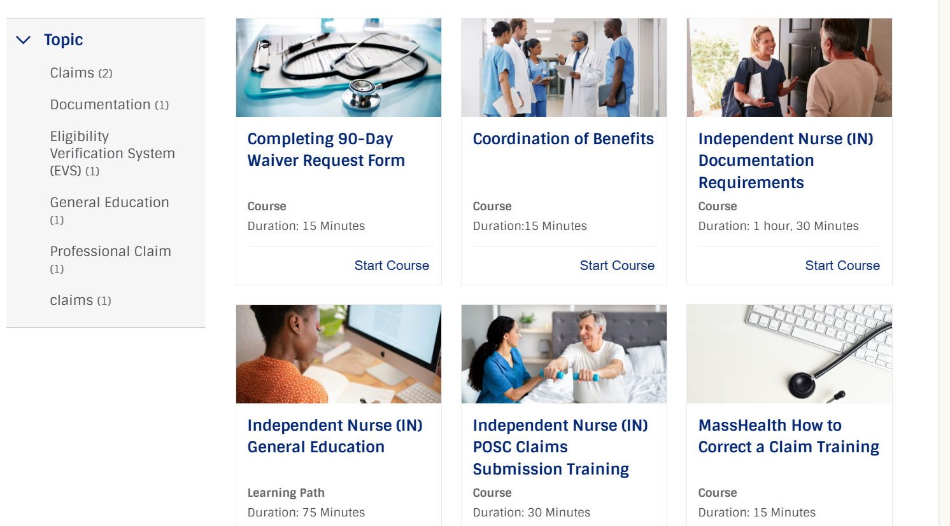
Independent Nurse Application (continued)
As shown below, they not only have access to the General Education but many other topics that will help them throughout their enrollment with MassHealth.

Slide 40
Revalidations for Group Practices & Independent Therapist
To efficiently complete revalidations for both Group Practices and the Independent Therapist that are associated with them. The LTSS enrollment team has been grouping the facilities and therapist together that are associated with one another and due in the current year.
The Enrollment Team will contact the Credentialing Specialist for the facility with a list of locations and therapists that are due for revalidation. They will confirm which therapists are still actively working at their facility. If they have left to work elsewhere, an email or phone number will be provided to for MassHealth to get in contact with the therapist for their due revalidation.
Once verification is completed, we will load their revalidations on the LTSS portal for them to complete. This reduces the outreach by staff to find the therapist or point of contact and has also reduced the time to process the revalidations.

Slide 41
Fiscal Soundness
MassHealth requires Adult Foster Care, Group Adult Foster Care, Home Health Agencies, and Continuous Skilled Nursing providers have to submit annually a statement of fiscal soundness attesting to the financial viability of the agency.
  All Adult Foster Care Providers and Group Adult Foster Care providers must complete a Statement of Fiscal Soundness Attestation at time of enrollment, by October 1st of each year, or during their revalidation.
  All Home Health Agency and Continuous Skilled Nursing providers must complete a Statement of Fiscal Soundness Attestation at time of enrollment, by May 31st of each year, or during their revalidation.
Again, to reduce the multiple outreaches to providers to submit in a timely manner, LTSS now includes the Fiscal Soundness form for providers that are due during their revalidation within 6 months of the due date for the Fiscal Soundness.
This has reduced the outreach to notify and remind providers to login and complete the required form by phone, email, and mail.

Slide 42
POSC Functionality Updates
Michael Gilleran, Sr. Provider Relations Specialist, MassHealth Business Support Service

Slide 43
Upcoming Updates – September 2025
MassHealth will be updating Primary User functionality to give providers the following capabilities:
View dates for Subordinate Users
  User account creation date
  Linked date (date PID/SL access granted)
  End date (date PID/SL access removed)
Generate a report that identifies all users for a given PID/SL
All POSC Users will have the ability to view the following information upon sign in:
View POSC role descriptions
View the primary user associated with a PID/SL
Dynamic Search capability

Slide 44
POSC Home Page Refresh
Michael Gilleran, Sr. Provider Relations Specialist, MassHealth Business Support Services

Slide 45
POSC Home Page Modernization
MassHealth recently implemented its POSC homepage refresh on June 29, 2025. The updates enhanced both the appearance and functionality of the Provider Online Service Center (POSC). These improvements included changes to both the pre-login and post-login experience, as well as the message displayed when a user requests an unauthorized service.

Slide 46

POSC Home Page Modernization: Pre-Login Page (continued)
More white space
Banner alerts at the top of the page
“Login” button placed more prominently on the page
Pre-login Services available
“View Broadcast Messages” button added

Slide 47
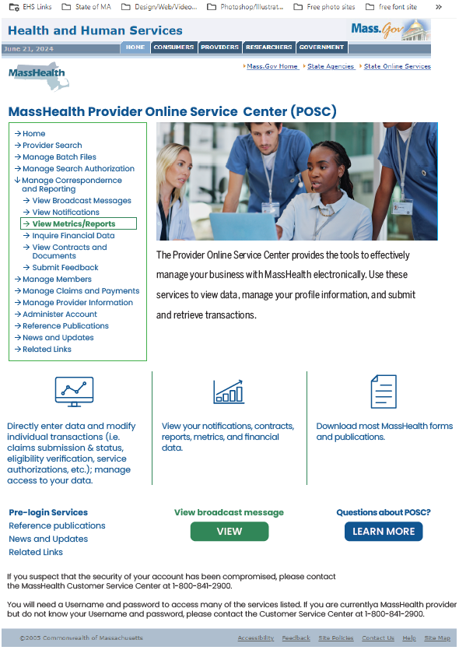
POSC Home Page Modernization: Post Login Page
More white space
Left Navigation accessible after log in
Updated Left Navigation
“View Broadcast Messages” button added
Pre-login services remain available

Slide 48
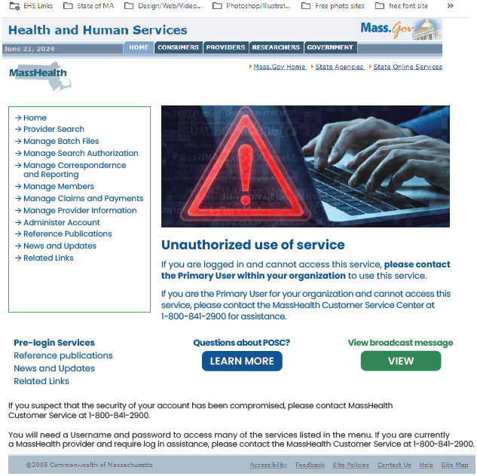
POSC Home Page Modernization: Unauthorized Access Page
Message appears if the user does not have access to the selected left navigation function
Updated the page to include an image
Includes troubleshooting tips
Pre-login services remain available

Slide 49
Robotics Processing Automation (RPA) Annual Validation
Michael Gilleran, Sr. Provider Relations Specialist, MassHealth Business Support Services

Slide 50
Reminder: MassHealth Robotics
Processing Automation (RPA)
MassHealth requires MassHealth providers, relationship entities, and business partners (hereafter referred to as “organizations”) that use Robotics Processing Automation (RPA) tools (aka bots) on MassHealth’s Medicaid Management Information System (MMIS) Provider Online Service Center (POSC) or intend to use RPA tools/bots in the future to register any/all bots with MassHealth by submitting a registration request for approval.
The ability to use a bot on the POSC is a convenience to organizations. Any organization that violates the MassHealth RPA Policy may have its access to submit transactions via the POSC using RPA technology revoked.
Please review RPA Policy to view the full scope of the monitoring and enforcement, and If you have questions regarding the RPA Policy please contact MassHealth at:
functional.coordination@mass.gov

Slide 51
RPA Policy Enforcement
If your organization is currently using a bot and have not submitted an RPA registration request, you are out of compliance with MassHealth’s RPA policy and subject to enforcement. Additionally, your organization may also be getting blocked in AWS. You must contact MassHealth immediately to initiate a Stage I RPA registration request. Enforcement includes but is not limited to:​
  Outreach and validation​
  Remediation of the violation (opportunity to cure)​
  If compliance is not achieved within mutually agreed upon timeframes, the organization will be subject to: ​
    Suspension or termination of the bot User ID​
    Prohibition from performing functions on the POSC​
    Organization-wide ban on ability to use RPA tools on the POSC​
    Other penalties or remedial actions as determined by MassHealth after outreach to the organization​

Slide 52
MassHealth Robotics Processing Automation (RPA) Annual Validation
This summer, MassHealth will require all organizations that have been approved to utilize RPA tools on the POSC complete the annual validation of their compliance.
The following will occur:
MassHealth will outreach to all affected organizations and share the RPA information that is on file at MassHealth
Organizations must validate the information and attest that they are still compliant with the RPA policy
Organizations that have modified their bot without MassHealth approval must submit an RPA Modification form
Please visit MassHealth Robotics Processing Automation (RPA) Policy webpage to review MassHealth’s RPA policy and learn how to submit an RPA registration request for MassHealth approval.

Slide 53
Self-Service Resources on Mass.gov/MassHealth
Presented by – Nestor Rivera, Sr. Provider Relations Specialist, Business Support Services

Slide 54
Self-Service Overview
Providers and their credentialing staff can use Provider Self-Service to submit provider file updates electronically, to check MassHealth enrollment, and verify provider application statuses.
Please note, this platform does not provide information on:
Dental providers
Long-Term Services & Supports (LTSS) providers
Managed Care Entity (MCE) Only providers
MassHealth Provider Self-Service Webpage

Slide 55
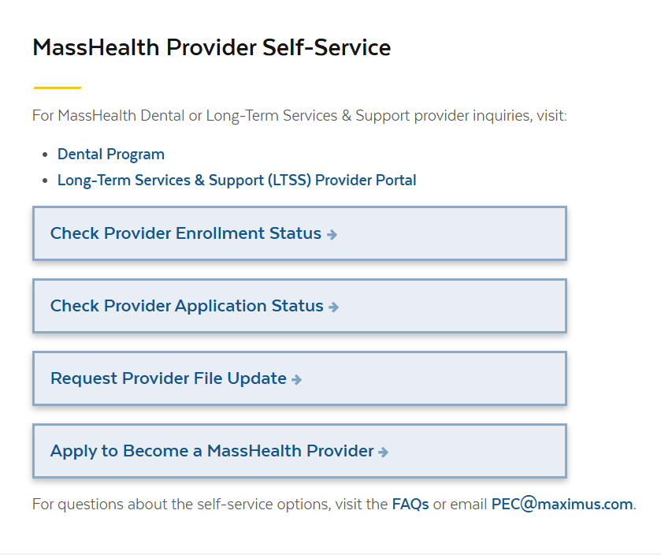
Self-Service Options for MassHealth Providers
The following web-based self-service options are available for providers to assist with enrollment inquiries:
Provider Enrollment Status
  Includes Group Link search
Provider Application Status
Request Provider File Update
Apply to be a MassHealth Provider
MassHealth Provider Self-Service Webpage

Slide 56
Provider File Updates –
Secure Document Upload & Online Requests
Self-Service Resources on Mass.gov/MassHealth

Slide 57
Provider File Integrity
Enrolled providers must notify MassHealth within 14 days of any changes in their information, as stated in 130 CMR 450.223(B). Failure to do so constitutes a breach of the provider contract which may result in fines or termination.
Historically, MassHealth providers have been required to report provider file changes on paper via FAX or mail, or electronically via the Provider Online Service Center (POSC).
Effective 5/1/2025, provider file updates may be submitted via secure electronic upload. This will eliminate the need for fax, mail, and unsecure emails.

Slide 58
Provider File Updates
Secure file upload is only available for the following providers:
Fee-for-Service (FFS)
Ordering, Referring, and Prescribing (ORP)
The secure upload webpage will NOT be available for the following providers:
Dental
Long-Term Services and Supports (LTSS)
Managed Care Entity (MCE) only

Slide 59
Request Provider File Update
The Request Provider File Update option is available to providers on mass.gov:
The Request Provider File Update option allows for secure document transmission
Requested changes may include;
  –Provider links and affiliations
  –Address and contact info change
  –And other general credentialing changes
Provider Self-Service Webpage

Slide 60
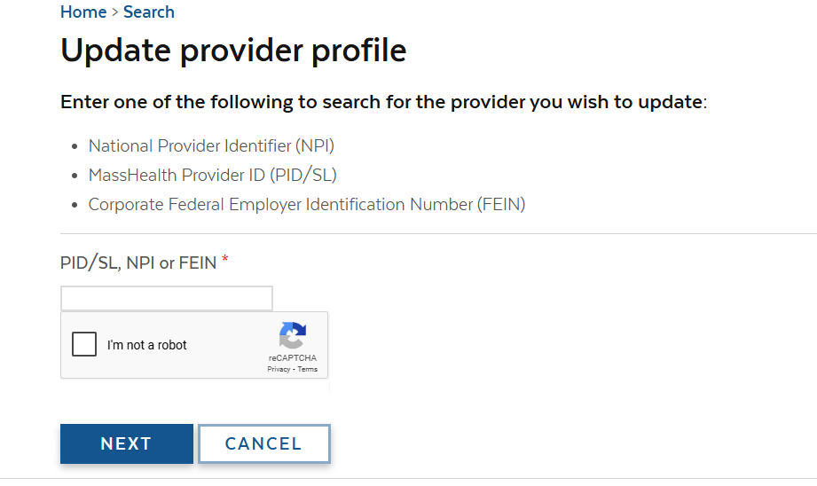
Searching for Providers
To begin, you will need to search for the provider that needs to be updated:
Enter the MassHealth PID/SL, NPI, or FEIN
Complete the reCAPTCHA
Select ‘Next’

Slide 61
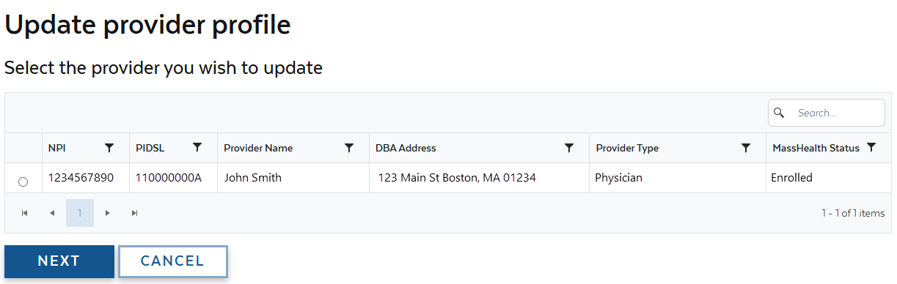
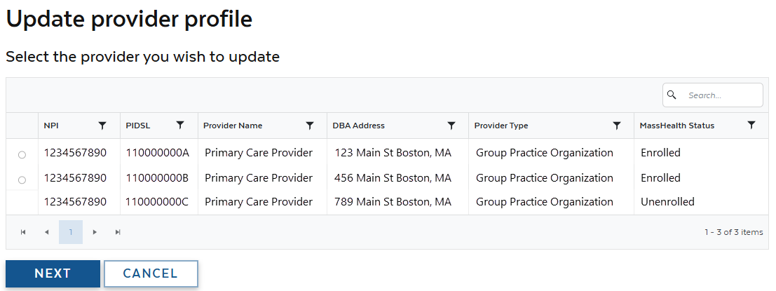
Search Results
Depending on the search values, one or more results may be displayed.
Select the Service Location being updated from the search results.
Select ‘Next’ to proceed.
Only 1 location may be selected at a time.

Slide 62
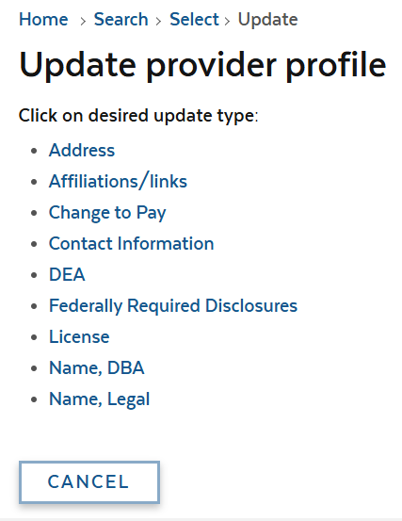
File Update Options
Available options are based on the selected provider’s type
To request a provider link/affiliate or address change, you must complete a web form
For all other provider file updates, you must electronically upload documents
Document(s) must be attached to the update request to be submitted

Slide 63
Affiliations/Links
When an individual practitioner is selected, you may update the practitioner’s
  Group links
  Entity affiliations
Select the ‘Affiliations/Links’ to proceed.
Click here for information on linking and affiliations for providers.

Slide 64
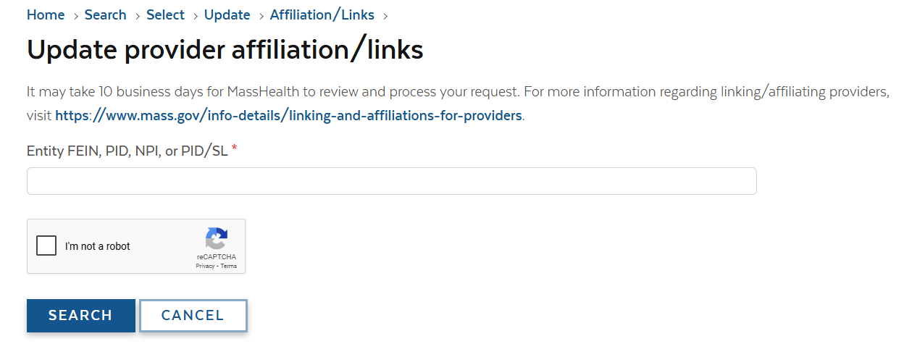
Affiliations/Links: Searching for Entity
You will need to search for the entity to proceed
Search by entering the entity’s
  FEIN
  PID
  PID/SL
Complete the reCAPTCHA, then select ‘Search’

Slide 65
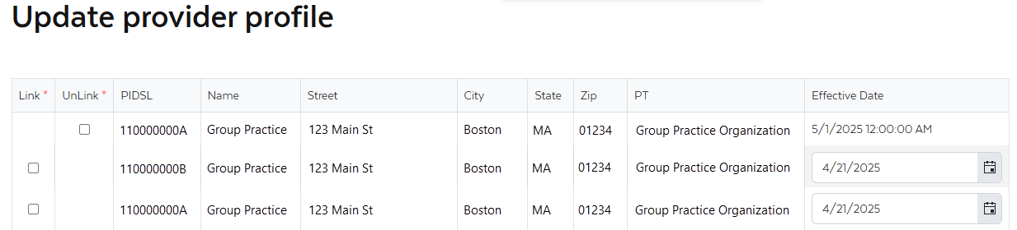
Affiliations/Links: Service Location(s) & Date(s)
Results will indicate if a link/affiliation exists and provide options to link or affiliate
One or more results may be displayed depending on the search criteria
Using the checkboxes, select which locations to link or affiliate
When selecting to link/affiliate, you may enter an effective date up to 9 days ahead (no retro effective dates are allowed)

Slide 66
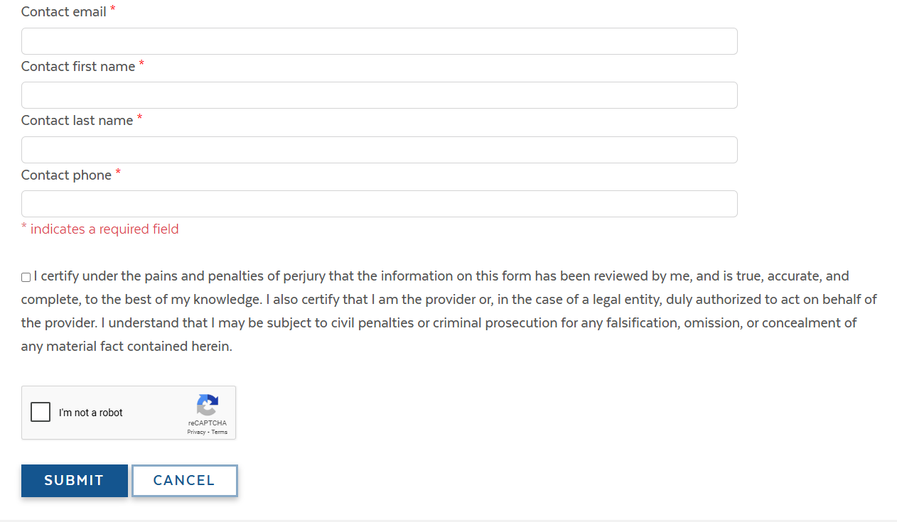
Affiliations/Links: Submitting the Request
Contact information is required with every request
Complete the indicated fields, including the attestation
Complete the reCAPTCHA
Select the ‘Submit’ button

Slide 67
Address Changes
Address changes may be requested using the Update Provider Profile option
Available options are based on the selected provider’s type
Certain address changes require that additional documentation be attached
  Note: a new application is required for most entity provider types when changing DBA address
If any documents are required, you will be prompted to upload the documents

Slide 68
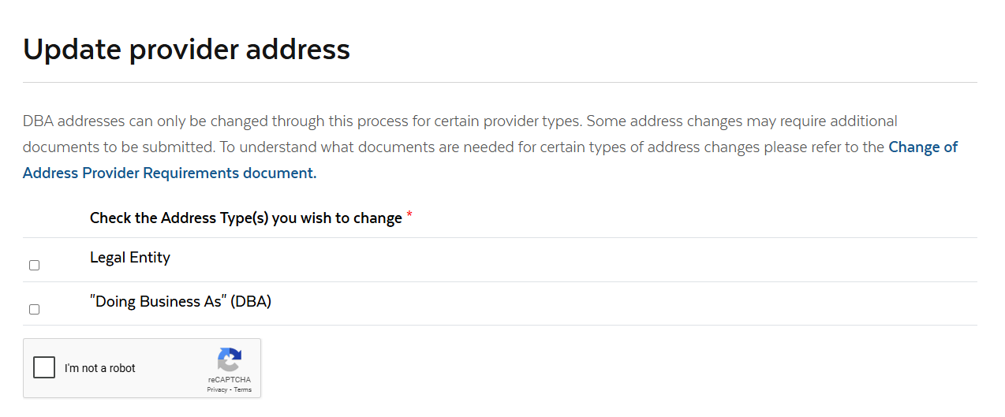
Address Change: Address Type(s)
You may update 1 or more addresses per provider at a time
The ‘Change of Address Provider Requirements’ link redirects you to a table that indicates the address change requirements by provider and address type
Using the checkboxes, select what addresses are being updated

Slide 69
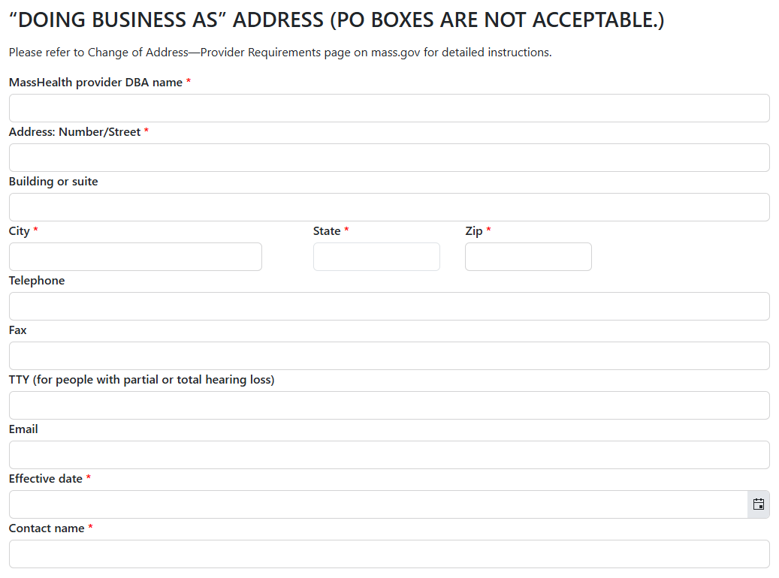
Address Change: Details
Complete all the required fields including:
  Name
  Address
  Effective date
  Contact name
If applicable, provide the following information:
  Telephone number
  Fax number
  Email address

Slide 70
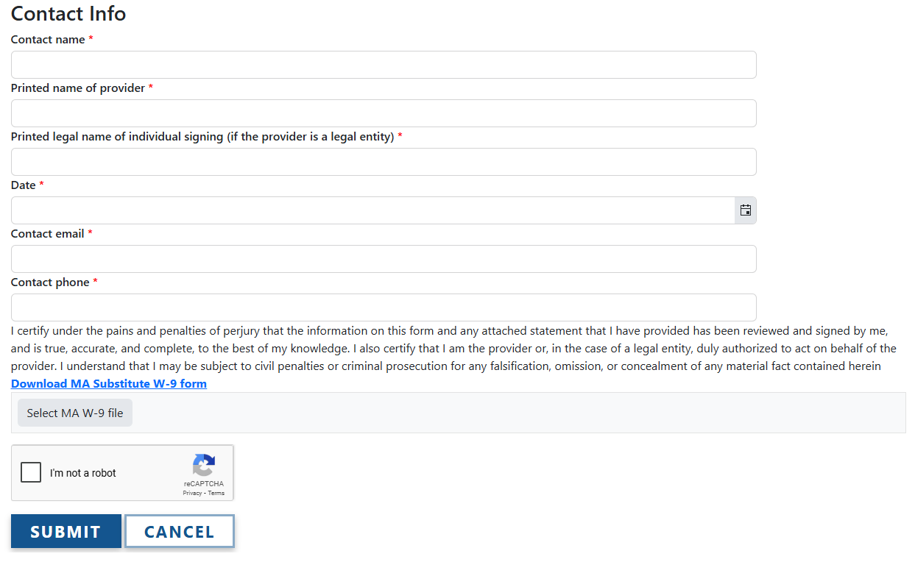
Address Change:
Submitting the Request
Contact information is required with every request
Complete the indicated fields, including the attestation
Complete the reCAPTCHA
Select the ‘Submit’ button

Slide 71
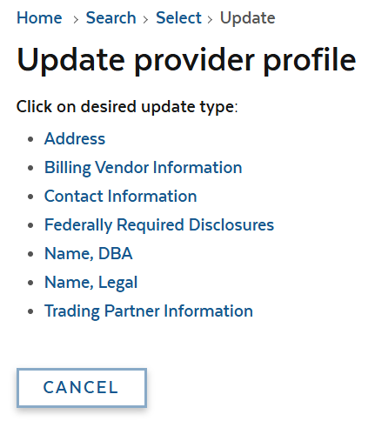
Secure Document Upload (slide 1 of 3)
Update Provider Profile allows you to securely upload documents including:
  Billing Vendor Information
  Federally Required Disclosure Forms
  Name information
  Etc.
Available options are based on the indicated provider type

Slide 72
Secure Document Upload (slide 2 of 3)
From the list, select the information being updated
The next screen will indicate what documentation is required for the update

Slide 73
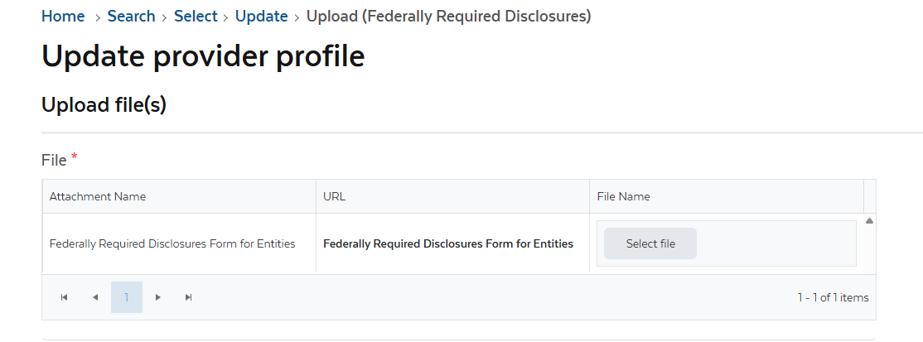
Secure Document Upload (slide 3 of 3)
Blank forms can be located in the Provider Library on mass.gov
Documents must be completed and saved electronically to proceed
Click the ‘Select file’ button to search your computer for the files
Once attached, you may proceed to submit the update request

Slide 74
Secure Document Upload –
Submitting the Request
Contact information is required with every request
Complete the indicated fields, including the attestation
Complete the reCAPTCHA
Select the ‘Submit’ button

Slide 75
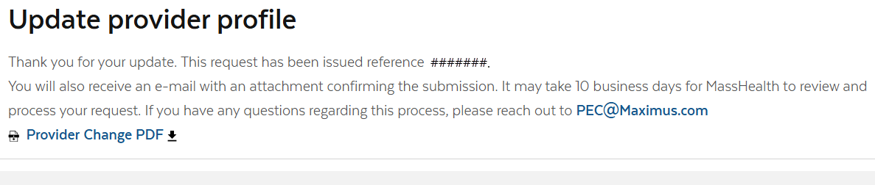
Post Submission
Once the update request is submitted, the service will provide a reference number for the request
An email will be sent to the indicated contact confirming the submission

Slide 76
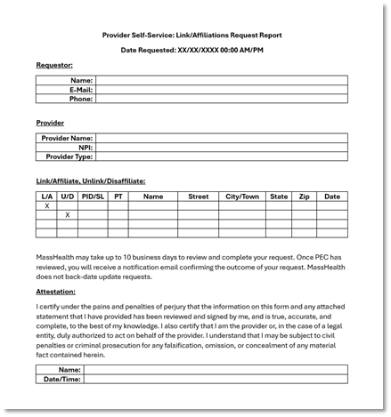
Provider Change PDF
The PDF will detail the following information:
  Requestor contact info
  Provider
  Type of change with details
After the update is processed, another email will be sent confirming the result of the request

Slide 77
Payment Error Rate Measurement (PERM) RY 2026
Presented by – Michelle Croy, Sr. Provider Relations Specialist, Business Support Services

Slide 78

PERM RY 2026
MassHealth is part of the CMS Payment Error Rate Measurement (PERM) audit for RY 2026. The PERM audit measures improper payments in Medicaid and CHIP programs and produces improper payment rates for each program.
PERM Cycle RY2026 Claim Review Period: July 1, 2024 to June 30, 2025
Timeframe for Medical Records Request Outreach: April 1, 2025 to April 15, 2026

Slide 79
PERM RY 2026 Provider Responsibilities
As part of the CMS PERM RY26 cycle, medical records requests will start going out to providers in the coming months. Providers are responsible for providing the requested documentation to the audit contractor timely.
When submitting records, providers must ensure the records are for the right patient and right date of service
Records must be legible with no highlights or marking that would obscure important facts
Make sure double-sided documents include both sides
All supporting documents for the claim identified must be included in the submission
CMS PERM Provider Required Document List

Slide 80
PERM RY 2026 Provider Documentation Errors
Please remind providers they must send all applicable documents related to the claim for the member/procedure/date of service. Current issues found so far include:
The provider did not submit the required general anesthesia documentation for the sampled date of service to support payment
The provider did not submit the required diagnostic study results and physician's order for the sampled date of service to support payment
The provider did not submit the required physician's order for the sampled date of service to support payment

Slide 81
PERM RY 2026 Resources
Information on the CMS PERM Audit can be found on the CMS website.
These materials are currently available on the Providers page of the CMS PERM website (link: https://www.cms.gov/data-research/monitoring-programs/improper-payment-measurement-programs/payment-error-rate-measurement-perm/providers).
CMS PERM Overview for Providers slide deck – https://www.cms.gov/files/document/provider-overview.pdf-0
CMS PERM Provider Education FAQ document –https://www.cms.gov/files/document/provider-education-faqs.pdf-0
* Failure to respond to the audit request will result in the claim being voided and the payment recouped

Slide 82
MassHealth Updates
Michelle Croy – Sr. Provider Relations Specialist, MassHealth Business Support Services

Slide 83
Claim Denial Edit 1010
Michelle Croy – Sr. Provider Relations Specialist, MassHealth Business Support Services

Slide 84
1010 – Rendering Provider Must Be Enrolled In Group Practice (slide 1 of 3)
MassHealth requires all claims submitted by a group practice to identify, the individual practitioner who provided the service(s) being claimed. See 130 CMR 450.302(B).
Claims submitted for individuals not linked to a group practice or not actively enrolled as a FFS provider, will deny for:
MassHealth EOB 1010 – Rendering provider must be enrolled in the group practice, or
HIPAA ARC 96 Non-covered charges, and
HIPAA remark code Rendering provider must be affiliated with the pay-to-provider.

Slide 85
1010 – Rendering Provider Must Be Enrolled In Group Practice (slide 2 of 3)
When the billing provider is a group practice, the rendering provider must be linked on to the group practice for the claim’s date of service, or the claim will deny for EOB 1010.
Providers must notify MassHealth when an individual practitioner joins/leaves the practice. See 130 CMR 450.223(B).

Slide 86
1010 – Rendering Provider Must Be Enrolled In Group Practice (slide 3 of 3)
When the billing provider is not a group practice organization and is an entity provider type such as Community Health Center (CHC), Mental Health Center, Substance Use Disorder Treatment, Urgent Care Center or hospitals billing professional services, the rendering provider should be left blank.
If a rendering provider is listed on the claim and is not actively enrolled as a FFS provider, the claim will deny. Since most providers employed by an entity are not permitted to enroll as a FFS provider, claims would deny.

Slide 87
MassHealth Customer Service Call Updates
Michelle Croy – Sr. Provider Relations Specialist, MassHealth Business Support Services

Slide 88
MassHealth Customer Service Calls
Effective September 1, 2025, when phoning MassHealth Customer Service, callers will be required to enter their nine-digit MassHealth Provider ID (PID) to connect to an agent.
Callers will first hear a voice prompt bringing their attention to resources on Mass.gov before being asked to enter their PID.
Callers will have 2 attempts to enter their nine-digit PID before they are disconnected from the call
Providers can find answers to many common questions on Information for MassHealth Providers
Callers without a MassHealth Provider ID can utilize MassHealth Provider Self-Service resources found on MassHealth Provider Self-Service where they can
  Look-up their Provider ID using their NPI
  Request an application
  Submit provider file update requests
Providers that have utilized self-service and online resources that still require assistance with enrollment/revalidation may contact PEC@Maximus.com

Slide 89

Provider Education LMS
The MassHealth Provider Learning Management System(LMS) for Non-OLTSS providers is a system providers can use 24/7 as an educational resource.
The Provider LMS delivers:
Previous live training presentations
New on demand training courses
Course surveys
If you are currently a registered user but have forgotten your user-name or password, you can retrieve it from the sign-in screen
New Users can create a profile and begin using the system immediately
Visit: MassHealth BSS Provider Training portal
OLTSS and Dental providers should visit their respective vendor site for training opportunities

Slide 90
All Provider Bulletins
All Provider Bulletin 402:Third-Party Liability Billing Requirements for Health Reimbursement
All Provider Bulletin 403:Ending the Suspension of Primary Care Clinician Plan & Primary Care ACO Referrals and Updating Referral Requirements for Urgent Care Services

Slide 91
Resources
Provider Email Alerts
Sign up to receive email alerts when MassHealth issues new bulletins and transmittal letters, fill out the Email Notification Request for Providers on Mass.gov.
MassHealth New Bulletin and Transmittal Letters
MassHealth Website
Bulletins are Available on Mass.gov
MassHealth Providers web page
The ACA ORP Requirements for MassHealth Providers

Slide 92
Trainings
New Provider Orientation: This session will introduce to MassHealth to Providers and will supply information on key terminology and resources, along with general requirements for all MassHealth providers. Click Here
Office Hours Billing and Claims: This session will be an open forum for providers to ask general billing and claims questions show you online tools to help you with claims questions. Please note that questions specific to your organization may need to be addressed individually. Click Here
Office Hours Enrollment and Revalidation: This session will provide background information on MassHealth Provider Enrollment for both ORP, FFS, and Group practice providers as well as detail the requirements for enrollment. This presentation is also designed to assist providers in working through the Revalidation process. Most of the webinar will be devoted to live Q&A where attendees may ask the host any questions they have regarding enrollment and revalidation. Click Here

Slide 93
Thank you!

