Slide 1

MassHealth Update
January 2026
MA Health Care Training Forum (MTF)

Slide 2
Agenda
MassHealth Renewal
MassHealth Premium Schedule
End of Year Tax Filing Process for Tax Year 2025
Medicare Savings Program (MSP)
2026 Cost of Living Adjustment (COLA)
MassHealth’s Systems and Tools: Updates and Reminders
  CMS Interoperability for Members
  My Account Page (MAP) Member Portal
  MassHealth Eligibility Verification System (EVS)
Recertification of Certified Application Counselors (CACs)

Slide 3
MassHealth Renewal

Slide 4
MassHealth Renewal Updates
MassHealth is federally required to renew individual members annually.
Prior to December 2025, MassHealth selected members eligible for renewal based on their next renewal date (typically 12 months from their initial application date or their last renewal).
Due to updated federal guidance, MassHealth will now select members for their renewal and redetermination 60 days before their annual application renewal date.
  Including, members determined eligible for Qualified Health Plan (QHP) plus MassHealth Limited, CMSP, or HSN, regardless of their QHP enrollment status.

Slide 5
Example
Jon, age 40 is a single, disabled adult who receives MassHealth Standard. Jon’s next renewal data is June 15, 2026. On April 16, 2026, Jon’s application is selected for the MassHealth renewal, and he is sent a pre-populated form with a due date of May 31, 2026. When Jon completes his renewal on May 15th, he was found to be no longer federally disabled, and so Jon is determined eligible for CarePlus, with his benefit starting May 1^{st.}
Since Jon’s current renewal date was June 15, 2026, this is the standard end date for his coverage, and Jon’s new or next renewal date is set for June 15, 2027.

Slide 6
MassHealth Premium Schedule

Slide 7
Update: MassHealth Premium
Certain MassHealth members may be charged a monthly premium if they are:
  MassHealth Standard, CommonHealth or Family Assistance members who have income above 150% of the federal poverty level (FPL).
Calculation of premium amounts.
  Premium amounts are calculated based on a member’s household modified adjusted gross income (MAGI) and their household size and the premium billing family group (PBFG).
On January 1, 2026, MassHealth increased monthly premium billing amounts by 10%.
  MassHealth expects the increase is between $2 - $10 per month for members with countable income of over 150% FPL.

Slide 8
MassHealth Future Premium Increases
Starting in March of 2027, MassHealth will increase premium billing amounts yearly by the same percentage that the annual FPL limits increases.
  For example, the percentage increase between the annual 2024 and 2025 FPL rates was approximately 2.9%. So, under the new policy, MassHealth’s premium billing amount would have also increased by 2.9%.
  Members will have their premiums redetermined yearly. MassHealth will notify members in advance of their new amount.
Learn More
Go to MassHealth Premium Schedule For Members for more information on how MassHealth premiums are calculated.

Slide 9
MassHealth: Financial Requirements Regulation
MassHealth is updating the 130 CMR 506.000: MassHealth: Financial Requirements regulation effective January 30, 2026.
  To comply with federal requirements, MassHealth will no longer impose a lock-out period for former members with an unpaid premium balance.
  MassHealth will remove premium billing tables and required member contribution tables from the regulations.
    MassHealth will update and publish these tables online annually, based on changes to the Federal Poverty Level.

Slide 10
End of Year Tax Filing Process for Tax Year 2025

Slide 11
Overview of Tax Forms
1095 – B
Form 1095-B is a federal tax document
The 1095-B form shows: Which months during the calendar year members were enrolled in a health plan that meets the federal MEC requirements for at least 1 day
Form 1095-B will be available for certain MassHealth members electronically and upon request
1099 – HC
Form 1099-HC is a Massachusetts state tax document which is sent to members by their health insurance carriers.
The 1099-HC form shows: Which months during the calendar year members were enrolled in a health plan that meets the state’s MCC requirements for at least 15 days
Individual member had income greater than 150% FPL at any point in the 2025 calendar year

Slide 12
MassHealth Member Forms
Members will receive a 1095-B and 1099-HC from MassHealth
Program | 1095 info | 1099-HC info
Standard | 1095-B from MassHealth | 1099-HC from MassHealth, unless member was 18 years or older and was <150% FPL all year
CarePlus | 1095-B from MassHealth | 1099-HC from MassHealth, unless member was <150% FPL all year
CommonHealth | 1095-B from MassHealth | 1099-HC from MassHealth, unless member was <150% FPL all year
Family Assistance (Direct Coverage) | 1095-B from MassHealth | 1099-HC from MassHealth, unless member was <150% FPL all year
Health Safety Net | No form – not MEC | No form – not MCC
Limited | No form – not MEC | No form – not MCC
  For questions about why members received the Form MA 1099-HC or Form 1095-B from MassHealth, or if members want a duplicate copy of either form, contact the MassHealth Customer Service Center at (866) 682-6745, TTY: 711 for people who are deaf, hard of hearing, or speech disabled.

Slide 13

Getting 1095-B and 1099-HC Forms for MassHealth Members
MassHealth will mail the Form 1095-B and 1099-HC to members starting 1/29/26.
Members can get a duplicate of their forms:
  Online at MassHealth | 1095-B Form Login, after February 1, 2026 to view and print the Form or
  Call MassHealth at 1-866-682-6745; TTY: 711 to request a duplicate hard copy
  A separate Form 1095-B must be requested for each covered individual.
Members with questions about why they received the Form MA 1099-HC, how to get their Form 1095- B from MassHealth, or if they need a duplicate copy for each individual member, should contact MassHealth at (866) 682-6745, TTY: 711 for people who are deaf, hard of hearing, or speech disabled.

Slide 14
Important Dates in 2026
Dates | Action
Mid-Late January | 1095-A forms sent to all Health Connector members enrolled in a QHP (including ConnectorCare members).
Early February | MassHealth members can access their 1095-B Form by going to MassHealth | 1095-B Form Login or request a hard copy by calling MassHealth.
March 1st | Individuals are asked to report any corrections to 1095 or 1099-HC forms to the Health Connector and/or MassHealth and new forms to be sent out prior to the tax filing deadline.
April 15th | State and Federal Tax filing deadline.

Slide 15
Free Tax Assistance
VITA: The Volunteer Income Tax Assistance (VITA) program offers free tax help to people who generally make $69,000 or less, persons with disabilities and limited English speaking taxpayers who need assistance in preparing their own tax returns. IRS-certified volunteers provide free basic income tax return preparation with electronic filing to qualified individuals.
TCE: The Tax Counseling for the Elderly (TCE) program offers free tax help for all taxpayers, particularly those who are 60 years of age and older, specializing in questions about pensions and retirement-related issues unique to seniors. The IRS-certified volunteers who provide tax counseling are often retired individuals associated with non-profit organizations that receive grants from the IRS.
AARP Foundation Tax-Aide: offers free tax help to anyone especially for those age 50 and older who can’t afford a tax preparation service. IRS-certified volunteers understand that retirement or other life changes may make tax filing a little more complicated. AARP membership is not required.

Slide 16
Medicare Savings Program (MSP)

Slide 17
Medicare Savings Program (MSP) (continued)
MassHealth Medicare Savings Program helps pay some of the out-of-pocket costs of Medicare. The MSP programs can also help get Medicare Part B for members who only have Medicare Part A. If members are in an MSP program, they will also be automatically enrolled in the Medicare Part D Extra Help program, which can help with pharmacy costs.
MSP is not insurance plans. MSPs are always combined with Medicare and do not offer any additional coverage or services that Medicare does not provide.
What happens after a determination is made for MSP?
  MassHealth will notify Medicare when a member is eligible for MSP.
  If the Part B premium is being deducted from the member’s social security or retirement check, the member’s benefits will be adjusted so that the Medicare premium is no longer being deducted.
  If members are not yet paying for Part B or if paying the Part B premium in some other way, such as getting a quarterly bill, MassHealth will start paying the bill.

Slide 18
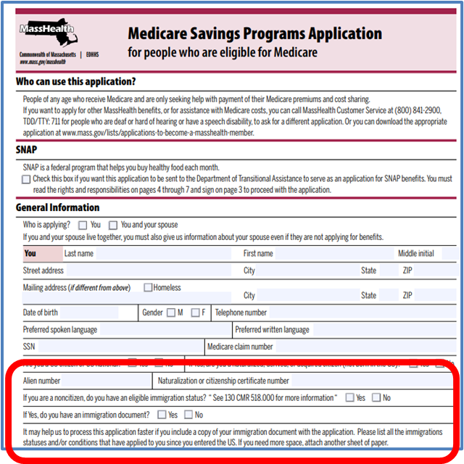
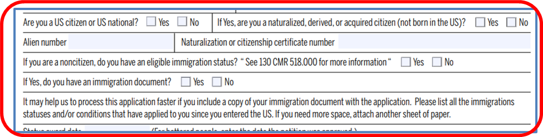
Revised MSP Application
Who can apply for MSP?
  Medicare beneficiaries
  MSP applicants do not have to be an existing MassHealth member
MSP Application
  MSP application was revised December 2025

Slide 19
Completing Application Best Practice
If an older MSP application is submitted, MassHealth will let the applicant know if additional information is needed to fully complete their application
Answer all require questions
Sign and date the application
When submitting a paper application, write legibly
Lighten photo-copied documents used for verifications
When using Adobe Sign, use an active email account
Member Notices and Cards
CommonHealth plus MSP members younger than 65 will receive a CommonHealth eligibility notice and an MSP eligibility notice
Qualified Medicare Beneficiary (QMB) members will receive their MassHealth card

Slide 20
2026 Cost of Living Adjustment (COLA)

Slide 21

Cost of Living Adjustment (COLA) 2023
The Social Security Administration announced on October 24, 2025, that beneficiaries would be receiving a 2.8% COLA increase for 2026
  On average, Social Security benefits will increase by about $56 per month starting in January
Updated eligibility figures for Eligibility Figures for Community Residents Age 65 or Older, Figures Used to Determine Minimum- Monthly-Maintenance-Needs Allowance (MMMNA)
* Federal poverty guideline updates in March

Slide 22
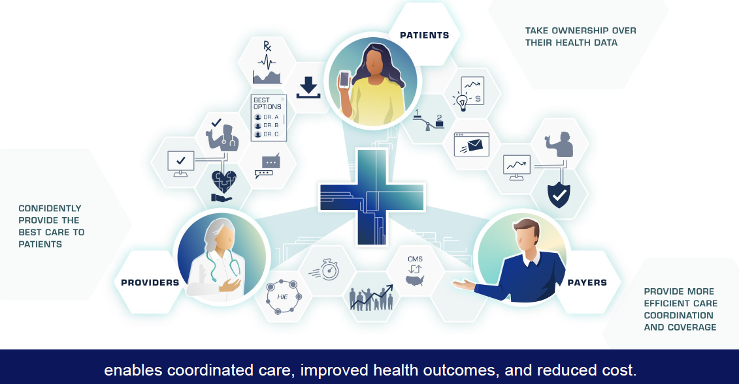
CMS Interoperability for Members

Slide 23
Patient Access
Application Programming Interface
What is a Patient Access Application Programming Interface (API)?
The Centers for Medicare & Medicaid Services (CMS) issued the Interoperability and Patient Access rule that gives MassHealth members the option to access their own health care information on a third-party application (third-party app) of their choice.
An API is a connection between computers or software programs that allows them to talk to each other. For example, an API makes it possible to use a third-party app on your phone to check your bank account.
What is the MassHealth Patient Access API?
The API allows MassHealth to securely share MassHealth members’ health information with a third-party app they choose as of January 1, 2026.
What information is available to members?
Health care information, such as historical claims data, back to January 1, 2016, explanation of benefits data, previous treatment, and list of current outpatient drugs covered by MassHealth.

Slide 24
Member Privacy and Resources
Who can access health care information with a third-party app?
Current MassHealth members and their personal representative, parent, legal guardian, or authorized representative designee.
Apps and privacy enforcement
Third-party apps are generally not regulated by HIPAA. A third-party app that publishes a privacy notice should comply with the terms of its notice. However, they are generally not subject to privacy laws. Once you allow your data to be shared with a third-party app, MassHealth is no longer responsible for the privacy and security of that data.
Learn more about Patient API at MassHealth Patient Access Application Programming Interface | Mass.gov.

Slide 25
MassHealth’s Provider Directory
The Provider Directory allows members to find MassHealth doctors, hospitals, or services nearby.
Active MassHealth members who are not in a health plan or are in the following health plans can utilize the Provider Directory:
  Community Care Cooperative
  Revere Health Choice
  Primary Care Clinician (PCC) Plan
Available on https://masshealth.ehs.state.ma.us/providerdirectory/

Slide 26
My Account Page (MAP) for Member Portal

Slide 27
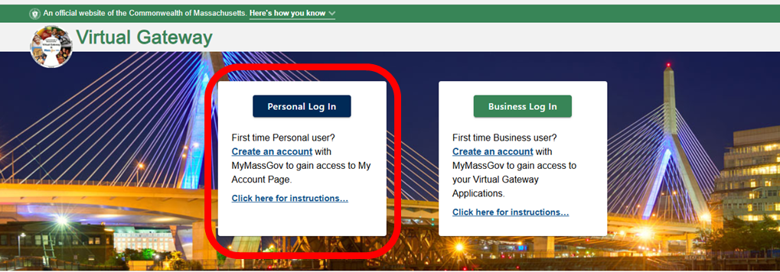
My Account Page (MAP) Portal
My Account Page (MAP) provides members/applicants and providers access to information related to notices and account details for certain MassHealth members younger than 65 and members over the age of 65.
On April 1, 2026, the member facing portal of MAP will be decommissioned. Members will be able to access their health insurance information at MyServices.
  Note, this change only impact the member’s ability to access the MAP portal and will not affect member benefits.
  Providers can continue to access MAP using the Business Log In.

Slide 28
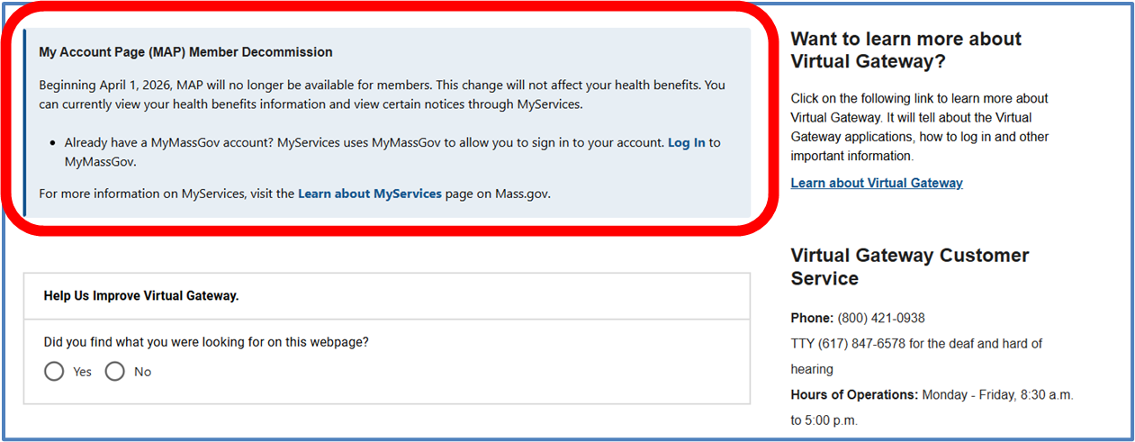
Notification to Members
In October of 2025, all members were informed of the decommission of MAPs through text or email.
  Another text and email communication is scheduled for January/February 2026.
A message will display on the Virtual Gateway and MAP log in pages, redirecting members to MyServices to access their information.

Slide 29
MyServices Member Portal
MyServices portal available for all MassHealth members
The MyServices portal is a member ONLY web portal designed for all applicants and members to:
  review contact information
  review eligibility status for MassHealth and the Health Connector
  review MassHealth enrollment information
  check the status of Requests for Information (RFIs) you have sent to MassHealth
  get alerts about important events and actions
  review eligibility notices sent by MassHealth
MyServices is only available to members and applicants and cannot be accessed by ARDs, PSIs, or Certified Assisters unless the member is present

Slide 30
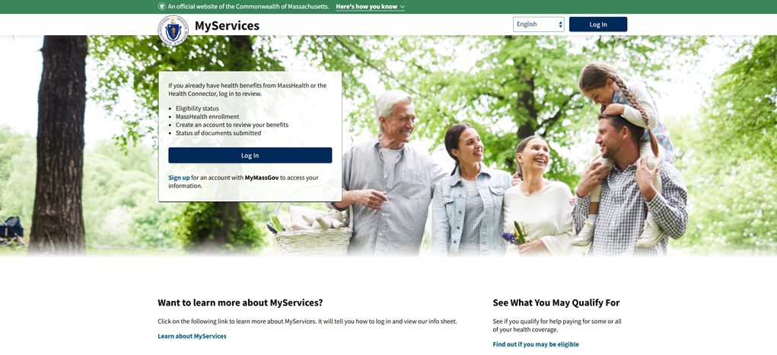
How to Access MyServices
Members that have a MyMassGov account should use their account to sign in to MyServces.
Members that do not have a MyServices account can create one. For more information on how to create a MyServices account, go to How MyServices works (or https://www.mass.gov/info-details/how-myservices-works).
Best Practice
Members should not use their work emails to create their MyServices account.

Slide 31
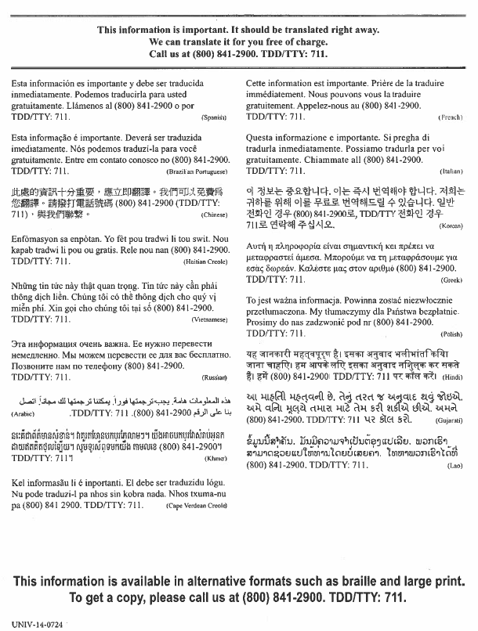
Language Access
Translated in six languages: English, Spanish, Brazilian Portuguese, Traditional Chinese, Vietnamese, and Haitian Creole.
Learn more about MyServices at Learn about MyServices | Mass.gov.

Slide 32
Eligibility Verification System (EVS)

Slide 33
Verify Eligibility
Eligibility Verification System (EVS)
Requirements
Providers should be requesting to see the member’s MassHealth card
Providers should be verifying MassHealth member eligibility prior to rendering services
  Failure to verify a member’s eligibility may result in non-payment of claims
Reminders
Providers should request to see the member’s MassHealth card
  Having a MassHealth card does not guarantee MassHealth eligibility
MassHealth coverage can change at any time, and it is imperative that a provider verifies the member’s eligibility
For POSC security access issues, contact your organization’s Primary User

Slide 34
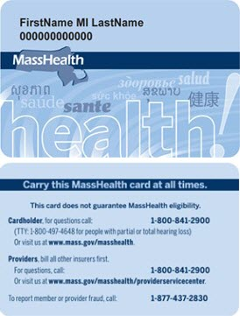
MassHealth Card (slide 1 of 2)
MassHealth card is issued for most MassHealth members.
MassHealth card contains the individual’s 12-digit numerical ID number.
Having a MassHealth card does not guarantee MassHealth eligibility.
MassHealth coverage can change at any time, and it is imperative that a provider verifies the member’s eligibility.

Slide 35
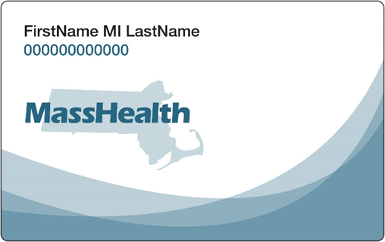
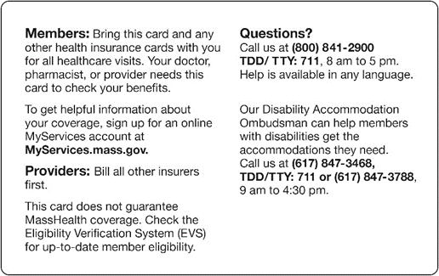
MassHealth Card (slide 2 of 2)
In January 2025, MassHealth began issuing MassHealth member cards with a new design and updated language.
MassHealth is not automatically issuing new member cards to all members. Instead, MassHealth will use the updated design for any new cards created after January 1, 2025, according to normal processes (for example, when a new member joins MassHealth or a current member requests a replacement card).
Resource: All Provider Bulletin 399.

Slide 36
Resources for MassHealth Providers
Long-Term Services and Supports
  Phone: (844) 368-5184 (toll free)
  Email: support@masshealthltss.com
  Portal: www.MassHealthLTSS.com
  Mail: MassHealth LTSS
  PO Box 159108
  Boston, MA 02215
  Fax: (888) 832-3006
All Other Provider Types
Phone: (800) 841-2900; TTY: 711
Email: provider@masshealthquestions.com

Slide 37
PACE Eligibility

Slide 38
PACE Program
Program of All-inclusive Care for the Elderly (PACE) is administered by MassHealth and Medicare to provide a wide range of medical, social, recreational, and wellness services to eligible participants. You do not need to be on MassHealth to enroll in PACE. However, if you meet the income and asset guidelines, you may be eligible for MassHealth and MassHealth may pay your PACE premium.
As of January 15, 2026, new married PACE applicants will be subject to the current asset limit for married couple.
  This amount changes yearly and is listed under MassHealth’s program financial guidelines for certain MassHealth applicants and members
This is in accordance with MassHealth regulation 130 CMR 520.005: Ownership of Assets.
The updates do not apply to single applicants of PACE, who will continue to be subject to the current individual asset limit.

Slide 39
Asset Spend Down
Once all household assets have been verified, if the total countable assets (example are bank accounts, life insurance, a house) exceeds the asset limit for married couples, applicants are permitted to spend down the assets in accordance with MassHealth regulation at 130 CMR 520.004: Asset Reduction.
  If the applicant is over the asset limit, but the total household assets are below the asset limit for married couples, the couple will have 90 days to transfer excess assets to, or for the sole benefits of, the spouse who does not live in a long-term-care facility (MassHealth regulation 130 CMR 520.016 (B)(3)).
  If the member does not complete and verify the transfer of assets to the spouse within 90 days, their eligibility may be terminated because of the excess assets.

Slide 40
Recertification of Certified Application Counselors (CACs)

Slide 41
CAC Recertification 2026
Annual recertification is federally mandated
Reminder: Current certification valid until April 30, 2026
Recertification period: March 16, 2026 – April 30, 2026
Current CACs will take a Recertification Assessment and the NEW: Core Competency Module
  All CACs are required to complete the Core Competency Module
Certificate valid from Assessment completion to April 30, 2027
Reminder: Print your 2026 CAC Certificate after completing recertification
Recertification requirements will be announced in the coming weeks.

Slide 42
THANK YOU!

