Slide 1



Medicare in 2026

Slide 2
Learning Objective
To increase access to and knowledge of Medicare related information so that the beneficiaries and assisters are aware of Medicare beneficiaries’ benefits, rights and options and to make a coverage choice that is likely to improve health care outcomes.

Slide 3
Agenda
SHINE overview
Medicare 101
Eligibility and Enrollment
What's new in 2026?
Other Resources

Slide 4
SHINE Overview
SHINE= Serving the Health Insurance Needs of Everyone…on Medicare
We are a federally funded program (and state funded) by the Administration for Community Living which is a part of the U.S. Department of Health and Human Services
Mission: To provide free, unbiased health insurance information, counseling and assistance to Massachusetts Medicare beneficiaries of all ages and their caregivers
Provide screening for Public Benefit programs
13 Regional Offices cover entire state and the Greater Boston Chinese Golden Age Center (statewide)
700+ SHINE counselors (57% volunteers)
90 Bilingual Counselors
  23 Languages and Dialects

Slide 5
What SHINE Does
Educate consumers, the community and professionals on:
  Understanding Medicare and MassHealth rights and benefits
  All their Medicare health insurance options
  Public Benefit programs that can help pay for certain Medicare costs such as (not limited to):
      Mass Health Standard
      Extra Help
      Medicare Savings Programs
Screen for public benefits (State and Federal)

Slide 6
Medicare

Slide 7
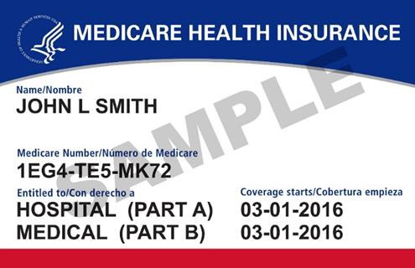
Medicare 101
Federal health insurance program for individuals who are 65 years old or older and a U.S. citizen or
permanent residents (i.e., green card holder),
Cuban-Haitian entrants,
or someone residing under the Compacts of Free Association
If 40 work credits through payroll tax, entitled to premium free part A (may qualify through spouse or ex-spouse)
Individuals under age 65 who have received 24 months of Social Security Disability (SSDI) payments
NOT a comprehensive health insurance program
  Gaps in Medicare coverage mean beneficiary must pay a portion of medical expenses

Slide 8



Medicare Overview
Part A Hospital Insurance
Part B Medical Insurance
Part D Medicare Prescription Drug Coverage
Part A & Part B is called “Original Medicare”
Medicare Advantage plans combine Parts A, B, and D- also known as Part C

Slide 9
Medigap Plans
Three standardized products in Massachusetts:
  Sold by insurance companies
  Offer continuous open enrollment (generally); community rating applies
Supplement 1* : no out-of-pocket costs for Medicare-covered benefits, adds foreign travel
Supplement 1A: same as Supplement 1 except the beneficiary pays Part B deductible
Core: beneficiary pays Parts A & B deductibles; plan covers Part B coinsurance and hospital co-pays
Basic coverage for each product is the same, regardless of company (plans may offer a few additional benefits, like foreign travel coverage with some Core plans)
You can use any provider who accepts Medicare and no referrals are needed
Part D drug coverage is NOT included – can add a stand-alone Part D drug plan
*Available only to those who were initially eligible for Medicare prior to 1/1/2020

Slide 10
Your Medicare Coverage Choices
Step 1: Decide how you want to get your medical coverage
Original Medicare
Medicare Advantage Plan (HMO or PPO)
-OR-
Part A Hospital Insurance
Part B Medical Insurance
Part C
Combines Part A & Part B medical, and usually Part D prescription benefits
Step 2: Decide if you need prescription drug coverage
Step 2: Decide if you need prescription drug coverage
Part D
Stand-alone PDP
Part D
Prescription benefits are offered together with the medical benefits under the plan
Step 3: Decide if you want to add supplemental medical coverage
If you join a Medicare Advantage Plan you cannot join a stand-alone PDP and you do not need (and cannot be sold) a Medigap policy
Medigap
Core, Supplement 1A, or Supplement 1 plan

Slide 11
Eligibility and Enrollment

Slide 12


Medicare Eligibility
Health insurance for:
  People 65 or older
  Certain people who are under 65 with disabilities
  People of any age with End-Stage Renal Disease (ESRD) (permanent kidney failure requiring dialysis or a kidney transplant)
NEW July 2025 (H.R. 1 OB3) Medicare eligibility is restricted to:
  U.S. citizens,
  Permanent residents (i.e., green card holders),
  Cuban-Haitian entrants, and
  People residing under the Compacts of Free Association.
Current Medicare coverage for those that do not meet these criteria will be terminated no later than January 2027.

Slide 13
Enrollment Periods
Initial Enrollment Period (IEP): 7 months around 65th birthday
  can enroll in Medicare A,B,C, & D
Special Enrollment Period (SEP): Qualifying events
  can enroll in Medicare B, C, D
General Enrollment Period (GEP): January 1st -March 31st if Medicare Part B enrollment missed
Open Enrollment Period (OEP): October 15th-December 7th
  change Medicare health or drug plan
Medicare Advantage Open Enrollment Period (MA-OEP): January 1st- March 31st if currently enrolled in an MA plan

Slide 14

How does someone enroll in Medicare?
Social Security handles enrollment in Parts A and B
If you’re not receiving Social Security benefits, you will need to enroll by making an appointment for an in-person or phone appointment at your local Social Security Office, or by enrolling online at www.ssa.gov
If you’re already receiving benefits from Social Security, you’ll get Medicare Part A and Part B automatically when you’re first eligible

Slide 15
Delaying Medicare Parts B & D
Evaluate if should take Medicare A – no penalty for waiting if eligible for Premium Free Part A
If currently contributing to HSA, should delay
There is a lifetime penalty for not signing up for Medicare Part B when initially eligible
  10% for every 12-month period you were not enrolled in Medicare Part B
If enrolling late into Part D, there is also a lifetime penalty, if you have not had prior creditable coverage
  1% for every month you were not enrolled in Medicare Prescription Drug Coverage or didn’t have other creditable coverage

Slide 16
Medicare
Costs in 2025*
Medicare Benefit | Cost in 2025
Part A Premium | Free for most Medicare beneficiaries
Part A Hospital deductible | $1,676 per benefit period (physician services charged to Part B)
Hospital coinsurance | $0 for days 1–60; $419/day for days 61-90 (per benefit period)
SNF coinsurance | $0 for days 1–20; $209.50/day for days 21–100 (per benefit period)
Part B Standard Premium | $185.00/month (higher-income individuals may pay more due to IRMAA- Income Related Monthly Adjustment Amount)
Part B Deductible | $257 (annual deductible)
Part B coinsurance | 20% (after deductible is met) for most Part B services
Part D premium (2026) | Range: $8.40-$238.60/month (higher-income individuals may pay more - IRMAA)
*Medicare premiums for 2026 not yet released.
Note: Many preventive benefits are available at no cost

Slide 17
Screening for Medicare Savings Programs
Qualified Medicare Beneficiary (QMB)- Medicare Part A (if applicable) and B premiums, deductibles & co-pays, automatic Extra Help
Specified Low Income Medicare Beneficiary (SLMB)- pays Part B premium, automatic Extra Help
Qualified Individual (QI)- pays Part B premium, automatic Extra Help
Eligibility may impact Part D plan selection!
  Ensure proper use of Extra Help filter on Plan Finder
Medicare Savings Programs reminders:
  Enroll at anytime in Medicare- Special enrollment Period to enroll in Medicare Part B
  Medicare Part B Penalty eliminated
  Medicare Part D Penalty eliminated
  MSP not subject to Estate Recovery
  Can use ACA/SACA or MHBI application
You are a | Your income is at or below *income limits change each year on March 1.
Single individual | $2,935
Married couple | $3,966

Slide 18
What’s New in 2026?

Slide 19
MA SEP: MPF Incorrect Provider Network
Special Enrollment Period (SEP) will be available if all the following apply:
the MA plan enrollment application was completed through the Medicare Plan Finder (MPF),
the MA plan effective date occurs between 1/1/26-12/1/26,
discovered preferred provider is not in the MA plan network within three (3) months of the effective date of the MA plan election, and
relied on incorrect MPF provider directory to confirm preferred provider network participation.
Call 1-800-Medicare to confirm the enrollment occurred through MPF and process the SEP enrollment request change prospectively (effective the following month) into:
  A new MA plan including MA-only or MA-Part D Prescription Drug (MA-PD) plan
  A new Part D Prescription Drug plan (PDP) and return to Original Medicare
  Return to Original Medicare without Part D PDP

Slide 20

Medicare.gov Email and Multifactor Authentication (MFA)
July 2025, CMS tested requiring an email address at Medicare.gov account creation, 50% were required to provide an email address and 50% could opt out
September 2025 and moving forward, both an email address and MFA are required for NEW Medicare.gov accounts
Existing care.gov accounts do not require an email address of MFA at this time

Slide 21
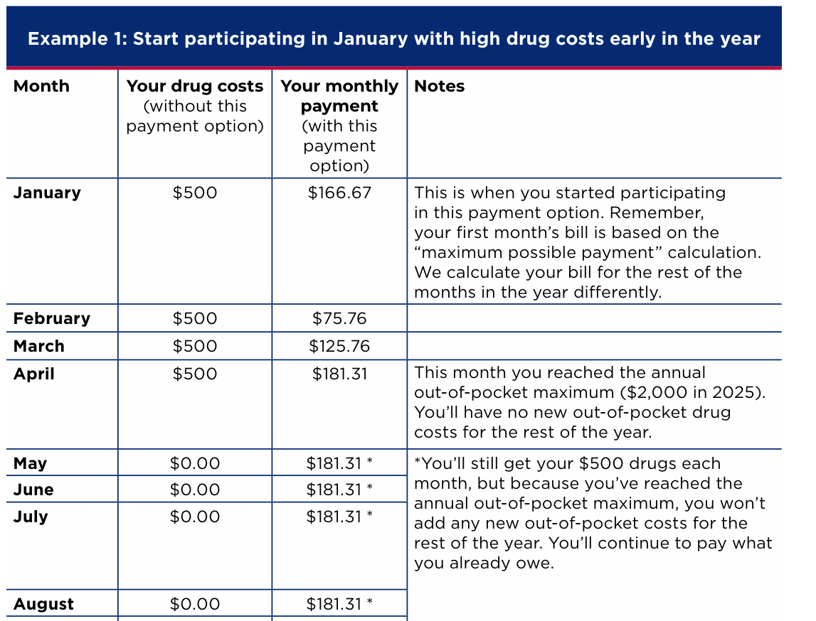
Medicare Prescription Payment Plan (MP3) Codification
Codifies and adds automatic re-enrollment, opt out option
MP3 helps high out-of-pocket drug costs (earlier in coverage)
  Calculation = annual cost / months remaining
  Cost may vary month-to-month
  Spreads (“smooths”) cost vs. lower cost
  Contact plan to sign up
CMS Tip Sheet & FAQs
  What’s the Medicare Prescription Payment Plan? (12 pages)
    Sample calculations (example on right)
  5/8/25 Plan FAQ Update to MP3

Slide 22

Medicare Advantage Supplemental Benefit Notification
Encourage use of MA Supplemental Benefits
  MA plans must notify members mid-year (mail a letter)
  List any supplemental benefits not used Jan. 1 to June 30th

Slide 23

Insulin Cost Sharing Change
For 2026 and each subsequent year, covered insulin product covered under a prescription drug plan (PDP) or a Medicare Advantage prescription drug (MA-PD) plan prior to an enrollee reaching the annual out-of-pocket threshold, the “covered insulin product applicable cost-sharing amount” is the lesser of
  $35;
  An amount equal to 25 percent of the maximum fair price established for the covered insulin product in accordance with Part E of title XI; or
  An amount equal to 25 percent of the negotiated price, as defined in § 423.100, of the covered insulin product under the PDP or MA-PD plan.

Slide 24

Medicare Drug Price Negotiation Program
Negotiations for maximum fair prices for the following 10 Part D drugs were completed for plan year 2026:
Eliquis
Jardiance
Xarelto
Januvia
Farxiga
Entresto
Enbrel
Imbruvica
Stelara
Fiasp; Fiasp FlexTouch; Fiasp PenFill; NovoLog FlexPen; NovoLog PenFill
The following drugs covered under Part D were selected for the next cycle of maximum fair price negotiations for 2027:
Ozempic; Rybelsus; Wegovy
Trelegy Ellipta
Xtandi
Pomalyst
Ibrance
Ofev
Linzess
Calquence
Austedo; Austedo XR
Breo Ellipta
Tradjenta
Xifaxan
Vraylar
Janumet; Janumet XR
Otezla

Slide 25
2026 Medicare Advantage Updates/Important Reminders
10 insurance carriers offering Medicare Advantage plans in 2026
NEW MA SEP: MPF Incorrect Provider Network available 1/1/2026-12/1/2026
Always check if doctors and hospitals accept plan and if drugs covered (use Plan Finder)
Compare premiums, co-pays, deductibles, and annual out-of-pocket maximums
Check plans for Restrictions (Prior Authorization, Quantity Limits, Step Therapy)
Cannot enroll in an MA plan (HMO, PPO) and a stand-alone PDP at the same time
  Selection of PDP will result in disenrollment from MA plan
New MA enrollment will result in automatic disenrollment from prior MA or PDP plan
Plans may offer extra benefits- check with individual plans
Part B drugs may be subject to prior authorization or step therapy. Some MA plans may charge a percentage co-insurance for Part B drugs

Slide 26
2026 Medicare Part D Updates
Total of 6 companies that offer a total of 11 plans available in 2026
  Decrease from 14 plans offered in 2025
2 plans with a $0 deductible:
  Blue Medicare RX Premiere
  Humana Premier RX
4 plans do not apply the deductible to all tiers
5 STAR plans in 2026- No announcement yet

Slide 27
2026 Medigap Updates
Humana has notified the DOI that it will stop selling all of its Medicare Supplement products beginning April 1, 2026, at which time these products will no longer be available to new customers. All existing members may remain enrolled.
The 15% discount and $150 eyewear reimbursement will no longer be offered on Fallon Medicare Supplement Core, 1 or 1A plans, effective January 1, 2026.​
  Any current members, enrolled in one of those plans will be “grandfathered” while Fallon discontinues those two benefits.​
  The Annual Notice of Change letters will be going to existing members soon, which will allow members to plan accordingly.
Rate increases average 10% across all available plans
  Lowest Core price in 2026: BCBS $142.64
  Lowest Supplement 1A price in 2026: BCBS $233.24
  Lowest Supplement 1 price in 2026: Humana $283.03

Slide 28
Other Resources

Slide 29

Reminder: Transitioning from the Health Connector to Medicare
For those in a Health Connector who become eligible for Premium-free Medicare Part A (which means they earned 40 credits working under Social Security and paying into Medicare):
  They should sign up for Medicare
  They will lose their Health Connector coverage
  They will lose any tax credits they are receiving
  If they don’t sign up for Medicare, they may be subject to a late enrollment penalty
If you are not eligible for Premium-free Medicare Part A, you can keep a Health Connector plan

Slide 30

Senior Medicare Patrol
Mission:
Reach and educate Medicare and Medicaid beneficiaries, family members, caregivers and professionals on the importance of becoming engaged healthcare consumers to protect, detect and report healthcare errors, fraud and abuse.
SMP Program Presentations cover:
Billing errors, fraud and/or abuse
Deceptive Marketing
Concerns related to Quality of Care
COVID Fraud, Vaccine Fraud, Braces
Contact: MA SMP Program info@MASMP.org or 800-892-0890
Senior Medicare Patrol Website

Slide 31
My Ombudsman
Assists individuals to address concerns or conflicts that may interfere with their enrollment in any MassHealth Managed Care Plan, including One Care, SCO and PACE
Works with MassHealth and the plans to help members resolve concerns and ensure access to benefits and services
Contact: Phone: 855-781-9898
Videophone: 339-224-6831 Email: info@myombudsman.org Website: MyOmbudsman Website

Slide 32

Mass College of Pharmacy and Health Sciences Pharmacy Outreach Program
Free information and referral service to help people take medications appropriately
Mission: To promote medication adherence for the community through cost solutions and education
Pharmacists, SHINE counselors, and pharmacy students on staff
Funded by Executive Office of Aging & Independence, City of Boston, Central Mass Agency on Aging, and the Massachusetts College of Pharmacy and Health Sciences
Help Line: 866-633-1617
MCPHS Pharmacy Outreach Website
*Better Adherence
*Improved Health Outcomes
Improve Access to Medications
Improve Understanding of
Medications

Slide 33

Mass Options
Connects Older Adults, individuals with disabilities and their caregivers with agencies and organizations that best meet their needs:
Housing
Food
Caregiver supports
Health and wellness
Day services
Insurance
Transportation
In-home supports
For more information you can:
Call: 1-800-243-4636
Visit: MassOptions Website

Slide 34
Other Resources for Consumers
Name of Agency/Organization | Phone Number
Social Security Administration | 800-772-1213
Medicare | 800-633-4227
MassOptions | 800-243-4636
MassHealth | 800-841-2900
Health Connector | 877-623-6765
Health Care for All Massachusetts | 800-272-4232
Massachusetts College of Pharmacy & Health Sciences Pharmacy Outreach Program | 866-633-1617
Medicare Advocacy Project Greater Boston Legal Services (Suffolk, Middlesex, Essex counties) Community Legal Aid (Hampshire, Hampden, Berkshire, Franklin, Worcester counties) South Coastal Counties Legal Services (Bristol, Plymouth, Barnstable, Dukes, Nantucket counties) | 800-323-3205 855-252-5342 800-244-9023

Slide 35
Take aways
Don’t miss deadlines to sign up for Medicare
  Contact SSA to find out if you have met your 40 quarters
If turning 65, eligible for Premium Free Part A and on the Health Connector, dis-enroll by calling the plan
Consumers receiving SSDI will be auto enrolled into Medicare after 24 months of SSDI payments
Be sure your doctors and hospitals are in the network of the Medicare health plan you’re choosing
Be sure all of your current medications are on your plan’s formulary
Remember to review Medicare plans every year during Open Enrollment: 10/15 – 12/7

Slide 36
Thank you
To contact a SHINE counselor near you:
MassOptions 800-243-4636
SHINE Website: Mass.gov/info-details/serving-the-health-insurance-needs-of-everyone-shine-program
This project is supported in part by Grant #90SAPG, from the US Administration for Community Living, Department of Health and Human Services, Washington DC, 20201. Grantees undertaking projects with government sponsorship are encouraged to express freely their findings and conclusions. Points of view or opinions do not, therefore, necessarily represent official ACL policy.

