Slide 1

From Seed to Savings:
The Office of
Economic Empowerment
Massachusetts Office of the Treasurer and Receiver General Deborah B. Goldberg

Slide 2

About OEE
The Office of Economic Empowerment (OEE) is a department of the State Treasury aimed at helping people learn how to confidently manage their money and plan for their family's future.
The department is also a resource to organizations, government agencies, and elected officials as they work to support their communities' economic well-being.
Under the guidance of Treasurer Goldberg, the department also works alongside policymakers to establish pathways to wealth equity in Massachusetts.

Slide 3





OEE’s Programs
OEE has programs for individuals looking to improve their financial literacy, including Enrich, the Worth & Wealth Seminars, workshops hosted by our Community Ambassadors, and grant offerings.
OEE also manages BabySteps, which provides a free $50 deposit into a MEFA U.Fund College Investing Plan 529 account for Massachusetts babies and recently adopted children, helping families save for their children's future education and job training costs.

Slide 4
BabySteps

Slide 5
What is BabySteps?
BabySteps is a program offered by State Treasurer Deborah B. Golberg that provides $50 to Massachusetts families to save toward their children’s education.
Any child in Massachusetts can claim their free $50 when they open a college and career savings account within one year of their birth or adoption.

Slide 6

Why is this important?
Educational Expectations​
Correlated with having a greater ‘college-bound identity’ (increased expectations). ​
Greater importance on education, higher attendance rates, and improvements in academic achievement, ie. standardized tests and grades. ​
Child Development and Social-Emotional Functioning​
Increased children’s social-emotional functioning, with similar effect size to Early Head Start.​
Lessened negative effects of material hardship on child development.​

Slide 7

Compound Interest
Julie saves $50 per month in a 529 account when her child is first born.
Jonathan saves $100 per month in a 529 account beginning when his child is in 2nd grade.
Who will have more money saved when their child turns 18?

Slide 8
Compound Interest (continued)
Julie saves $50 per month in a 529 account when her child is first born.
$21,536
  $10,800 contributed
  $10,736 interest earned
Jonathan saves $100 per month in a 529 account starting when his child is in 2nd grade.
$19,798
  $13,200 contributed
  $6,598 interest earned
*This assumes consistent monthly saving until the child is 18 and an annual investment return of 7%

Slide 9
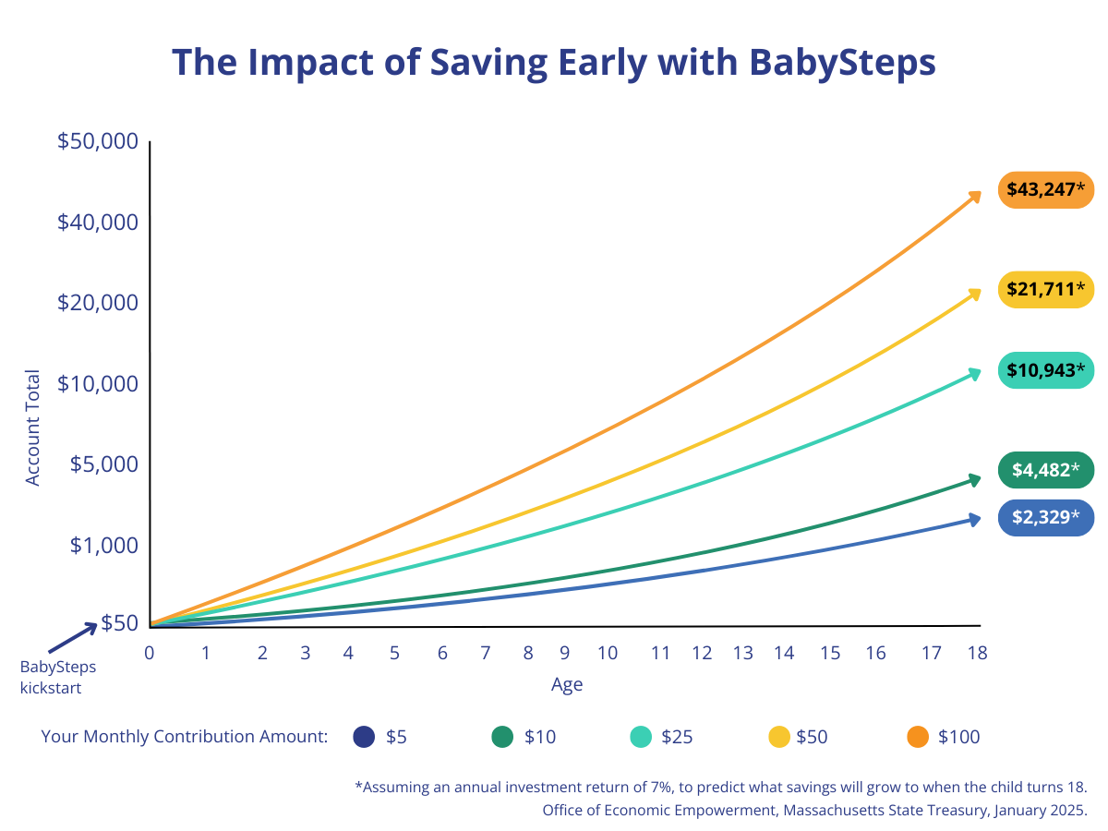
BabySteps Seed Growth Over Time

Slide 10

SNAP into BabySteps
Any child in Massachusetts who:
Has opened their BabySteps College and Career Savings Account (under 1YO)
Is enrolled in SNAP benefits
Lets OEE know by filling out a Formstack
Receives $10 a month for one year, totaling $170 into their savings account.

Slide 11
Benefits Eligibility – NOT AFFECTED
Family Self-Sufficiency (FSS)
Housing Choice Voucher (Section 8)
Public Housing
Low Income Home Energy Assistance (LIHEAP
Emergency Aid to Elderly, Disabled and Children (EAEDC)
Transitional Aid to Families with Dependent Children (TAFDC)
Unemployment Insurance
Income Eligibility Voucher
Head Start & Early Head Start
SNAP
WIC
Children's Health Insurance Program (CHIP)

Slide 12
Benefits Eligibility – AFFECTED
MassHealth
  Only affecting individuals over age 65 or receiving long term care
  For seniors: $2,000 for individual $3,000 for family
Medicare
  Only affecting Medicare Savings Program
  Varies, but most often: $7,730 for individuals, $11,600 for married couples
Supplemental Security Income (SSI)
  Total Countable Assets must not exceed: $2,000 for individuals, $3,000 for family
Earned Income Tax Credit
  Total of all Investment Income for the year must not exceed $11,600

Slide 13
Public Programs Eligibility and Savings Limit
Public Program | Eligibility Affected by 529? | Savings Limit
Childcare | Eligibility | Total Savings Allowed
Income Eligible Vouchers | Not Affected | N/A
Head Start and Early Head Start | Not Affected | N/A
Nutrition | Eligibility | Total Savings Allowed
Snap | Not Affected | N/A
WIC | Not Affected | N/A
National School Lunch Program (Free/Reduced Lunch) | Not Affected | N/A
Healthcare | Eligibility | Total Savings Allowed
Children’s Health Insurance Program (CHIP) – Part of Medicaid | Not Affected | N/A
MassHealth | Only affected for individuals over age 65, or receiving long term care | For seniors: $2000 for individual, $3000 for family
Medicare | Only affects Medicare Savings Program | Varies, but most often: $7,730 for individuals, $11,600 for married couple

Slide 14
Public Programs Eligibility and Savings Allowed
Housing | Eligibility | Total Savings Allowed
Family Self-Sufficiency Program (FSS) | Not Affected | N/A
Housing Choice Voucher (Section 8) | Not Affected | N/A
Public Housing | Not Affected | N/A
Low Income Home Energy Assistance Program (LIHEAP) | Not Affected | N/A
Income Supports and Insurance | Eligibility | Total Savings Allowed
Earned Income Tax Credit (EITC) | Affected | Total of all investment income (including 529) for the year must not exceed $11,600*
Emergency Aid to Elderly, Disabled, and Children (EAEDC) | Not Affected | N/A
Supplemental Security Income (SSI) | Affected | Total countable assests must not exceed: $2,000 for individual $3000 for family
Transitional Aid to Families with Dependent Children (TAFDC) | Not Affected | N/A
Unemployment Insurance | Not Affected | N/A
13

Slide 15

How do families enroll?
Families can hear of us from page two of the parent worksheet but must enroll themselves
Visit mass.gov/babysteps to be directed to fidelity.com/ufund
Free Investment Advice in multiple languages: 800-544-2776

Slide 16
Testimonials
“I feel relaxed. My thinking is that even if I am not able to save enough to cover 100% college costs, that's not an issue. Something is always better than nothing. Anything is better than 0 or ignoring the goal.”
“I have told everyone I know who has had a kid since 2020 to start one of these funds. The seed money makes it worth it even if they are unable to further contribute on their own. I am proud to live in a state that places such value on higher education and planning for the future.”
“I think it’s a wonderful idea to set up these accounts. My wife and I might not have thought of it otherwise when we had our first baby. Now we’ve also been able to start saving for our second child too after she was born!”

Slide 17
Enrich Program

Slide 18
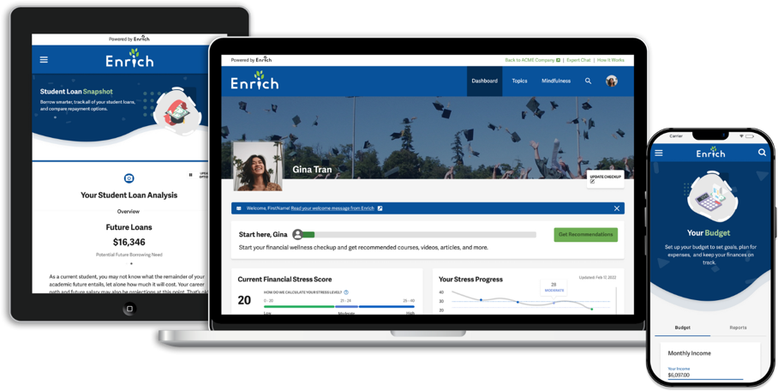
About Enrich
Enrich is where Massachusetts residents can get answers and make a money plan, regardless of their age or situation.
A digital platform, Enrich provides personalized financial literacy resources, including assessments, courses, articles, credit simulators, and more.
Enrich is free, secure, and available in English, Chinese, French, Portuguese, and Spanish.

Slide 19
Getting Started
Visit masstreasury.enrich.org to create your account.
Take one of the assessments, such as the money personality quiz or the financial stress score.
Explore the courses recommended by Enrich based on your personal needs and goals.
Check out the tools Enrich offers, like budget templates, credit simulators, scholarship searches, and more.
Enrich uses data-driven approaches to helping its users change their money mindsets. Visit the “Money Mindfulness” section and check out the meditation and journal prompts.

Slide 20
Valor Y Dinero Seminarios and Worth & Wealth Seminars

Slide 21
Worth & Wealth/Valor y Dinero
Sponsored by Citizens, the Worth & Wealth Seminars are webinars offered by OEE each year that are designed to help participants feel more confident managing their money. Participants are also invited to schedule a free 1:1 session with a certified financial coach.
Los Seminarios de Valor y Dinero is Worth & Wealth's sister program, providing free financial education workshops in Spanish.

Slide 22
Community Ambassadors

Slide 23
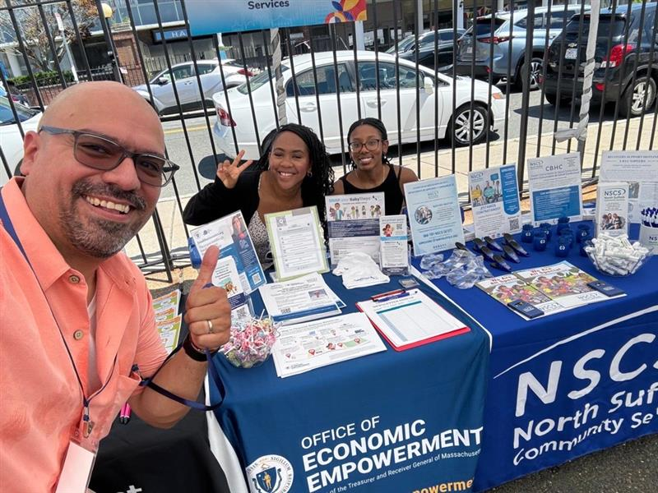
Community Ambassadors
Community Ambassadors are volunteers who help spread the word about financial empowerment initiatives, host workshops, and conduct community assessments to help inform OEE program and policy priorities.
Ambassadors receive comprehensive training on all OEE programs, an official citation from the State Treasurer, a certificate of completion, and a $2,800 stipend for an eight-month term.

Slide 24
Next Steps
      Place free materials in lobby/waiting area and/or post information graphics on social media
      Add a link to OEE on your organization’s website
      Invite an OEE representative or designated OEE Community Ambassador to host an information table at your organization and/or run an event (in-person or virtual)
      Learn how to enroll families into BabySteps/SNAP into BabySteps in as little as 15 minutes with our free, one-hour training
      Connect with us on social media

Slide 25
Thank You!

