Slide 1

MassHealth Training Forum Provider Updates
January 2025
Executive Office of Health & Human Services

Slide 2
Agenda
Welcome and Agenda Overview
Health Related Social Needs (HRSN)
Provider Self-Service Tool Update: Check Provider Enrollment Status and Group Links
Mass.gov Updates
Provider Directory Initiative
Expanded Program Changes
Long-Term Services and Supports Provider
Provider Revalidation Automation
MassHealth MMIS/POSC Migration to Amazon Web Services (AWS
Multi-Factor Authentication Transition Termination of Legacy Option
New Dental Third-Party Administrator
MassHealth Training and Bulletins

Slide 3
Health Related Social Needs (HRSN) Supplemental Services Update for the Provider Association Forum (PAF)
Nestor Rivera, Sr. Provider Relations Specialist, MassHealth Business Support Services

Slide 4
HRSN PAF Agenda
Topic
HRSN Services Overview
Selecting HRSN Supplemental Housing and Nutrition Services
Determining Criteria for Receiving HRSN Supplemental Services
For additional information on each service and resources available for Plan, Providers, and Members, please visit the MassHealth HRSN Website.

Slide 5
HRSN Services: Past State
Past State (through 12/31/2024):
Flexible Services Program (FSP)
Specialized Community Supports Program (Specialized CSP)
MassHealth Accountable Care Organization (ACO) Enrollees could receive supports for their Health-Related Social Needs (HRSN) through the FSP. FSP was a pilot grant program that launched in January 2020 to provide housing and nutrition goods and services to a subset of eligible ACO Enrollees based on certain criteria. Flexible Services were not covered services; Enrollees were not entitled to these services.
In April 2023, MassHealth implemented three Specialized CSPs for homeless individuals (CSP-HI), individuals with unstable housing (CSP Tenancy Preservation Program (CSP-TPP)), and individuals with justice involvement (CSP-JI). Services were provided to eligible managed care Enrollees and MassHealth fee-for-service members with behavioral health (BH) diagnoses.

Slide 6
HRSN Services: Current State
(slide 1 of 2)
Current State (began 1/1/2025):
In September 2022, the Centers for Medicare & Medicaid Services (CMS) approved MassHealth’s 1115 Demonstration Waiver renewal, which included re-authorization of and changes to both FSP and Specialized CSP for ACO Enrollees only. As approved in this waiver:
  FSP ended on 12/31/2024.
  As of January 1, 2025, there are two categories of services that address HRSNs (i.e., HRSN Services) for ACO Enrollees – Required Services and Supplemental Services.
    HRSN Required Services: A subcategory of HRSN Services that Accountable Care Partnership Plans (ACPPs) and Primary Care ACOs (PCACOs) (through Massachusetts Behavioral Health Partnership, or MBHP) must provide to Enrollees
      These are the Specialized CSP Services – the only changes being made are to expand eligibility for ACO Enrollees beyond those with BH conditions

Slide 7
HRSN Services: Current State
(slide 2 of 2)
Current State (began 1/1/2025):
    HRSN Supplemental Services: A subcategory of HRSN Services that ACPPs and PCACOs (through MBHP) may choose to provide to Enrollees in accordance with MassHealth Managed Care rules.
      Each ACO needs to provide at least one HRSN Supplemental Nutrition Service and one HRSN Supplemental Housing Service
      MassHealth has created a standardized list of HRSN Supplemental Services.
      Each ACO may select different services to offer, but once the ACO selects a service, it must be offered to all Enrollees who meet the criteria to receive the services.
MassHealth worked with ACOs and HRSN Providers to prepare for the delivery of these services beginning January 2025.

Slide 8
Selecting HRSN Supplemental Housing Services
ACOs must choose at least one HRSN Supplemental Housing Service.
MassHealth HRSN Supplemental Housing Services for 2025
For Members Experiencing Homelessness
For Members Experiencing Housing Instability
For Members Living in Housing that is Unhealthy
Housing Search
Transitional Goods
HRSN Housing Navigation
Healthy Homes

Slide 9
ACOs must choose at least one HRSN Supplemental Nutrition Service.
If ACOs choose to provide more than one Category 1 service, they may only select one ‘service type’ from each Category 1 service ("Medically Tailored" or "Nutritionally Appropriate“).
Nutrition assessment and coordination is integrated into all Category 1 Services.
Category 2 services may only be provided to members receiving Category 1 services.
Selecting HRSN Supplemental
Nutrition Services (slide 1 of 2)
MassHealth HRSN Supplemental Nutrition Services for 2025
Category 1: Nutrition Services
Home Delivered Meals
Food Boxes
Food Prescriptions
Medically Tailored Home Delivered Meals
Medically Tailored Food Boxes
Medically Tailored Food Prescriptions and Vouchers
OR
OR
OR
Nutritionally Appropriate Food Prescriptions and Vouchers
Nutritionally Appropriate Home Delivered Meals
Nutritionally Appropriate Food Boxes

Slide 10
Selecting HRSN Supplemental
Nutrition Services (slide 2 of 2)
Category 2: Nutrition Services
Nutrition Education
Kitchen Supplies
Nutrition Education Classes and Skills Development
Kitchen Supplies
Nutrition Counseling

Slide 11
Determining Criteria for Receiving HRSN Supplemental Services (slide 1 of 2)
To receive HRSN Supplemental Services, an individual must be an ACO Enrollee. An enrollee must also meet certain criteria which may vary by the respective service.
An enrollee meets the criteria for services when they meet the Health Needs Based Criteria, Risk Factor, and any additional program criteria of the service, as set forth in the HRSN Service Manuals.
Plans may not restrict eligibility criteria to target certain populations.

Slide 12
Determining Criteria for Receiving HRSN Supplemental Services (slide 2 of 2)
Criteria
To receive HRSN Services:
MassHealth ACO Enrollment
Health Needs Based Criteria (HNBC)
Risk Factors (RF)
Other Programmatic Criteria as Required
Criteria
 | Varies by service. Examples:
✓ | Behavioral Health Need
✓ | Complex Physical Health Need
✓ | Assistance with one or more Activities of Daily Living or Instrumental Activities of Daily Living
✓ | Repeated Emergency Department (ED) Use
✓ | Pregnant individual with high-risk pregnancy or complications
✓ | Pregnant individuals without additional clinical factors
 | Varies by service: Examples
✓ | Experiencing Very Low Food Security
✓ | Living in Housing that is Unhealthy
✓ | Experiencing Homelessness
✓ | Experiencing Housing Instability
 | Varies by service: Examples
✓ | Unable to Prepare Meals
✓ | HRSN Service Manuals detail additional criteria for each service
✓ | Enrolled in a MassHealth ACO
As is the case for all ACO Covered Services, HRSN Providers need to verify ACO enrollment each time a service is delivered. This can be done using the Eligibility Verification System (EVS)¹ or Plans’ provider portals.
¹Only HRSN Providers who are enrolled as a MassHealth Fee-For-Service provider can access EVS.

Slide 13
Questions?

Slide 14
Provider Self-Service Tool Update:
Check Provider Enrollment Status & Group Links
Nestor Rivera, Sr. Provider Relations Specialist, MassHealth Business Support Services

Slide 15
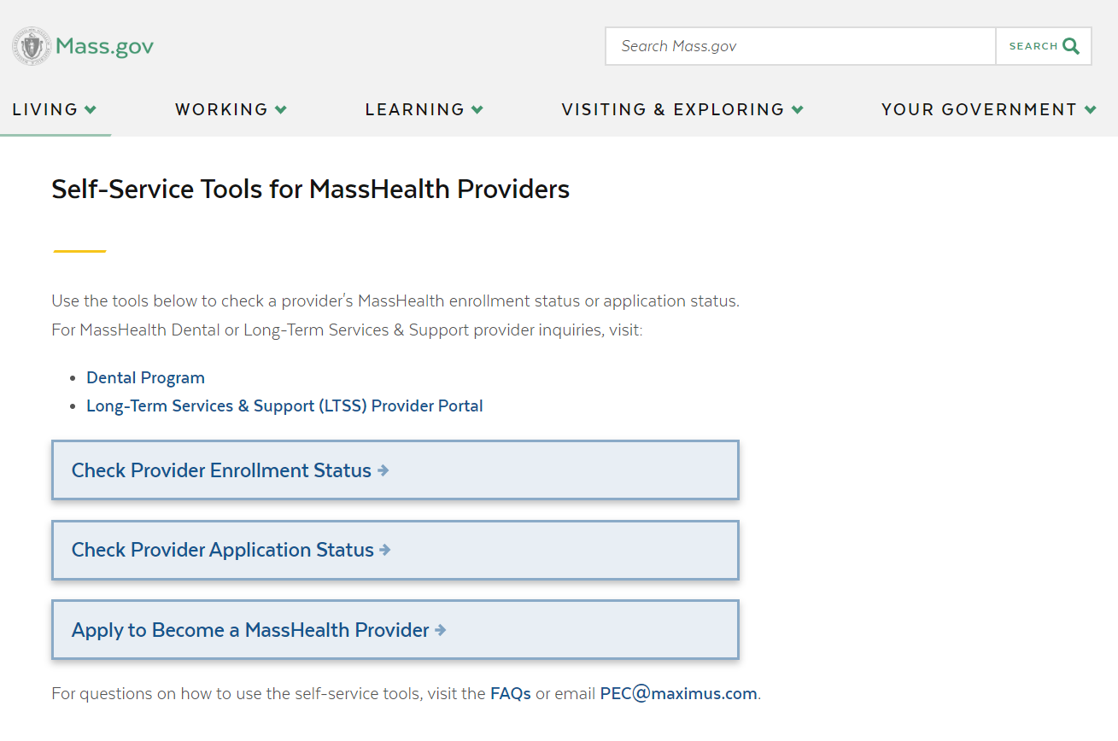
Check Provider Enrollment Status Tool Update
In October 2024, Business Support Services (BSS) launched two new web-based self-service tools to assist with enrollment inquiries:
Provider Enrollment Status
Provider Application Status
Effective January 31st, 2025, the Provider Enrollment Status tool will now feature Group Link data information.
Provider Self-Service Tools

Slide 16
Reminder: Provider Status Tools
These tools allow providers and their credentialing staff to verify the current MassHealth provider enrollment status and application status for:
Fee-for-Service (FFS) providers
Ordering, Referring, and Prescribing (ORP) providers
Note, these tools will not display application information on the following:
Dental providers
Long-Term Services & Supports (LTSS) providers
MCE Providers

Slide 17
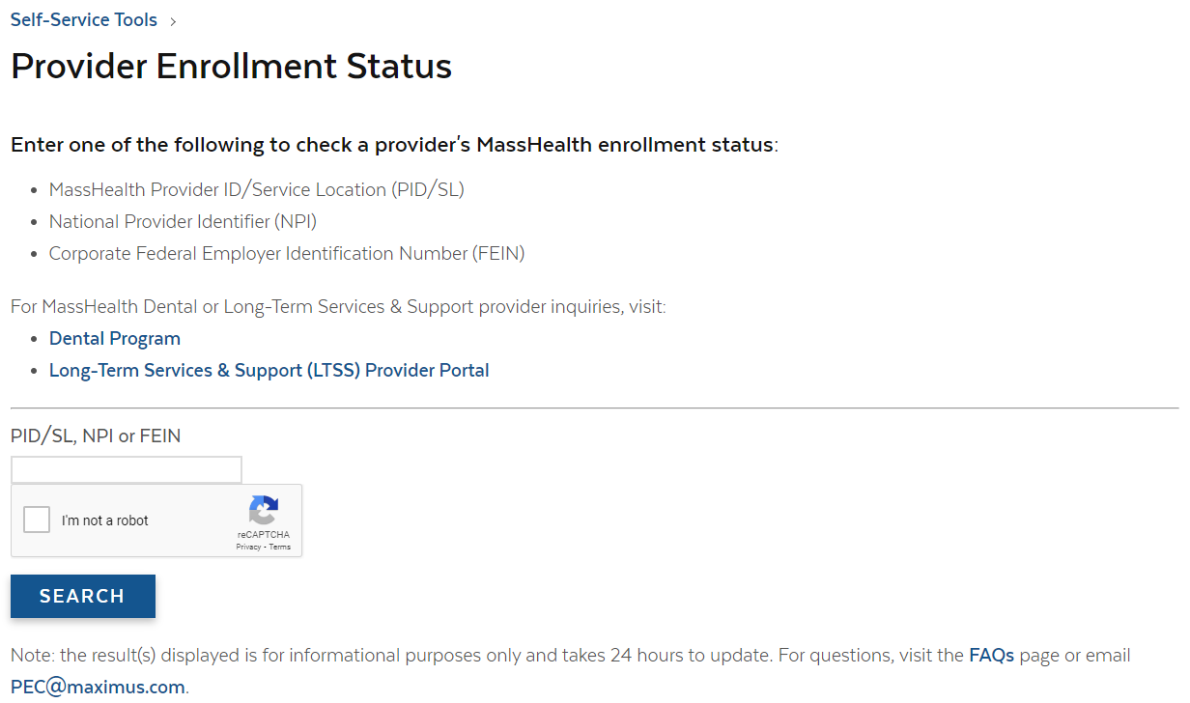
Provider Enrollment Status
This tool is used to search the status of current MassHealth Providers and Entities
The tool returns the following:
Enrolled providers and entities
Inactive providers and entities
Providers with applications in process
This tool will now allow users to check the Group Links for an individual provider.

Slide 18
Searching for Providers
(slide 1 of 2)
Search with one of the following:
  Provider ID/Service Location (PID/SL),
  NPI
  FEIN
1234567890

Slide 19
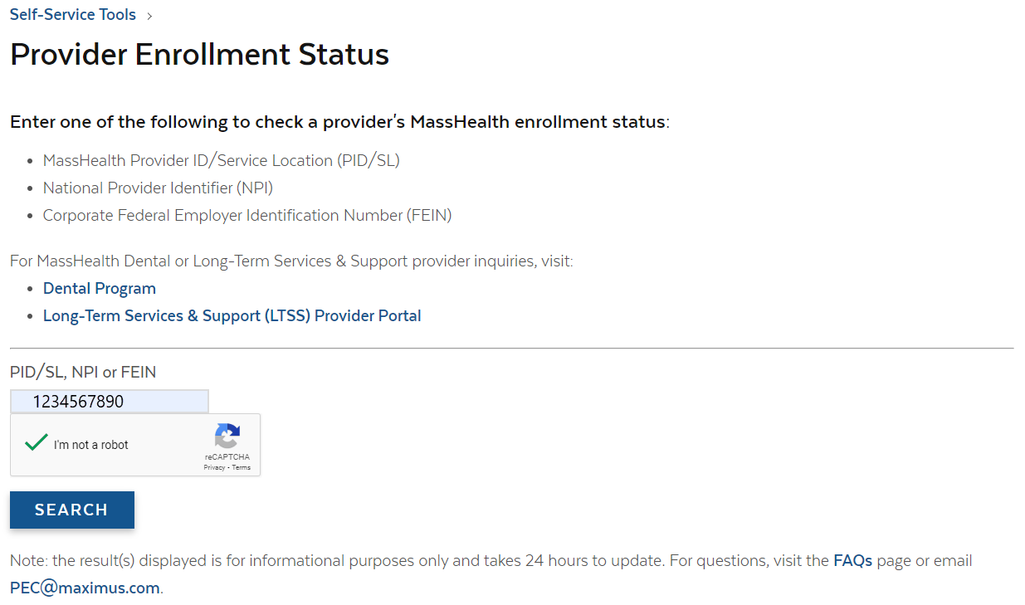
Searching for Providers
(slide 2 of 2)
Select the box labeled I’m not a robot box and complete the CAPTCHA
Next, select the Search button to proceed

Slide 20
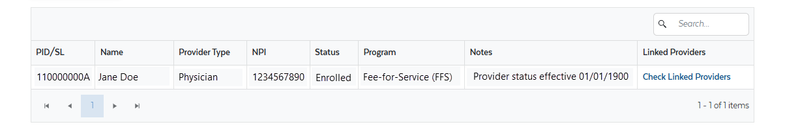
Provider Status Search Results
The search results will now include the link, Check Linked Providers:

Slide 21
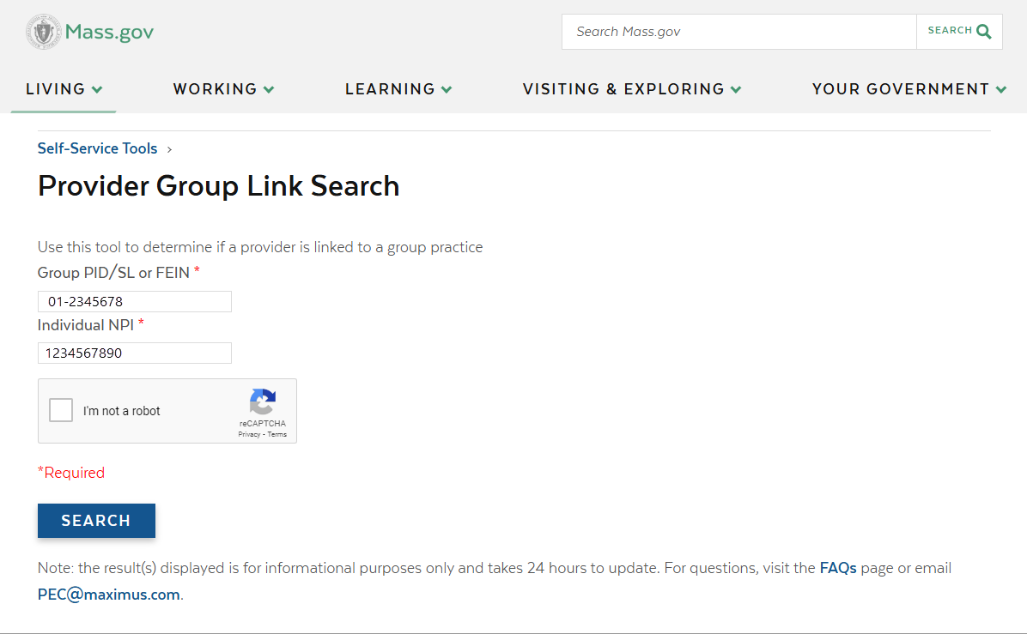
Provider Group Link Search
(slide 1 of 2)
Enter the Group Practice’s PID/SL or FEIN.
Confirm the Individual Practitioner’s NPI

Slide 22

Provider Group Link Search
(slide 2 of 2)
Select the box labeled I’m not a robot box and complete the CAPTCHA.
Next, select the Search button to proceed.

Slide 23
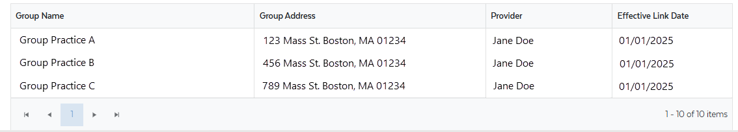
Provider Group Link Search Results (slide 1 of 2)
The search results will display the following information:
Group Practice DBA Name
Group Practice DBA Address
Individual Provider Name
Group Link Effective Date

Slide 24
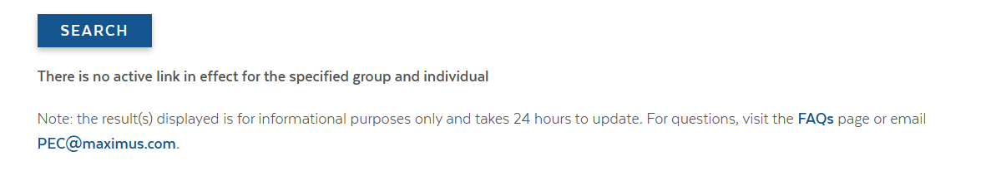
Provider Group Link Search Results (slide 2 of 2)
If there are no active links for the specified group and individual, the search results will display the following message:

Slide 25
Questions?

Slide 26
Mass.gov Updates
Nestor Rivera, Sr. Provider Relations Specialist, MassHealth Business Support Services

Slide 27
Mass.gov Updates
In response to feedback received from the provider community, MassHealth has updated the layout of provider information on Mass.gov
This initiative to update Mass.gov is ongoing and works to confirm that all published information is accurate and relevant

Slide 28
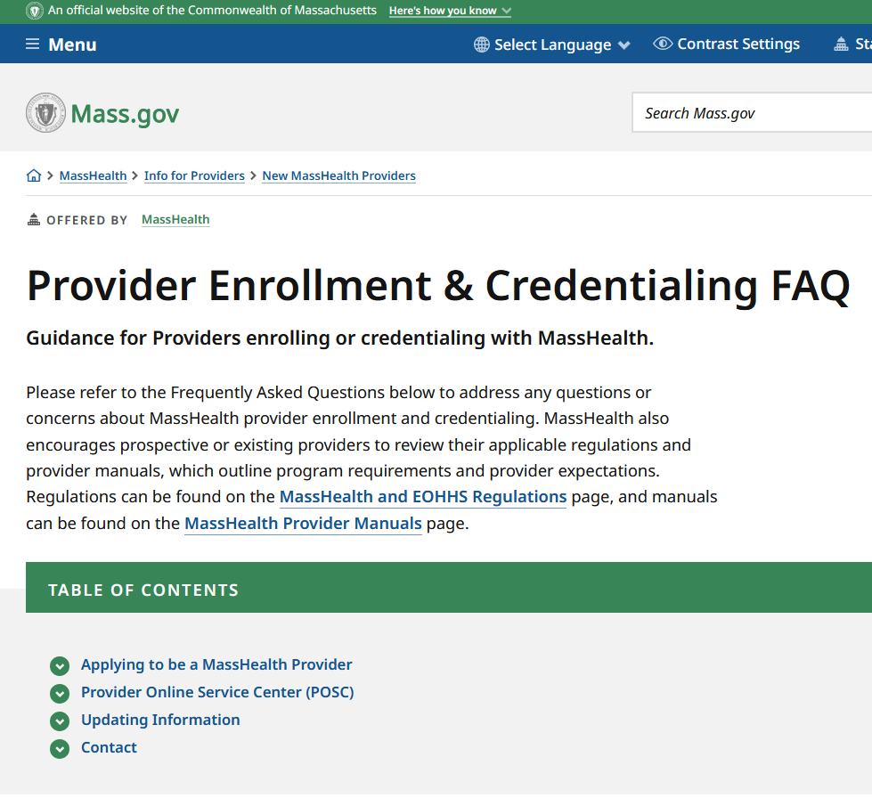
Mass.gov Updates – PEC FAQ
In November 2024, MassHealth introduced an updated version of enrollment and credentialing Frequently Asked Questions
Topics that are addressed in the FAQ include need-to-know information for providers who are applying, already enrolled, and helpful tools that they can utilize when participating in the MassHealth program.
Visit: Provider Enrollment & Credentialing FAQ | Mass.gov

Slide 29
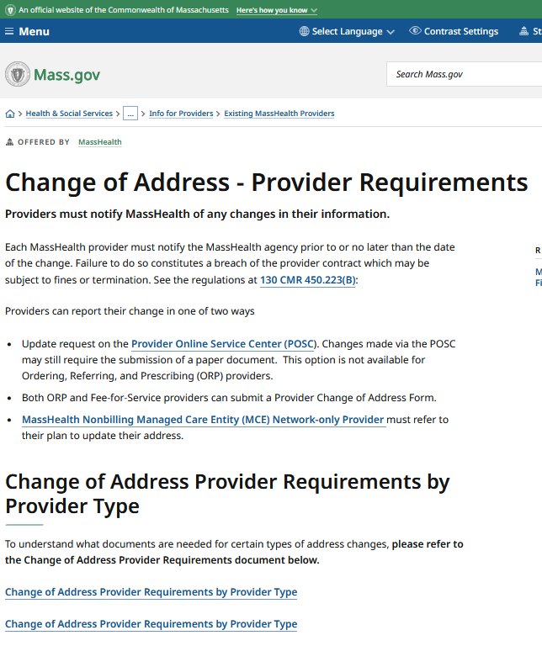
Mass.gov Updates – Change of Address
The Change of Address page has also recently undergone an update to one of its resources.
The CAD Grid now provides more in-depth descriptions for how ORP and FFS providers can update their MassHealth profiles.
This includes all provider types, excluding dental and LTSS types.
Visit: Change of Address - Provider Requirements | Mass.gov

Slide 30
Questions?

Slide 31
Provider Directory Initiative
Nestor Rivera, Sr. Provider Relations Specialist, MassHealth Business Support Services

Slide 32
Background – CMS Guidance
On July 16, 2024, The Centers for Medicare & Medicaid Services (CMS) issued a State Health Official (SHO) letter to provide guidance on requirements and expectations for compliance with Division H, Title V, Section 5123 of the Consolidated Appropriations Act (CAA), 2023, entitled “Requiring Accurate, Updated, and Searchable Provider Directories”.
Collection of additional data elements will begin in early 2025 and the changes to Provider Directories per this communication will take effect on July 1, 2025.

Slide 33
New Data Elements
The Executive Office of Health & Human Services (EOHHS) will work to collect the following data elements to display on MassHealth Providers Directories:
  Cultural capabilities
  Languages Spoken
  Accessibility Accommodations
  Telehealth
  Accepting New Patients
  Providers and Locations URLs

Slide 34
Data Collection Plan
Step 1
Step 2
Step 3
Step 4
EOHHS will be meeting with large organizations to introduce the initiative and discuss the roster clean-up and collection process
EOHHS will work with large organizations to conduct roster clean-up and validation
The large organizations will take time to collect and compile the requested data elements
Once collected, EOHHS will work to update MMIS and the Provider Directories to display this additional information

Slide 35
Data Collection Timeline
Winter 2025
MassHealth will conduct roster clean-ups with and collect additional data from large organizations
Spring 2025
MassHealth will work to update MMIS with collected data and develop the Provider Directory changes
Summer 2025
New data elements will be displayed on Provider Directories

Slide 36
Questions?

Slide 37
Expanded Program Changes
Nestor Rivera, Sr. Provider Relations Specialist, MassHealth Business Support Services

Slide 38
MassHealth Doula Program
Effective November 8, 2024, the MassHealth Doula Program:
Allows MassHealth doula providers to join MassHealth-enrolled non-doula group practices.
Allows MassHealth-enrolled non-doula group practices to bill MassHealth for doula services rendered by a MassHealth doula provider.
Clarifies that group doula visits are a non-covered service.
Establishes that doula services are covered for eligible MassHealth members who are adoptive parents, until the adopted infant reaches one year of age.
Please refer to 130 CMR 463.000 for details.

Slide 39
Certified Nurse Midwives
Effective January 1, 2025:
Certified Nurse Midwives will be reimbursed for their services at 100% of the physician rate.
Please refer to the Provider Payment Rates for details.

Slide 40
Questions?

Slide 41
Long-Term Services and Supports
Lindsey Klauka, Manager of Provider Enrollment & Networking, Optum

Slide 42
LTSS Provider Communications (slide 1 of 2)
The MassHealth LTSS Provider Service Center utilizes provider data to identify behavior trends for areas of targeted training via email. These emails may contain attached job aids or links to additional educational resources via the LTSS Provider Portal.
Areas of focus for these communications include but are not limited to:
High claims denials for specific error codes ​
High prior authorization denials or administrative holds, and/or
Audit findings/SURs reports
The goal of each communication is to assist the Provider in reducing their administrative errors in billing and prior authorization.

Slide 43
LTSS Provider Communications (slide 2 of 2)
Over the last 3 months, Optum has sent over 87 email communications via our LTSS support inbox to LTSS Providers.
There have been 8 provider bulletins published on the MassHealth website.
If you have not received or wish to begin receiving these communications, you may do so by following steps:
For the LTSS support box communications, please reach out to the LTSS Provider Service Center and we can help ensure your inclusion in future communications
For communications from MassHealth on mass.gov, follow this link:
Email Notifications for MassHealth Provider Bulletins and Transmittal Letters

Slide 44
LTSS Provider Trainings and Quality Forums
Training or Quality Forums for MassHealth LTSS Providers:
Trainings:
  Continuous Skilled Nursing Training: 4/10/25
  Home Health Agency Applicant Orientation Training: 4/15/2025
Quality Forums:
  TBD

Slide 45
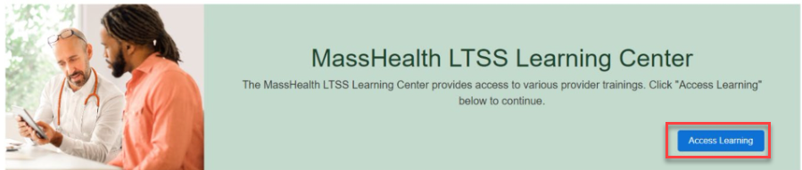
LTSS Provider Service Center (PSC) (slide 1 of 2)
MassHealth Learning Center
As of October 1, 2024, Active Portal Users are able to access the MassHealth Learning Center. Providers will find innovative and tailored courses that address specific challenges and needs faced by healthcare providers on this modern learning platform.
Access the MassHealth Learning Center via the LTSS Provider Portal. Once on the LTSS Provider Portal homepage, scroll to the green MassHealth LTSS Learning Center block and click the blue Access Learning button.

Slide 46
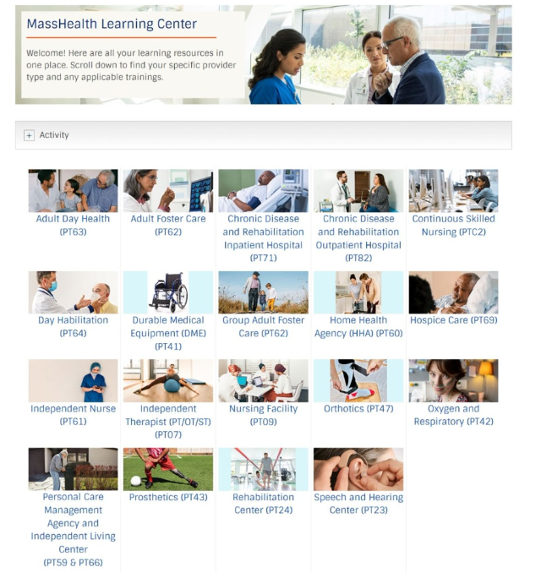
LTSS Provider Service Center (PSC) (slide 2 of 2)
MassHealth Learning Center Dashboard
The image to the right shows you the dashboard of the MassHealth Learning Center. Click any tile to access the training content for the selected Provider Type.

Slide 47
Federally Required Disclosure Form Owner Repository (slide 1 of 3)
When LTSS providers are completing a Federally Required Disclosure Form in an application or update on the LTSS Provider Portal, providers have the option to look up existing owner information in the repository.
The provider will search to see if the owner's information is already existing in the system. If so, the ownership information will automatically populate which will save time for the provider without having to re-enter information.
For revalidations, the previously entered ownership information by the provider will automatically populate in the FRDF, and the provider will verify that the owner information is still current.
Form pre-population is for provider convenience but can always be adjusted prior to submission.

Slide 48
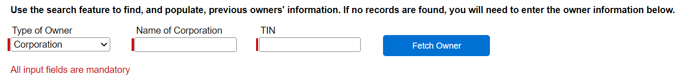
Federally Required Disclosure Form Owner Repository (slide 2 of 3)
The image below shows that after clicking into the Federally Required Disclosure Form, the provider will have the option to use the search feature. The type of owner (corporation or individual), name of corporation or individual, and TIN or SSN is required to search the repository. Once those fields are completed, the provider will click on “fetch owner”. The results will populate and if there is a match, the provider will select the owner.

Slide 49
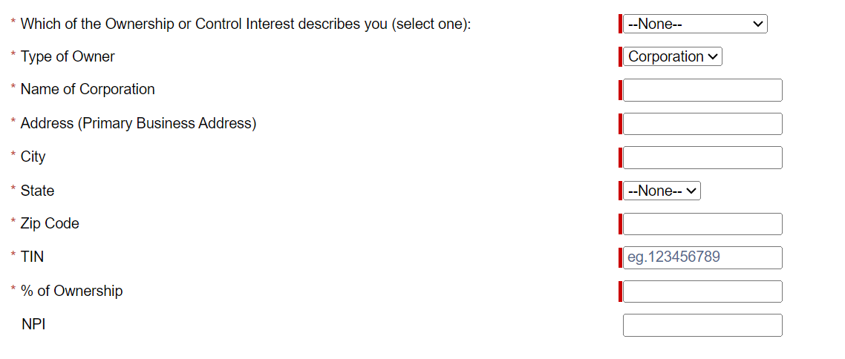
Federally Required Disclosure Form Owner Repository (slide 3 of 3)
After the provider selects the owner result in the repository, all the below required fields will populate. The provider will have the ability to edit any fields as needed before saving and submitting the form.

Slide 50
Questions?

Slide 51
Provider Revalidation Automation
Michael Gilleran, Sr. Provider Relations Specialist, MassHealth Business Support Services

Slide 52
The Purpose of Revalidation
  Providers enrolled in MassHealth are required to revalidate their relationship with MassHealth every 5 years, based on the date of their enrollment.
  Each Provider is required to maintain their provider file information to minimize fraud, waste, and abuse and ensure you remain in good standing*
  The first automated revalidation pilot started in May 2023, with ORP providers able to complete the MassHealth revalidation requirement online (without using fax or postal mail to submit any needed documents)
  The automated revalidation pilot process has been expanded over time to include individual fee for service (FFS) Summer 2024
  providers and is now being rolled out to individual providers within Fall 2024 large organizations and Group Practices
  When it is time for the individual provider to revalidate an email notification is sent to the email on file which could be the individual provider or a representative
  All communications, forms, and submission methods for this new process are entirely online
  * as required by Section 6401 of the Affordable Care Act

Slide 53
Automated Revalidation Overview
MassHealth has introduced the following electronic automation to help providers manage their revalidation:
  Implemented an electronic survey to confirm revalidation intent and contact info for ORP and Unlinked Individual Fee-For-Service (FFS) providers
  Implemented electronic roster confirmation process for large organizations and group practices for linked providers due for revalidation
  Transitioned revalidation communication from letters to emails
  Implemented an online electronic Individual Federally Required Disclosure Form (FRDF)
  Allow e-signatures and electronic form submission
  Working to implement secure document upload for entities

Slide 54
The Unlinked Individual FFS and ORP Revalidation Process
  Selected Providers receive an email from revalidation@mahealth.net informing them that it is time to revalidate.
  These providers then take the questionnaire in the notification email to determine their intent to revalidate with MassHealth program
  Providers who opt to revalidate are sent a follow-up email with a link to access the electronic Federally Required Disclosure Form (FRDF) and provided instructions on any other requirements
  In the case of unresponsive providers, will receive outreach and sanction communication including termination notices

Slide 55
Group Practice Automated Revalidation Process
Group Practices will receive an email with a list of providers in their practice that are due for revalidation on a monthly basis
Revalidation due dates are based on date of enrollment or last revalidation date
The FFS Provider revalidation process will be electronic only
The purpose of the roster confirmation process is to determine:
  Group practices are required to respond to the confirmation email with the requested information
  Once completed the provider(s) will be launched for revalidation and
  will receive and email for each provider with instruction on how to complete an electronic individual FRDF or securely upload an Entity FRDF

Slide 56
Group Practice Automated Revalidation Email Timeline
Type of Email | Send Time
Contact and Roster Confirmation Email | Sent to group contact on file at the beginning of the month
E-FRDF Launch Email | Sent to contact 1-3 days after we have received the group confirmation email
E-FRDF Delegation Email | Sent to delegate email address after contact has signed into the E-FRDF and added a delegate email
Reminder Email | Sent every 5 days to the contact and/or delegate email
Initial Sanction Email | Sent on 45th day after the revalidation has been launched
Second Sanction Email | Sent on the 60th day after the revalidation has been launched
Final Sanction/Termination Email | Sent on the 75th day after the revalidation has been launched

Slide 57
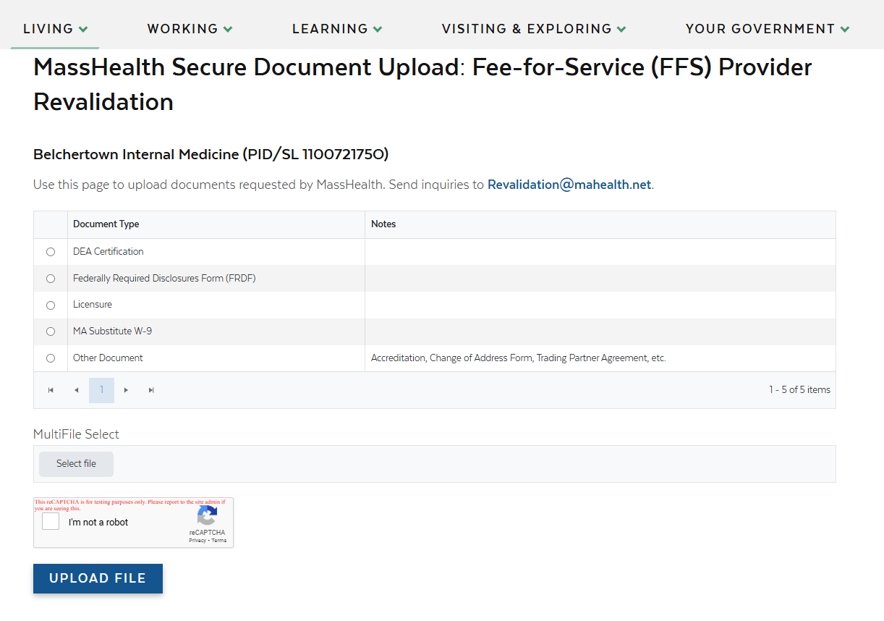
Secure Document Upload for Entities
Entities/Group Practices will soon be able to submit Entity FRDFs for revalidation.
Links will be sent to access the Secure Document Upload for Entity FRDFs
The links are unique to the group/entity due for revalidation
Those responsible for entity FRDFs will now be able to click on the corresponding secure document upload link and upload the FRDF
For any providers or groups/entity that are in WFI during revalidation will also have the ability to securely upload additional documentation

Slide 58
Benefits of Revalidation Automation
Streamlines process for organizations/group roster management
Enhances the provider experience by sending pre-populated FRDF forms to be reviewed, updated, and submitted entirely online
Provides transparency into upcoming and ongoing revalidations
Transition all revalidation communication from letters to emails
Allow e-signature and electronic form submission
Provide transparency into revalidation status/progress
Reduces the need to mail or fax documents through online processing and secure document upload

Slide 59
MassHealth Resources
Helpful Resources
MassHealth revalidation regulation requirement See 130 CMR 450.223(B)
Provider Enrollment Status tool
Contacts
MassHealth Revalidation Team:
  email Revalidation@mahealth.net
Sign up for E-mail Alerts
  Email: join-masshealth-Provider-pubs@listserv.state.ma.us

Slide 60
Questions?

Slide 61
MassHealth MMIS/POSC Migration to Amazon Web Services (AWS)
Michael Gilleran, Sr. Provider Relations Specialist, MassHealth Business Support Services

Slide 62
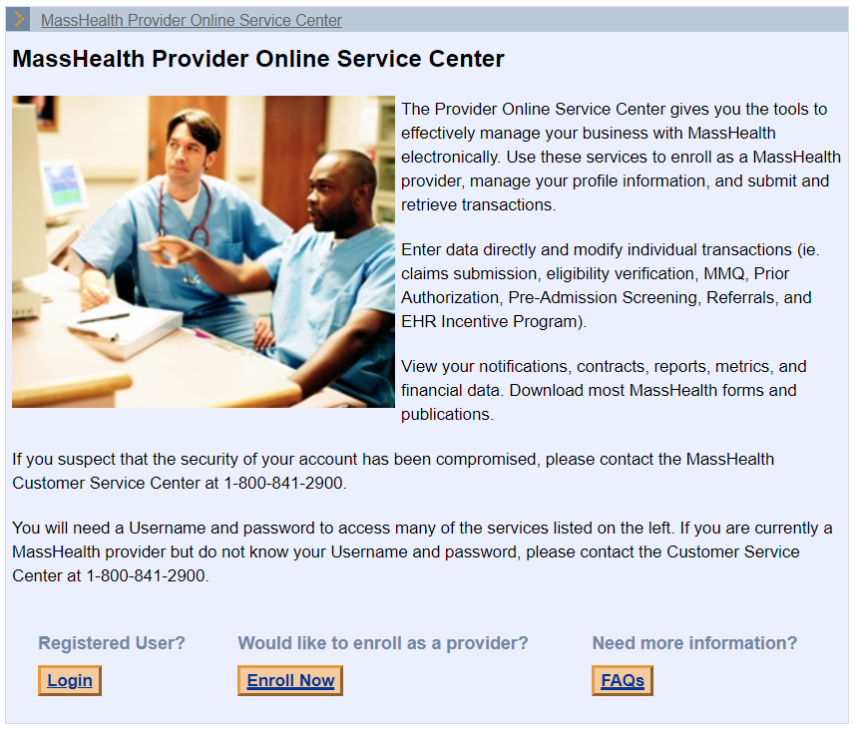
MMIS/POSC Migration to AWS
MassHealth will migrate its Medicaid Management Information System (MMIS) base application and Provider Online Service Center (POSC) to an Amazon Web Services (AWS) data center in 2025.
The migration will provide MassHealth with greater security, scalability, and will enable the agency to implement hardware/software technology refreshes without major disruptions to the MMIS POSC availability.
All-Provider Bulletin is forthcoming

Slide 63
AWS Migration Timing
The shutdown is necessary to capture a snapshot of the database at a point-in-time to ensure a clean production cutover from the existing datacenter to the AWS Cloud datacenter.
Providers and trading partners should prepare for some service interruptions during the cutover.
MassHealth has delayed the cutover that was originally scheduled to ensure a smooth transition.
MassHealth will notify all providers once the new cutover date is established.
*If an alternative cutover date is necessary, MassHealth will notify all MassHealth providers.

Slide 64
Technical Considerations & Updates
Upon completion of the migration, MassHealth will re-direct all MMIS POSC and point-to-point transactions received from MassHealth Providers to AWS*
Update and Use the following URL to access the POSC on/after the cutover:
https://mmis-portal.ehs.state.ma.us/EHSProviderPortal
If your organization requires a modification to your network to facilitate access to AWS, please use the following IP Addresses. Begin to update systems now to avoid disruptions at cutover
There are 2 IP addresses to support redundancy: 15.197.248.41 & 35.71.150.175
If you experience an issue with MMIS at any time after the AWS migration cutover, please open a ticket by calling the EHS Helpdesk at: (617)-994-5050 or send an email to EOHHS-IT-CustomerService.Hancock@mass.gov.

Slide 65
Resources
Email Notifications for MassHealth Provider Bulletins and Transmittal Letters
MassHealth Provider Remittance Advice Message Text
All-Provider Bulletin webpage

Slide 66
Questions?

Slide 67
Multi-factor Authentication Transition Termination Of Legacy Option
Michelle Croy – Sr. Provider Relations Specialist, MassHealth Business Support Services

Slide 68
Multi-Factor Authentication Timeline
On May 19, 2024, the Executive Office of Health and Human Services (EOHHS) Virtual Gateway (VG) implemented Multi-Factor Authentication (MFA).
The VG enabled a Legacy Login option to allow users sufficient time to transition to MFA.
The VG is removing the Legacy Login option used to access MassHealth’s Provider Online Service Center (POSC) or point-to-point connectivity methods on February 23rd , 2025.
MassHealth is requesting that all users that have not yet transitioned set up MFA by Friday, February 14th ahead of the official removal date established by the VG. This will ensure that user can continue to access MassHealth’s system.

Slide 69
Each Affected User
Each affected user must take immediate action to update their user ID and transition to MFA.
MassHealth strongly encourages each user to complete the tasks below as soon as possible; Do NOT wait until February 23rd to make this modification.
No later than February 14, 2025, each affected user must complete the following:
  Identify your User ID/s used to access MassHealth Systems, then go to VGPortal Landing Page
  FIRST - Use the “Legacy Log In” to update the email address associated with the single user ID that you will retain.
  SECOND – Use the “Business Log In” to create your new MFA account. Follow the instructions outlined by the VG to
  Please Note: Use of more than 1 user ID to access the MassHealth systems is a violation of the VG terms and conditions.
  User Ids that are not transitioned to MFA on or after February 23rd will be automatically terminated by the VG

Slide 70
What the Primary User Must Do
Before January 31, 2025, the Primary User must complete the following:
Ensure that all the users within your organization is aware of the elimination of the VG Legacy option and are actively updating their user IDs to reflect a unique email address.
Evaluate your list of users and “de-link” any user that no longer works for your organization or no longer has a contractual relationship with your organization to perform services on your behalf.
System user IDs are only created for staff that require a systems ID to submit HIPAA transactions to MassHealth via point-to-point (HTS/SOAP/MIME)
Ensure that any/all common named user IDs are eliminated and replaced (where relevant) with a User ID that aligns with an individual.
Important: MassHealth strongly encourages each Primary User to complete these tasks as soon as possible.

Slide 71
MFA Resources
Provider Information Sessions:
January 30th, 2025 at 10am
February 12th, 2025 at 1pm
Register for a session here: https://tinyurl.com/y6xkjehr
Functional Coordination email: Functional.Coordination@mass.gov
Virtual Gateway Customer Service
Phone: (800) 421-0938
TTY (617) 847-6578 for the deaf and hard of hearing
Hours of Operations:
Monday - Friday, 8:30 a.m. to 5:00 p.m.
Update Virtual Gateway MyMassGov Account and/or Multi-Factor Authentication Reference Guide
Virtual Gateway Portal

Slide 72
Questions?

Slide 73
New Dental Third-Party Administrator Vendor
Go-Live February 1, 2025
Michelle Croy – Sr. Provider Relations Specialist, MassHealth Business Support Services

Slide 74
Dental TPA Vendor Transition Update
The anticipated operational start date for the new Dental TPA is delayed and is no longer February 1, 2025. The new anticipated operational start date will be announced in the coming weeks in a future communication from EOHHS.

Slide 75
What does this mean?
The current MassHealth Dental Program TPA, DentaQuest will continue as the Dental TPA for MassHealth until the transition to BeneCare. Providers should conduct business as usual until otherwise specified.
Provider training dates, contact information, and any other operational considerations related to BeneCare's transition will be announced in a subsequent correspondence in early 2025.
Frequently asked questions regarding the transition
Continue to contact Tuyen Vu for any dental inquiry at Tuyen.vu@mass.gov

Slide 76
Questions?

Slide 77
Other Systems Integration Reminders
Michelle Croy – Sr. Provider Relations Specialist, MassHealth Business Support Services

Slide 78
REMINDER: Primary User Modifications
Effective August 11, 2024, the Medicaid Management Information System (MMIS)/Provider Online Service Center (POSC) was updated to ensure that no more than 2 individuals per PID/SL will have access to the renamed “Primary User & Backup User” role
Each organization is limited to only a single Primary User and a single Backup and must ensure that it removes the Primary User & Back up User” role from all other users under each PID/SL
Primary Users that encounter an error when attempting to add or modify a back up primary user must first remove the “Primary User & Backup User” role from all other users before they can assign that role to the back up Primary User of their choice.
If a Primary User needs a list of users that have the Primary User and Back-up User Role under their PID/SL to assist with the cleanup effort, please email: Functional.Coordination@mass.gov
Primary Users should review the MassHealth Provider Online Service Center(POSC) Primary User Policy and as well as the All Provider Bulletin 377: MassHealth Provider Online Service Center(POSC) Primary User Policy on Mass.gov and ensure that your organization follows and continues to adhere to the policy.

Slide 79
Primary User Modifications
For questions or concerns regarding Primary User designations, MassHealth providers should refer to their respective customer service center.
Long-Term Services and Supports:
Phone: (844) 368-5184 (toll free)
Email: support@masshealthltss.com
Fax: 888-832-3006
All Other Provider Types:
Phone: (800) 841-2900; TTY: 711
Email: provider@masshealthquestions.com

Slide 80
Reminder: MassHealth Robotics
Processing Automation (RPA) (slide 1 of 2)
MassHealth requires MassHealth providers, relationship entities, and business partners (hereafter referred to as “organizations”) that use Robotics Processing Automation (RPA) tools (aka bots) on MassHealth’s Medicaid Management Information System (MMIS) Provider Online Service Center (POSC) or intend to use RPA tools/bots in the future to register any/all bots with MassHealth by submitting a registration request for approval.
If your organization is currently using a bot and have not submitted an RPA registration request, you are out of compliance with MassHealth’s RPA policy and subject to enforcement. You must contact MassHealth immediately to initiate a Stage I RPA registration request. Enforcement includes but is not limited to:
  Outreach and validation
  Remediation of the violation (opportunity to cure)
  If compliance is not achieved within mutually agreed upon timeframes, the organization will be subject to:
    Suspension or termination of the bot User ID
    Prohibition from performing functions on the POSC
    Organization-wide ban on ability to use RPA tools on the POSC
    Other penalties or remedial actions as determined by MassHealth after outreach to the organization

Slide 81
Reminder: MassHealth Robotics
Processing Automation (RPA) (slide 2 of 2)
The ability to use a bot on the POSC is a convenience to organizations. Any organization that violates the MassHealth RPA Policy may have its access to submit transactions via the POSC using RPA technology revoked.
Please review RPA Policy to view the full scope of the monitoring, enforcement, and If you have questions regarding the RPA Policy please contact MassHealth at functional.coordination@mass.gov

Slide 82
Questions?

Slide 83
MassHealth Updates
Michelle Croy – Sr. Provider Relations Specialist, MassHealth Business Support Services

Slide 84
All Provider Bulletins
All Provider Bulletin 396: Changes to MassHealth’s Accountable Care Organizations effective January 1, 2025
All Provider Bulletin 397: Requirements for Completion of Data Fields on Claims for Clinician-Administered Drugs
All Provider Bulletin 398: Childrens Medical Security Plan (CMSP) Copays Eliminated
New Provider Bulletin 399: New MassHealth Member Card

Slide 85

Provider Education LMS
The MassHealth Provider Learning Management System(LMS) for Non-OLTSS providers is a system providers can use 24/7 as an educational resource.
The Provider LMS delivers:
Previous live training presentations
New on demand training courses
Resources
Course surveys
If you are currently a registered user but have forgotten your user-name or password, you can retrieve it from the sign-in screen
New Users can create a profile and begin using the system immediately
Visit: MassHealth BSS Provider Training portal
OLTSS and Dental providers should visit their respective vendor site for training opportunities

Slide 86
Resources
Provider Email Alerts
Sign up to receive email alerts when MassHealth issues new bulletins and transmittal letters, fill out the Email Notification Request for Providers on Mass.gov.
MassHealth New Bulletin and Transmittal Letters
MassHealth Website
Bulletins are Available on Mass.gov
MassHealth Providers web page
The ACA ORP Requirements for MassHealth Providers

Slide 87
Questions?

