Slide 1
Massachusetts Healthcare Training Forum – Provider Services
April 2026
Executive Office of Health & Human Services

Slide 2
Agenda (slide 1 of 2)
Welcome and Agenda Overview – Nestor Rivera, Sr. Provider Relations Specialist, MassHealth Business Support Services
Primary Care Clinician Plan / Primary Care ACO Referrals – Nestor Rivera, Sr. Provider Relations Specialist, MassHealth Business Support Services ​
MassHealth Claim Denials – Nestor Rivera, Sr. Provider Relations Specialist, MassHealth Business Support Services
Advancing Interoperability and Improving Prior Authorization Processes New Web Page – Nestor Rivera, Sr. Provider Relations Specialist, MassHealth Business Support Services ​
One Big Beautiful Bill Act (OBBBA/OB3) Resources on MassHealth – Michael Gilleran, Sr. Provider Relations Specialist, MassHealth Business Support Services
Mass.gov Improvements – Michael Gilleran, Sr. Provider Relations Specialist, MassHealth Business Support Services
Provider Self-Service Enhancements – Michael Gilleran, Sr. Provider Relations Specialist, MassHealth Business Support Services
Long-Term Services and Supports – Lindsey Klauka, Associate Director of PERT, Optum

Slide 3
Agenda (slide 2 of 2)
MassHealth Robotic Processing Automation (RPA) – Michelle Croy, Sr. Provider Relations Specialist, MassHealth Business Support Services
MassHealth Updates – Michelle Croy, Sr. Provider Relations Specialist, MassHealth Business Support Services
  MassHealth Dental Program Vendor Transition
  Training Opportunities​
  Bulletins

Slide 4
Primary Care Clinician Plan / Primary Care ACO Referral
Presented by – Nestor Rivera, Sr. Provider Relations Specialist, MassHealth Business Support Services

Slide 5
Primary Care Clinician and Primary Care ACO Referrals
On August 1st, 2025, the Executive Office of Health and Human Services reinstated referral requirements for MassHealth covered services for the Primary Care ACOs and the PCC Plan.
Members enrolled in the Primary Care Clinician (PCC) Plan or a Primary Care ACO need a referral from their primary care to receive any MassHealth covered service that requires a referral.
  See 130 CMR 450.000: Administrative and Billing Regulations
MassHealth subsequently published All Provider Bulletin 406 in August 2025 and All Provider Bulletin 409 in October 2025, with updates to services that are exempt from referral requirements for members enrolled in the Primary Care Clinician Plan or Primary Care ACO. A list of services can be found in 130 CMR 450.000: Administrative and Billing Regulations .

Slide 6
Referring Provider Requirements
Claims submitted to MassHealth for services that require a referral must include the National Provider Identification (NPI) of an authorized individual referring provider.
Billing providers must include the NPI of an authorized, enrolled referring provider on every claim for a service for which a referral is required for the claim to be payable.
Details on Ordering, Referring & Prescribing (ORP) requirements, including the list of individual provider types that are considered authorized referring providers can be found in All Provider Bulletins 286, 361, 376, 389 and 391.

Slide 7
Referrals Review Findings
A review of claims denied revealed a high volume of claims denied due to following:
    3120 Referral Required
    1200 Referring Provider required
This further highlights the importance of specialists to collaborate with primary care providers to secure referrals and to include the referring provider on their claims.

Slide 8
Provider Support and Resources
Reminder that referrals must be submitted in the Provider Online Service Center and can be submitted retroactively, giving providers flexibility
Providers can contact Customer Service with questions at (800) 841-2900, TTY/TDD: 711
Providers can access online job aids and resources Submit, Update, or Inquire on a Referral Job Aids

Slide 9
MassHealth Claim Denials
Presented by – Nestor Rivera, Sr. Provider Relations Specialist, MassHealth Business Support Services

Slide 10
Edit 1010 - Rendering Provider Must Be Enrolled In The Group Practice

Slide 11
Group Practice Claim Submission Requirements
Per 130 CMR 450.302
(B): All claims submitted by a group practice must clearly identify by provider ID/service location number the individual practitioner who actually provided the services being claimed.
(C): A group practice may submit claims only for services provided by individual practitioners who are MassHealth providers and who have been enrolled and approved by the MassHealth agency as a participant in the group.
130 CMR 450.000: Administrative and Billing Regulations

Slide 12
Entity Provider Types
All other provider types billing on a Professional Claim (CMS-1500/837P), should indicate the billing provider NPI as the servicing provider.
This includes, but is not limited to, the following:
  Abortion/Sterilization Clinic
  Ambulatory Surgery Center
  Certified Independent Laboratory
  Community Behavioral Health Center
  Early Intervention
  Family Planning Agency
  Independent Diagnostic Testing Facility
  Mental Health Center
  Psychiatric Hospital
  Radiation Oncology Treatment Center
  Substance Use Disorder Treatment
  Urgent Care Clinic

Slide 13
Edit 1010
Claims will deny for edit 1010 when either of the following is applicable:
  The billing provider is not a group practice, and the rendering/servicing provider ID is different from the billing provider ID
  The billing provider is a group practice, and the rendering/servicing provider is not linked to the group for the given date of service.

Slide 14
March 2026 Denials – Count of NPIs per Provider Type
The following chart displays the count of NPIs that received the edit 1010 denial on claims where the billing provider was not a group practice organization.
Provider Type | Count of NPIs
ABORTION/STERILIZATION CLINIC | 2
AMBULATORY SURGERY CENTER | 7
CERTIFIED INDEPENDENT LABORATORY | 40
COMMUNITY BEHAVIORAL HEALTH CENTER (CBHC) | 9
COMMUNITY HEALTH CENTER (CHC) | 39
EARLY INTERVENTION | 1
FAMILY PLANNING AGENCY | 1
INDEPENDENT DIAGNOSTIC TESTING FACILITY (IDTF) | 1
MENTAL HEALTH CENTER | 40
PSYCHIATRIC INPATIENT HOSPITAL (ALL AGES) | 17
PSYCHIATRIC OUTPATIENT HOSPITAL | 3
QMB ONLY PROVIDERS | 21
RADIATION ONCOLOGY TREATMENT CENTERS | 1
SUBSTANCE USE DISORDER TREATMENT | 20
URGENT CARE CLINIC | 25

Slide 15
March 2026 Denials – Count of Claims by Provider Type
The following chart displays the count of claims that received the edit 1010 denial on claims where the billing provider was not a group practice organization.
Provider Type | Count of Claims
ABORTION/STERILIZATION CLINIC | 4
AMBULATORY SURGERY CENTER | 7
CERTIFIED INDEPENDENT LABORATORY | 284
COMMUNITY BEHAVIORAL HEALTH CENTER (CBHC) | 25
COMMUNITY HEALTH CENTER (CHC) | 151
EARLY INTERVENTION | 4
FAMILY PLANNING AGENCY | 1
INDEPENDENT DIAGNOSTIC TESTING FACILITY (IDTF) | 1
MENTAL HEALTH CENTER | 172
PSYCHIATRIC INPATIENT HOSPITAL (ALL AGES) | 23
PSYCHIATRIC OUTPATIENT HOSPITAL | 3
QMB ONLY PROVIDERS | 27
RADIATION ONCOLOGY TREATMENT CENTERS | 2
SUBSTANCE USE DISORDER TREATMENT | 58
URGENT CARE CLINIC | 31

Slide 16
March 2026 Denials – Group Practice Organizations
The following chart displays the count of claims and NPIs that received a 1010 denial.
Provider Type | Count of NPIs | Count of Claims
GROUP PRACTICE ORGANIZATION | 1566 | 3208

Slide 17
Edit 1945 - BILLING PROVIDER NPI IS MAPPED TO Multiple Service Locations

Slide 18
Edit 1945 Denials
The 1945 denial occurs when the MMIS is unable to determine the appropriate Provider ID/ Service Location (PIDSL) for where the service was rendered due to a mismatch of information on the claim and the provider’s profile in the MMIS system.
This error typically occur when the provider uses HIPAA Batch Claim Transactions (837s) to submit their claims. All claims in a batch file will deny for this error.
The error description that would appear on the MassHealth Remittance Advice (RA) is: 1945 – Billing Provider NPI Is Mapped To Multi Serv Loc

Slide 19
NPI Crosswalk
An NPI crosswalk is the process the MMIS system performs to identify the appropriate PID/SL for a submitted claim. This process occurs when the following conditions are met:
  There are multiple service locations (PID/SLs) enrolled with the same NPI, and
  There are multiple service locations with the same DBA address, and/or
  There are multiple service locations with the same taxonomy code.
The MMIS logic for the NPI crosswalk is in the following order:
  Claim Type/Type of Bill
  Taxonomy
  Billing provider address

Slide 20
Claim Type / Type of Bill (TOB)
This data element is only applicable for provider types that submit both Professional (CMS-1500) and Institutional (UB-04) claims.
MassHealth enrolls inpatient and outpatient providers as separate service locations, and provider organizations may also enroll a group practice for professional services:
  110000000/A – Inpatient
  110000000/B – Outpatient
  110000000/C – Group Practice
MassHealth’s HIPAA Companion Guides specify the appropriate claim type for a given provider type and service.
Claim denials may occur if a provider submits a claim under the wrong claim type for the provider type and service.
Example: Outpatient submitting Inpatient claims

Slide 21
Taxonomy Codes
MassHealth does not allow providers to self-identify their taxonomy code(s).
MassHealth assigns taxonomies to providers upon enrollment based on the specialty of the provider.
MassHealth billing providers should not include a taxonomy code on their claims unless instructed to do so.
If the taxonomy on a claim does not match the assigned taxonomy on the provider’s profile, then the claim may not process correctly.
This data is contained in the 837 2000A loop and PRV03 segment.

Slide 22
Billing Provider Address
MassHealth providers are required to indicate the DBA service address where services were rendered (field 32 on the CMS -1500) in the billing provider address loops of their 837 files.
Example: 837P
If the address information on the claim(s) does not match the billing provider’s address on file, then the system may not be able to properly identify the correct PID/SL.
See the MassHealth Standard HIPAA Companion Guides for details.
Loop | Segment | Value
2010AA | N301 | Address
2010AA | N401 | City
2010AA | N402 | State
2010AA | N403 | Zip Code

Slide 23
Claim Denial Resolution
If claims are denying for 1945, you must validate the information contained in the 837 file:
  When did the denials start?
  Was information changed on the 837 file(s) prior to the denials:
    Is the correct claim type/type of bill being used?
    Is a taxonomy code being included when MassHealth has not instructed the provider to do so?
    Does the address information on claim match address information on provider’s profile?
Once the discrepancy has been identified, make the appropriate changes to the 837 file to resolve the denials.

Slide 24
March 1945 Claim Denials
Provider Type | Week end 3/7/26 | Week end 3/14/26 | Week end 3/21/26 | Week end 3/28/26
COMMUNITY HEALTH CENTER (CHC) | 5235 | 11541 | 6459 | 0
MENTAL HEALTH CENTER | 97 | 2339 | 1472 | 478
SUBSTANCE USE DISORDER TREATMENT | 1 | 0 | 0 | 0
HOME HEALTH AGENCY | 173 | 0 | 0 | 0
ADULT FOSTER CARE / GROUP ADULT FOSTER CARE | 28 | 999 | 0 | 0
GROUP PRACTICE ORGANIZATION | 2996 | 5227 | 3650 | 3090
NURSING FACILITY | 0 | 1483 | 1 | 0
DAY HABILITATION | 0 | 4043 | 4294 | 0
COMMUNITY BEHAVIORAL HEALTH CENTER (CBHC) | 0 | 1318 | 0 | 0

Slide 25
Advancing Interoperability and Improving Prior Authorization Processes New Web Page
Presented by – Nestor Rivera, Sr. Provider Relations Specialist, MassHealth Business Support Services

Slide 26
General Overview
On January 17, 2024, the Centers for Medicare & Medicaid Services (CMS) issued the Advancing Interoperability and Improving Prior Authorization Processes Final Rule (the “Final Rule”).
The rule required that MassHealth implement the prior authorization
disposition timelines by January 1, 2026, and make a series of prior authorization metrics available to CMS and the public by March 31, 2026.
The rule also requires that MassHealth update the existing Patient Access API with prior authorization data and launch the Provider Access, Payer-to-Payer and Prior Authorization APIs effective 1/1/2027.

Slide 27
New Resources On Mass.gov
Item | Link
Interoperability Landing Page | MassHealth’s Implementation of Interoperability and Prior Authorization Requirements | Mass.gov
CMS Interoperability Requirements Overview | CMS Interoperability Requirements | Mass.gov
Prior Authorization Process Changes and Metrics | MassHealth Interoperability Project Prior Authorization Process Changes and Metrics | Mass.gov

Slide 28
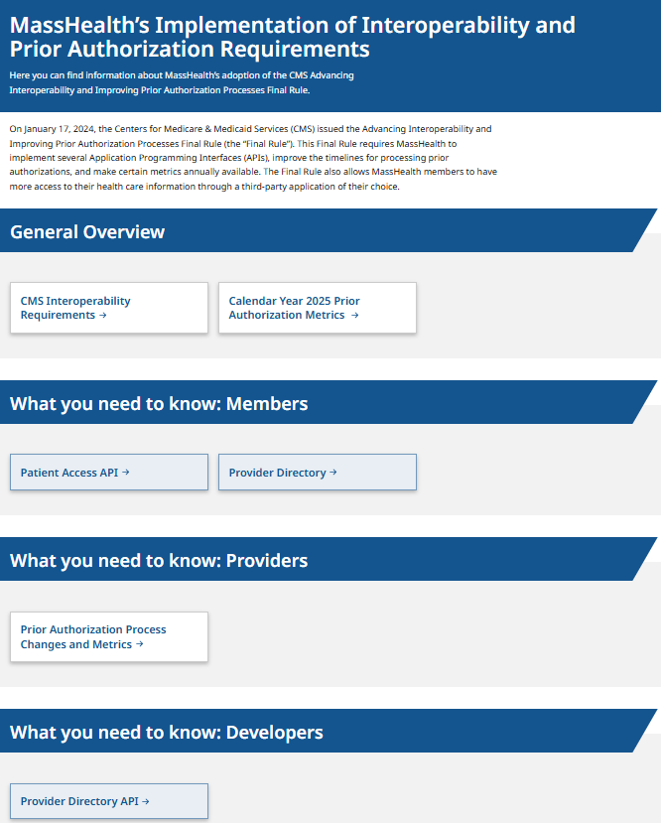
Interoperability Landing Page
MassHealth’s Implementation of Interoperability and Prior Authorization Requirements | Mass.gov
The Mass.gov Interoperability and Prior Authorization page is where you can find links that provide:
  A General Overview
  Information for Members
  Information for Providers
  Information for Developers

Slide 29
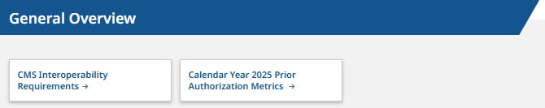
General Overview Selections
CMS Interoperability Requirements
The Advancing Interoperability and Improving Prior Authorization Processes Final Rule requires MassHealth to improve access to health care information for members, providers, and other payers.
CMS Interoperability Requirements webpage
Calendar Year 2025 Prior Authorization Metrics
For a list of all items and services that require a Prior Authorization, please review Subchapter 6 of the MassHealth provider manuals.
Calendar Year 2025 Prior Authorization Metrics

Slide 30

What Members Need to Know
MassHealth Patient Access Application Programming Interface:
MassHealth may be able to share certain health care information with members through a third-party app.
MassHealth Patient Access Application Programming Interface webpage
Important: MassHealth did not create the third-party apps discussed on this web page and wants members to be able to make informed decisions about using them. If members choose to use a third-party app to access their health care information, MassHealth will provide the members health care information to that app through a Patient Access Application Programming Interface (API). It’s up to the member to decide if they want to use a third-party app, and which third-party app they choose. MassHealth does not endorse or recommend one third-party app over another. MassHealth is not responsible for the use of a third-party app and is not responsible for any outcomes from that use.

Slide 31
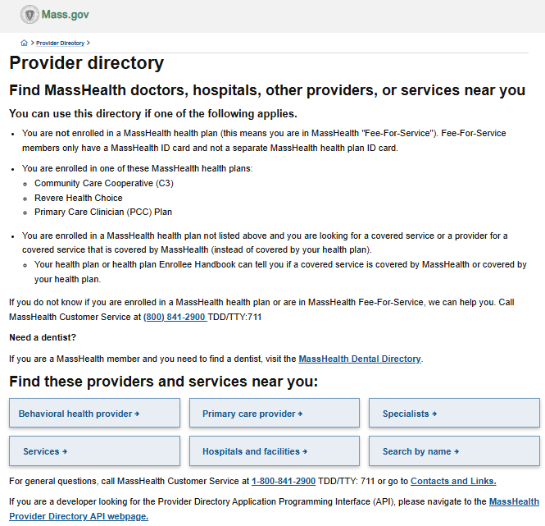
What Members Need to Know: Provider Directory
Members can click the provider directory button to find doctors in the MassHealth network.

Slide 32
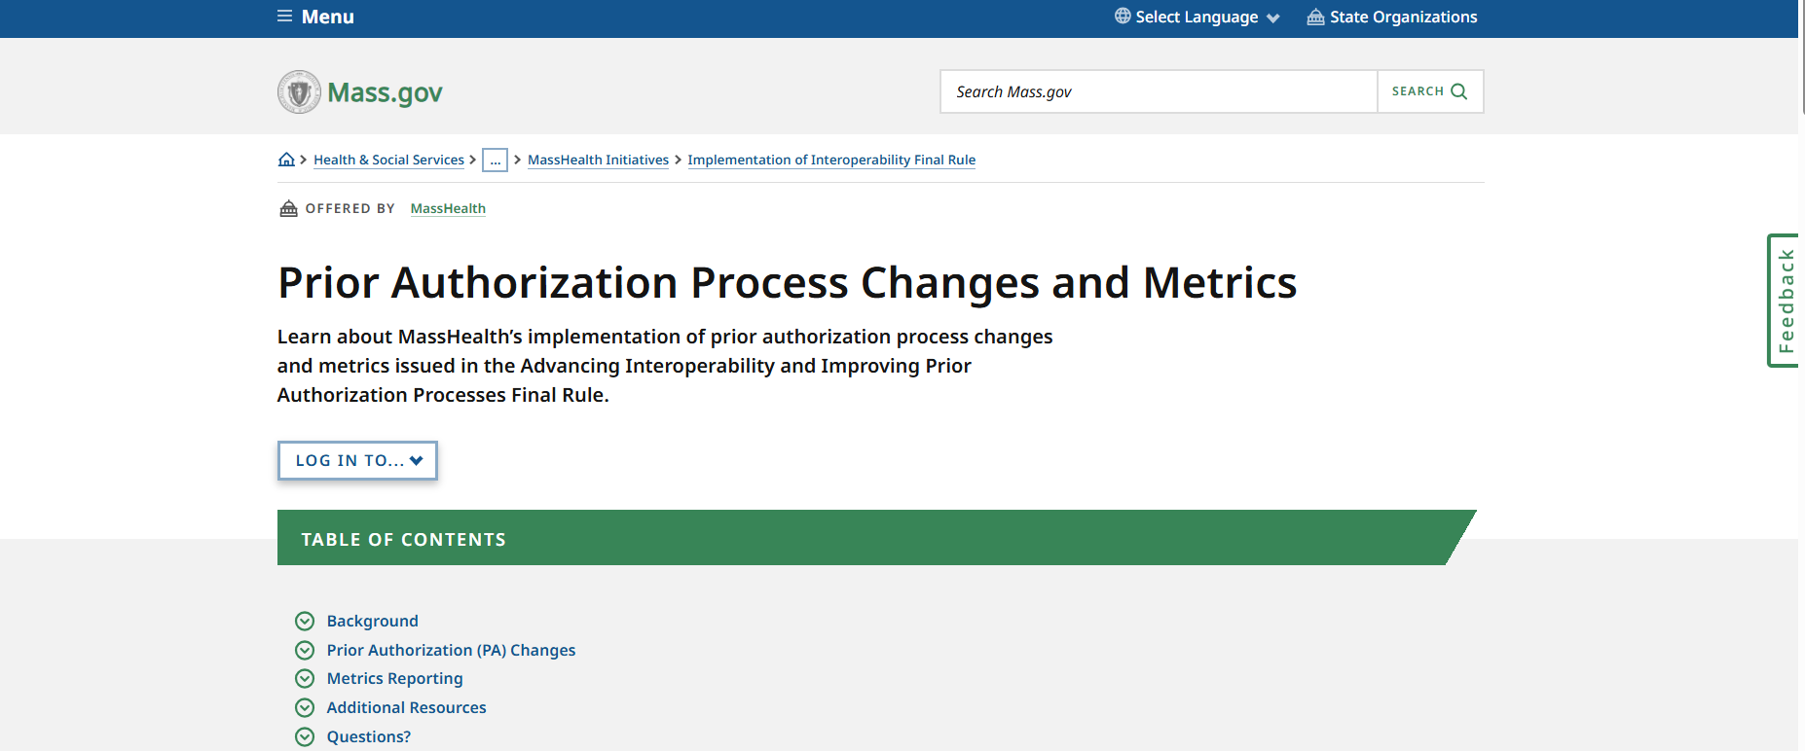
What Providers Need to Know
Prior Authorization Process Changes and Metrics
Learn about MassHealth’s implementation of prior authorization process changes and metrics issued in the Advancing Interoperability and Improving Prior Authorization Processes Final Rule.
Prior Authorization Process Changes and Metrics webpage

Slide 33
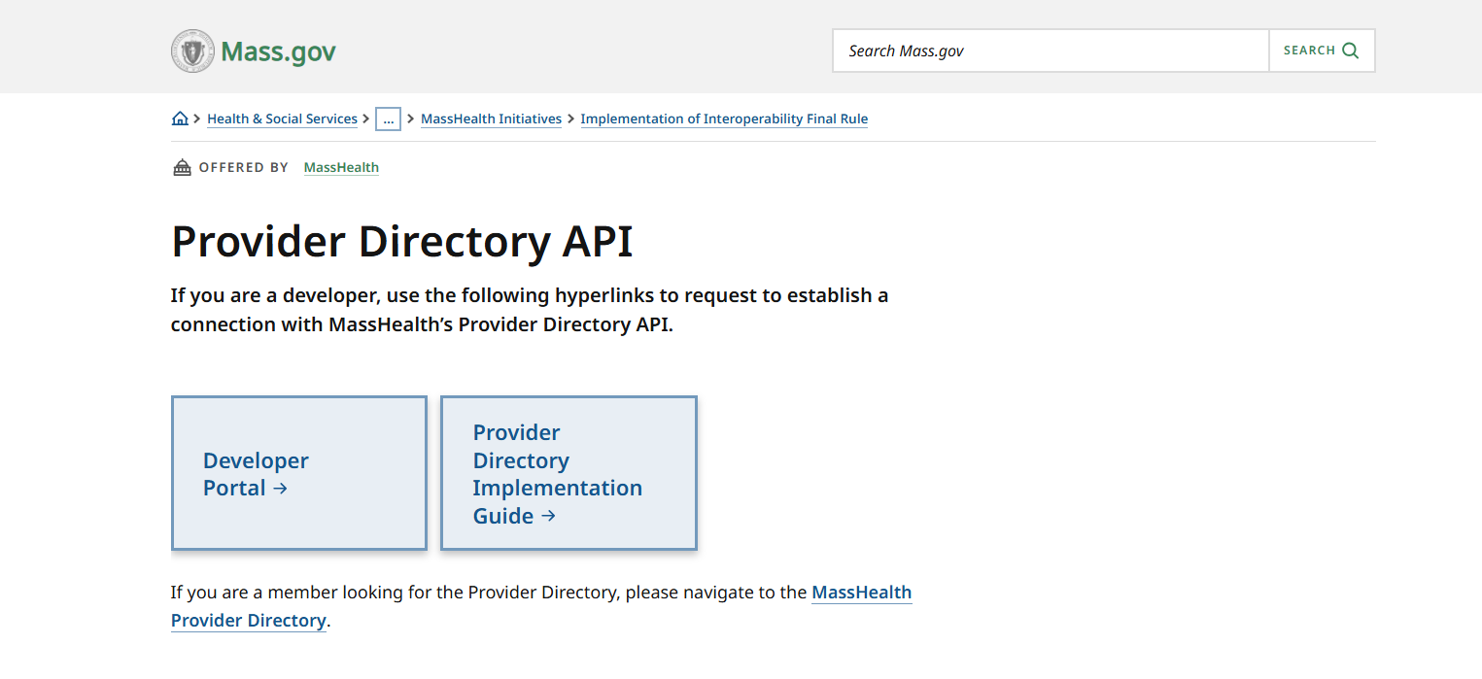
What Developers Need to Know
Provider Directory API
A developer can request to establish a connection with MassHealth’s Provider Directory API using the hyperlinks on this page to
Provider Directory API webpage

Slide 34
Impact of the One Big Beautiful Bill Act (OBBBA/OB3) on MassHealth
Presented by - Michael Gilleran, Sr. Provider Relations Specialist, MassHealth Business Support Services

Slide 35
Background on Federal Medicaid
Changes (slide 1 of 2)
FOR DISCUSSION ONLY. SUBJECT TO CHANGE BASED ON CMS GUIDANCE AND FURTHER ANALYSIS
What is OB3?
  In July 2025, the One Big Beautiful Bill Act (known as OBBBA, or OB3) was signed into law.
  This law includes major changes to Medicaid (which in Massachusetts is MassHealth).
  OBBBA also made large changes to Health Connector coverage, SNAP, Medicare, and more.
  MassHealth is legally required to follow federal law, which means that we must implement these changes.
When do the new rules begin?
  The new rules do not all happen right away.
  The biggest changes affecting MassHealth members don’t start until Fall 2026.

Slide 36
Background on Federal Medicaid
Changes (slide 2 of 2)
FOR DISCUSSION ONLY. SUBJECT TO CHANGE BASED ON CMS GUIDANCE AND FURTHER ANALYSIS
How will MassHealth members be affected?
  The new federal rules will only affect certain members. Some members will not see any changes.
  The largest impacts will be for some adults ages 19 to 64 and certain immigrants.
  To fully understand the impact of federal changes, MassHealth needs guidance from the federal government. We expect to get this guidance in June 2026.
  We will keep members and stakeholders informed of the upcoming changes. We will begin communicating with affected members starting in Summer 2026.

Slide 37
How is MassHealth responding to OB3?
MassHealth’s priority is maintaining coverage and care for as many Massachusetts residents as possible, while complying with these new federal requirements and remaining good stewards of taxpayer dollars. We are committed to working with the legislature, sister agencies, providers, plans, our member advisory council, and other stakeholders to navigate changes imposed by OB3.
While we wait to receive more detailed guidance from the Centers for Medicare & Medicaid Services (CMS), MassHealth is currently:
  Not making any changes for MassHealth members, providers, or plans until we are required to. As we get closer to the start dates for work requirements and more frequent eligibility checks, MassHealth will get in touch directly with impacted members, using notices, robocalls, text messages, or other means of communication.
  Planning to communicate with and train MassHealth staff, community partners, providers, and stakeholder groups who are uniquely positioned to help MassHealth members navigate these new requirements.

Slide 38
Stay Informed
Are you an employer, nonprofit, provider, plan, or other stakeholder who wants to stay up to date on federal changes that impact MassHealth? We want to keep in touch – sign up for our email list to keep informed.
Visit Mass.gov at the MassHealth Federal Updates and Impact webpage to learn more.

Slide 39
Application Changes and Mass.gov Improvements
Presented by - Michael Gilleran, Sr. Provider Relations Specialist, MassHealth Business Support Services

Slide 40
Application Changes
Due to the expanded data elements that will be added to the Provider Directory, provider applications are being modified to include questions that collect this information. The following applications have been updated so far:
  Medical Practitioner
      This application comprises of most individual provider types (physicians, nurse practitioners, social workers, etc.)
  Group Practice Application
  Doula Provider (Individual)
  Doula Provider (Group)
  Acute Hospital
  Pharmacy

Slide 41
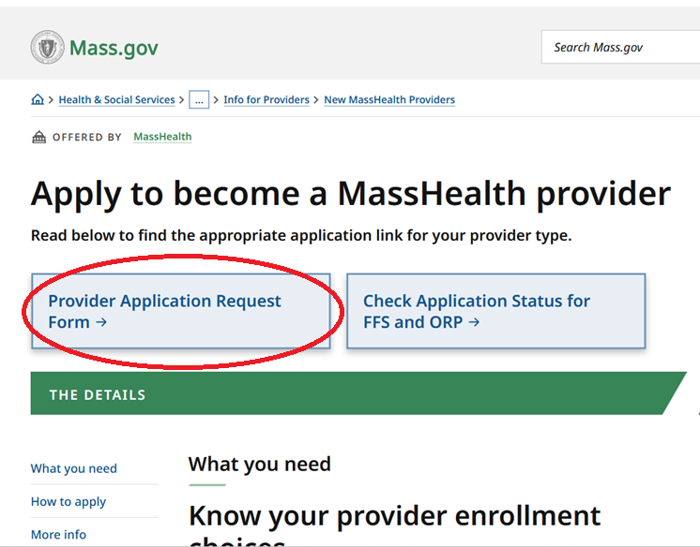
Application Requests on Mass.gov
In order to be in compliance with CMS and MassHealth regulations, providers are reminded that they must complete and current versions of MassHealth applications
Providers are reminded that they may request a FFS application on Mass.gov
Visit: Apply To Become A MassHealth Provider webpage

Slide 42
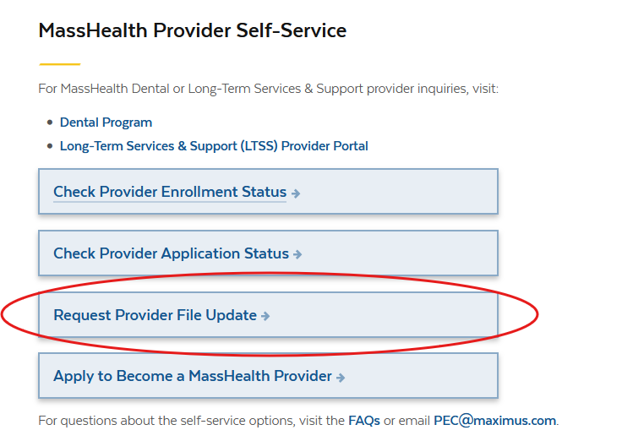
Updating Provider Files
MassHealth providers are advised that any changes to their information will require they submit an update request.
Provider files should be updated whenever there is a modification to information such as addresses, employers, or any information that differs from when the application was first processed.
Visit: Provider Self Service webpage

Slide 43
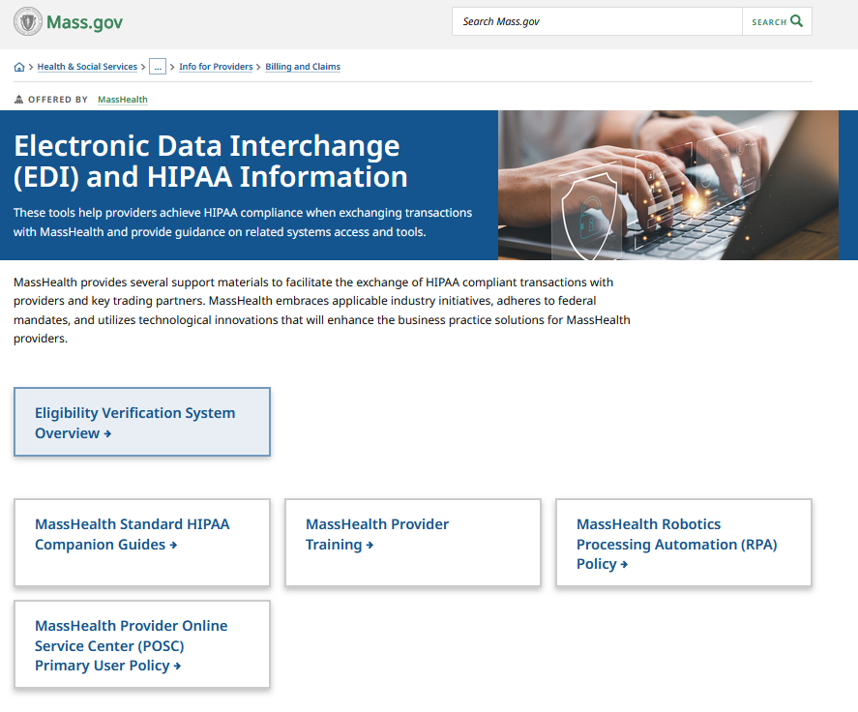
Mass.gov Updates – EDI Request Form
Electronic Data Interchange (EDI) facilitates the exchange of HIPAA files as electronic transactions; many written resources are currently available on Mass.gov relating to EDI transactions
MassHealth offers an online inquiry form to enable more in-depth assistance for providers who are experiencing issues with EDI/HIPAA files
Electronic Data Interchange (EDI) and HIPAA Information webpage

Slide 44
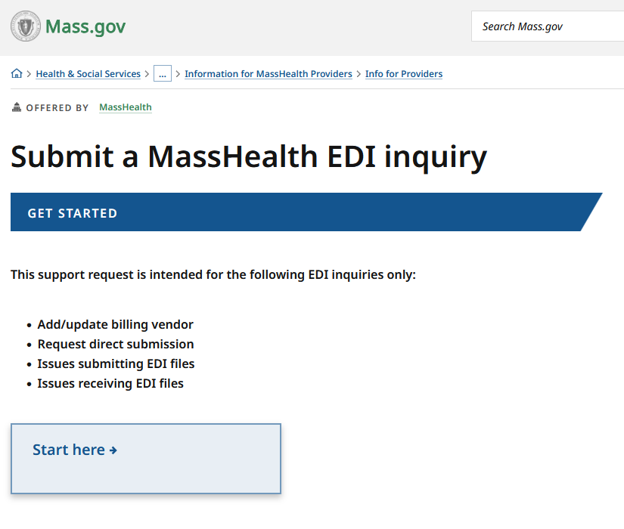
Mass.gov Updates – EDI Request Form continued
The Electronic Data Interchange (EDI) Inquiry form specifically offers support for:
  Updating/Adding a billing vendor
  Setting up EDI transactions
  Address issues submitting EDI transactions
  Address issues receiving EDI transactions
Submit a MassHealth EDI Inquiry webpage

Slide 45
Provider Self-Service Enhancements
Presented by - Michael Gilleran, Sr. Provider Relations Specialist, MassHealth Business Support Services

Slide 46
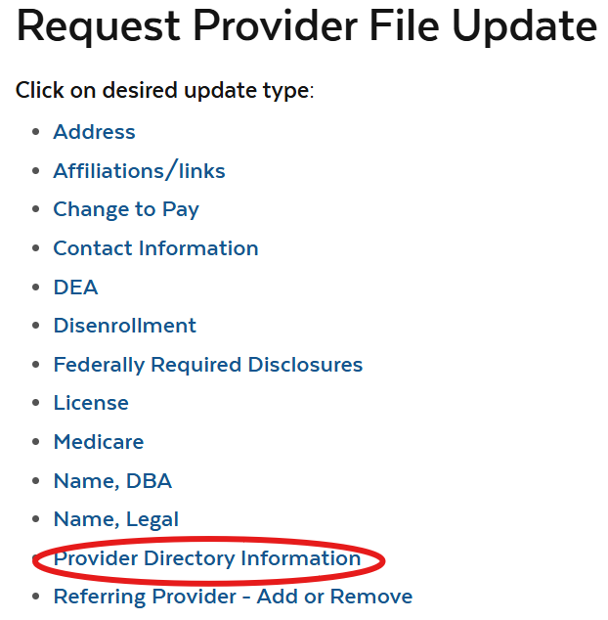
Provider Self-Service (PSS): Directory Requirements
The PSS Provider Directory Information update request went live in January 2026
Under the Consolidated Appropriations Act (CAA 2023), MassHealth providers must keep their profiles accurate and update Directory information when changes occur
Existing providers without Directory information must submit an update request
The following Directory elements are required by CMS from providers:
  Languages Spoken
  Telehealth
  Accepts New Patients
  Accessibility Accommodations
  Website
Visit: Provider Self Service webpage

Slide 47
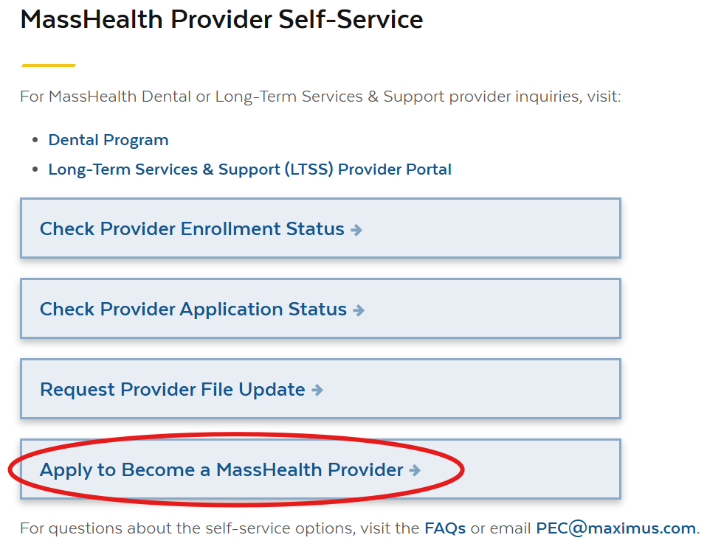
Provider Self-Service (PSS): Application Requests
Fee-for-Service (FFS) providers should use this form to request a MassHealth provider application
Before submitting an application request, providers should use the Check Provider Enrollment Status & Check Provider Application Status options to avoid submitting duplicate applications
Note: PSS does not currently support ORP application requests.
Eligible providers who wish to enroll as ORP can download the application and contract here: Nonbilling ORP Provider Contract and Application
Visit: Provider Self Service webpage

Slide 48
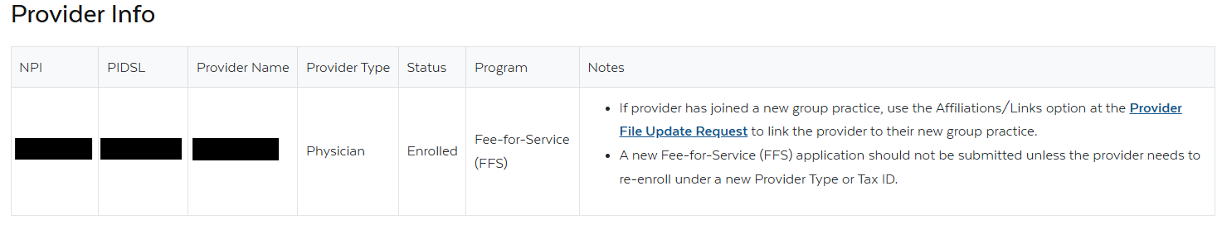
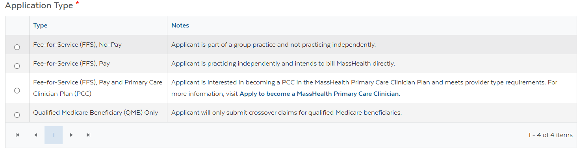
Provider Self-Service (PSS): Application Requests continued
New enhancements to the request form now show a provider’s enrollment status and program (if applicable) and provide additional guidance for application selection

Slide 49
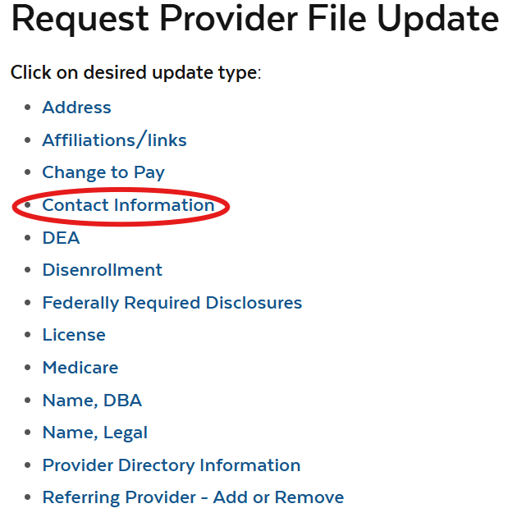
Provider Self-Service (PSS):
Updating Contact Information
Providers and organizations or vendors acting on their behalf should use the “Contact Information” update request to ensure MassHealth has a valid provider contact
MassHealth FFS providers are required to revalidate every 5 years, and updated contact information is required for revalidation
Providers without a known or responsive contact are at risk of disenrollment at revalidation

Slide 50
Long-Term Services and Supports
Presented by - Lindsey Klauka, Associate Director of Provider Enrollment Revalidation Training Team

Slide 51
LTSS Provider Communications (slide 1 of 2)
The MassHealth LTSS Provider Service Center utilizes provider data to identify behavior trends for areas of targeted training via email. These emails may contain attached job aids or links to additional educational resources via the LTSS Provider Portal.
Areas of focus for these communications include but are not limited to:
  high claims denials for specific error codes ​
  high prior authorization denials or administrative holds, and/or
  audit findings/SURs reports
The goal of each communication is to assist the Provider in reducing their administrative errors in billing and prior authorization.

Slide 52
LTSS Provider Communications (slide 2 of 2)
Over the last 3 months, Optum has sent over 128 email communications via our LTSS support inbox to LTSS Providers.
There have been 12 provider bulletins published on the MassHealth website: MassHealth Provider Bulletins webpage
If you have not received or wish to begin receiving these communications, you may do so by following steps:
  For the LTSS support box communications, please reach out to the LTSS Provider Service Center and we can help ensure your inclusion in future communications
  For communications from MassHealth on mass.gov, follow this link:
    Email Notifications for MassHealth Provider Bulletins and Transmittal Letters

Slide 53
LTSS Provider Trainings and Quality Forums
Training or Quality Forums for MassHealth LTSS Providers:
Recent Trainings:
  Continuous Skilled Nursing Training: 4/07/26
  Home Health Agency Applicant Orientation Training: 4/13/2026
Quality Forums:
  Durable Medical Equipment and Oxygen & Respiratory Therapy: 4/27/2026

Slide 54
Training Videos for Enrollment Process
Optum has been creating microburst (short, focused) training videos for MassHealth LTSS providers that guide them through the application process, required forms, and improving efficiency.
These microbursts are 2–5-minute training videos that:
  Walk providers through each step of the LTSS application process
  Highlight required forms and common errors
  Improve submission accuracy and processing efficiency
Current microbursts that are available:
  W9
  Electronic Funds Transfer Form
Next to be released are:
  Federal Required Disclosure Form (FRDF) for entities and individuals
  Durable Medical Equipment (DME) application
  Independent Nurse application

Slide 55
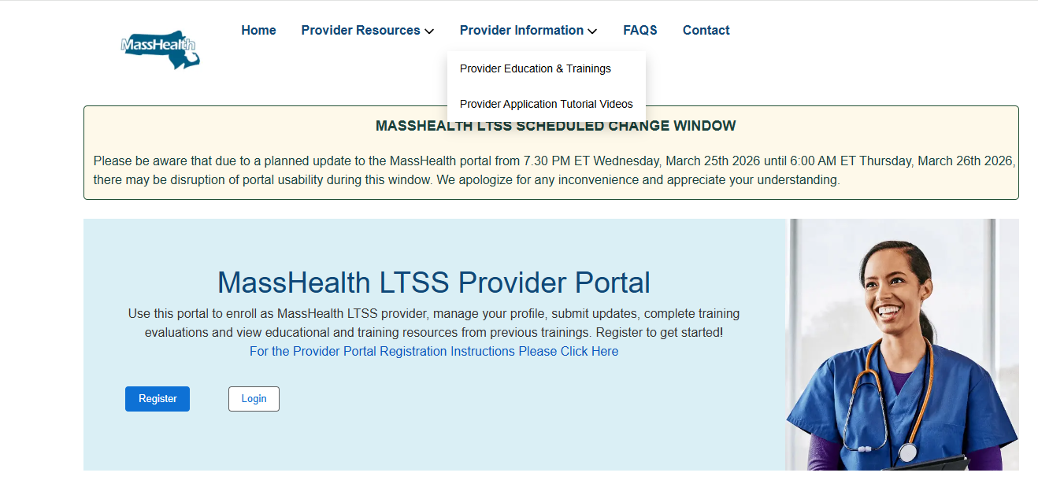
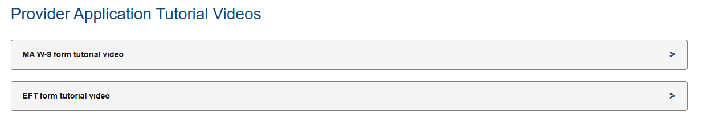
Training Videos for Enrollment Process continued

Slide 56
MassHealth Robotic Processing Automation (RPA)
Presented by – Michelle Croy, Sr. Provider Relations Specialist, MassHealth Business Support Services

Slide 57
MassHealth Robotics Processing
Automation (RPA)
MassHealth requires all providers, relationship entities, and business partners (“organizations”) that use—or plan to use—Robotic Process Automation (RPA) tools (i.e., bots) on the MMIS Provider Online Service Center (POSC) to register each bot with MassHealth. Registration must be completed by submitting a request for approval.
If an organization is currently using a bot and has not submitted an RPA registration request, it is out of compliance with MassHealth’s RPA policy and may be subject to termination of user access. Organizations must contact MassHealth immediately to initiate a Stage I RPA registration request. (MassHealth Robotics Processing Automation (RPA) Policy)
Use of a bot on the POSC is a convenience extended to organizations. Any organization that violates the MassHealth RPA Policy may have its ability to submit transactions via the POSC using RPA technology revoked.

Slide 58
MassHealth Robotics Processing Automation (RPA) Annual Validation
MassHealth will be conducting its annual validation of compliance for all organizations approved to use Robotic Process Automation (RPA) tools (bots) on the Provider Online Service Center.
What to expect:
  MassHealth will contact all approved organizations and share the RPA information currently on file.
  Organizations will be required to review, validate, and attest that their use of RPA tools remains compliant with MassHealth policy.
  Any organization that has modified a bot without prior MassHealth approval must submit an RPA Modification Form for review.
For more information, please visit the MassHealth Robotic Process Automation Policy webpage (MassHealth Robotics Processing Automation (RPA) Policy) to review policy requirements and instructions for submitting an RPA registration or modification request for approval.

Slide 59
External User Access
MassHealth performs on-going reviews of user access to ensure compliance with security and access management requirements. These reviews may include but are not limited to the following:
  Users who have not accessed the system for an extended period
  Provider IDs/Service Locations (PID/SLs) with more than two primary users
  Users associated with PID/SLs that have been inactive for more than one year
  System accounts to support point-to-point connectivity
  RPA (bot) access
  Instances where users may be accessing the system using another individual’s account
  Generic or shared accounts
  In addition, MassHealth will reinforce expectations for primary users, including how to regularly audit user access and remove access for individuals who are no longer with their organization.

Slide 60
MassHealth Updates
Presented by – Michelle Croy, Sr. Provider Relations Specialist, MassHealth Business Support Services

Slide 61
Immunization Updates
Register for the 2026 Immunization Updates, a series of webinars for health care providers.
Need more information? Be sure to check out our website for more details.
These live webinars take place on Wednesdays in May and June, from noon to 1 p.m. (unless otherwise noted).
Wednesday, May 6: Epidemiology of Vaccine Preventable Diseases in Massachusetts
Wednesday, May 20: Vaccine Confidence
Wednesday, May 27: MIIS - Massachusetts Immunization Information System
Wednesday, June 3: Vaccine Program Compliance: Storage and Handling
Wednesday, June 10: Immunization 101
Wednesday, June 17: Immunization Schedule Updates
· Childhood Immunization Schedule: 11:30 a.m.-12:15 p.m.
· Adult Immunization Schedule:12:20-1:05 p.m.

Slide 62
MassHealth Dental Program Vendor Transition
DentaQuest became MassHealth’s dental program third-party administrator (TPA) on February 1, 2026
The previous dental TPA, BeneCare, administered the MassHealth dental program through January 31, 2026

Slide 63
Where to get more information?
The new webpage is now live here: MassHealth Dental Program Updates | Mass.gov.
On this page you can find:
  Dental Provider Training and Support
  Post-Transition Claims Remediation
  Frequently asked questions
  Sign up for email updates

Slide 64
All Provider Bulletins
Below is a list of bulletins that have been released since the previous Provider Association Forum.
  All Provider Bulletin 414: Changes in Exclusion of Designated 340B Drugs for MassHealth Fee-for-Service Coverage
  All Provider Bulletin 415: Update to MassHealth Coverage of Speech-Generating Devices and Review of Coverage for Augmentative and Alternative Communication-related Services

Slide 65
Trainings
New Provider Orientation: This session will introduce to MassHealth to Providers and will supply information on key terminology and resources, along with general requirements for all MassHealth providers. Maximus New Provider Orientation webinar registration
Office Hours Billing and Claims: This session will be an open forum for providers to ask general billing and claims questions show you online tools to help you with claims questions. Please note that questions specific to your organization may need to be addressed individually. Maximus Office Hours - Billing and Claims webinar registration
Office Hours Enrollment and Revalidation: This session will provide background information on MassHealth Provider Enrollment for both ORP, FFS, and Group practice providers as well as detail the requirements for enrollment. This presentation is also designed to assist providers in working through the Revalidation process. Most of the webinar will be devoted to live Q&A where attendees may ask the host any questions they have regarding enrollment and revalidation. Maximus Office Hours - Enrollment and Revalidation webinar registration

Slide 66

Provider Education LMS
The MassHealth Provider Learning Management System(LMS) for Non-OLTSS providers is a system providers can use 24/7 as an educational resource.
The Provider LMS delivers:
  Previous live training presentations
  New on demand training courses
  Resources
  Course surveys
If you are currently a registered user but have forgotten your user-name or password, you can retrieve it from the sign-in screen
New Users can create a profile and begin using the system immediately
Visit: MassHealth LMS webpage
OLTSS and Dental providers should visit their respective vendor site for training opportunities

Slide 67
Resources
Provider Email Alerts
Sign up to receive email alerts when MassHealth issues new bulletins and transmittal letters, fill out the Email Notification Request for Providers on Mass.gov.
MassHealth New Bulletin and Transmittal Letters
MassHealth Website
  Bulletins are Available on Mass.gov
  MassHealth Providers web page
  The ACA ORP Requirements for MassHealth Providers

